Slide 1
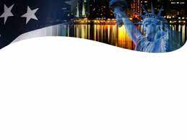
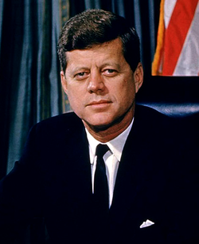
My palms sweaty, nuke codes ready
Call Khrushchev on the red phone, keep my heartbeat steady
Nervous as heck, cause the world aint ready
Nuclear Holocaust, and JFK’s the heavy?
They’re blaming me cause the Bay of Pigs went belly-
John F. Kennedy
Up, and yup, the whole world might die on the telly
HARRY TRUMAN

Slide 2
A young president dealing with the Cuban underbelly
My hands and feet start to shake like jelly!
Snap back to reality, the world might blow if I don’t show
The U.S. won’t be played by Castro
So, I blockade Cuba with American Ships
John F. Kennedy
Inform the Soviets they can’t equip
HARRY TRUMAN

Slide 3
Our island neighbor with nuclear-tipped
Warheads, and what’s more, I’m getting the hang of this
I led America through one of its worst crisis
John F. Kennedy
JFK the president you simply can’t dismiss!
HARRY TRUMAN

Slide 4
You better prove yourself in the movement, the moment
You own it, better not let it go
You’ve only got one shot to stop Khrushchev and Moscow
John F. Kennedy
This opportunity comes once in a lifetime
HARRY TRUMAN

Slide 5
You better prove yourself in the movement, the moment
You own it, better not let it go
You’ve only got one shot to stop this nuclear show
John F. Kennedy
This opportunity comes once in a lifetime
HARRY TRUMAN

