Slide 1
Horticulture II - Landscape
Unit c landscape installation and maintenance

Slide 2
Objective 6.02
Understand pests and their control in the landscape

Slide 3
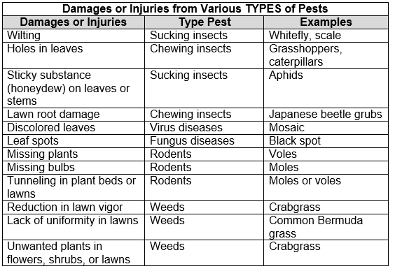
Damage of Injuries from Various TYPES of pests

Slide 4
Methods of Pest Control
Biological – plant pests are controlled by natural agents. Agents may be predators, parasites, or pathogens. Some examples include:
  Predator – releasing lady beetles to control aphids on roses
  Parasite – a digger wasp (parasitic wasp) controls Japanese beetle larvae
  Pathogen – Bacillus thuringiensis (Bt) bacterium kills caterpillar larvae
Mechanical – pests are controlled non-chemically using direct measures to destroy pests. Examples include:
  Hand picking to remove insects
  Tilling to remove weeds
  Traps to catch insects or rodents

Slide 5
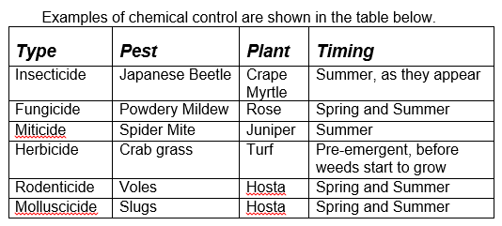
Methods of Pest Control
Chemical – Pest populations are controlled by using pesticides

Slide 6
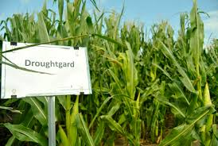
Methods of Pest Control
Cultural – pests are prevented or reduced by using methods to alter the plant environment. Examples include:
  Irrigation and fertilization schedules
  Sanitation practices
Genetic – pests are prevented by using biotechnology to transfer or to manipulate genes to make plants resistant to specific pests. Examples include: making plants resistant to certain insects or diseases that may affect the plant

Slide 7
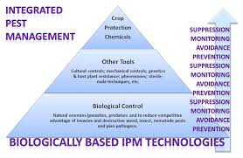
Methods of Pest Control
IPM – Integrated Pest Management – Pest control strategies rely on multiple control practices. Examples include:
  Regular monitoring is used to detect pests when they first become active. Monitoring is done through regular inspections of plants
  Traps and remote sensing equipment can be used to indicate pest levels without observing the plants visually
  Determine acceptable level of damage and when to initiate other pest control measures

Slide 8
Pesticide User Responsibilities
Types of pesticides
  Fungicides – used to eradicate diseases caused by fungi
  Insecticides – used to control insects and related arthropods
  Herbicides – used to kill unwanted plants
  Rodenticides – used to kill rodents
  Miticides – used to control spiders and mites
  Molluscicides used to control snails and slugs

Slide 9
Pesticide User Responsibilities
Signal words and toxicity levels
  Caution – slightly toxic
  Warning – moderately toxic
  Danger – extremely or highly toxic
  Restricted
    Restricted use pesticides can only be purchased by licensed applicators and must be applied under the direct supervision of a licensed person
    Individuals must pass a written exam and can be certified in a number of specialty areas

Slide 10
Pesticide User Responsibilities
Labels and other chemical information
  Pesticides must be approved by the EPA before they can be sold in the U.S. and should have a registration number on the label to be legal
  Restricted Entry Intervals regulations state that no unprotected person may be in the treated area during pesticide application and that a re-entry time must be stated in a language that workers can understand so that no one will be accidentally exposed to the pesticide
  Make certain chemical is correct for intended use. Refer to label and/or North Carolina Agricultural Chemicals Manual. It is against the law to use a pesticide for purposes not listed on the label

Slide 11
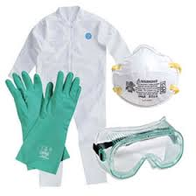
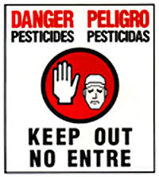
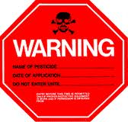
Pesticide User Responsibilities
Proper clothing and safety equipment for various products
  Always wear gloves and safety goggles when applying any chemical
  Use respirators for dusts or fumigants
  Wear rubber boots and/or aprons along with a hard hat for liquid sprays
  Always follow label recommendations for correct apparel and equipment

Slide 12
Pesticide User Responsibilities
Pesticide storage and disposal
  Keep pesticides in the original containers to prevent mistaken identity of chemicals
  Pesticides storage area should be well ventilated and locked to prevent access by children, pets, and unauthorized individuals
  Keep children and animals away from pesticides to prevent injury or death
  Store pesticides separately from food or animals feeds to prevent contamination of foods or feeds
  Triple rinse containers and use rinse water on intended crop or area to prevent soil and water contamination
  Check with Cooperative Extension Service or sanitary landfill about proper disposal procedures for the local area because rules vary in different locations for different pesticides

Slide 13
Application Formulations
Pesticides can be purchased and applied in several forms
Aerosols (AE) – are in gas form and must be used in an enclosed area such as under plastic sheeting for soil fumigation. Smokes and other fumigants are also used in this way
Dusts (D) – are applied in dry form. Advantages are that simple equipment can be used to apply them and they can easily be seen on foliage. A disadvantage is that drift is a major problem on windy days
Granules (G) – are applied in dry form, usually to the soil since they will not stick to foliage. No mixing necessary and drift is minimal. Most seeding and fertilizer spreading equipment will also apply granules

Slide 14
Application Formulations
Wettable Powders (WP) – are applied as liquids although they do not dissolve in the liquid. They are suspended through some type of agitation. Phytotoxicity is generally low and they are usually safer to handle compared to liquid concentrates, but Wettable Powders are abrasive and tend to wear out pumps and nozzles.
Soluble Powders (SP) – are similar to Wettable Powders except they dissolve, producing a solution. Soluble Powders are less abrasive than WP formulations.
Flowables (F) – come suspended in liquid form. They are diluted and used similarly to EC formulations and have similar advantages and disadvantages

Slide 15
Application Formulations
Emulsifiable Concentrates (EC) – are purchased in liquid form. These oil-based pesticides are mixed with detergents and other chemicals so that they will dissolve in water. They are not abrasive to nozzles, but can degrade rubber hoses and gaskets. They are more dangerous to handle because they absorb through the skin faster than other formulations. They also are more likely to cause plant injury.
Poisonous Baits – are used to control rodents and are mixed with an attractant for the animal to eat. They must be kept away from children or domestic animals to prevent poisoning them.

Slide 16
Types of Chemical Control
Contact Poisons – chemical kills pest by touching the pest’s body – effective for insects that are easily seen and/or move through the applied chemical
Stomach Poisons – chemical must be ingested to control the pest – effective for insects and other pests with chewing mouthparts
Systemic Insecticides – controls pests by absorbing the chemical through the system of the plant which is then ingested by the pest – effective for insects with piercing/sucking mouthparts

Slide 17
How to Determine Time of Application
Time of Application
  Plant must be at the proper stage of growth
  Pest must be at the proper stage of growth for certain applications
  Excessive wind can affect the method of applying chemicals
    Increase droplet size
    Spray closer to the ground
    Delay spraying
  Soil type must be considered. Pesticides are more subject to leaching on sandy soils

Slide 18
Types of Application Equipment
Hand pressurized sprayers - (pump up, hand held, and backpack) are for small jobs requiring just a few gallons of spray
High volume, low pressure – equipment used for spraying large amounts of a diluted pesticide where complete coverage is necessary such as wettable powder formulations
Low volume, low pressure – sprayers often used on aircraft where weight is a concern. They are also used for many formulations where total coverage is not as critical. EC formulations are often applied with low volume sprayers.
High pressure mist blowers – often used for treating trees
Aerosols – must be used in confined areas such as greenhouses or under plastic

Slide 19
Types of Application Equipment
Granular pesticides – can be applied with simple seeding and fertilizer spreading equipment. They are often used for pre-emergent herbicides
Soil injectors – can be used to incorporate certain pesticides into the soil so that the chemicals can be taken up by plant roots
Spraying conditions often dictate what type of applicator may be used. Many, such as dusts are not suitable for windy conditions.

