Slide 1
Horticulture II - Landscape
Unit C Landscape installation and maintenance

Slide 2
Objective 6.01
Apply procedures to prune, fertilize, and mulch landscape plants

Slide 3
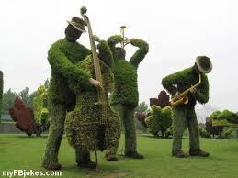
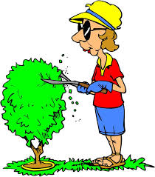
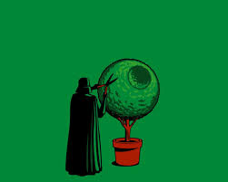
Pruning Procedures to Maintain Landscape Plants

Slide 4
Decide the Time to Prune
Winter
  Branches can be seen on deciduous plants
  Most plants are not flowering and are dormant
  Ex: crape myrtle, glossy abelia, broadleaf evergreens
Spring
  Swelling buds indicate live branches
  There is not much foliage to block shape of plant
  Provides maximum time for cuts to heal
  New leaves hide fresh cuts
  Early spring flowering plants produce flower buds for next year’s flowers on summer growth
  Ex: azalea, forsythia, conifers, and broadleaf evergreens
Summer
  Allows time for wounds to heal before winter
  Branches are difficult to see because of leaves
  Ex: ligustrum, boxwoods, broadleaf evergreens
Fall
  Small branches can be pruned in early fall if there is enough time for new growth to harden and the wound to heal before winter
  Early spring flowering plants should NOT be pruned in the fall
  Ex: summer flowering plants, broadleaf evergreens

Slide 5
Decide the Type of Pruning Required
Thinning – remove an entire branch back to the trunk or main stem
  Ex: all deciduous trees – Redbud, Red Maple, River Birch, Crape Myrtle
Heading back – shorten the length of the branch
  Ex: several broadleaf evergreen shrubs – Eleagnus, Camellias, Wax Myrtle, Laurels
Rejuvenation (renewal) – Remove extensive amounts of mature branches to promote new growth of unkept and/or damaged shrubs. In some cases removing entire branches to the ground.
  Ex: Spireas

Slide 6
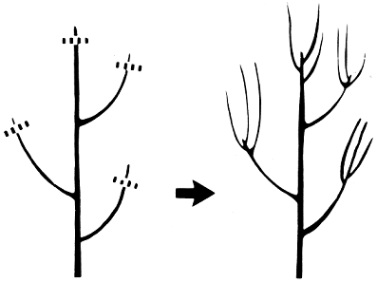
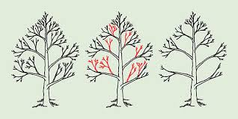
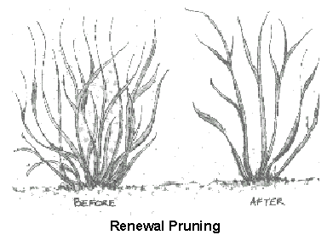
Types of Pruning
Thinning
Heading Back
Rejuvenation

Slide 7
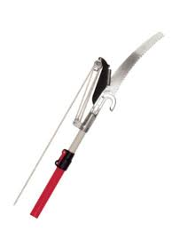
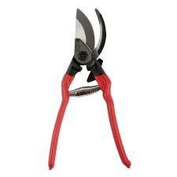
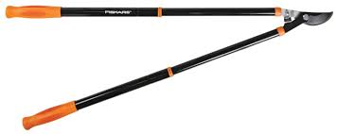
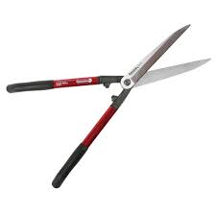
Tools Needed Based on Materials to be Pruned
Size of branch:
  Less than ½” diameter
    Use hand pruners
    Use hedge shears to shape shrubs
  ½” to 1-½” diameter
    Use loppers
  Over 1-½” diameter
    Use pruning saw or chain saw
Location of branches to be pruned
  Low enough to be reached standing on the ground
    Use any of the tools listed to the left
  High enough NOT to be reached standing on the ground using tools listed to the left
    Use pole pruner or power pole pruner

Slide 8
Use proper Personal Protective Equipment (PPE)
When pruning, make sure you know where your non-cutting hand is at all times to prevent injury
Look for electrical lines to prevent injury or damage to property
Look for dead or hanging branches when positioning your ladder to prevent bodily injury
Tie extension ladder to the tree and have a spotter on the ground
Drink plenty of liquids to prevent dehydration
Take short frequent breaks to stay focused
Use proper lifting techniques to prevent back and other injuries
Choose appropriate PPE

Slide 9
Appropriate PPE
Goggles (eyewear) – wear to prevent damage to eyes due to dust and debris
Chaps (American version) – use protective covering for legs, typically made of Kevlar, worn while using a chainsaw. (British version) – use male friends to warn you of impending danger while using a chainsaw.
Gloves – wear to reduce injury from sharp blades and chains
Boots – wear to protect feet not only from pruning tools but also falling debris or dropped tools and equipment
Snug fitting clothing – wear to prevent clothing from being caught in moving equipment
Hard hat – wear to prevent injury from falling tree limbs, branches, etc. May include face shield and ear muffs
Ear protection – wear to protect from hearing loss as most small engines produce over 90 decibels (db) which is the level at which sound waves can damage human hearing

Slide 10
Pruning Twigs and Small Branches
Decide safety procedures and PPE that are needed
Choose and use the correct PPE
Cut back to a vigorous bud or intersecting branch
Make cuts that do not leave a stub or that do not cut too close to the bud
Make slanting cuts when removing limbs that grow upward (prevents water collection and expedites healing)

Slide 11
Prune Thick Heavy (Large) Branches
Decide safety procedures and PPE that are needed
Choose and use the correct PPE
Remove just outside the branch collar (not flush with the trunk)
Avoid using paint or wound dressing to seal the cut (may trap moisture and increase disease problems)
Use a 3-part cut when cutting branches over 1-½” in diameter
  1st cut – saw the bottom of the branch 6-12” out from the trunk and about 1/3 of the way through the branch
  2nd cut – saw down from the top about 3” farther out than the first cut until branch falls
  3rd cut – saw the stub back to the collar

Slide 12
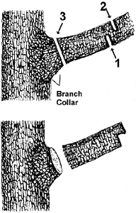
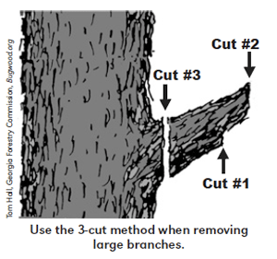
3-Part Cut

Slide 13
Fertilization Procedures to Maintain Landscape Plants

Slide 14
Woody Ornamentals
Decide if ornamental plant is woody or herbaceous
Decide the frequency of application depending on type of plant, plant vigor, desired growth rates, and season of the year
Take a soil sample to get recommended fertilizer ratio and rate of application
Apply fertilizer according to soil sample report recommendations, or use 3-5 pounds of nitrogen per 1000 square feet.
Apply fertilizer by broadcasting under canopy of trees, shrubs, and climbing vines or over the top of ground covers

Slide 15
Herbaceous Ornamentals
Decide if ornamental plant is woody or herbaceous
Decide the frequency and time of application based on type of plant
  Fertilize annuals at planting and at 6-8 week intervals during growing season
  Fertilize perennials at planting and once a year during growing season
  Fertilize bulbs at planting and when they start to produce foliage
Calculate how much fertilizer is required to get a specific amount of nitrogen applied to ornamentals. (Refer to Objective 2.01)
Use ordinary garden fertilizer such as 10-10-10 or a slow release fertilizer

Slide 16
Mulching Procedures

Slide 17
Mulching to Maintain Landscape Plants
Decide the correct mulching material depending on desired appearance and availability and cost of materials
Purchase correct mulching material depending on desired appearance and availability and cost of materials
Take out about 2” of old mulch before spreading new mulch if total depth of old mulch is over 4”
Spread evenly about one inch of the same type of mulching material on top of the old mulch to maintain appearance (aesthetics) if plants were mulched when installed
Spread evenly about 2-3” of mulch if mulching was not done when plants were installed
Keep mulch 3-5” away from young trees and shrubs and 8-12” away from larger trees to prevent diseases

