Slide 1
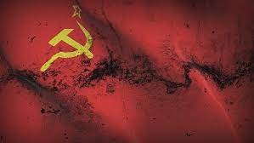
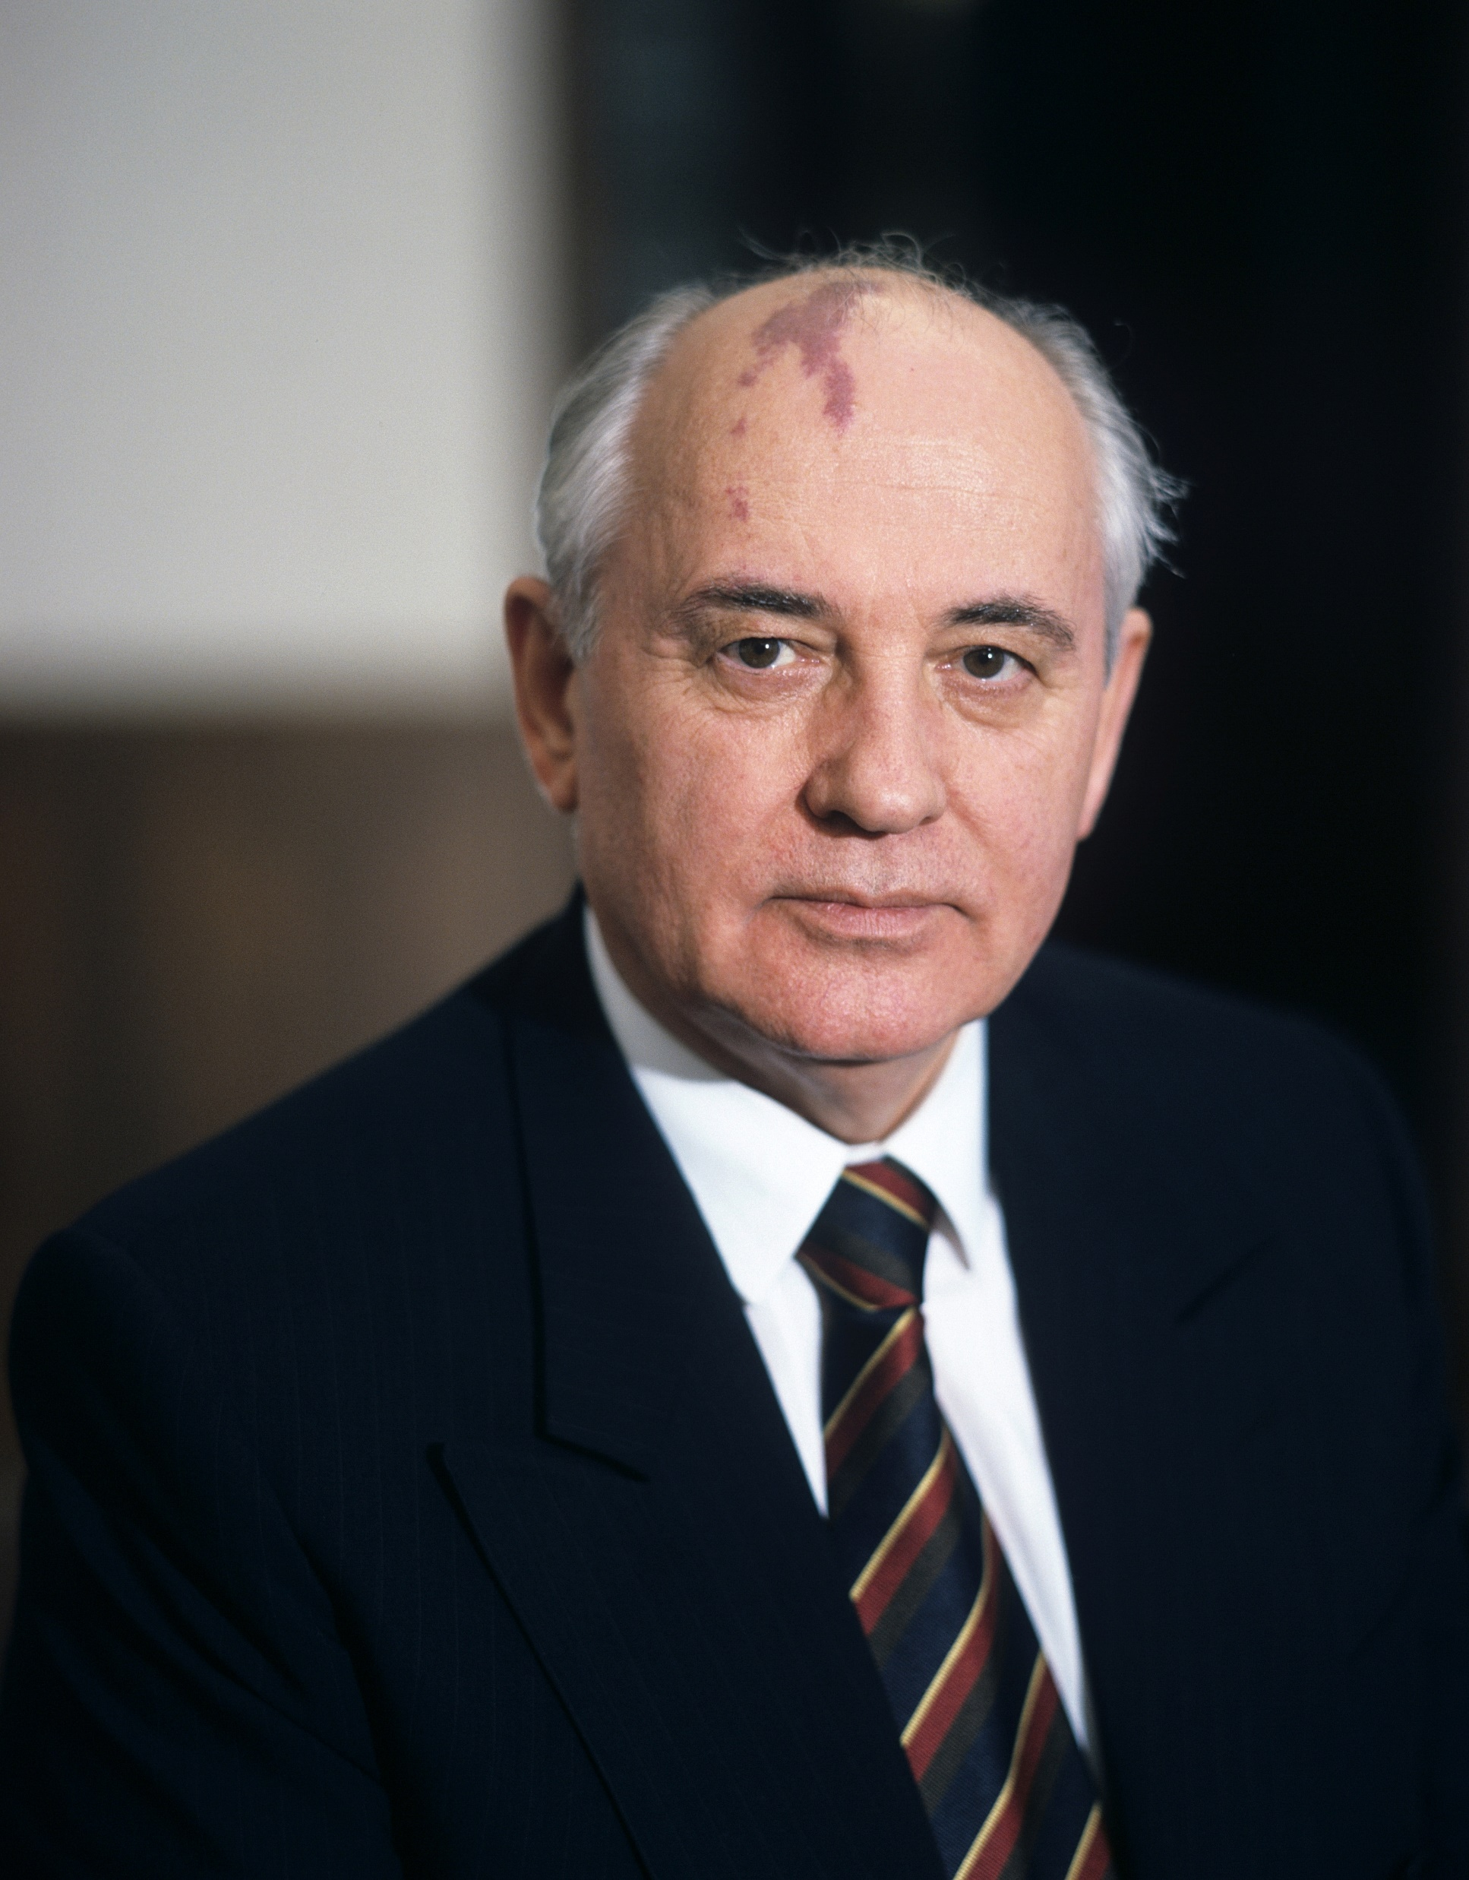
I’m peerless, now hear this, I’m fearless
Make the connection from where your heart to where your ear is
When I was on the Russian scene
I realized communism as it was, was not a dream
Mikhail
Gorbachev
But more like a nightmare, Stalin left us so scared
Send us to the Gulag, look around and no one cares

Slide 2
How can I stop this? I asked my wife, she said
work hard my love and wait until the time is right, so
That’s what I did, kid, brought the truth to the light
Glasnost, we called it, man our hope was bright
Mikhail
Gorbachev
As the leader of the nation, made us take flight
Perestroika helped the economy reach new heights

Slide 3
Mikhail
Gorbachev

Slide 4
Sat down with Reagan, brought peace between our nations
We got rid of nuclear weapons left and right
But freedoms brought fears to the old regime
Used to ruling by force, man those guys were mean
Mikhail
Gorbachev
They tried to take me out, a coup to bring to my knees
But I was brave and strong, refused to give in to their schemes

Slide 5
Found a way out that left the Russian people free
Didn’t budge an inch when they tried to kill me
I was forced to step down, but I held my head proud
My country would survive all the nonsense going down
Mikhail
Gorbachev
So you Americans with your heads up in the clouds
When you hear my name in history, you’d better write this down

Slide 6
Mikhail
Gorbachev
I sacrificed myself for the betterment of my nation
Gorbachev a name that deserves acclimation

