Slide 1
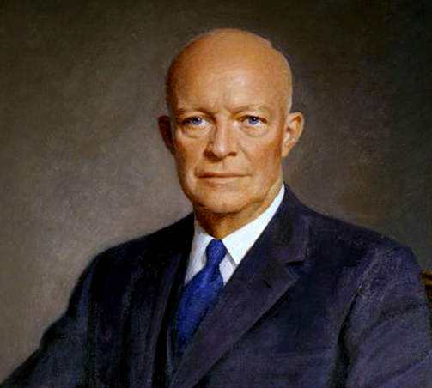

I rose to top of a talented crop
Bling on my shoulders too heavy to top
Salute me son and bid a proper adieu
Dwight Eisenhower
U.S.A. is the best! I won WWII…….
Let’s clean up this mess and get the world sorted out
I’m coming for the Oval to get me some clout!

Slide 2
Blew you away at the polls, a legend foretold,
My legacy is for…. y’all to behold
I slain the goliath, I’ll do it again,
Dwight Eisenhower
A Russian ain’t nuthin’….. don’t call none my friends.
The Korean War, yeah, I slapped that one down,
Like I said before, I’m the greatest around.

Slide 3
Dwight Eisenhower

Slide 4
Killed it term one, and came back at it again…
I changed everything with a stroke of a pen,
Passed legislation long overdue to amend.
Dwight Eisenhower
The Civil Rights Act was now on the books
My administration was making it real
I mobilized the Army to enforce the whole deal

Slide 5
The Interstate Highway System, we did that one too
Jump in the whip now and hit up the crew
Defense! Science! Human Rights! Compliance!
Dwight Eisenhower
Shut down the Commies with nuclear reliance
As I leave the spotlight and I bid you farewell,
On to Marine One, time for Ike to bail!

