Slide 1
Objective 1.02
Understand effective leadership and communication skills.

Slide 2
Leadership Development in FFA
1. Purpose
  Develops confidence, character and citizenship
  Builds cooperative attitudes that help students work with others
  Encourages the improvement of scholarship

Slide 3
Leadership Development in FFA
2. Ways and Means
  Develop an appreciation of FFA traditions
    Colors- National Blue and Corn Gold
    Program of Activities (POA)
      calendar of activities that provides fun opportunities for members, creates a better chapter and provides service to the local community

Slide 4
Leadership Development in FFA
2. Ways and Means continued
    Symbols and their meaning:
      Eagle
        National Scope of FFA
      Plow
        Labor and tillage of the soil
      Owl
        Knowledge and wisdom
      Rising Sun
        Progressive nature of agriculture
        Need for cooperative effort to reach common goals
      Ear of corn
        Unity
        FFA is a national organization with members from across the U.S. and Puerto Rico
      Lettering “Agricultural Education” and “FFA”
        signifies the combination of learning and leadership

Slide 5
Leadership Development in FFA
2. Ways and Means continued:
  The FFA Motto:
Learning to Do
Doing to Learn
Earning to Live
Living to Serve

Slide 6
Leadership Development in FFA
2. Ways and Means continued
  Serving in leadership roles as an FFA Officer
    President (rising sun)
      presides over meetings
    Vice president (plow)
      coordinates all committee work
    Secretary (ear of corn)
      keeps records of all meetings
    Treasurer (bust of Washington)
      keeps financial records
    Reporter (flag)
      public relations
    Sentinel (hand clasp and shield of friendship)
      welcomes guests and visitors

Slide 7
Leadership Development in FFA
2. Ways and Means continued
  Other opportunities to develop leadership in FFA
    Leaderships schools, camps and conferences (WLC)
    Committee involvement (Community service committee)
    State and National Conventions
      Raleigh, North Carolina in June
      Louisville, Kentucky in October
    Competitive events

Slide 8
Conducting Business Meetings (Agenda)
Agenda
  Call to order by the President
    Opening ceremony in FFA meetings
  Minutes of the previous meeting
    read by the Secretary
    approved by the body in accordance to organizational by-laws and parliamentary procedure
    reminds members of what occurred at the last meeting
  Treasurer reports
  Report on Chapter Program of Activities (POA)
    presented by officers and committee chairperson
  Old Business
  New Business
    presented by members in the form of motions
  Adjournment and closing ceremony
    occurs by either passing a motion or by consensus of the body

Slide 9
Conducting Business Meetings (Agenda)
Purpose for an agenda
  The agenda keeps the meeting moving forward
  The agenda forms the framework for the development of a good meeting

Slide 10
General Principles of Parliamentary Procedure
Extends courtesy to everyone
  Members must be recognized to speak
    except in cases of emergency or to enforce parliamentary law
  Members ask the president for recognition to speak
    standing and saying ” Madame/Mr. President”
Focuses on one thing at a time
  only one motion on the floor at a time
  a main motion is presented by saying “I move to/that…”

Slide 11
General Principles of Parliamentary Procedure
Observes the rule of the majority
  Only main motions that have been seconded can be discussed
  Most motions require a simple majority to pass
  Action only after the passing of a motion
Ensures the rights of the minority
  Everyone has the right to voice their opinion during discussion of a motion regardless of which side they may be on
    Therefore, a motion to stop discussion requires a 2/3 vote to pass
      20 out of 30 would have to vote to end discussion

Slide 12
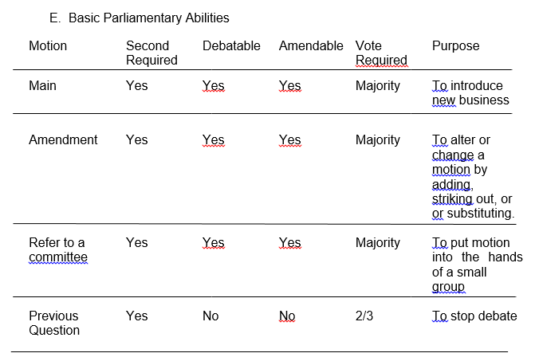

Slide 13
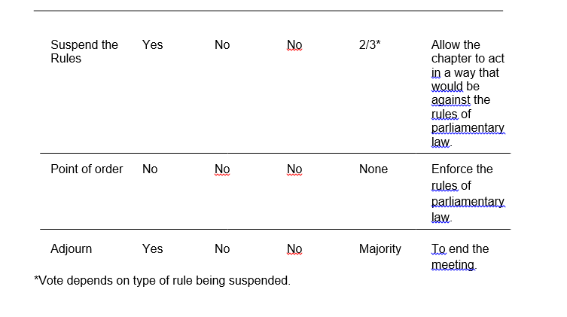

Slide 14
Main Motion
Introduce new business
  Address the presiding officer
  Receive recognition to speak
  State the motion
    “I move that our FFA chapter conduct a community service project.”
  Someone seconds the motion
  Discussed by the group
  Vote
  Chair announces result of vote
Requires a second
Debatable
Amendable
Majority vote required

Slide 15
Amendment
Alter or change a motion
  adding
  striking out
  Substituting
Requires a second
Debatable
Amendable
Majority vote required

Slide 16
Refer to a Committee
To put the motion in the hands of a small group
  “I move to refer this motion to a committee of three people appointed by the chair, who will report back at the next regular meeting”
Requires a second
Debatable
Amendable
Majority vote required

Slide 17
Previous Question
To stop debate
  “I move the Previous Question.”
Requires a second
Not Debatable
Not Amendable
2/3 Majority vote required

Slide 18
Suspend the Rules
Allow the chapter to act in a way that would be against the rules of parliamentary law.
  “I move to suspend the rules and waive the reading of the minutes.”
Requires a second
Not Debatable
Not Amendable
2/3 Majority vote required

Slide 19
Point of Order
Enforces the rules of parliamentary law.
  “I rise to a Point of Order.”
No second required
Not Debatable
Not Amendable
No vote taken

Slide 20
Adjourn
Ends the meeting
  “I move to adjourn.”
Second required
Not Debatable
Not Amendable
Majority vote required

Slide 21
Voting
Common methods
  Voice vote
    by saying “aye” or “no”
  Rising vote
    Standing
    show of hands
  Secret ballot
    written vote
  Roll call
    each member speaking their vote when the secretary calls their name

Slide 22
Gavel
Taps are used to signal members of action they should take or to signal the completion of a parliamentary action
  One tap
    follows announcement of adjournment
    follows the completion of a business item
    to be seated
  Two taps
    signal the official start of the meeting and calls the meeting to order
  Three taps
    are used to signal all members to stand
      members are to rise in unison at the third tap of the gavel

Slide 23
Public Speaking
Oral communication skills are one of the most important factors in determining career success
  The FFA Creed
    gives students the opportunity to develop basic public speaking skills
    helps to develop confidence
Oral communication can be improved through practice (and more practice)
Practice improves the speaker stage presence
    Attitude
    Confidence
    Personality
    Ease before the audience
    Personal appearance
    Poise
    Posture

Slide 24
The FFA Creed
History
  Written by E.M. Tiffany
  Adopted at the 3rd National FFA Convention in 1930
  Revised in 1965 and 1990
  Each of the 5 paragraphs begins with “I believe……”
Use
  Basic statement of beliefs that helps members understand the importance of FFA
  Expresses belief in work ethic, fairness, patriotism, and tradition that all members can share
  Requirement for the first degree of FFA membership
    Greenhand Degree

