Slide 1
Leadership and SAE
Essential Standard 1.00: Understand leadership opportunities and SAE related to the agriscience industry

Slide 2
Objective 1.01
Understand the history, opportunities and structure of organizations related to the agriscience industry.

Slide 3

History of the National FFA Organization
1917 Smith-Hughes Act
  established funding
  vocational agriculture in high school
1920’s – Virginia was the first state to have Futures Farmers clubs
  Boys only

Slide 4
History of the National FFA Organization
1928 – FFA became a national organization
  A network of teachers guided the establishment of FFA
  Effort to establish a club for boys with similar farm interests
1935 – NFA was formed (New Farmers of America)
  Black students studying agriculture

Slide 5
History of the National FFA Organization
1950 – Public Law 740
  FFA became one of a few student organizations to receive a Federal Charter from Congress
1965 – FFA and NFA merged
1969 – Girls allowed in FFA for the first time

Slide 6
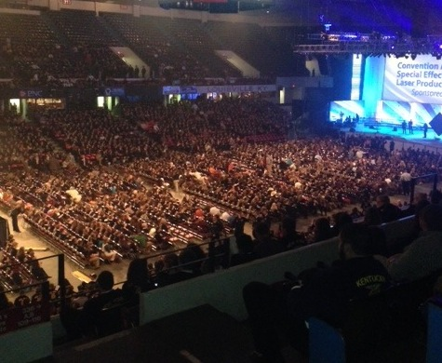
History of the National FFA Organization
1988 – Name change
  Future Farmers of America to National FFA Organization
  Reflects the growing diversity in the agriculture industry
2012 – National Convention completes 7 year run in Indianapolis
  Returns to Louisville, Kentucky in 2013 for 3 years

Slide 7
FFA Mission
FFA makes a positive difference in the lives of students by developing their potential for premier leadership, personal growth and career success through agricultural education.
  Promotes teamwork, cooperation, and citizenship

Slide 8
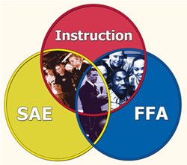
SAE
Supervised Agricultural Experience
  Component used to help students learn to keep records, perform practical job skills, and gain opportunity for work and exploratory experience in Agriscience

Slide 9
Opportunities within the FFA
Career Development Events (CDE’s)
  Competitive Events - benefits
    Most events progress from the local (chapter) to the federation, regional, state and national level.
    Develops technical and leadership skills as well as confidence.
    Recognition is received and prize money is often received for 1st place state finish.

Slide 10
Opportunities within the FFA
Career Development Events (CDE’s)
  Animal Science Competitive Events - examples
    Dairy Evaluation
      grade and evaluate dairy cattle
    Poultry Evaluation
      grade and evaluate chickens and chicken products
    Livestock Judging
      grade and evaluate beef cattle, sheep, swine and goats
    Horse Judging
      evaluate several classes of horses and present oral reasons

Slide 11
Opportunities within the FFA
Career Development Events (CDE’s)
  Plant Science Competitive Events - examples
    Introduction to Horticulture
      knowledge of horticulture and plant identification
    Nursery/Landscape
      knowledge of the nursery and landscape industry and plant identification
    Floriculture
      knowledge of floral arrangement , horticulture and plant identification
    Forestry
      identification of trees and forestry tools as well as measurement of trees

Slide 12
Opportunities within the FFA
Career Development Events (CDE’s)
  Leadership Competitive Events - examples
    Creed speaking
      recitation of the FFA creed.
    Prepared Public Speaking
      prepare and present a 6-8 minute speech on an agriculturally related topic of your choice
    Extemporaneous Public Speaking
      present a 4-6 minute speech on a topic given to you with 30 minutes preparation time
    Parliamentary Procedure
      present a mock business meeting
      solve business problems and knowledge of business principles

Slide 13
Opportunities within the FFA
Career Development Events (CDE’s)
  Agriculture Business Competitive Events - examples
    Job Interview
      performance of a mock interview for an agriculturally related job
    Agricultural Sales
      knowledge of sales and marketing
    Farm Business Management
      solve business problems and knowledge of business principles

Slide 14
Opportunities within the FFA
Career Development Events (CDE’s)
  Agriculture Mechanical Competitive Events - examples
    Agricultural Tools and Materials
      knowledge and identification of tools
    Agricultural mechanics
      knowledge of agricultural mechanics as well as performance of specific mechanical skills

Slide 15
Agricultural Organizations related to the Agriscience Industry
Goals
  Allow professionals the opportunity to network, learn, and communicate
  Provide trade shows and journals
    update members on new methods, products, and technology
  Uses membership dues
    commodity advertisement
    trade journals
    educational programs
    scholarships for members

Slide 16
Agricultural Organizations related to the Agriscience Industry
Types (examples)
  Commodity related
    Corn Growers Association (NCGA)
      to create and increase opportunities for corn growers
    North Carolina Pork Producers Council (NPPC)
      promotes and educates a socially responsible and profitable NC pork industry

Slide 17
Agricultural Organizations related to the Agriscience Industry
Types (examples)
    North Carolina Nursery and Landscape Association (NCNLA)
      flexible, knowledgeable, responsive, environmentally- conscious organization
      provides the nursery and landscape industries with leadership, technological and business advancement opportunities and information services
    American Quarter Horse Association (AQHA)
      world’s largest breed registry and membership organization
    North Carolina Christmas Tree Association (NCCTA)
      promotes “real” Christmas trees through marketing and education

Slide 18
Agricultural Organizations related to the Agriscience Industry
Other Types (examples)
  NC Farm Bureau
    unified voice in agricultural issues
    offers insurance
    provides scholarships and educational opportunities for youth
  Carolina Farm Stewardship Assoc. (CFSA)
    farm driven, membership based, non-profit, that helps people in the Carolinas grow and eat local, organic foods……
  Grange
    is a family–oriented organization
    serves its members through a variety of programs and promotes agriculture as an essential industry for our economy
  FFA Alumni
    open to those who wishes to support students in agricultural education

