Slide 1
Writing a
CounterClaim

Slide 2
In a good opinion/argument paper, the writer always acknowledges the counter claim, or the opposing opinion. However, the writer must discredit the counterclaim… show how it is wrong.

Slide 3
Here is an example of a strong Counter claim paragraph. This counterclaim paragraph is from the article ”Zoochois”
“Although zoos claim that their main purpose is to help prevent animals from becoming extinct and to help educate people about animals, we think the only thing zoos do is make animals crazy.”

Slide 4
“Although zoos claim that their main purpose is to help prevent animals from becoming extinct and to help educate people about animals, we think the only thing zoos do is make animals crazy.”
Think about what the author did first in this paragraph.

Slide 5
“Although zoos claim that their main purpose is to help prevent animals from becoming extinct and to help educate people about animals,
The writers stated the other sides claim… they acknowledge the counterclaim.

Slide 6
Now, we need to think about how the writer did this.
*I believe the writer most likely thought through their own claim and thought about how someone might be able to argue it.

Slide 7
Items people might be able to argue about Chocolate milk in schools:
* Added sugar in chocolate milk causes obesity in children
* Drinking too much chocolate milk can cause diseases later in life
* Children aren’t use to drinking chocolate milk in schools

Slide 8
Items people might be able to argue about Chocolate milk not allowed in schools:
* chocolate milk is healthy
* chocolate milk doesn’t have much added sugar
* students will pick other sugary drinks if chocolate milk is not offered.

Slide 9
Think about one of the reasons you have to support your claim.
What would the opposing side be able to argue about your reason?
Select a reason from your claim that the could be argued.

Slide 10
Let’s look back at the counterclaim from “Zoochois”
“Although zoos claim that their main purpose is to help prevent animals from becoming extinct and to help educate people about animals, we think the only thing zoos do is make animals crazy.”

Slide 11
Next the writers of “Zoochois”, discredited the counterclaim with their main reason animals should not be in zoos.”…we think the only thing zoos do is make animals crazy.”
Now, think about how you could discredit the counter claim. Use the STRONGest reason from your paper that will show the counter claim is wrong.

Slide 12
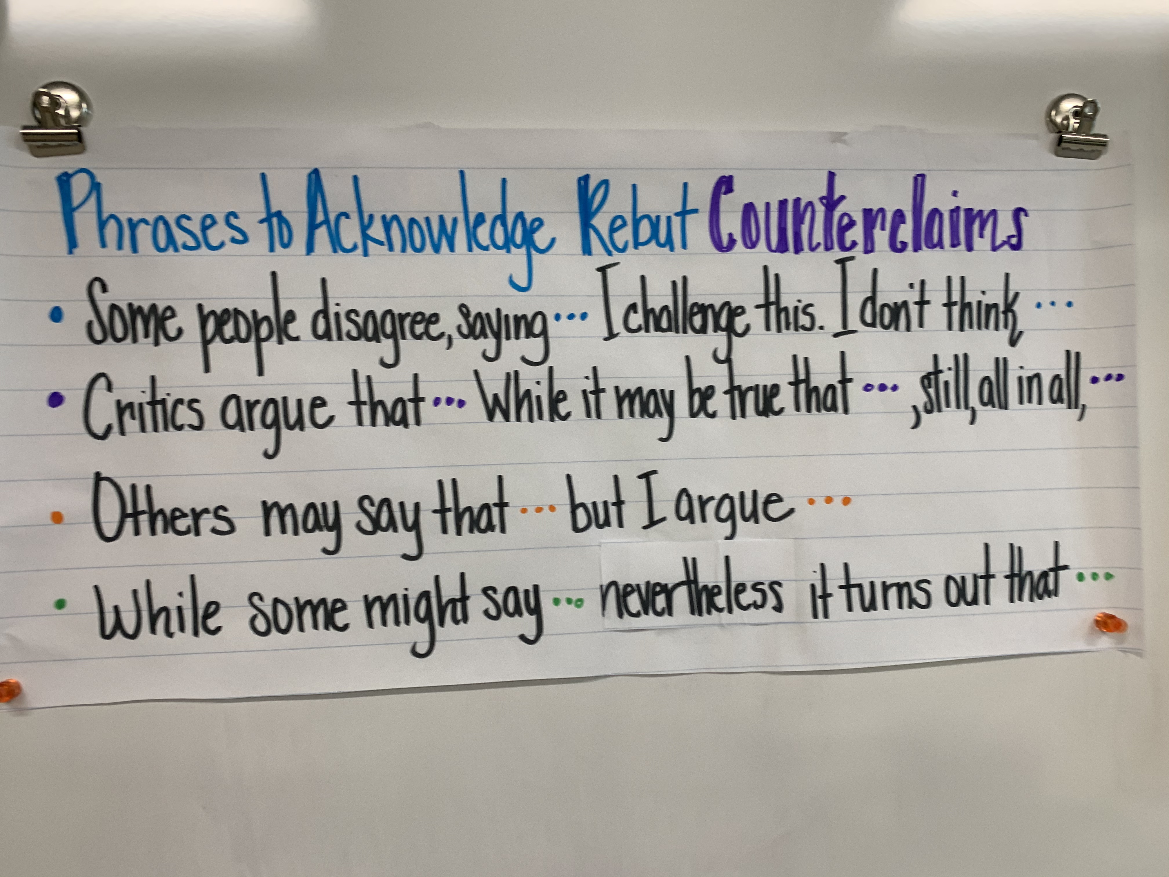
Ways to state and discredit Counter Claims
The 3 dots is where you would place the counter claim. The phrase after the 3 dots is where you place your strongest reason.

Slide 13
Now its time to write your counter claim paragraph.
Go to Google Classroom
If you have difficulty accessing Google Classroom, here are some steps to get you there.
School webpage. Clever. Mrs. Shakespeare’s page. Google Classroom icon….VIOLA!!!

Slide 14
Once in Google Classroom, compose your counterclaim paragraph under the second ”body” paragraph.
I look forward to reading your counter claim.
Once counter claims are written and I see them, you will receive a DOJO

