Slide 1
Winds and Breezes
Carl A Furr Grade 5
2018-2019

Slide 2
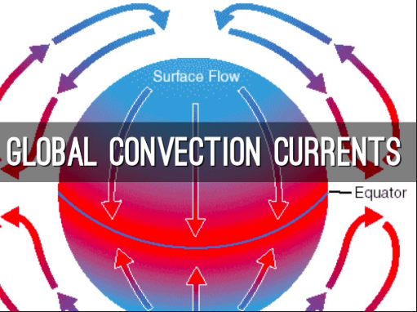
What Causes Wind?
Wind is the movement of air caused by differences in air pressure. The uneven heating of the earth produces these pressure belts, which cause winds; the air rises and sinks (convection currents). When this happens at the poles of the earth, global winds occur. These winds move all over the world.
Bill Nye video on wind

Slide 3
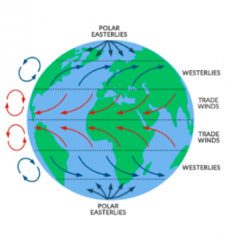
Global Winds
Global winds are patterns of wind that happen all over the world. They are created by the spin of the earth and the difference in temperatures.

Slide 4
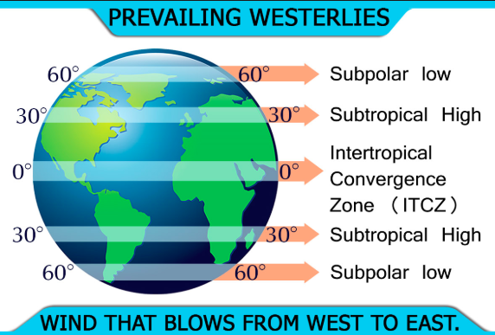
Prevailing Westerlies
These winds predict most of our weather. They blow from west to east across the United States (California to North Carolina).

Slide 5
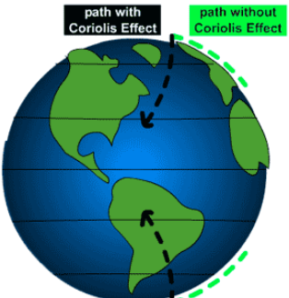
Polar Easterlies
These winds blow close to the north and south poles. They blow away from the poles and curve east to west. These winds are cold, dry winds.

Slide 6
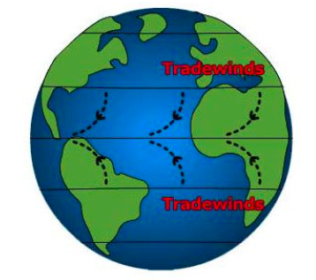
Trade Winds
Trade winds are winds that circle near the equator. Trade winds have been used by ships sailing the ocean for centuries. They help ship captains know which direction they are going.

Slide 7
Local Winds
Local winds in one particular area. Types of local winds include:
Sea breeze
Land breeze
Mountain breeze
Valley breeze

Slide 8
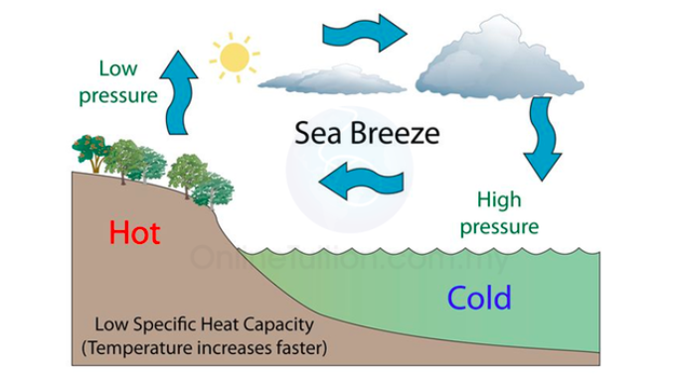
Sea Breeze
During the day, the sun heats the ocean and the land. The land heats up much quicker than the large ocean does. This causes the air above the land to heat up and rise. The cool air from the water moves toward the land to replace the rising warm air. When the air moves from the sea to the land, this is called a sea breeze.

Slide 9
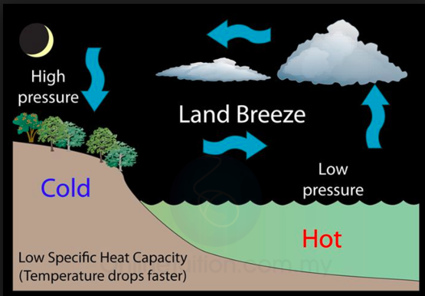
Land Breeze
At night, a land breeze occurs near the ocean. The air above the land cools down fast, while the air above water stays warm. The cool air from the land sinks and moves toward the ocean to replace the rising warm air. When the air blows from the land out to the sea, this is called a land breeze.
Land and Sea Breeze Video

Slide 10
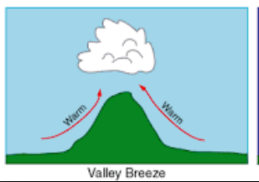
Valley Breeze
During the day, the sun heats the valley air quickly. The warm air rises and moves up the mountain. This creates a valley breeze.

Slide 11
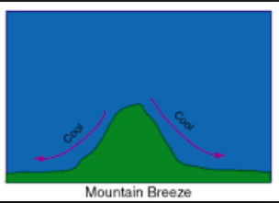
Mountain Breeze
At night, the mountain air cools faster than the valley. The cool air sinks down the mountain causing the wind to move in the opposite direction. This creates a mountain breeze.

