Slide 1
Wind

Slide 2
Wind
State of the Atmosphere
Air moves in response to density imbalances created by the unequal heating and cooling of Earth’s surface.
These imbalances, in turn, create areas of high and low pressure.
Wind can be thought of as air moving from an area of high pressure to an area of low pressure.
Wind speed generally increases with height in the atmosphere because there is less friction.

Slide 3


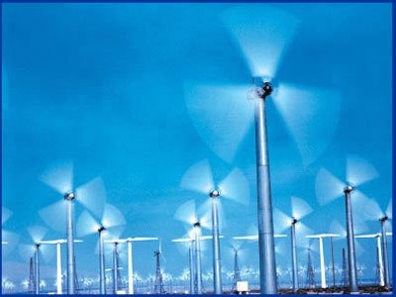

Wind – What causes it?
Wind is a result of horizontal differences in air pressure
Air flows from areas of high pressure to areas of lower pressure.

Slide 4
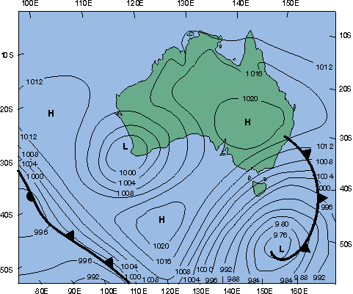
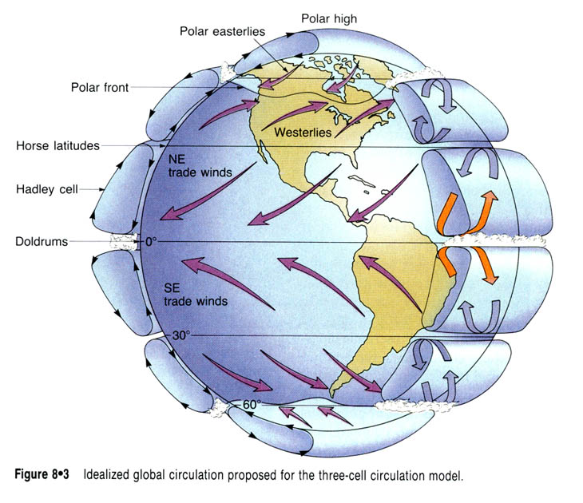
How do we get pressure differences on Earth?
The unequal heating of earth’s surface generates pressure differences
Solar radiation is the ultimate energy source for most wind

Slide 5
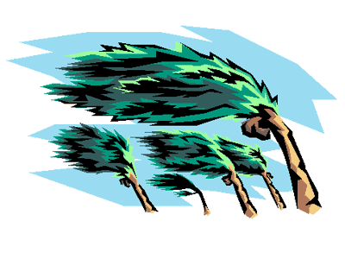
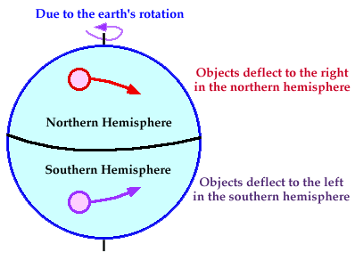
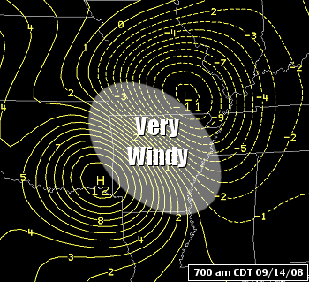
Three Factors that Combine to Control Wind
Pressure Differences
Coriolis Effect
Friction

Slide 6
Pressure and Wind
  Unequal heating of the earth creates pressure differences
  Air flows from areas of high pressure to areas of low pressure creating wind
  The greater the difference in pressure the greater the wind speed

Slide 7
  Differences in pressure are show on maps using isobars – lines on a map of equal pressure
Spacing of lines indicate amount of pressure change called pressure gradient
Closely spaced lines show a steep pressure gradient and high winds
Widely spaced lines show a weak pressure gradient and light winds
A pressure gradient
  The spacing of isobars indicates the amount of pressure change over a given time

Slide 8
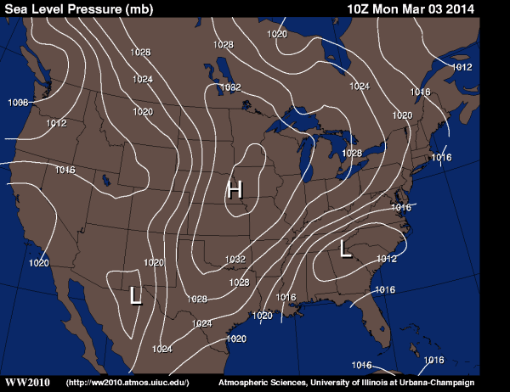

Slide 9
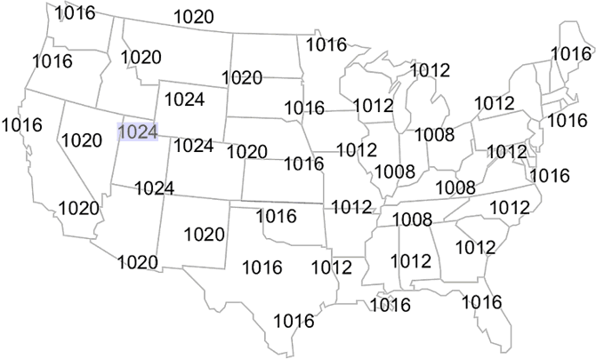

Slide 10
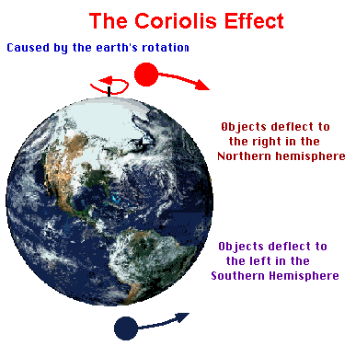
Coriolis Effect
The Coriolis effect describes how Earth’s rotation affects moving objects.
Northern Hemisphere
  Deflected to right,
  Moves counterclockwise
Southern Hemisphere
  Deflected to the left,
  Moves clockwise

Slide 11
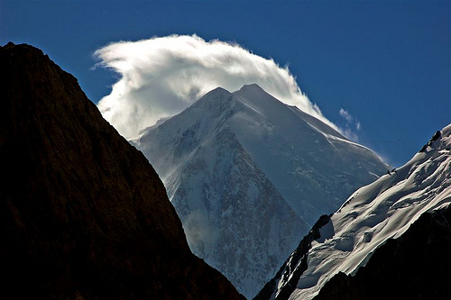
Friction
Important only within a few km of Earth’s surface
Acts to slow air movement, which changes wind direction
Friction is at its highest in mountains.

Slide 12
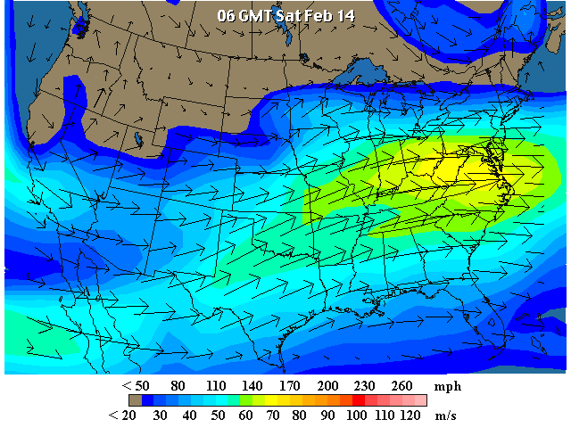
Jet Streams
Jet streams are fast-moving rivers of air
Speed: 120 and 240 kilometers per hour
Direction: West-to-east direction.

Slide 13
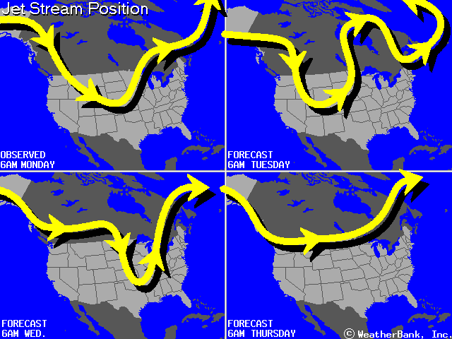
http://www.weatherimages.org/data/imag192.html(current position)

Slide 14
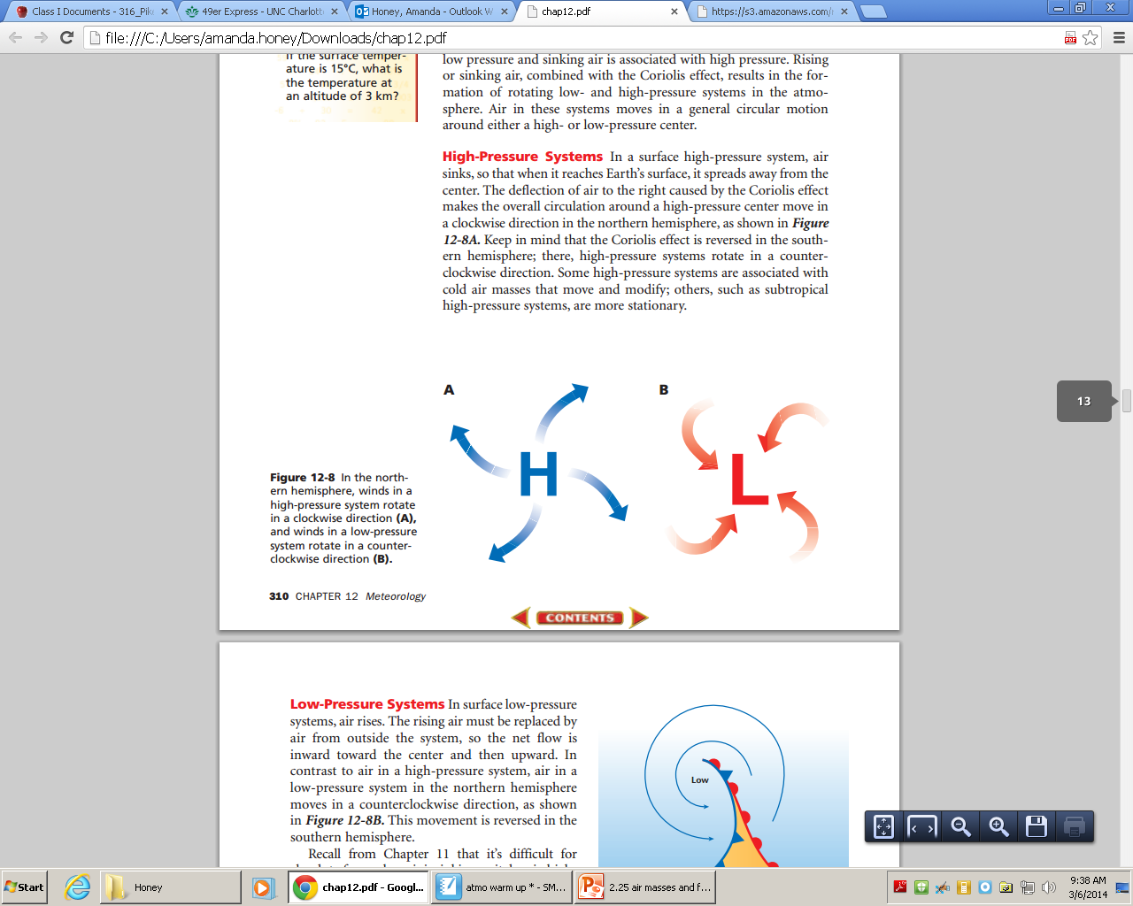
Pressure Systems
Low Pressure
  Air moves in a counter-clockwise direction
  Made of rising warm air that flows inward
  Associated with clouds and precipitation
High Pressure
  Air moves in a clockwise direction
  Made of sinking cold air that flows outward
  Associated with fair weather

Slide 15
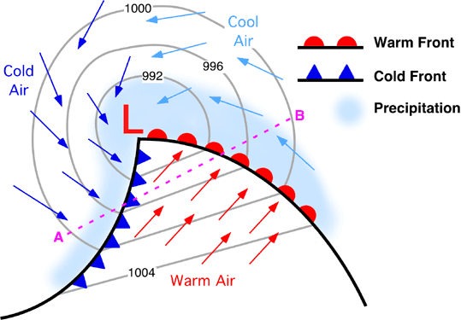

Slide 16
High and Low Pressure Systems
Low Pressure Systems (cyclones)
  Pressure decreases toward the center
  Wind blows inward and counter clock wise
  Air mass shrinks and increases in height
    Causes cloud formation and precipitation
    Unstable conditions, stormy

Slide 17
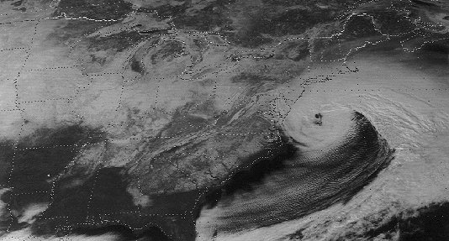
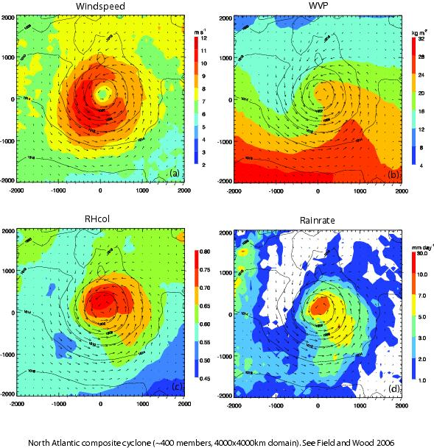
Middle Latitude Cyclone
Large centers of low pressure
Travel from west to east
Causes stormy weather
Also known as Nor’ Easterns

Slide 18
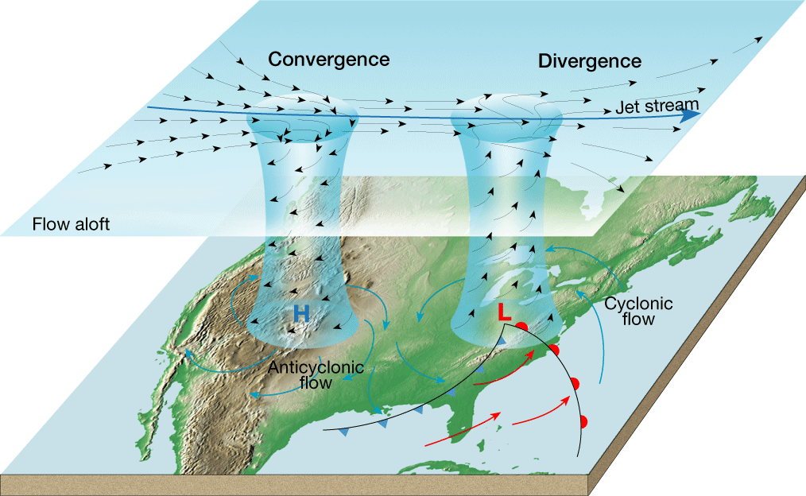
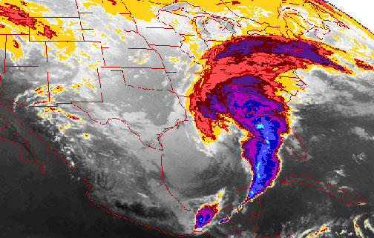
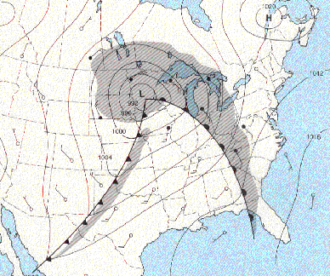
The Role of Airflow Aloft
Plays an important role in maintaining cyclonic and anti-cyclonic circulation
More often than not, air high up in the atmosphere fuels a middle latitude cyclone

Slide 19
High Pressure Systems (anti-cyclones)
  Pressure increases towards the center
  Wind blows outward and clockwise
  Air mass expands and moves downward
    Causes nice conditions
    Dry, calm, stable conditions

Slide 20
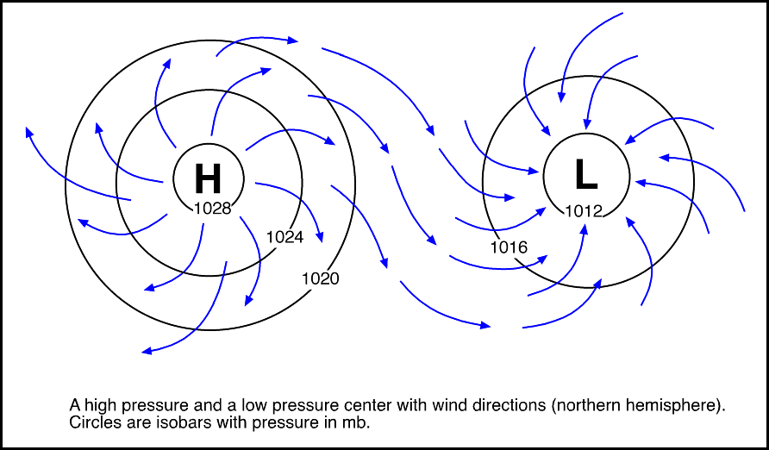

Slide 21
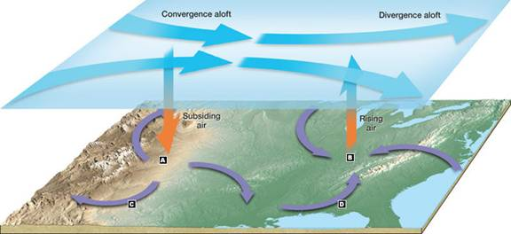

Slide 22
High and Low Pressure System
 | Low Pressure Centers | High Pressure Centers
Centers of | Low Pressure | High Pressure
AKA | Cyclones | Anti-cylones
Pressure Behavior | Pressure decreases from the outer isobars towards the center | The values of the isobars increase from the outside towards the center
Wind Behavior | Winds blow inward and counterclockwise | Winds blow outward and clockwise
Weather Associated | Severe and stormy | Fair and Sunny
Symbol | “L” that is RED | “H” that is BLUE

Slide 23
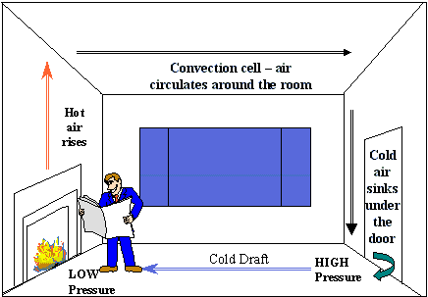
Wind blows from areas of
to areas of
high
pressure
low
pressure

Slide 24
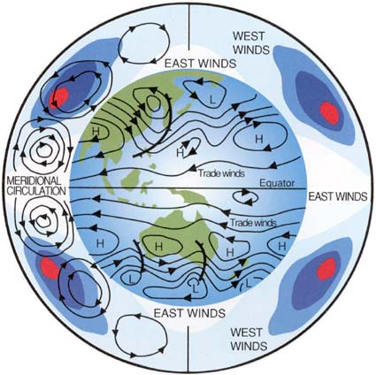
Global Winds
The atmosphere balances itself by acting as a giant heat-transferring system
Moves warm air to the poles and cool air towards the equator

Slide 25
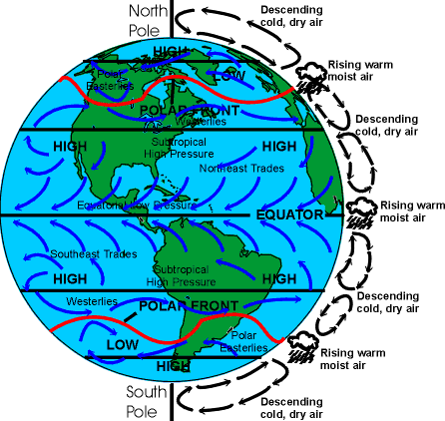
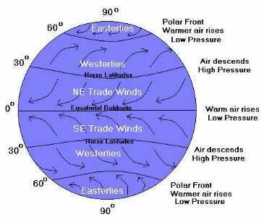
Global Winds
Equatorial Low
  A region characterized by abundant precipitation and rising air
Trade winds
  Two belts of winds that blow almost constantly from east to west
Subtropical High
  Area of sinking air at 30˚north or south latitude

Slide 26
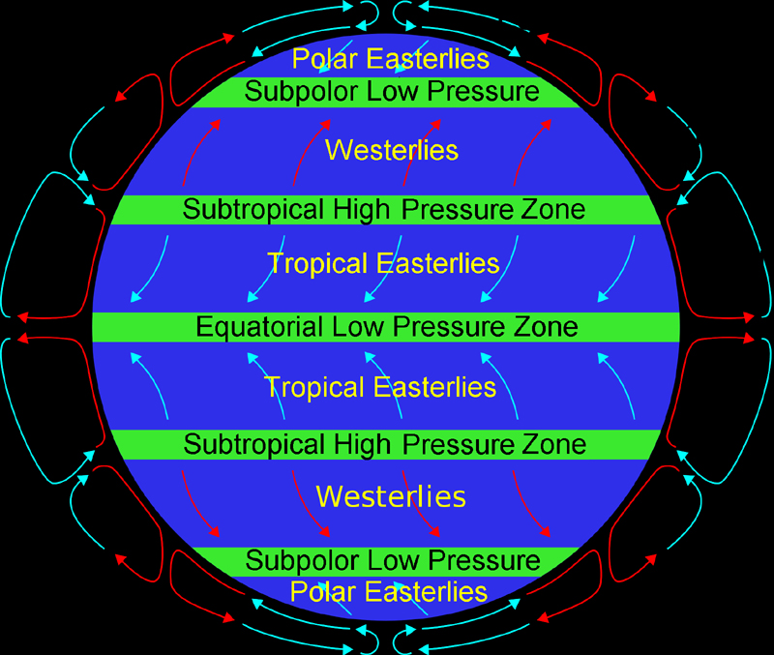
Westerlies
  Dominate west to east motion of the atmosphere
  (Jet Stream occurs here)
Subpolar Low
  Rising air area
Polar easterlies
  Winds that blow east to west
Polar High
  Sinking air area
Polar front
  Interaction of warm and cool air masses produces a stormy belt

Slide 27
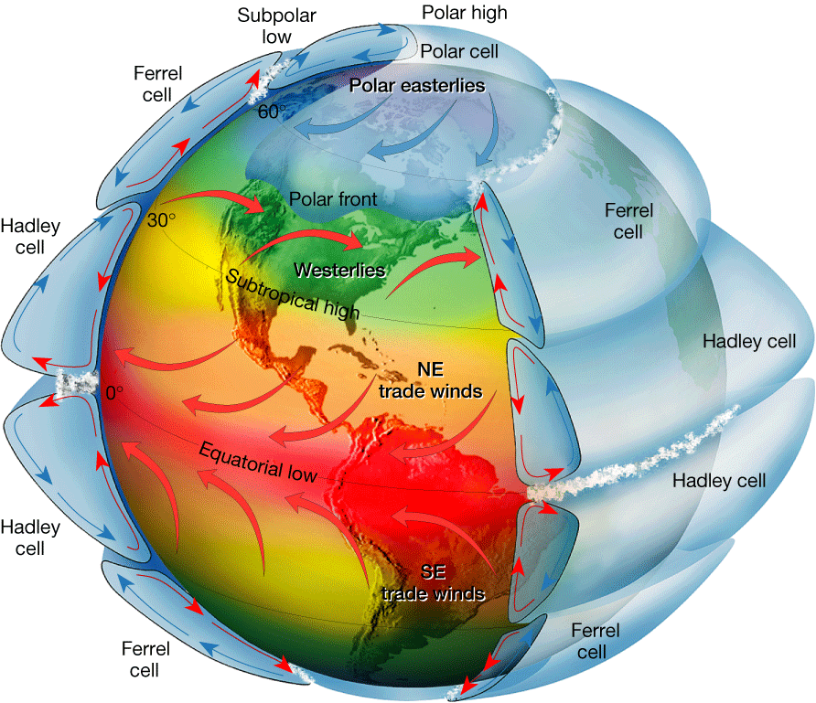
Circulation on a Rotating Earth
Notes:
Makes no sense without caption in book

Slide 28
Pressure Centers and Winds
Global Winds
◆ Influence of Continents
• The only truly continuous pressure belt is the subpolar low in the Southern Hemisphere. In the Northern Hemisphere, where land masses break up the ocean surface, large seasonal temperature differences disrupt the pressure pattern.
• Monsoons are the seasonal reversal of wind direction associated with large continents, especially Asia. In winter, the wind blows from land to sea. In summer, the wind blows from sea to land.

Slide 29
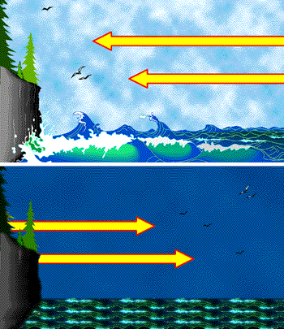
Local Winds
Small scale winds produced by a locally generated pressure gradients
Types of Local Winds
  Land Breezes
  Sea Breezes
  Valley Breezes
  Mountain Breezes

Slide 30
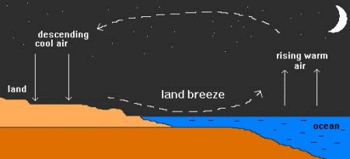
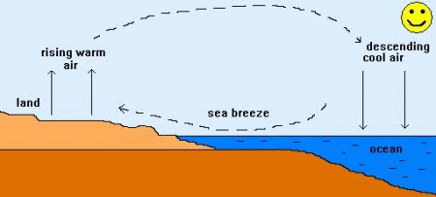
Sea and Land Breezes
Sea Breezes
  Day – air above the land heats, expands, and rises (area of lower pressure)
  Cooler air over water moves towards the warmer land
  Strongest in mid-afternoon
Land Breezes
  Night – air above the land quickly cools off
  The cooler air over land moves to the warmer sea air
  Known as the “Lake Effect”

Slide 31
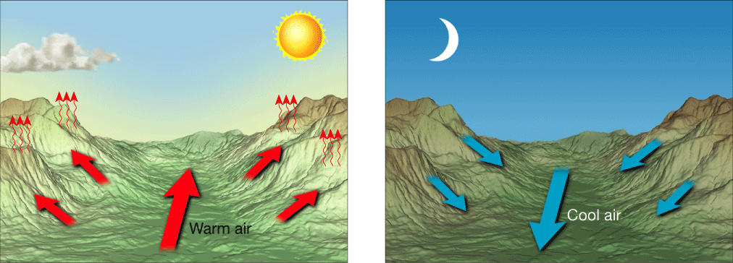
Valley and Mountain Breezes
Valley
  Day – heating during the day generates warm air that rises from the valley floor.
  “Upslope Breezes”
Mountain
  Night –cooling of the air near mountain slopes results in cool air moving into the valley
  “Down-slope Breezes”
Ex. Grand Canyon at night

Slide 32
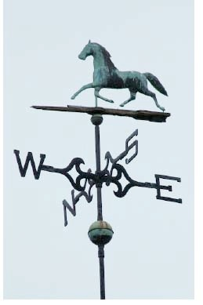

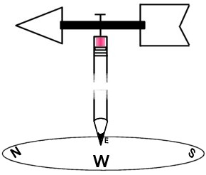
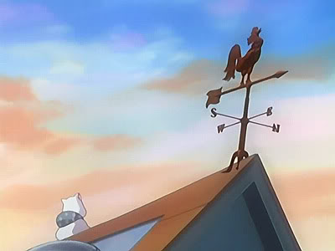
Measuring
Wind
Direction
  Labeled by the direction from which they blow
  Tool: Wind Vane

Slide 33
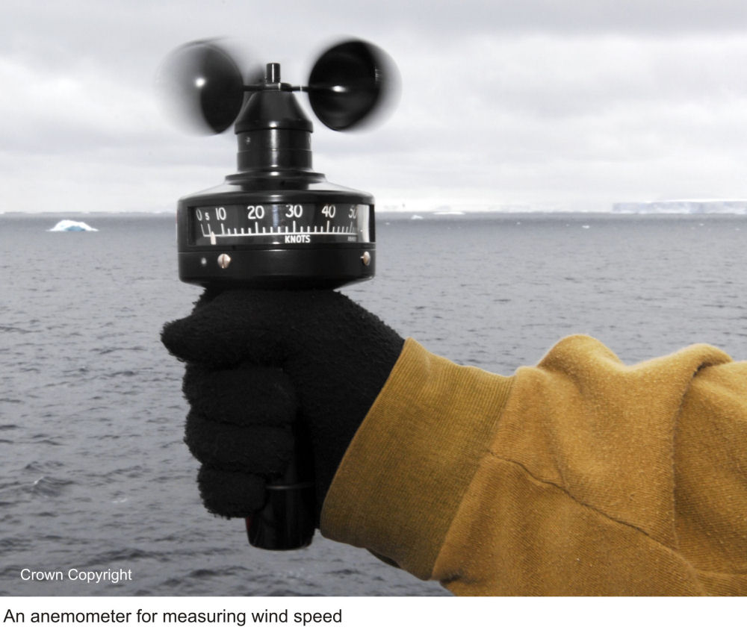
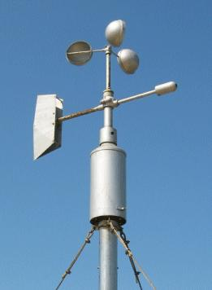
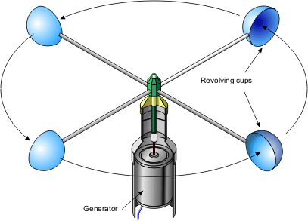
Wind Speed
  Anemometer
    Measures how fast wind is blowing

Slide 34
Regional Wind Systems
El Niño and La Niña
◆ El Niño
• El Niño is the name given to the periodic warming of the ocean that occurs in the central and eastern Pacific.
• At irregular intervals of three to seven years, these warm countercurrents become unusually strong and replace normally cold offshore waters with warm equatorial waters.
• A major El Niño episode can cause extreme weather in many parts of the world.

Slide 35
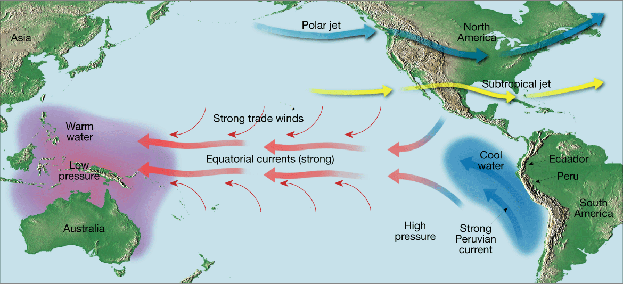
Normal Conditions
Notes:
Makes no sense without caption in book

Slide 36
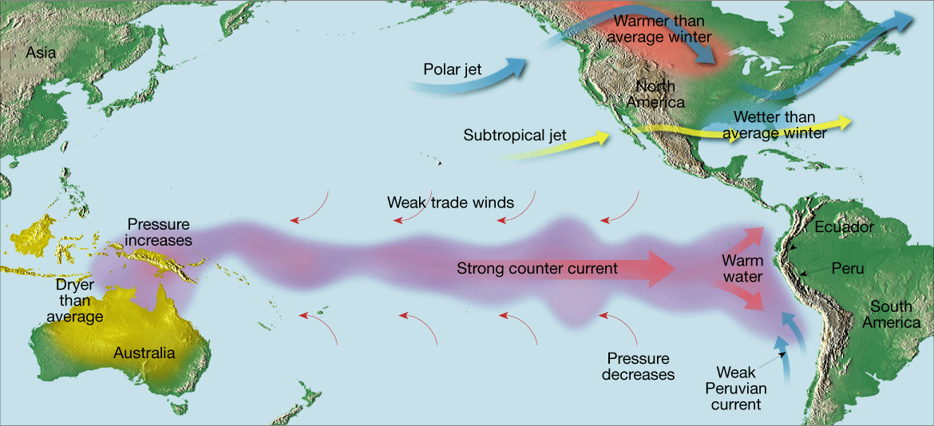
El Niño Conditions
Notes:
Makes no sense without caption in book

Slide 37
Regional Wind Systems
El Niño and La Niña
◆ La Niña
• Researchers have come to recognize that when surface temperatures in the eastern Pacific are colder than average, a La Niña event is triggered that has a distinctive set of weather patterns.

