Slide 1
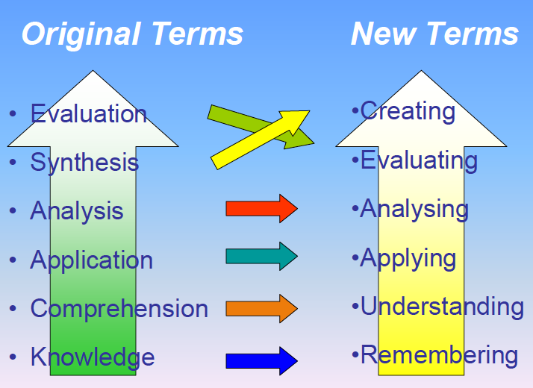
Revised Bloom’s Taxonomy

Slide 2

William’s Taxonomy
(Creative Thinking)

Slide 3
William’s Taxonomy
Fluency
  Flexibility
    Originality
        Elaboration
        Risk Taking
        Complexity
        Curiosity
        Imagination

Slide 4

Fluency
Generating a great many ideas, related
answers or choices.

Slide 5
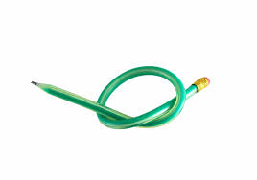
Flexibility
Changing everyday objects to generate a variety of
categories, by taking detours and varying sizes,
shapes, quantities, time limits, requirements, objectives
or dimensions.

Slide 6

Originality
Seeking new ideas by suggesting unusual twists to
change content or coming up with clever responses.

Slide 7

Elaboration
Expanding, enlarging, enriching, or embellishing
possibilities that build on previous thoughts or ideas.

Slide 8

Risk Taking
Dealing with the unknown by taking chances, experimenting
with new ideas or trying new challenges.

Slide 9

Complexity
Creating structure in an unstructured setting or building
a logical order in a given situation.

Slide 10

Curiosity
Following a hunch, questioning alternatives,
pondering outcomes and wondering about options.

Slide 11

Imagination
Visualizing possibilities, building images in the mind,
picturing new objects, reaching beyond the limits
of the practical.

Slide 12
William’s Taxonomy
Question
Stems
Source: Dynamite in the Classroom: A How to Handbook.

Slide 13
List as many words as you can to describe _____________.
Name all the _____________things you can think of.
How many items can be made from a _________? List them.
Form as many new words as possible using the letters in the word ___.
List the many things that have ______________.
Invent as many new uses for the ____________ as you can think of.
Name all the characteristics of a _____________.
Fluency

Slide 14
Group objects that are ______ in at least three different ways.
If you had ________, tell all the ways your life would be different.
Classify _______ that use a _________in as many ways as possible.
Describe the many different combinations of ______that you can order.
How many different ways can you ___________?
List all the different forms of __________you can think of.
If someone says a number/color/etc., list all the items you wish you had of that number/color/etc.
Flexibility

Slide 15
Think of a new accessory for a __________.
Make up an original story about a(n) ________.
Think of some practical and not so practical uses for a ______.
What clever things might _______say to ___________?
Think up three uses for a broken ____________.
What are you ways that you can ________(complete a specific task) without _____________(the required equipment)?
Originality

Slide 16
Expand upon this idea: ____________.
Explain ways that you could improve ______________.
Stretch your imagination and think of ways __________ is like a ____________.
Add lines to this __________.
Explain why ______________ is a ______________.
Explain what you think this means _________________.
Complete this statement: ______________________.
Describe what it would be like if you were __________________.
Elaboration

Slide 17
Artistically describe your bare feet.
Pantomime one event or activity that makes you happy.
What three book or song titles best describe you?
Practice telling a joke.
Think of six words that describe you as a person.
What would be a dream come true for you in a make-believe situation?
Draw a picture of your greatest fantasy.
If you had three wishes, what would they be?
If summer holidays require that your parents go to school and students go to work, what kind of students would your parents be?
Risk Taking

Slide 18
Think up three questions to find out more about ________.
Explain how the world would be different if there were no _______.
Explain all the different ways a _________influences our lives.
What is most fascinating (given two items)?
Complexity

Slide 19
What do you think will happen if……..?
Do you agree or disagree with this saying: ___________?
Invent a new way to ____________.
What are you more curious about (given two options)? Explain.
List three things you want to learn more about.
If __________ were to visit your class today, what three questions would you ask him/her?
If you could be a news reporter for a day, who would you interview and why?
Curiosity

Slide 20
Imagine you are the first ___________. What things would excite you the most?
Imagine your life as an ________. Which one would you want to be and why?
If people had ______ and could ______, how would life be different?
Pretend you are a _______and describe an adventure.
If your ________could talk, what would it/they say about you?
Imagination

Slide 21
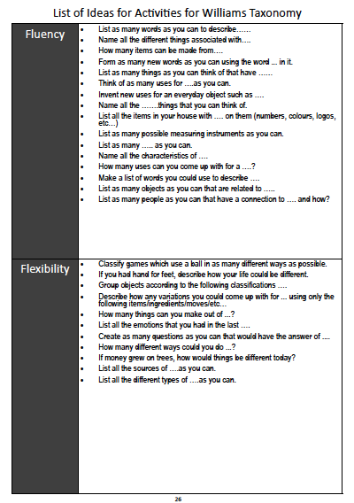

Slide 22
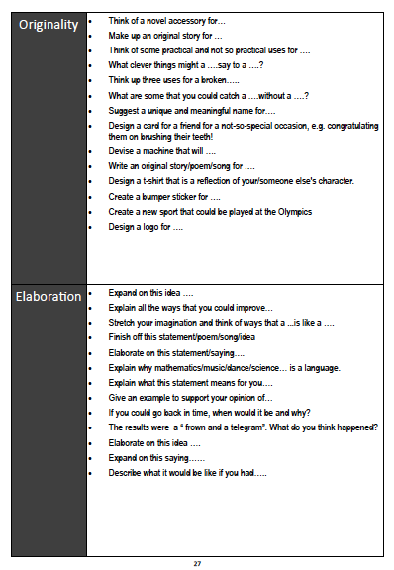

Slide 23
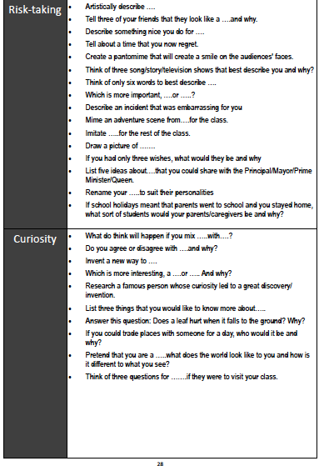

Slide 24
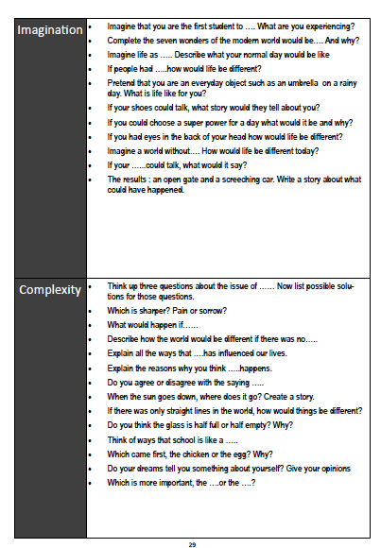

Slide 25
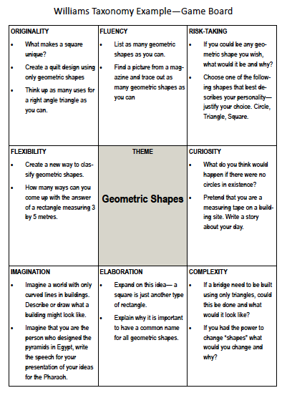

Slide 26
