Slide 1
Health and Wellness

Slide 2
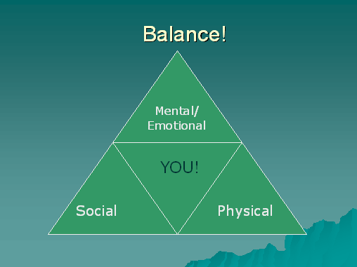
What is Health?
Defined as the combination of physical, mental/emotional and social well being, your health is something that is constantly changing.
Who’s responsible for your health?
Draw the Health Triangle
Why is it important to keep it balanced?

Slide 3
What is Physical Health
Basically how well your body functions.
Normally you should be able to perform daily activities with energy, deal with everyday stress, avoid injury, and resist disease.
But how does one achieve such greatness?
Rest: How many hours of sleep should you get?
Eat/fluids: How often should you eat and how much water should you get per day?
Physical activity: How long should you exercise?
Abstinence: What should you avoid?
Hygiene: What should you do daily?

Slide 4
What is Mental/Emotional Health
This is about your feelings/thoughts about yourself, how you meet the demands of daily life and how you cope with problems that occur in life.
So what are you?
Positive, negative, optimist, pessimist, type A personality or type B personality
Spiritual Health is a deep-seated sense of meaning and purpose in life.
Who am I and what am I here for?
As person who is mentally/emotional healthy you……
Enjoy challenges that help you grow
Accept responsibility for your actions and make thoughtful and responsible decisions
Have a sense of control of your life
Can deal with life’s stresses and frustrations
Can express your emotions in appropriate ways

Slide 5
What is Social Health
Basically….. Your ability to get along with others.
What is your social network?
Family
Friends
Teachers
Members of your community
How do you maintain a healthy relationship?
Seeking and lending support when needed
Communicating clearly and listening to others
Showing respect and care for yourself and others
What do you consider an unhealthy relationships?

Slide 6
Keeping it all balanced
http://www.mcgrawhill.ca/web_resources/sch/GlencoeHealthsamplech1.pdf
Page 4
To keep balance you should also set goals for your health.
Choose a goal that will enhance your health and the health of others. Apply the goal-setting steps to help you reach your goal.
Identify a specific goal and
write it down.
2. Is your goal measurable?
3. Is your goal attainable?
4. Is your goal realistic?
5. Is your goal achievable in an
appropriate timeline?
Once you have set your goals what should you do next?
Monitor, adjust (break it into smaller goals), and ask for help when you need it.
When your health triangle is balanced, you have a high degree of wellness.
(an overall state of wellbeing or total health)
The Health continuum shows you what can happen when your health triangle gets out of balance.
What are the risks factors that can cause this imbalance and possible lead to chronic disease?
Heart disease, smoking, over weight/obesity, poor nutrition or physical activity, and lack of health screenings
What are considered “health screenings”?

Slide 7
What can affect your health
Behavior
Do you avoid high-risk behaviors and practice healthful behaviors?
Can your behavior cause problems for the people around you?
Media and Technology
How can this two forms of communication affect your health?
What are the positives and negatives of both?
How do you know if it’s a good medical site?
CDC, AMA, and WHO
Heredity
What can you inherit from your family?
Environment
How does your Physical environment, social environment and culture affect you?
Attitude
How does the way you view situations affect your health?

Slide 8
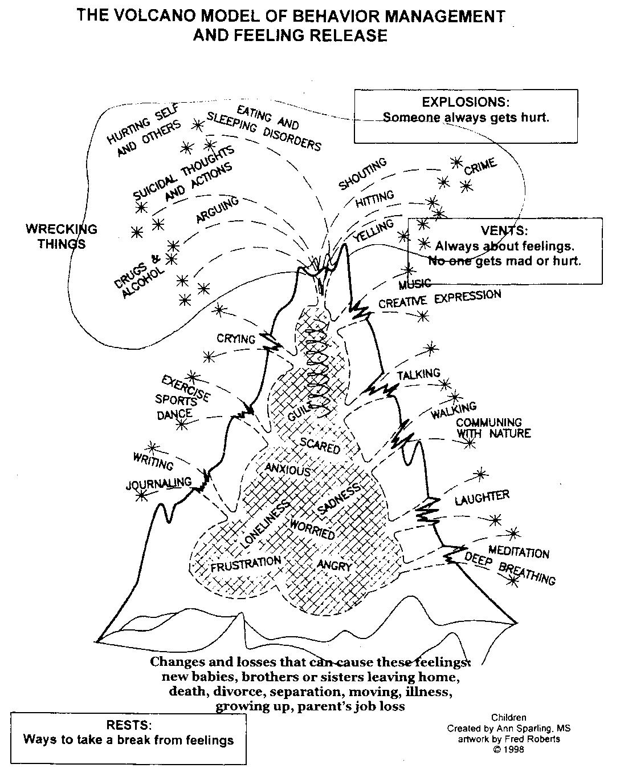
Stress
Negative
ways to
deal with stress
Positive ways to deal with stress
What can
cause stress
What is positive stress
Verses negative stress?

Slide 9
Job stress
http://www.cnbc.com/id/45859025/America_s_Most_Stressful_Jobs_2012
What’s the common theme in all of these jobs?
Double bubble map compare and contrast stress for adults and stress for teenagers

Slide 10
Components The Stress Response
Autonomic Nervous System: Action within the central nervous system that is “reflexive.”
Sympathetic Nervous System
Parasympathetic Nervous System
Notes:
Such as the stress response.

Slide 11

Fight or Flight =
ALARM Stage
The Sympathetic Nervous System takes an active role in triggering the stress response.
The Sympathetic Nervous System effects include increased:
  arousal
  blood pressure
  heart rate
  respiratory rate
  physical activity
Notes:
For more effects, see Appendix 1 on the Lesson Plan.

Slide 12
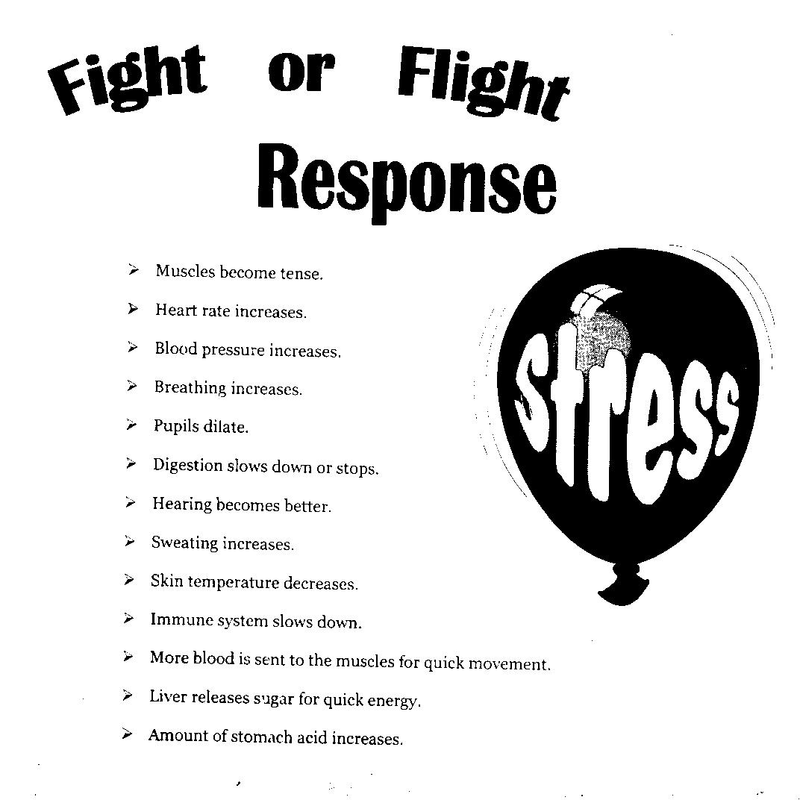
Pick 5

Slide 13

Resistance Stage
Acts as an equalizer
Brings body functions back to stability
Notes:
Needs to be a healthy balance between sympathetic and parasympathetic. These 2 systems are constantly active, thus constantly trying to maintain balance.
http://www.google.com/imgres?q=balance&num=10&um=1&hl=en&biw=1920&bih=950&tbm=isch&tbnid=uOr_BMGMwPZHlM:&imgrefurl=http://www.crystalvaults.com/pages/crystal_harmony.php&docid=CNXY7ZEZW1AbcM&imgurl=http://www.crystalvaults.com/images/balance_yinyang_symbol.gif&w=352&h=341&ei=t6a6TvHfIIjg2AW735j-Bg&zoom=1&iact=hc&vpx=542&vpy=317&dur=560&hovh=221&hovw=228&tx=117&ty=109&sig=106962588013688018438&sqi=2&page=1&tbnh=132&tbnw=136&start=0&ndsp=51&ved=1t:429,r:12,s:0

Slide 14
Exhaustion Stage
Energy is depleted
Body returns to normal if stress is removed
Body returns to alarm stage if stress continues which can result in stress-related diseases:
  Skin disorders
  Gastrointestinal upset
  Menstrual irregularities
  Cardiovascular disorders

Slide 15
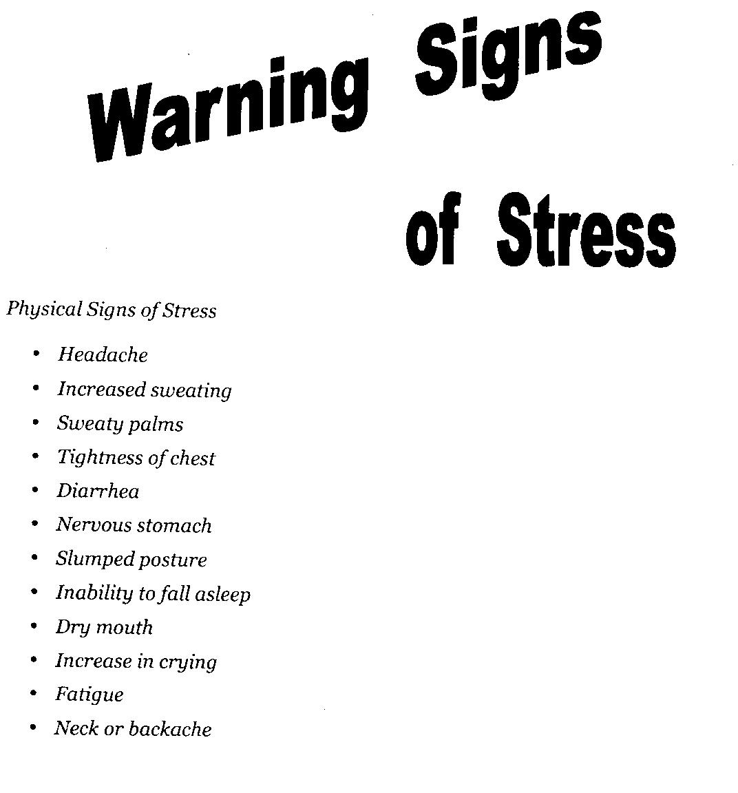
Pick
4

Slide 16
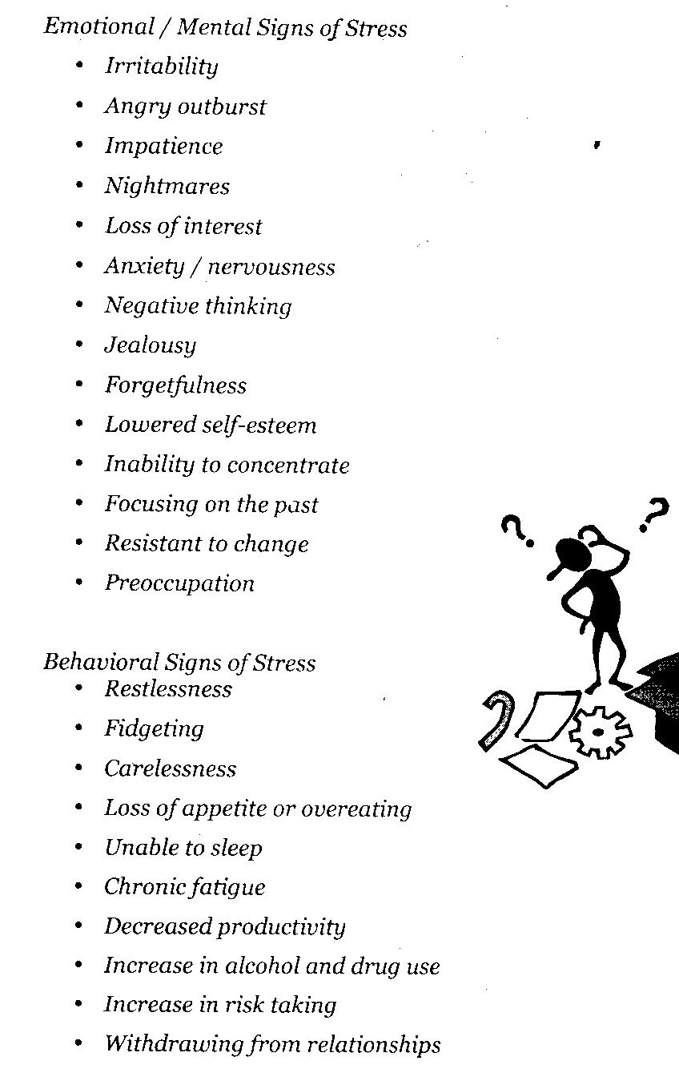
Pick 4

Slide 17

Stress-Related
Diseases & Conditions
Gastrointestinal disorders
Skin Disorders
Cancer
Cardiovascular disorders
Depression
Anxiety

Slide 18

Your Mental Health
List what makes you stressed out and the warning signs you get when you are getting stressed.
Now list how you cope with these stresses and decided if the way you cope with them is healthy or unhealthy.
Do you need to improve your ability to cope with stressful situations? How will you do it? (pick some healthy stress relievers from your notes)
What are some health concerns that could develop from not coping with stress?
**** Normal or Excessive Stress activity

Slide 19
Tools to Reduce Stress
ht before the test.
Believe
Reduce the Number of Commitments
We often fall into a trap that we believe we can take on more than we should. Before you say, “Yes” to a request, ask yourself if you have time to do what is being asked. Will it add stress to your life? Will the rewards outweigh the stress? If you need to say no, politely explain that you are not able to take on an additional activity.
Time Management
The wonderful thing about 9th grade is that you get to choose among many new and interesting activities. But this requires you to take responsibility for scheduling your time efficiently. Setting priorities correctly is a sign of maturity and the best tool for reducing stress. Homework and studying should be at the top of your list. Use a calendar. Place test dates on your calendar. Studies show that individuals who study several nights in a row before a test perform better than those who try to learn all the information the night before the test.
***Calendars
Believe in Yourself
It is easy to think negative thoughts before stressful situations. “I never have been very good with math!” “Everyone knows algebra is hard.” While it may seem more difficult, it is far more productive to concentrate on positive self-talk. Try to come up with sentences with a positive tone. “I have been studying very hard for this test, I’m sure I will do well.” Since this is self-talk, no one will hear it but you. You could even sound like you are bragging. “I am very smart. I am wise, good looking, and cool. I am the master of the universe.” So what if you chuckle to yourself, the trick is to relax and to keep out the negative “vibes”.
Exercise and Eat Well
A wise man said, If your mind is tired, exercise your body. If your body is tired, exercise your mind. If you have been studying hard, take a break. Try taking a walk, shooting some hoops, or going for a bike ride. When you return, you should feel more mentally awake and ready to return to the books. Anxiety may be accompanied by physical sensations including increased heartbeat, shortness of breath, stomachaches, or head aches. A healthy body will come to your aid.

Slide 20
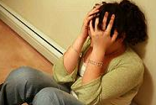
Mental Disorders and Symptoms

Slide 21
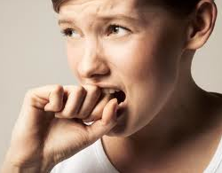
General Anxiety Disorder
(GAD)
Definition: Severe, ongoing anxiety that interferes with day to day activities.
Treatment methods:
medication and/
or therapy
Notes:
http://www.mayoclinic.com/health/generalized-anxiety-disorder/DS00502

Slide 22

Social Phobia
(Social Anxiety Disorder)
Definition: Social phobia is a strong fear of being judged by others and of being embarrassed.
Similar to GAD, Social Phobia can also interfere with day to day activities.
Treatment methods:
medication and or
therapy/counseling
Notes:
http://www.nimh.nih.gov/health/publications/social-phobia-social-anxiety-disorder-always-embarrassed/what-is-social-phobia.shtml

Slide 23
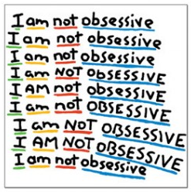
Obsessive-Compulsive Disorder
(OCD)
Definition: OCD is an anxiety disorder that leads people to performing repetitive tasks that interfere with everyday life.
Treatment Methods:
medication and
behavioral therapy

Slide 24
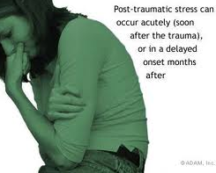
Post Traumatic Stress Disorder
(PTSD)
Definition: A mental health condition that is triggered by a terrifying event. Symptoms may include nightmares, flashbacks and severe anxiety.
Treatment Methods:
therapy and or
medication
Notes:
http://www.mayoclinic.com/health/post-traumatic-stress-disorder/DS00246

Slide 25

Panic Disorder
Definition: An involuntary anxiety or “panic” attack, triggering severe physical reactions.
Treatment Methods:
medication and/
or therapy
Notes:
http://www.mayoclinic.com/health/panic-attacks/DS00338

Slide 26
5 Types of Anxiety
Type of Anxiety
1. Generalized Anxiety Disorder
2. Obsessive Compulsive Disorder
3. Panic Disorder
4. Post Traumatic Stress Disorder
5. Social Phobia
Questions:
1. Can two people experience the same stress yet only one acquires an anxiety disorder? If so, why?
2. If you found out that somebody around you had social anxiety disorder, how would knowing this help to better understand that person?
3. Does an anxiety have to be logical for it
Symptoms
a. Unexpected and repeated episodes of intense fear
b. A pattern of constant worry and anxiety over many different activities and events
c. Unwanted and repeated thoughts, feelings, ideas, sensations, or behaviors that make them feel driven to do something
d. A persistent and irrational fear of situations that may involve scrutinyor judgment by others, such as parties and other social events
e. This anxiety can occur after you've seen or experienced a traumatic
event that involved the threat of injury or death

