Slide 1
Weather, Climate, and Seasons
Carl A. Furr – Grade 5

Slide 2
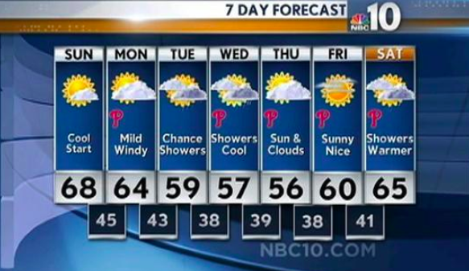
Weather vs. Climate
Weather is what the atmosphere is like day-to-day. It is short term. It can be a day, a week or a few weeks.
Example: The weather is sunny and clear today OR the weather has been cloudy and wet this week.

Slide 3

Climate is the weather conditions over a long period of time. It can be months or a season.
Example: The climate of North Carolina in the summer is hot and humid.

Slide 4
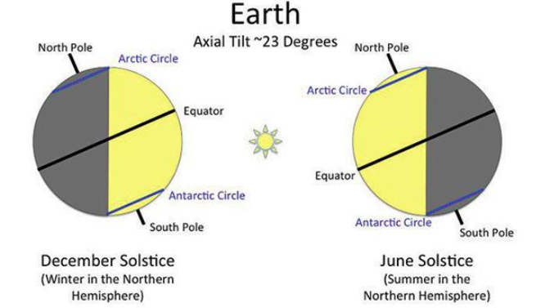
What Causes the Seasons?
The four seasons happen because of the tilt of the Earth's axis. At different times of the year, the sun's rays hit different parts of the globe more directly.

Slide 5
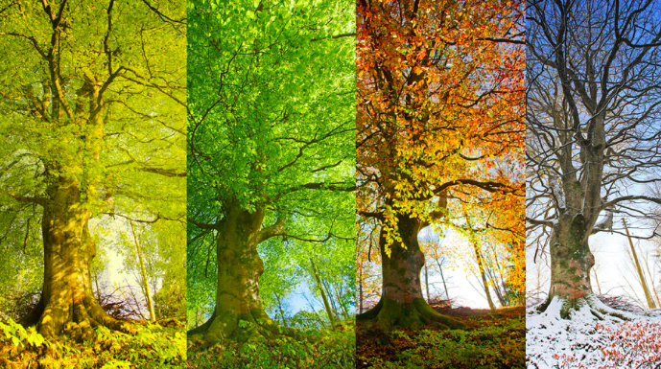
Opposite Hemispheres = Opposite Seasons
Due to the tilt of the earth, opposite hemispheres= opposite seasons. So, when it is summer in the Northern Hemisphere (the United States and Canada) , it is winter in the Southern Hemisphere (Australia and Brazil).

Slide 6
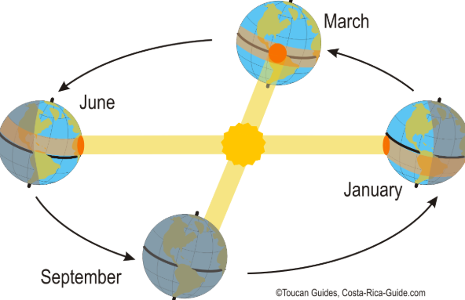
Near the equator, the temperature is always.....
Hotter!!! Places near the equator are always warmer because they are closer to the sun all year long.

Slide 7
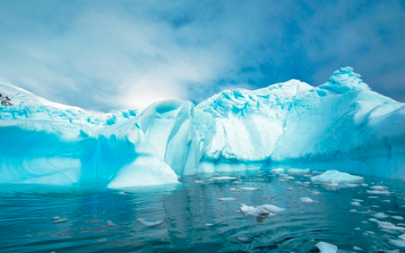
Near the poles, the temperature is always....
Colder!!! Places near the poles are always colder because they are so far from the sun. Think about the north pole and south pole... Brrr!

