Slide 1
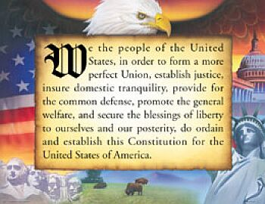
“We The People”
The United States Constitution
My American History

Slide 2
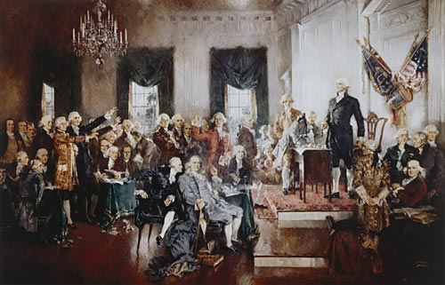
“We the people…”
The founding fathers of the United States made their intentions clear to Great Britain by signing the Declaration of Independence.
Each of the 13 United States had its own Constitution, but they needed one Constitution to become a strong national government.
After representatives from each state had a long debate, the United States worked together to create the Constitution of the United States of America.
Intentions-a plan
Constitution-a written plan of government
Government-a group of people who lead a community, state or nation
Debate-a formal discussion about a topic in public where different views are presented
My American History
The Signing of the United States Constitution

Slide 3
“We the people of the United States…”
The Preamble is an introduction to the Constitution and summarizes its purpose.
Preamble-the introduction to the U.S. Constitution
Introduction-the action of introducing something.
Purpose-why something exists, the reason for why something is done.
My American History

Slide 4
“We the people of the United States, in order to form…”
A Constitution is a written plan for a government to follow.
The United States Constitution is a guide to help our nation’s leaders in making decisions so our government will run smoothly in 3 separate, yet equal, parts called “branches”.
The Capitol Building in Washington, D.C.
The Senate and the House of Representatives
make up the
Legislative Branch of the United States.
My American History

Slide 5
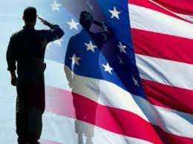

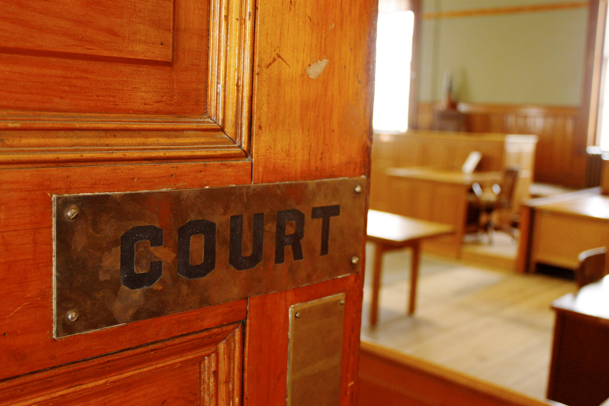
“We the people of the United States, in order to form a more perfect union…”
Why do we have a constitution?
To Guarantee (Ensure) Peace in Our Country to Enjoy freedom as Americans
To Establish Justice
Making laws
setting up fair and equal courts
By protecting the rights of all people
To Defend and Protect Our Nation
My American History
Ensure (Guarantee) Peace

Slide 6
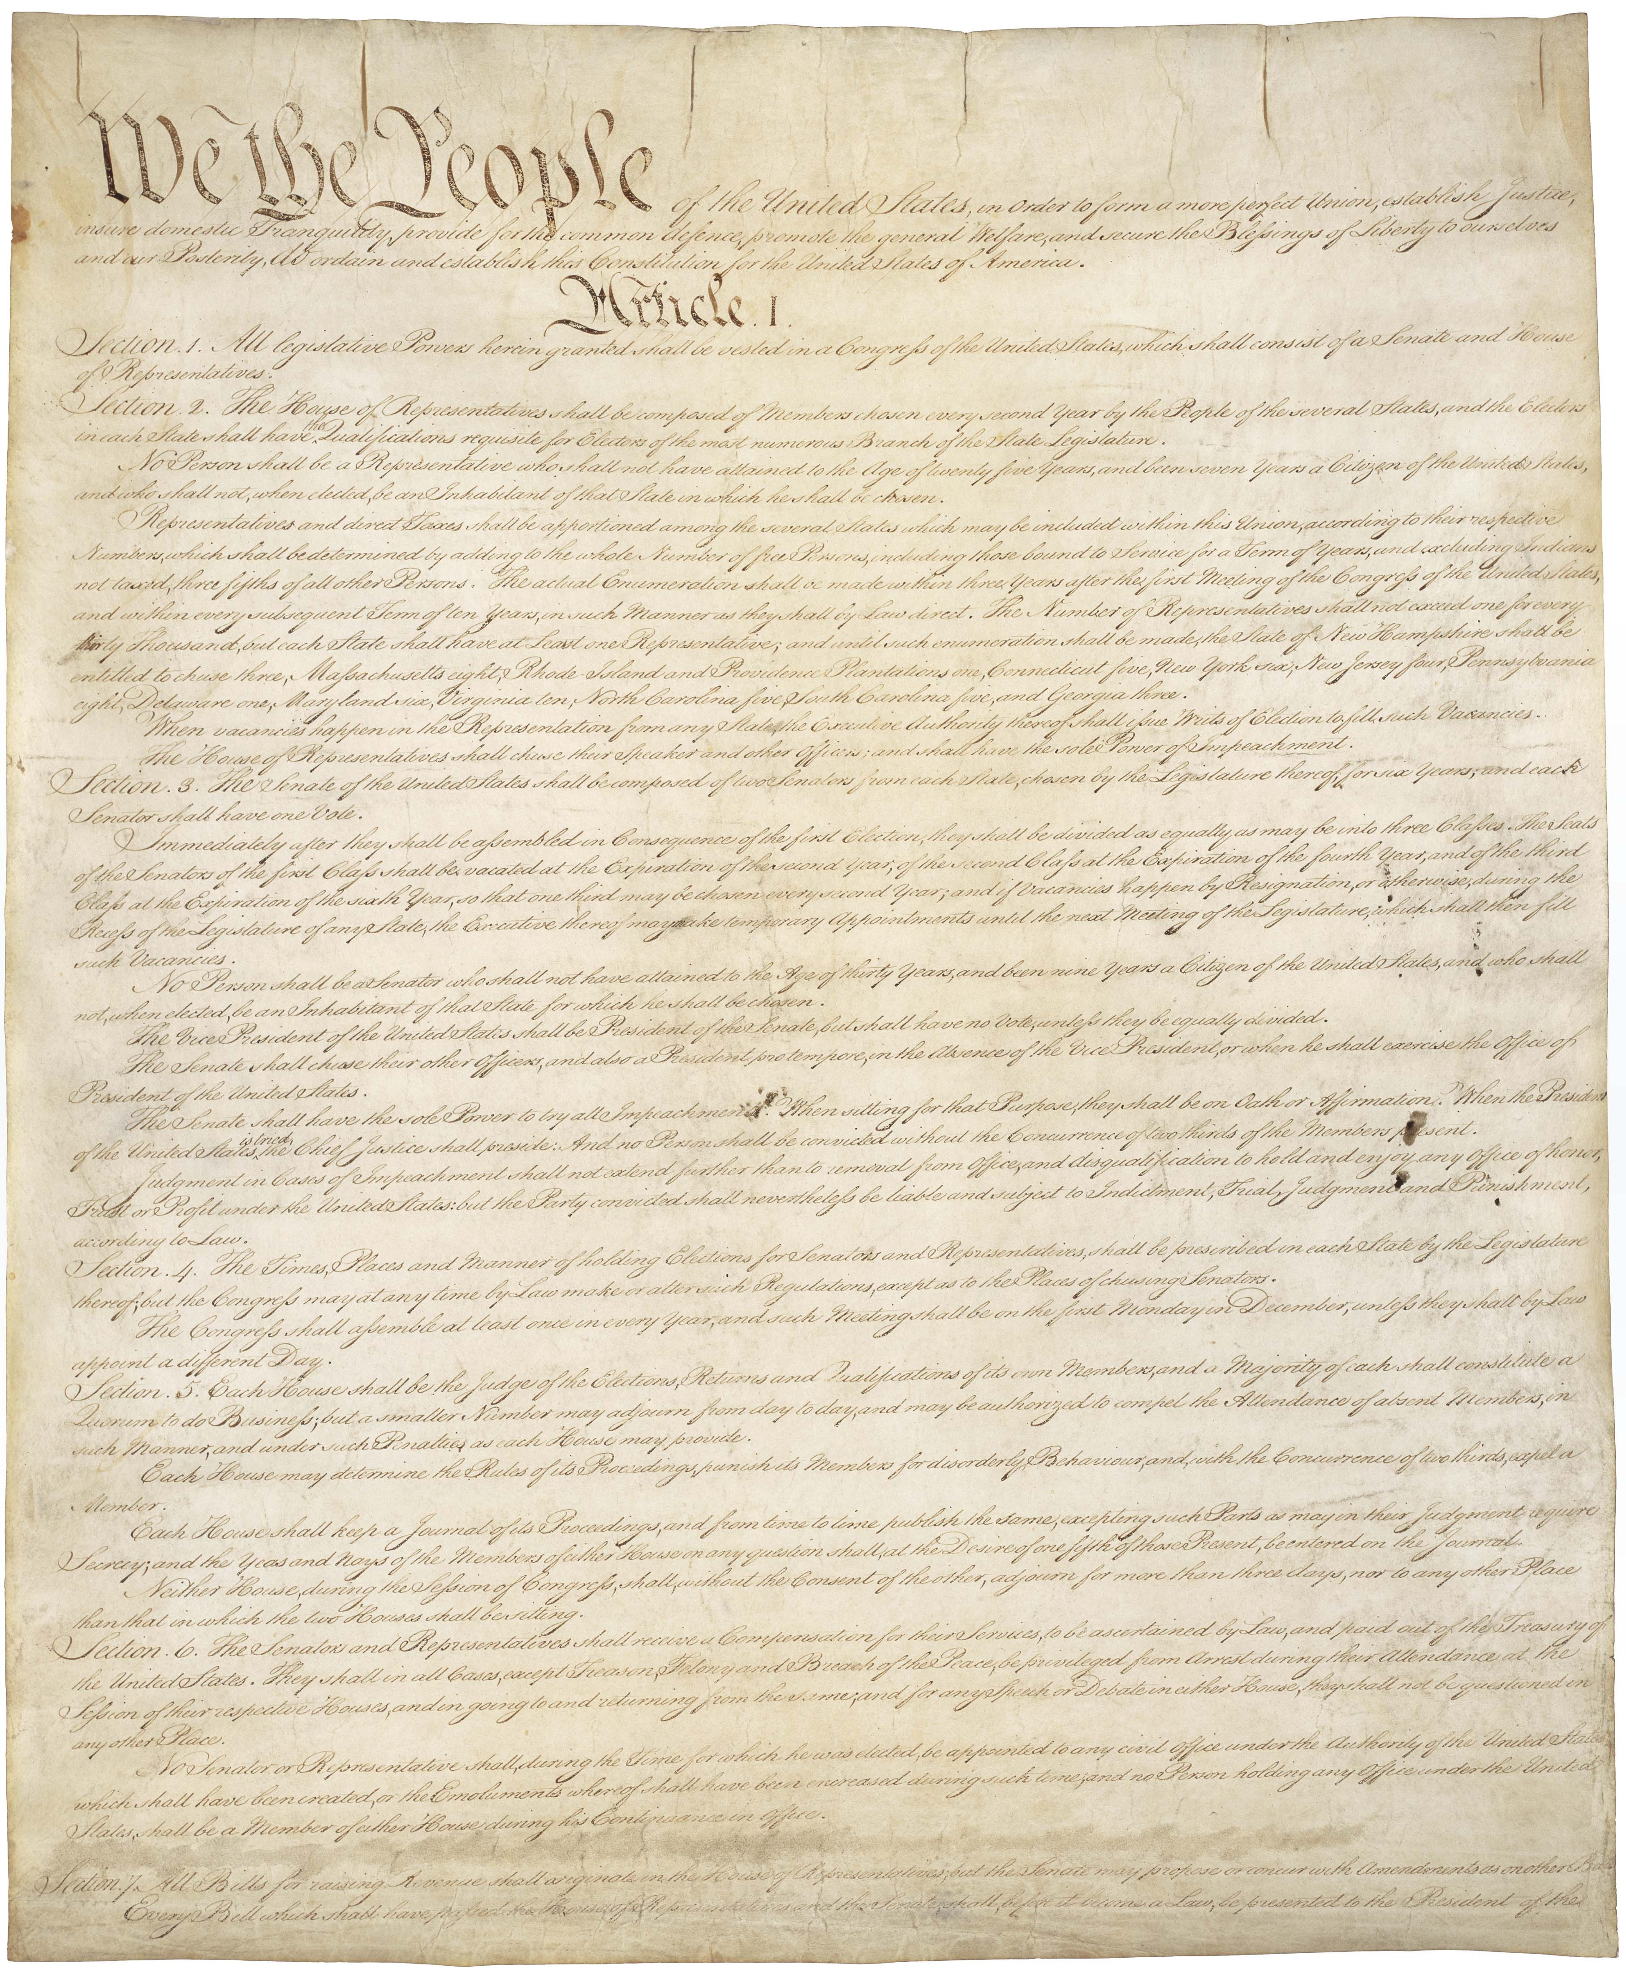
“We the people of the United States, in order to form a more perfect union, establish justice…”
The U.S. Constitution provides principles which help each branch of our government work together as one.
Many of these ideas came from the Greek, Roman, British, and Iroquois Indian Civilizations.
This is an image of the original Constitution of the United States of America on display for everyone to see 364 days (except for December 25th) between 10 a.m.-5 p.m. and until 9 p.m. during the summer. in the National Archives Museum in Washington, D.C.
(After hours, the U.S. Constitution is moved by a conveyor belt to a climate controlled high security vault to prevent it from fading.
Principles-the ideas that people follow because they are the reasons for why they do things a certain way and believe in these ideas strongly.
My American History

Slide 7
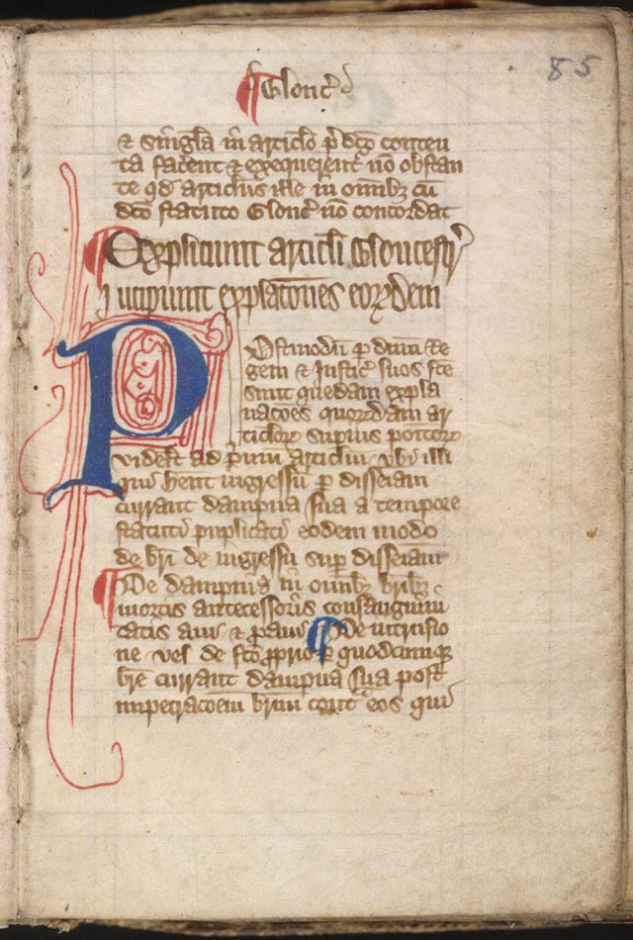
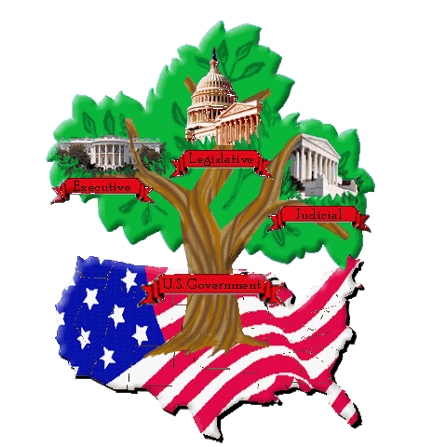
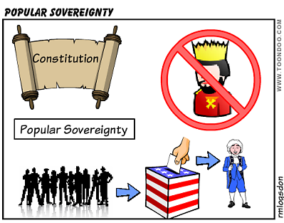
“We the people of the United States, in order to form a more perfect union, establish justice, insure domestic tranquility…”
The Magna Carta was signed by King John of England in 1215. It stated what we now know as the Rule of Law
Principle 1: Popular Sovereignty
People create and give power to the government and its leaders to lead them.
Principle 2 Rule of Law
No one is excused from obeying the law no matter-no matter if they’re rich, poor, weak, or have an important position.
Principle 3 Separation of Powers
Each branch of government must function independently from the other branches.
My American History

Slide 8
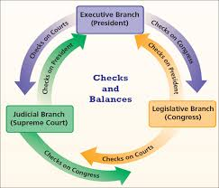
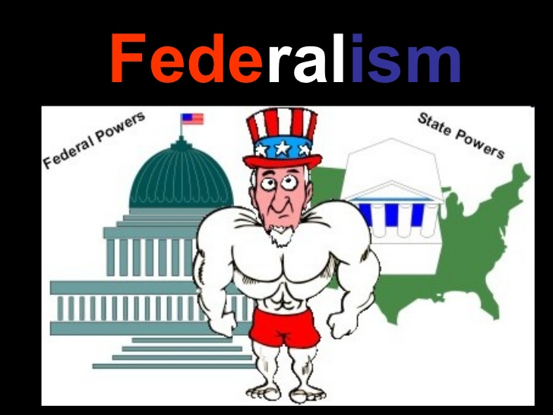
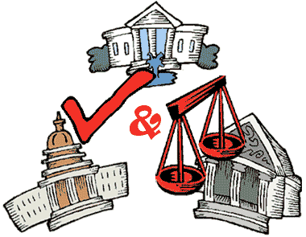
“We the people of the United States, in order to form a more perfect union, establish justice, insure domestic tranquility, provide for the common defense…”
Principle 4 Checks and Balances
A system of “Checks and Balances” meant no one government branch had more power than another.
Principle 5 Federalism
National and Federal Government has power to govern and rule the country as a whole, but the states have power to rule over themselves.
My American History

Slide 9

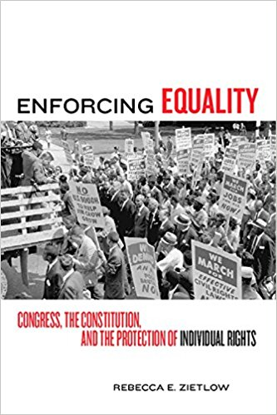
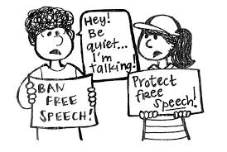
“We the people of the United States, in order to form a more perfect union, establish justice, insure domestic tranquility, provide for the common defense, promote the general welfare…”
Principle 6 Individual Rights
Specific rights of American citizens stated in the U.S. Constitution.
My American History

Slide 10
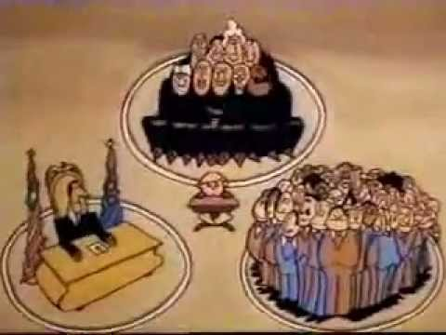
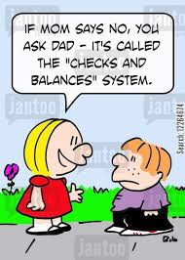
“We the people of the United States, in order to form a more perfect union, establish justice, insure domestic tranquility, provide for the common defense, promote the general welfare, and secure the blessings of liberty…”
Separation of Powers is the MOST important aspect of the Constitution. This is done through a system of Checks and Balances.
Separation of Powers-no one branch can abuse power or control the other branches of the federal government.
My American History

Slide 11
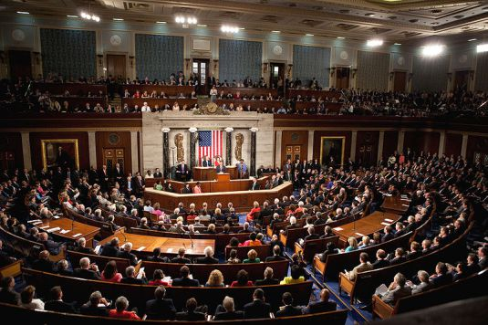
“We the people of the United States, in order to form a more perfect union, establish justice, insure domestic tranquility, provide for the common defense, promote the general welfare, and secure the blessings of liberty, to ourselves and our posterity…”
Legislative Branch (Congress)
Senate
House of Representatives.
Bill-a proposed law) about how money should be spent to help Americans.
Check out the links below to find out more about the Legislative Branch of the U.S. Government
https://www.congressforkids.net/Legislativebranch_index.htm
Congress makes laws and passes bills that are presented by a Senator (in the Senate or a Representative (from the House of Representatives).
https://kids-clerk.house.gov/young-learners/
My American History

Slide 12
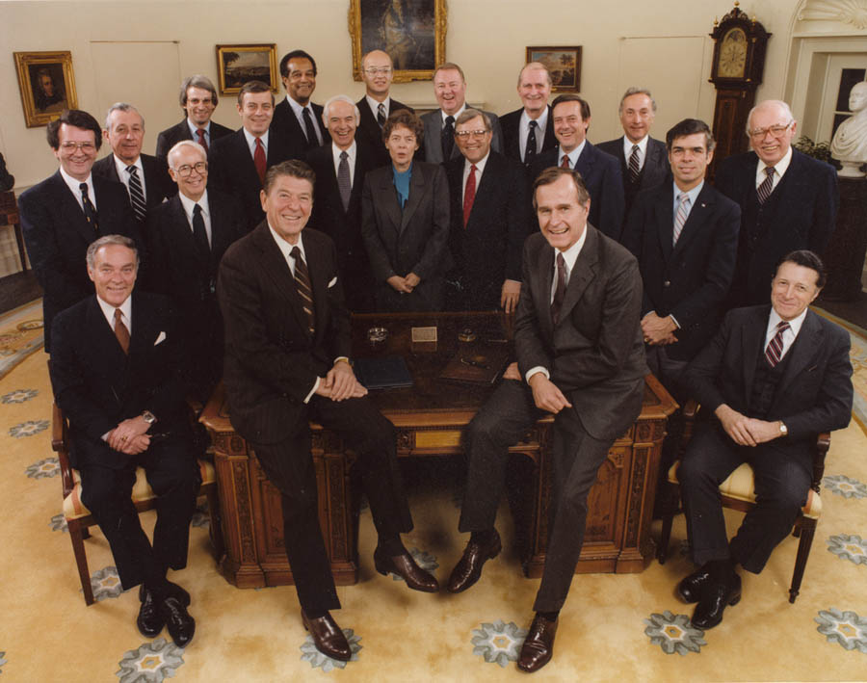
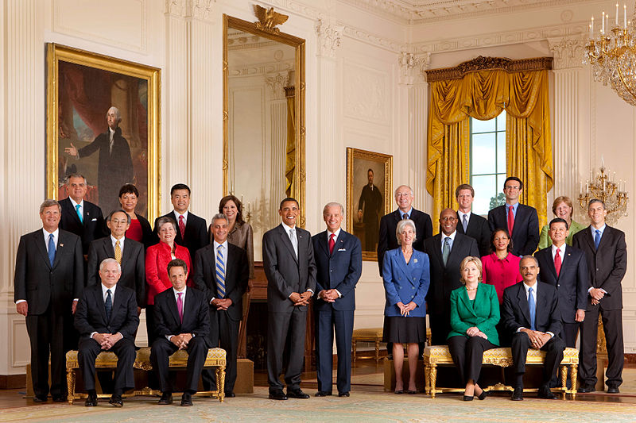
“We the people of the United States, in order to form a more perfect union, establish justice, insure domestic tranquility, provide for the common defense, promote the general welfare, and secure the blessings of liberty, to ourselves and our posterity, do ordain and establish…”
Executive Branch
President (also known as the Commander-in-Chief and the Chief Executive of the Federal Government.
Responsible for carrying out laws
includes the President, the Vice-President and his Cabinet members
President Barack Obama and his Cabinet
President Ronald Reagan
and his Cabinet
Click on the link to learn more about the Executive Branch of the U.S. Government
http://mrnussbaum.com/government/
My American History

Slide 13
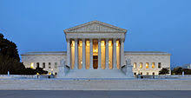
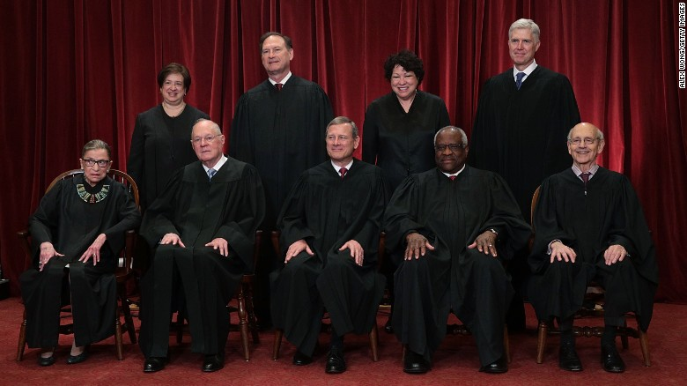
“We the people of the United States, in order to form a more perfect union, establish justice, insure domestic tranquility, provide for the common defense, promote the general welfare, and secure the blessings of liberty, to ourselves and our posterity, do ordain and establish this Constitution…”
The Judicial Branch
Supreme Court
federal courts
Enforce federal laws
Determine if a federal law is carried out correctly or if the law’s been broken
Determine if a law Congress has passed is unconstitutional
Determine if something the president has done is unconstitutional.
The Supreme Court
Members of the Supreme Court
Unconstitutional-something that goes against what the Constitution says
Learn more about the Judicial Branch of the U.S. Government: http://mrnussbaum.com/government/
My American History

Slide 14
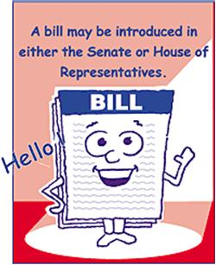

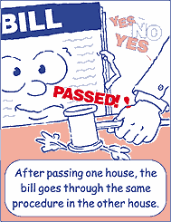
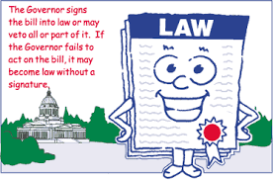
“We the people of the United States, in order to form a more perfect union, establish justice, insure domestic tranquility, provide for the common defense, promote the general welfare, and secure the blessings of liberty, to ourselves and our posterity, do ordain and establish this Constitution of the United States…”
Work with others to write a bill that you think would become a law.
Check to make sure your bill has “passing power”
Ask these questions:
Why do you think the bill would make a good law?
Who would the bill help most?
Click here to learn more about the Legislative Branch of the U.S. Government
https://kids-clerk.house.gov/young-learners/
My American History

