Slide 1
Water Properties

Slide 2
Engage... 10min
Fill your cup of water until it is one centimeter from the rim.
Drop a paperclip into the cup.
  What happens?
See if you can make it float.
See how may paperclips you can get to float.
Why was this happening?
  Write your explanation on a piece of paper.

Slide 3
Notes
Record on your guided note sheet

Slide 4
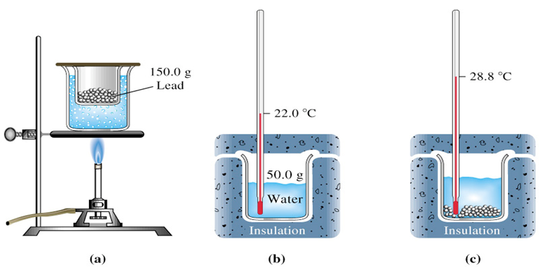
Specific
Heat
Specific Heat = the amount of energy needed to increase the temperature of something 1 degree C.
Water has a really HIGH specific heat.
That means it takes a lot of energy for water to increase its temperature.
This is because of the STRONG ATTRACTION between water molecules.

Slide 5
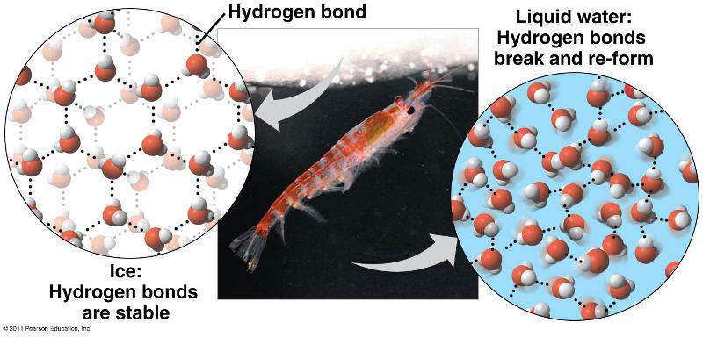
Density
The amount of matter in a given volume of an object
Density = Mass/Volume
The density of water is 1.0 g/mL
The density of ice is 0.9167 g/mL
The solid state of water is less dense than the liquid state.

Slide 6
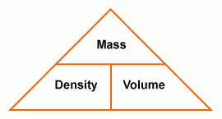
To calculate density…
To calculate density of an object, you need to have the mass and volume measurement.

Slide 7
Volume
Volume of a cube: L x W x H
Volume of an irregular solid?
  Displacement method: When you put an object into water it will displace (or push out) some of the water. Measuring how the water level changes is an easy and accurate method of determining the object volume.

Slide 8
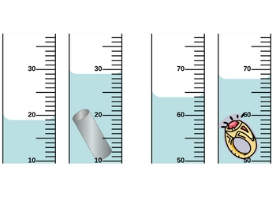
Displacement Method

Slide 9
Demo - Density Column
Predict….How would the following materials stack up in a density column?
Water = 1.0 g/mL
Mineral Oil = 0.8 g/mL
90% Alcohol = 0.786 g/mL
Vegetable Oil = 0.91 g/mL
70% Alcohol = 0.858 g/mL

Slide 10
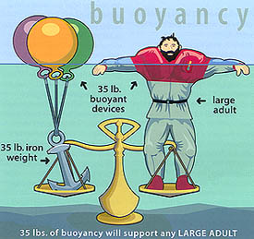
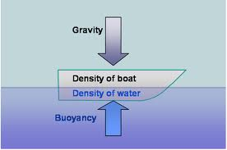
Buoyancy
An upward force that pushes on objects placed in water acting against its weight.

Slide 11
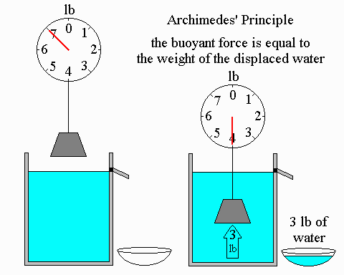
Buoyancy

Slide 12
Video Clip
Watch BrainPOP – Buoyancy
  Login – hickoryridge
  Password - brainpop

Slide 13
Workbook
Complete pages 191-198 : Due Friday

