Slide 1
War of 1812
1812-1815

Slide 2
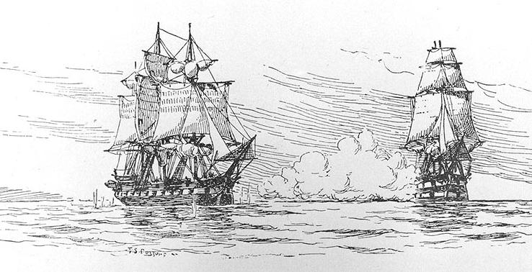
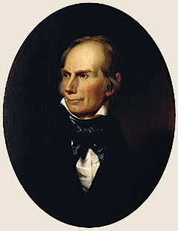
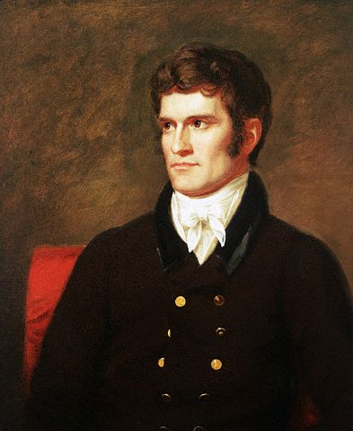
Cause #1: Napoleonic Wars
British Blockade Europe
  “Re-Impress” Deserters
  Chesapeake-Leopard Affair
    Near coast of VA
    Boat attacked by Brits
    4 Soldiers Taken
    1 Hanged
  Rise of “War Hawks”
      Clay and Calhoun

Slide 3
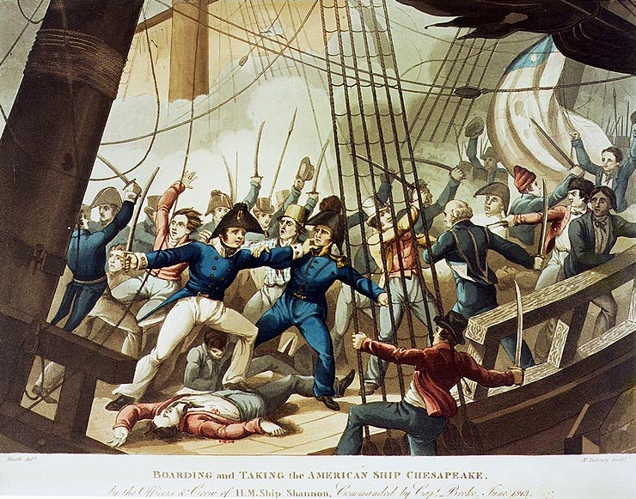

Slide 4
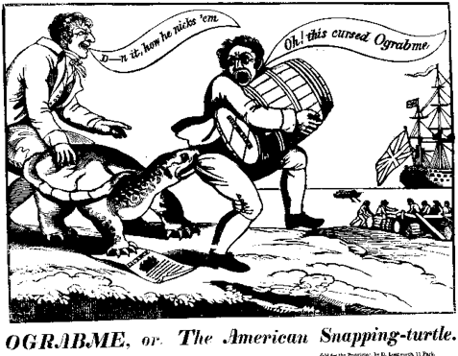
Cause #1: Napoleonic Wars
Jefferson’s “Peaceful Coercion”
  Embargo of 1807
    U.S. Cuts off all trade to Eur.
    Leads to Depression in U.S. (N.E)
    Angers Federalists

Slide 6
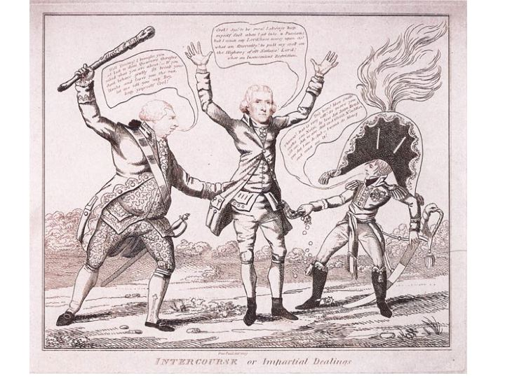

Slide 7
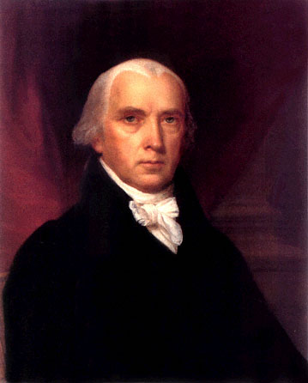
James Madison
1808-1816
The War of 1812

Slide 8
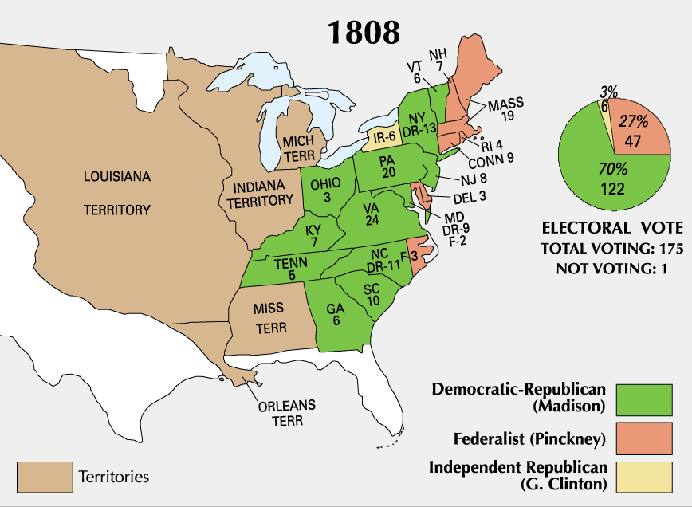
Presidential Election of 1808

Slide 9
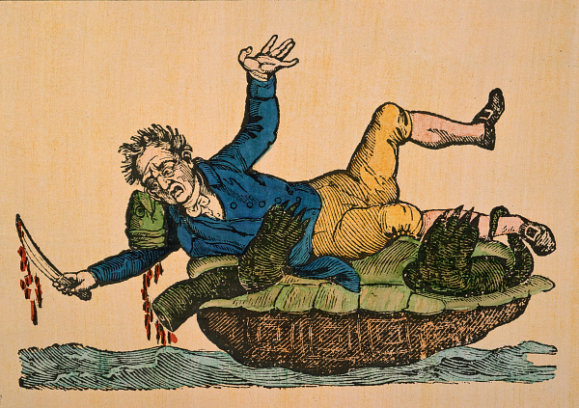

Slide 10
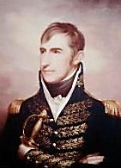
Cause # 2: Native Americans
William H. Harrison
  Appointed by Jefferson
    In charge of Indiana
  Natives given 2 options
    Assimilate or Move
    Harrison uses threats, bribes, and trickery to gain land from N.A.

Slide 11
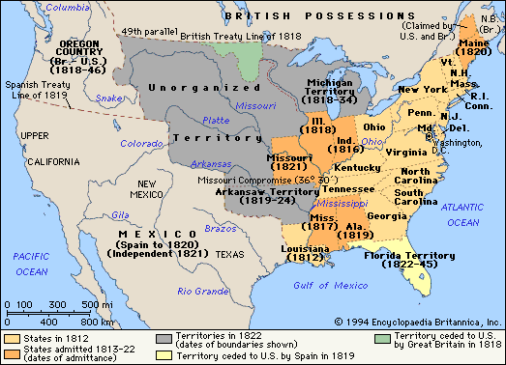

Slide 12
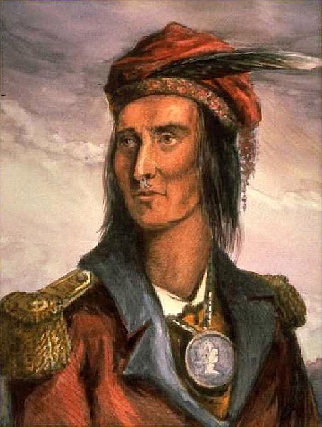
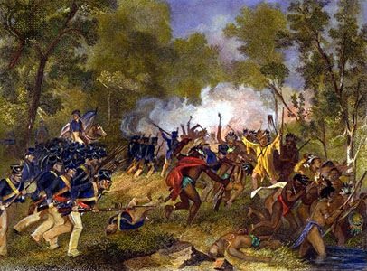
Cause # 2: Native Americans
Tecumseh
  Goal: Unite Tribes
    a.k.a. Tecumseh Confederacy
  Encourages tribes to…
    form alliance
    Reject treaties
    Reject assimilation
Battle of Tippecanoe (1811)
  Harrison attacks confederacy when Tecumseh is away
    Shows Brits are arming N.A.
    Convinces U.S. need to rid Americas of Brits (Canada)

Slide 13
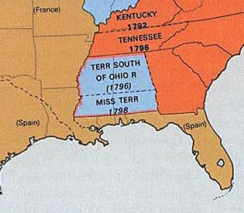
Cause # 3: Florida
Why?
  Rivers access Gulf of Mexico
  Native American attacks
  Spain allies with Britain

Slide 14
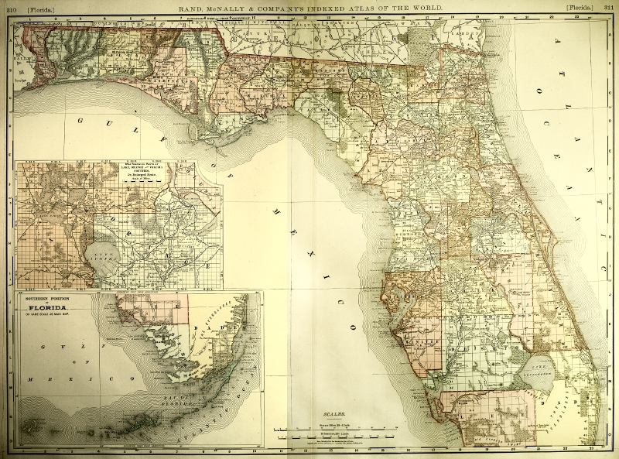

Slide 15
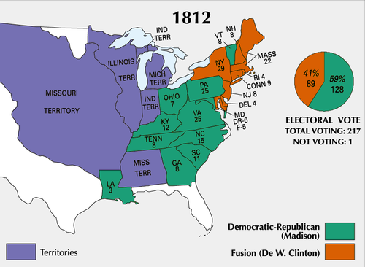
Presidential Election of 1812

Slide 16
War!
June 1812
US Declares war on Britain
Who in America would be upset about this?

Slide 17
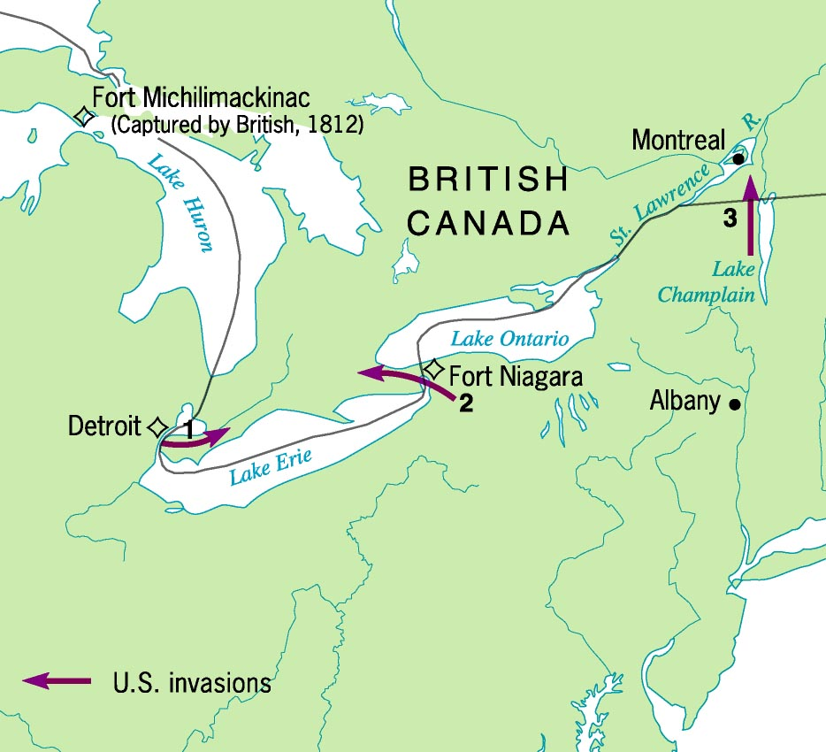
3 U. S. Invasions of 1812

Slide 18
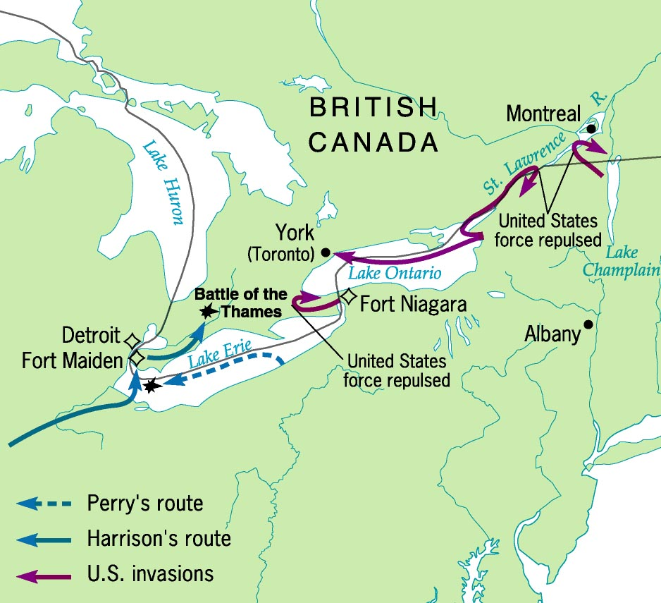
Campaigns of 1813

Slide 19
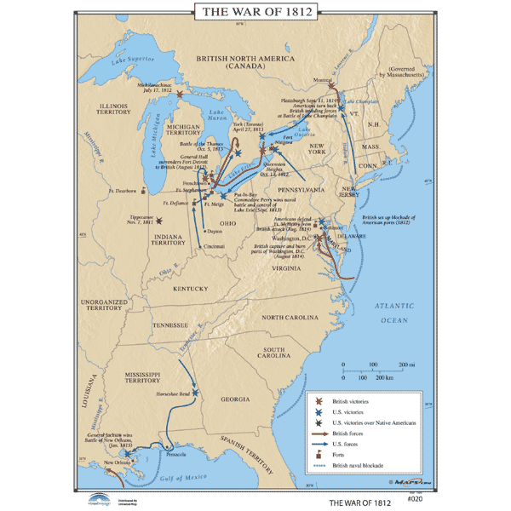

Slide 20
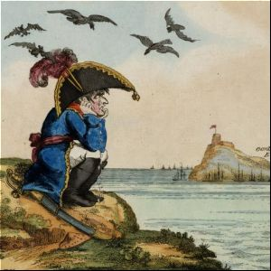
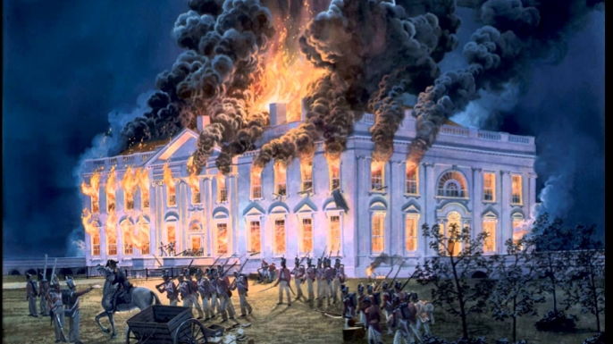
The War –1812-1815
Defeats
  US tries to invade Canada
    Fails Miserably
  1814 - Napoleon defeated
    Allows Brits to send troops to U.S.
    Washington DC torched

Slide 21
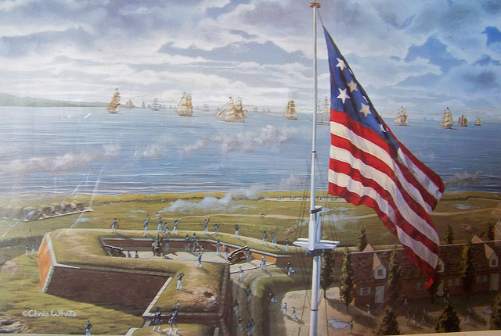
The War –1812-1815
Successes
  US defeats Native Americans and British attacks within US borders
    Fort McHenry – Baltimore
    Battle of New Orleans
    The US invades Florida
**Star Spangled Banner written after battle at Fort McHenry

Slide 22
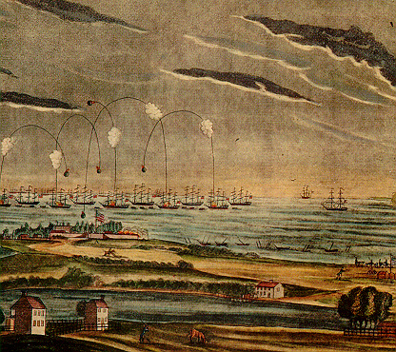
Fort McHenry

Slide 23
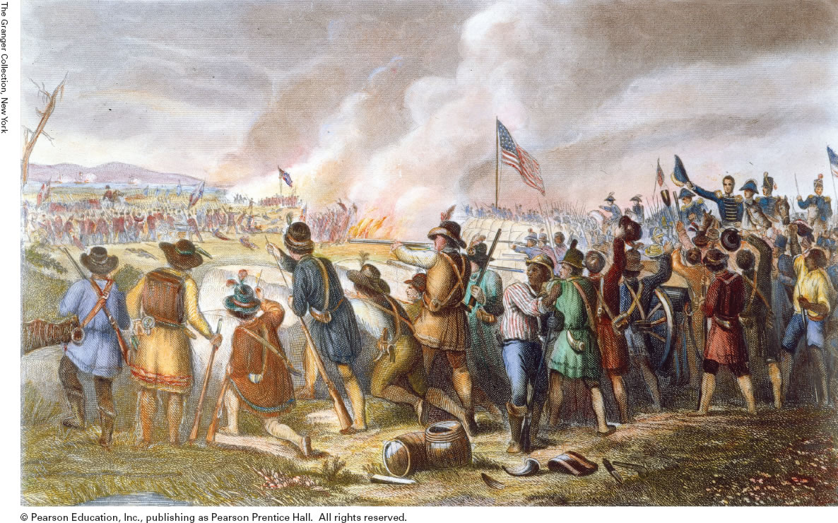
The U.S. was not expected to win!
How does this picture show that the Americans lacked a regular, professional army?

Slide 24
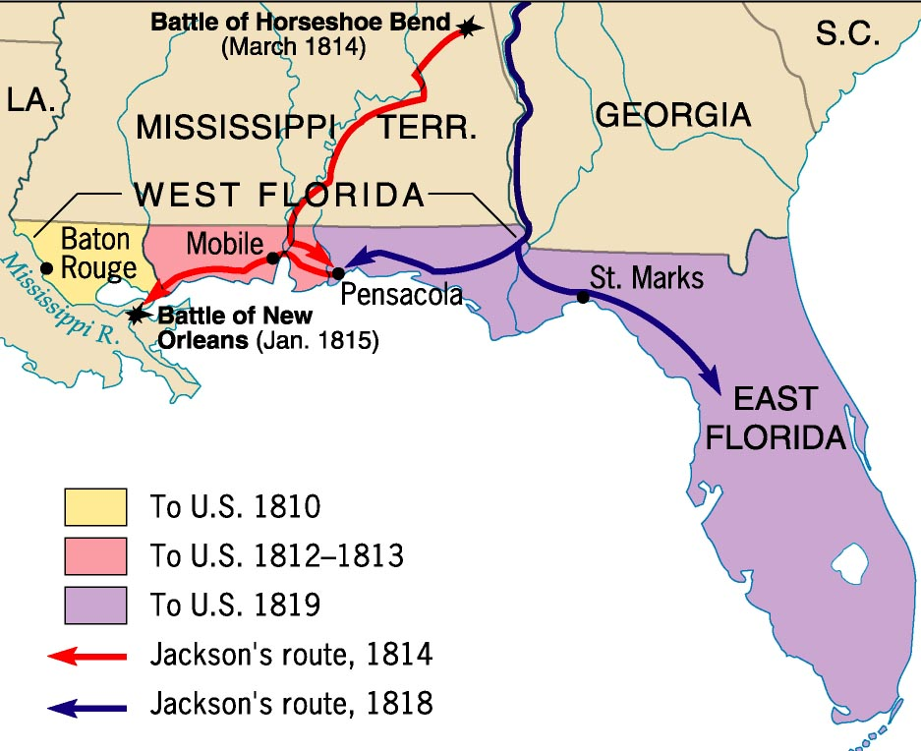
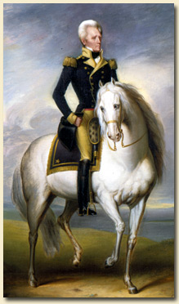
Jackson’s Florida Campaigns

Slide 25
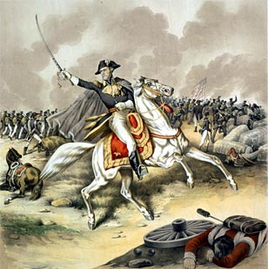
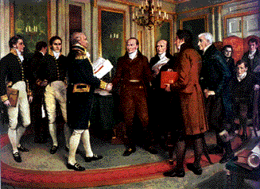
The End of the War
Treaty of Ghent, Dec. 1814 - Belgium
- Ends war
- “Status Quo Ante Bellum”
Battle of New Orleans, Jan. 1815
- 2 weeks later, British try to invade LA
- huge American victory, led by Andrew Jackson

Slide 26
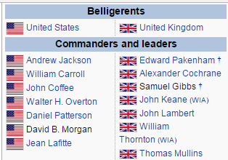

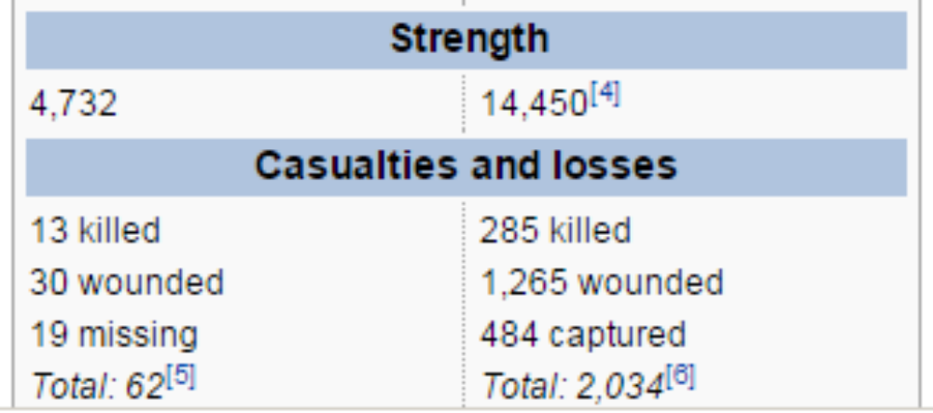
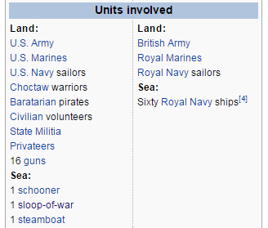

Slide 27
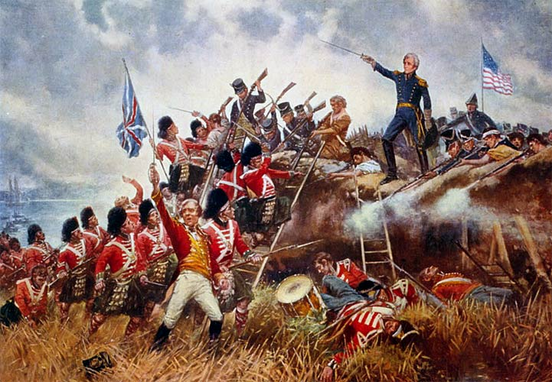

Slide 28
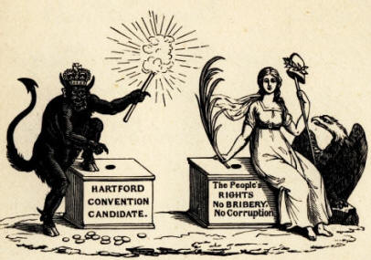
The End of the War
The Hartford Convention
  Federalists meet and discuss…
    New England Secession
    Amendments to Constitution
  Why?
    They hate the war
  Effects
    Ignored & criticized
    Shows growing “Sectionalism”
    Marks end of the Federalist party

Slide 29
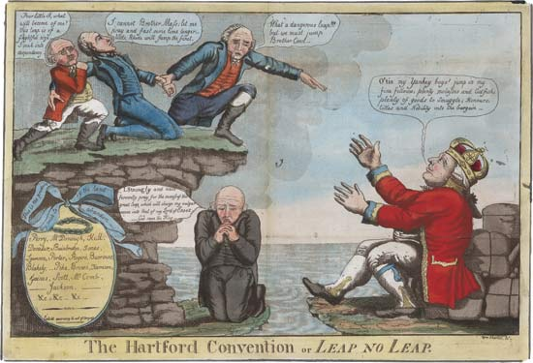

Slide 30
Effects of the War of 1812
Need for a strong army
Revival of American nationalism
End of the Federalist party
Weakens Native American resistance
Paved way for American take- over of Florida

