Slide 1
WWII
The Aftermath

Slide 2
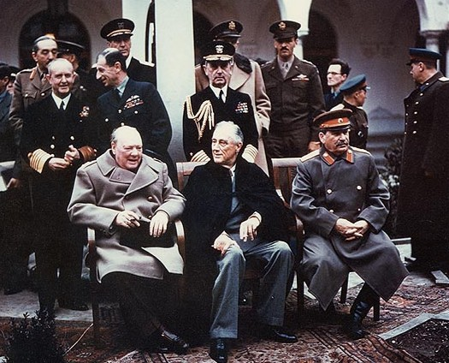
First.. what agreements were made as WWII was ending in Europe?
Yalta Conference
  8 Days
  Roosevelt, Churchill, and Stalin
  What to do with Germany once they are defeated?

Slide 3
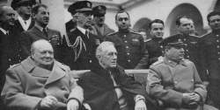
Roosevelt
Acted as a mediator
Stalin
Churchill
His country is devastated after the war.
Feels that Germany should be harshly punished
Did not want to punish Germany in fear of repeating WWI mistake.

Slide 4
Initial Agreements
To please Stalin…
    Germany divided
      4 zones (U.S., British, USSR, France)
2. In return…
    Stalin agrees to allow Poland to hold free elections
3. Also…
    Stalin agrees to join U.S. against Japan

Slide 5
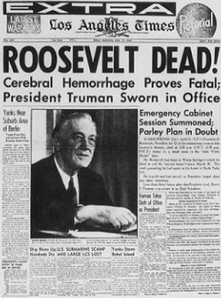
Death of FDR
Prior to signing U.N. Agreement
While in Georgia, suffers a stroke
Dies April 12, 1945
  Before VE Day

Slide 6
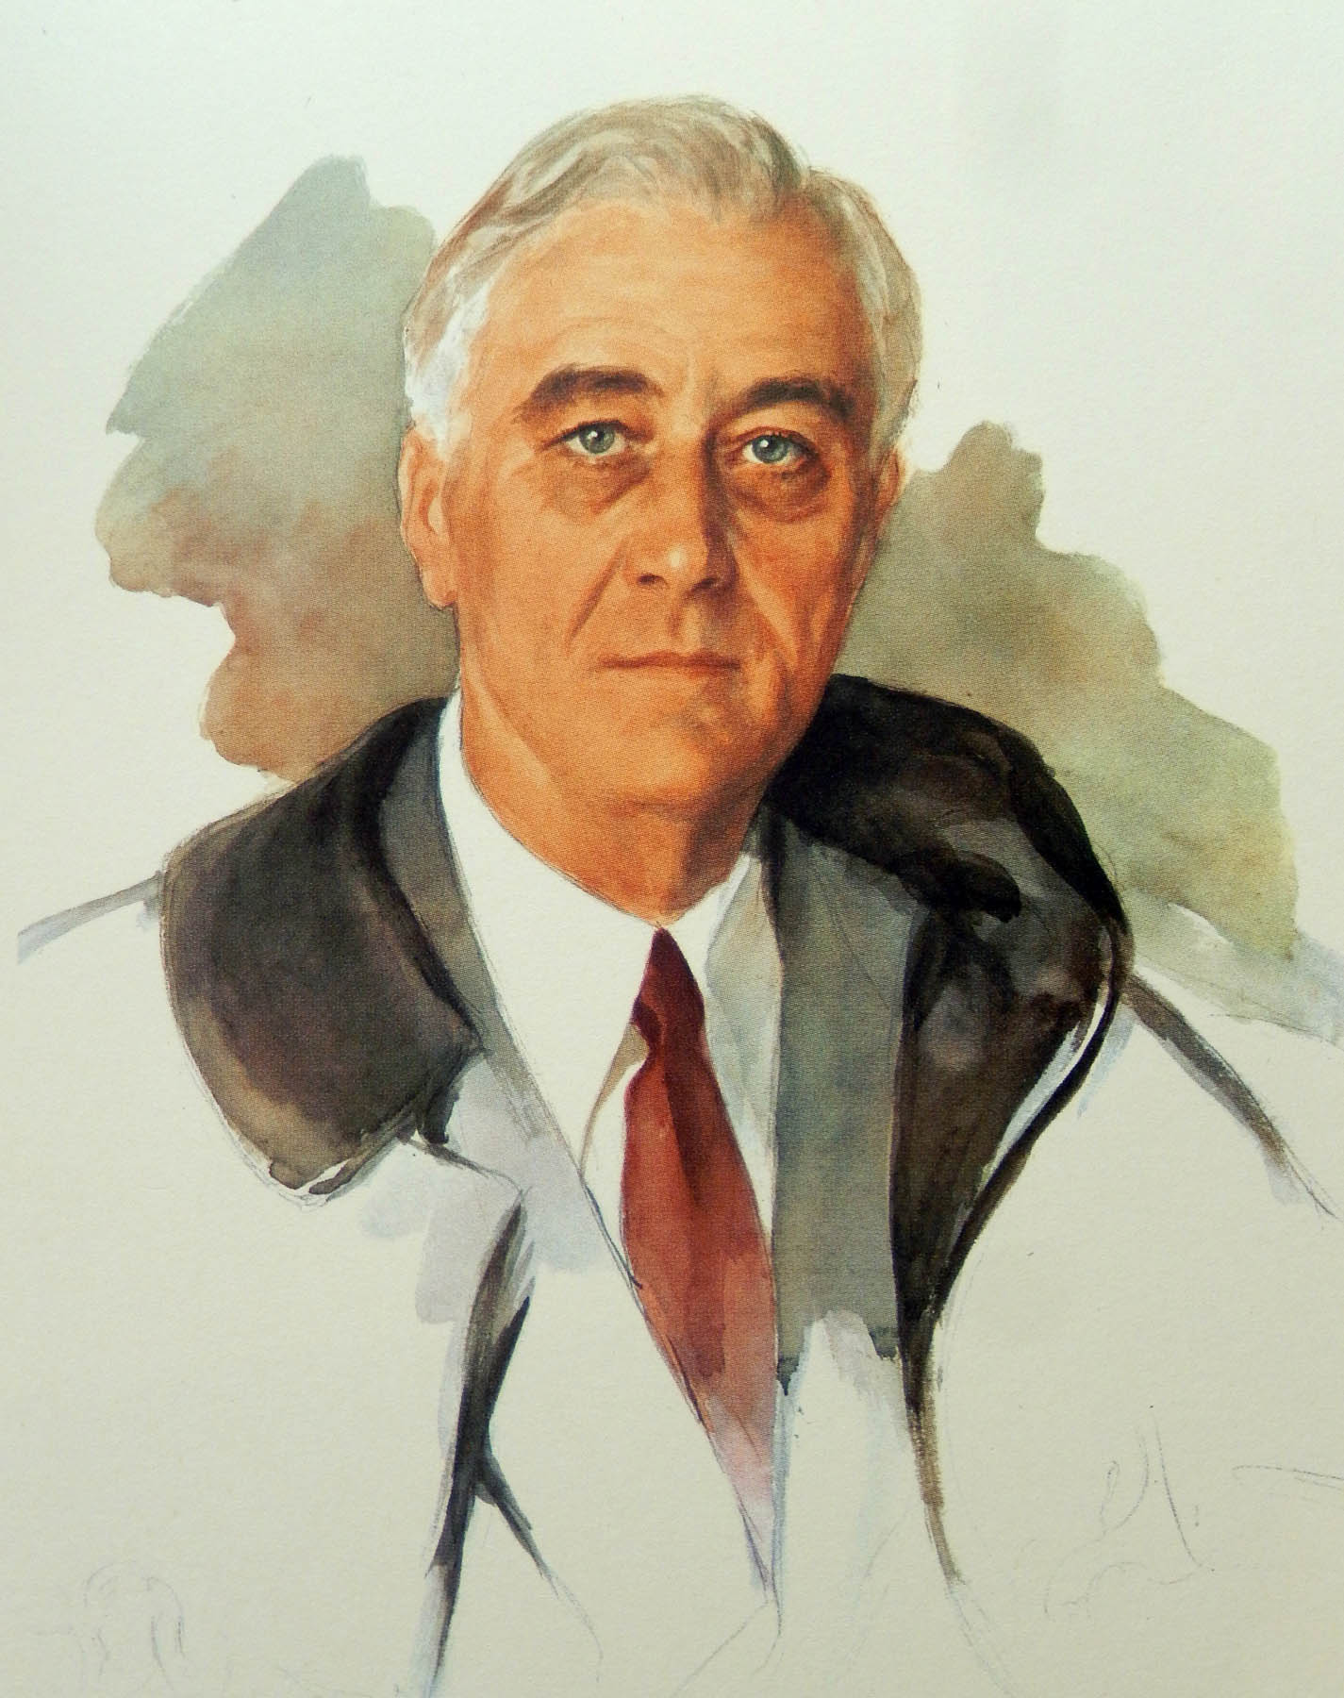

Slide 7
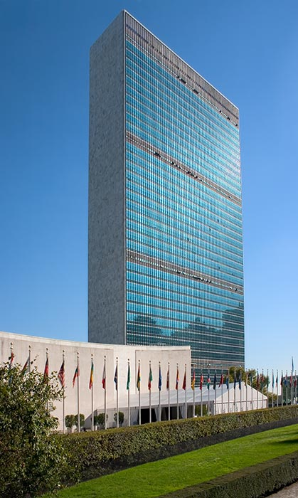
The United Nations
April 25th, 1945
50 countries
  193 today
Peacekeeping body

Slide 8
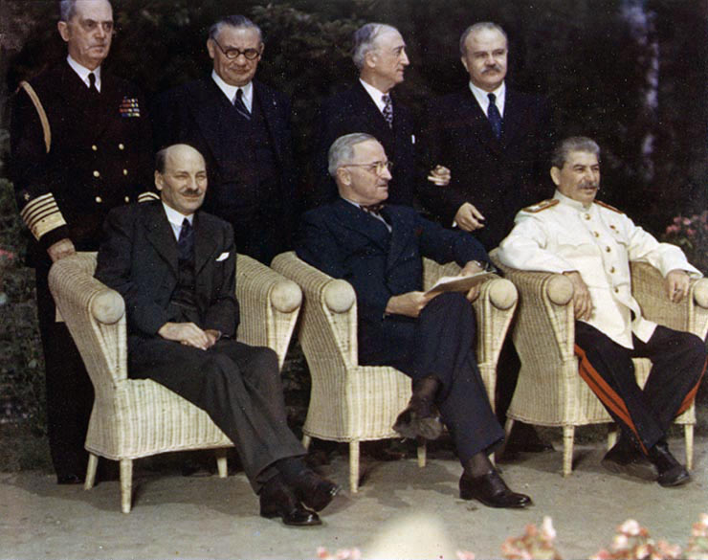
Potsdam Conference
Changes since Yalta
  USSR was occupying eastern Europe
  Britain had a new Prime Minister
  Truman now President
  US had tested Atom Bomb
Stalin is less willing to negotiate

Slide 9
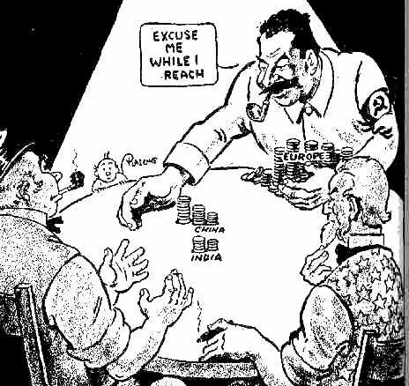
Potsdam Conference Terms
Indo China
  Split at 16th Parallel
Germany
  Split into 4 zones
  War criminals – put on trial
  Land – returned to pre WWII
  Reparations - Soviet zone only
  Destruction of Military supplies
Poland
  Controlled by USSR
Potsdam Declaration
  Called for Japanese “surrender or destruction”

Slide 10
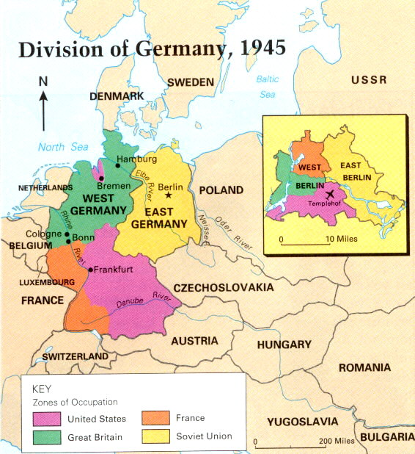

Slide 11
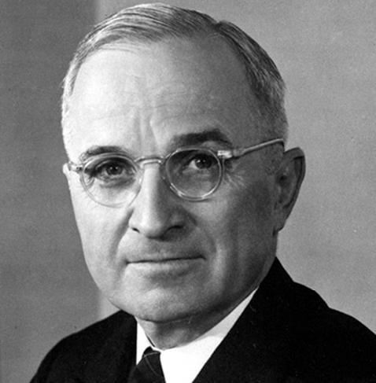
“The Russians only understand one language - ‘how many armies have you got?’ I’m tired of babying the Soviets.”
  President Truman
Now I know what happened to Truman yesterday. I couldn't understand it. When he got to the meeting after having read this report he was a changed man. He told the Russians just where they got on and off and generally bossed the whole meeting.
  Churchill, on Truman's behavior on that day (i.e. the day after he had found out about the atomic bomb)

Slide 12
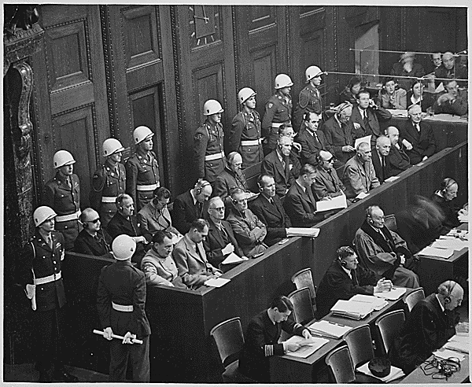
The Nuremberg War Trials
24 Nazi leaders put on trial for involvement in Holocaust
12 of 24 sentenced to death…
…Most others sent to Prison.
Eventually, over 200 additional leaders punished.
Although controversial, trials
set a precedent…
“…Following orders” is not an excuse for crimes against humanity.

Slide 13
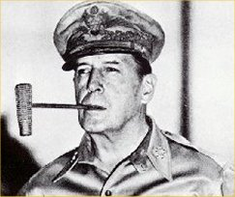
What about Japan?
After Japan’s surrender, the U.S. Remained in the country under the command of Douglas Macarthur for 7 years.
Over 1000 Japanese leaders were imprisoned or sentenced to death including Hideki Tojo.

Slide 14
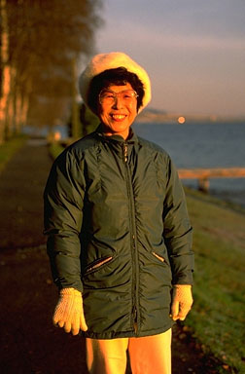
Occupied Japan
Under Macarthur, the following occurred in Japan…
  …. Introduction to free-market practices
  …. Call for women's suffrage
  …. New constitution
  …. Guaranteed basic freedoms
  To this day, the Constitution is known as the
  Macarthur Constitution.
  Happy Japan? →

Slide 15
The Cold War [1945-1991]:
Soviet Union
[“Iron Curtain”]
Democracies
GOAL → “Containment” of Communism & collapse of the Communist world.
GOAL → spread world-wide Communism
METHODOLOGIES:
Espionage [KGB vs. CIA]
Arms Race
Communism vs. Democracy
NATO vs. Warsaw Pact

Slide 16
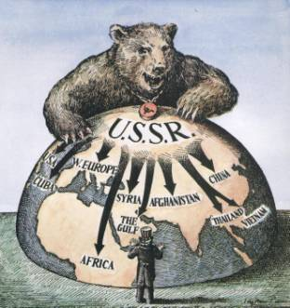
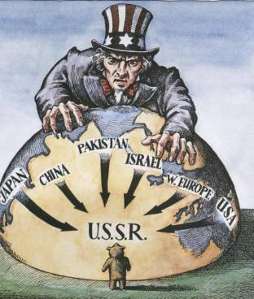

Slide 17
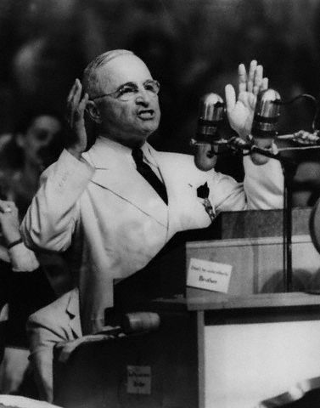
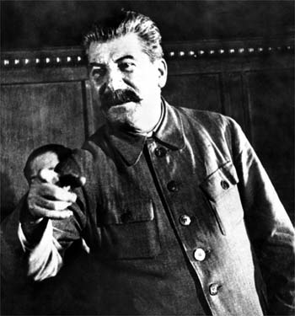
Origins of the Cold War
Soviets are Angry
  U.S. did not recognize their Government
  Allies waited too long to Attack Germany.
  We kept atomic bomb a secret
American’s are Angry
  Soviets signed non-aggression pact with Germany

Slide 18
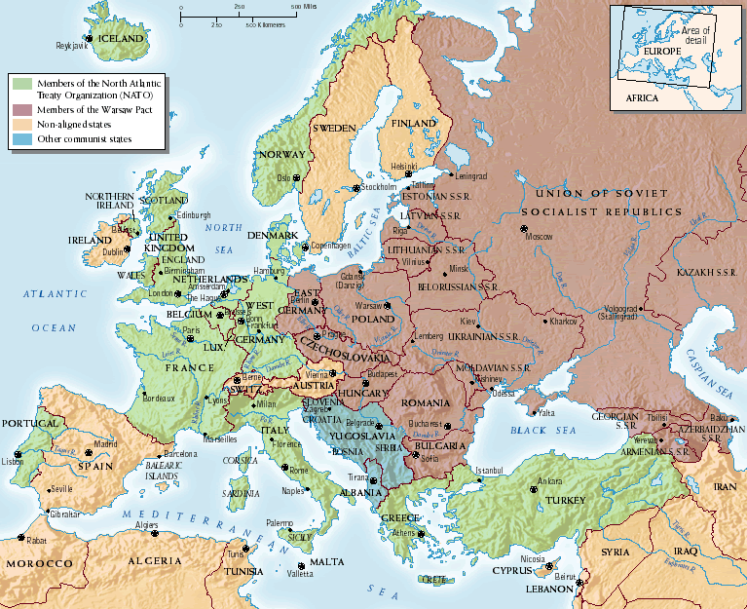
Satellite Nations
Albania
Bulgaria
Czechoslovakia
Hungary
Romania
Poland

Slide 19
Containment & The Iron Curtain
Feb. 1946: George Kennan
  U.S. diplomat in Moscow
  First to use the word “containment”
    Block the Soviet spread of communism
March 1946: Winston Churchill
  Gave speech in the United States
  “From Stettin in the Baltic to Trieste in the Adriatic, an iron curtain has descended across the Continent”

Slide 20
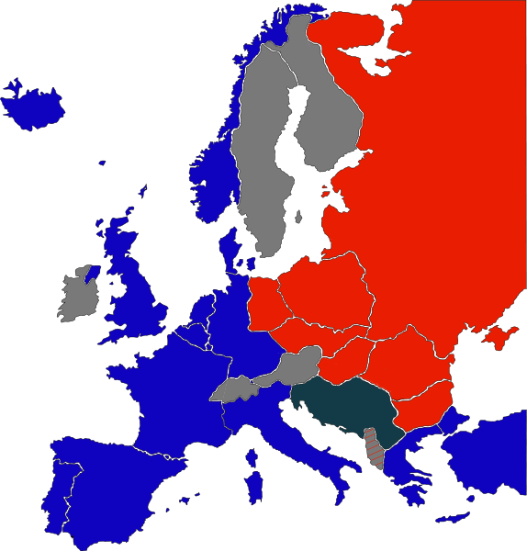
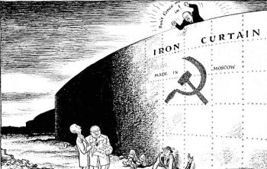
Containing the Iron Curtain

Slide 21
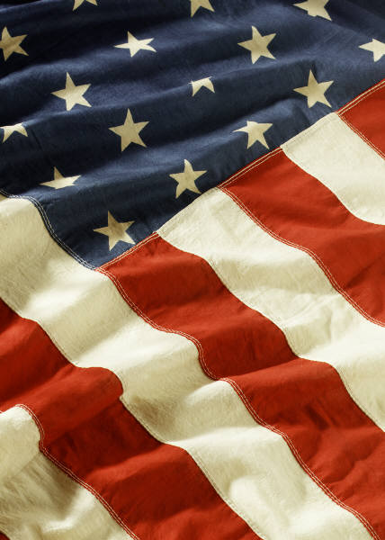

The Cold War Begins

Slide 22
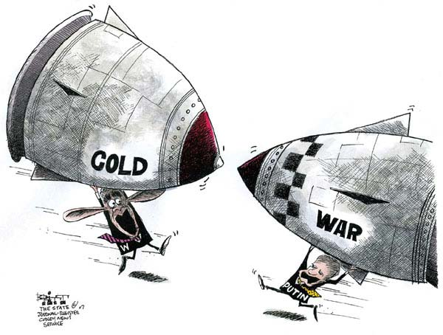
The Cold War Begins
1945-1991 (46 years!)
U.S. – Soviet Union
Neither nation directly confronted one another on the battlefield

Slide 23
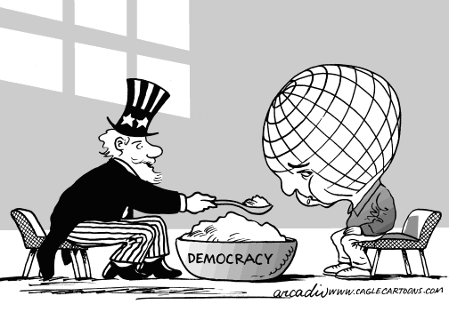
The Truman Doctrine
President Truman
  aid to any country resisting communism
  $400 million given to Turkey & Greece from 1947-1950

Slide 24
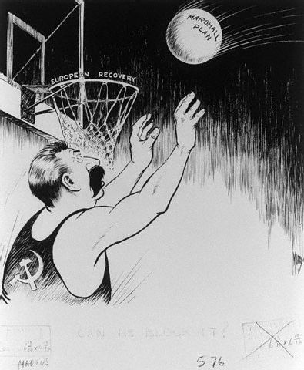
The Marshall Plan- 1947
Most of Europe destroyed from WWII
Secretary of State: George Marshall
  Aid to all European nations that needed it
  16 countries
  $13 billion
  4 years

Slide 25
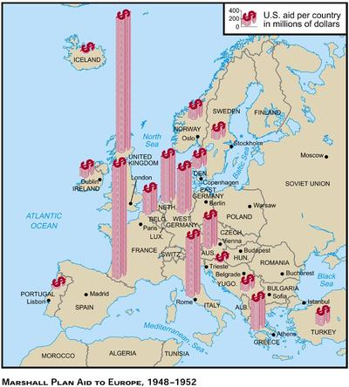

Slide 26
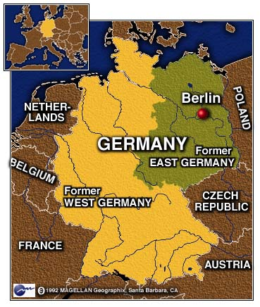
Struggle over Germany
After WWII, Germany divided into 4 zones
  Yalta Conference
G.B./France/U.S. combine zones
  West German / Democracy
Soviet Union remains separate
  East Germany – Communist
Berlin Also divided

Slide 27
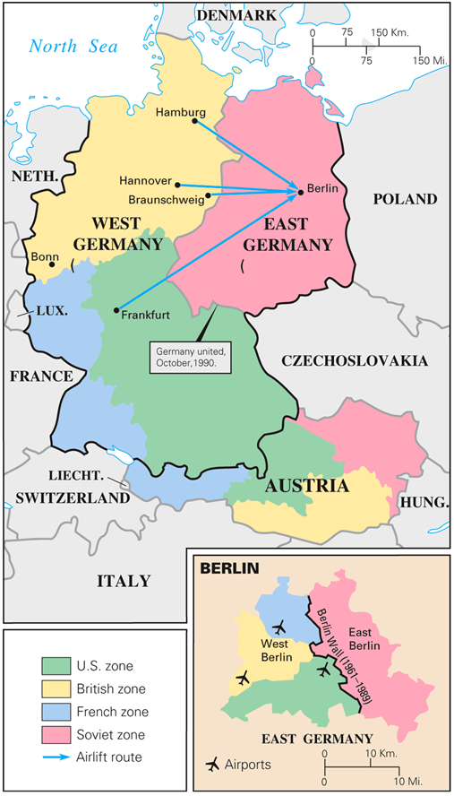
Berlin Airlift
Berlin in East Germany
Soviets impose blockade on West Berlin
  Retaliation to combining of zones
  stop people trying to leave East Berlin
U.S. & G.B. fly food & supplies to W. Berlin for 327 days
May 1949: Soviets lift blockade

Slide 28
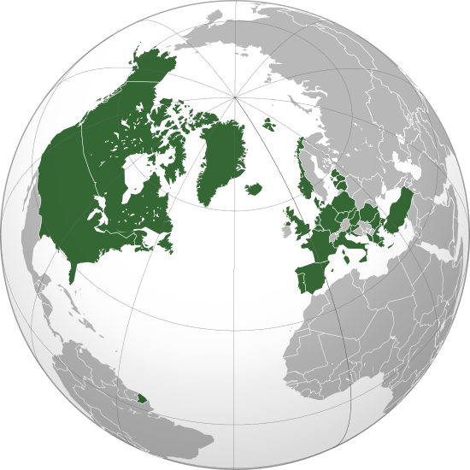
NATO 1949
North Atlantic Treaty Organization
  military alliance
  1st time for U.S. during peacetime
Nations:
- U.S. – Canada
– Belgium – Denmark
– Luxem. – Netherlands
-Norway -Portugal
– Greece –Turkey
– West Germany

Slide 29
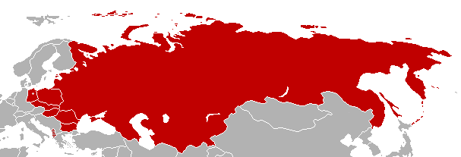
Warsaw Pact 1955
Created in response to unification of “Democratic” zones of Germany
Alliance of 9 Soviet Controlled Countries

Slide 30
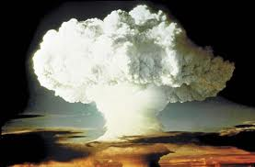
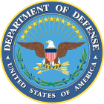

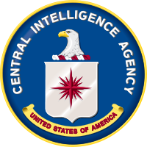
Cold War = Federal Agencies
Atomic Energy Commission
  Research Nuclear Technology
  H - Bomb
National Security Act
  Dept of Defense
  Dept of the Air Force
  National Security Council(NSC)
  Central Intelligence Agency (CIA)

Slide 31
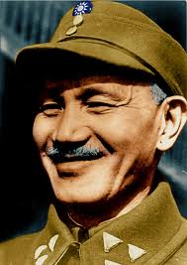
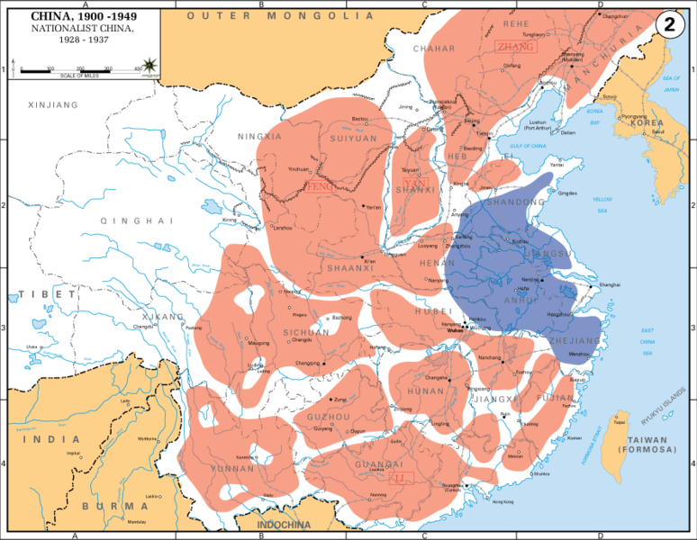
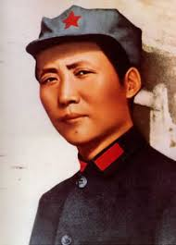
The Cold War - China
Before WWII
  China controlled by Nationalist Party Chiang
  Led by Chiang Kai-Shek
Beginning of Chinese Civil War 1927
  Communist Minority attempt to gain control of country
  Led by Mao Zedong
  Mostly unsuccessful
Japanese Invasion – 1930s
  Nationalists and Communists
  Agree to a “truce” to fight
  against Japanese

Slide 32
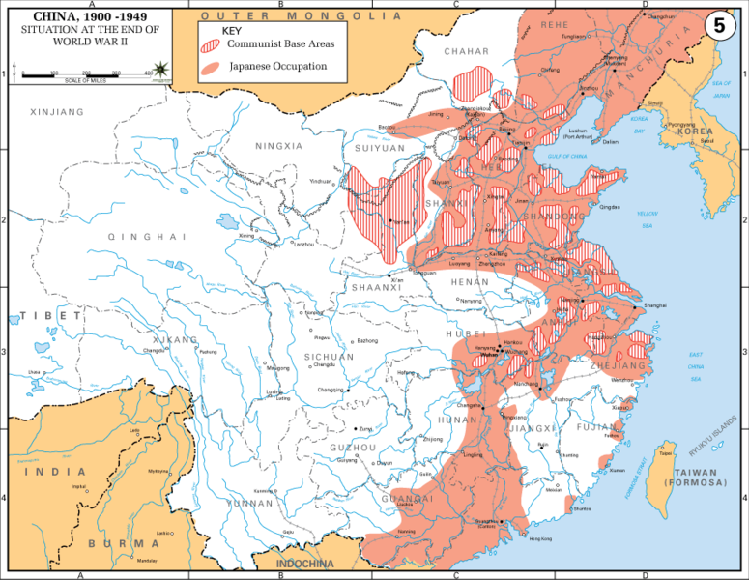
China During WWII

Slide 33
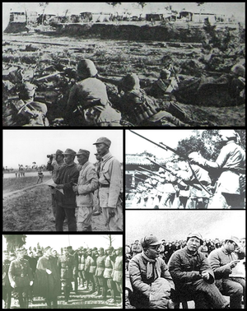
Post WWII
Civil War Resumes-1945
  Nationalists see heavier losses during war
  Communists win over peasant population
    Promised farmland upon victory
  Communists also receive support from USSR
  Eventually overrun Nationalist forces

Slide 34
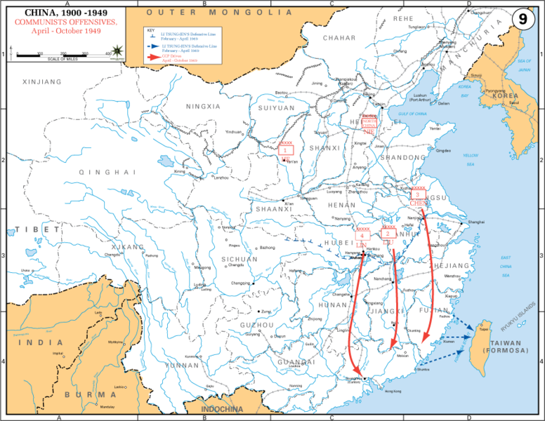

Slide 35
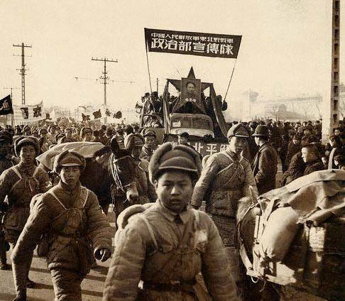
Communist China
1949: Nationalists flee to Taiwan
  Chiang Kai-shek 2 Million followers
  Still consider themselves in control
1949 - Mao People’s Republic of China
  Mao Zedong takes place as “Chairman”
U.S. did not recognize China until 1970s
Tension between Taiwan and China remains today

Slide 36
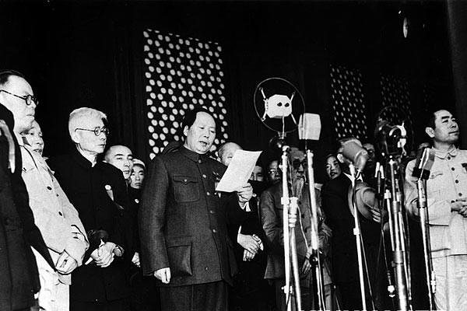

Slide 37

Loss of China
America sees this as a failure of containment
  NSC – 68
    Expansion of Containment to Asia
    Expansion of size and cost of U.S. Military

Slide 38
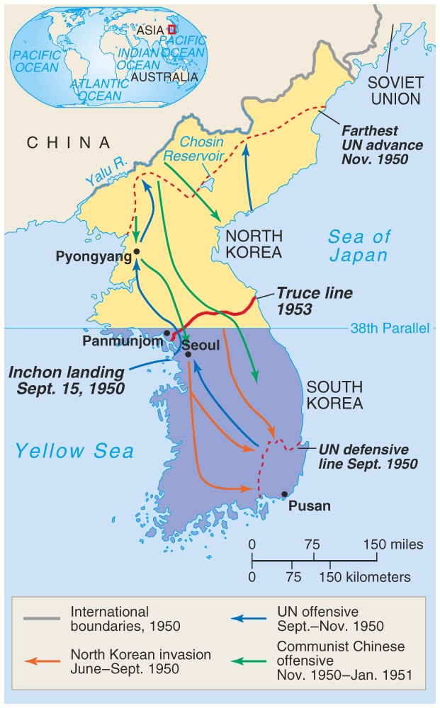
Korean War
[1950-1953]

Slide 39
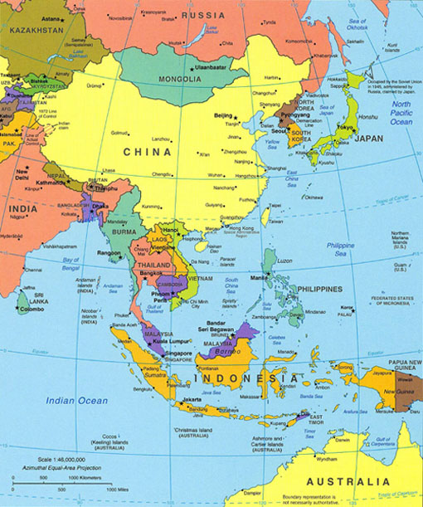
The Korean War
1910-1945 - Japanese rule Korea
1945 - 38th Parallel
  North of line - Soviets
  South of line - U.S.
By 1949, Americans & Soviets pull out of both areas
Conflict would begin soon after

Slide 40
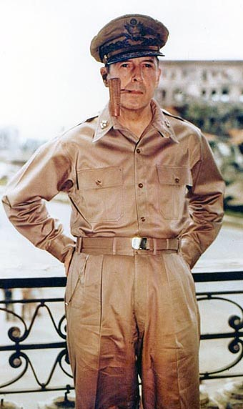
The Korean War (Cont.)
1950: N. Korea invades S. Korea
  President Truman orders air support for S. Korea
  “Police Action,” NOT WAR
“United Nations” sends 520,000 troops to help S. Korea
  90 % of troops were Americans
  Led by WWII hero, Douglas MacArthur

Slide 41
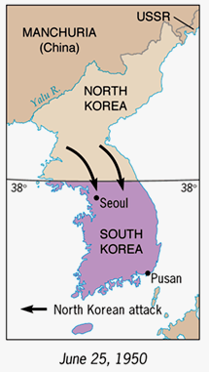
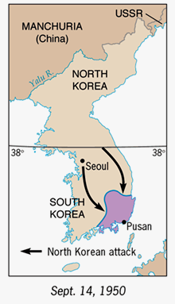

Slide 42
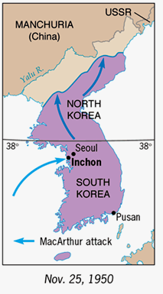
The Korean War
U.N. Troops forces North Korea to retreat and gain control of most of the Peninsula

Slide 43
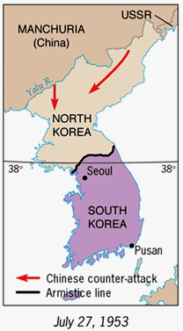
The Korean War
China sends aid and Soldiers to North Korea
300,000 Chinese drive UN Forces back
Eventually, over 1 Million Chinese Soldiers
Fighting stalls near the original 38° Line

Slide 44
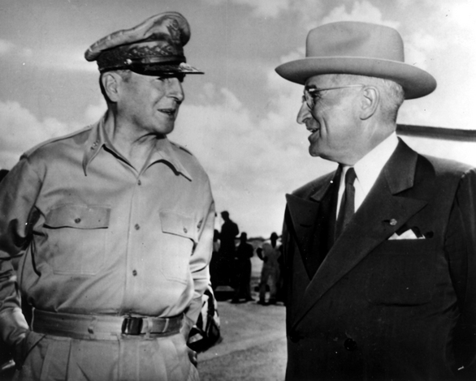
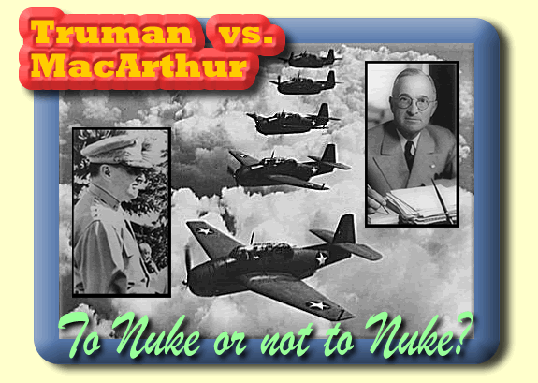
Korean War on the Home front
5 Star recommends bombing major Chinese cities
  Recommends considering Nuclear Weapons
President Truman says no
  China and USSR are allies
  MacArthur openly criticizes Truman
  President Truman fires MacArthur
Americans were angered: 70% favored MacArthur

Slide 45
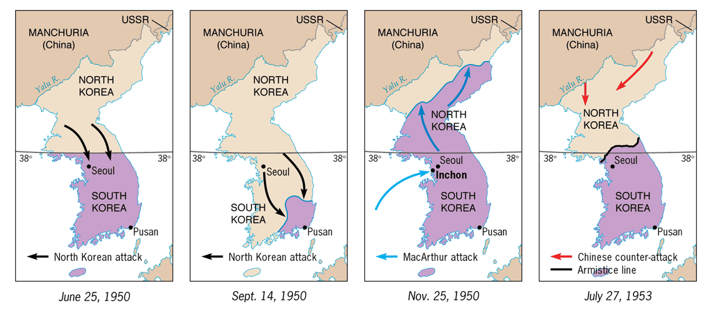
The Shifting Map of Korea
[1950-1953]

Slide 46
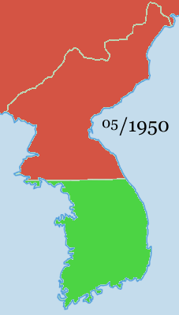
Stalemate
June 23, 1953- Ceasefire
U.S. Results of War
  36,516 KIA
  92,134 Wounded
  8,176 MIA
  7,245 POW
  $67,000,000,000
No declaration of war by Congress
Referred to as “The Forgotten War”

Slide 47

Effects of the Korean War
Rejection of Democratic Party
Election of Republican Dwight Eisenhower as president
38th parallel still exists today (DMZ)

Slide 48


Slide 49


