Slide 1
Visual-Spatial Learners
What does it mean to be
gifted in nonverbal reasoning?
Notes:
This PowerPoint presentation is meant to be used with parents—probably at a curriculum night for parents of students who have been identified as gifted in nonverbal reasoning. It applies to K-8 students. When students are identified after curriculum night or throughout the year, it could be sent to their parents to be viewed at home.
Please feel free to edit, add to, or alter this slide show as you choose for your purposes.

Slide 2
What is Nonverbal Reasoning?
Ability in spatial and abstract thinking
Ability to solve problems using shapes
and figures
Items on these subtests of the Cognitive Abilities Test involve neither words nor numbers.
NNAT 2 test is ALL non-verbal.
Notes:
Make the connection between nonverbal reasoning and visual-spatial learners.
Many people learn better visually than auditorally.

Slide 3
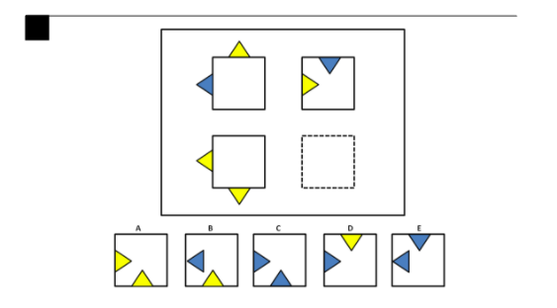
Sample Nonverbal Test Questions

Slide 4
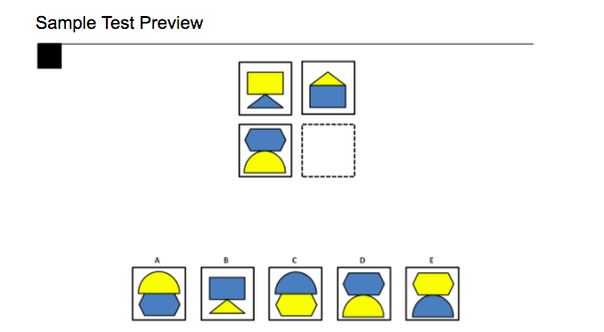
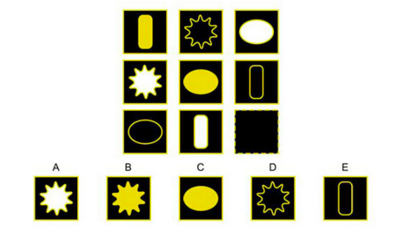

Slide 5
Learning Styles
There are two main ways people learn
  Visual-spatial learners think in pictures rather
  than words. They have a different brain organization than auditory-sequential learners. They learn better visually than auditorally.
  Auditory-sequential learners think in words.
  They learn better by hearing information and following a logical sequence.
Notes:
Talk about how about 33% of people are primarily visual-spatial learners, about 23% are primarily auditory-sequential, and the rest (about 56%) learn equally well with both styles, but about 2/3 of those who learn equally well tend toward visual-spatial.

Slide 6
Auditory-Sequential Visual-Spatial
Thinks primarily in words
Has auditory strengths
Step-by-step learner
Usually has good organization
Can show steps of work easily
Progresses from easy to difficult material
Relates well to time
Learns by trial and error
Thinks primarily in pictures
Has visual strengths
Whole-to-part learner
Creates unique methods of organization
Arrives at correct solutions intuitively
Gets difficult concepts, often struggles with easy
Relates well to space
Learns concepts all at once
Notes:
Lots of info. here, but no visuals. Don’t read the whole thing aloud.

Slide 7


Auditory-Sequential Visual-Spatial
Does well with algebra
Good at math
computation
Analysis
Phonics
Can write quickly and
neatly
Does well with geometry
Good at math
reasoning
Synthesis
Sight words
Prefers keyboarding to
writing
Notes:
Same as last slide.

Slide 8
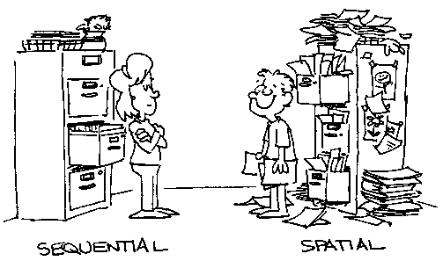
Notes:
No need for comment here.

Slide 9

The Visual-Spatial Learner
Sees how things exist in space
Sees how parts go together to make a whole
Develops asynchronously (unevenly)
Is a late bloomer
Loses track of time
May struggle with public
speaking
Notes:
Invite parent comments

Slide 10

The Visual-Spatial Learner
When the light bulb goes on, the learning
is usually permanent.
Notes:
Needed to say something positive here. We’ve been kind of beating up on the VS kid.

Slide 11

Gifted in Nonverbal Reasoning
How do we know this?
  Your child scored at or above the 97th percentile
  on the subtest of the Cognitive Abilities Test
  (or other state-approved assessment)
  that measures nonverbal reasoning.
Notes:
Background Information on the Nonverbal Battery of the CogAT:
The Nonverbal Battery presents the most novel problems to students. The items on these tests use only geometric shapes and figures that have had little direct relationship to formal school instruction. The tests require no reading. The nonverbal battery is particularly suitable for obtaining an accurate estimate of development for students who have difficulty with reading, who have limited competency in English, or who have limited opportunities. The tests in the nonverbal battery are between fifteen and twenty-five questions each and students are given ten minutes for each test.

Slide 12

Gifted in Nonverbal Reasoning
What does this mean?
  Your child is very good at reasoning with spatial stimuli or particularly adept at solving novel problems.
Notes:
They also tend to notice things in their environment that other people miss.
Many times the art teacher is already aware of these students even before they are identified. In fact, art teachers are a good source of gifted referrals.

Slide 13

Gifted in Nonverbal Reasoning
Spatially gifted students have the ability to draw conclusions based on a set of given information. They often learn by thinking or “seeing through their mind’s eye”
instead of listening verbally.
Notes:
They may even seem to not be paying attention to you.
Often these children are more sensitive and intense.

Slide 14

Gifted in Nonverbal Reasoning
Puzzles, manipulative games, pattern, and building/creating things come easily for kids who are gifted in this area. They can “see” how things go together and are able to “see” what is missing.
Their thinking is often in the
form of patterns or pictures.
Notes:
Parents may have noticed that their kids were always good at doing puzzles. They may be very much into Legos, blocks, etc. Invite comments.
This is exceptional ability! Celebrate it!

Slide 15
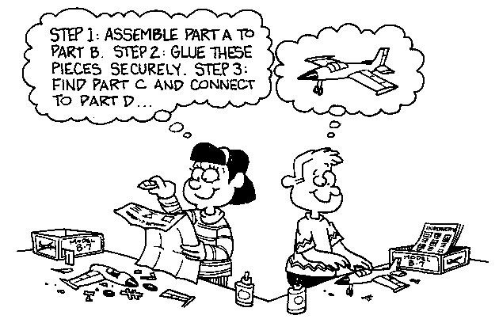
Notes:
Have you ever assembled something with someone of the opposite learning style? Fun!

Slide 16

What Are the Implications for Learning and School Success?

Slide 17

What Are the Implications for Learning and School Success?
Traditionally, instruction in schools has tended to be geared to the auditory-sequential style of learning.
Notes:
Schools have been great at catering to auditory-sequential learners (lectures, textbooks, drill and practice, traditional reading instruction, etc.)

Slide 18

What Are the Implications for Learning and School Success?
Students with strong spatial skills often experience difficulties in school.
They may have difficulty in verbal fluency
(as when writing under time pressure or
speaking extemporaneously)
or difficulties in remembering
sequences of words or letters
(as in spelling).

Slide 19
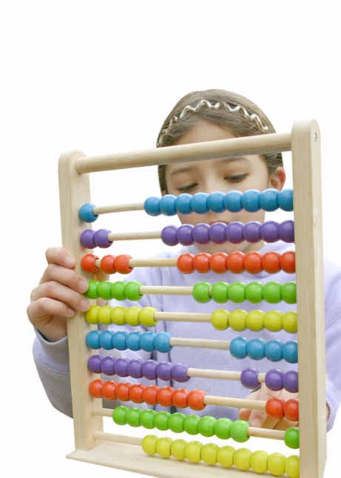
Brain-Based Research
Teachers are now much more
aware of brain-based research.
We know that the left side of the
brain is responsible for language,
for breaking words and thoughts
apart, and for details.
Notes:
Brain-research as it pertains to learning is a fairly new field.

Slide 20

Brain-Based Research
The right side of the brain is responsible for feeling and rhythm, for blending words and thoughts, and for getting the big picture.
Notes:
This is the visual-spatial side.

Slide 21
Teaching Strategies
Teachers in Kyrene are provided ongoing training on strategies by which they can tap into the exceptional abilities of students who are identified as gifted in nonverbal reasoning.
Teachers of the gifted at each school are a resource to regular classroom teachers to advise them on those particular teaching strategies that tend to be the most successful with students who are gifted in nonverbal reasoning.

Slide 22

Teaching Strategies
What are some of these?
  Visual directions
  Models, charts, tables, graphs, pictures
  Hands-on learning experiences
  Visualization techniques
  Whole-to-part approach
  Use of color
  Organization strategies
  Computers and other technology
  Use of context clues
  Timing strategies
  Wait time
  Questioning techniques
  Disciplining strategies
Notes:
This is a brief summary of some of the teaching strategies that classroom teachers utilize with their VS students. See the corresponding PowerPoint slide show “Teaching Strategies for the Visual-Spatial Learner” for greater detail.

Slide 23

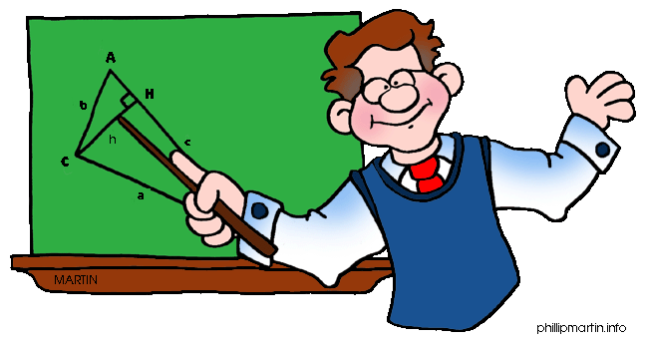
What Are Kyrene’s Services for Students Gifted in Nonverbal Reasoning?
Spatial reasoning is not a subject area—like language arts, math, or science.
It is a learning modality, a way that people learn.
Notes:
“Nonverbal” doesn’t necessarily mean that the child is nonverbal. It identifies a learning style.

Slide 24
What Are Kyrene’s Services for Students Gifted in Nonverbal Reasoning?
Our district’s thinking is that the best way for Kyrene to provide services to students who are gifted in nonverbal reasoning is to provide consultation and assistance to their teachers on ways to tap into this learning style in order to maximize students’ learning in all content areas.
Teachers of the gifted at each site are provided with consultative time to work with classroom teachers in developing instructional strategies which accomplish this.
Notes:
This occurs K-5.

Slide 25

Collaboration
The classroom teacher collaborates with the gifted resource (g.r.) teacher to identify strengths, objectives, methods and materials that would optimize learning for the student.
Notes:
Collaboration is an important part of a teacher’s job. This occurs outside of class time.

Slide 26
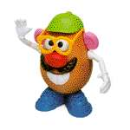
Some Commercial Materials for the Visual-Spatial Learner
puzzles
Pentominoes
Tangrams
Pythagoras
3-D Tic-tac-toe
3-D Scrabble
D-Stix
Mira
Pattern Blocks
Soma Blocks
Tessellations
Perceptual Puzzle Blocks
Triominos
Attribute Dominoes
Attribute Logic
Crazy Quilt
Drive Ya Nuts
Globe
Maps
Take 5
Square Up
Logic Links
Noodlers
Connect 4
Hexed
Rack-O
Master Mind
Simon
Battleship
Set
Chess
Checkers
any skill card game
Bridge
Canasta
Hearts
many Discovery Toys
any construction material
Erector sets
K’Nex
Capsela
Legos
Notes:
This list is available on the Kyrene Gifted Website.
These are just a small sample of the games and materials that are good for the VS learner. Teaching supply stores and game stores have many more.

Slide 27

For More Information…
Books
  Upside-Down Brilliance: The Visual-Spatial Learner
  by Linda Kreger Silverman, Ph.D.
  Visual-Spatial Learners by Alexandra Shires Golon
Websites
  www.visualspatial.org
  www.visual-learners.com
  www.gifteddevelopment.com
Notes:
You may wish to click on the websites (right click on the website and go to Open Hyperlink) to take the parents to these websites.

