Slide 1
Stress & Relationships
Unit Two

Slide 2
Chapter 4- Part One
Understanding Stress

Slide 3

What is Stress?
Stress is the reaction of the body and mind to everyday challenges and demands.
Often, stressful situations are unavoidable.
    Can appear quickly (You are late for the bus and have to run)
    Can appear slowly (You have a big game on Friday and keep thinking about it)

Slide 4

What is Happening?

Slide 5
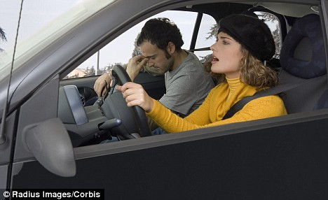
What is Happening?

Slide 6
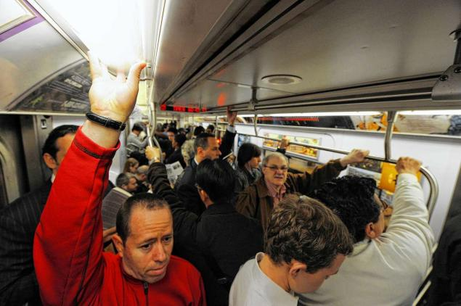
What is Happening?

Slide 7
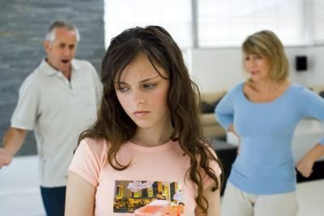
What is Happening?

Slide 8
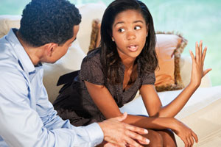
What is Happening?

Slide 9
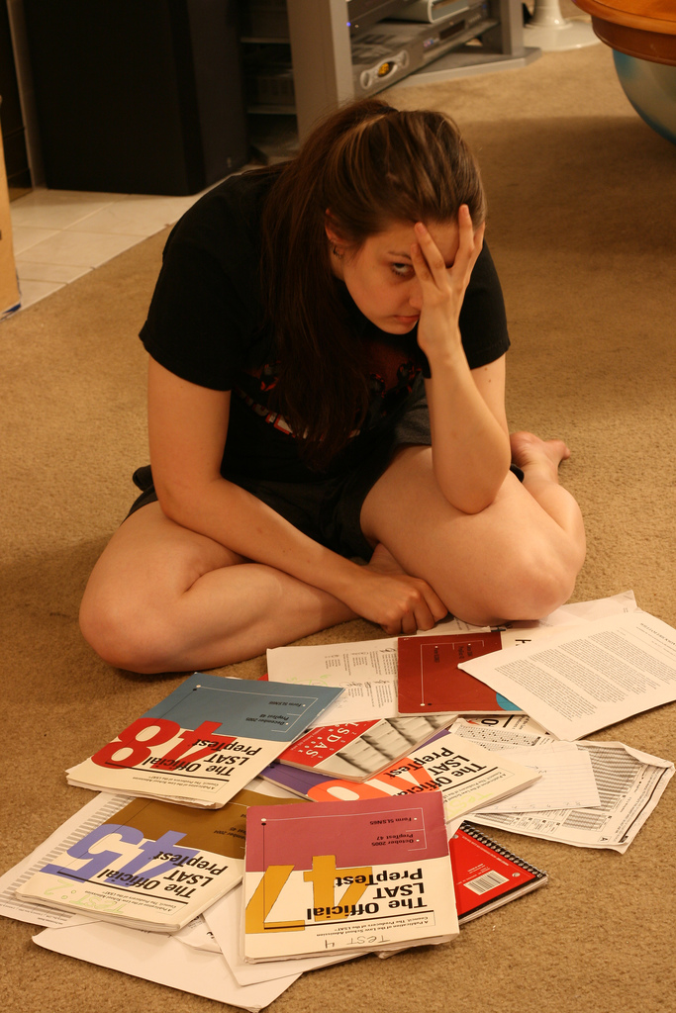
What is Happening?

Slide 10
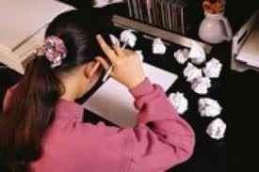
What is Happening?

Slide 11
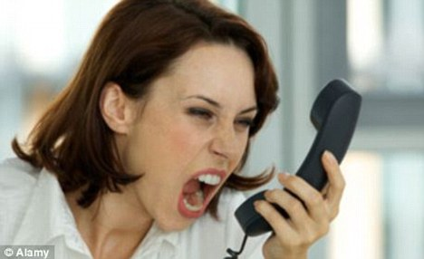
What is Happening?

Slide 12
It’s all in the Perception!
Perception- the act of becoming aware through the sense.
    ….BUT, your PERCEPTION of the situation changes your stress level. Your perceptions depend on previous experiences.
    Example: You and your friend get in a huge fight. You think the friendship is over (last time this happened you lost a friend). Your friend doesn’t worry too much and thinks you will work it out (they have never dealt with this before). Your perceptive view leads to more stress for yourself, because you are worried about losing your friend.

Slide 13
It’s also How You React to it!!!
Positive
Negative
Some people may react positive to stress.
  Examples:
    You have a paper due in English tomorrow so it bumps you into high gear writing it.
    You played Robinson last week and had the best game of your life because of all of the mental preparation!
Some people may react negative to stress.
  Examples:
    Instead of working diligently on the paper all you can think is how you don’t want to do it and you don’t get it done you are so distracted.
    You are so nervous for the Robinson game, that the night of you can’t even catch a ball.

Slide 14

Causes of Stress
Stressor- anything that causes stress.
  These things can be real or imagined….
  They can be anticipated or unexpected…
  People, objects, places, events, and situations can all be stressors.
  http://www.youtube.com/watch?v=ZvTL2Z1Jm9A

Slide 15
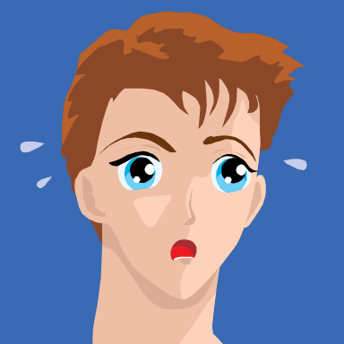
Your Body on Stress
Both your:
  Nervous System (the part of the body that controls voluntary and involuntary actions and transmits signals)(your brain, spinal cord & nerves)
  AND
  Endocrine System (system of glands that produces hormones to the blood stream)
  Are active during the stress response.

Slide 16
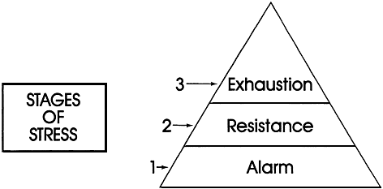
Your Body on Stress
Your physical response is involuntary or automatic.
Your stress response involves THREE stages.

Slide 17
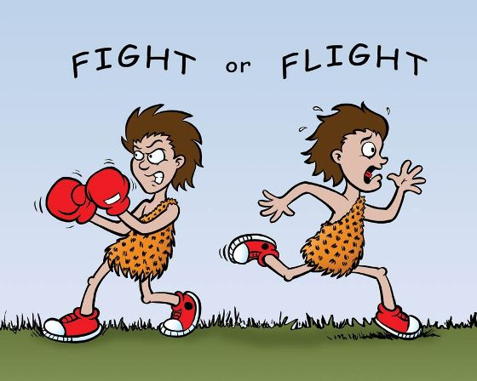
STAGE ONE: ALARM
Alarm Stage- Your mind and body go on high alert. This is sometimes referred to as “fight or flight” response because it prepares your body to either defend yourself or flee from a threat.

Slide 18
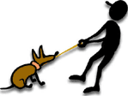
STAGE TWO: RESISTANCE
Resistance Stage-
If your body is still exposed to stress, your body adapts and reacts to the stressor. You may perform better at a high level with more endurance for a brief period.
http://www.youtube.com/watch?v=ngzyhnkT_jY

Slide 19
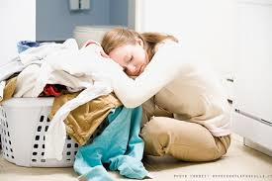
STAGE THREE:FATIGUE
Fatigue Stage-
If exposure to stress is prolonged, your body stops adapting to it. You start to get tired and lose the ability to manage stressors effectively.

Slide 20
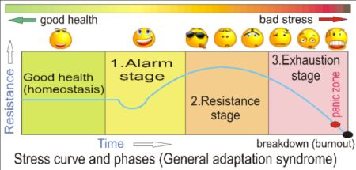
The Stress Cycle

Slide 21
Teen Stressors
What are YOU stressed about as a teen?
What do you do to relieve stress?
Think, Pair, Share with a neighbor.

Slide 22
Teen Stressors
Life situations
environmental
School demands
Problems with friends, bullying
Peer pressure
Family problems, abuse
Moving or changing schools
Breaking up with a boyfriend or girlfriend
Media
Natural disasters
Threat of terrorist attack
War

Slide 23

Teen Stressors
Biological
Cognitive
Changes in your body
Illness
Injury
Disability
Poor self-esteem
Personal appearance
Not fitting in
PERSONAL BEHAVIOR
Taking on a busy schedule
Relationship issues
Smoking
Using alcohol or other drugs

Slide 24
Stress and Your Body
Many times when you are stressed your body reacts in different ways. This is a physical response due to stress instead of the usual injury/illness. This can include:
  Headaches
  Weakened Immune System
  High Blood Pressure
  Clenching teeth/Grinding teeth
  Digestive Disorders

Slide 25

Classwork
Page 96
*Complete Questions: 1-6
Page 108
    Complete Questions: 1-8, 10,12

Slide 26
Chapter 4-Part Two
Managing Stress

Slide 27
Stress Can be a Problem…
Chronic Stress-stress associated with long-term problems that are beyond a person’s control.
The effects of stress will add up over time! If you don’t find a way to manage your stress, it will begin to take a toll on your body.
You can’t eliminate stress, but you CAN find a way to manage it!

Slide 28
Stress Management Techniques
How to Avoid/Limit Stress
  Use Refusal Skills! Do you have time for this? If not, don’t agree.
  Plan ahead. Make a timeline for your tasks.
  Think Positive! A positive outlook limits stress!
    “Life is ten percent what happens to you and ninety percent how you respond to it.”
    -Lou Holtz (Famous former University of South Carolina Football Coach)

Slide 29

Handling Stress
Some stress is unavoidable!
    Getting stuck in traffic when you’re trying to make it to an appointment on time.
    Your parent’s car will not start and you don’t make it to a movie where you are supposed to meet your friends.
    You slip and fall in front of everyone in the cafeteria.
    Your printer will not work for the class that your teacher says “no excuses” about having things printed on time for class!

Slide 30
Handling Stress
How to reduce the effects of stress:
  Practice relaxation. This includes deep breathing, thinking good thoughts, stretching and laughing!
  Redirect your energy. Work on a project, go for a walk, play an instrument.
  Seek support. Talk to someone you trust!

Slide 31

Take care of yourself!
Taking care of yourself is essential to stress management!
  Get Adequate Rest.
    Too little sleep will affect schoolwork, athletics, and even relationships! Use time management to give yourself rest!
  Physical Activity.
    This will help your energy levels and you will sleep better!
  Eat Right & Drink Water.
    Poor eating can contribute to stress, cause weakness, fatigue and the ability to concentrate.

Slide 32

Case Study/Partner Work
With/without a partner, read:
  “When Demands Are Too High” at the top of Page 100. Juan is very busy and overextended. Read through the thought provoking questions in the yellow, to the right of the paragraph and complete the letter to Juan as described. One partner writes. Be prepared to share your responses with class and to hand this in for a classwork grade!

Slide 33
Stress Video
Stress Video from Discovery Education

Slide 34

Classwork
Complete:
Page 96 #1-6
Page 101, #1-5
Page 108, #1-8, 10,12
Page 109, #14-21

Slide 35
Chapter 4- Part Three
Coping with Loss and Grief

Slide 36
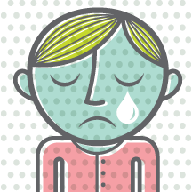
Myths About Grieving
Myth: We grieve only deaths.
Fact: All losses cause grief.

Slide 37
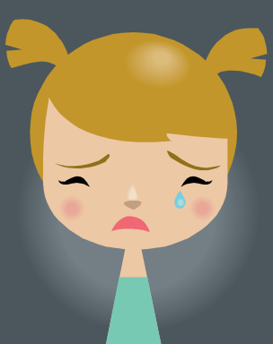
Myths About Grieving
Myth: Grief eventually ends.
Fact: We only learn to live with the loss.

Slide 38
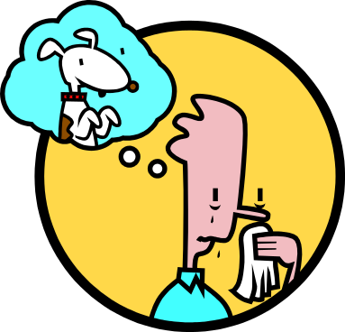
Myths About Grieving
Myth: People should be left alone to grieve.
Fact: Grieving people need the support of others.

Slide 39

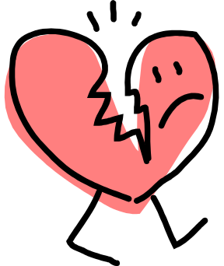

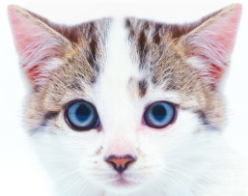
Acknowledging Loss
Examples of Loss
  Moving to a new city, leaving friends behind.
  The death of a loved one.
  A breakup in a relationship.
  Death of a pet.
  Divorce of your parents.

Slide 40
The Grieving Process
Swiss-American psychiatrist Elisabeth Kubler-Ross developed the grieving process which includes many Stages of Grief.
Stages of Grief- A variety of reactions that may surface as an individual makes sense of how a loss affects him or her.

Slide 41

The Grieving Process
ONE-
Denial/ Numbness
  It may be difficult to believe that this loss has even occurred!
TWO-
Emotional Release
  The loss is recognized. This stage often involves periods of crying.

Slide 42

The Grieving Process
THREE-
Anger
  The person uses anger because he or she feels powerless and unfairly deprived.
FOUR-
Bargaining
  As the reality of the loss sets in, the person may promise to change if what was lost can be returned.

Slide 43
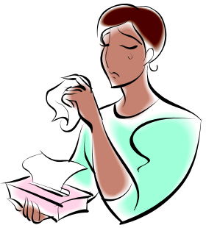
The Grieving Process
FIVE-
Depression
  Beyond the feelings of sadness, feelings of isolation, alienation, and hopelessness may occur.
SIX-
Remorse
  The person may become preoccupied with thoughts about how the loss could have been prevented.

Slide 44

The Grieving Process
SEVEN-
Acceptance
  The person faces the reality of the loss, and experiences closure.
  Closure- the acceptance of a loss.
EIGHT-
Hope
  Remembering becomes less painful, and the person begins to look ahead to the future.

Slide 45
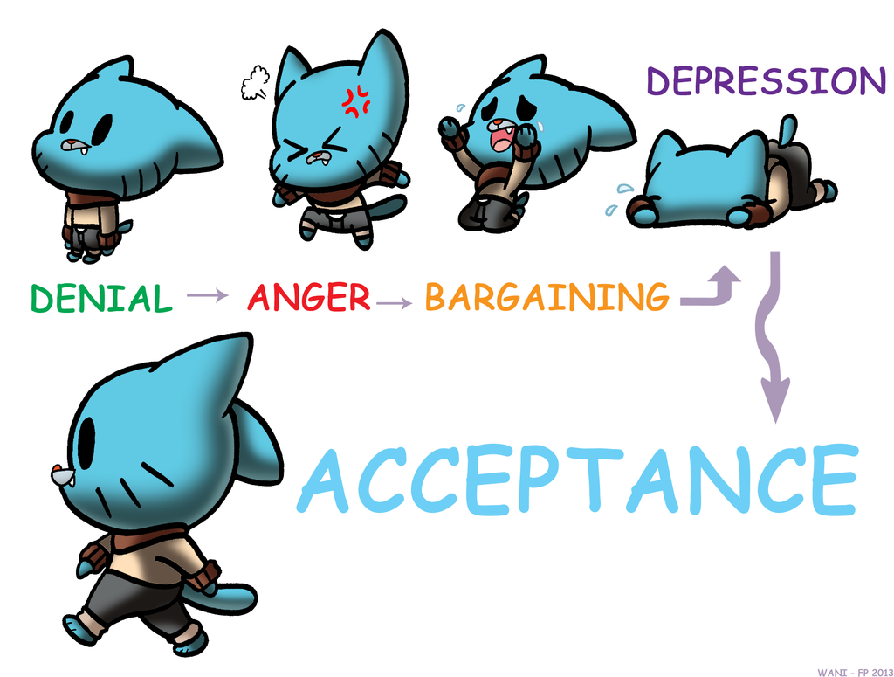
Stages of Grief in Pictures…

Slide 46
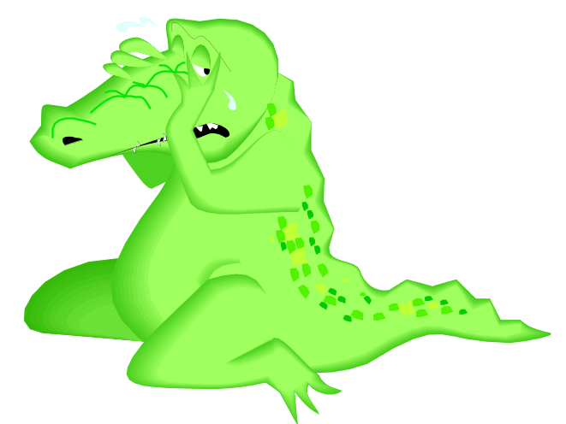
Coping
Coping- Dealing successfully with difficult changes in your life.
Experiencing and accepting your feelings during grieving is necessary for healing. These feelings are part of coping.

Slide 47
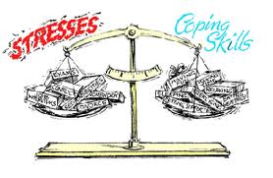
The Coping Balance
To stay FEEL balanced, you must balance your stresses with your coping skills.

Slide 48
Coping with Death
Death is one of the most painful losses we can experience.
Even after someone has a long battle with an illness, or is very old, it is very likely survivors will grieve.
Most survivors respond with mourning.

Slide 49
Coping with Traumatic Events
Traumatic Event- any event that has a stressful impact sufficient to overwhelm your normal coping strategies.
  Examples:
        Accidents
        Violent Assaults
        Suicides
        Natural Disasters
Unfortunately these things happen and are prevalent in the world we live in today.
Seek support from family, friends and community groups and agencies to help manage your shock and grief.

Slide 50
Mourning
Mourning- the act of showing sorrow or grief.
  This can include:
                Talking about the person
                Experiencing the pain of the loss
                Searching for meaning of why the loss occurred

Slide 51
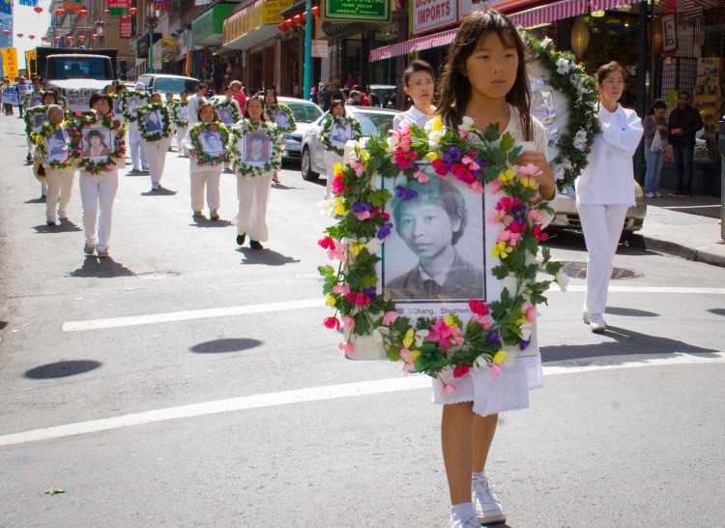
Different Culture’s Mourning
http://on.aol.com/video/chinese-funeral-ceremony-516948277
This is an interesting look at mourning in China.

Slide 52
Empathy
What is Empathy??
How can you show someone Empathy?

Slide 53
Showing Empathy
Empathy for another person is to…
Identify with their feelings-
ASK: How do they feel?
Put yourself in their shoes-
ASK: How would I feel?
Respond and show your understanding –
ASK: What can I do ?

Slide 54
Empathy Activity
In-Class Empathy Activity (Classwork grade)
    How Much Empathy Do YOU have?

Slide 55
1 - not at all
2 - a little
3 - some of the time (about 1/2 and 1/2)
4 - most of the time
5 - almost all of the time
*You may want to be the person who answers these questions with 5’s, but just try and be honest - answer for who you really are!
1. I feel empathy for people who are less fortunate than me.
2. I find it easy to understand other people’s point of view.
3. I am usually greatly upset by other people’s hardships and misfortunes.
4. If someone needed help in an emergency, I would willingly offer it.
5. There are two sides to every story, I remember this fact and try to look at both sides.
6. I would give money to people in need even if I did not know them well.
7. If I saw they had a need I would offer to help a neighbor, even without being asked.
8. I would let an elderly or disabled person go ahead of me in line even if I was in a hurry.
9. I would try and stop a friend from hurting someone, even if the person they wanted to hurt was not our friend.
10. When I make decisions I try and think of the rights of everyone involved (thinking of others and not just what’s best for me!)

Slide 56
1 - not at all
2 - a little
3 - some of the time (about 1/2 and 1/2)
4 - most of the time
5 - almost all of the time

Slide 57
Empathy Scores
What your EMPATHY score means:
0 - 30 You are not very empathetic! You are probably reluctant to help other people, especially if you don’t know them. You need to work on your empathy skills! A little kindness goes a long way. IT IS A CHOICE!!!!
31 – 40 You are average in your empathy and you are generally willing to help others- you may need to work at being more empathetic and/or helping when you don’t know the person, or when it doesn’t come as easily and as naturally to you!
41 - 50 You are very empathetic and willing to help others! Keep it up - you never know the difference you might make in someone’s life! (WHAT GOES AROUND, COMES AROUND).

Slide 58

Classwork
Complete:
  Page 105: 1-3
  Page 109: 27-40

Slide 59
Chapter 5- Part One
Mental and Emotional Problems

Slide 60

What is Anxiety?
Anxiety- the condition of feeling uneasy or worried about what may happen.
Occasional anxiety is a normal, manageable reaction to many short-term, stressful situations.
This can be in reaction to feelings of worry, insecurity, fear, self-consciousness or panic.
Usually, once the stressful situation is over, so is the anxiety it created.

Slide 61
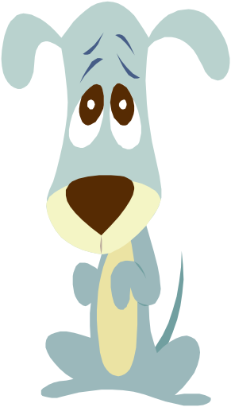
What is Depression?
Depression- a prolonged feeling of helplessness, hopelessness and sadness.
Feelings of sadness affect everyone, but depression usually lasts longer and may produce symptoms that do not go away over time.
Depression is a serious condition that may require professional medical help.

Slide 62

Causes and Effects of Depression
Depression can be caused by Physical, Psychological or Social/Environmental reasons.
Examples:
Physical- Medical condition/illness
Psychological- Surviving a traumatic event
Social/Environmental- Living in poverty or in an emotionally harmful environment.

Slide 63


Symptoms Include…
Changes in thinking
  This includes trouble concentrating and making decisions that can include self-destructive thoughts.
Changes in feelings
  These people may feel apathy (lack of strong feelings, interest or concern). They may not feel pleasure in things they once enjoyed. They could be sad, irritable or angry.
Changes in behavior
  Depressed people may become emotional, may eat too little/too much, may not sleep well, neglect basic hygiene and withdraw from social situations.

Slide 64

Warning Signs of Depression
Persistent sad or irritable mood
Loss of interest in activities once enjoyed
Significant change in appetite/body weight
Difficulty sleeping
Physical signs of nervousness
Loss of energy
Feelings of worthlessness or inappropriate guilt
Difficulty concentrating
Recurrent thoughts of death or suicide.

Slide 65

Getting Help
If you recognize signs of depression in yourself or a friend, discuss your concerns with a trusted adult.
Depression is serious, but treatable!
This may include taking medication, making changes in environment and/or counseling.

Slide 66
Video
https://www.youtube.com/watch?v=HRjSVNYlwBE
Movie about Anxiety/Depression

Slide 67
Chapter 5- Part Two
Mental Disorders

Slide 68
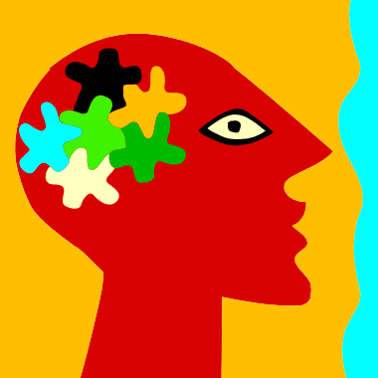
Mental Disorders
Mental Disorder- an illness of the mind that can affect the thoughts, feelings and behaviors of a person, preventing him or her from leading a happy, healthful and productive life.
Each year, approximately 57.7 million people in the U.S. are affected by some sort of Mental Disorder.

Slide 69
Anxiety Disorders
Generalized Anxiety Disorder (GAD)
Phobia
Obsessive-Compulsive Disorder
Panic Disorder
Post-Traumatic Stress Disorder

Slide 70
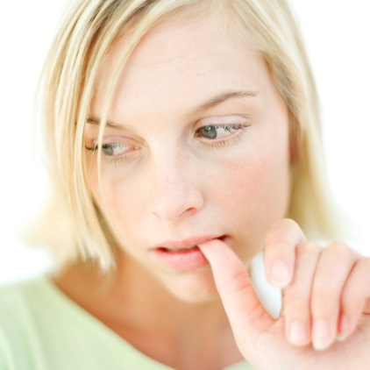
Generalized Anxiety Disorder (GAD)
GAD- Exaggerated worry and tension for no reason.
People with GAD startle easily and have difficulty concentrating, relaxing and sleeping.

Slide 71

Phobia
Phobia- A strong, irrational fear of something specific, such as heights or social situations.

Slide 72
Obsessive-Compulsive Disorder (OCD)
OCD- Persistent thoughts, fears or urges (obsessions) leasing to uncontrollable repetitive behaviors (compulsions).
Example: The fear of germs leads to constant hand washing.

Slide 73
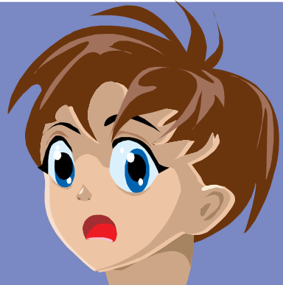
Panic Disorder
Panic Disorder- Attacks of sudden, unexplained feelings of terror.
“Panic attacks” are accompanied by trembling, increased heart rate, shortness of breath, or dizziness.

Slide 74
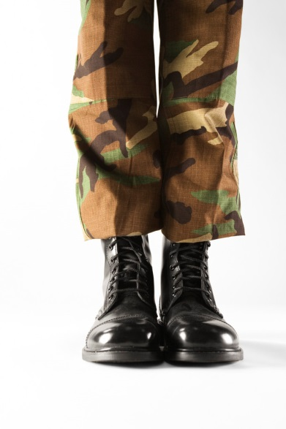
Post-Traumatic Stress Disorder (PTSD)
PTSD- A condition that may develop after exposure to a terrifying event.
Symptoms include flashbacks, nightmares, emotional numbness, guilt, sleeplessness and problems concentrating.

Slide 75


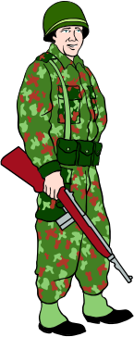
PTSD Examples
Being in, or seeing, a serious car accident
Being sexually assaulted/raped
Experiencing or witnessing natural disasters (earthquakes, hurricanes, floods, fire)
Experiencing or witnessing a violent crime (kidnapping, physical assault, assault or murder of a loved one)
Being involved in a war or witnessing violence or death during wartime

Slide 76

Getting Help
Mental Health professionals include:
Counselors
School Psychologists
Psychiatrists
Neurologist
Clinical Psychologists
Psychiatric Social Worker

Slide 77
Treatment Methods
Psychotherapy-dialogue between a patient and a mental health professional
Behavior therapy- treatment process that focuses on changing unwanted behaviors through rewards and reinforcements
Cognitive therapy- treatment designed to identify and correct distorted thinking
Family therapy- helping the family function
Group therapy- treating a group of people with similar problems
Drug therapy- use of certain medications to treat or reduce symptoms of a mental disorder.

Slide 78
Create- Poster or Infographic
Topics can include:
Depression
Anxiety
Generalized Anxiety Disorder (GAD)
Phobia
Obsessive-Compulsive Disorder
Panic Disorder
Post-Traumatic Stress Disorder
*Teens suffering from mental disorders often feel confused, isolated, scared or ashamed…
Create a poster or promoting awareness of and empathy toward mental illnesses. Focus on specific ways to be supportive, patient and understanding. OR, create an infographic about your chosen disorder.

Slide 79
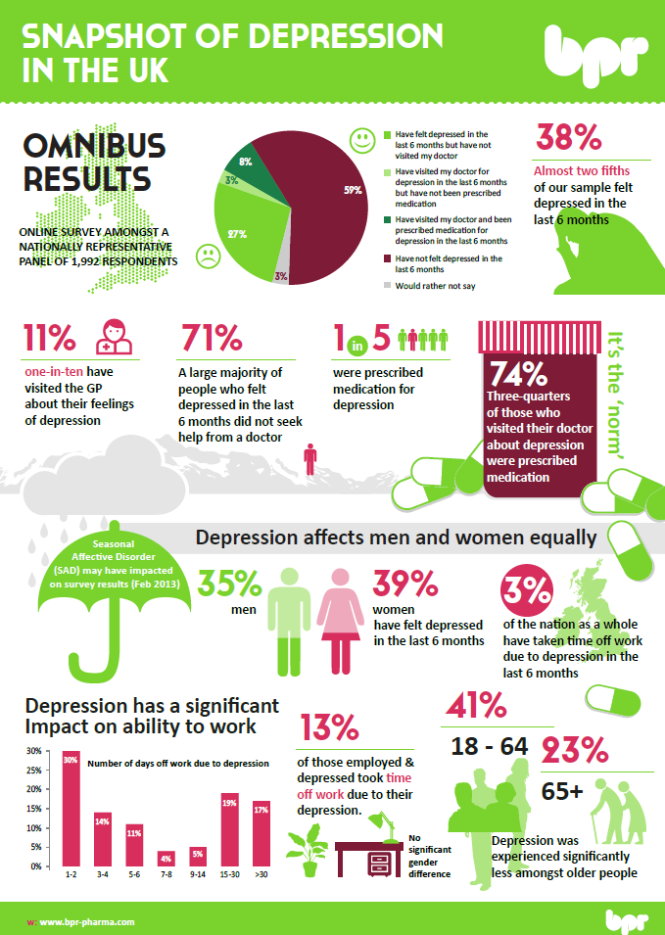

Slide 80
Classwork
Page 117
1-5 & 7
Page 121
    1-5
Page 132
1-10

Slide 81
Chapter 6- Part One
Skills for Healthy Relationships

Slide 82
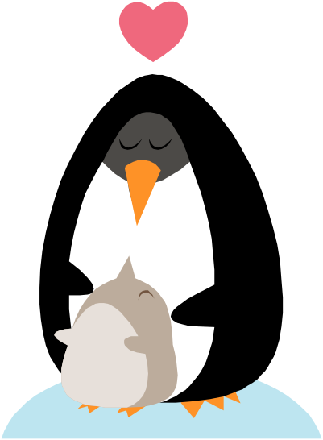
What is a Relationship?
Relationship- a bond or connection you have with other people.
A lot of time people think this is only a romantic relationship. This also includes relationships with:
    Family members
    Teachers
    Friends
    Classmates
    People in your community

Slide 83
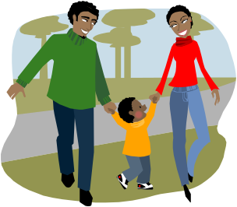
Relationships with Family
Some of the most important relationships are the ones with those who live in your home! (Parents, guardians, brothers & sisters). Other important family relationships include your grandparents, aunts, uncles and cousins.
What makes these relationships special?
  They are relationships for life! Your friends in high school may not be your friends ten years from now, but family is there for life!
  These relationships strengthen all sides of your Health Triangle.
    Your physical needs are taken care of by your immediate family (food, shelter & clothing).
    Your social health is improved by teaching values and social skills.
    The love, encouragement and care they provide helps improve your emotional and mental health.

Slide 84
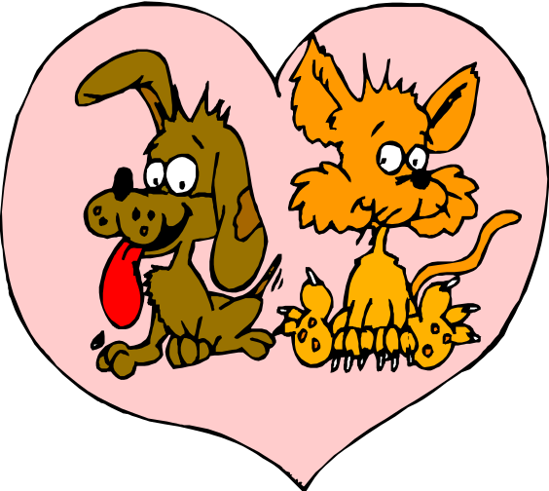
Relationships with Friends
Friendship- a significant relationship between two people that is based on trust, caring, and consideration.
What do you look for in a friend?
Remember…
    Friends can be your own age or any age!
    They can be selected based on values, neighborhoods or interests, or just because you like them!

Slide 85
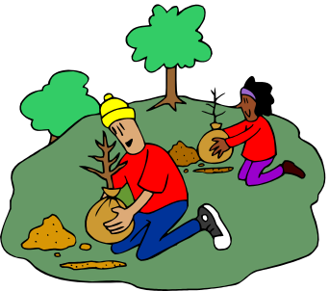
Relationships in Your Community
Being part of your community can have a positive impact in all aspects of your health and can also provide resources to help you when you are in trouble.
Citizenship- the way you conduct yourself as a member in the community
  Good citizens help their communities by obeying laws, being friendly to neighbors, and helping to improve where they live.

Slide 86
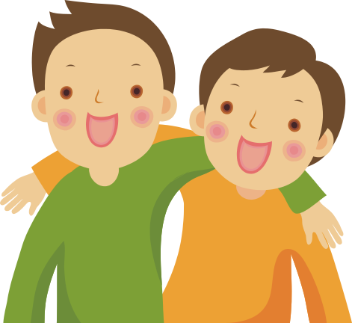
Roles in Relationships
Role- part you play in a relationship. Your role may change during the day.
      Ex)You babysit your brother so you turn from brother/sister to caregiver or your co-worker turns into a friend after you leave work.
In one day, you will play different roles in different relationships with different people!
    a son or daughter at home
    a student at school
    a friend with your “group”
    a teammate on the volleyball team
    an employee at your after-school job

Slide 87

Healthy Relationships
What are some qualities that YOU think are important in a healthy relationship?
Think, Pair and Share with someone sitting close to you

Slide 88

Traits of a Healthy Relationship
Healthy relationships NUTURE you and bring out the BEST in you!
Qualities include:
  Mutual Respect! You accept each other’s opinions, tastes and traditions even if they are different than yours.
  Caring. You show kindness and encouragement. During hard times you practice empathy and support.
  Honesty. You are open and honest rather than concealing thoughts, feelings or actions.
  Commitment. You both contribute to the relationship and work to keep it strong, even if that means making sacrifices.

Slide 89

Building Healthy Relationships
Maintaining a healthy relationship takes work!
Those involved need to make an effort to understand one another and to get along in different situations.
The “Three C’s” of a relationship will get you there. Communication, Cooperation & Compromise!

Slide 90
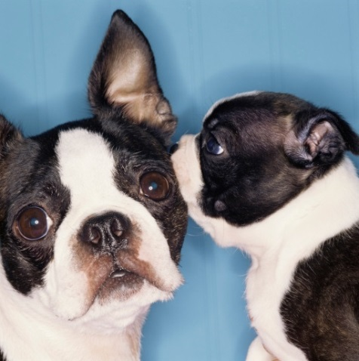
Communication
Communication- the exchange of thoughts, feelings and beliefs between two or more people.
  In relationships, people need to understand each other. You need to be able to communicate respectfully so you can express your thoughts, feelings and expectations with one another.
  “Communication ends confusion.”

Slide 91

Cooperation
Cooperation- working together for the good of all.
Working together with others for a common goal can strengthen relationships!
  ex) Your family is moving. You all pitch in to help move your belongings and carry things out to the truck. You learned to interact better together, and you share a sense of accomplishment when it’s done!

Slide 92

Compromise
Compromise- a problem-solving method in which each participant gives up something to reach a solution that satisfies everyone.
  This is a give and take exchange which strengthens relationships!
  Although, compromise only works when both parties are happy with the solution. You should NOT compromise things that really matter to you such as your values and beliefs.

Slide 93
Role Play
Develop and write a role play with a partner. You and your partner share some type of relationship. In your narrative, show how the communication between these two people affects their relationship in either a positive or negative way. You can use body language too! You will hand this in and some people will act theirs out.
***THINK of all of the different roles you play in one day that are considered relationships. That we talked about (son/daughter, teacher/student, friends, boyfriend/girlfriend, teammates etc…)

Slide 94

Role Play
This should include both of your names (who you are represented) and a dialogue, at least 4 lines each person.
Ex) Mother: Can you finally clean your room?!?
Son: Can you stop bugging me?
Mother: Why can you never do what you are told?
Son: Why are you always telling me what to do? Etc……
This should display either a positive or negative communication tone, YOUR choice!

Slide 95

Six Traits of Good Character
Trustworthiness
Respect
Responsibility
Fairness
Caring
Citizenship

Slide 96
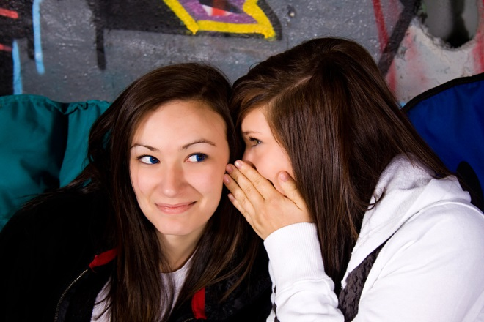
Six Traits of Good Character
Trustworthiness
Jessica made a promise to her friend Claire to go the movies on Friday night. Jessica met a guy she really likes who asks her out the same night. She wants to go out with him, but already has plans with Claire. By keeping her promise to Claire, Jessica shows she’s a trustworthy friend.
Respect
Taylor’s mom always taught her to not speak when others are speaking at home. This skill has helped Taylor when she tries to communicate with others so they know they can also speak their mind.

Slide 97

Six Traits of Good Character
Responsibility
At a party at a neighbor’s house, Carl knocks over a vase and breaks it, on accident. He apologizes and tells his neighbor even though no one saw it happen, and helps clean it up. His responsible actions improve his neighbor’s opinion of him.
Fairness
Jack and his sister have to share the computer at home to do school work, send emails and surf the web. They take turns. Sharing the computer makes it fair for both, and keeps them from disagreeing.

Slide 98

Six Traits of Good Character
Caring
Lisa’s good friend Mallory has been struggling lately in math. This is one of Lisa’s strengths. She invites her over after school to tutor her. Mallory considers her a good friend for caring for her and for helping her out.
Citizenship
Jake’s family just bought a new leaf blower, so he cleaned up his yard. He noticed that a few of his elderly neighbor’s yards were also being taken over by leaves, so he cleaned them up. His actions improve his relationships with his neighbors and his reputation in the community.

Slide 99

Classwork
Page 147: #1-5
Page 160: #1-10

Slide 100
Chapter 6- Part Two
Respecting Yourself and Others

Slide 101

Personal Identity
Personal Identity-your sense of who you are and where you belong in the world
  When you are teen, you continue searching for your personal identity. Along the way you may change your appearance or experiment with different interests or hobbies.
  You will also be developing your personal values system. Your identity will change as you move through life!

Slide 102

Respect for Yourself
Having self-respect is the first step in the path of developing healthy relationships with others! People are attracted with those who show they have self-respect.
When you respect yourself, you’re more likely to seek out relationships with others who treat you with respect!

Slide 103
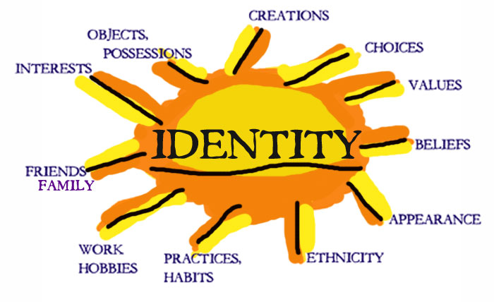
What makes you…

Slide 104

Clarifying Values
Unclear Values
Clear Values
If you are not clear about your values, it’s much more difficult to communicate them to others! As a result, others will not know what is important to you. This could increase your chances to be involved in unhealthy behaviors.
When you are clear about what your values are, you strengthen your relationships! Others people know what’s important to you and understand what’s important to you.

Slide 105

Respect for Others
You can show respect for others by:
  Listening to other people. Hear and consider their points of view whether you agree or not.
  Be considerate of others’ feelings. Consider how your actions might make the other person feel.
  Develop mutual trust. Be honest and dependable. Let them know they can count on you!
  Be realistic in your expectations. You can’t always expect others to make you their top priority.

Slide 106
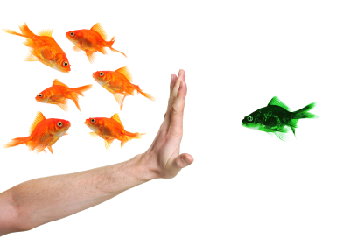
Prejudice
Prejudice- an unfair opinion or judgment of a particular group of people.
  Prejudice is a barrier to healthy relationships. It can keep people from getting to know each other as individuals.
    Ex) You got dumped by a guy on the football team. You decide that you dislike ALL football players and that they are all jerks.

Slide 107

Stereotypes
Stereotype-an exaggerated or oversimplified belief about people who belong to a certain group.
  This thought is adopted about a select group of individuals, but it may not accurately reflect reality.
    Can be related to ethnicity, gender, profession, hobbies, appearances etc…
    Ex)Assuming all boys like sports.

Slide 108
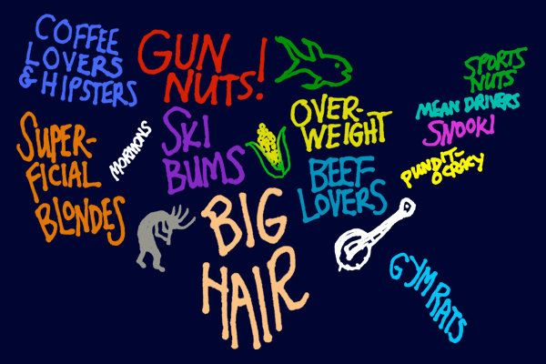

Slide 109
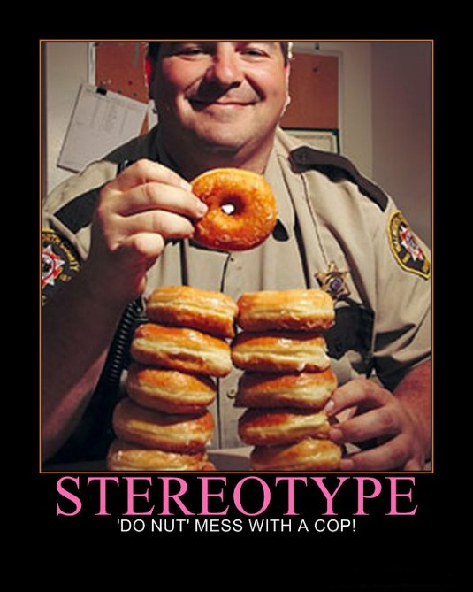

Slide 110
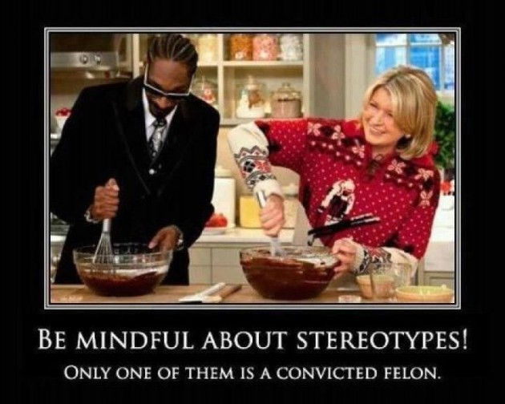

Slide 111
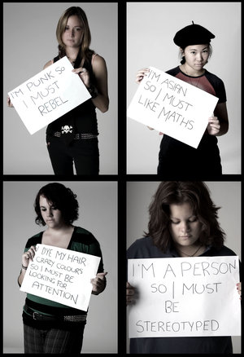

Slide 112

Tolerance
Tolerance- the ability to accept others’ differences.
  People who are tolerant value diversity and can appreciate differences in other people’s cultures, interests and beliefs.

Slide 113
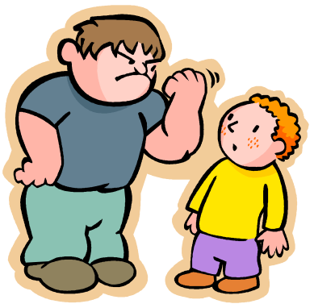
Bullying- Disrespectful Behavior
Bullying- deliberately harming or threatening other people who cannot easily defend themselves.
  Bullies may tease their victims, spread rumors about them, or try to keep them out of a group.
  Bullies may also escalate their bullying physically by pushing, shoving or hitting them.

Slide 114
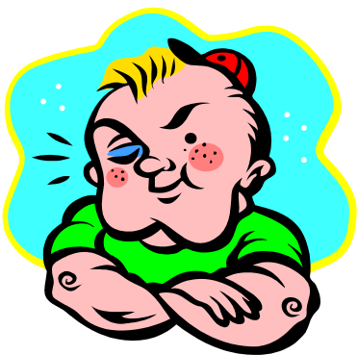
Dealing with a Bully
1) Tell a trusted adult! If you need a friend there, bring them to back up your story.
2) Stick with a group. Bullies tend to pick on teens who are by themselves a lot. Having a group of friends makes you less of desirable target.
3) Stand up to the bully. Bullies pick on those they see as weaker than themselves. Standing up to them shows you won’t be intimidated.

Slide 115
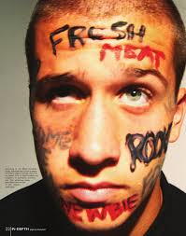
Hazing- Disrespectful Behavior
Hazing- making others perform certain tasks in order to join the group.
  This may be physically or emotionally harmful.
  Meant to humiliate new members or prove they are inferior to existing members.
    Ex)
      Forcing new members to go without sleep
      Forcing new members to drink alcohol
      Physically beating new members
      http://www.cbsnews.com/8301-3445_162-57371657/

Slide 116

Classwork
Page 151: #1-5
Page 160-161: #11-20

Slide 117
Chapter 6- Part Three
Communicating Effectively

Slide 118
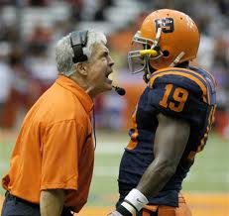
Communication Styles
Three Types of Communicators
  Aggressive
  Passive
  Assertive

Slide 119
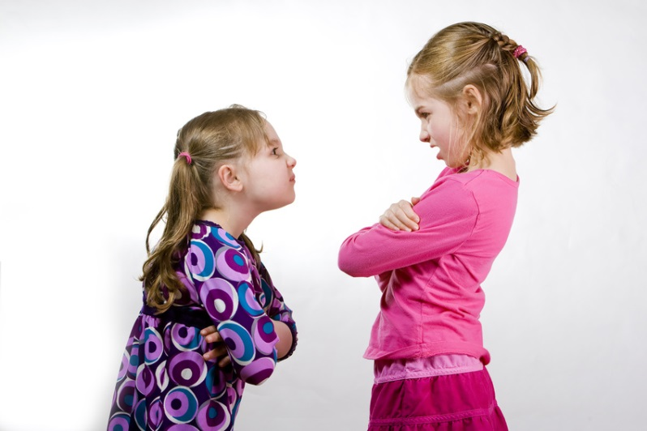
Aggressive
Aggressive- being overly forceful, pushy or hostile.
  This may involve bullying or intimidation. Many times this type of communicator does not pay attention (or really care) to others’ thoughts, feelings or needs.

Slide 120
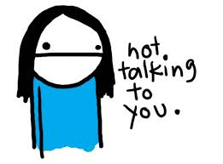
Passive
Passive- being unwilling or unable to express thoughts or feelings in a direct or firm manner.
  This often involves putting others’ needs ahead of your own. People often develop this type of communication style because they dislike conflict and confrontation. They go out of their way to avoid an argument.

Slide 121

Assertive
Assertive- expressing your views clearly and respectfully.
  Assertiveness involves standing up for your rights and beliefs while also respecting those of others.
  Dealing with a disagreement in assertive fashion can result in negotiating with others to find the best solution to the problem.
  Using this communication style will improve your relationships with others! It will help ensure that your own needs are met, along with those of others.***

Slide 122
Let’s Compare!
http://www.get.gg/communication.htm

Slide 123
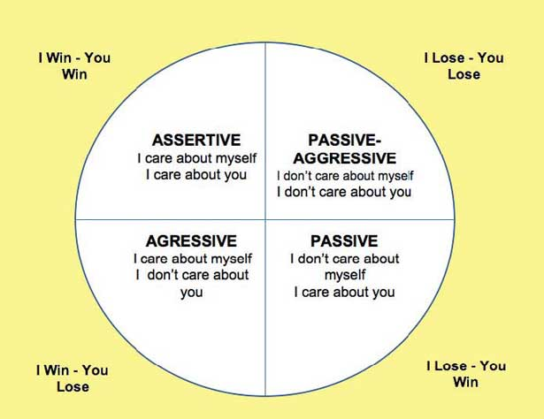

Slide 124
Your Style
Assertiveness Quiz
First, write down numbers from 1 to 10 on a piece of paper. Second, depending on your choice in each question, write a, b, or c after each number.

Slide 125

Situation #1
1. You are in a restaurant and order pasta with meat sauce. You are served pasta with plain sauce. You would:
a) Accept it since you sort of like it plain anyway.
b) Angrily refuse the food and insist on seeing the manager to complain about the poor service.
c) Call the waiter and indicate you ordered meat sauce, then give it back.

Slide 126

Situation #2
2. You are a customer waiting in line to be served. Suddenly, someone steps in line ahead of you. You would:
a) Let the person be ahead of you since he/she is already in line.
b) Pull the person out of line and make him/her go to the back.
c) Indicate to the person that you are in line and point out where it begins.

Slide 127

Situation #3
3. After walking out of a store where you purchased some items you discover you were short-changed. You would:
a)Let it go since you are already out of the store and have no proof you were short-changed.
b)Go to the manager and indicate how you were cheated by the clerk, then demand the proper change.
c) Return to the clerk and inform him/her of the error.

Slide 128

Situation #4
4. You are in the middle of watching a very interesting television show when your mom comes in and asks you for a favor. You would:
a) Do the favor as quickly as possible, then return to the program to finish watching it.
b) Say "no," then finish watching your program.
c) Ask if it can wait until the program is over and, if so, do it then.

Slide 129

Situation #5
5. A friend drops in to say hello, but stays too long, preventing you from finishing an important class project. You would:
a) Let the person stay, then finish your work another time.
b) Tell the person to stop bothering you and to get out of your house, you need to work!
c) Explain your need to finish your work and request he/she visit another time.

Slide 130

Situation #6
6. You are at a “they pump it for you” gas station and ask a gas station attendant for five dollars worth of gas. However, he fills up your tank by mistake and asks for fifty dollars. You would:
a) Pay the fifty dollars since the gas is already in your tank and you will eventually need it anyway.
b) Demand to see the manager and protest being ripped off.
c) Indicate you only requested five dollars worth of gas and give him only five dollars.

Slide 131

Situation #7
7. You suspect someone of talking about you behind your back, but you don't know why. You don’t even really know them! You would:
a) Pretend you are unaware of them doing this and ignore it, hoping it will correct itself.
b) Get even with the person somehow so he/she will learn not to talk behind your back.
c) Ask the person if they have an issue with you, then try to be understanding.

Slide 132

Situation #8
8. You and your mom bring her car to a garage for repairs and receive a written estimate. But later, when you pick up the car, you are billed for additional work and for an amount higher than the estimate. Now your family cannot go on vacation because of the price increase! You would:
a) Encourage your mom to pay the bill since the car must have needed the extra repairs anyway.
b) Tell her to refuse to pay, and then complain to the Motor Vehicle Department or the Better Business Bureau.
c) Have her indicate to the manager that you agreed only to the estimated amount, then pay only that amount.

Slide 133

Situation #9
9. You invite a good friend to your house for a family party, but your friend never arrives and neither calls to cancel nor to apologize. You find out later they were hanging out with their boyfriend/girlfriend. You would:
a) Ignore it, but manage not to show up the next time your friend invites you to a party.
b) Never speak to this person again and end the friendship.
c) Call your friend to find out what happened and why they would choose to do that.

Slide 134

Situation #10
#10) You are in a group discussion at your new part-time job that includes your boss. A co-worker asks you a question about your work, that you SHOULD know, but you don't know the answer. You would:
a) Give your co-worker a false, but believable answer so your boss will think you are on top of things.
b) Do not answer, but attack your co-worker by asking a question you know he/she could not answer.
c) Indicate to your co-worker you are unsure just now, but offer to give him/her the information later.

Slide 135

What are you???
The "a" choices in the quiz are representative of the Passive style. Thus, the more "a" choices you made, the more passive you are. Six or more "a" choices suggest you are probably passive in your interpersonal behavior.
The "b" choices in the quiz are representative of the Aggressive style. Thus, the more "b" choices you made, the more aggressive you are. Six or more "b" choices indicate you are most likely aggressive in your interpersonal behavior.
The "c" choices in the quiz are representative of the Assertive style. Thus, the more "c" choices you made, the more assertive you are. Six or more "c" choices suggest you are probably assertive.

Slide 136

Ways to Communicate
Communication is a two way street! You must be able to understand the messages being sent to you. This includes verbal and non-verbal messages.

Slide 137

Speaking Skills
The key to good communication is saying what you mean!
It is not reasonable to expect others to be able to read your mind or pick up on subtle hints.
  Example: If someone hurts your feelings you need to let them know clearly and directly as you can! Everyone does not realize how they make others feel.

Slide 138

“I” Messages
“I Message”- A statement that focuses on your feelings rather than on someone else’s behavior.
  An “I Message” helps your communicate without putting blame on someone.
  Being clear and direct does not mean being disrespectful! When people feel that they are being attacked, they are much less likely to listen to what you have to say.

Slide 139

Comparison
“You message”
“I message”
“Why can’t you ever show up on time?”
“I really don’t like to be left waiting- it makes me feel like you don’t think I’m important.”

Slide 140
Comparison
“You message”
“I message”
“You never listen to anything I say.”
“I feel like my suggestions aren’t being taken seriously.”

Slide 141
Comparison
“you message”
“I message”
“I said I’d take out the trash and I will! You don’t have to nag me about it every five minutes!”
“I’m feeling stressed because I have a big project due tomorrow. I’ll take out the trash as soon as I finish working on this.”

Slide 142
Comparison
“You message”
“I message”
“You’re always borrowing my clothes without asking.”
“It bothers me when I get home and find all of my favorite shirts in your room.”

Slide 143
Comparison
“You message”
“I message”
“You always ignore me when your other friends are around.”
“I feel hurt when I’m left out of a conversation.”

Slide 144

Listening Skills
To effectively communicate, listening is just as important as speaking!
Active Listening- Paying close attention to what someone is saying and communicating.

Slide 145

How to Practice Active Listening
Don’t interrupt! Give full attention to what the speaker is saying.
Show interest. Make eye contact to show you are paying attention.
Restate what you hear. Rephrase or summarize the speaker’s words.
Ask questions. This will help you understand what the speaker is saying.
Show empathy. Let the speaker know you can relate to their feelings.

Slide 146

Nonverbal Communication
Sometimes, WHAT you say is not as important as HOW you say it!
Your TONE of voice is an example of nonverbal communication.
  Ex) “That’s a really nice outfit!”
      “That was a really great job on your homework!”
      “She sounds like a really great friend!”

Slide 147

Nonverbal Communication
Body Language- nonverbal communication through gestures, facial expressions, behaviors and posture.
  This includes everything from nodding to show that you understand to turning away to show that you are not listening.

Slide 148

Nonverbal Communication
Have you ever been misunderstood in a text or on social media because of not being able to express yourself in nonverbal ways, or have you misunderstood someone else?
What are some strategies or techniques you use in written communication to replace body language or tone of voice?

Slide 149

Constructive Criticism
Even in strong relationships, people occasionally do things that bother or offend each other.
  Ex) You have a friend who you love hanging out with but they are always interrupting you when you try to talk, and usually are talking about themselves all of the time.

Slide 150

Constructive Criticism
The Goal of constructive criticism is to bring about positive changes.
To offer this, point out the specific problem, explain why it bothers you, and suggest a solution, and use “I” messages.
  Ex) I feel like that sometimes my ideas don’t get heard. I would like to finish what I’m saying. Then I’ll be glad to listen to any responses.

Slide 151

Classwork
Page 157: #1-5
Page 161-162: #22-30, 32

Slide 152
Workbook Review
Page 72-73
#1-13
Page 75
#1-7
Page 76
All

