Slide 1
Unit Three
Nutrition & Physical Activity

Slide 2
Importance of Nutrition
Nutrition- The process by which your body takes in and uses food.
Nutrients- substances in food that your body needs to grow, to repair itself and to supply itself with energy.

Slide 3
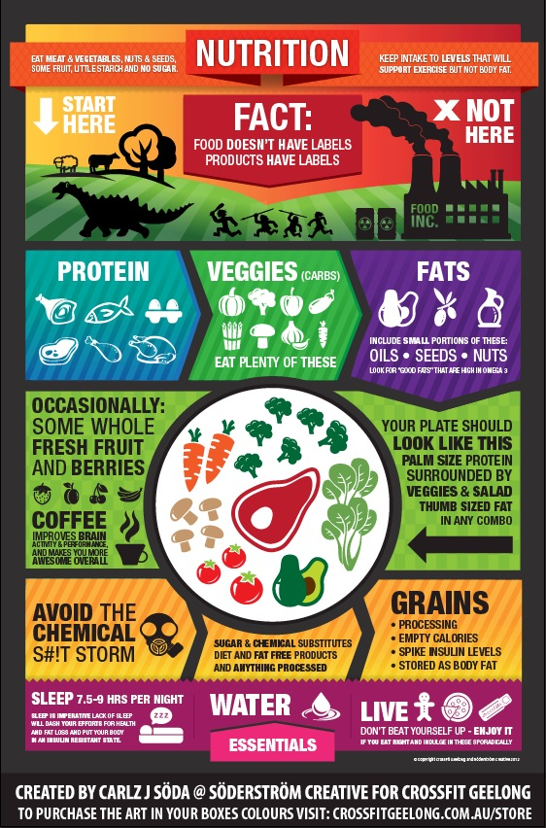

Slide 4
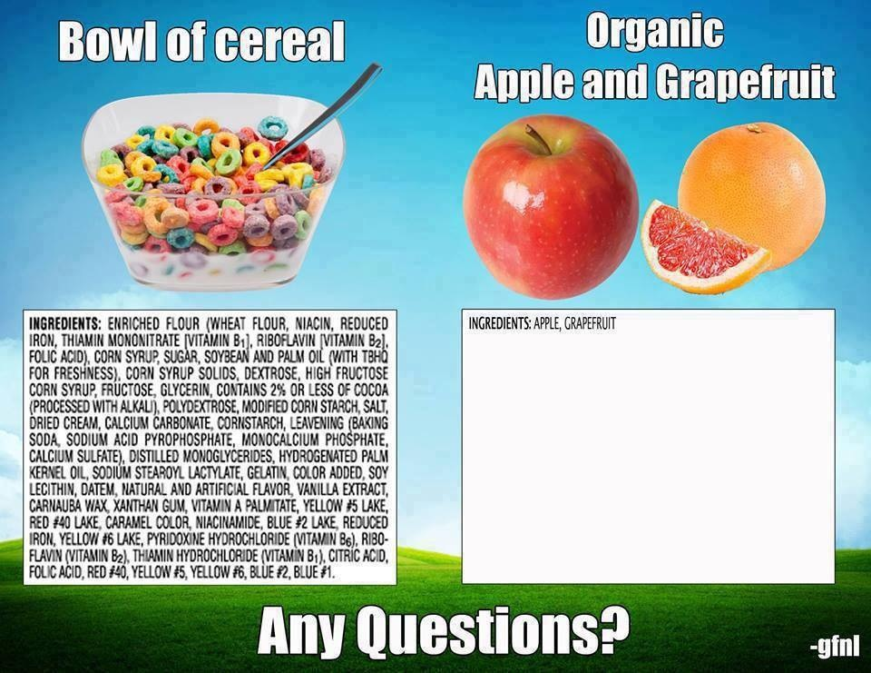

Slide 5
Importance of Nutrition
Calorie- unit of heat used to measure the energy your body uses and the energy it receives from food.
3500 Calories= 1 pound of fat

Slide 6
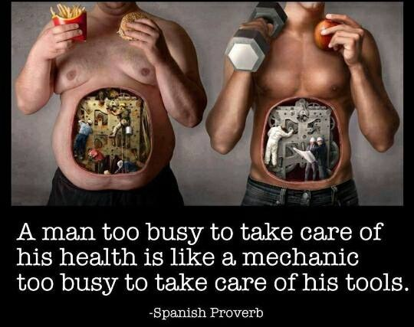

Slide 7
Carbohydrates (4 kcals/gram)
Plant based foods
Sugars
Starches
  Breads
  Potatoes
Fiber
Source of energy
  Used immediately
  Stored
Better Choices
  Whole grains
    Breads
      Pasta
  Beans
  Fiber rich vegetables
  Dairy
Limited
  Added sugars
  Refined grains
  Stay away from white!

Slide 8
Protein (4 kcals/gram)
Made up of amino acids
Help body repair cells
Make new cells
Growth and development
  Muscles
  Hair and nails
  Immunity
  Carry oxygen in blood
RDA
  40-50 grams
  Can vary on age, gender, athlete
Examples
  Tuna
  Meat
  Poultry
  Beans
  Nuts/seeds
Vegetarian
  Beans
  Whole grains
  Soy products

Slide 9
Fats (9 kcals/gram)
Essential
  Physiologic functioning
  Stored
    Heart
    Liver
    Kidneys
    Muscle
Hold organs/nerves in position
Protect against traumatic injury/shock
Protect against mechanical pressure
Insulate
  Body temp
Digestion, absorption, and transport
  Vitamins
  Phytochemicals
Slows digestion
Texture
Immunity
12% essential body fat/females
Ideal- 21-33%

Slide 10
Good vs Bad Fat
Good
Not As Good
Unsaturated
Lower cholesterol
Keeps body healthy
  Nuts
  Seeds
  Some vegetables
  Oils
Saturated
  Increase cholesterol
    Meats
    Junk food
    Potato chips
    Cookies
Increase risk of Type 2 Diabetes, cardiovascular disease, stroke
VERY BAD!
  Trans Fat
    Man made
    Increases shelf life
    Add texture
    Raise cholesterol
Notes:
Not as good, saturated, Bad for Trans fat,

Slide 11
Vitamins & Minerals
Vitamins- compounds found in food that help regulate many body processes
Minerals- elements found in food that are used by the body
Vitamins, minerals, and water do not provide energy, but perform a wide variety of body functions.

Slide 12
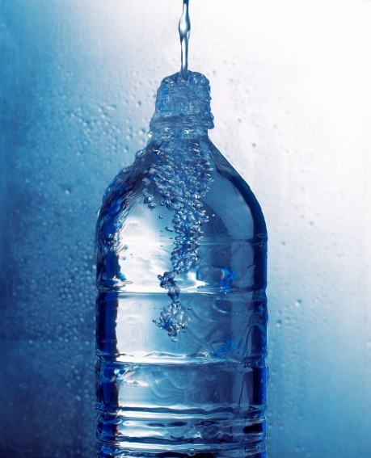
Water
Water is essential for most body functions. All of the body cells contain water!
Functions of Water include:
  Moving food through digestive system
  Transporting nutrients and removing waste
  Cooling the body through perspiration
  Cushioning the eyes, brain & spinal cord
  Lubricating the joints

Slide 13
Healthy Food Guidelines

Slide 14
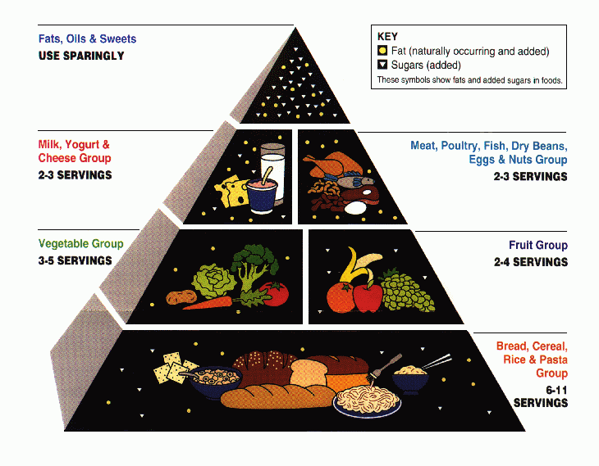
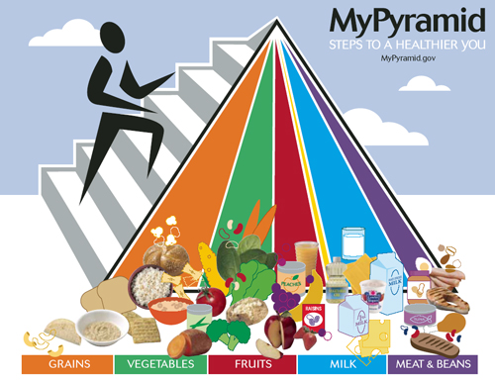
Food Pyramid vs MyPyramid

Slide 15
MyPyramid vs. Food Pyramid
Fruits
  2 cups
Dairy
  3 cups
Protein
  5.5 ounces
6 tsp oil
< 260 discretionary calories
  Calories left over after meeting nutrient requirements
* Based on 13 yr old with average weight and height and exercise 30-60 minutes/day
MyPyramid
National reference for dietary intake
13 yr old
  Approximately
    2000 calories/day *
  Grains: 6 oz.
    Aim for 3oz whole grains
  Vegetables
    2.5 cups
    Consume a wide variety

Slide 16
MyPyramid and MyPlate
1992 – Food Pyramid
  Graphical image of the USDA’s guidelines
  Confusing serving size
MyPlate gives visual idea of the 2010 dietary guidelines
  Proportions
  Split into multiple sections
Half of the plate
  Vegetables and fruit
Smaller portion
  Whole grains
  Lean protein
    Fish
    Skinless poultry
Circular shape
  Reminder non-fat/low fat dairy foods

Slide 17
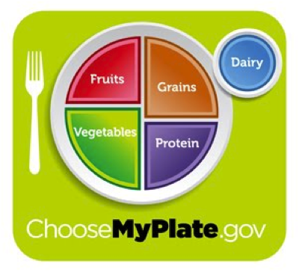
MyPlate

Slide 18
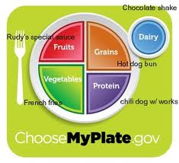
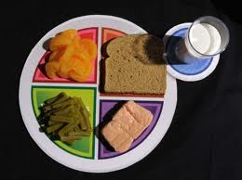
Realistic Plate Example

Slide 19
MyPlate
Important points
  Balancing calories
    Physical activity
    Enjoy food, but eat less
      Hunger and fullness cues
    Avoid over sized portion
      Smaller dishes/glasses
  Increase
    Vegetables
    Fruits
    Whole grains
    Fat free or 1% dairy products
    Choose red, orange, dark green vegetables
      Tomatoes, sweet potatoes, broccoli
    Add fruits as main dish or dessert
    More whole grains instead or refined
  Reduce
    High in solid fats
    Added sugars
    Salt
  Drink water!

Slide 20
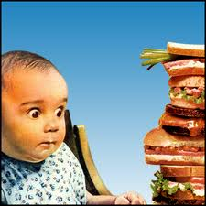
Over the Years…
Portion sizes of everything have grown majorly
1970’s
  47% Americans were overweight/obese
Now
  68% are overweight/obese
Increase sizes
  Higher calories
  Eat more
  Distort perceptions of appropriate food quantities
Sedentary lifestyles

Slide 21
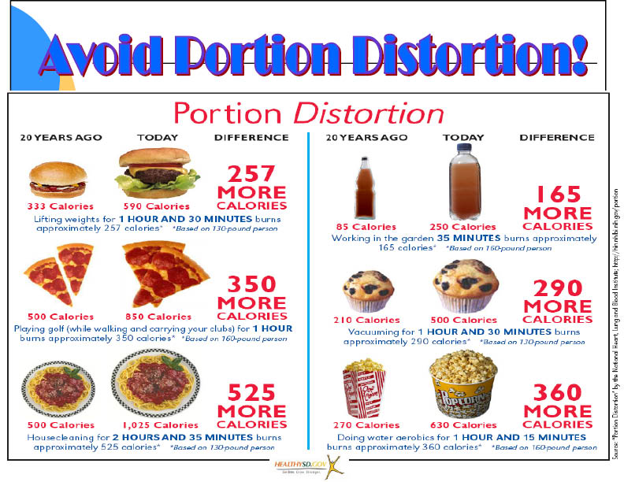

Slide 22
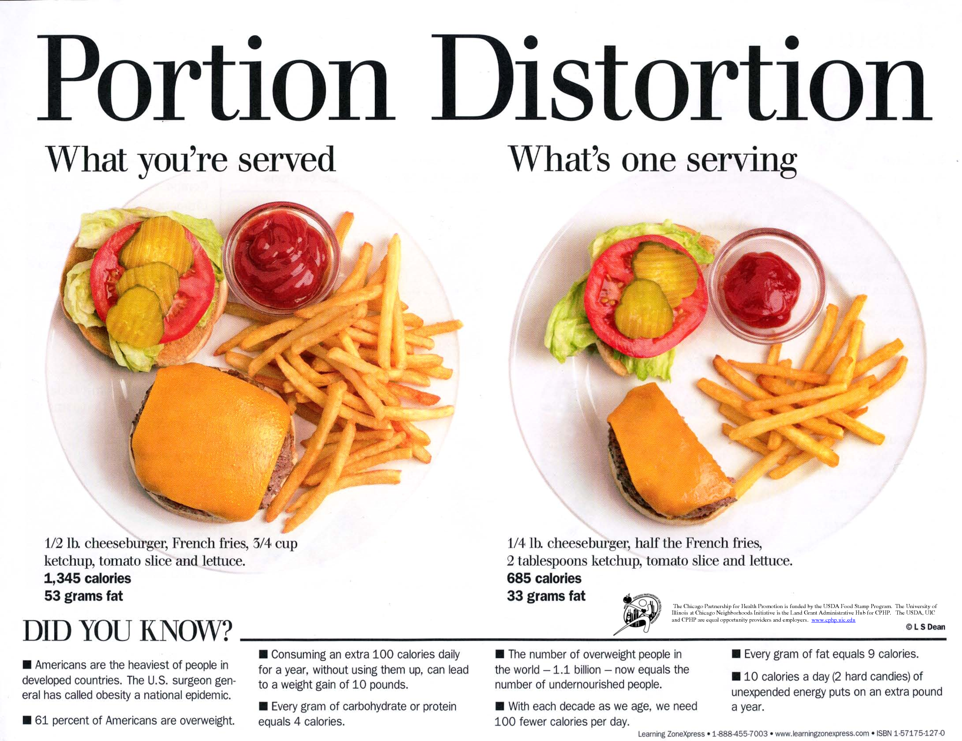

Slide 23
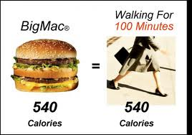
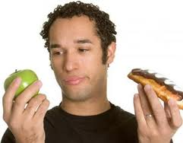
Calories in = Calories Out
WORK WORK WORK!
Donut = more exercise

Slide 24
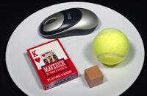
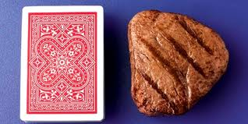
How do you know correct portion sizes?
Think of common objects
Baked potato
  Computer mouse
Meat
  Deck of cards
Rice
  Tennis ball
Cheese
  1-inch dice

Slide 25
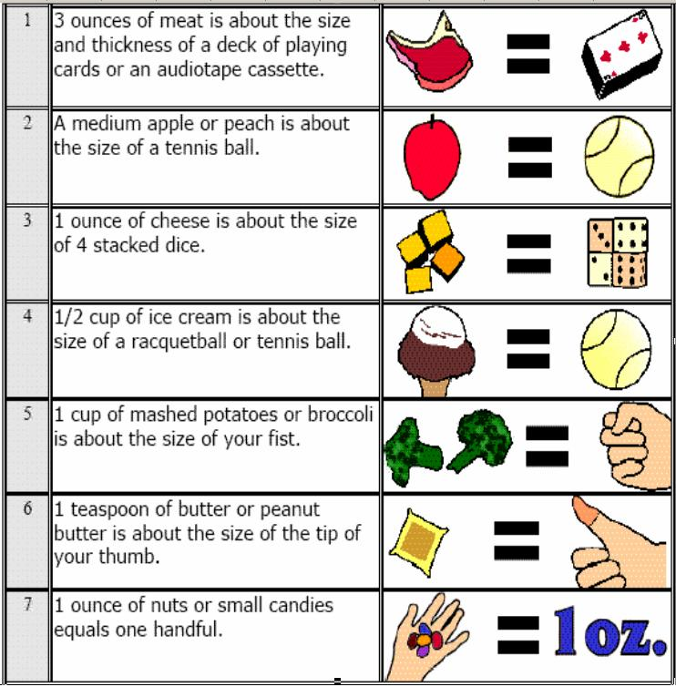

Slide 26
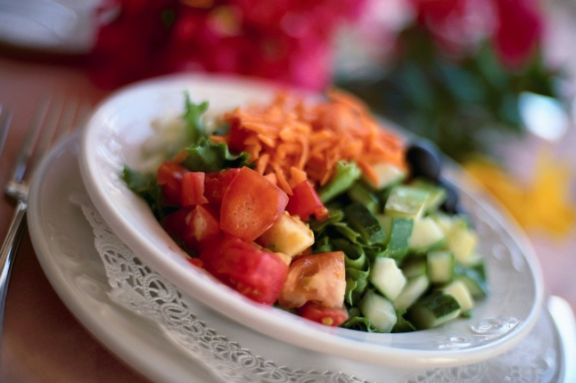
Tips on Eating Out
Smaller portions
  Take half plate home
  Split with friend
Substitute High Fat for healthy
  Salad, baked potato, steamed vegetable
Low Fat
  Avoid breaded, batter-dipped, fried foods
  Try grilled, broiled, roasted, or flamed
  Avoid creamier sauces and toppings
  Don’t drink your calories!

Slide 27
Healthy Snacks for Teens
Pudding made with skim milk
Glass of skim milk
  Teaspoonful of chocolate or strawberry syrup
Apples with Peanut Butter
Air popped popcorn
Peeled and sectioned oranges
Hummus and pita bread
Mozzarella or string cheese
Trail mix
Baby carrots
Whole grain crackers

Slide 28
Food Habits
Irregular Meals
Excessive snacking
Eating away from home
Dieting
Meal Skipping
Sleeping later
Try to lose weight
Busy lives
24% teen girls skip breakfast
Fast Food/ Convenience Foods
  Vending machines/school cafeterias
  Convenient stores
    Low in vitamins, minerals, fiber
    High in added fat, sweeteners, sodium
    Low in price
    Taste good
Notes:
Combine with 34, importance of having a regular eating schedule

Slide 29
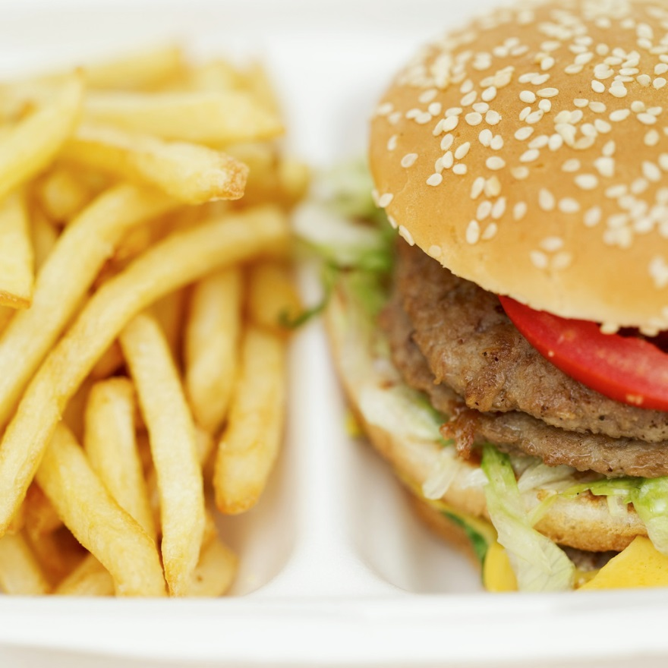
Tips for Teens
http://www.youtube.com/watch?v=vx0ZTy2SWfk

Slide 30
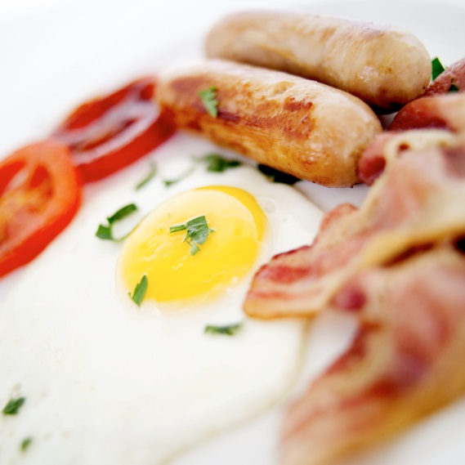
Starting the Day off Right!
Eat breakfast!
http://www.youtube.com/watch?v=WaKokCoU1Ro
  Teens that eat breakfast typically do better in school and are less likely to be overweight.
  Prepare the night before!

Slide 31
Create a Plate Diagram
Figure 10.11 page 271 shows an example of a plate diagram.
In a group of 3, Create a plate diagram for a healthful breakfast, lunch, and dinner.
Be sure to add different cultures in your plates as well as 1 vegan/vegetarian.
  Example: Pasta (Grain) = ?
  Rice (Grain) = ?

Slide 32
Nutrition Labels

Slide 33
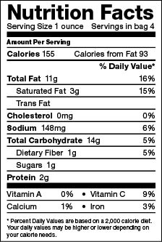
Food Labels
Required by law
  Total Calories
  Calories from Fat
  Total Fat
  Saturated Fat
  Trans Fat
  Cholesterol
  Sodium
  Carbohydrates
  Sugar
  Dietary Fiber
  Protein
  Vitamin A and C
  Calcium
  Iron

Slide 34
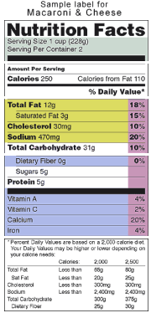
Food label
Nutrition Facts
  Serving size
  Calories
  Calories from Fat
Grams-Calories
  Fat- 9 kcal
  Protein- 4 kcal
  Carbohydrate- 4 kcal
Ingredient List
  Descending order regarding amount

Slide 35
Nutrition Facts
Percentages- Percent daily values in Pink
    How much for entire day
    Based on either 2000-2500 calories/day
Fat, Sugar, Sodium, Cholesterol
  In Mustard Yellow
Vitamins, Mineral, and other Info
  Blue
Try to eat less then 100% of Fat, saturated fat, sodium, cholesterol

Slide 36

Portion vs. Serving
Portion
Serving
A portion is the amount of food that you choose to eat for a meal or snack. It can be big or small—you decide.
A serving is a measured amount of food or drink, such as one slice of bread or one cup (eight ounces) of milk
  For example
    Can of soda
      One portion
      2 ½ servings
http://www.youtube.com/watch?v=7yQmXWuH10g

Slide 37
How companies might deceive
you on a food label:
Unrealistic serving size - Many Chips
Servings per container - Muffin, Cheetos
Packaging- pop tart- 2 in one PACKAGE
Listing an amount and then having a “ * ”
- Mac n’ Cheese
see examples
on next slides…

Slide 38
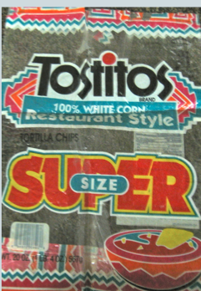
Label Deception-Serving Size:
Servings Size: 6 chips
Servings per Container: 20
Calories: 130 (x20)
Total Fat: 6 grams (x20)

Slide 39
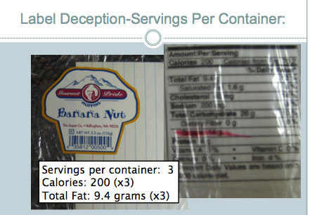

Slide 40
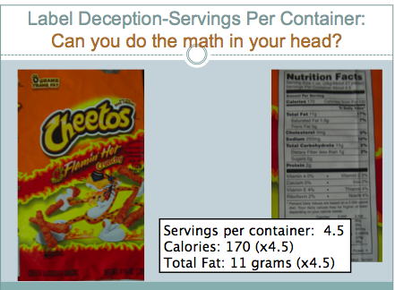

Slide 41
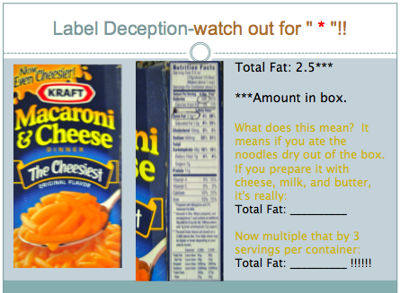

Slide 42


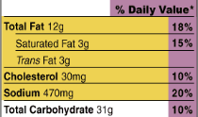
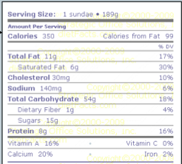
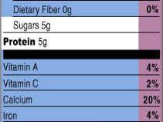

#3 If there is more than 1
Serving per container
Total Fat x 2 = _______
Sugars x 2 = ______
Notes:
42

Slide 43
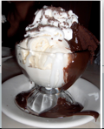
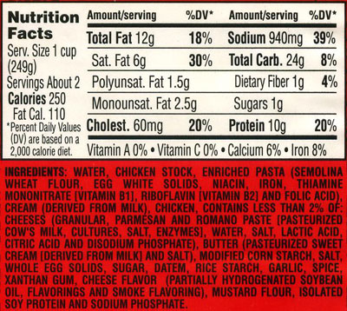
#4
Total Fat?
Saturated fat?
Trans fat?
Notes:
43

Slide 44
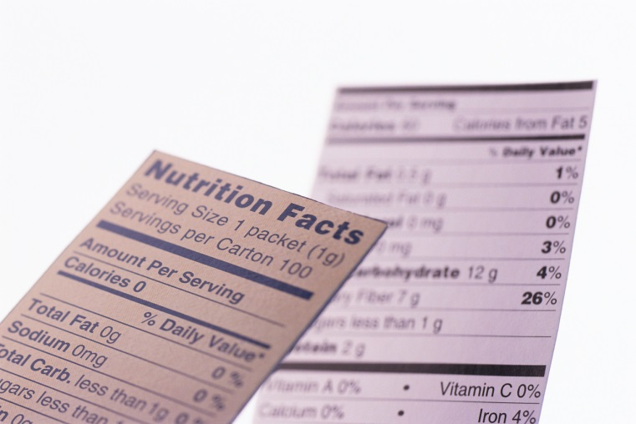
Nutrition Label Search
Start with one Nutrition Label from the class set. Fill out your worksheet for Product #1.
Put your product up on the front table and do the same for products #2-#4.

Slide 45
Comparison
Use the Application “Nutrient Facts” and look up basic things you commonly eat. Be prepared to share something you were surprised to find.
Using your BYOT or laptop, search two different products that you usually eat or that you have once had. Pick one that you think is healthy, and pick one that you think is not healthy (same product, two versions)…. THEN really find out the truth!

Slide 46
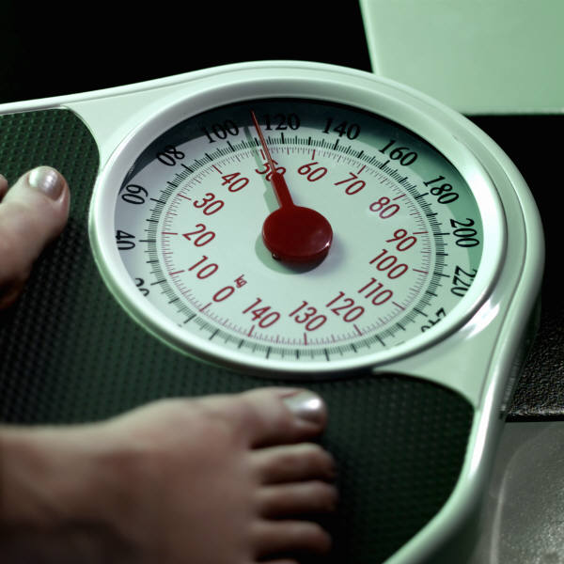
BMI
Body Mass Index (BMI) compares a persons’ weight and height to determine the individual’s overall height/weight ratio.

Slide 47
BMI Height Conversion Table & Online Calculator
http://www.unitarium.com/blog/articles/human-height-conversion-table
http://www.cdc.gov/healthyweight/assessing/bmi/adult_bmi/english_bmi_calculator/bmi_calculator.html

Slide 48
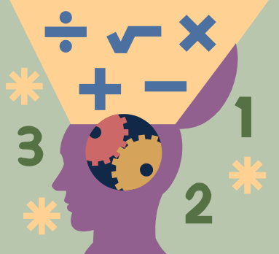
BMI Caluculations
Weight in pounds multiplied by 703 divided by height in inches divided by height in inches.
Example:
210 lbs x 703 / 72 / 72 = 28.4
Figure out you own BMI and show your work!

Slide 49

BMI Chart
Underweight = less than 18.5%
Normal weight = 18.5-24.9%
Overweight = 25-29.9%
Obese = 30% or greater

Slide 50

BMI Questions
Underweight = less than 18.5%
Normal weight = 18.5-24.9%
Overweight = 25-29.9%
Obese = 30% or greater
1) What are you considered based on your BMI? Look at the chart.
2) Does your BMI mean that you are healthy or unhealthy and why?
3) Is it possible to have a BMI of 25-29.9 and still have a high level of fitness? Explain your answer.
4) What steps can you take to lower/raise or maintain your BMI? Explain.
5) What would you guess the average American BMI is? Explain why you feel this way.

Slide 51
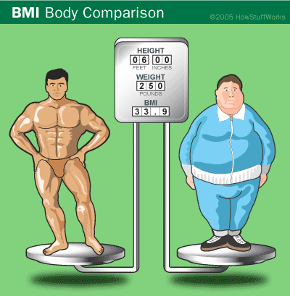
It's important to note that although BMI is accurate most of the time, it may overestimate or underestimate body fat. For example, BMI doesn't distinguish between body fat and muscle mass, which weighs more than fat. Many NFL players have been labeled "obese" because of their high BMI, when they actually have a low percentage of body fat.

Slide 52


Vegetarian and Vegan Diets

Slide 53
What is a Vegetarian diet?
There are four types of vegetarian diets:
  Vegan or total vegetarian- diet includes only foods from plants: fruits, vegetables, legumes (dried beans and peas), grains, seeds and nuts
  Lacto vegetarian- diet includes plant foods and dairy foods
  Ovo-lactovegetarian- diet includes foods from plants, dairy and eggs
  Semi-vegetarians- diet does not include red meat but include chicken and fish with plant foods, dairy products and eggs

Slide 54
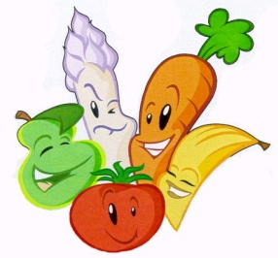
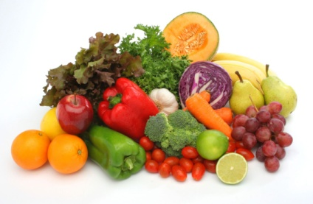
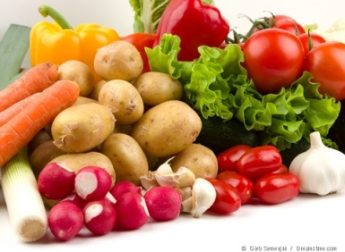
Are vegetarian diets healthy?
Vegetarian diets can be healthy if they’re carefully planned to include essential nutrients
Many studies have shown that vegetarians seem to have a lower risk of obesity, heart attacks, high blood pressure, diabetes mellitus and some forms of cancer

Slide 55
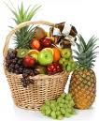
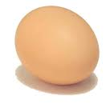
Why do people become Vegetarians?
They have serious ethical problems eating meat.
Dietary reasons- They believe it’s very high in cholesterol.
Slaughtering chickens and other animals seem unacceptable to vegetarians.
They complain consumption of meat causes farmers to deforest land, so they have more room for their cattle.

Slide 56
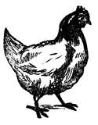
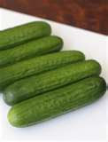
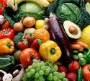
Why do people become Vegans?
Animal rights is one reason people become vegan.
Many people have been able to lose a lot of weight by becoming vegan.
People with diabetes are able to eliminate or control their diabetes by becoming vegan.
By becoming vegan you are lowering the demand for livestock which protects animal rights.

Slide 57

What are Vegans?
Vegans, are basically vegetarians, except they don’t use anything from animals. For example, they don’t eat any sort of meat, beef, or poultry. They don’t use any other animal products such as wool, fur, and all other things from animals.
People become vegans for different reasons. Some people do it, because it is healthy. Other’s do it for environmental, or ethical reasons. People think that it will make a more peaceful and humane world.

Slide 58


What foods could/should a vegan eat?
While vegans don’t eat any animal products, they do eat a wide variety of foods to make up for the nutrients they don’t get from the foods they don’t eat. Some examples are oatmeal, cereal, and orange juice.
Some suggested foods vegans should eat when going out, are Chinese moo shu vegetables, pizza without cheese, and lentil (bean) stew.

Slide 59
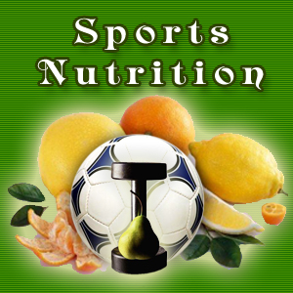
Nutrition for Athletes

Slide 60
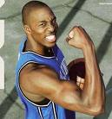

What is Sports Nutrition?
The study and practice of nutrition and diet as it relates to athletic performance.
It is concerned with the type and quantity of fluid and food taken by an athlete
It deals with nutrients such as vitamins, minerals, supplements and organic substances such as carbohydrates, proteins and fats.

Slide 61
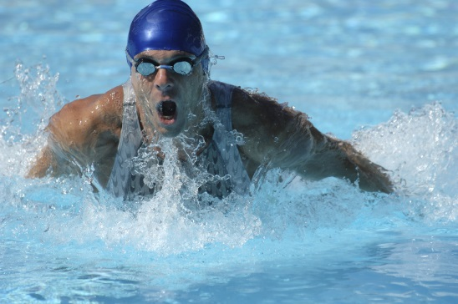
Nutrition For Athletes
Eating right affects an athlete’s performance!
Teen athletes need a total of 2,000-4,000 calories depending on their sport and on the intensity, length and frequency of their training.
http://www.youtube.com/watch?v=fUO1ClTWpwc

Slide 62



The History of Sports Nutrition
Evolution of Gatorade (sports drink) in 1960’s by 4 physicians at the University of Florida to help the football team (the Gators) stay energized during the game.
Sports Nutrition research started in 1960’s at Ball State University under direction of Dr. David Costill

Slide 63
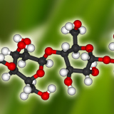
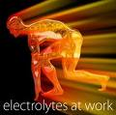
What are Carbohydrates and Electrolytes?
Carbohydrates are any compound of carbon, hydrogen, and oxygen. We need these while we play sports so our body can stay fueled so we can keep participating.
Electrolytes are any ions that in a biological fluid that regulate our metabolic processes. When we exercise we lose electrolytes. A drink like Gatorade will refuel your electrolytes.

Slide 64

What are Some Examples of
Sports Nutrition?
Foods high in proteins like meats
When you are exercising, drinks with carbohydrates and lots of WATER
Some examples of drinks with carbohydrates are:
  GATORADE(University of Florida), POWERADE
Minerals can fuel the body while exercising
Vitamins are good for replenishing the body

Slide 65
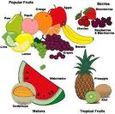
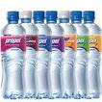
Eating/Drinking Before,
During, and After Exercise
Before ( 1-2 hours)- fruits, carbohydrates in a liquid, bagel, cereal, electrolytes, carbohydrates- digest quickly. Lots of WATER.
During- drinks that have carbohydrate concentration if feeling low on fuel combined with WATER every 15 minutes.
After- Meal with protein, carbs and a little good fat.

Slide 66

Consequences of Poor Sports Nutrition
Strength Loss
Fatigue
Drop in performance
Body soreness
Respiratory infections

Slide 67

Hydration/Dehydration
Teen girls need 9 cups of non-caffeinated fluids each day. Teen boys need 13 cups.
When you sweat, you lose fluid. This must be replaced or will result in dehydration.
    Dehydration can lead to fatigue, dizziness, light-headedness and cramping. It can cause an imbalance in electrolytes.

Slide 68

Myths & Truths About Vegetarianism
http://www.youtube.com/watch?v=nclHgRDRsUY

Slide 69
Managing Weight & Eating Behaviors

Slide 70

The Calorie Connection
Calories- units used to measure the energy found in your food.
  If you use more calories than you take in, you LOSE weight.
  If you consume more than your body needs, you GAIN weight.

Slide 71
The Energy Balance
Metabolism- the process by which the body breaks down substances and gets energy from food.
Review- 3500 Calories=1 pound of fat.
    To lose one pound for week, consume 500 fewer calories each day.

Slide 72

Your Weight & Your Health- Weighing Too Much
More than 13% of teens in the United States are overweight
Obese- having an excess of body fat
Weighing too much puts you at risk for
  Heart Disease
  Cancer
  Asthma
  Osteoarthritis
  Gallbladder Disease
  Type 2 Diabetes

Slide 73
Your Weight & Your Health- Weighing Too Little
Underweight- below the standard weight range for your height
  You may be underweight because of genetics or a fast metabolism.
  As a teen you are growing and your body may not be keeping up with the height yet, which is OK!
  As a teen your doctor is the best person to keep you in check if your weight is healthy or not.
  As an adult you may be more at risk for disease if you are underweight.

Slide 74

Healthy Ways to Lose Weight
Choose nutrient-dense foods. Fruit, vegetables and whole grains supply nutrients with fewer calories.
Watch portion sizes. Stick to recommended portion sizes for each major food group.
Eat fewer foods that are high in added fat and sugars.
Enjoy favorite foods in moderation.
Be active!
Tone your muscles. Muscle tissues take more calories to maintain that fat- which increases all day calorie burn.
Stay hydrated.

Slide 75

Healthy Ways to Gain Weight
Select foods from the five major food groups that are higher in calories. (Not more junk food, though high in calories!!!) Ex: Whole Milk instead of low-fat milk.
Choose higher-calorie, nutrient-rich foods. Ex: Nuts, dried fruits, cheese & avocados.
Eat nutritious snacks.
Get regular physical activity. This will make sure you gain muscle, not fat!

Slide 76



Fad Diets

Slide 77

So… What is a Fad Diet?
A fad diet is a weight loss diet
Makes unrealistic promises or claims
Fad diets are linked to eating disorders
This is usually a short-term fix

Slide 78


Examples of Fad Diets
Acai Berry Diet- Has been extremely popular since promoted on the Oprah Show.
Atkins Diet- Written in the 1970’s but became popular in the last few years.
Low Fat Diet- Very popular between the 1980’s and 1990’s
http://www.youtube.com/watch?v=V9keK-_BJg4 (4:30)

Slide 79


Slide 80

5 Ways to Spot a Fad Diet
The diet is based on drastically cutting back calories.
The diet is based on taking special pills, powders, or herbs.
The diet tells you to eat only specific foods or foods in certain combinations.
The diet makes you completely cut out fat, sugar, or carbs
The diet requires you to skip meals or replace meals with special drinks or food bars.

Slide 81


Slide 82


Slide 83


Pros of Fad Diets
Although some fad diets may actually work (short-term), there is basically no pros about fad diets. Many don’t work or are too difficult to follow. They are not lifestyle changes, which is necessary to keep weight off for good.
Weight loss may occur but will it will quickly return after the person goes back to their typical eating patterns.

Slide 84



Cons of Fad Diets
Fad diets normally don’t work, and you just end up using your hard earned money
Studies show that most people end up gaining more weight than they lost after they stop following the fad diet
Many lead to an unbalanced diet that lack necessary nutrients
Some may actually lead to diseases like heart attacks, high blood pressure, and other body disorders later on

Slide 85


Who is Prone to Fad Diets?
Teens girls and women
Anyone linked to Eating Disorders
People who are desperate to lose weight
People looking for that “quick-fix” diet for an upcoming special event

Slide 86
The Truth About Fad Diets
Companies sponsoring fad diet products actually replace many of the fats with other fat-substitutes (AKA CHEMICALS)
Fad Diets do not always work.
People tend to see Fad Diets as the only option, versus a healthy lifestyle change.
Fad Diets are unhealthy.

Slide 87


Slide 88


How to Avoid Fad Diets
Conduct research about the diet in question
Stay away from diet plans that show signs of fad diets and make unrealistic claims
Create an eating & exercise plan versus a “diet” that fits into your lifestyle and that you can keep up with
Exercise and eat balanced each day so you won’t need them in the first place!

Slide 89


Slide 90

Eating Disorders

Slide 91

What is an Eating Disorder?
A psychological disease of the body in which someone obsesses over his/her intake of food as a way of gaining some control in his/her life.
There are many forms of eating disorders.
Approximately 8-10 million people today suffer from some form of an eating disorder.
Eating disorders are common among women, but some men also suffer from eating disorders.

Slide 92

Inside the Mind of Someone with an Eating Disorder
“I'm fat. I'm too skinny. I'd be happy if I were taller, shorter, had curly hair, straight hair, a smaller nose, bigger muscles, longer legs.”

Slide 93
The Media & Body Image
Many teens are influenced by the media because they see stars and how “perfect” that they look.
The truth is, many stars struggle with eating disorders because it effects their livelihood.
Demi Lovato’s Experience:
http://www.youtube.com/watch?v=vCTXV15mKQ4

Slide 94

Anorexia Nervosa
What it is
Signs & Symptoms
  An eating disorder in which a person either eats very little or nothing at all. The person becomes very sick and on average, is 15% below the normal body weight.
  With Anorexia, the person many times does not realize what they actually look like because their reflection is different than what they actually see.
Thin appearance/extreme weight loss
Fatigue/dizziness or fainting
Seizures
Brittle nails/ hair that thins, breaks or falls out
Absence of period(amenorrhea)
Constipation
Dry skin
Intolerance of cold
Irregular heart rhythms
Low blood pressure
Dehydration

Slide 95

Anorexia Nervosa
Warning Signs
Possible Causes
refusal to eat
denial of hunger, even when starving
difficulty concentrating
obsession with body size and shape
skipping meals
making excuses for not eating
eating only a few certain foods considered safe, usually those low in fat and calories
adopting meal or eating rituals, such as cutting food into tiny pieces or spitting food out after chewing
cooking elaborate meals for others but refusing to eat
Low self-esteem, which may stem from unresolved experiences of neglect or abuse during childhood
Obsessive or compulsive personality traits, which make it easier to adhere to strict diets and resist hunger
Perfectionism, when centered on the body leads to thought distortions such as "I'm never thin enough."
Low levels of serotonin, one of the brain chemicals involved in depression

Slide 96


Bulimia Nervosa
What it is
Signs & Symptoms
An eating disorder in which the person typically binge eats and then purges what they have just eaten. Binge eating is when you consume uncomfortable amounts of food, often leaving you feeling sick. Many people purge by vomiting the food they just consumed.
Many times this person may seem like they eat “normally” but then quickly excuse themselves to the restroom.
Purging or Exercise Bulimia***
Habitually going to the bathroom immediately after eating or during meals
Damaged teeth and gums
Swollen salivary glands in the cheeks (chipmunk cheeks)
Persistent sores in the throat and mouth
Sores, scars or calluses on the knuckles or hands caused by self-induced vomiting
Scratchy or raspy voice quality
Misuse of ipecac syrup to induce vomiting

Slide 97


Bulimia Nervosa
Warning Signs
Possible Causes
Eating much more food in a binge episode than in a normal meal or snack
Feeling that eating can't be controlled once a binge begins
Hiding or hoarding food
Making excuses for missing food, or money taken to pay for binge foods
Eating until the point of physical discomfort or pain
Depression
Anxiety
Social isolation
Having a distorted, excessively negative body image
Preoccupation body shape and weight

Slide 98

Binge Eating
What it is
Signs & Symptoms
This eating disorder doesn’t involve fasting, and actually causes the person to do the opposite. When you binge eat, you consume a large amount of food. Most people with this disorder become obese and have a history of depression.
This is also called compulsive overeating
Inability to stop eating or control what you’re eating
Rapidly eating large amounts of food
Eating even when you're full
Hiding or stockpiling food to eat later in secret
Eating normally around others, but gorging when you’re alone
Eating continuously throughout the day, with no planned mealtimes

Slide 99

Binge Eating
Warning Signs
Possible Causes
Feeling stress or tension that is only relieved by eating
Embarrassment over how much you’re eating
Feeling numb while bingeing—like you’re not really there or you’re on auto-pilot.
Never feeling satisfied, no matter how much you eat
Feeling guilty, disgusted, or depressed after overeating
Desperation to control weight and eating habits
Biological abnormalities
Social pressure to be thin
Depression
Eating as an emotional response
Stress

Slide 100

Impact?
Eating disorders are very common
1-2 out of 100 students struggle
Each year thousands develop:
    Eating disorders
    Problems with weight, eating or body image
  ***More than just a diet to lose weight or exercising daily

Slide 101

What Causes Eating Disorders in Teens?
Emotional and physical changes
Academic pressures
Greater degree of peer pressure
Both boys and girls
  1 in 5 teens with eating disorders are boys
Anxiety
Depression
Trauma
Societal pressures
Genetics
The Media

Slide 102

How Can you Prevent Eating Disorders?
Regarding Weight:
Don’t measure your worth by a number on a scale and aim for a healthy, realistic weight for your body type.
Regarding Exercise:
Exercise regularly to stay healthy and choose activities that you can truly enjoy.
Regarding Food:
Eat healthy, balanced meals and snacks when needed. Also, eat sweet treats in moderation. Make sure to read food labels to check size portions as an occasional reference.

Slide 103

How do Eating Disorders
Affect People?
Eating disorders damage vital body functions and causes the body to lose nutrients it needs-which may lead to organ failure.
They cause dramatic weight fluctuations.
They cause a person to have negative thoughts and feelings about themselves.
They lower a person’s self-esteem.

Slide 104

How Can You Help a Person With an Eating Disorder?
Professional treatment- Doctors, therapists and nutritionists can help talk to the victim and provide help.
Boost their self-esteem! Remind them that they are human and we all make mistakes and will never be perfect.
Be aware- Teach others about the risks and threats of having an eating disorder, and how to act if you see or know someone with an eating disorder.
Many times people have eating disorders, because of a fear of not being able to fit in. Let the victim know that they can talk to you and be around you comfortably.

Slide 105

Getting HELP!
Reach out
  Teacher
  School nurse/counselor
  Coach
  Neighbor
  Doctor
  Family member
  Friend
  Trusted Adult
Online Sites
  Free sources
Learn to be comfortable at your weight
To unlearn and relearn behaviors takes time
Be patient!

