Slide 1
Unit One
What is Health and what does it mean to you?

Slide 2
Chapter 1, Part 1
Understanding Health and Wellness

Slide 3
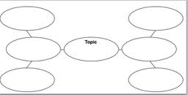
What does Health mean to you??? What makes you “healthy?”
Put the word HEALTH in the middle of a cluster chart. What makes up the general term “health?”
Think, Pair, Share with a neighbor.

Slide 4
What is Health?
Health is….
http://www.youtube.com/watch?v=KrTma9vJAc0

Slide 5
The Health Triangle
HEALTH is the combination of:
  Physical Health
  Mental/Emotional Health
  Social Health

Slide 6
A Partnership: Health & Health Education
http://www.youtube.com/watch?v=HgEWLUH2ZoE

Slide 7
Think with your neighbor about decisions you make every day that affect your health triangle.
What choices do you make? What are things that can improve your triangle? Be ready to share your answers.

Slide 8
Decisions that could alter your Health Triangle examples:
Deciding to eat breakfast this morning or not.
Going to visit your grandma on Saturday instead of watching TV.
Attending church with your family.
Turning down a beer on Saturday night.
Choosing a salad with grilled chicken instead of a burger and fries at Applebee’s last night.

Slide 9


If you do the following…..
You are on your way to a healthy triangle!!!

Slide 10
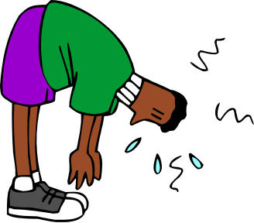
Physical Health- How your body functions!
Get 8 hours of sleep each night!
Eat nutritious meals and drink 8 cups of water each day.
Be physically active 30-60 minutes each day.
Avoid the use of tobacco, alcohol and drugs!
Bathe daily, brush and floss every day!

Slide 11
Mental/Emotional Health-Feelings and Thoughts
You enjoy challenges that help you grow as a person!
You accept responsibility for your actions!
You have a sense of control over your life.
You can express emotions in appropriate ways.
You usually can deal with life’s stresses and frustrations.
You generally are a positive person.
You make thoughtful and responsible decisions.

Slide 12
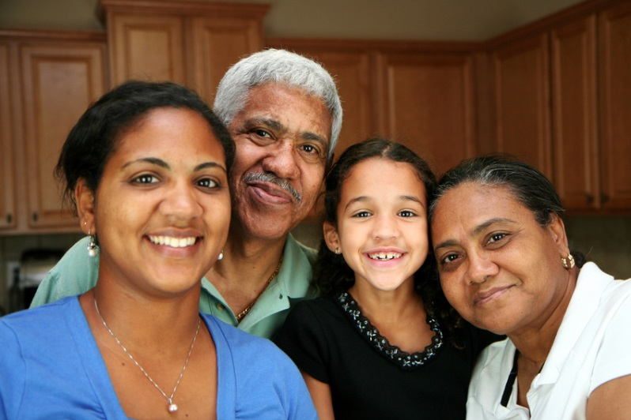
Social Health- Getting along with others.
You seek and also lend support when needed.
You communicate clearly and listen to others.
You show respect for yourself and others.

Slide 13
Keeping a Balance
Read “Keeping a Balance” (about 4 paragraphs) on Page 9 to yourself.
What do you think about “Keeping the Balance?” Do you think any part of the triangle is more important?

Slide 14

Classwork
Independently, complete:
  Questions 1-5 on Page 10
  Questions 1-11 on Page 28.
Be ready to share your answers!

Slide 15
Chapter 1, Part 2
What Affects your Health?
Take control of what you can, work with what you cannot.

Slide 16
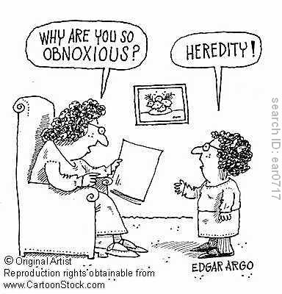
Heredity
All the traits that were BIOLOGICALLY passed on to you.
Includes what you look like, but also includes illnesses and disorders that your parents and grandparents have been dealing with.
Ask your family and get to know what you need to be aware of!

Slide 17

Environment
Environment is the sum of your surroundings.
  This includes both the physical places in which you live and the people who make up your world.

Slide 18

Environment
Physical Environment- You may not have much control of this right now!
  Includes:
    Neighborhood and School Safety
    Air and Water Quality
    Available Recreation, Parks & Libraries
    Access to Medical Care

Slide 19

Environment
  Social Environment – Includes everyone around you, including your family and peers.
    Your social environment can either hurt or help your healthful decisions! Choose your friends wisely.

Slide 20

Environment
Culture- The collective beliefs, customs, and behaviors of a group.
  Can include ethnic group, community, nation or a specific part of the world.
  http://www.youtube.com/watch?v=UTE0G9amZNk

Slide 21
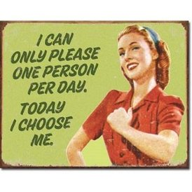
Attitude & Behaviors
Attitude- How you view it WILL have a big effect on your health!
Behaviors- You can’t choose your heredity, or maybe environment, but you can make healthy choices.

Slide 22
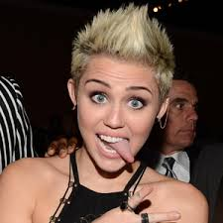
Media & Technology
We are influenced by Media (ways of communicating information) each day.
Sometimes, this can be positive achievements, sometimes negative.

Slide 23
You be the judge.
http://www.youtube.com/watch?v=FNXwKGZHmDc
http://www.youtube.com/watch?v=a1DCZ3dcbRM

Slide 24

Celebrities, Media Personalities and You
How do you think celebrities and media personalities can influence the behaviors of others, both positively and negatively?
Pick a specific media personality and examine how you think the actions of this specific person can influence the decisions and behaviors of teens. Write a paragraph and explain.

Slide 25
Classwork
Complete 1-4 on Page 15.
Complete 12-20 on Pages 28-29.
Be ready to hand in and/or share your answers!

Slide 26
Chapter 1, Part 3
Health Risks and Your Behavior/Promoting Health and Wellness
Your decisions matter!

Slide 27

What is a Risk Behavior?
Risk Behaviors- Actions that can potentially threaten your health or the health of others.
http://www.youtube.com/watch?v=ryojIh6Z3AU

Slide 28

CDC
(Center for Disease Control)
The Center for Disease Control has worked to identify reasons for teen death and health disabilities.
These reasons can contribute to other serious illnesses and/or early death.

Slide 29
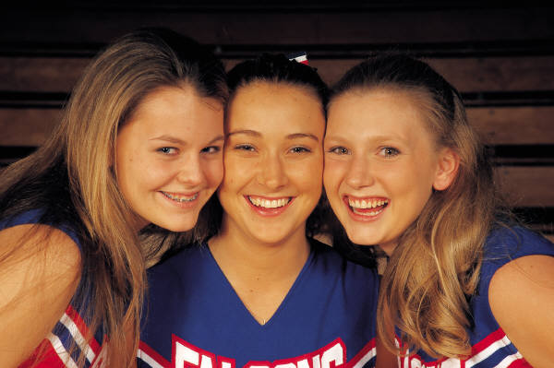
The 6 Risk Behaviors for Teens:
Tobacco use
Unhealthy dietary behaviors
Inadequate physical activity
Alcohol & drug use
Sexual behaviors
Behaviors that turn into injuries and violence. (Not wearing a seat belt, driving under the influence etc…)

Slide 30

Risk Short & Long Term Effects
Smoking
Immediate Effects
  Bad Breath
  Yellow Teeth
  Headaches
Smoking
Long-Term Effects
  Lung Cancer
  Emphysema
  Heart Disease

Slide 31
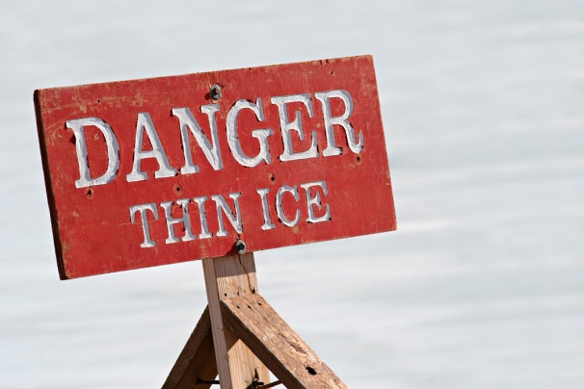
Cumulative Risks
Cumulative Risks- risks that increase in effect with each added risk.
Example: Eating a high fat and calorie meal occasionally is enjoying comfort food in moderation. Eating it every day can lead to weight gain and heart disease in the future.

Slide 32

Personal Health Responsibility
How does personal responsibility for health benefit society as a whole? Do you think a healthier society creates a better environment?
http://www.democratandchronicle.com/VideoNetwork/2241564528001/CVS-to-Start-Health-Incentive-Program

Slide 33
Real Life Examples:
Employers providing discounts on health insurance if you life a healthy lifestyle.
States drug testing in order for families to receive welfare.
Employers asking if you smoke and having you get a physical and adjusting your health insurance accordingly.
Car Insurance being raised for bad driving records/accidents/DWIs.

Slide 34

Personal Opinions
Do you think the government should provide incentives such as tax breaks for positive health decisions or disincentives (such as fines) for those who participate in risk behaviors?

Slide 35
Group Work
Join your assigned group. Develop a plan to promote personal and social responsibility for one specific health behavior related to teens.
Create a Poster with your slogan and plan advertised. Be sure to state the chosen topic as well as the hypothetical benefit given by the government.
Be ready to present to class!

Slide 36

Examples to Promote:
Sleep Habits
Spending time with Family
Eating Breakfast
Eating Nutritiously
Being Physically Active
Maintaining a Healthy Weight
Quitting Smoking/Tobacco Products
Abstaining from Alcohol/Drugs/Sex
Helping your friends say “NO”.

Slide 37
Classwork
Complete 21-35 & 38 on Page 29 & 30.
Complete 1-5 on Page 20.
Be ready to hand in and/or share your answers!

Slide 38
Chapter 2
Taking Charge of Your Health

Slide 39
Building Health Skills
Health Skills- specific tools and strategies to maintain, protect and improve all aspects of your health.
Also called Life Skills, because once you develop these, you will use them for life!

Slide 40

Communication
Communication- MORE than just talking!
Involves CAREFULLY choosing your words and expressions as well as your body language.

Slide 41
Group Work
Your friend borrowed your ______________ and returned it, but accidentally damaged it while they had it.
Develop a role-play and show how body language can be used to effectively convey emotions as a part of RESPECTFUL communication.
Be ready to share with class.

Slide 42
Refusal/Conflict Resolution
Refusal Skills- communication strategies that can help you say NO when urged to take part in behaviors that are unsafe or unhealthful, or go against your values.
Conflict Resolution- The process of ending a conflict through cooperation and problem solving. (could happen after refusing!)

Slide 43
Accessing/Analyzing
Accessing Information- How to find it!
  Health care professionals
  Valid internet sites
  Parents & trusted adults
  Published materials
Analyzing Influences- why do you do what you do?
  Includes personal values, beliefs, perceptions and fears. Family, media & technology, friends and your community influences.

Slide 44
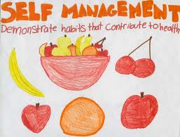
Self-Management & Advocacy
Self-Management- taking charge of your own health!
  You have the power to make good choices.
Advocacy- Taking action to influence others to address a health-related concern or support a health-related belief.
  You are learning, so share it!

Slide 45
Classwork
Complete 1-3 on Page 39.
Complete 1-7, 9&10 on Page 56.
Be prepared to turn in and/or share your answers!

Slide 46
Chapter 2, Part 2
Making Responsible Decisions and Setting Goals
Decision making will be there through adulthood.

Slide 47
Making Choices as a Teen…
Have you started to feel stress or pressure making decisions the older you get?
Relax, decision making is a skill that continues to develop into adulthood. You continue to develop these skills the better you understand yourself.

Slide 48
Values
Values- The ideas, beliefs, and attitudes about what is important that help guide the way you live.
Think to yourself: What do you value? Do you find that you surround yourself with people with similar values? Where did you learn your values and how are they shaped?

Slide 49
Decision Making
Decision-making skills help you make successful, responsible choices.
Your decisions have consequences, good and bad!
http://www.youtube.com/watch?v=Pu6hMgkuMTw

Slide 50
The Decision Making Process
Use the HELP Strategy:
  H (Healthful) Does this choice present any health risks?
  E (Ethical) Does this choice reflect what you value?
  L (Legal) Does this option violate any local, state, or federal laws?
  P (Parent Approval) Would your parents or guardians approve of this choice?

Slide 51
How to Make an Important Decision
State the Situation
  Example:
    I have a project due tomorrow in Earth Science which I have not even started. My friend calls me and her family got free tickets to the Panthers game tonight, VIP in a box seat. I’m a HUGE Panthers fan! Do I stay and work on my project or head to the game?

Slide 52
How to Make an Important Decision
List the Options:
  I stay home and work on my Earth Science project. My grade depends on this and I haven’t even looked at the rubric.
  I go to the game with my friend and think of a really good excuse to give my teacher tomorrow.

Slide 53
How to Make an Important Decision
Weigh the Possible Outcomes:
  If I stay home, I get my project done! I will now pass Earth Science easily!
  If I go to the Panthers game I get to see my favorite team play! I get free tickets! It could be the time of my life! But, I may have to re-take Earth Science all summer long.

Slide 54
How to Make an Important Decision
Consider Values:
  Do I really want to lie to my Science Teacher?
  Do I really want to lie to my parents that I don’t have any homework even though I do?
  Do I want to face the ramifications if I get caught by either person?

Slide 55
How to Make an Important Decision
Make a Decision and Act on it:
  I am going to turn down the tickets. Though I know it may be a once in a lifetime experience, I’d rather have fun all summer than have to take that class over.

Slide 56
How to Make an Important Decision
Evaluate the Decision:
  I am happy that I finished my project. I got a 95 on it, which pulled my grade up and made it so I passed with a 90! This improved my GPA, and I made High Honor Roll! For a reward, my parents got me tickets to see the Panthers play the Bills next week!

Slide 57

Goal Setting
How do you see yourself in the future?
What would you like to accomplish?
What are your hopes and dreams?

Slide 58
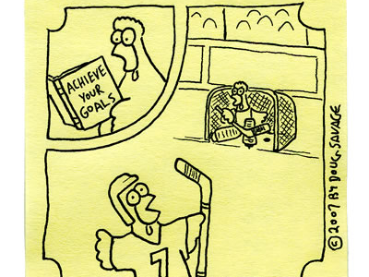
Goal Achievement
Is it that easy?

Slide 59
Types of Goals
Short-term
  Passing next week’s English test
  Eating healthy all day tomorrow
  Making it to the gym 3 times next week.
  Making a new friend in your youth group.
Long-term
  Being accepted to your #1 college choice.
  Running a 5K in March.
  Making the baseball team in the spring.
  Passing 9th grade.

Slide 60
Goal Setting
http://www.youtube.com/watch?v=g-jwWYX7Jlo

Slide 61
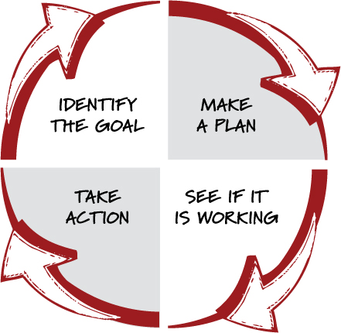
Setting Goals!

Slide 62
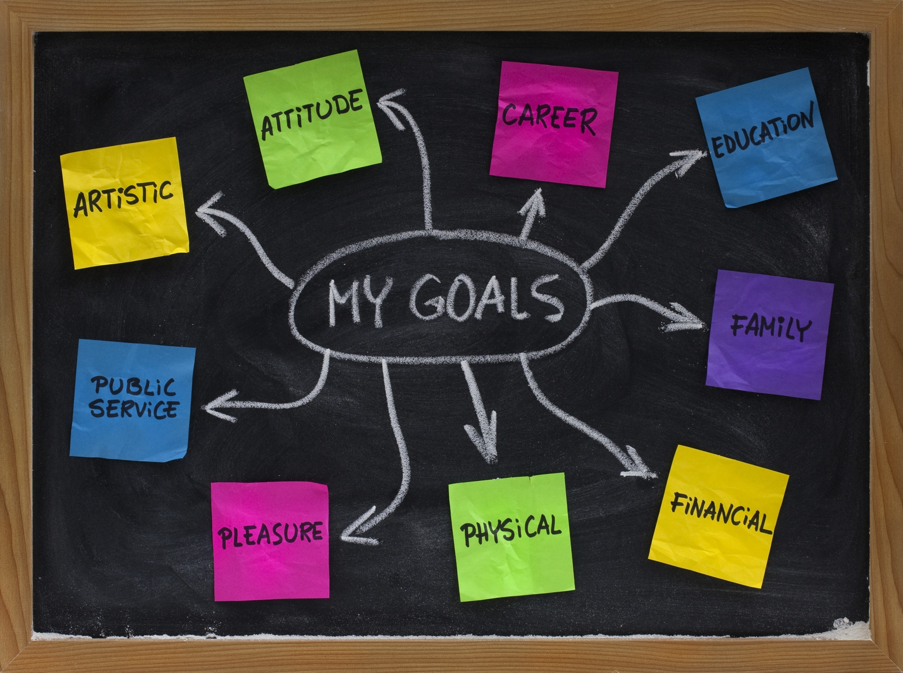
Goals……..
Goal idea categories

Slide 63
Developing an Action Plan (Page 44, Figure 2.10)
Select a specific goal and write it down.
List the steps you will take to reach your goal.
Identify sources of help and support.
Set a reasonable time frame for achieving your goal.
Evaluate your progress by establishing checkpoints.
Reward your progress by establishing checkpoints.

Slide 64
Example: My Goal- Making it to CrossFit Mid-Atlantic Regionals
Steps to make it to my goal:
  Work with Coach Dan 4x a week on my Olympic Lifting to improve my form.
  Continue to work on my METCON performance to keep my cardio up the days I do not work with Coach Dan.
  Have one day per week that I focus on gymnastic movements such as Muscle-Ups.
  Continue to work on perfecting my nutrition and to understand how my body works depending on the food I eat.

Slide 65
Example: My Goal- Making it to CrossFit Mid-Atlantic Regionals
Sources of Help and Support:
  My coaches, Dan & Frankie.
  My fiance, to help with nutrition at home.
  My fellow CrossFit friends for tips on specific movements I struggle with that they excel at.
  Myself, to keep myself accountable.

Slide 66
Example: My Goal- Making it to CrossFit Mid-Atlantic Regionals
My Timeframe:
I will make it to CrossFit Mid-Atlantic Regionals after competing in the CrossFit Open in April. I have to qualify in the open to make it Regionals, which happen in June.

Slide 67
Example: My Goal- Making it to CrossFit Mid-Atlantic Regionals
Evaluating my Progress:
  Increase my Clean & Jerk by 20 pounds by December 2013.
  Increase my Front Squat by 20 pounds by December 2013.
  Be able to do a Kipping Muscle-Up before the Open.
  PR my Benchmark WODs every time I get to do one.
  Be in the top 3 on the leaderboard everyday at my gym.

Slide 68
Example: My Goal- Making it to CrossFit Mid-Atlantic Regionals
Rewards:
  New Olympic Lifting shoes when I get to my Clean and Jerk and Front Squat Goals!
  Post a video of my Muscle-Up for my friends and family to see after obtaining it!
  Go to Sweet Frog for a treat after PRing my a benchmark WOD!

Slide 69
Classwork Goal Project
Using Page 44, Figure 2.10 as a reference, pick a Long-Term goal and develop an action plan.
This goal can be any goal you want, from any category!
Include EVERY in Figure 2.10!
You will be handing this in for a grade on completeness. Take your time, this is a PROJECT grade.

Slide 70
Classwork
Complete 1-3 on Page 45.
Complete 11-16 on Page 57.
Be prepared to share and/or hand in your work!

Slide 71
Chapter 2, Part 3
Being a Health-Literate Consumer/Managing Consumer Problems

Slide 72
Beating the Odds.
http://youtu.be/iFsusXdwUFs

