Slide 1
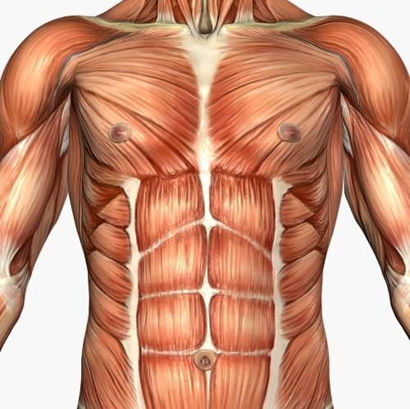
Chest & Abdomen Unit

Slide 2
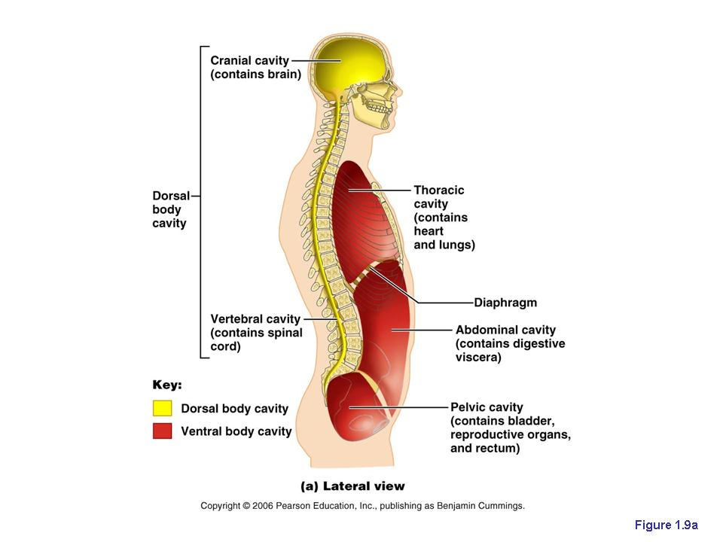
4 cavities
Cranial
Spinal
Thoracic
Abdomino-pelvic

Slide 3
Cavities (cont’d)
Cranial & Spinal – dorsal (posterior) cavities
Thoracic & Abdominopelivc – ventral (anterior) cavities
Diaphragm – divides ventral cavity into upper thoracic & lower abdominopelvic

Slide 4
THORACIC CAVITY
Central area – mediastinum: lies between the lungs and extends from sternum to vertebrae
Organs: esophagus, bronchi, lungs, trachea, thymus gland, heart
Pericardial cavity – contains heart
Thoracic cavity further divides into two pleural cavities for left and right lungs

Slide 5
Thoracic Cavity (cont’d)
Pleura – serous membrane protecting the lungs and lining the internal surface of thoracic cavity

Slide 6
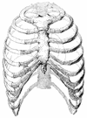
Thorax is supported by
  thoracic vertebrae
  Ribs
  sternum

Slide 7
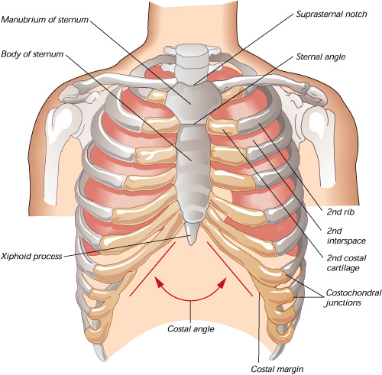
Sternum
Manubrium
Body
xyphoid process

Slide 8
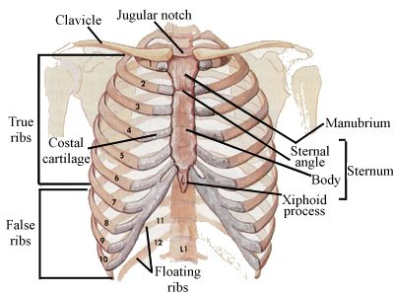
Ribs
true ribs – 7 pairs which connect directly to sternum
false ribs – 5 pairs
  3 pairs - the costal cartilage attaches to 7th rib
  Last 2 pairs – “floating” ribs

Slide 9
Respiratory System
Provides structures for exchange of O₂ & CO₂ in the body through respiration
Also responsible for sound

Slide 10
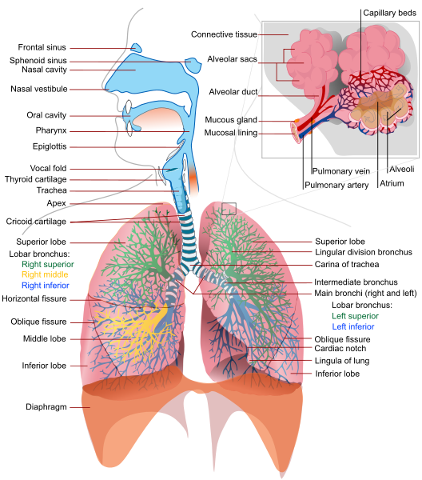

Slide 11
Nasal Cavity
Air enters nostrils which is divided by nasal septum
In nasal cavity there are 3 nasal conchae
Cilia – tiny lashlike processes of protoplasm; filters dust and dirt particles
Olfactory nerve – supplies nasal mucosa and provides sense of smell

Slide 12
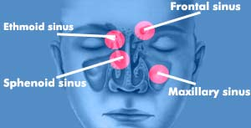
Sinus Cavities
recessed cavity of hollow space filled with air
Sinuses give resonance to voice
      Frontal – above eyes
      Ethmoidal – corners of eyes
      Sphenoidal – sides of nose
      Maxillary – above teeth

Slide 13
Pharynx
“throat”; common passageway for air and food; ~ 5”
3 sections
  Nasopharynx – above and behind soft palate; connects with each middle ear by the Eustachian tube
  Oropharynx – oral part of mouth; from soft palate to hyoid bone
  Laryngopharynx – above larynx

Slide 14
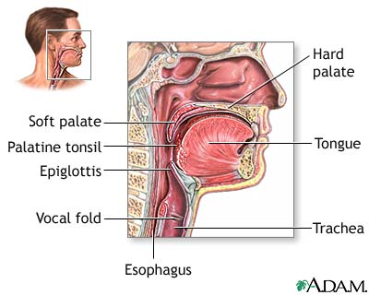
Epiglottis
elastic cartilage that prevents food from entering trachea

Slide 15
Larynx
Voice box
9 cartilaginous plates; largest is “Adam’s Apple”

Slide 16
Trachea
Windpipe – tubelike passageway ~ 4 ½“
Walls composed of C-shaped rings of hyaline cartilage; non-collapsible

Slide 17
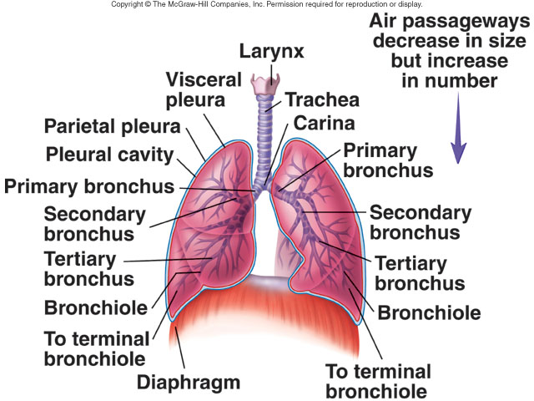
Bronchi & Bronchioles
Bronchi enter lungs and divide into bronchial tubes and smaller bronchioles; divisions are Y shaped

Slide 18
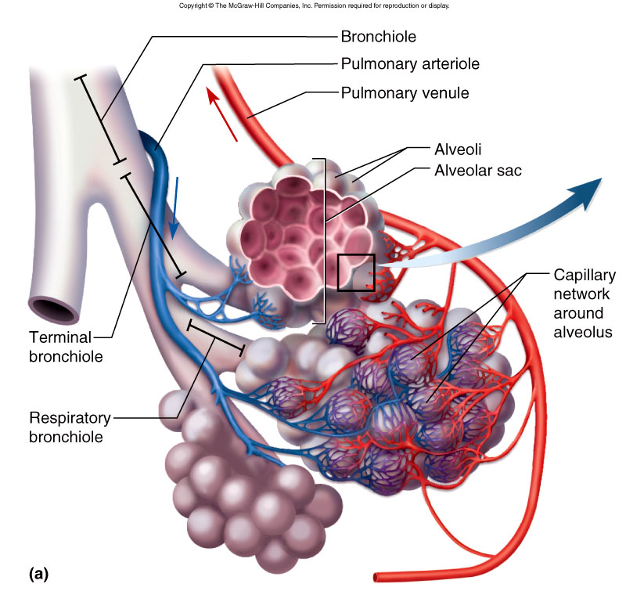
Alveoli
Air sacs
~ 500 million in the adult lung

Slide 19
Lungs
Large and cone shaped
Separated by mediastinum and heart
Apex – under collar bone
Right lung is larger and broader than left because heart inclines to the left
Right lung is shorter because of diaphragm’s upward displacement to accommodate liver

Slide 20
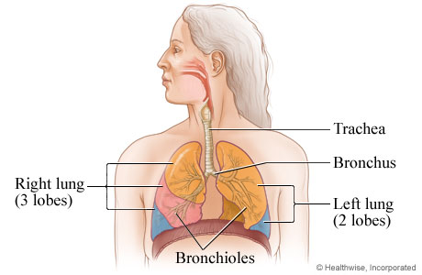
Lungs
Right lung = 3 lobes
Left lung = 2 lobes

Slide 21
Pleura
Thin, moist, slippery membrane covering lungs
Visceral pleura – lines lungs and between lobes
Parietal pleura – lines thoracic cavity and upper surface of diaphragm
Pleurisy – inflammation of the lining of the lungs

Slide 22
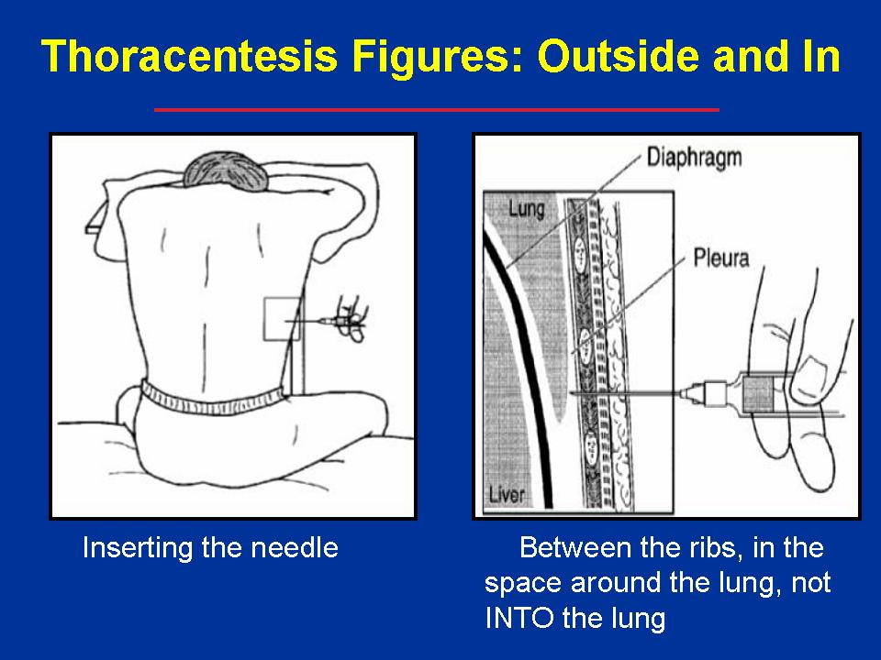
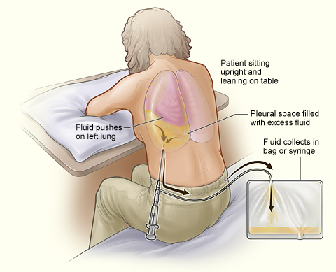
Thoracentesis
tube inserted through thoracic cavity into pleural cavity to drain fluid

Slide 23
Respiration
Physical & chemical process by which the body supplies cells and tissue with O₂ and rids CO₂

Slide 24
External respiration
breathing; exchange of O₂ & CO₂ between lungs and outside; acts of inspiration and expiration

Slide 25
Internal respiration
exchange or CO₂ & O₂ between cells and lymph surrounding them

Slide 26
Cellular respiration
use of O₂ to release energy from a cell

Slide 27
Breathing
Accomplished by change in air pressure within chest cavity
Inspiration – breathing in; external intercostals lift ribs up & out and diaphragm flattens
Expiration – breathing out; passive process

Slide 28
Normal breathing
  Adult - 14-20 bpm
  @ birth – 40-60 bpm
  5 years – 24-26 bpm
  Sitting - ~18bpm
  Standing - ~ 20-22 bpm

Slide 29
Breathing Issues
Coughing – deep breath followed by forceful exhalation to clear lower respiratory tract
Hiccups – spasm of diaphragm & spasmodic closure of glottis
Sneezing – air forced through nose to clear upper respiratory tract
Yawning – prolonged breath to fill lungs; caused by need to increase O2 in blood

Slide 30
Lung capacity & volume
Tidal volume – amount of air that moved in and out of lungs (500 mL)
Inspiratory reserve (IRV) – force to take in over TV (2100-3000 mL)
Expiratory reserve (ERV) – for to exhale over TV (1000 mL)

Slide 31
Lung capacity & volume
Vital lung capacity = TV + IRV + ERV = ~ 4500mL
Residual volume – amount that can’t voluntarily be expelled; maintains continuous gas exchange (1500 mL)
Total lung capacity = TV + IRV + ERV + RV = ~ 6000 mL

Slide 32
Thorax Injuries

Slide 33
Rib contusion
Forceful blow that bruises intercostal muscles
bruising causes pain in inhalation & exhalation

Slide 34
Rib fracture
Can be serious if displaced near organs
Flail chest – 3+ ribs fractured on the same side of chest causing rib movement during breathing to be paradoxical (opposite)
Crepitus – grating feeling when 2 bones rub together

Slide 35
Chest contusion
Bruising over central area of chest as result of compressive blow

Slide 36
Myocardial contusion
Bruising of heart muscle
Rare but caused when force is applied to sternum great enough to push heart to spine

Slide 37
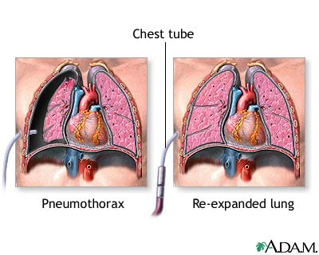
Pneumothorax
Condition where air enters pleural space between chest wall and lungs
Difference in pressure causes lung to collapse

Slide 38
Sucking chest wound
injured chest cavity and air moves through wound but remain in pleural space

Slide 39
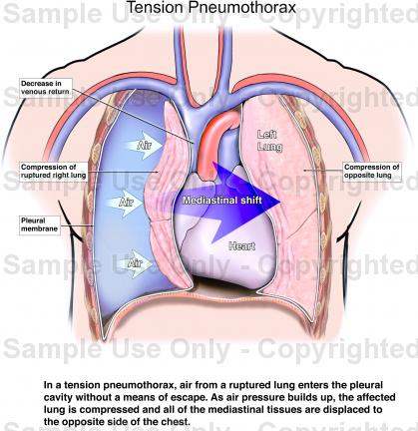
Tension pneumo
air enters but doesn’t exit; collapsed lung presses against other lung and heart

Slide 40
Hemopneumothorax
Accumulation of blood in pleural space

Slide 41
Pulmonary contusion
Bruise directly to lung causing bleeding in lung tissue
24-48 hours after injury – experience SOB, chest pain, coughing, hemoptysis (coughing up blood), rales (crackling sound with breathing)

Slide 42
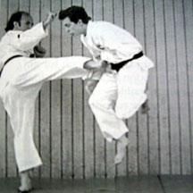
Celiac “solar” plexus contusion
Transitory paralysis of diaphragm
Getting the wind knocked out of you

Slide 43
Hyperventilation
Breathing faster than required
Brought on by anxiety & stress
CO₂ depletion causes dizziness and LOC
LOC is defense mechanism to return to normal

Slide 44
Side stitch
Pain under ribs during vigorous exercise
More common in unconditioned athletes

Slide 45
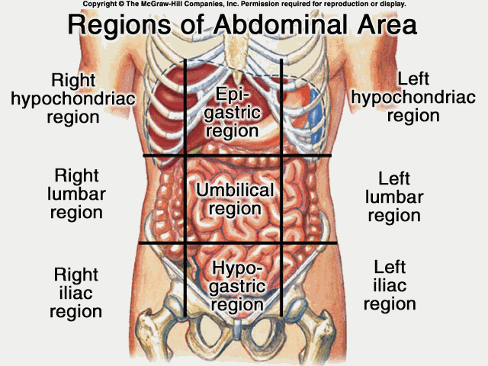
ABDOMINOPELVIC CAVITY
One large cavity from diaphragm to pubic floor

Slide 46
Abdominal cavity
Stomach
Liver
Gallbladder
Pancreas
Spleen
Small Intestines
Appendix
Large Intestines

Slide 47
Pelvic cavity
Bladder
Reproductive Organs
Rectum
Large Intestines

Slide 48
Organs

Slide 49
Stomach
Major organ of digestion
Located in upper left quadrant of abdominal cavity
3 parts
  Fundus – upper
  Greater curvature – middle
  Pylorus – lower

Slide 50
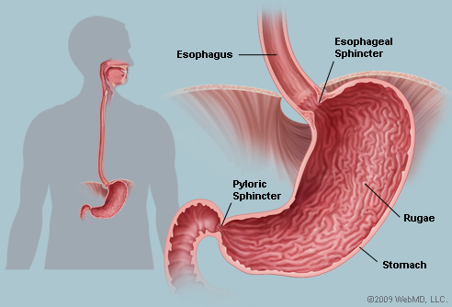
Sphincters of the Stomach
Cardiac sphincter – opening of esophagus into stomach; controls passage of food
Pyloric sphincter – valve that regulates movement of food from stomach to duodenum

Slide 51
Small intestines
Can be as long as 20 feet
3 parts
  Duodenum
    12”; connects to stomach
    wraps around head of pancreas
    Ampulla of Vater – pancreatic duct & bile duct of liver
  Jejunum
    8 feet
    between duodenum and ileum
  Ileum
    10-12”
    between jejunum and large intestines

Slide 52
Absorption – passage of substance into body fluids and tissues by villi which contain network of blood and lymph capillaries
Digested portion of food passes through villi
Undigestible portions pass to large intestines

Slide 53
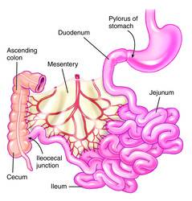
Anatomy of Small Intestines

Slide 54
Pancreas
Behind the stomach
Function as exocrine & endocrine gland
  Exocrine – duct that carries away secretions
  Endocrine – ductless & secretions emptied into blood stream
Digestive juices carried by pancreatic duct into duodenum at sphincter of Oddi

Slide 55
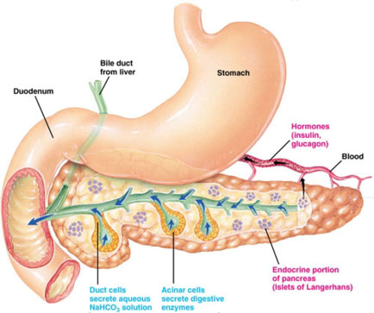
Anatomy of the Pancreas

Slide 56
Liver
Largest organ in the body
Located below diaphragm in upper right quadrant
Portal vein – products of digestion from SI to liver

Slide 57
Liver’s Function
Manufacture bile (digestion of fat)
Hepatic + cystic duct = common bile duct; if blocked can cause bile to enter bloodstream = jaundice
Produce and store glucose as glycogen
Detoxify alcohol and drugs
Prepare urea from breakdown of amino acids

Slide 58
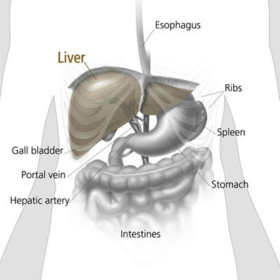
Anatomy of the Liver

Slide 59
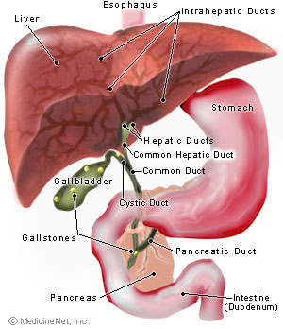
Gallbladder
Stores and concentrates bile
Not needed by the body

Slide 60
Large intestines
Ileocecal valve – permits intestinal chime and prevents backflow into ileum
~ 5 feet long & 2 inches in diameter - colon
Cecum – pouch at the end of colon
Vermiform appendix – unknown function

Slide 61
Colon
Ascending (right)
Transverse (across body)
Descending (left)
Enters S-shaped bend - sigmoid colon ~ 7-8 feet
Moves from sigmoid colon to rectum

Slide 62
Kidneys
Bean shaped
Between T12 & L3
Right kidney is slightly lower than left because of liver
Renal fascia – tough fibrous tissue covering kidney

Slide 63
Kidneys (cont’d)
Hilum – indentation on medial border; passageway for lymph vessels, nerves, renal artery & vein, and ureter
Renal pelvis – funnel shaped structure at the beginning of ureter
2 layers
  Cortex – outer portion, contains nephrons
  Medulla – inner layer, contains renal pyramids

Slide 64
Kidneys (cont’d)
Nephron – functional unit of the kidney; the afferent arteriole carries blood from renal artery to Bowman’s capsule, which surrounds the glomerulus ~ 50 separate capillaries. Bowman’s capsule and glomerulus make up the renal corpusule which goes into the proximal convoluted tubule and descends to the Loop of Henle to the distal convoluted tubule and opens into the collecting tubule, which contains urine
Ureter – carries urine from kidney to urinary bladder ~ 10-12 inches
Urinary bladder – muscular sac that holds urine; can store ~ 1 pint
Urethra – from bladder to outside; bladder contractions force urine out

Slide 65
Abdominal Injuries

Slide 66
Kidney Contusion
Violent blow o upper posterior abdominal wall
Pain radiating into lower abdominal region
Show signs of shock, nausea, vomiting, rigidity, and hematuria
Hematuria – blood in urine

Slide 67
Liver Contusion
Life Threatening
Cause severe bleeding and shock
Referred pain below the right scapula, shoulder, and substernal region

Slide 68
Spleen Injury
Spleen – large mass of lymphatic tissue that filters blood and activates immune system
Ruptured spleen may radiate pain into left shoulder
Kher’s sign – referred pain to the left shoulder down 1/3 arm; may go into shock b/c of low BP

Slide 69
Hernia
Protrusion of the abdominal tissue (SI) through a portion of the abdominal wall
Caused by chronic coughing, straining to lift, persistent sneezing, obesity

