Slide 1
Unit 4
Tobacco, Alcohol & Drugs

Slide 2
Tobacco

Slide 3
Health Risks of Tobacco Use
Medical studies have shown that tobacco use is the leading cause of PREVENTABLE death and disability in the United States.
This use has been linked to Lung Disease, Cancers & Heart Disease.
This includes:
    Smoking
    Chewing
    Dipping

Slide 4
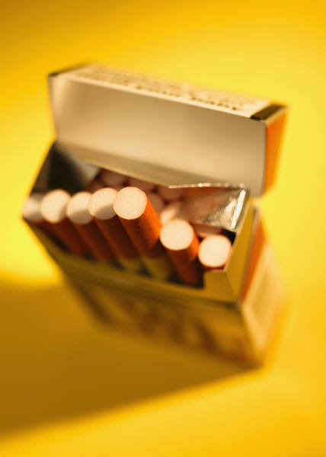
Tobacco Habits
What percent of adult tobacco users began the habit as teenagers?

Slide 5
Teen Tobacco Use
90%!!!
Most teens think they can just quit whenever they choose, but the reality is that quitting is very difficult.
It’s easier to avoid use than to quit later!

Slide 6
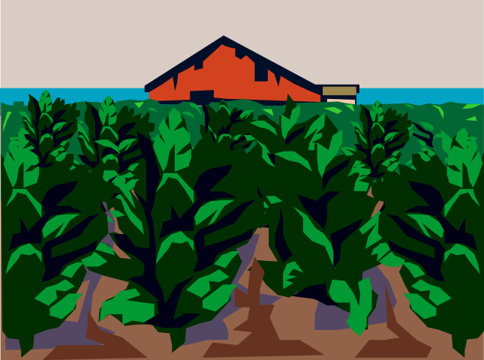
What’s in Tobacco?
Nicotine- the addictive drug found in tobacco leaves

Slide 7
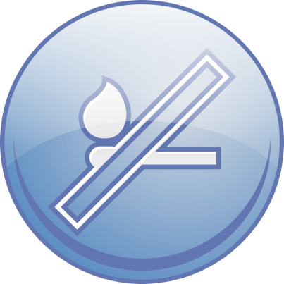
What’s in Tobacco?
Tar- a thick, sticky, dark fluid produced when tobacco burns (in cigarette smoke).
  Tar damages a smoker’s respiratory system by paralyzing and destroying cilia (the tiny hair-like structures that line the upper airways and protect the body against infection). This is why smokers are more likely to develop diseases like bronchitis, pneumonia, emphysema, heart disease and cancer.
  87% of cancer deaths result from smoking.
  Are you still smoking?

Slide 8

What’s in Tobacco?
Carbon Monoxide- a colorless, odorless and poisonous gas found in cigarette smoke.
  This is absorbed easier than oxygen and deprives the body’s tissues and cells of oxygen. This increases the risk of high blood pressure, heart disease, hardening of the arteries and other circulatory problems.

Slide 9

Pipes & Cigars
One cigar can contain as much nicotine as 20 cigarettes (one pack).
Pipe and cigar smokers increase the risk of developing cancers of the lips, mouth, throat, larynx, lungs and esophagus.

Slide 10
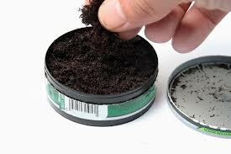
Smokeless Tobacco
Smokeless Tobacco- tobacco that is sniffed through the nose, held in the mouth or chewed.
  Many think this is “safer.”
  BUT, the harmful chemicals are absorbed into the body at levels up to 3x the amount of a one cigarette.

Slide 11
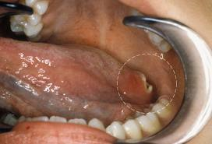
Smokeless Tobacco
Using smokeless tobacco also irritates the sensitive tissues of the mouth, causing leukoplakia.
Leukoplakia- thickened, white, leathery-looking spots on the inside of the mouth that can develop into oral cancer.

Slide 12


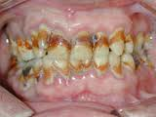
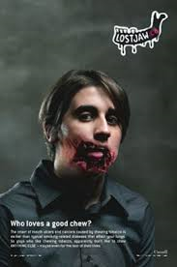
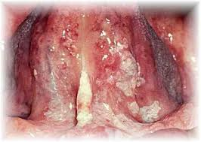
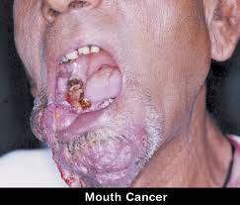
Effects of Smokeless Tobacco

Slide 13
Long-Term Effects of Tobacco Use
Chronic Bronchitis- the cilia in the bronchi become so damaged that they are useless. This leads to chronic coughing and excessive mucus secretion.
Lung Cancer- can develop when the cilia in the bronchi are destroyed, and extra mucus cannot be expelled. Cancerous cells multiply, block the bronchi, and move to the lungs. 90% of Lung Cancer deaths are from smoking.
Emphysema- a disease that destroys the tiny air sacs in the lungs. Someone with advanced emphysema uses 80% of their energy just to breathe!

Slide 14
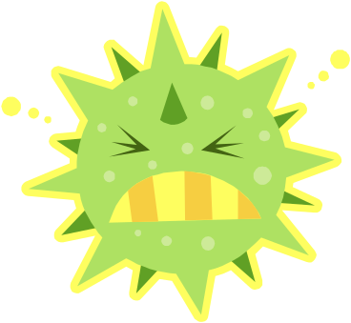
Long-Term Effects of Tobacco Use
Coronary Heart Disease & Stroke- Nicotine constricts blood vessels, which cuts down on blood flow to the body’s limbs.
    Nicotine also contributes to plaque buildup in the blood vessels which can lead to hardened arteries, called arteriosclerosis. Arteries become clogged, increasing the risk for heart attack and stroke.
A Weakened Immune System- long-term tobacco use makes the body more vulnerable to disease.

Slide 15
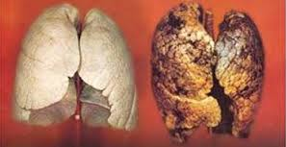
The Effects of Tobacco
http://www.youtube.com/watch?v=TqqApcqKcY0

Slide 16
Interactive Biopsy
http://www.oxygen.org.au/games/InteractiveBiopsy/default.asp
Use a scalpel, syringe or tweezers to take body samples and see why this tobacco user may have died.

Slide 17
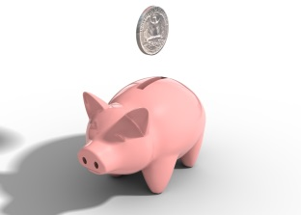
Other Consequences of Tobacco Use
Costs to society. Tobacco-related illnesses cost the United States about $165 billion each year. Productivity suffers when smokers call in sick due to tobacco-related illnesses.
Costs to individuals. A person smoking one pack of cigarettes a day will spend $1700/year in North Carolina at $4.64/pack. Other states much higher- NY $11.90/pack-$4400/year!

Slide 18
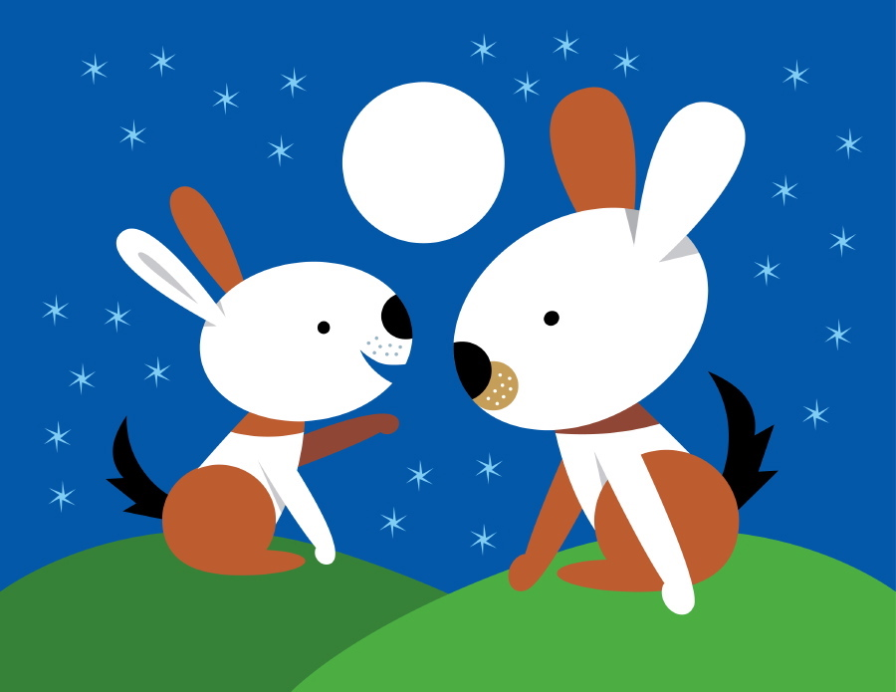
Think, Pair, Share
Why do you think some teens begin to use tobacco?
Discuss with a neighbor and be ready to share your opinions!

Slide 19
Teen Tobacco Use
Why Some Teens Use Tobacco:
Will help lose weight
Will make them look mature/independent
Media Images- movies, TV, celebrities
Peer pressure
Teen Tobacco Use is Reduced compared to the past!
35% in 1995 to 22% in 2005.
Tobacco legislation in 1998 made it illegal to aim advertisements at young people
No-smoking policies in public places
Increased family values towards tobacco use
Increased knowledge about health risks

Slide 20
Secondhand Smoke/Environmental Tobacco Smoke
Secondhand Smoke/Environmental Tobacco Smoke- air that has been contaminated by tobacco smoke.
This smoke is make up from smoke exhaled from the lungs of a smoker as well as smoke from the burning end of the smoked product.

Slide 21
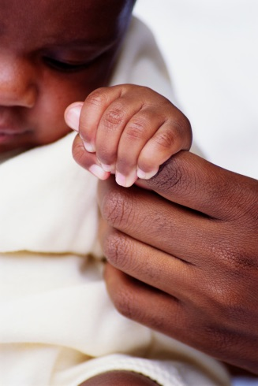
Health Risks to Unborn Children and Infants
Smoking while pregnant can seriously harm the developing fetus!
  Nicotine passes through the placenta, constricting the blood vessels of the fetus.
  Carbon monoxide reduces the oxygen levels in the blood of the mother and the fetus.
  This increases the risk of impaired fetal growth, miscarriage, prenatal death, premature delivery, low birth weight, deformities and stillbirths.
  Babies of smoking mothers are more likely to die of Sudden Infant Death Syndrome (SIDS)
  Infants exposed to Second-hand smoke after birth are twice as likely to die of SIDS.

Slide 22
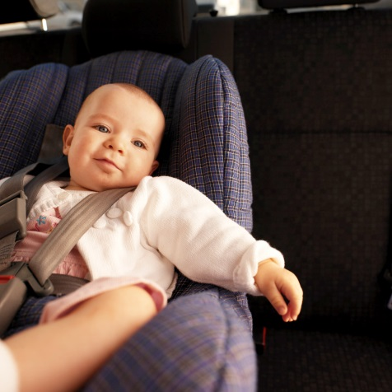
Health Risks to Young Children
Young children are especially at risk to Secondhand smoke.
Children of smokers tend to have a higher incidence of sore throats, ear infections, and upper respiratory problems.
Secondhand smoke can slow lung development. They will have weaker lungs than children of non-smokers.
Children of smokers are more than twice as likely to smoke themselves.

Slide 23

Partner Writing Activity
Scenario:
You have a cousin who is 25. She is married and has just found out that she is pregnant. This cousin, though, is a smoker.
Compose a respectful but informative letter to your cousin about the harmful effects her smoking can have on the unborn baby, on the infant after birth and on the child as it gets older. This letter should be at least ½ a page and includes risk factors for each life cycle (unborn, infant, child). If you need a textbook, grab one! ☺

Slide 24
Alcohol

Slide 25

Health Risks of Alcohol Use
Alcohol is a depressant, a drug that slows the central nervous system.
Using Alcohol:
Slows reaction time
Impairs vision
Diminishes judgment

Slide 26

Factors that Influence Alcohol’s Effects
Body Size. Smaller people feel the effect of the same amount of alcohol faster than a larger person does.
Gender. Alcohol moves into the bloodstream faster in females than males because females tend to have smaller bodies.
Food. Food in the stomach slows down alcohol into the bloodstream.
Rate of Intake. The faster the intake the faster the person becomes intoxicated.
Amount. As the amount of alcohol consumed increases, the level of alcohol in the bloodstream rises.
Medicine. Alcohol can interfere with the effects of medicines and some medicines can heighten the effects of alcohol.

Slide 27
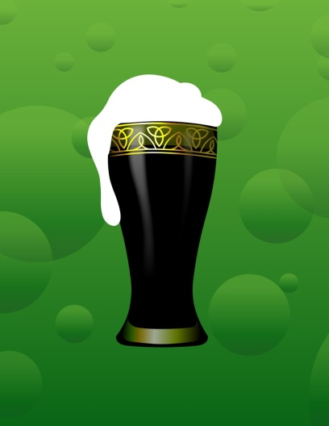
Long-Term Effects of Alcohol
Alcohol use can have a long-term effect on a user’s physical, mental/emotional and social health!
Excessive use over a long period of time can damage many body systems such as:
Damage to brain cells
Increased blood pressure
Buildup of fat calls in the liver
Damage to the digestive lining of the stomach causing ulcers
Destruction of the pancreas

Slide 28

Teens and Alcohol
What percent of students in the United States do you think have consumed (aka tried) alcohol by 8th grade?

Slide 29

Teens and Alcohol
41%

Slide 30
Teens and Alcohol
What percent of students in the United States say they have consumed alcohol by the time they graduated from High School?

Slide 31
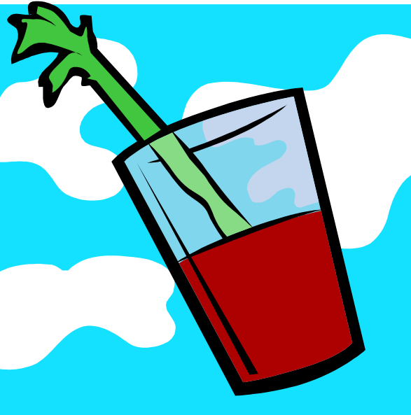
Teens and Alcohol
75%

Slide 32
Situation
http://www.youtube.com/watch?v=TuFIyYKsmos

Slide 33
Situation
1. What could’ve Chrystal done to deal with the stress she was going through, in a healthy way?
2. Why do you think that Chrystal took the pills that were handed over to her?
3. Why do you think that Chrystal did not stop drinking once she started?
4. Why do you think Chrystal’s friends did not notice that she was passed out?
5. Why do you think that Chrystal’s friends did not call 911?

Slide 34
Factors That Influence Alcohol Use in Teens
Teen’s choices to use alcohol is influenced by:
  Peer Pressure. When alcohol use is not an accepted activity in a group, one will be less likely to drink. If it is accepted, it is more likely.
  Family. When a teen’s parents discourage and avoid the use of alcohol, the teen is likely to do the same.
  Media Messages. Media messages may make alcohol seem glamorous and fun.

Slide 35
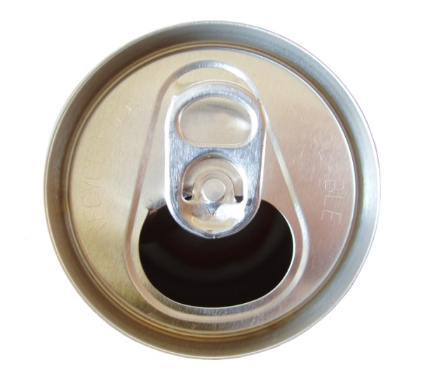
Binge Drinking
Binge Drinking- drinking five or more alcoholic drinks at one sitting.
  http://abcnews.go.com/Nightline/video/teen-girls-binge-drinking-16008701

Slide 36

Alcohol Poisoning
Alcohol Poisoning- a severe and potentially fatal physical reaction to an alcohol overdose.
  Alcohol acts as a depressant on body organs.
  Involuntary actions such as breathing and the gag reflex that prevents choking may be impaired.

Slide 37
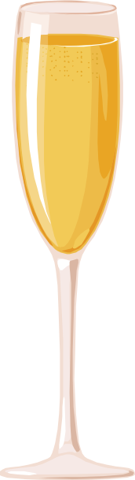
Alcohol Poisoning
Someone who drinks too much alcohol may eventually pass out. Though they are passed out, alcohol in the stomach continues to enter the bloodstream, so their blood alcohol level will continue to rise, which increases the risk of alcohol poisoning.
It is very dangerous to assume that someone is OK if they are passed out and that they will “sleep it off.”

Slide 38
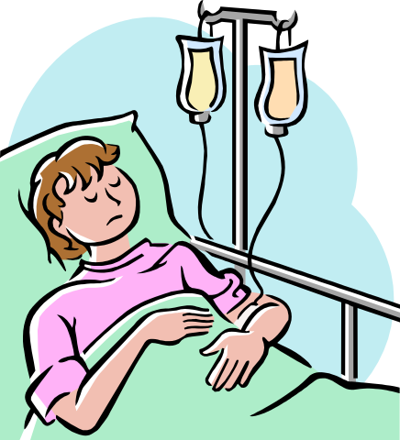
Alcohol Poisoning
The symptoms of Alcohol Poisoning include:
  Mental confusion and stupor
  Coma and inability to be roused
  Vomiting and seizures
  Slow breathing
  Irregular heartbeat
  Hypothermia or low body temperature- pale or bluish skin color
  If you suspect someone has alcohol poisoning, CALL 911 immediately!!!

Slide 39
Comparing Beer, Wine & Spirits
Drink | Alcohol By Volume | Alcohol Content
Beer (12 ounces) | 4% | .5 ounce
Wine (5 ounces) | 10% | .5 ounce
Vodka etc… (1.25 ounce) | 40% | .5 ounce

Slide 40
Fetal Alcohol Syndrome
Fetal Alcohol Syndrome (FAS)- a group of alcohol-related birth defects that include physical and mental problems. This happens by drinking during pregnancy.
  Small head and deformities of face, hands, or feet
  Heart, liver and kidney defects
  Vision and hearing problems
  Central nervous system problems, developmental disabilities, and poor coordination
  Difficulties learning and attention span
  Hyperactivity, anxiety and social withdrawal

Slide 41
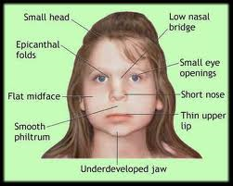
Fetal Alcohol Syndrome Characteristics

Slide 42
Classwork
Read Pages 572-576
Answer Questions #1-6

Slide 43
Illegal Drugs

Slide 44
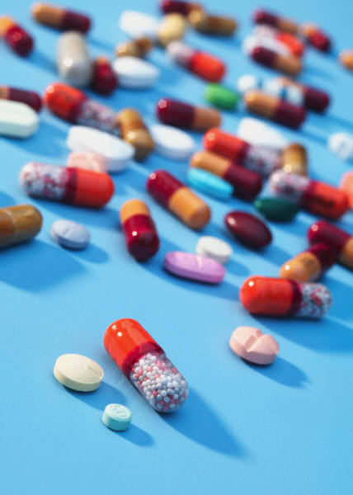
Substance Abuse
Substance Abuse- any unnecessary or improper use of chemical substances for non-medical purposes.
  This includes both illegal drugs AND prescription drugs used by those they were not intended for.

Slide 45
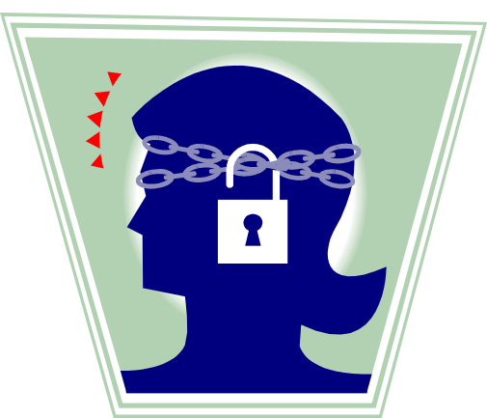
General Effects of Drug Use
Physical Health. A serious risk is overdose- a strong, sometimes fatal reaction to taking a large amount of a drug. Also there is an increased risk of HIV & Hepatitis B with injectable drugs.
Mental Health. Drug use may impair a teen’s ability to reason and think. This will lead to changes in the brain, which will have the person act against their values.

Slide 46
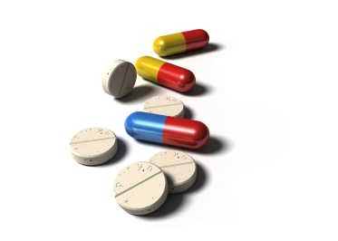
General Effects of Drug Use
Social Health. Teens who use drugs may lose friendships with those who choose to live drug free. Relationships with family members will also suffer! Legal consequences will also happen if caught.
Tolerance. The body starts to need more and more of the drug to achieve the desired effect.
Psychological Dependence. This is when the person thinks they need the drug to feel good or normally function.

Slide 47
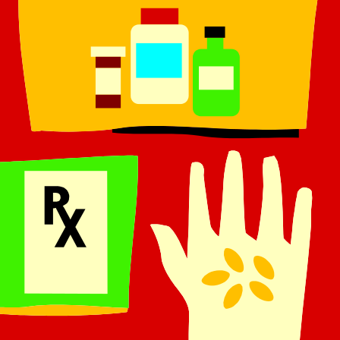
General Effects of Drug Use
Physiological Dependence. The user develops a chemical need for the drug. Withdrawal symptoms occur which include nervousness, insomnia, headaches, vomiting, chills and cramps. Withdrawal symptoms can be so severe they can result in death.
Addiction. This includes a combination of psychological and physiological dependence on a drug. This usually requires professional intervention to stop using.
http://www.youtube.com/watch?v=NaMgdlUcsko

Slide 48

Medicine Abuse
Intentionally taking medications for nonmedical reasons is medicine abuse.
Many people think prescription and over the counter medicines are safer than illegal drugs. Abusing ANY medicine is dangerous and illegal!

Slide 49
Steroids
Anabolic Steroids- synthetic substances similar to male sex hormones.
  Steroid use will result in unnatural muscle growth. Which is also NOT PERMANENT.
  When combined with physical conditioning, steroids will increase strength, but not tendons and ligaments, which can lead to injury.

Slide 50
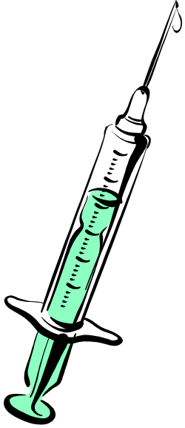
Effects of Steroids
General Side Effects of Steroids includes:
  Weight gain
  Acne
  High blood pressure
  Liver & kidney tumors
  Violent behavior
  Extreme mood swings
  Paranoia
  Side Effects in Males:
    Shrinking testicles
    Reduced sperm count
    Baldness
    Development of breasts
    Increased risk for prostate cancer
  Side Effects in Females:
    Facial hair
    Baldness
    Deepened voice

Slide 51
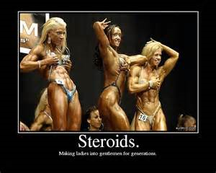

Slide 52
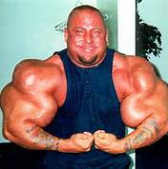
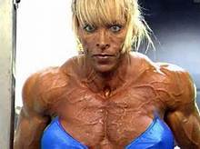
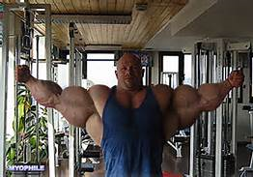
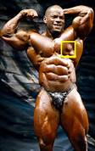
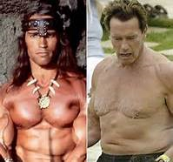


Slide 53
Group Work
Group 1- Marijuana
Group 2- Meth
Group 3- LSD
Group 4- Cocaine
Group 5- Crack
Group 6- Steroids
Group 7- PCP
Group 8- DXM
Group 9- Codeine
Group 10- Heroin
Group 11- Rohypnol
Using your textbooks, with your group, find out:
  What the drug actually is
  What kind of drug it is (stimulant etc…)
  What the drug does to your body/risks

