Slide 1
Plant Science
Essential Standard 3.00: Understand the plant industry

Slide 2
Objective 3.01
Remember careers in the plant industry.

Slide 3
Major Plant Science Industries:
Ornamental Horticulture
  The science and art of producing, processing, marketing and distributing plants grown for their appearance or beauty
Examples
  Flowers
  Shrubs
  Trees
  Grasses
  Interior plants

Slide 4
Major Plant Science Industries:
Fruit and Vegetable Production
  The science and art of producing, processing, marketing and distributing fruits and vegetables
Examples:
  Blueberries
  Apples
  Peaches
  Strawberries
  Tomatoes
  Cucumbers
  Sweet corn
  Squash
  Sweet potatoes

Slide 5
Major Plant Science Industries:
Agronomy
  The science of soil management and crops.
Examples
  Wheat
  Barley
  Field corn
  Soybeans
  Cotton

Slide 6
Examples of Ornamental Horticulture Careers
Florist
  designs and arranges cut flowers
Groundskeeper
  maintains lawn and landscape areas
Landscape Architect
  a professional trained in the art and science of arranging land and objects upon it
Golf Course Superintendent
  manages the golf course grounds

Slide 7
Examples of Ornamental Horticulture Careers
Nursery Operator
  manages a business that grows and sells trees, shrubs and other ornamental plants
Greenhouse Manager
  manages a business that grows and sells greenhouse plants
Gardener
  a person who grows and maintains plants for estates, institutions, etc.
Landscape Contractor
  a person licensed to install landscapes based on passing certification exams

Slide 8
Examples of Fruit and Vegetable Careers
Vegetable Grower
  grows and sells vegetables for the fresh, wholesale and retail markets
Produce Manager
  manages retail produce departments of grocery stores
Winery Supervisor
  manages the production of wines

Slide 9
Examples of Agronomy Careers
Agronomist
  a specialist in soil and crop sciences
Forage Manager
  grow, manage and sell hay crops for various animal producers
Federal grain Inspector
  Federal employee that inspects harvested grain crops

Slide 10
Examples of General Plant Science Careers
Plant Physiologist
  person who studies plant processes and functions
Plant Breeder
  person who develops new plants through, selection, hybridization, etc
Plant Propagator
  a person who reproduces plants
Entomologist
  a person who studies insects

Slide 11
Objective 3.02
Understand biotechnology in the plant industry.

Slide 12
Biotechnology Basics
Biotechnology is the use of living organisms (microorganisms) to make new products or carry out new processes (solve problems).
  New product – Yogurt
  New Process –Tissue culture
    propagation method that rapidly multiplies plants

Slide 13
Historic Applications of Biotechnology
Yeast to make bread rise
Bacteria to produce cheeses and other dairy products
Microorganisms to transform fruit or grains into alcoholic beverages
Use of bacteria to “produce” silage
E.coli bacteria used to produce insulin
  It became one of the first commercial products created by genetic engineering

Slide 14
Basic Genetics
The science of heredity
  Gregor Johann Mendel
    discovered the effect of genetics on plant characteristics with his experimentation with garden peas
  Heredity
    transmission of characteristics from an organism to its offspring through genes in reproductive cells
  Genes
    determine the individual characteristics of living things
    segments of double stranded DNA
  Generation
    the offspring, or progeny, of common parents

Slide 15
Basic Genetics
DNA –Genetic Code of Life
  Chromosome
    a structure that holds the genetic information of a cell
    DNA is wound tightly to form the chromosome
  DNA (deoxyribonucleic acid)
    coded material in all cell nuclei
    determines what that cell and its successive cells will become
    structure is that of a twisted ladder
      double helix

Slide 16
Basic Genetics
Gene
  small section of DNA
  thousands of genes on a strand of DNA
Gene mapping
  process of both finding and recording the locations of genes

Slide 17
Basic Genetics
Bases
  Like rungs of a ladder that hold the two sides of the DNA strands together.
  The bases are:
    Adenine (A) - only pairs with “T”
    Thymine (T) – only pairs with “A”
    Guanine (G) – only pairs with “C”
    Cytosine (C) – only pairs with “G”
  Example:
    A – T
    G – C
    T - A
The sequence of the bases between the DNA strands is the code by which a gene controls a specific trait
  Baldness in humans
  The color of flowers on a plant

Slide 18
Processes and Practices in biotechnology
Genetic engineering
  developed in the early 1980’s
  process of moving genetic information in the form of genes from one cell to another
    Gene splicing or Recombinant DNA technology
      process of removing and inserting genes from one organism and inserting them into the DNA of another
    Some examples are:
      Alter a plant’s susceptibility to disease
      Make a plant resistant to insects
    Process in animals is newer and not as well developed

Slide 19
Processes and Practices in biotechnology
Cloning (micropropagation in plants)
  creating an exact genetic duplicate of another organism
Indicator species
  one of the oldest methods of biological detection.
    uses plants, animals and microbes to warn us about pollutants in the environment

Slide 20
Processes and Practices in biotechnology
Bioremediation
  use living organisms to clean up toxic wastes in water and soil
Biostimulation
  Adding nutrients such as nitrogen and phosphorus to stimulate the growth of naturally occurring beneficial microbes
    faster more efficient work

Slide 21
Processes and Practices in biotechnology
Phytoremediation
  plant absorbs or immobilizing pollutants
  First tested in the 1990’s
Animal Reproduction and Production
  improving the efficiency of reproduction and production involve the use of biotechnology
    These are considered the more conventional uses of biotechnology
Biofuels
  Fuels composed of or produced from biological raw materials

Slide 22
Importance of Recombinant DNA Technology
Improve plants’ and animals’ performance
  The manipulation of genes
Alter characteristics or performance of microorganisms
Controlling disease, insects, weeds, and other pests
  Less use of chemical pesticides
  Potential for helping clean the environment

Slide 23
Concerns with the use of Biotechnology
Safety
  State and federal government monitor
  Consumer resistance to new biotech food products remains high
    safety of the environment
    human health concerns
  Rapidly changing field, which when not fully understood
    can create a fear of the unknown
  Labeling of genetically modified organisms (GMO) foods
    many people feel if a product is safe it should be labeled
    Concern has been expressed over the effect GMO’s may have on biodiversity

Slide 24
Concerns with the use of Biotechnology
Ethics
  system of moral principles
    defines what is right and wrong in a society
  raises important ethical questions about how biotechnology should be used

Slide 25
Scientific Method used in Biotechnology/Agriscience
Steps of the scientific method:
  Identify the problem
  Review literature
  Form a hypothesis
  Prepare a project proposal
  Design the experiment
  Collect the data
  Draw conclusions
  Prepare a written report

Slide 26
Biotechnology in the plant science industry
Herbicide and insect resistant crops
Examples:
  Herbicide tolerant soybean (Round-Up Ready Soybeans)
    contains a gene that provides resistance to broad spectrum herbicides
    Others being developed – canola, corn, cotton, alfalfa, lettuce, potatoes, sugar beets, tomatoes.
  Insect- resistant corn (Bt corn)
    contains a built-in insecticidal protein
    from a naturally occurring soil microorganism
      Bacillus thuringiensis
    gives season- long control of corn borers

Slide 27
Biotechnology in the plant science industry
Crops with better nutrition and longer shelf life are products of genetic engineering
  High Oleic Peanut
    genetically modified to produce nuts in high oleic acid
    longer life for nuts, candy and peanut butter
  High Oleic Sunflower
    sunflower oil that is low in trans-fatty acids
  Delayed- ripening tomato
    longer shelf life
    commercial advantages in harvesting and shipping

Slide 28
Biotechnology in the plant science industry
Tissue culture
  Micropropagation
  use of a very small actively growing parts of the plant
  produces a large number of new plants
    African violets

Slide 29
Objective 3.03
Understand basic horticultural (ornamental, fruit and vegetable) and agronomic principles and practices.

Slide 30
Type of Plant Growing Media
Soil is the top layer of the Earth’s surface and is the primary medium of cultivated plants
    Topsoil
    Subsoil
    Parent material

Slide 31
Type of Plant Growing Media
Sphagnum moss
  used for encouraging root growth under certain conditions
Peat moss
  consists of partial decomposed mosses in waterlogged areas called bogs

Slide 32
Type of Plant Growing Media
Perlite
  volcanic glass material
  has water-holding capabilities
  used for starting new plants and in media mixes
Vermiculite
  mineral- type mica
  used for starting plant seeds and cuttings and in media mixes

Slide 33
Amending the Plant Growing Media
Add organic matter
Specific nutrients
Modify soil pH
  Improper pH will impact the availability of nutrients
  measure of the degree of acidity or alkalinity
    pH scale ranges from 0-14
  high alkalinity are made more acidic (lowering the pH) by adding sulfur or aluminum sulfate
  high acidic level is made more alkaline (raising the pH) by adding lime
    finely ground dolomitic limestone
      supplies both Ca (calcium) and Mg (magnesium)

Slide 34
Fertilizers
Complete fertilizer
  Contains the three primary nutrients
    N (nitrogen)
    P (phosphorus)
    K (potassium)
Organic fertilizers
  made with plant or animal products
    Dried cow manure
    Bone meal (high in phosphorus)
    Blood meal
  slow acting and long lasting forms of N
  lacking in the other primary nutrients (except bone meal)
Inorganic fertilizers
  higher analysis of soluble nutrients
  blended together for a specific purpose

Slide 35
Fertilizer Application
Broadcasting
  evenly spreading over the entire surface of a lawn or other growing area
Side-dressing
  placing fertilizer in bands about 8” from the row of growing plants
  popular for field crops like corn and soybeans
Foliar application
  spraying of liquid fertilizer directly onto the leaves of plants

Slide 36
Principle Parts of Plants
Roots
  Generally two types
    Fibrous
    tap root
  Function
    anchor the plant
    take in water and nutrients

Slide 37
Principle Parts of Plants
Stems
  Two basic types of aboveground stems
    Woody
    Herbaceous
  Supports other plant parts
  Water and nutrients are carried up to the leaves
  Sugar made in the leaves is transported down to the roots

Slide 38
Principle Parts of Plants
Leaves
  manufactures food for the plant by using light energy (photosynthesis)
  The chemical equation for photosynthesis is:
light energy
6 CO2 + 6 H2O = C6H1206 + 6 02
Chlorophyll
    Occurs best in a temperature range of 65-85 degrees F
  Leaves are very useful in identifying plants and vary greatly
    leaf margin (edge), shape and arrangement are all important in plant identification

Slide 39
Principle Parts of Plants
Flowers
  The primary function is the production of seed
  Male flower part is the stamen (anther, filament)
  Female part is the pistil (stigma, style, ovary).
  Can be male, female or both
  Petals attract insects to aid in pollination

Slide 40
Principle Parts of Plants
Fruit
  The ovary (lower part of the pistil) of a flower matures into a fruit that surrounds the seeds
  Seed develops in the female part (pistil) of the flower
    The seed has 3 basic parts:
      Seed coat- protection for the seed
      Endosperm – food for the seed
      Embryo – baby plant

Slide 41
Common Plant Science Skills
Transplanting
  Can be done by hand or machine
  Involves moving a young plant from one location to another.
    Example: a seedling tomato from a cell pack in the greenhouse into a home garden

Slide 42
Common Plant Science Skills
Propagation
  Increasing the number of a plant species
    Sexual
      is the use of seeds for reproducing plants
    Asexual (vegetative)
      use of a part or parts of a plant for reproducing plants
      results in an exact duplication of the parent plant

Slide 43
    Asexual Propagation
Cuttings (stem)
  Vegetative parts that the parent plant uses to regenerate itself.
  Rooting hormones are often applied to speed up the development of roots
Division
  A method of dividing or separating the main part of a plant into smaller parts
Grafting
  method of joining two plants together to grow as one
Tissue culture
  use of a very small piece of a plant (explant) to produce a large number of new genetically identical plants

Slide 44
Objective 3.04
Remember tools and their safety practices related to the plant industry.

Slide 45
Plant Science Related Tool Safety Concepts
Choosing the right tool for a job
  promote safety in the shop and workplace
Caring for tools and keeping them in good working condition
  promote safety in the shop and workplace

Slide 46
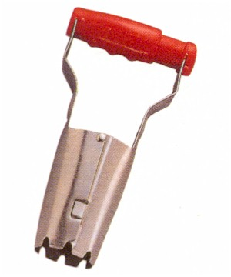
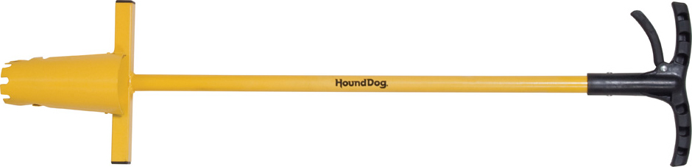
Plant Science Related Tools
Bulb planter
  planting and transplanting bulbs

Slide 47
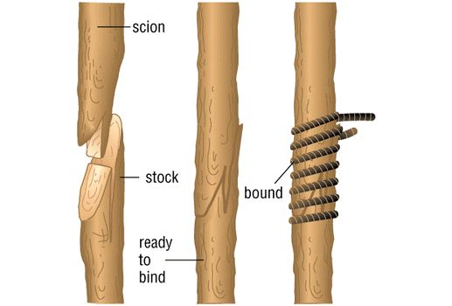
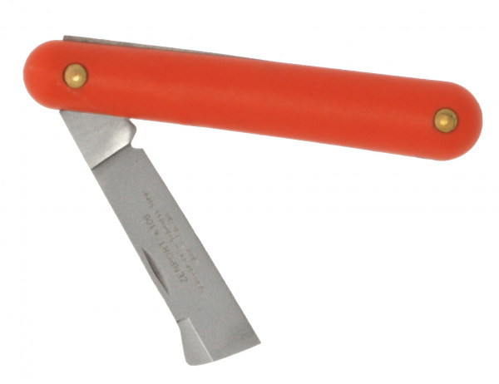
Plant Science Related Tools
Grafting tool
  preparing woody parts for grafting

Slide 48
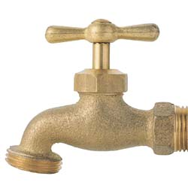
Plant Science Related Tools
Hose bib
  valve for attaching a water hose and turning water supply on and off

Slide 49
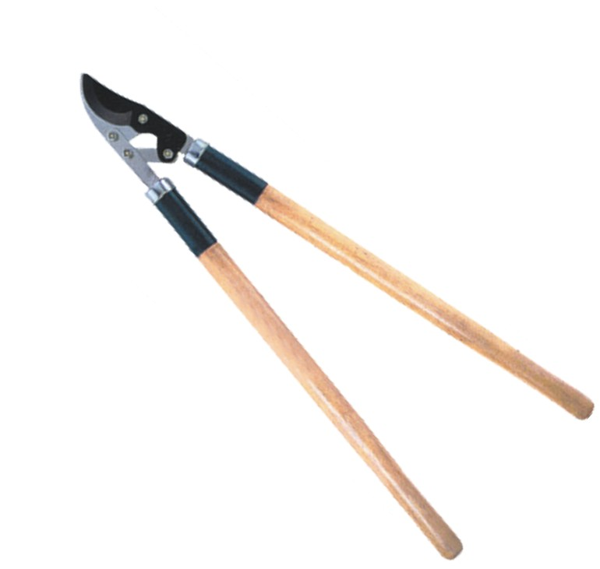
Plant Science Related Tools
Lopping shears
  Cutting large branches when pruning shrubbery.

Slide 50

Plant Science Related Tools
Pruning saw
  sawing limbs from shrubbery and trees

Slide 51
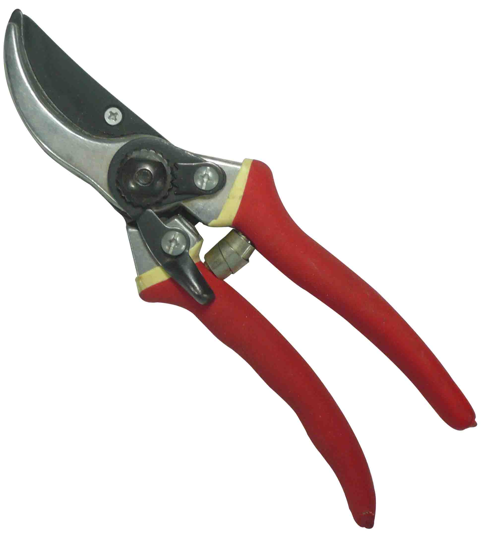
Plant Science Related Tools
Pruning shears
  cutting and shaping shrubbery

Slide 52
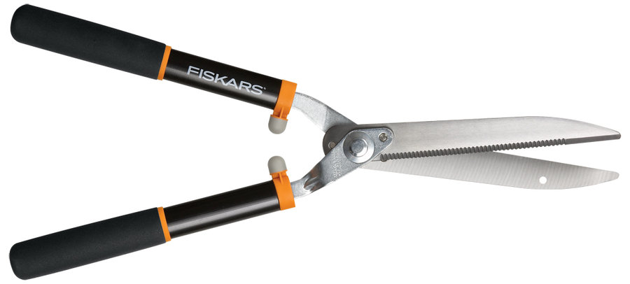
Plant Science Related Tools
Hedge shears
  trimming and shaping shrubbery

Slide 53
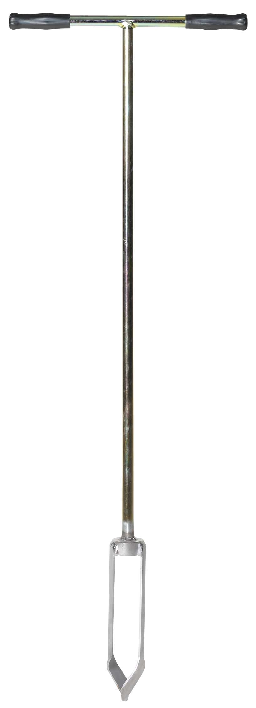
Plant Science Related Tools
Soil auger
  boring into soil to get samples

Slide 54
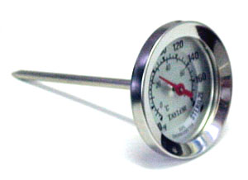
Plant Science Related Tools
Soil thermometer
  determining soil temperatures

Slide 55
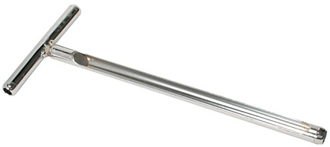
Plant Science Related Tools
Soil tube
  obtaining soil for testing

Slide 56
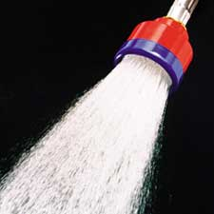
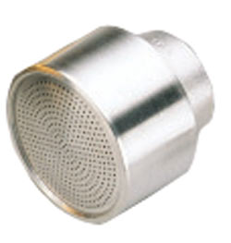
Plant Science Related Tools
Water breaker
  reduces the impact of water pressure on soil and plants

