Slide 1
Special Test
Injury
Bones
Motions
Ligament
$100
$100
$100
$100
$100
$200
$200
$200
$200
$200
$300
$300
$300
$300
$300
$400
$400
$400
$400
$400
$500
$500
$500
$500
$500

Slide 2
Answer: Position knee in 30 degree flexion, Stabilize femur with one hand, place other around tibia pull forward

Slide 3

What is Lachman’s Test?
100

Slide 4
Answer: Place one hand on lateral aspect of knee and other on later side of lower leg, press with one hand on the joint line

Slide 5
What is Valgus Stress Test?
200

Slide 6
Answer: Place one hand on the medial aspect of knee and other hand on lateral side of lower leg, press with one hand on the joint

Slide 7
What is Varus Stress test?
300

Slide 8
Answer: Lie supine with knee fully extended, “milk” the upper and lower leg toward the knee joint

Slide 9
What is Effusion Stroking?
400

Slide 10
Answer: Place goniometer over midpoint of the patella with the stationary arm iline with ASIS and the moveable arm with tibial tubercale

Slide 11
What is Q-angle?
500

Slide 12
Answer: Tissue connecting muscle to bone becomes inflamed

Slide 13
What is Tendonitis?
100

Slide 14
Answer: Bruising to the peroneal muscles

Slide 15
What is Peroneal Contusion?
200

Slide 16
Answer: A condition where the knee stay apart even when standing feet apart and ankles together

Slide 17
What is Genu Varum?
300

Slide 18
Answer: Damage to the cartilage under the knee cap

Slide 19
What is Chondromalacia patella?
400

Slide 20

DAILY
DOUBLE!!!!!

Slide 21
Answer: Abnormally low lying patella

Slide 22
What is Patella Baja?
500

Slide 23
Answer: This bone is known as the knee

Slide 24
What is the Patella
100

Slide 25
Answer: Largest bone in the body

Slide 26
What is the femur?
200

Slide 27
Answer: Attachment to LCL

Slide 28
What is the fibular head?
300

Slide 29
Answer: Also known as the shin

Slide 30
What is Tibial Tubercle?
400

Slide 31
Answer: Left side of the knee cap

Slide 32
What is Adductor Tubercle
500

Slide 33
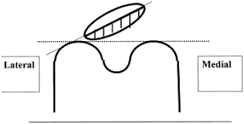
Answer:

Slide 34
What is
Lateral Tilt?
200

Slide 35
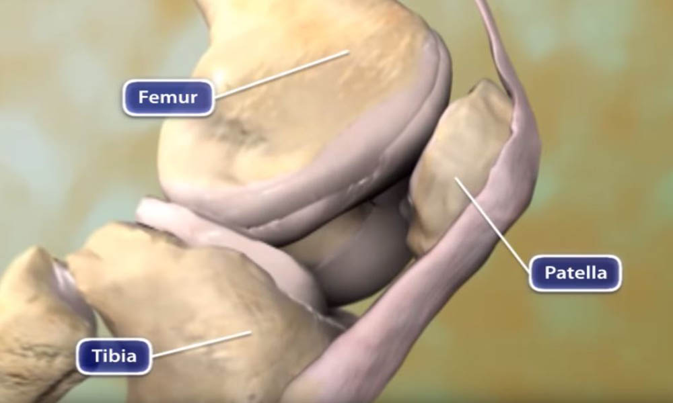
Answer:

Slide 36
What is a Glide Component?
100

Slide 37
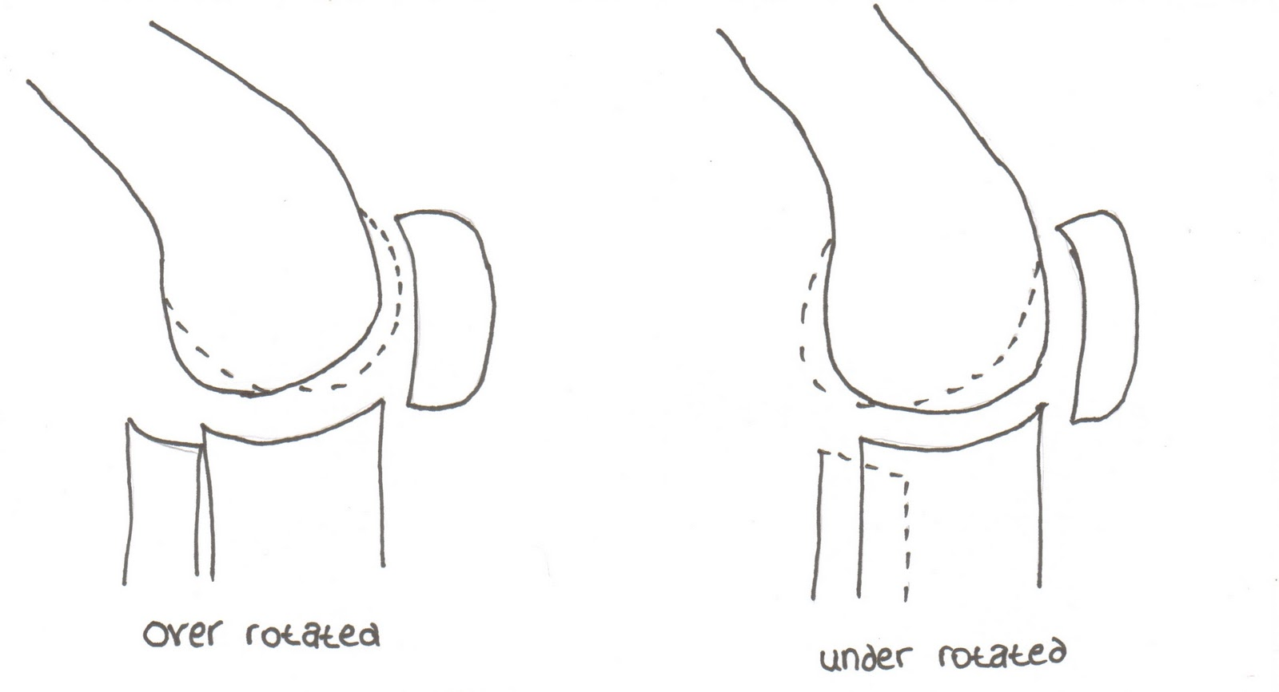
Answer:

Slide 38
What is Rotation?
300

Slide 39
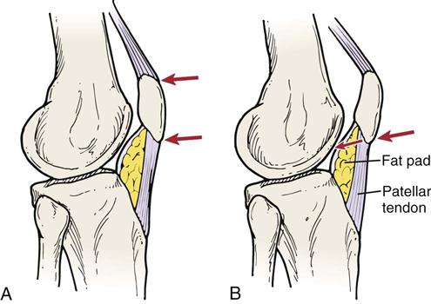
Answer:

Slide 40
What is A-P Tilt?
400

Slide 41
Answer: The only dynamic medial stabilizer

Slide 42
What is VMO
500

Slide 43
Answer: Lateral Collateral ligament

Slide 44
What is LCL
100

Slide 45
Answer: Anterior cruciate ligament

Slide 46
What is ACL
200

Slide 47
DAILY
DOUBLE!!!

Slide 48
Answer: Medial Collateral Ligament

Slide 49
What is MCL
300

Slide 50
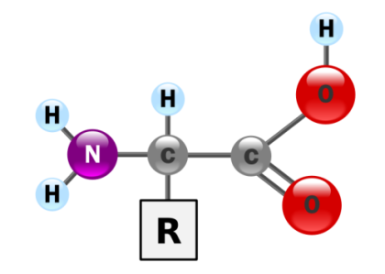
Answer: Posterior Cruciate Ligament

Slide 51
What is PCL
400

Slide 52
Answer: Two parts of the MCL

Slide 53
What is Deep and Superficial
500

