Slide 1
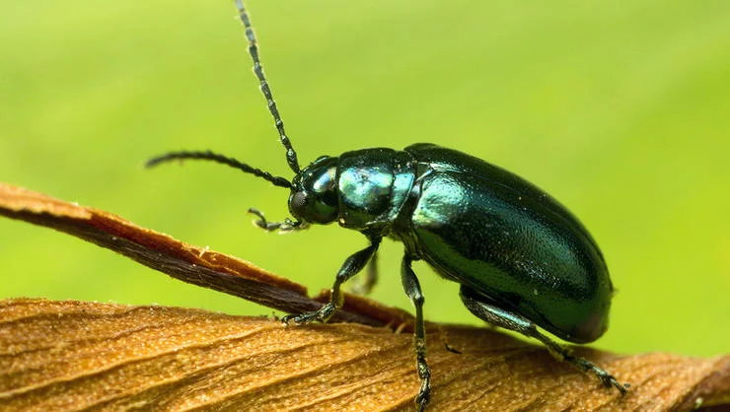
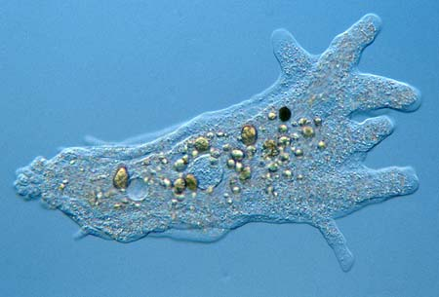
Unicellular vs. Multicellular Organisms

Slide 2
Unicellular vs. Multicellular Organisms

Slide 3
What is an “organism”?

Slide 4
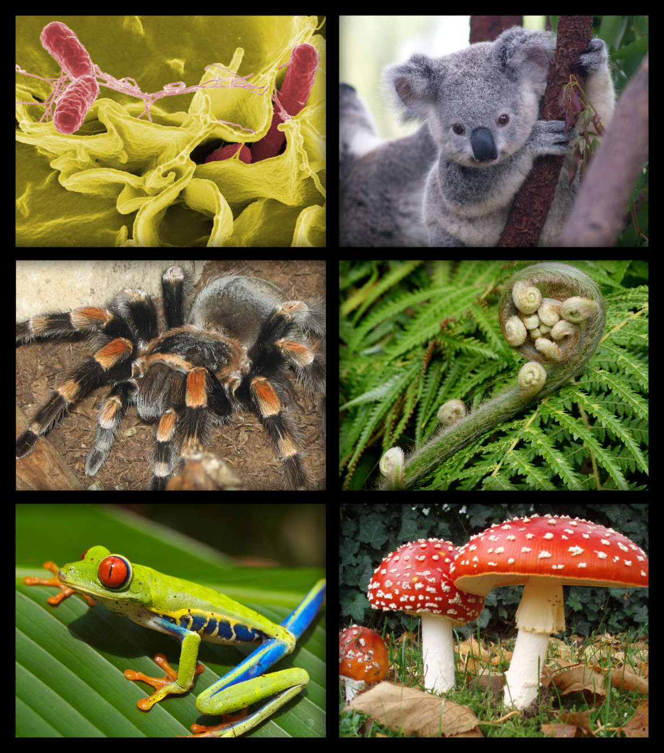
Organism:
An organism is something that is living.

Slide 5
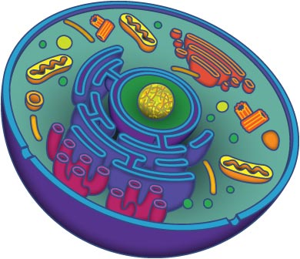
Cells:
A cell is the smallest unit of life that is classified as a living thing.
http://vimeo.com/37107992

Slide 6
Do all living things have the same amount of cells?

Slide 7
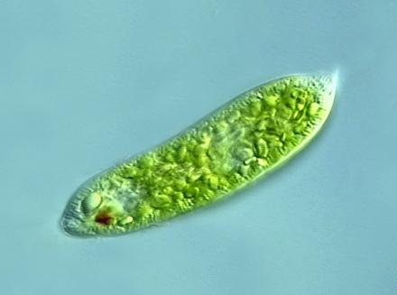
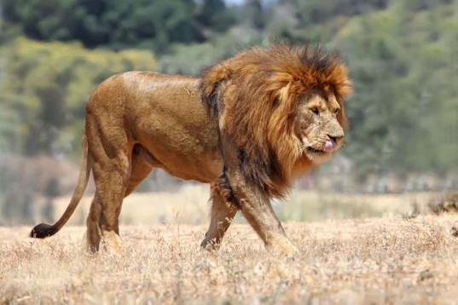
Structure
Unicellular Organism
Multicellular Organism
Body is made up of a single cell
Body is made up of numerous cells

Slide 8
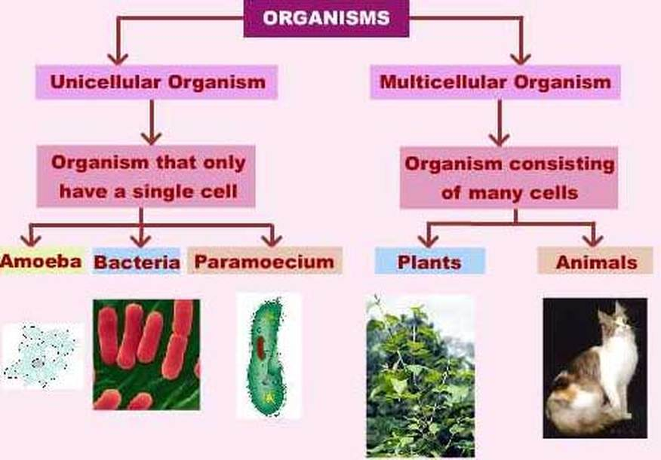
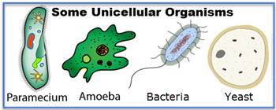

Slide 9
All organisms perform the following LIFE FUNCTIONS:
growth
movement
reproduction (make more of themselves)
respiration (breathing/gas exchange)
nutrition (finding food for energy)
excretion (getting rid of wastes)

Slide 10
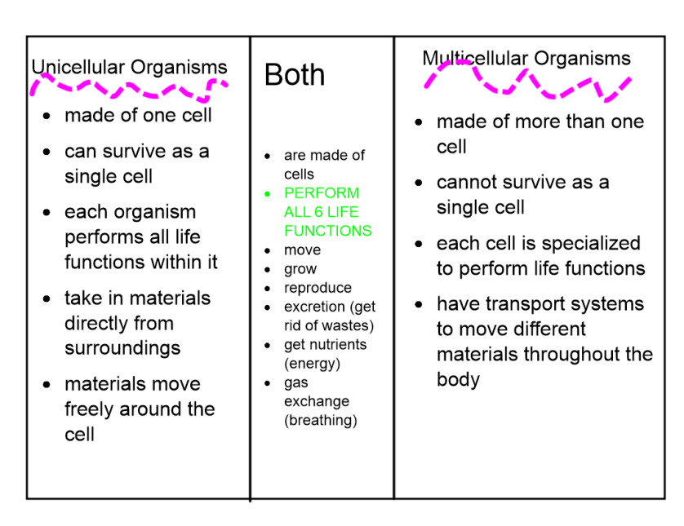

Slide 11
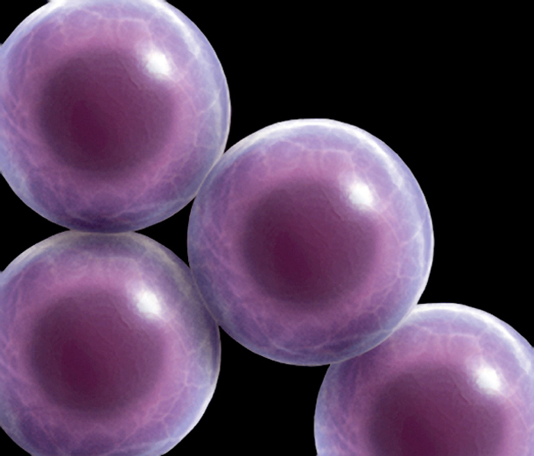
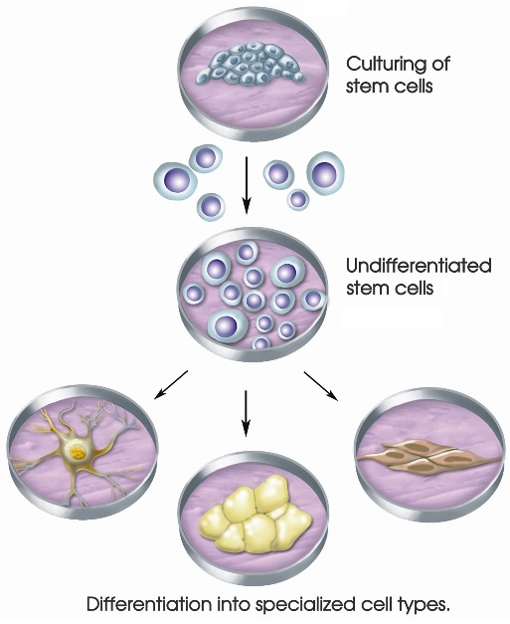
Specialization
Unicellular Organism
Multicellular Organism
A single cell carries out all the life processes
Different cells are specialized to perform different functions

Slide 12
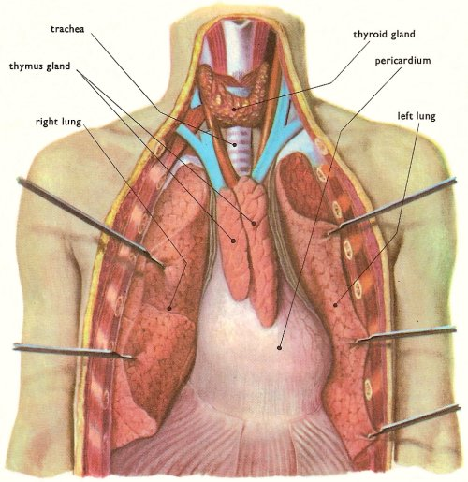
Exposure to Environment
Unicellular Organism
Multicellular Organism
The cell is exposed to the external environment on all sides
Only outer cells are specialized to face the environment. Inner cells are devoted to other functions

Slide 13
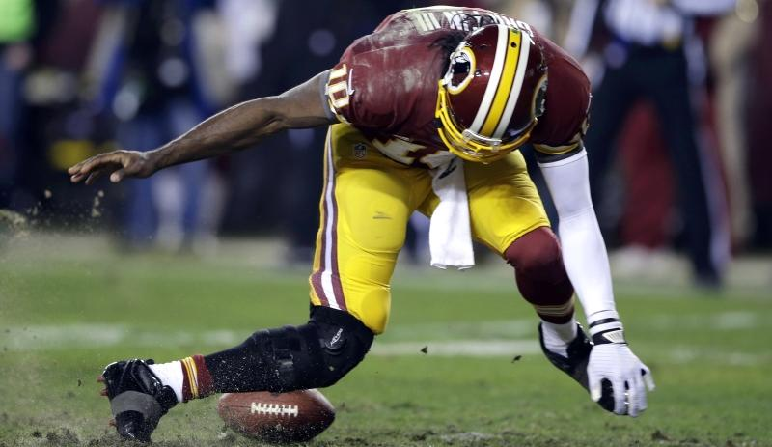
Injury
Unicellular Organism
Multicellular Organism
An injury of the cells can cause death of the organism
Injury or death of some cells does not affect the organisms as the same can be replaced by new one

Slide 14
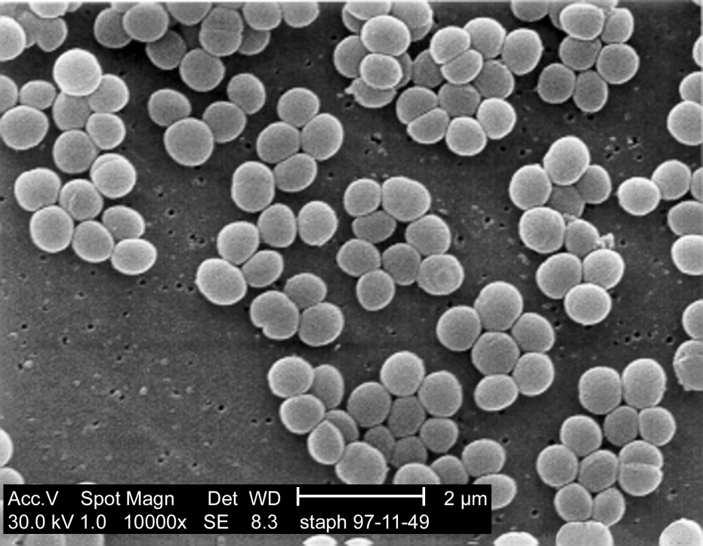
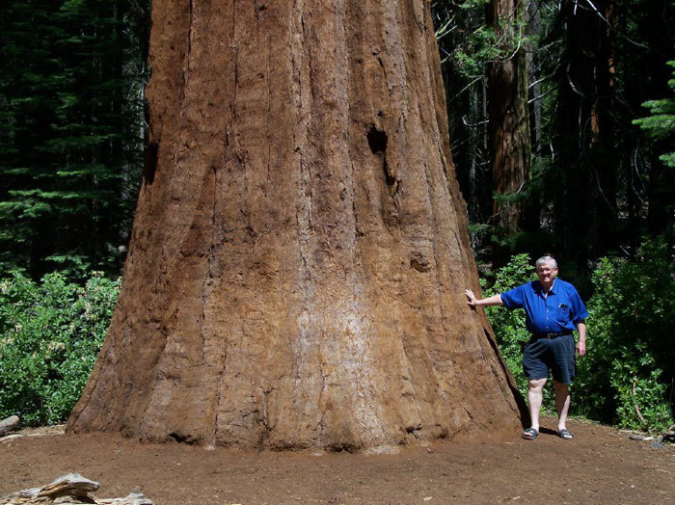
Size Limitation
Unicellular Organism
Multicellular Organism
A cell body cannot attain a large size because of the limit imposed by surface area to volume ratio
A multicellular body can attain a large size by increasing the number of small cells

Slide 15

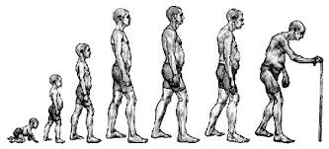
Lifespan
Unicellular Organism
Multicellular Organism
Lifespan is short due to heavy load of work
Lifespan is long due to limited load of work for each cell type

Slide 16
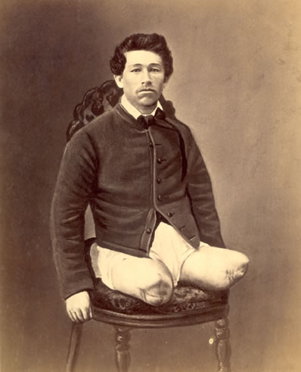
Regeneration
Unicellular Organism
Multicellular Organism
A well-marked capacity of regeneration is present
The capacity of regeneration decreases with increasing specialization (more special = less easy to regenerate)

Slide 17
What is an “organism”?

Slide 18
Organism:
An organism is something that is living.

Slide 19
Cells:
A cell is the smallest unit of life that is classified as a living thing.
http://vimeo.com/37107992

Slide 20
Do all living things have the same amount of cells?

Slide 21
Structure
Unicellular Organism
Multicellular Organism
Body is made up of a single cell
Body is made up of numerous cells

Slide 23
All organisms perform the following LIFE FUNCTIONS:
growth
movement
reproduction (make more of themselves)
respiration (breathing/gas exchange)
nutrition (finding food for energy)
excretion (getting rid of wastes)

Slide 25
Specialization
Unicellular Organism
Multicellular Organism
A single cell carries out all the life processes
Different cells are specialized to perform different functions

Slide 26
Exposure to Environment
Unicellular Organism
Multicellular Organism
The cell is exposed to the external environment on all sides
Only outer cells are specialized to face the environment. Inner cells are devoted to other functions

Slide 27
Injury
Unicellular Organism
Multicellular Organism
An injury of the cells can cause death of the organism
Injury or death of some cells does not affect the organisms as the same can be replaced by new one

Slide 28
Size Limitation
Unicellular Organism
Multicellular Organism
A cell body cannot attain a large size because of the limit imposed by surface area to volume ratio
A multicellular body can attain a large size by increasing the number of small cells

Slide 29
Lifespan
Unicellular Organism
Multicellular Organism
Lifespan is short due to heavy load of work
Lifespan is long due to limited load of work for each cell type

Slide 30
Regeneration
Unicellular Organism
Multicellular Organism
A well-marked capacity of regeneration is present
The capacity of regeneration decreases with increasing specialization (more special = less easy to regenerate)

