Slide 1


TYPES OF DOUGH

Slide 2
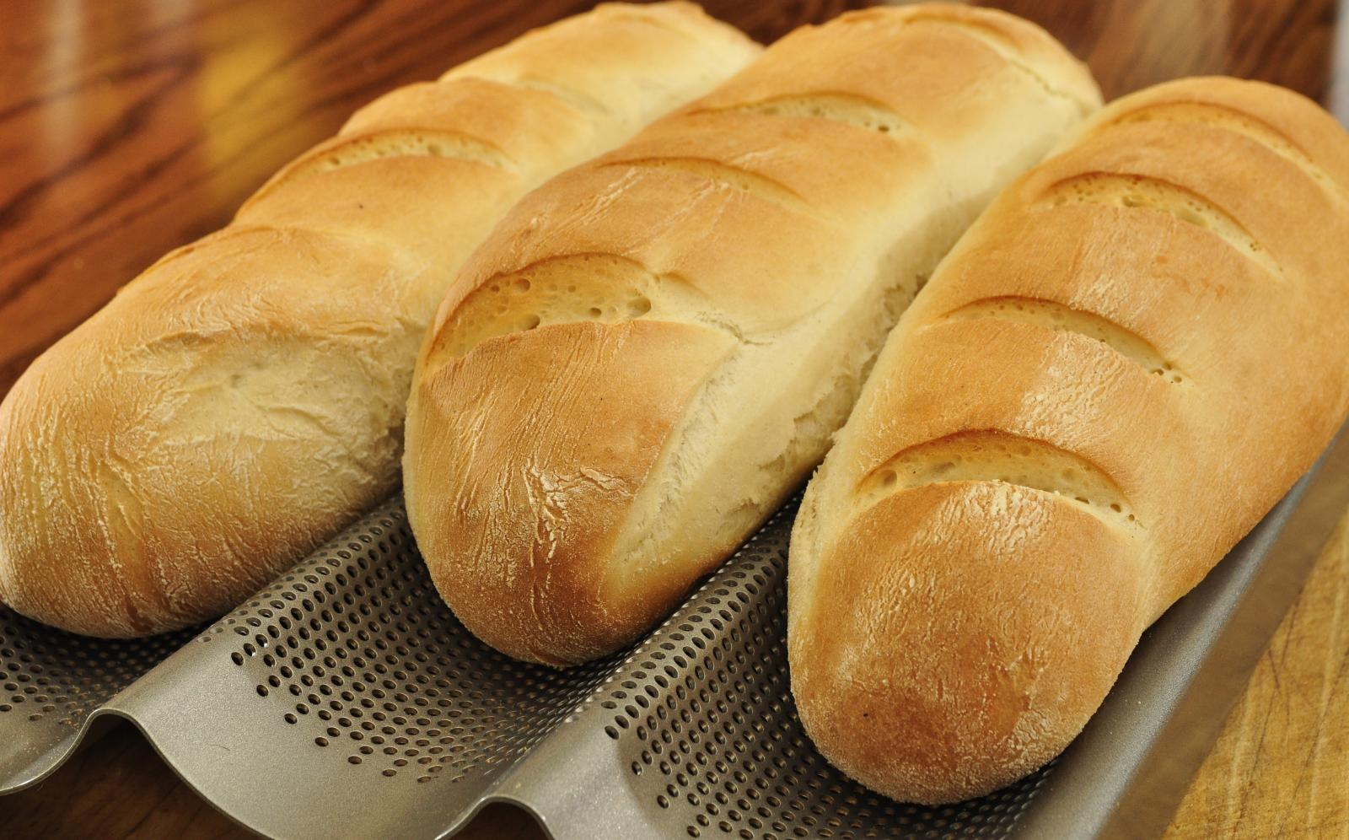
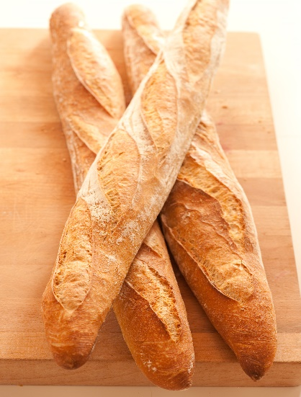
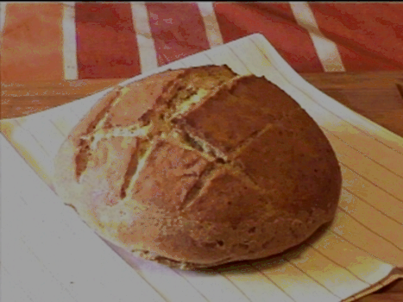
LEAN DOUGH
  Has little to no fat and sugar
  Made solely of flour, water, yeast and salt
  Have a relatively dry, chewy crumb, and hard crust
  Examples: French bread, Italian bread, baguettes, sourdough
Notes:
Most basic dough.

Slide 3
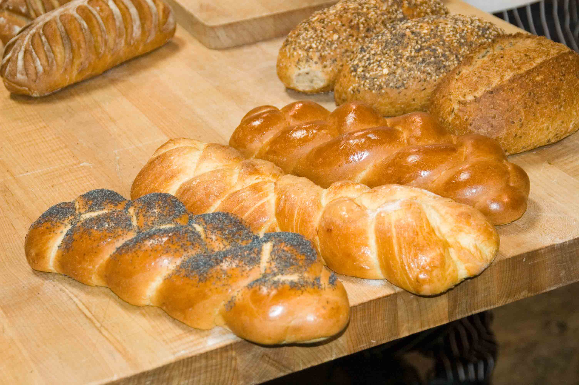
RICH DOUGH
  Consists of some fat (9%) and sugar
  Elastic and tears easily
  Have a soft crumb and crust
  Examples: Dinner rolls, Parker House rolls, Pullman bread, challah, brioche

Slide 4
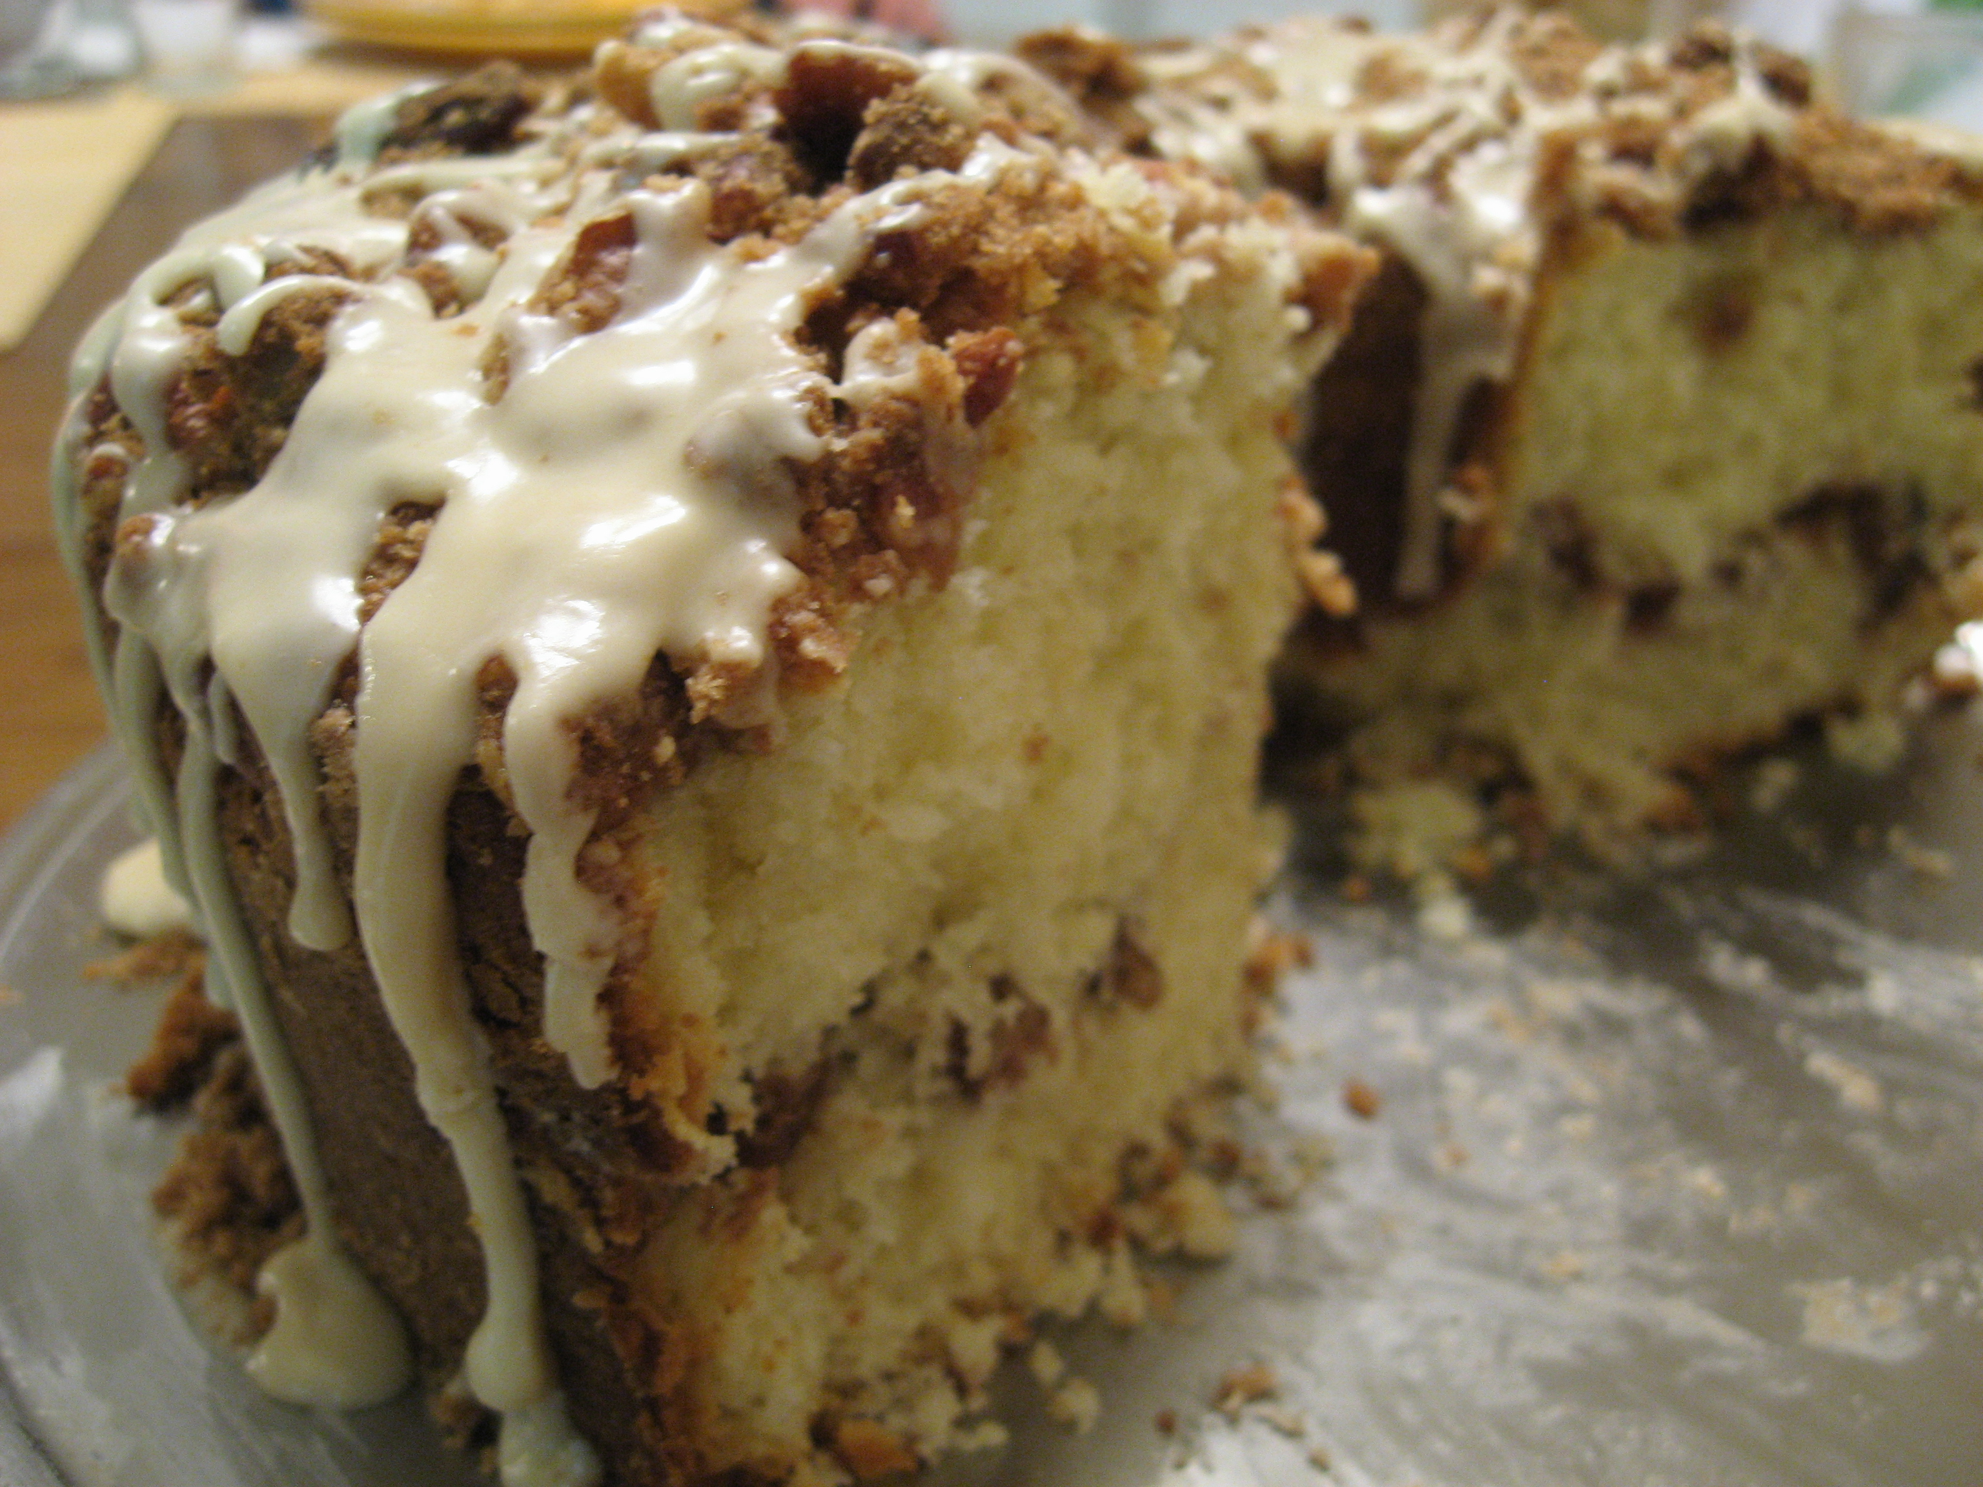
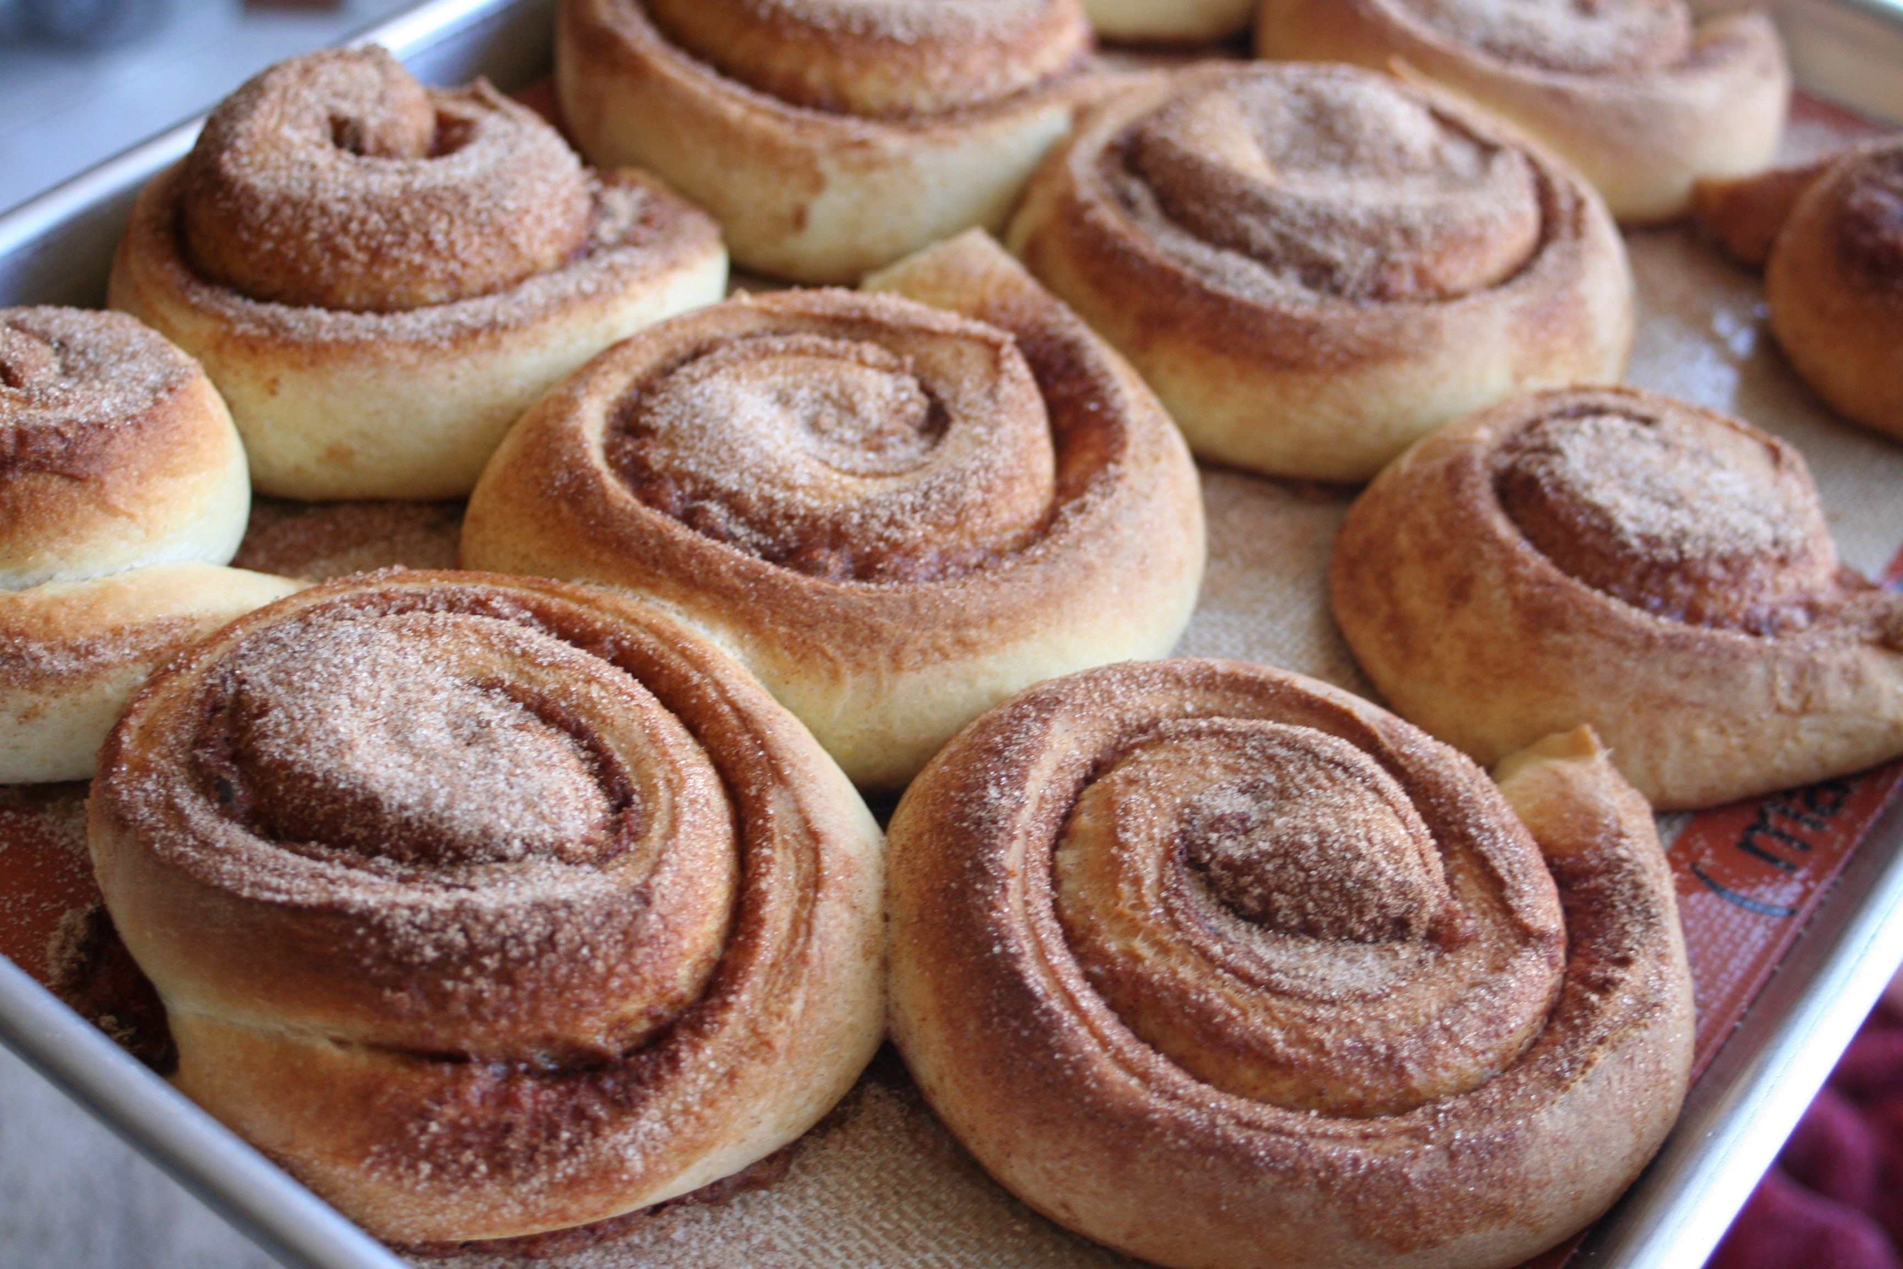
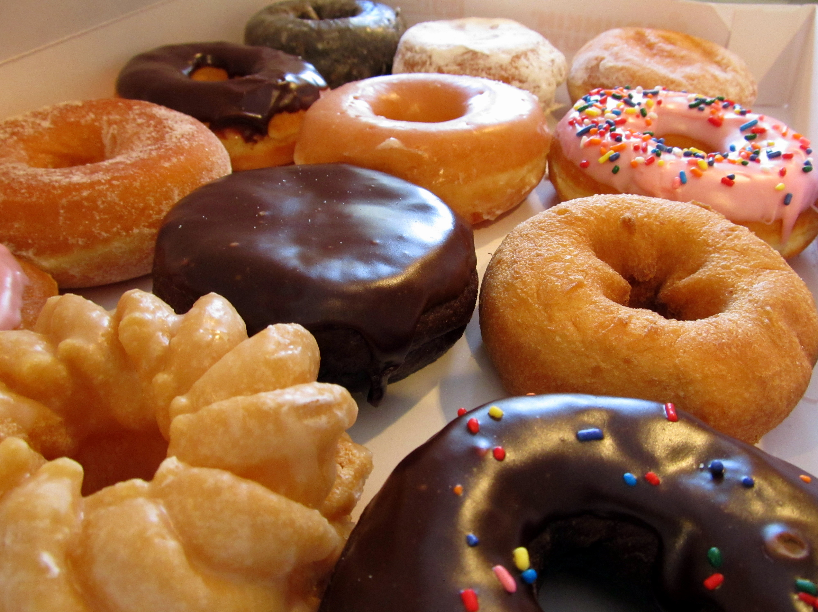
SWEET RICH DOUGH
  Incorporates up to 25% fat and sugar
  Structure is soft and heavy
  High gluten allows the dough to support the additional fat and sugar
  Examples: Coffee cakes, cinnamon buns, and doughnuts

Slide 5
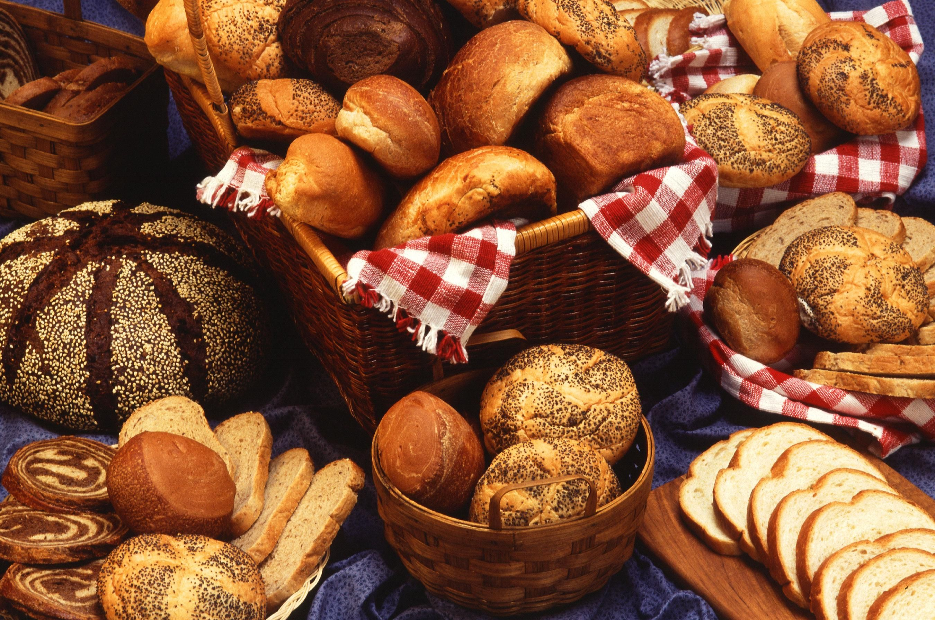
Characteristics of a high quality yeast bread
  Evenly browned crust that is not too rough
  Uniform crumb (inside of the bread)
  Well-developed flavor, not too yeasty
  Light texture, high volume

