Slide 1
Topic 9
Fatigue

Slide 2
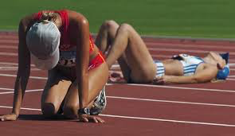
What is fatigue?

Slide 3
How is the feeling of fatigue different in the following examples?
Exercising to exhaustion in a 400m race (60-70 seconds)
Prolonged exhaustive muscular effort of running a marathon (2-4hours)

Slide 4
Definition of Fatigue
A reversible, exercise-induced decline in performance.

Slide 5
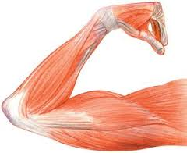
Different types of fatigue.
Fatigue is a complex phenomenon and can arise from a number of factors.
There are two main areas that fatigue can come under:
Peripheral fatigue
Peripheral fatigue occurs in
the muscle itself. It develops
rapidly and is caused by reduced
muscle cell force.

Slide 6
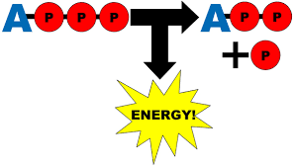
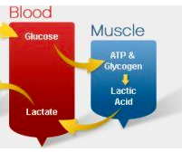
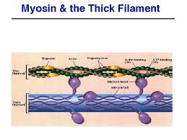
Different types of fatigue.
Causes of peripheral fatigue include:
Energy delivery
Accumulation of metabolic by-products
Failure of the muscles contractile
mechanism

Slide 7
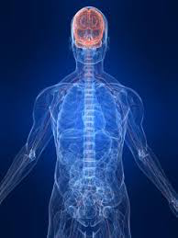
Different types of fatigue.
2. Central (or mental) fatigue
Develops during prolonged
exercise and is caused by
impaired function of the
central nervous system
(brain and spinal cord).

Slide 8
Different types of activity
High-intensity vs endurance activity
Task:
Make a list of activities that can be classed as either high intensity or endurance activities.
What characteristics do the activities from each category have in common?

Slide 9
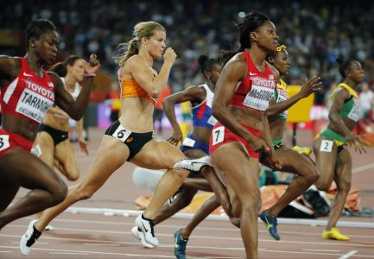
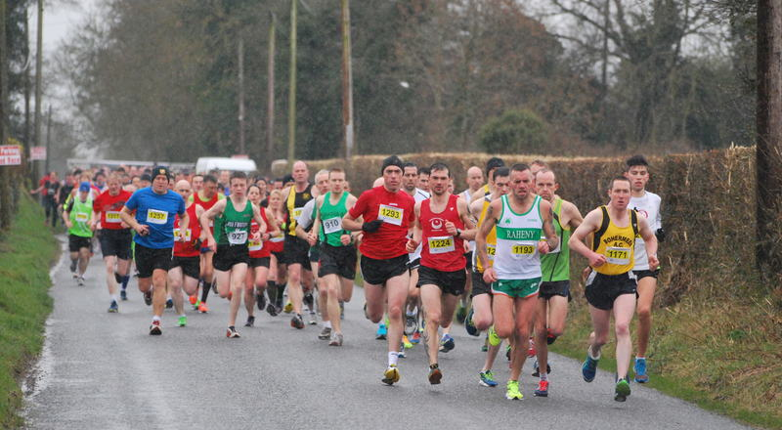
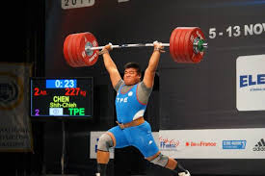
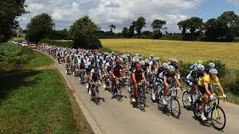
Different types of activity

Slide 10
Different types of activity
High-intensity exercise
involves a vigorous bout of intense activity that may last for less than a second, or as long as 1–2 minutes
E.g. some types of interval training, plyometrics, 100m sprint, Olympic lifting
The major sources of energy for this are derived from anaerobic processes (ATP-PC and Lactic acid sytems)

Slide 11
Different types of activity
Endurance activities
involve prolonged sessions of medium-intensity activity that may last from several minutes to several hours,
E.g. continuous cycling or jogging, 10000m, tour de France
The major sources of energy for endurance activities are aerobic processes.

Slide 12
Causes of fatigue
Fatigue is perceived differently by individual athletes and may depend on multiple factors such as:
age
level of fitness
specific type of activity or exercise carried out

Slide 13
Causes of fatigue in high intensity activities
On a physiological level, the development of peripheral fatigue in high-intensity activities depends on:
The rate of depletion of energy sources (creatine phosphate and ATP)
CP is used in anaerobic conditions, short duration high intensity exercise
It maintains ATP levels in the muscle
Depletion of CP will cause fatigue in this type of exercise

Slide 14
Causes of fatigue in high intensity activities
2. Increase in levels of the by-products of exercise
Lactic acid is a by-product of anaerobic glycolysis.
Activities of a short duration and high intensity rely heavily on the anaerobic glycolysis and produce large amounts of lactate and H⁺ ions.
Increased H⁺ ions decreases the pH in the cell.
A decreased pH leads to decreased energy production and decreased contraction force in the muscle.

Slide 15
Causes of fatigue in endurance activities
The physiological causes of peripheral fatigue in endurance activities include:
The depletion of muscle and liver glycogen reserves
Aerobic glycolysis relies on stored glycogen for the production of ATP.
The body stores glycogen in the muscles and liver.
During moderate intensity, prolonged exercise glycogen concentration decreases and is depleted after around 2 hours of activity.

Slide 16
Causes of fatigue in endurance activities
2. Reduction in Ca²⁺ release
Ca²⁺ Plays an important role in the contraction of muscle fibres (refer to sliding filament theory)
Reduced Ca²⁺ levels will inhibit muscle contraction

Slide 17
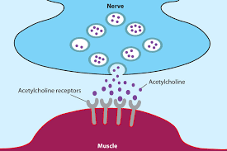
Causes of fatigue in endurance activities
3. Depletion of acetylcholine (Ach)
Ach is a neurotransmitter that relays the nerve impulse from the neuron to the muscle.
Depleted levels of Ach inhibit the ability of the muscle to contract.

Slide 18
Causes of fatigue in endurance activities
4. Dehydration
Dehydration leads to a decrease in blood plasma volume
This causes an increase in HR in order to maintain CO

Slide 19
Causes of fatigue in endurance activities
5. Electrolyte loss
Electrolytes are minerals that dissociate into the body as ions
They are lost in sweat along with water.
Electrolytes are essential for conducting electrical impulses used by the body’s nerves and in the contraction of muscles
E.g. Sodium, potassium and calcium

Slide 20
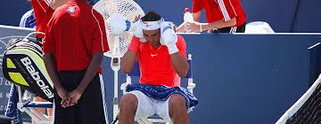
Causes of fatigue in endurance activities
6. Overheating
Increase in core body temperatures during prolonged exercise result in an increase in carbohydrate utilization and hasten glycogen depletion.

Slide 21
Causes of fatigue
Central (mental) fatigue is a significant factor in many endurance sports
Caused by failure of neural transmission.
The CNS is thought to limit exercise performance as a protective mechanism.
The perceived discomfort of fatigue generally precedes the onset of decreased physiological performance

Slide 22

Recovery from fatigue
The main aim of the recovery process is to restore the body to its pre-exercise state
(what it was like
before exercise
started).

Slide 23
Recovery from fatigue
Different aspects of recovery can occur at different rates, and recovery rate also depends on the type of activity (high-intensity, team sports or endurance).
This involves the removal of by-products produced during exercise and replenish the fuels used up during exercise.

Slide 24
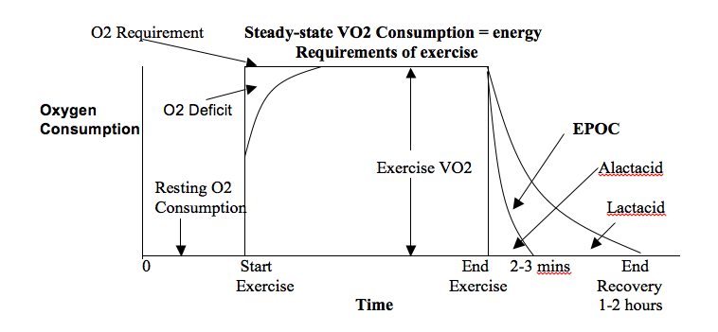
Recovery from fatigue

Slide 25
Recovery from fatigue
The initial rapid recovery stage (Alactacid Debt)
1. Resynthesizes the muscles’ store of ATP and CP
It takes 3 minutes for the ATP/PC stores to fully recover (in about 30 seconds for 50% of recovery and about 75% recovery in 60 seconds)
This process also uses 3-4 litres of oxygen

Slide 26
Recovery from fatigue
2. Replenishment of myoglobin stores in the muscle
Myoglobin is a Protein, similar to Haemoglobin (helping to transport oxygen) and is found in the muscle sarcoplasm
They store oxygen before transferring it to the mitochondria for aerobic respiration

Slide 27
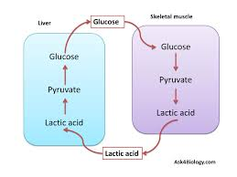
Recovery from fatigue
The slow recovery stage (Lactacid Debt)
The removal of lactic acid/lactate
Research findings suggest
that Lactic Acid can be
converted into pyruvic acid,
glucose/glycogen and
proteins.

Slide 28
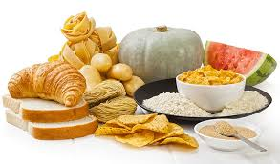
Recovery from fatigue
2. Replacement of muscle and liver glycogen stores.
With carbohydrate ingestion a large percentage of glycogen can be replaced up to 10-12 hours after exercise.
Muscle and liver glycogen
levels are fully restored within
24-48 hours after a bout of
intense aerobic exercise.

