Slide 1

Topic 8 (HL)
Sports, Exercise and Health Science
The Endocrine System

Slide 2

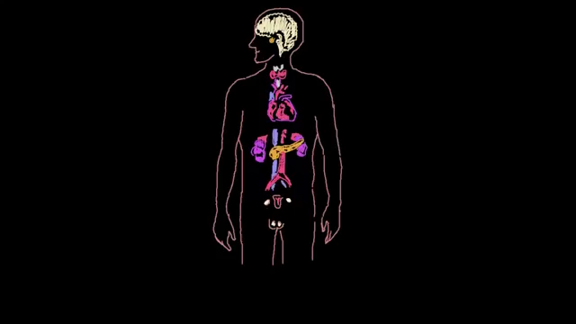
Intro to the Endocrine System

Slide 3
8.1.1-Label the location of the major endocrine organs in the human body.
Limit to:
Hypothalamus, pituitary gland,
pineal gland, thyroid gland,
adrenal glands, pancreas,
ovaries and testes

Slide 4
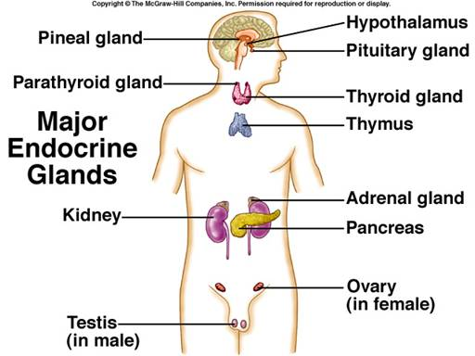
8.1.1-Label the location of the major endocrine organs in the human body.

Slide 5
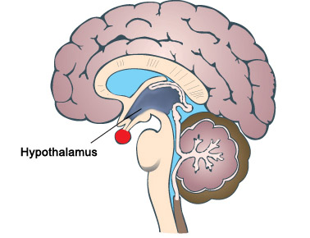
8.1.1-Label the location of the major endocrine organs in the human body.
Hypothalamus

Slide 6
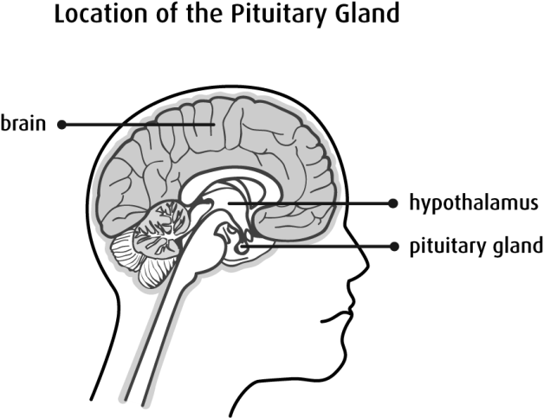
8.1.1-Label the location of the major endocrine organs in the human body.
Pituitary Gland

Slide 7
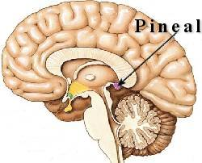
8.1.1-Label the location of the major endocrine organs in the human body.
Pineal Gland

Slide 8
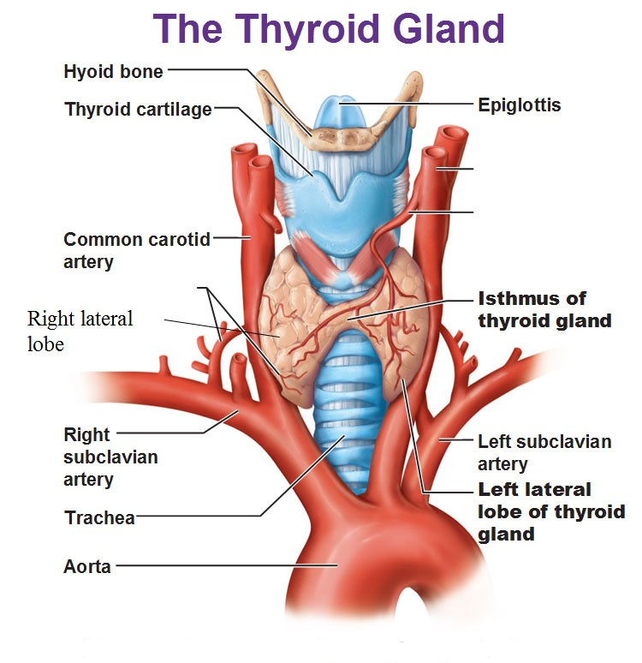
8.1.1-Label the location of the major endocrine organs in the human body.
Thyroid Gland

Slide 9
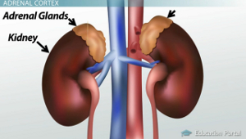
8.1.1-Label the location of the major endocrine organs in the human body.
Adrenal Glands

Slide 10
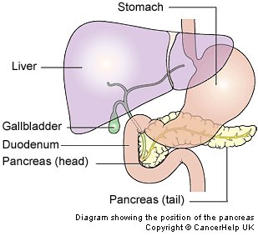
8.1.1-Label the location of the major endocrine organs in the human body.
Pancreas

Slide 11
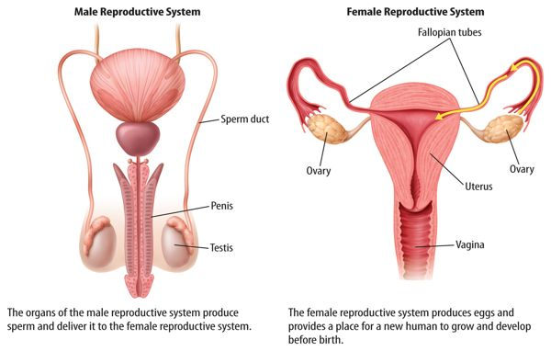
8.1.1-Label the location of the major endocrine organs in the human body.
Ovaries / Testes

Slide 12
8.1.2- Describe the role of circulating (blood) and local hormones.
Hormones are secreted by endocrine glands to regulate and coordinate a range of bodily functions.
E.g. Growth & metabolism

Slide 13
8.1.2- Describe the role of circulating (blood) and local hormones.
Release of most hormones occurs in short bursts, although some are secreted over longer periods of time in order to stimulate permanent changes to the body.

Slide 14
8.1.2- Describe the role of circulating (blood) and local hormones.
Hormones affect only specific target cells by (chemically) binding to specific receptors.

Slide 15
8.1.2- Describe the role of circulating (blood) and local hormones.
Circulating hormones travel around the body in the blood.
Examples include:
adrenaline and testosterone.

Slide 16
8.1.2- Describe the role of circulating (blood) and local hormones.
Local hormones act on neighbouring cells without entering the bloodstream and are usually inactivated quickly.
Examples include:
glucagon and serotonin.

Slide 17
8.1.3 - Explain how circulating hormone levels are regulated.
They are regulated by complex feedback loops that may be influenced by:
signals from the nervous system, such as adrenaline
chemical changes in the blood, such as insulin
other hormones, such as growth hormone.

Slide 18


8.1.4 - Explain the relationship between the hypothalamus and the pituitary gland.

Slide 19
8.1.4 - Explain the relationship between the hypothalamus and the pituitary gland.
The hypothalamus and the pituitary gland are together responsible for homeostasis.
The hypothalamus is the part of the brain that controls the pituitary gland.
The pituitary gland is an endocrine gland located in the brain below the hypothalamus.

Slide 20
8.1.4 - Explain the relationship between the hypothalamus and the pituitary gland.
Neurohormones, such as GHRH and somatostatin from the hypothalamus, directly influence the pituitary gland.
Nerve impulses from the hypothalamus also stimulate the pituitary gland.

Slide 21
8.1.4 - Explain the relationship between the hypothalamus and the pituitary gland.
The pituitary gland secretes hormones, such as: Antidiuretic hormone (ADH) and growth hormone (GH), that help regulate a wide range of bodily functions including growth, and water and temperature regulation.

