Slide 1
TOPIC 3
Energy systems

Slide 2
3.1.1 List the macronutrients and micronutrients.
Macronutrients include:
  Lipid (fat)
  carbohydrate and
  protein.
Micronutrients include:
  Vitamins
  Minerals
  Water
  Fibre

Slide 3
3.1.2 Outline the roles of macronutrients and micronutrients.
Specific knowledge of individual vitamins and minerals are not required.
MACRONUTRIENTS:
These are present in our diets in large amounts, and make up the bulk of our diets providing the human body with energy.
It is recommended that our diets are made up of 50 -60% of carbohydrates, 12 – 15% of protein and less than 30% fat.

Slide 4
ROLES OF CARBOHYDRATE
Carbohydrates are stored in the muscle and liver and excess carbohydrate can be converted and stored as triglyceride.
Both carbohydrates and triglycerides are mainly used as fuel sources.

Slide 5
ROLES OF LIPID
Triglycerides (broken down lipid) is stored as adipose tissue.
Heat insulation: a layer of subcutaneous fat under the skin reduces fat loss in mammals and birds.
Cell membranes: are composed of phospholipids.
Steroid hormones: cannot be manufactured without lipids.
Buoyancy: lipids are less dense than water so help animals to float.

Slide 6
ROLES OF PROTEIN:
Protein is not normally used for fuel but amino acids (broken down protein) can be used to build muscle fibres.

Slide 7
MICRONUTRIENTS: These are in our diets, but in very small amounts. These can be found in vitamins, minerals and trace elements.
Micronutrients, just like water do not provide energy, however they are still needed in adequate amounts to ensure that all our body cells function properly.
Most of micro nutrients are known to be essential nutrients, meaning they are those which are dispensable to life processes, and what the body can-not make itself. In other words meaning these essential nutrients can only be obtained from the food in which we eat.

Slide 8
3.1.3 State the chemical composition of a glucose molecule.
Carbon, Hydrogen and Oxygen.
It’s chemical formula is C6H12 O6
1:2:1 ratio

Slide 9
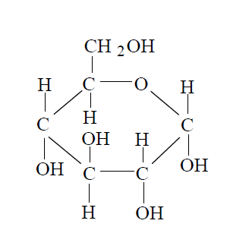
3.1.4 Draw a diagram representing the basic structure of a glucose molecule.

Slide 10
3.1.5 Explain how glucose molecules can combine to form disaccharides and polysaccharides.
The basic subunits of carbohydrates are monosaccharides.
The monosaccharides can be linked to form a disaccharide.
More monosaccharides can be linked to a disaccharide to form a polysaccharide.
These reactions are all condensation reactions producing water.

Slide 11
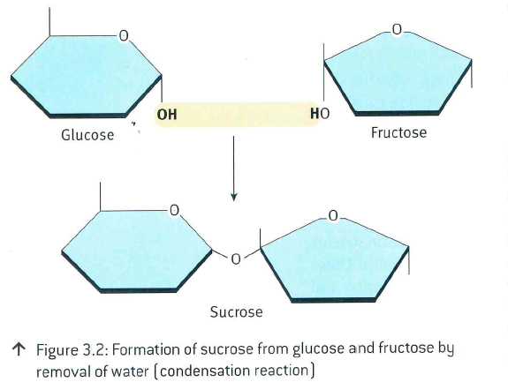
Monosaccharides: One molecule, easily absorbed. Glucose, fructose and galactose.
Disaccharides: Formed by two monosaccharides by the loss of a water molecule.

Slide 12
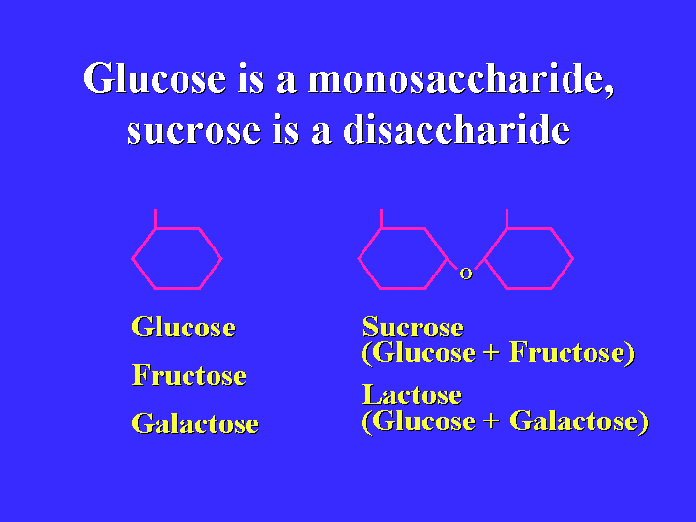

Slide 13
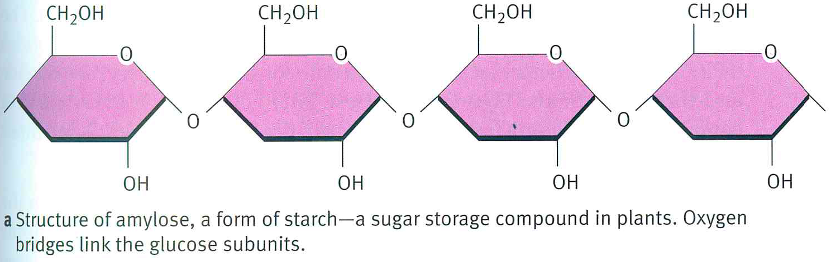
MACRONUTRIENTS
Carbohydrates
Oligosaccharides: Carbohydrates with three to nine molecules
Polysaccharides: Molecule chains longer than ten molecules. Ex: Starch and glycogen

Slide 14
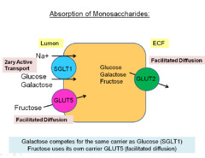
MACRONUTRIENTS
Carbohydrates
Di-, oligo- and polysaccharides need to be broken down to monosaccharides in the gut in order to be absorbed.
What is dietary
fiber then?

Slide 15
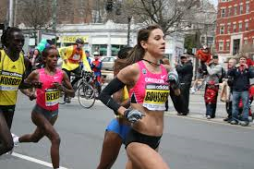
MACRONUTRIENTS
Carbohydrates
Important source of energy for intense and prolonged periods of exercise.
100 g of carbs yield 1,760 kj

Slide 16
3.1.6 State the composition of a molecule of triacylglycerol.
Triglycerides are formed from a single molecule of glycerol, combined with three fatty acids
Ester bonds form between each fatty acid and the glycerol molecule.

Slide 17
IB
Sports, exercise and health science
Energy Systems
Topic 1
Anatomy
3.1.6 State the composition of a molecule of triacylglycerol (TAG)
Triacylglycerols are storage lipids stored mostly in adipose (fat) cells and tissues, which are highly concentrated stores of metabolic energy.
As the name triacyglycerols implies the molecules are composed of three Fatty Acids attached to a glycerol skeleton. (Glycerol is a central component of lipids)
TAG is the preferred form for energy storage because Fatty Acids have greater potential chemical energy due to the reduced CH groups than does glucose, which is already partly oxidised with plenty of OH groups.
http://www-biol.paisley.ac.uk/Courses/stfunmac/glossary/triacylglycerol.html
Sub-topics
1. Nutrition
2. Carbohydrate and fat metabolism
3. Nutrition and energy systems

Slide 18
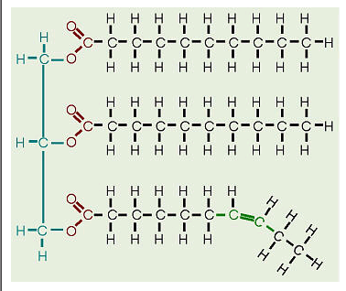
Structure of triacylglycerol.
Saturated Fatty acid
Unsaturated Fatty acid

Slide 19
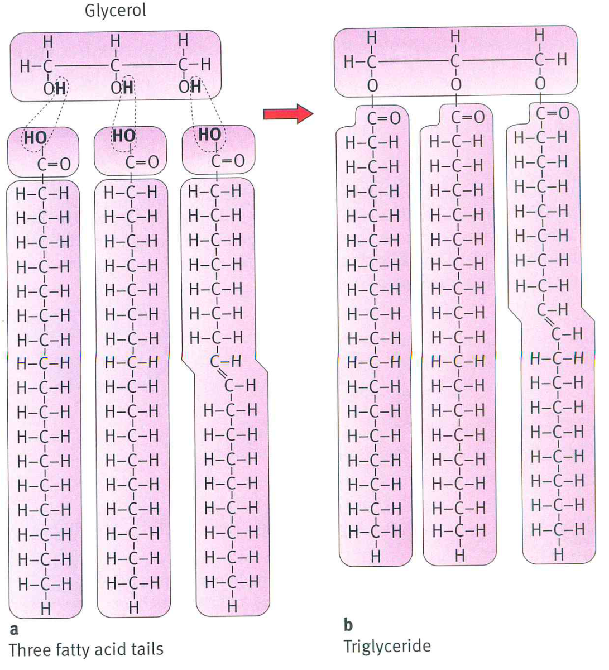
MACRONUTRIENTS
Fat
Found in animal and
plant sources.
Dietary fats:
- Tryglicerides (95 %)
- Phospholipids
- Sterols
Triglyceride:
1 glycerol +
3 fatty acids

Slide 20
Fatty acids
The different structure of fatty acids determines the characteristic and biological function of tryglicerides.
Structure: Chain of C atoms with H attached
Methyl group (CH3)
Carboxyl group (COOH)
The ones that we cannot synthesize are called essential fatty acids.<--- DIET

Slide 21
IB
Sports, exercise and health science
Energy Systems
Topic 1
Anatomy
3.1.7 Distinguish between saturated and unsaturated fatty acids
A fatty acid is a carboxylic acid, which is either saturated or unsaturated.
Most of the natural fatty acids have an even number of carbon atoms, because there biosynthesis involves acetyl-CoA, a coenzyme carrying a two carbon atom group.
http://en.wikipedia.org/wiki/Fatty_acid
Sub-topics
1. Nutrition
2. Carbohydrate and fat metabolism
3. Nutrition and energy systems

Slide 22
3.1.7 Distinguish between saturated and unsaturated fatty acids
An unsaturated fat is a fat or fatty acid in which there are one or more double bonds in the fatty acid chain.
A fat molecule is monounsaturated if it contains one double bond, and polyunsaturated if it contains more than one double bond.
a saturated fat is "saturated" with hydrogen atoms.
In cellular metabolism hydrogen-carbon bonds are broken down to produce energy, thus an unsaturated fat molecule contains somewhat less energy (i.e fewer calories) than a comparable sized saturated fat.

Slide 23
Substituting (replacing) saturated fats with unsaturated fats helps to lower levels of total cholesterol and LDL cholesterol in the blood.
Foods containing unsaturated fats include avocado, nuts, and vegetable oils such as canola, and olive oils.
Meat products contain both saturated and unsaturated fats.
Although unsaturated fats are healthier than saturated fats,^{[3]} the Food and Drug Administration (FDA) recommendation stated that the amount of unsaturated fat consumed should not exceed 30% of one's daily caloric intake (or 67 grams given a 2000 calorie diet).

Slide 24
IB
Sports, exercise and health science
Energy Systems
Topic 1
Anatomy
3.1.7 Distinguish between saturated and unsaturated fatty acids
Saturated fats have no double bonds between their carbon atoms and tend to be solid at room temperature, whereas unsaturated fats (one or more double bonds) are liquid at room temperature and therefore considered oils.
Sewell et. al 2005
Sub-topics
1. Nutrition
2. Carbohydrate and fat metabolism
3. Nutrition and energy systems

Slide 25
Fat as a source of energy
100 gr of fat provide 4000 kJ
Found in the adipose tissue
Functions:
  Recovery between high intensity exercise
  Source of energy during prolonged exercise
  Physical protection of vital organs
  Control of body temperature
  Synthesis and transport of hormones

Slide 26
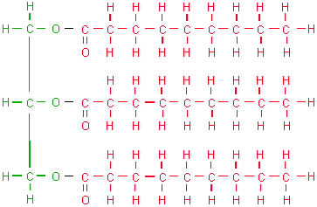
3.1.8 Draw a diagram representing the basic structure of a lipid molecule.

Slide 27
Fatty acids can be linked to glycerol by a condensation reaction to produce lipids called glycerides.
A maximum of three fatty acids can be linked to one glycerol molecule, producing a triglyceride.

Slide 28
Learning Objectives
Everyone will be able to
State the composition of a protein molecule.
2. Distinguish between essential and non-essential amino acids
3. Distinguish types of proteins depending on their function

Slide 29
3.1.9 State the chemical composition of a protein molecule.
Protein molecules consist of Carbon, Hydrogen, Oxygen and Nitrogen.
The smallest part of a protein is called an amino acid.
Chains of amino acids
Amino acids: C, H, O and N and a side chain determining their physical and chemical properties.

Slide 30
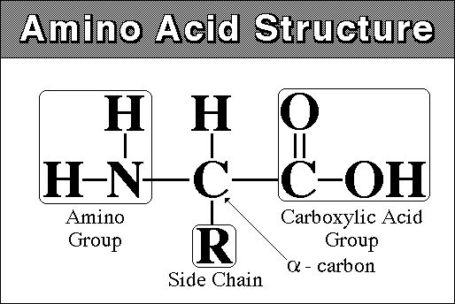
Proteins are the most complex and functionally diverse of molecules of living organisms. They compose enzymes, blood and muscle tissue just to name a few and are therefore associated with meat products.

Slide 31
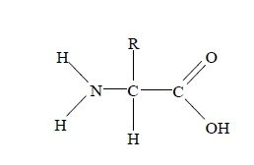
3.1.10 Draw a diagram representing the basic structure of an amino acid.

Slide 32
Two amino acids can be joined together to form a dipeptide by a condensation reaction. The new bond formed is a peptide linkage.
Further condensation reactions can link amino acids to either end of the dipeptide, eventually forming a chain of many amino acids. This is called a polypeptide.

Slide 33
3.1.11 Distinguish between an essential and a nonessential amino acid.
The human body requires 20 naturally occurring amino acids for its proper functioning.
There are 8 essential amino acids for humans: phenylalanine, valine, threonine, tryptophan, isoleucine, methionine, leucine, and lysine.
They are called essential because the body does not manufacture them but must be ingested in the diet.

Slide 34
Therefore a proper diet should be balanced and must include all the essential amino acids. Foods that contain a good and varied amount of amino acids, including the essential ones should be included in our daily diet.
Based on their content of amino acids, foods are often classified as complete, partially complete, or incomplete protein sources. In order for a protein to be complete, it must contain all of the essential amino acids.

Slide 35
The body continually breaks down protein molecules and rebuilds the resulting amino acids into other usable chains required by particular areas of the body.
In addition to their main functions of building needed proteins, amino acids also assist vitamins and minerals to do their jobs properly. Even if vitamins and minerals were absorbed and assimilated rapidly, they would not be as effective as they are in the presence of amino acids.

Slide 36
An adequate diet must contain enough protein to supply these amino acids. The generally accepted sources of amino acids are meat and dairy products.
However, the necessary amino acids can be supplied on a vegetarian or vegan diet but good nutritional planning is necessary to make sure of an adequate supply.
Certain combinations of cereal grains (wheat, corn, and rice) along with legumes (beans, peanuts) will provide a complete amino acid.

Slide 37
IB
Sports, exercise and health science
Energy Systems
Topic 1
Anatomy
3.1.11 Distinguish between an essential and a non-essential amino acid
Sub-topics
In addition, CYSTEINE (cystine) and TYROSINE, sometimes classified as NONESSENTIAL AMINO ACIDS, are now considered semiessential because if the diet contains them (meat, milk, fish, poultry and legumes are good sources), the body can use them in place of two essential amino acids methionine and phenylalanine, respectively to make protein. The nonessential amino acids are ALANINE, ARGININE, ASPARAGINE, ASPARTIC ACID, GLUTAMIC ACID, GLUTAMINE, GLYCINE, PROLINE, SERINE and TAURINE.
http://www.becomehealthynow.com/article/proteins/335/
1. Nutrition
2. Carbohydrate and fat metabolism
3. Nutrition and energy systems

Slide 38
Types of Proteins
Function of proteins depends on their structure, shape and size.
  Structural: muscle, bones, skin and cells
  Transport/communication: hormones, receptors, neurotransmitters
  Protective: antibodies, anti-inflammatory
  Enzymatic: Digestion, metabolism

Slide 39
MACRONUTRIENTS
Water and its functions
Medium in cells for reactions and transport
Transport: Nutrients, metabolites, waste and resparotary gases
Thermoregulation (?) and excretion (?)
Cell-cell and cell-environment communication
Lubrication of joints and sliding surfaces

Slide 40
Learning Objectives
Everyone will be able to
Distinguish between water-soluble and fat-soluble vitamins
2. Understand the importance of minerals and trace elements in the well function of the human body

Slide 41
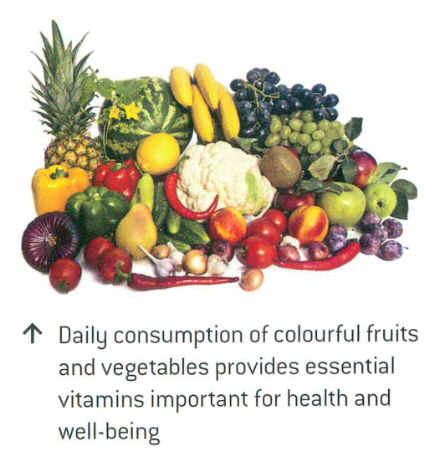
MICRONUTRIENTS
Vitamins
Where? → Fruits, vegetables and meat
Funtion → Regulators of energy release
Types of vitamins
  Water-soluble: Overdose not toxic (urine)
  Fat-soluble: Stored in adipose tissue and liver

Slide 42
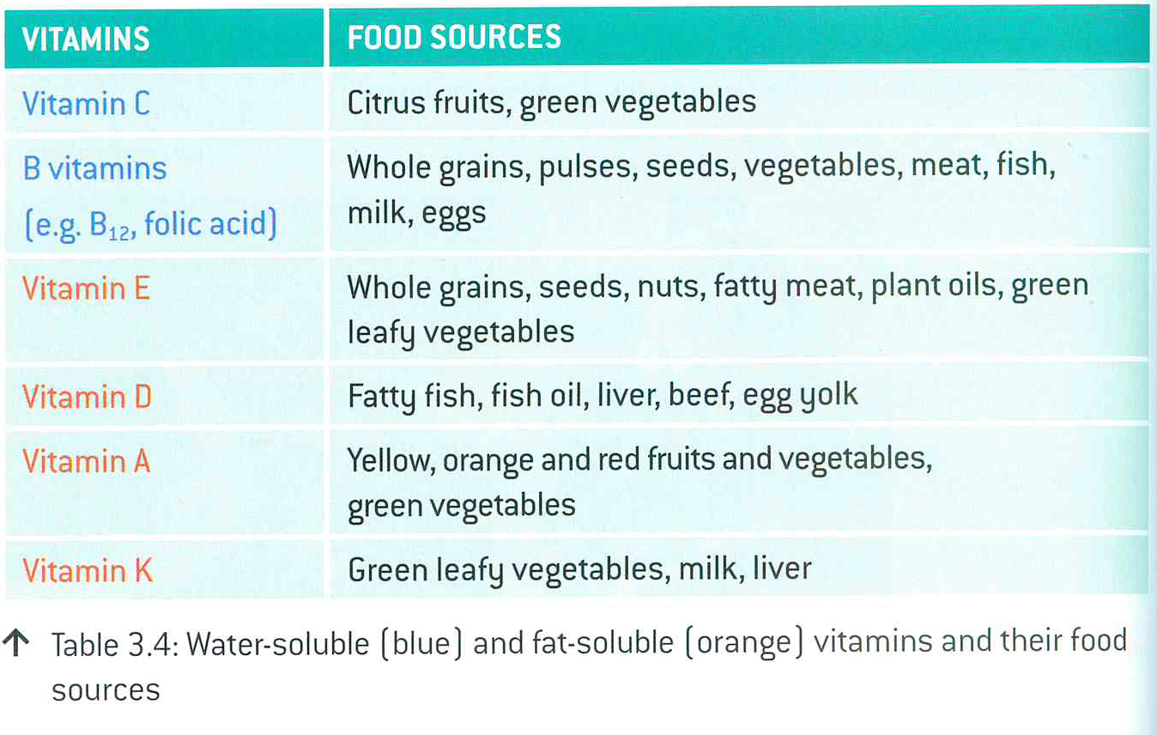
Vitamins and their food sources

Slide 43
Recommendations for a healthy balanced diet
Dietary advice differs depending on the country
WHO recommended population´s intake of nutrients of 400 gr per day:
The recommended amounts of intake vary depending on age, gender, activity, pregnancy and lactation

Slide 44

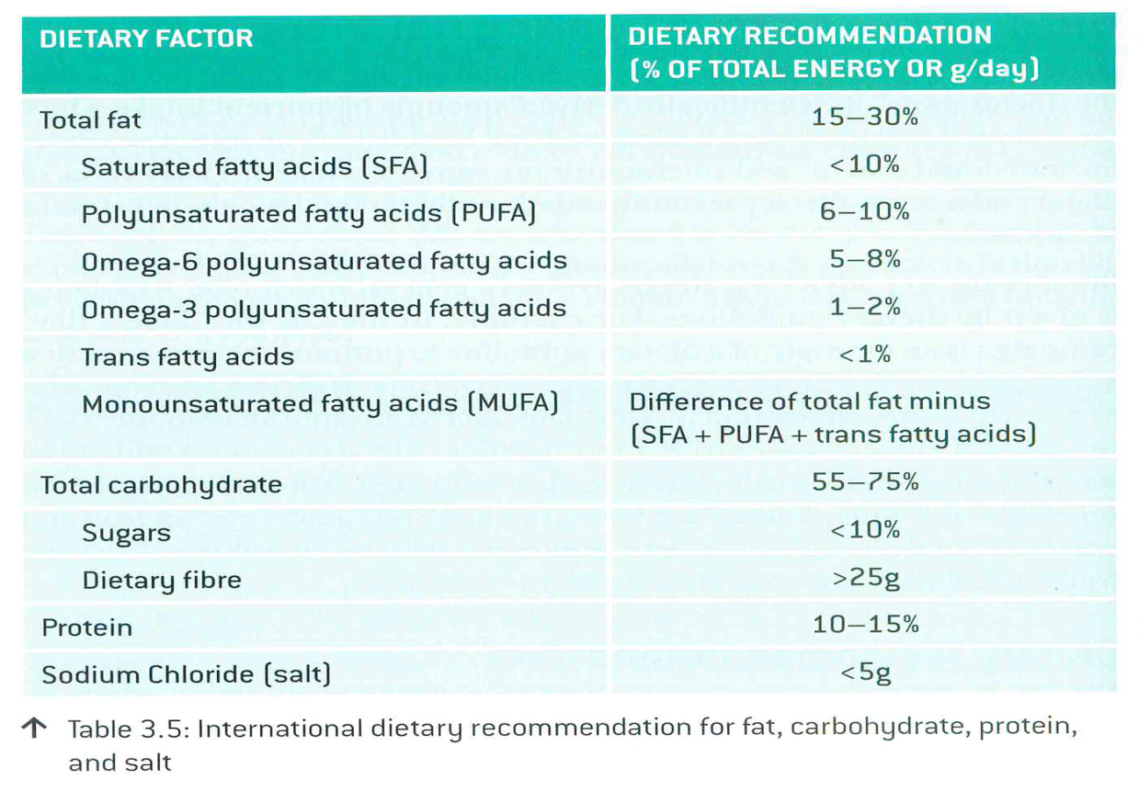
World Health Organization and Food and Agriculture Organization
These two organizations developed dietary goals for both developing and developed countries for prevention of long-term disease
YOU CHOOSE

Slide 45
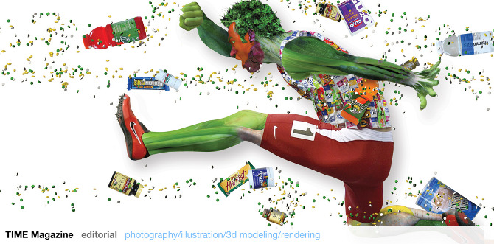

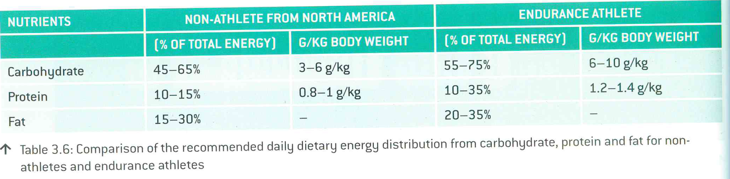
Endurance athletes vs non-athletes
Endurance athletes need far more energy intake: Mainly more carbohydrates for high performance and delay of fatigue.
Protein, fat and water also need to increase in the diet of an endurance athlete.

Slide 46
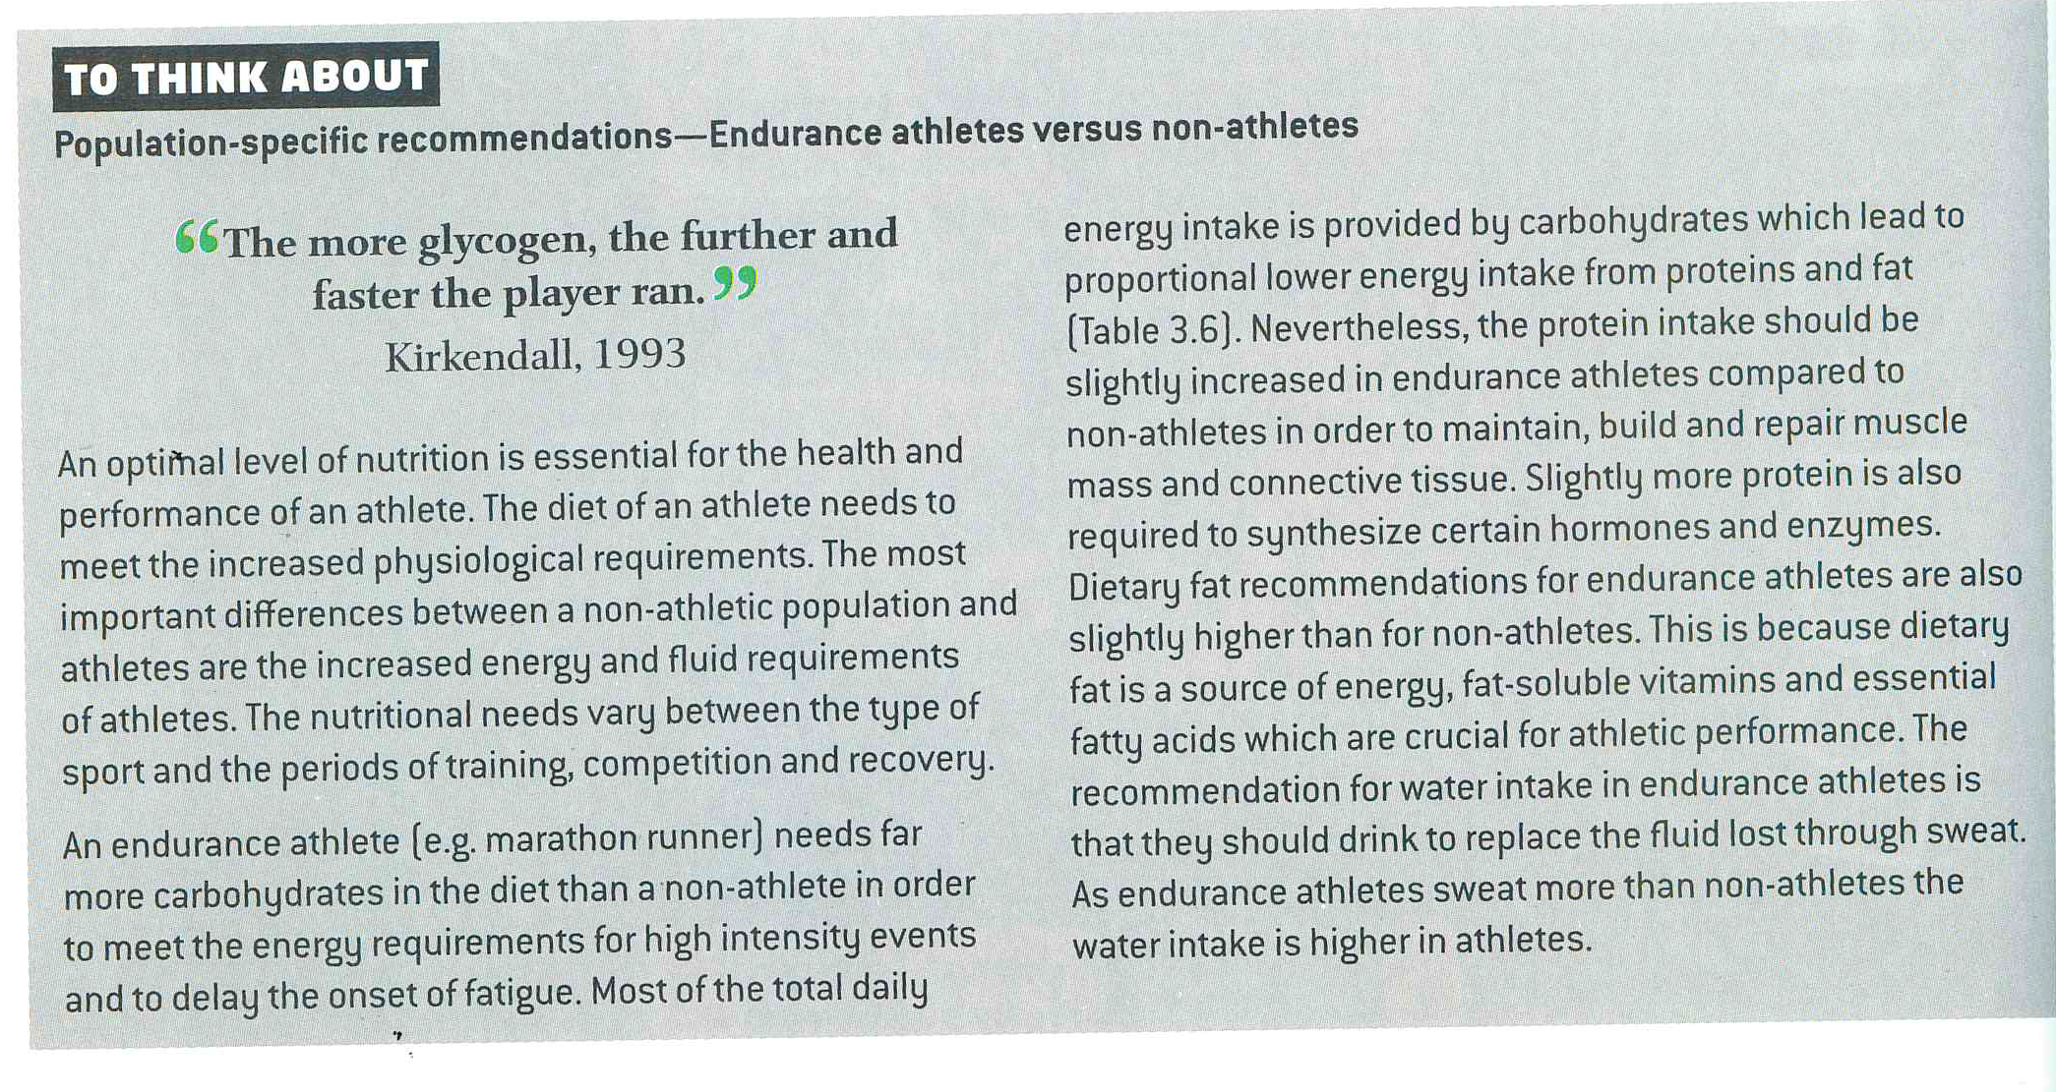
Endurance athletes vs non-athletes

Slide 47
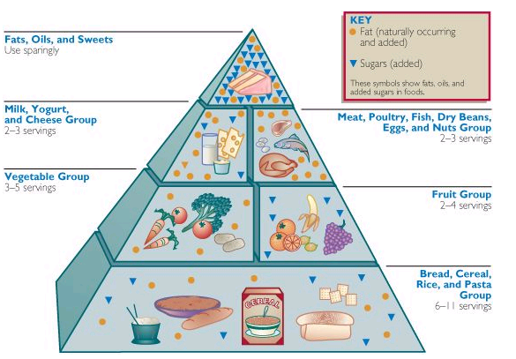
3.1.12 Describe current recommendations for a healthy balanced diet.

Slide 48
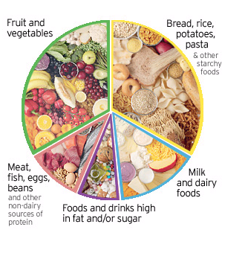
UK

Slide 49
It is recommended that our diets are made up of 50 -60% of carbohydrates, 12 – 15% of protein and less than 30% fat.
In conclusion, a healthy diet must include proteins, carbohydrates and fats.
Intake of saturated fats should be strictly limited,
as should intake of high glycemic index carbohydrates.
Protein and fat nutrition must emphasize the essential acids
while carbohydrates shall include only those of low glycemic index.
Protein foods should also be chosen in consideration of the fat content.

Slide 50
3.1.13 State the energy content per 100g of carbohydrate, lipid and protein.
Carbohydrate = 1600 kJ
Protein = 1700 kJ
Fat =3700 kJ
Both carbohydrates and lipids can be used for energy storage in humans. Carbohydrates are usually used for energy storage over short periods and lipids for long term storage.

Slide 51
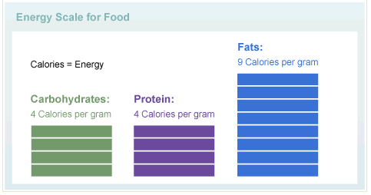

Slide 52
3.1.14 Discuss how the recommended energy distribution of the dietary macronutrients differs between endurance athletes and non-athletes.
Depending on intensity and duration of exercise, an athlete may regularly expend twice as much energy as a sedentary person. Furthermore, many sports are performed in environments that can increase energy expenditures (cold, humidity, altitude).
Consequently, sporting activities can involve additional energy expenditure ranging from around 1,000 kilocalories/day (dancing, martial arts) to as much as 7,000 kilocalories/day (long-distance cycle races, endurance treks).

Slide 53
During prolonged, aerobic exercise, energy is provided by the muscle glycogen stores – which directly depend on the amount of carbohydrates ingested.
This is not the only reason why dietary carbohydrates play a crucial role in athletic performance; they have also been found to prevent the onset of early muscle fatigue and hypoglycaemia during exercise.

Slide 54
By keeping carbohydrate intake high, an athlete therefore replenishes his glycogen energy stores, and reduces the risk of rapid fatigue and a decline in performance.
At the same time, carbohydrate intake should not be so high as to drastically reduce the intake of fat, because the body will use fat as a substrate once glycogen stores are depleted.

Slide 55
The use of body protein in exercise is usually small, but prolonged exercise in extreme sports can degrade muscle, hence the need for amino acids during the recovery phase.

Slide 56
3.2
CARBOHYDRATE
&
FAT METABOLISM

Slide 57
Learning Objectives
Everyone will be able to
Distinguish between metabolism, anabolism and catabolism.
2. State what glycogen is and its major sites of storage

Slide 58
3.2.1 Outline the terms metabolism, anabolism, aerobic catabolism and aerobic catabolism .
Metabolism is the set of biochemical reactions that occur in living organisms in order to maintain life.These processes allow organisms to grow and reproduce, maintain their structures, and respond to their environments.
  Catabolism - breaks down organic matter (destruction), for example to harvest energy in cellular respiration; release energy –triglycerides to glycerol and fatty acids
  Anabolism - uses energy to construct components of cells such as proteins and nucleic acids (construction): glucose to glycogen

Slide 59
3.2.2 State what glycogen is and its major storage sites.
Glycogen is a polysaccharide (storage form) of glucose which functions as the secondary short term energy storage in animal cells.
It is stored by the liver and the muscles.
Glycogen forms an energy reserve that can be quickly mobilized to meet a sudden need for glucose, but one that is less compact than the energy reserves of triglycerides (fat).
Glycogenesis – formation of glycogen from linked glucose molecules
Glycolysis – glycogen broken down into pyruvate and ATP

Slide 60
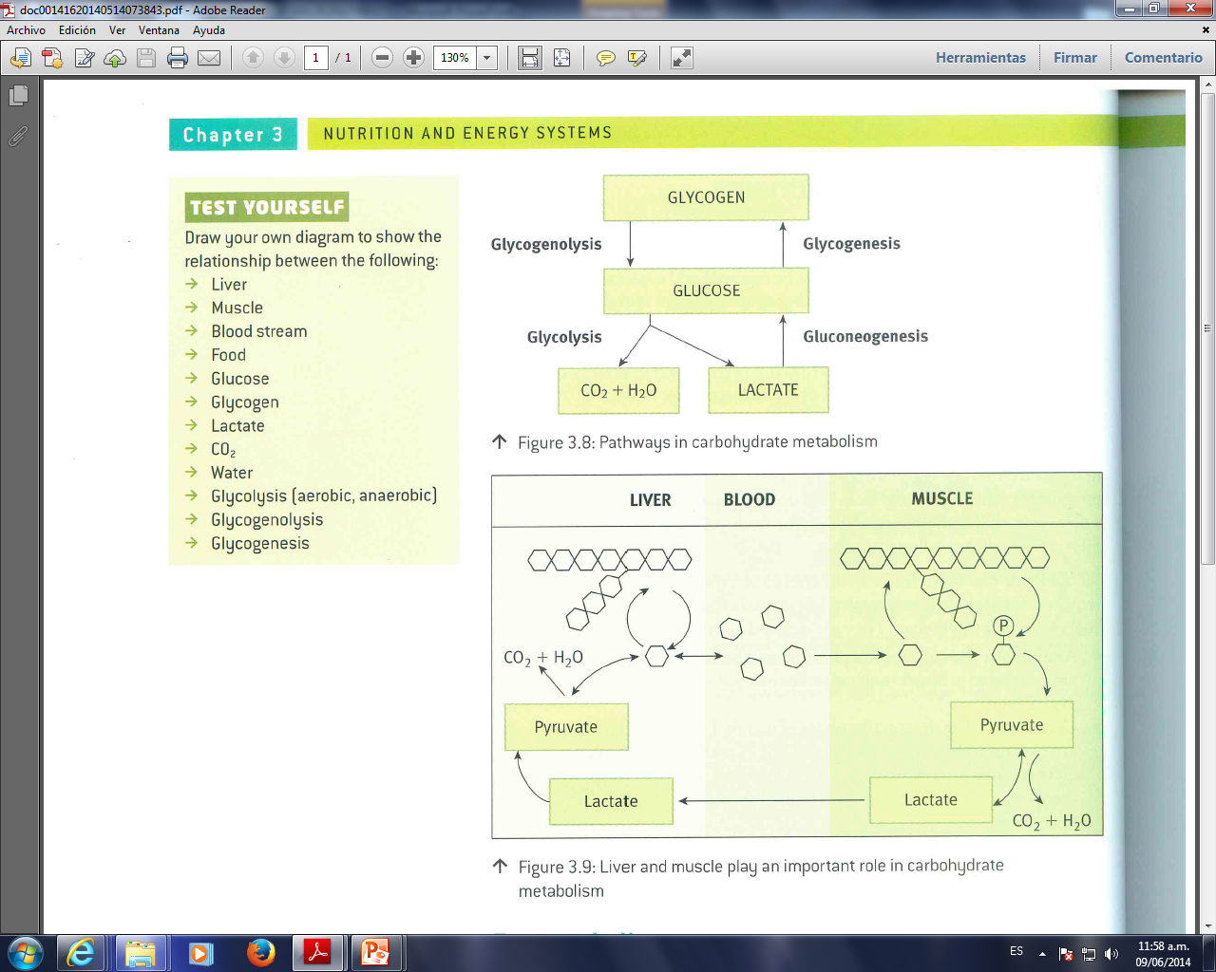
Metabolism of Glycogen

Slide 61
3.2.3 State the major sites of triglyceride storage.
Major storage site of triglycerides are adipose tissue (fat) and skeletal muscle.
β- oxydation: Release of energy from breaking down fatty acids to acetyl CoA
Inside the human body, the primary function of body fats for humans is as a store of energy. Nature originally intended this store of fat to fluctuate depending on availability of food, but in the developed world of the twenty-first century we have problem of over nutrition, which manifests itself as overweight and obesity in large numbers of people in some countries.
Sewell et.al 2005

Slide 62
IB
Sports, exercise and health science
Energy Systems
Topic 3
Energy Systems
3.2.3 State the major sites of triglyceride storage
Sub-topics
Adipose tissue cells are specialized cells of connective tissue that store fat. The consensus is that the number of adipocytes we have remains relatively constant, but the capacity to increase our fat stores is brought about by the ability of adipose cells to greatly increase in size.
Sewell et.al 2005
1. Nutrition
2. Carbohydrate and fat metabolism
3. Nutrition and energy systems

Slide 63
IB
Sports, exercise and health science
Energy Systems
Topic 3
Energy Systems
3.2.3 State the major sites of triglyceride storage
Sub-topics
Adipose tissue is found beneath the skin in the hypodermis and is also found around organs such as the heart and kidneys, in order to protect and cushion.
Fat tends to accumulate in different parts of the body depending on gender; in women around skeletal muscle of the thighs and hips, and in men around skeletal muscle of the abdomen, between the shoulder blades and around the waist.
Sewell et.al 2005
1. Nutrition
2. Carbohydrate and fat metabolism
3. Nutrition and energy systems

Slide 64
IB
Sports, exercise and health science
Energy Systems
Topic 3
Energy Systems
3.2.4 Explain the role of insulin in the formation of glycogen and the accumulation of body fat.
Sub-topics
Insulin is an animal hormone whose presence informs the body's cells that the animal is well fed, causing liver and muscle cells to take in glucose and store it in the form of glycogen, and causing fat cells to take in blood lipids and turn them into triglycerides. In addition it has several other anabolic effects throughout the body.
http://en.wikipedia.org/wiki/Insulin
1. Nutrition
2. Carbohydrate and fat metabolism
3. Nutrition and energy systems

Slide 65
3.2.4 Explain the role of insulin in the formation of glycogen and the accumulation of body fat.
Insulin and glucagon regulate the sugar level in the body.
These two hormones are manufactured in the pancreas and through circulation are carried to the liver where they perform their functions.
Enzymes that convert glucose to glycogen though a condensation reaction are stimulated by Insulin from β-cells, which increases the transport of glucose into cells (muscle and liver) which promotes glycogenesis
Storage of triglycerides in the adipose tissue is is stimulated by insulin.

Slide 66
Enzymes that hydrolyse glycogen to glucose are stimulated by glucagon.
Receptors in the pancreas are sensitive to the changes in sugar level, thus releasing the necessary requirements of insulin and glucagon depending on the needs of the body.
A diet high in sugar and fat will result in a high release of insulin and consequently an increase in glycogen storage and accumulation of fat.

Slide 67
IB
Sports, exercise and health science
Energy Systems
Topic 3
Energy Systems
3.2.4 Explain the role of insulin in the formation of glycogen and the accumulation of body fat.
Sub-topics
In response to exercise we need muscle to be utilizing glycogen, not storing it in the liver and muscle, so insulin concentration goes down when exercise begins.
Sewell et.al 2005
1. Nutrition
2. Carbohydrate and fat metabolism
3. Nutrition and energy systems

Slide 68
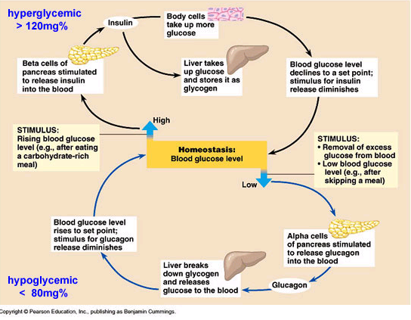

Slide 69
IB
Sports, exercise and health science
Energy Systems
Topic 3
Energy Systems
3.2.4 Explain the role of insulin in the formation of glycogen and the accumulation of body fat.
Sub-topics
Research task: Explain the role of insulin in the formation of glycogen and the accumulation of body fat.
Le Magazine, September 2004 - Cover Story: Novel Fiber Limits Sugar Absorption
1. Nutrition
2. Carbohydrate and fat metabolism
3. Nutrition and energy systems

Slide 70
3.2.5 Outline the terms glycogenolysis and lipolysis.
Glycogenolysis is the formation of blood glucose by hydrolysis of stored liver glycogen. In other words, it is the breakdown of glycogen to glucose.
In the liver, the breakdown of glycogen results in elevated blood glucose.
In the muscle, the breakdown of glycogen is used by the muscle for energy. There is no release of glucose into the blood stream from the muscle.
This occurs as a result of the hormone glucagon.

Slide 71
IB
Sports, exercise and health science
Energy Systems
Topic 3
Energy Systems
3.2.5 Outline the terms glycogenolysis and lypolysis
Sub-topics
Glycogenolysis:
Is the breakdown of glycogen.
In glycogenolysis, glycogen stored in the liver and muscles, is converted first to glucose-1- phosphate and then into glucose-6-phosphate. Two hormones which control glycogenolysis are a peptide, glucagon from the pancreas and epinephrine from the adrenal glands.
http://www.elmhurst.edu/~chm/vchembook/604glycogenesis.html
1. Nutrition
2. Carbohydrate and fat metabolism
3. Nutrition and energy systems

Slide 72
IB
Sports, exercise and health science
Energy Systems
Topic 3
Energy Systems
3.2.5 Outline the terms glycogenolysis and lypolysis
Sub-topics
Glycogen is a highly branched polymeric structure containing glucose as the basic monomer.
http://www.elmhurst.edu/~chm/vchembook/604glycogenesis.html
1. Nutrition
2. Carbohydrate and fat metabolism
3. Nutrition and energy systems

Slide 73
IB
Sports, exercise and health science
Energy Systems
Topic 3
Energy Systems
3.2.5 Outline the terms glycogenolysis and lypolysis
Sub-topics
Glucose-6-phosphate is the first step of the glycolysis pathway if glycogen is the carbohydrate source and further energy is needed. If energy is not immediately needed, the glucose-6-phosphate is converted to glucose for distribution in the blood to various cells such as brain cells.
http://www.elmhurst.edu/~chm/vchembook/604glycogenesis.html
1. Nutrition
2. Carbohydrate and fat metabolism
3. Nutrition and energy systems

Slide 74
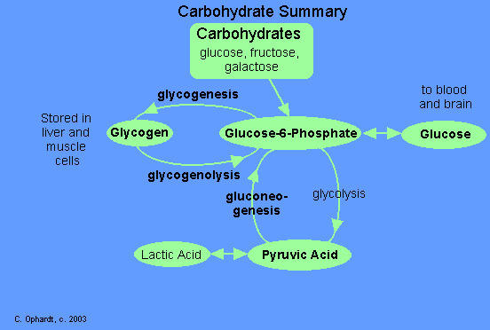
IB
Sports, exercise and health science
Energy Systems
Topic 3
Energy Systems
3.2.5 Outline the terms glycogenolysis and lypolysis
Sub-topics
1. Nutrition
2. Carbohydrate and fat metabolism
3. Nutrition and energy systems
http://www.elmhurst.edu/~chm/vchembook/604glycogenesis.html

Slide 75
IB
Sports, exercise and health science
Energy Systems
Topic 3
Energy Systems
3.2.5 Outline the terms glycogenolysis and lypolysis
Sub-topics
Glucagon is released from the pancreas in response to low blood glucose and epinephrine is released in response to a threat or stress. Both hormones act upon enzymes to stimulate glycogen phosphorylase to begin glycogenolysis and inhibit glycogen synthetase (to stop glycogenesis).
http://www.elmhurst.edu/~chm/vchembook/604glycogenesis.html
1. Nutrition
2. Carbohydrate and fat metabolism
3. Nutrition and energy systems

Slide 76
Lipolysis is the breakdown of fat stored in fat cells.
Triglycerides undergo lipolysis (hydrolysis by lipases) and are broken down into glycerol and fatty acids.
During this process, free fatty acids are released into the bloodstream and circulate throughout the body.
The following hormones induce lipolysis: epinephrine (also called adrenaline), norepinephrine, glucagon

Slide 77
3.2.6 Outline the functions of glucagon and adrenaline during fasting and exercise.

Slide 78
During fasting and exercise the blood glucose level drops and therefore the release of glucagon and adrenaline will result in an increase of blood glucose.
Glucagon role: During fasting or exercise, glucose in blood decreases, glucagon secreted by α-cells from pancreas, promoting glycogenolysis and lipolysis for energy supply.
Adrenaline: Also increases with low glucose levels and also promotes glycogenolysis and lipolysis

Slide 79
3.2.7 Explain the role of insulin and muscle contraction on glucose uptake during exercise.
Insulin will result in an increased uptake of blood glucose into the liver and muscle.
Muscle contraction will also result in an increase of blood glucose uptake from the blood due to higher energy demands.

Slide 80
IB
Sports, exercise and health science
Energy Systems
Topic 3
Energy Systems
3.2.7 Explain the role of insulin and muscle contraction on glucose uptake during exercise
Sub-topics
Insulin and glucagon are antagonistic hormones that regulate the concentration of glucose in the blood.
Metabolic balance depends on maintaining blood glucose concentrations near a set point, which is around 90mg/100mL in humans.
Campbell et.al 2006
1. Nutrition
2. Carbohydrate and fat metabolism
3. Nutrition and energy systems

Slide 81
IB
Sports, exercise and health science
Energy Systems
Topic 3
Energy Systems
3.2.7 Explain the role of insulin and muscle contraction on glucose uptake during exercise
Sub-topics
When blood glucose drop below a set point, due to exercise, glucagon is released, and it’s effects increase blood glucose concentration.
Subsequently, insulin and muscle contractions have both been shown to increase muscle glucose transport, and subsequent uptake into skeletal muscle.
Campbell et.al 2006
http://physiologyonline.physiology.org/cgi/content/full/20/4/260
1. Nutrition
2. Carbohydrate and fat metabolism
3. Nutrition and energy systems

Slide 82
3.3
NUTRITION
&
ENERGY SYSTEMS

Slide 83
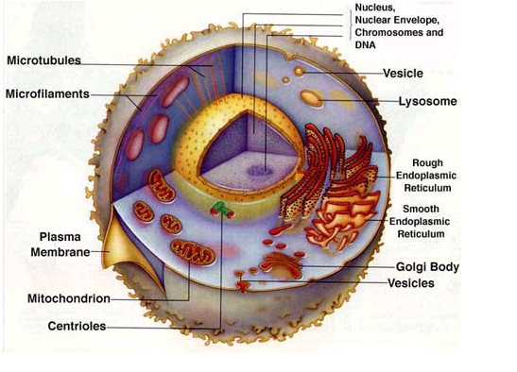
3.3.1 Draw a diagram to show the ultrastructure of a generalized animal cell.
With ribosomes
Apparatus

Slide 84
Nucleus: A membrane bound structure found in eucaryotic cells. It contains chromosomes made up of DNA and protein. The DNA component of the chromosomes forms the genes which direct what proteins the cell will make.

Slide 85
Ribosomes: responsible for the manufacture of proteins. They are often found in the endoplasmic reticulum but can also be found in other areas of the cell.
Endoplasmic reticulum: (literally translated: ‘network within the cytoplasm). A network of membrane-bound channels providing a means of transport within the cells.
  Rough endoplasmic reticulum: is coated with ribosomes.
  Smooth endoplasmic reticulum: generally found in cells producing lipids (fat), is devoid of ribosomes.

Slide 86
Golgi apparatus: a series of flattened membranous sacs which are believed to store materials prior to secretion from the cell. This is achieved by small vesicles which break off from the golgi apparatus and fuse with the cell membrane.
Lysosome: a membrane bound structure found in animal cells which contain very powerful digestive enzymes.

Slide 87
Mitochondrion: a membrane bound structure consisting of a series of folded membranes. On these membranes, the reactions of aerobic respiration occur which produces energy for use by the cell.

Slide 88
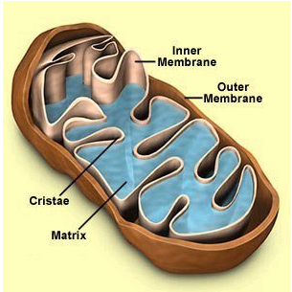
3.3.2 Draw a diagram to show the ultrastructure of a mitochondrion.

Slide 89
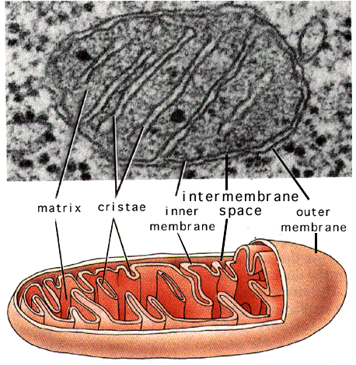

Slide 90
Mitochondria are membrane-enclosed organelles distributed through the cytosol of cells.
Their number within the cell ranges from a few hundred to, in very active cells, thousands.
Their main function is the conversion of the potential energy of food molecules into ATP. Mitochondria have: an outer membrane that encloses the entire structure
an inner membrane that encloses a fluid-filled matrix
between the two is the intermembrane space
the inner membrane is elaborately folded with shelflike cristae projecting into the matrix.
The number of mitochondria in a cell can
  increase by mitosis (after aerobic training)
  decrease by their fusing together. (after a period of inactivity)

Slide 91
3.3.3 Define the term cell respiration.
Cellular respiration is the process by which the chemical energy of "food" molecules is released and partially captured in the form of ATP.
Carbohydrates, fats, and proteins can all be used as fuels in cellular respiration.

Slide 92
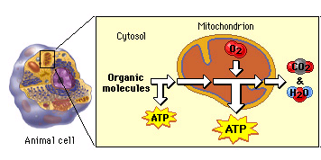

Slide 93
We can divide cellular respiration into three metabolic processes: glycolysis, the Krebs cycle, and oxidative phosphorylation. Each of these occurs in a specific region of the cell.
1. Glycolysis occurs in the cytosol.
2. The Krebs cycle takes place in the matrix of the mitochondria.
3. Oxidative phosphorylation via the electon transport chain is carried out on the inner mitochondrial membrane.
In the absence of oxygen, glycolysis occurs in the cytosol.

Slide 94
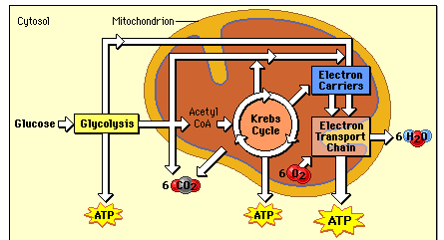

Slide 95
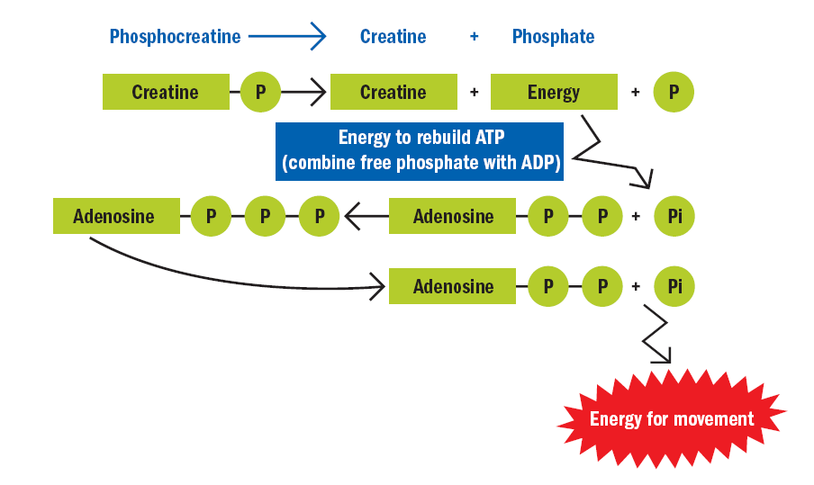
3.3.4 Explain how adenosine can gain and lose a phosphate molecule.

Slide 96
ATP works by losing the endmost phosphate group when instructed to do so by an enzyme.
This reaction releases a lot of energy, which can then use to build proteins, contract muscles, etc.
The end product is adenosine diphosphate (ADP), and the phosphate molecule.
Even more energy can be extracted by removing a second phosphate group to produce adenosine monophosphate (AMP).
When the body is resting and energy is not immediately needed, the reverse reaction takes place and the phosphate group is reattached to the molecule using energy obtained from food.
Thus the ATP molecule acts as a chemical 'battery', storing energy when it is not needed, but able to release it instantly when the body requires it.

Slide 97
3.3.5 Explain the role of ATP in muscle contraction.
Many chemical reactions of the cell use the energy from ATP which released when the phosphate bonds of ATP are broken.
The energy released from the ATP supplies the energy necessary to form or break chemical bonds in biochemical reactions.

Slide 98
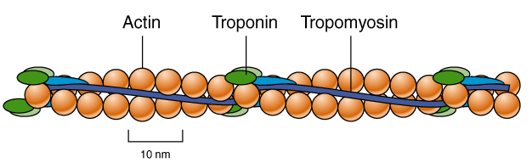
Myosin heads
The myosin filaments have small projections called myosin heads.
These extend to the actin but do not touch it.
A protein called tropomyosin is bound to the active sites of the actin.
Tropomyosin prevents the myosin head forming an attachment to the actin.

Slide 99
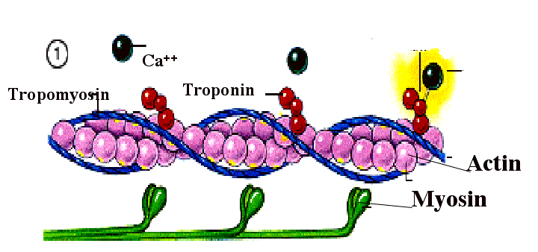
Another protein bound to actin is called troponin.
This protein can neutralise the effect of tropomyosin BUT only in the presence of Calcium ions (Ca ²⁺).

Slide 100
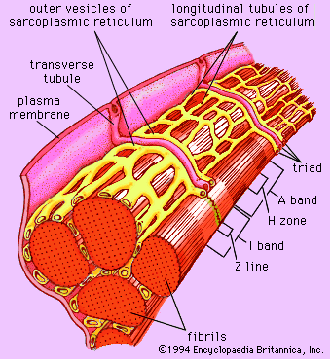
When a nerve impulse is transmitted down the transverse tubules, it stimulates the release of calcium ions from the sarcoplasmic reticulum.

Slide 101
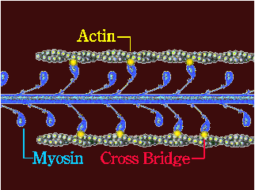
The troponin is then able to move the tropomyosin from the active site so that the myosin can attach to the actin to form actomyosin.
The coupling of actomyosin stimulates the breakdown of ATP (releasing energy).

Slide 102
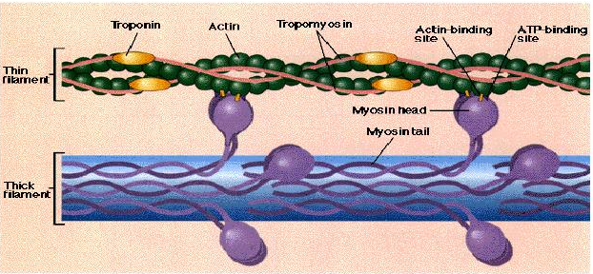
The crossbridges swivel towards the middle of the sarcomere, pulling the actin over the myosin, making the muscle shorter.

Slide 103
When the stimulus from the nerve stops, the calcium ions diffuse back into the sarcoplasmic reticulum and the muscle returns to resting state.
ADP is rejoined to Phosphate to reform ATP.

Slide 104
3.3.6 Describe the re-synthesis of ATP by the ATP–CP system.

Slide 105
Creatine phosphate (a high energymolecule) is broken down to provide energy for the re-synthesis of ATP that has been utilized during the initial stages of exercise.

Slide 106
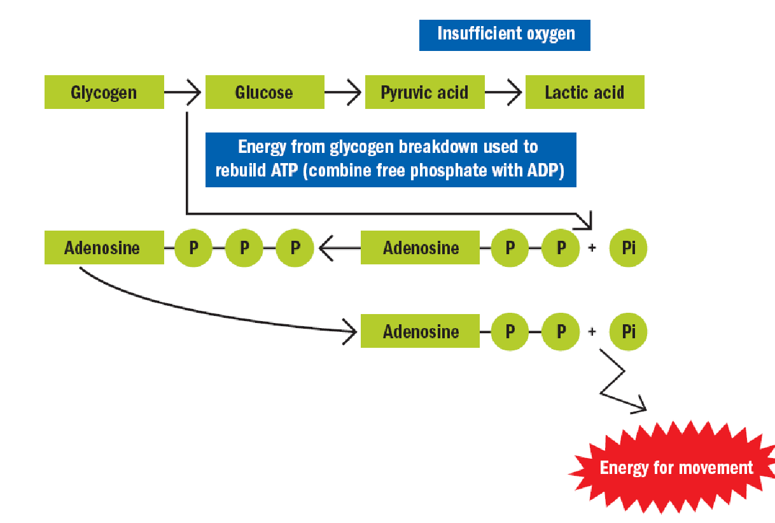
3.3.7 Describe the production of ATP by the lactic acid system.

Slide 107
Also known as anaerobic glycolysis—the breakdown of glucose to pyruvate without the use of oxygen. Pyruvate is then converted into lactic acid, which limits the amount of ATP produced (2 ATP molecules).
The lactic acid system is generally used for high to medium intensity activities lasting no longer than 2 minutes.

Slide 108
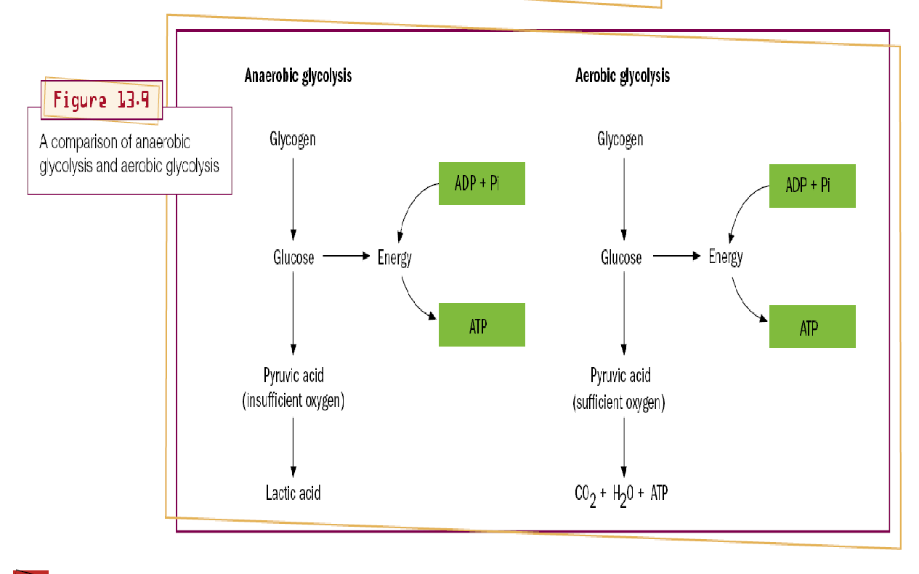
A comparison of anaerobic and aerobic glycolysis

Slide 109
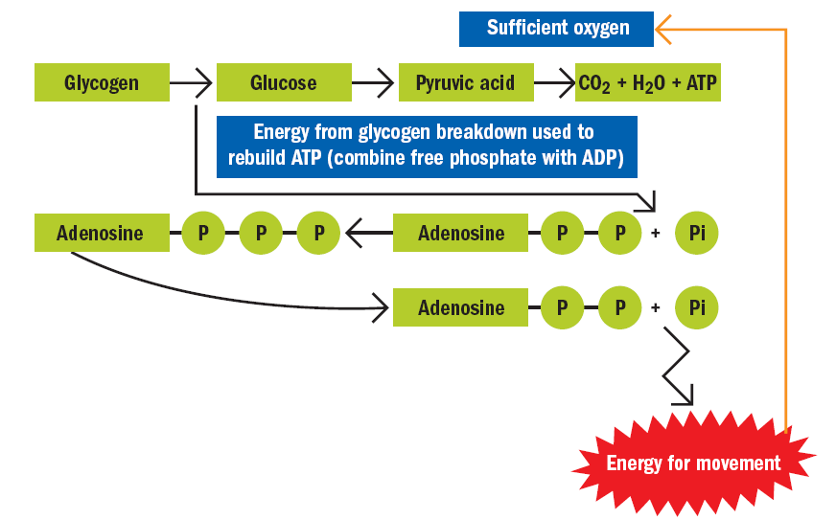
Aerobic system

Slide 110
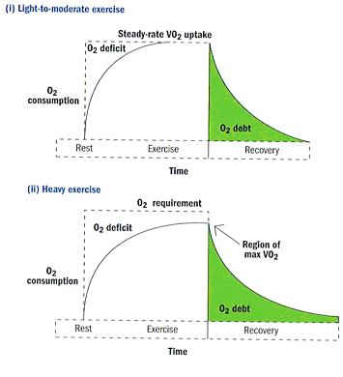
3.3.8 Explain the phenomena of oxygen deficit and oxygen debt.

Slide 111
These terms refer to a lack of oxygen while training/racing and after such activity is over.
Oxygen Deficit. While exercising intensely the body is sometimes unable to fulfill all of its energy needs.
In order to make up the difference without sacrificing the output, the body must tap into its anaerobic metabolism.
This where the body goes into a mix of aerobic and anaerobic energy production.
While not hugely detrimental, oxygen deficits can grow to a level that the anaerobic energy system cannot cover.
This can cause performance to deteriorate.

Slide 112
Oxygen Debt. This term describes how the body pays back its debt incurred above after the exercise is over.
You will notice that even after you have finished racing you will continue to breath hard.
At this point your body is still trying to repay the oxygen debt that was created when you were working hard.
Technically, it is excessive post-exercise oxygen consumption (EPOC).

Slide 113
3.3.9 Describe the production of ATP from glucose and fatty acids by the aerobic system.
In the presence of oxygen pyruvate is converted to Acetyl Co A and is processed by the Krebs cycle which liberates electrons that are passed through the electron transport chain producing energy (ATP).
Fats are also broken down by beta oxidation that liberates a greater number of electrons thus more ATP.
In the presence of oxygen and in extreme cases protein is also utilized.

Slide 115
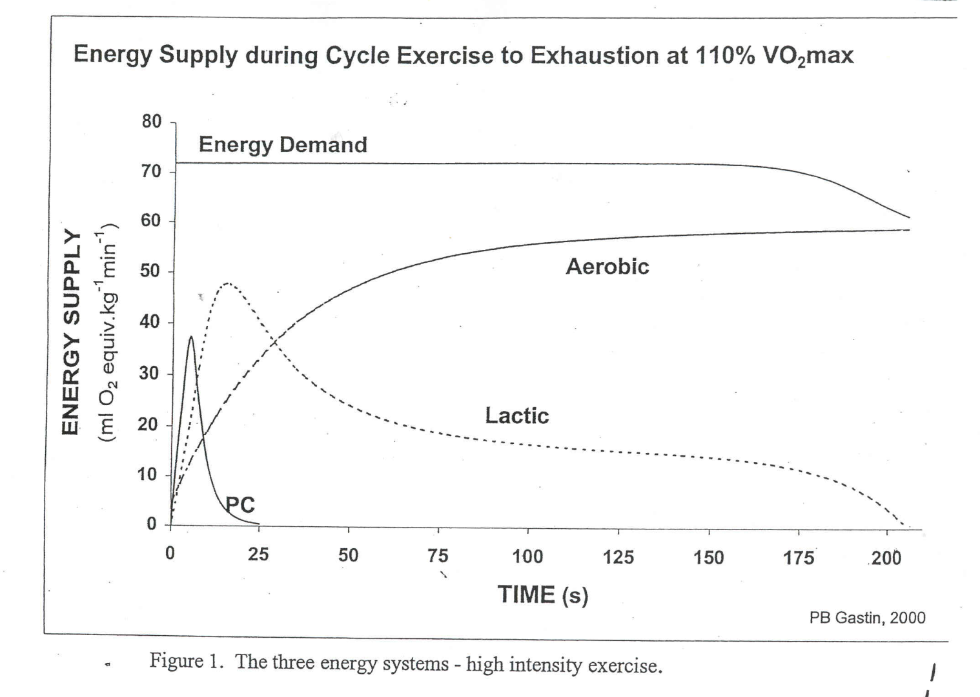
3.3.10 Discuss the characteristics of the three energy systems and their relative contributions during exercise.

Slide 116
Aerobic energy system can provide all required energy
  Note we use the term “can” to indicate that it could, however, we know that all systems are working all the time.
The ATP-CP & LA systems provide a minimal amount of energy
Aerobic energy system is the major provider of energy
The ATP-CP system provides a minimal amount of energy
The LA system provides the extra required energy

Slide 117
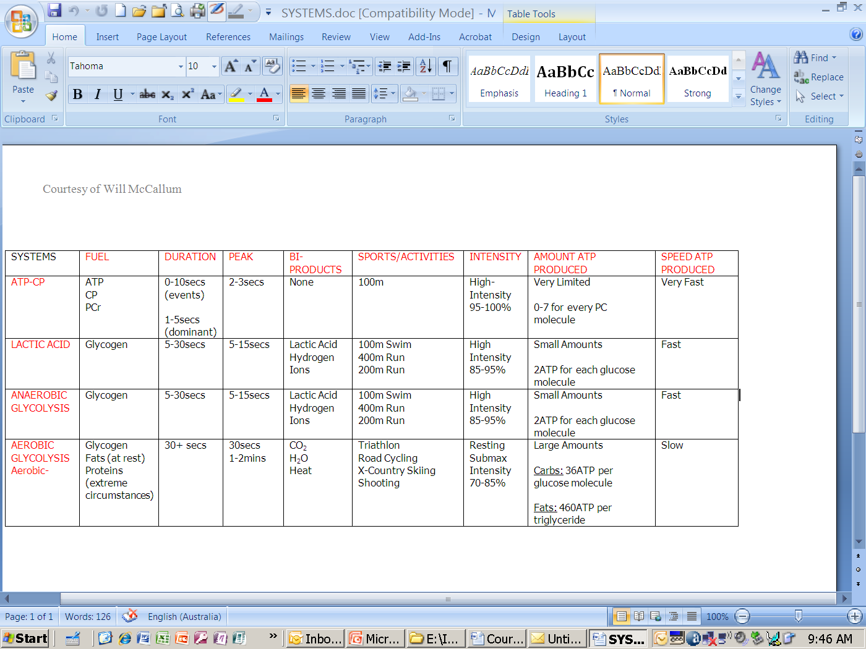
3.3.11 Evaluate the relative contributions of the three energy systems during different types of exercise.

Slide 118
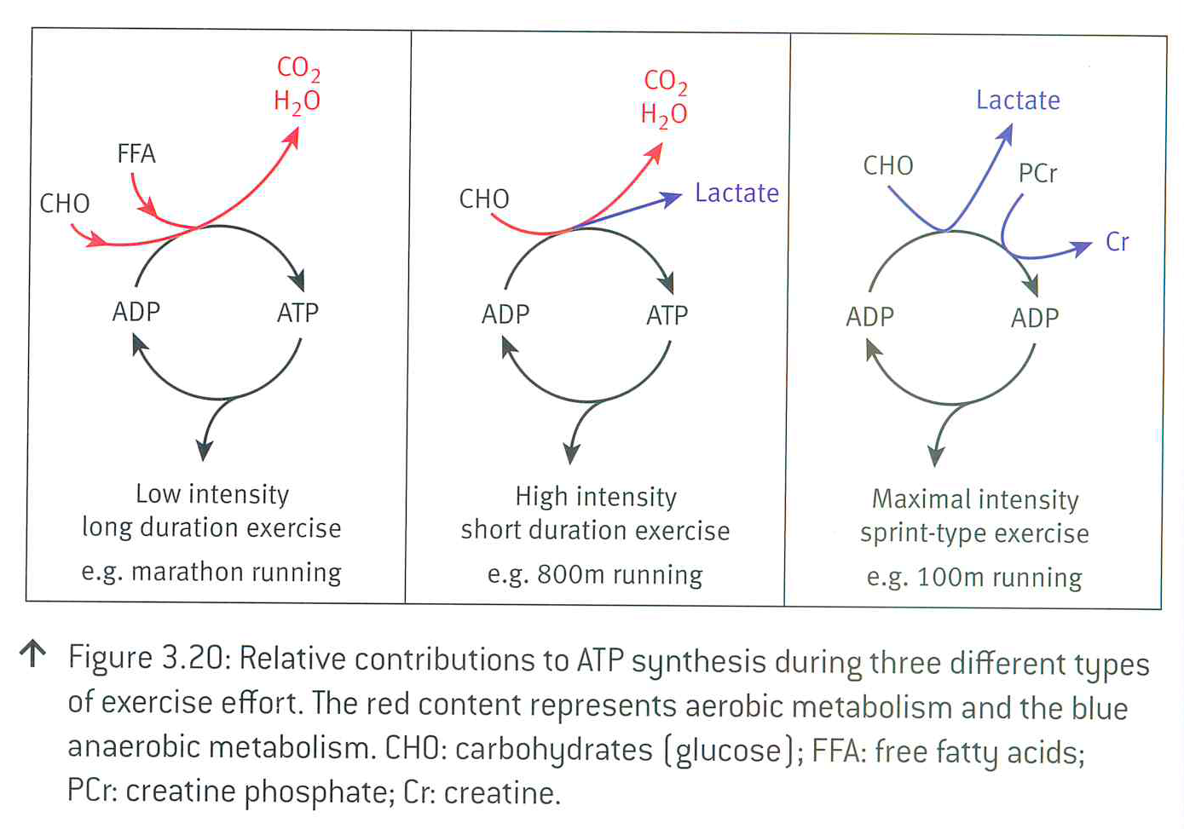
3.3.11 Evaluate the relative contributions of the three energy systems during different types of exercise.

