Slide 1
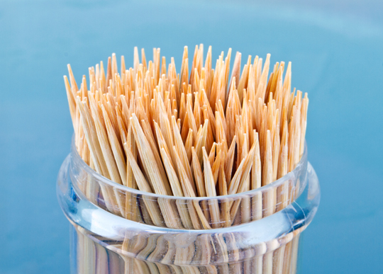
Toothpick
Sculptures

Slide 2
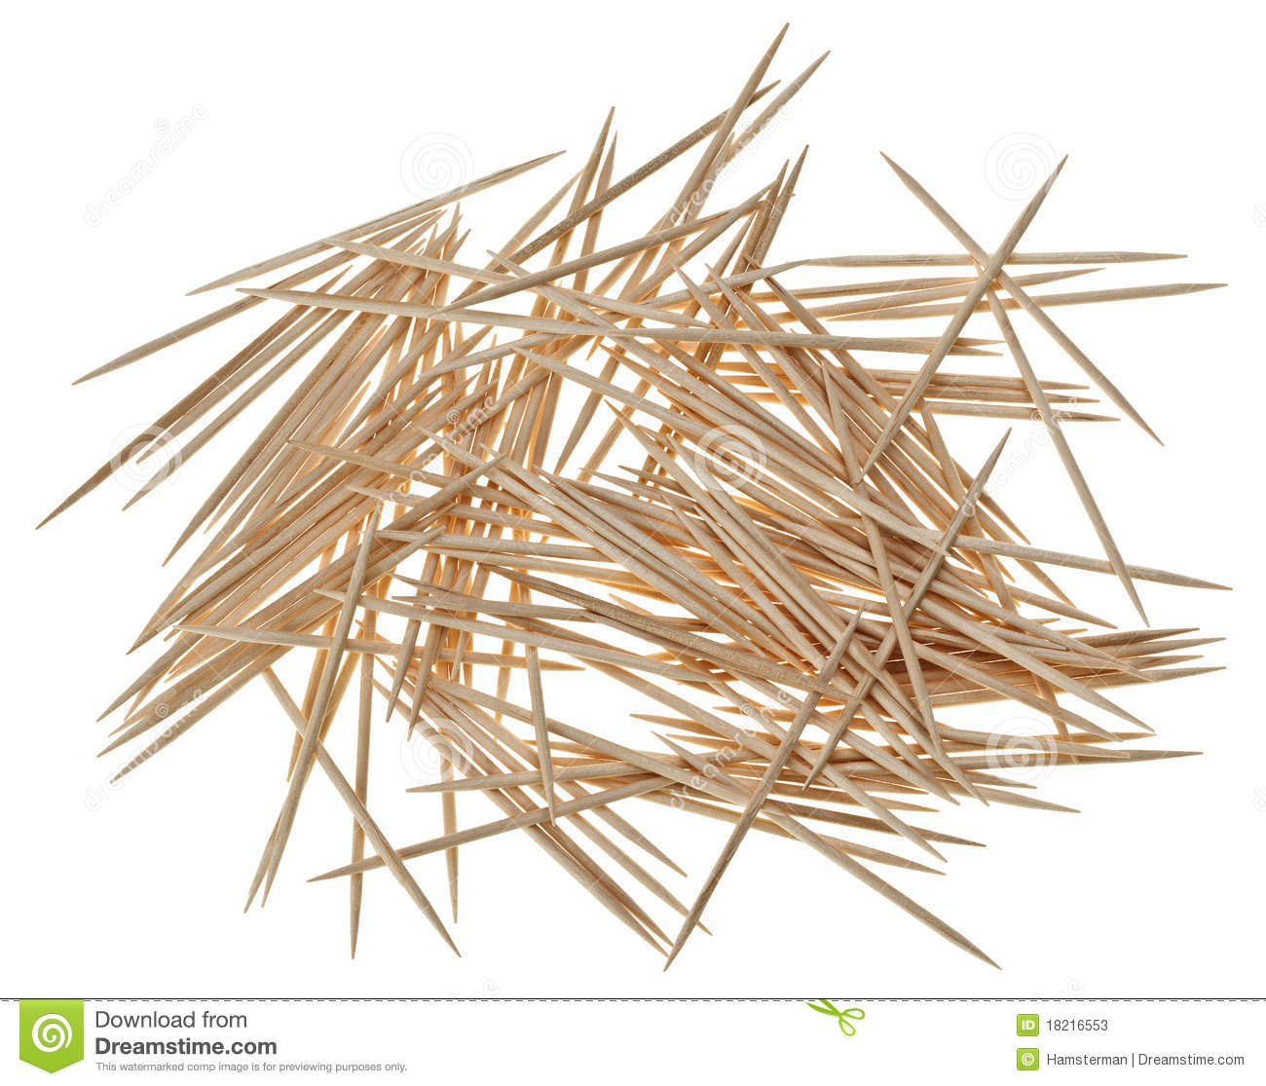
Project Details
You will be given approximately 150 toothpicks
You will begin by gluing two, three or four toothpicks together creating a unit. The unit can be a geometric shape such as a square or triangle or as simple as two toothpicks glued side by side. Make some thumbnail sketches of sculpture plan using unit.
Then you will create as many units as possible using ALL the toothpicks. It should be noted that construction of the units couldn’t be done quickly. The wood glue will take approximately 30 minutes to dry.
Once all units have been created you will begin to create a three dimensional form using all the units. The form created must show movement, repetition, negative space, and line.
The base for the sculpture will be Styrofoam or wood.
Once the sculpture is created the entire sculpture will be spray-painted. More than one coat may be needed to completely cover the sculpture.

Slide 3
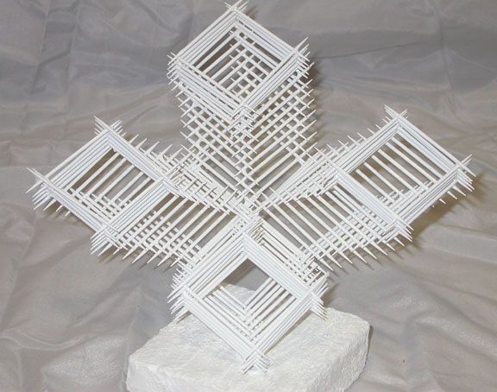
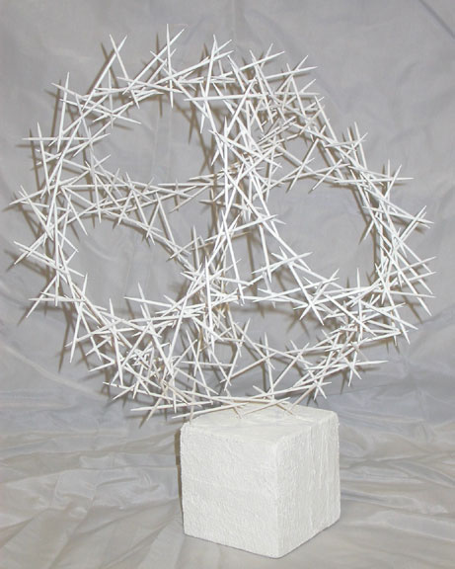
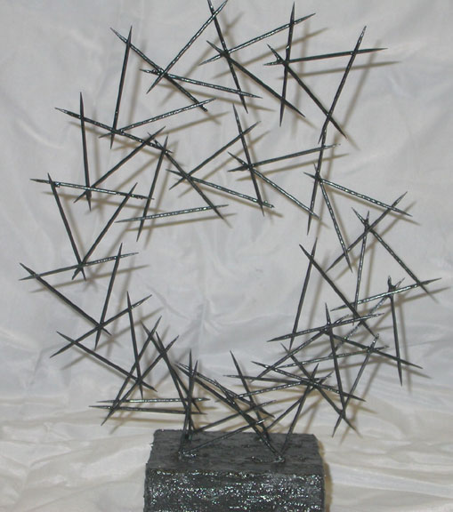

Slide 4
