Slide 1
Outline of the Middle Ages
World History
E.Pleasants

Slide 2
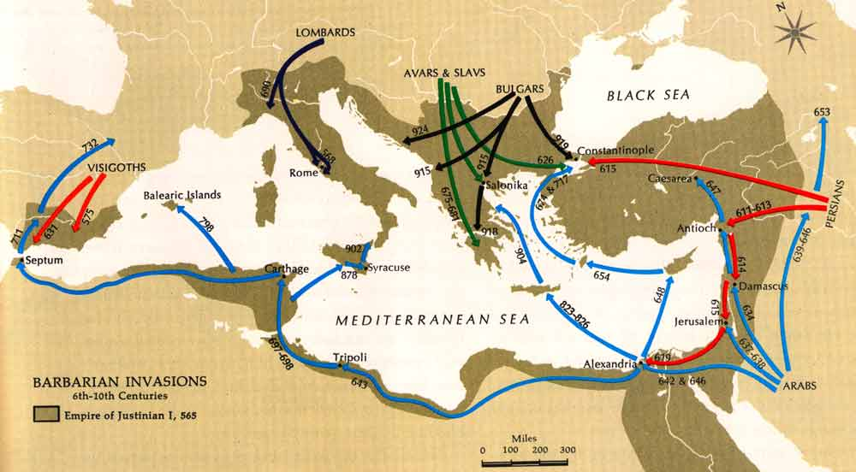
476 A.D.
Barbarian Invasions - Beginning of the "Middle Ages" - Fall of the (western) Roman Empire

Slide 3
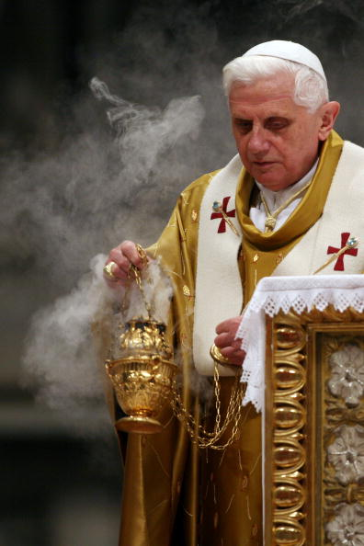
500-600 A.D.
Increased power of the Church - spreading of the monasteries
- Pope Gregory I - Increased power of the Pope

Slide 4
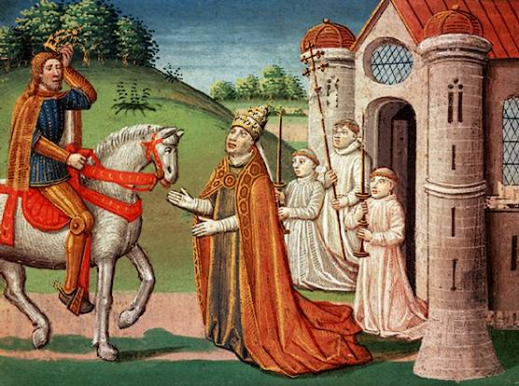
800 A.D.
Complete the Charlemagne Personality Profile using the clip and your textbook.
CHARLEMAGNE - crowned Holy Roman Emperor
- 1st official union of church and state

Slide 5
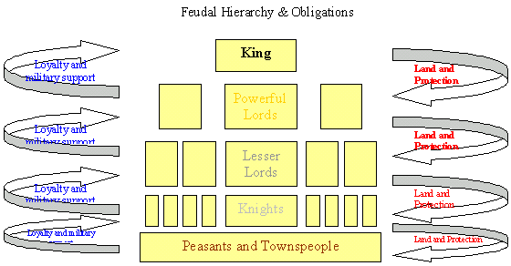
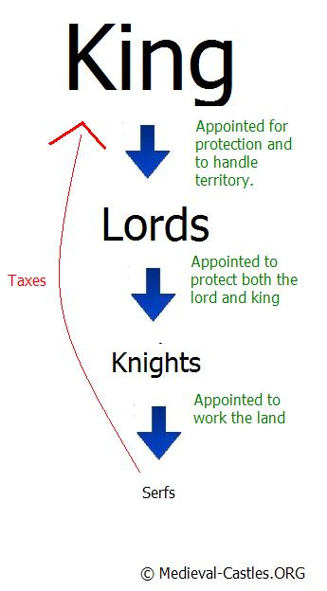
900 A.D.
Manorialism - economic system
Feudalism - political system based on land

Slide 6

Feudalism
PAGE 358-360

Slide 7
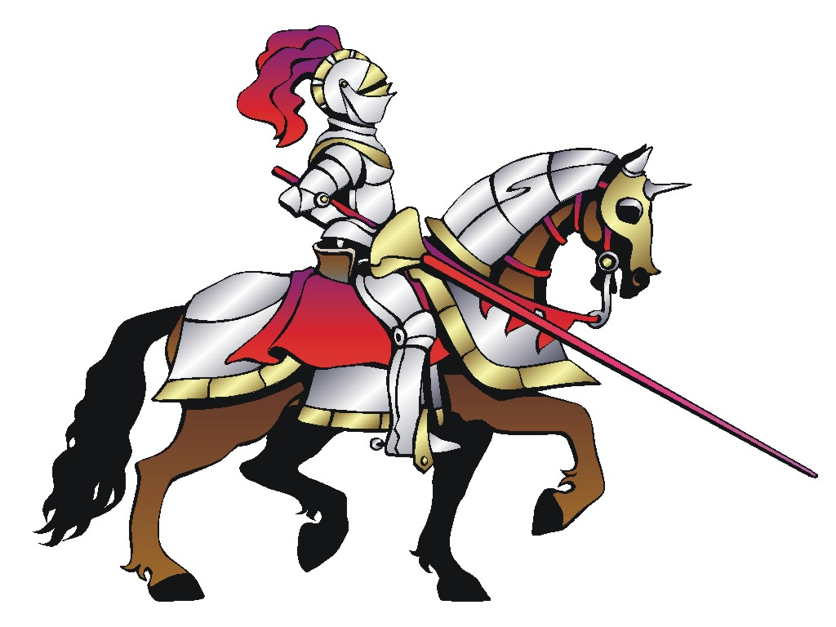
Feudalism: a political/social system where a lord offers protection in return for service
LORD – ruled over all land in a manor – nobleman
VASSAL – noble who serves a lord of a higher rank in a military capacity
INVESTITURE – ceremony between lord and a vassal to exchange land
FIEF – land that is given to vassal – comes with peasants
MANOR – small estate belonging to a lord and worked by peasants
SERF – worked on the fief, bound to the land! (protection and necessities were the responsibility of the lord)

Slide 8
Manorialism
Self-sufficiency – everything that was needed for the lord and the people living on the manor was produced on the manor (food, fuel, cloth, leather goods, lumber)
Peasants – did the work, were tenants on the manor
The Manor:
A. Serfs – not free – bound to the land; could not be traded to other lords, could not leave the manor
B.Free Peasants – could leave the manor
a. Owed duties:
Read “Kings, Nobles, Knights, and Serfs” by Janet Brett. What duties did serfs owe to the lord?
What would you find in a feudal village?

Slide 9
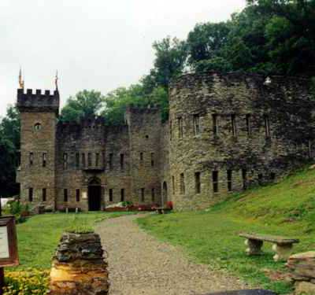
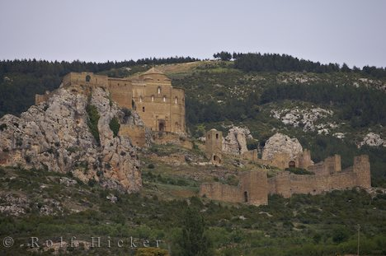
AGE OF FAITH
1000 - 1300 A.D.
Growth and reform in the Catholic Church
farming improvements
growth of towns
Nobles & Castles - power of the Noble families
Knights & the Code of Chivalry
Code of Chivalry

Slide 10
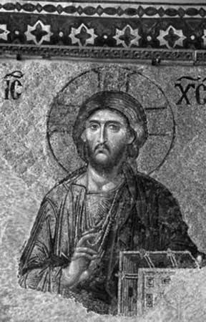
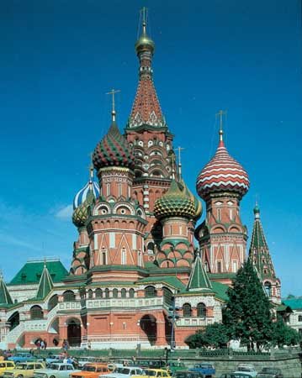
Great Schism
1054 A.D.
Split between the Roman Catholic Church in the West and the Eastern Orthodox Church in the East

Slide 11
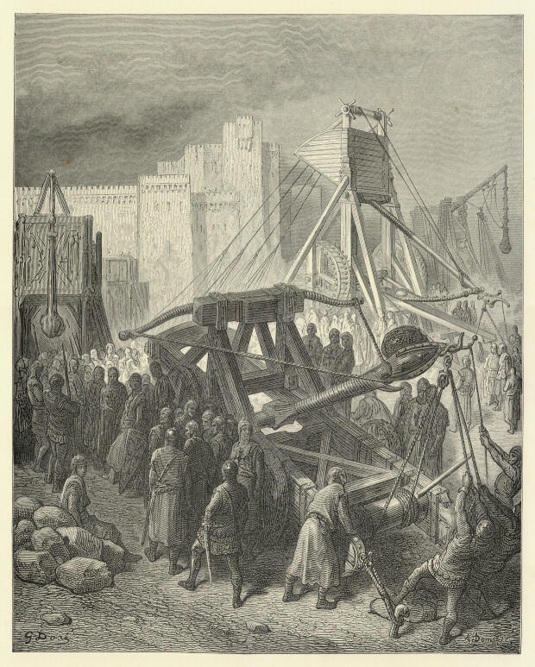
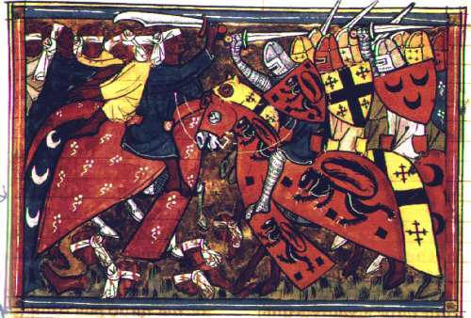
1096 - 1300 A.D.
CRUSADES
Europeans attemped to conquer the "Holy Land" in the name of the Church

Slide 12
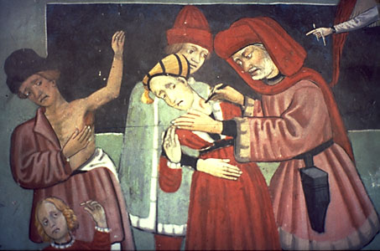
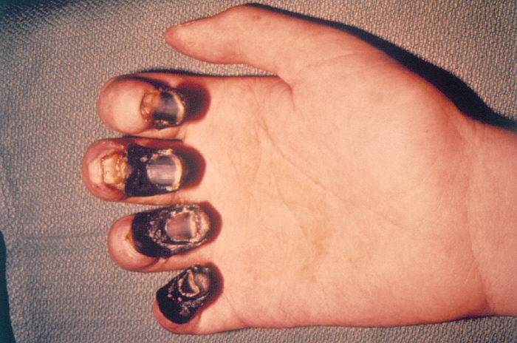
1300 - 1400 A.D.
Beginning of the end of the Middle Ages - Rise of Nations! Loyalty to the state.
Black Plague

Slide 13
Body Biography - A Knight
Complete the provided diagram using words and symbols to indicate the following:
Equipment used by a knight
Code of Chivalry
Knight Training
Duties of a Knight
Use Pages 364-369 for ideas.
Incorporate these concepts into your knight's thoughts, speech, heart, hands,and feet. Dress your knight accordingly.

Slide 14
Attachments
Charlemagne.wmv

