Slide 1
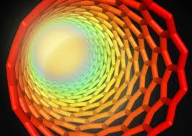
THERMAL ENERGY

Slide 2

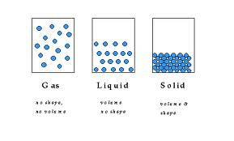
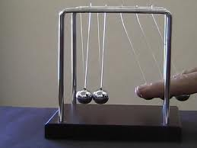
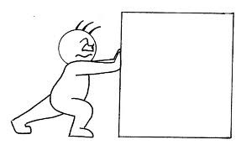
What is Energy?
Energy – The ability to move or change matter
What does this
mean?
This means that energy is needed to apply a force to an object to make it move. Energy is also needed to make a change in the state of matter (solid, liquid, or gas).

Slide 3
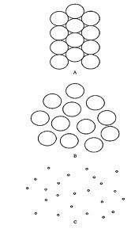
What is Heat?
Heat (thermal energy)– the movement of tiny particles that make up matter.
Which one has more THERMAL ENERGY?
Solid
Liquid
Gas
The GAS has the most Thermal Energy. The particles move the fastest. As the gas cools, the particles slow down and loose energy. Solids have the least amount of energy.

Slide 4
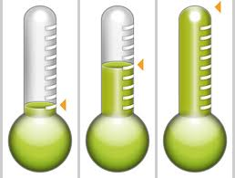
How do you measure thermal energy?
Temperature – the measure of the thermal energy of an object
Temperature = thermal energy = speed of particles
A B C
Which of these thermometers shows a temperature that has the most thermal energy? ____
Which shows an object that has the least speed in the particles?____

Slide 5
Energy is on the Move?
When warm and cool objects touch, energy is transferred from the warmer object to the cooler object.
ACTIVITY:
Touch the metal on your desk and your paper with your other hand. Which one is colder?
NEITHER! They are the same temperature. They are both the same temperature as the room. Why do they feel different them? It has to do with insulators and conductors.

Slide 6

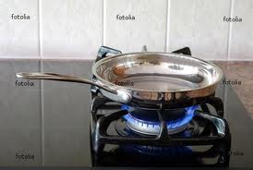
What is an insulator?
What is a conductor?
Insulator – a material that does not transfer heat very well.
This blanket traps
body heat to keep
you warm
Conductor – a material that transfers heat very well.
Pans transfer
heat easily

Slide 7

Are Heat and Temperature the Same?
NO
Think back…heat is the flow of energy from one materials to another.
Temperature is a measure of how hot or cold something is.

Slide 8
How Does a Thermometer Work?
Discuss with a partner
Write your ideas here:

Slide 9
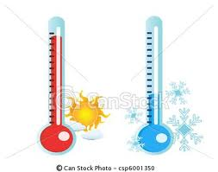
Let’s figure this out…
What happens to material when heat is added?
It expands or gets bigger.
What happens to material when heat is taken away? It contracts or gets smaller.
So, when the material in
a thermometer hotter, the
material expands and
moves higher in it.
When colder, it shrinks.

Slide 10
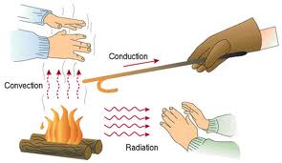
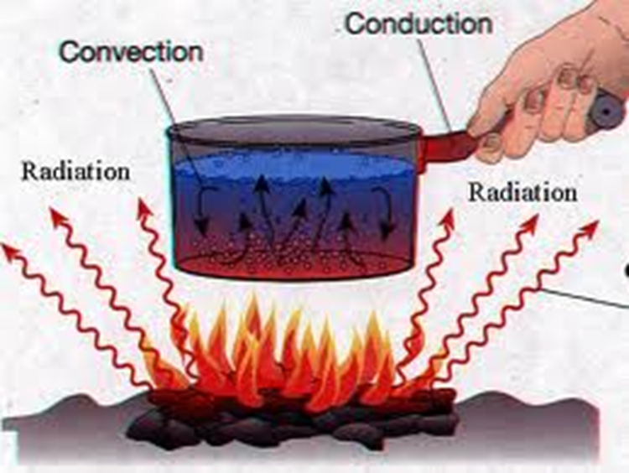
How is Heat Transferred?
Heat is transferred in three ways:
Conduction – heat transferred when two objects touch
Convection – heat transferred by the flow of a liquid or a gas
Radiation – heat transferred through an open space

Slide 11
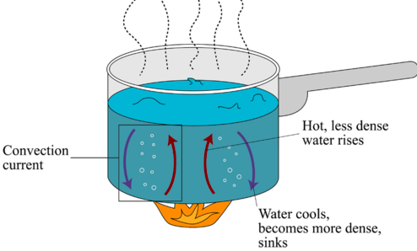
Heat is also transferred by Convection Currents
In a convection currents gases and liquids rise and sink in a circular path due to the differences in temperature.

