Slide 1
The Roaring Life of the 1920s
Chapter 21
tinyurl.com/bargelohapush
Notes:
1920: 51.2% lived in communities of 2,500-1million
22-29 2 million left farms and towns a year for cities

Slide 2
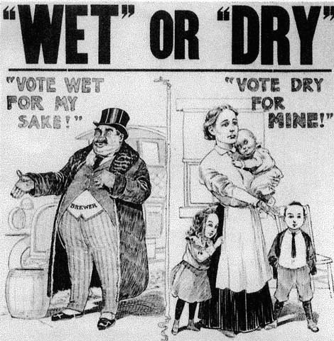
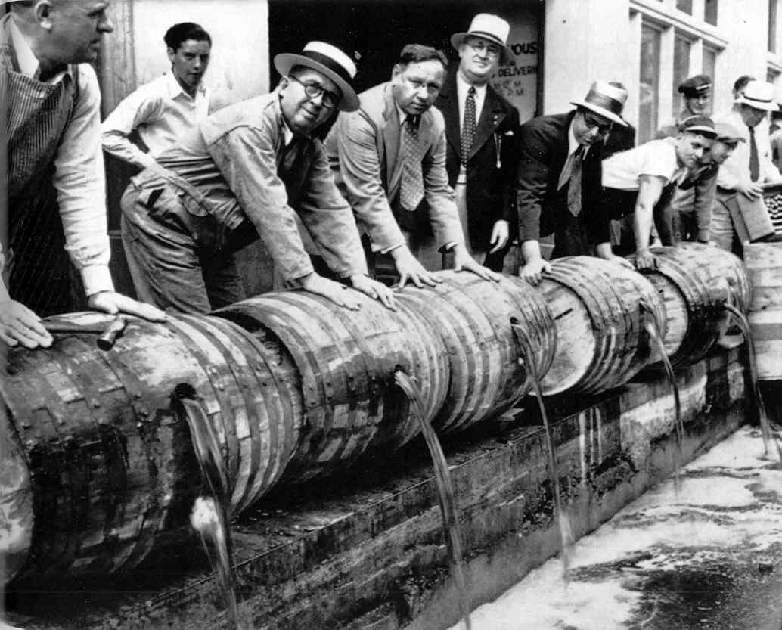
“Noble Experiment”
18th Amendment – Jan 1920
  “the manufacture, sale, or transportation of intoxicating liquors is hereby prohibited”
Volstead Act
  Established the Prohibition Bureau
  Ultimately it was underfunded and undermanned
Notes:
Manufacture, sale and transport of alcoholic beverages prohibited
Saloons closed but post WWI people fed up with idea
Prohibition Bureau at Treasury est. in 1919
1,500 agents and local cops to patrol all USA

Slide 3
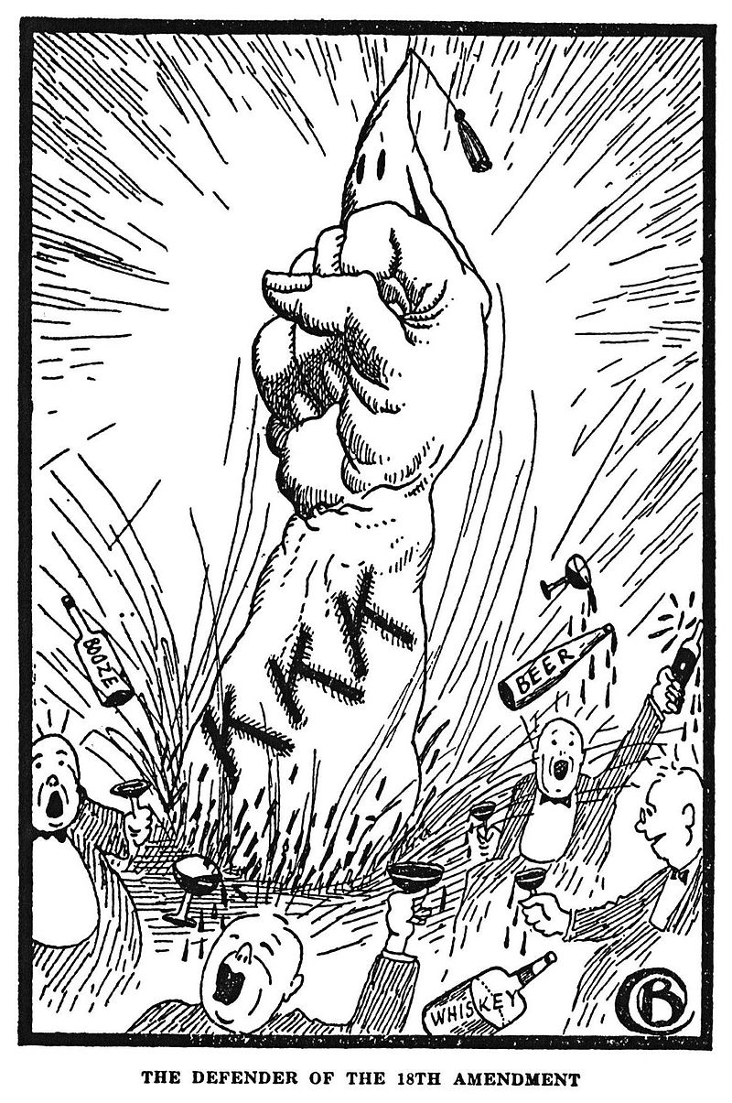
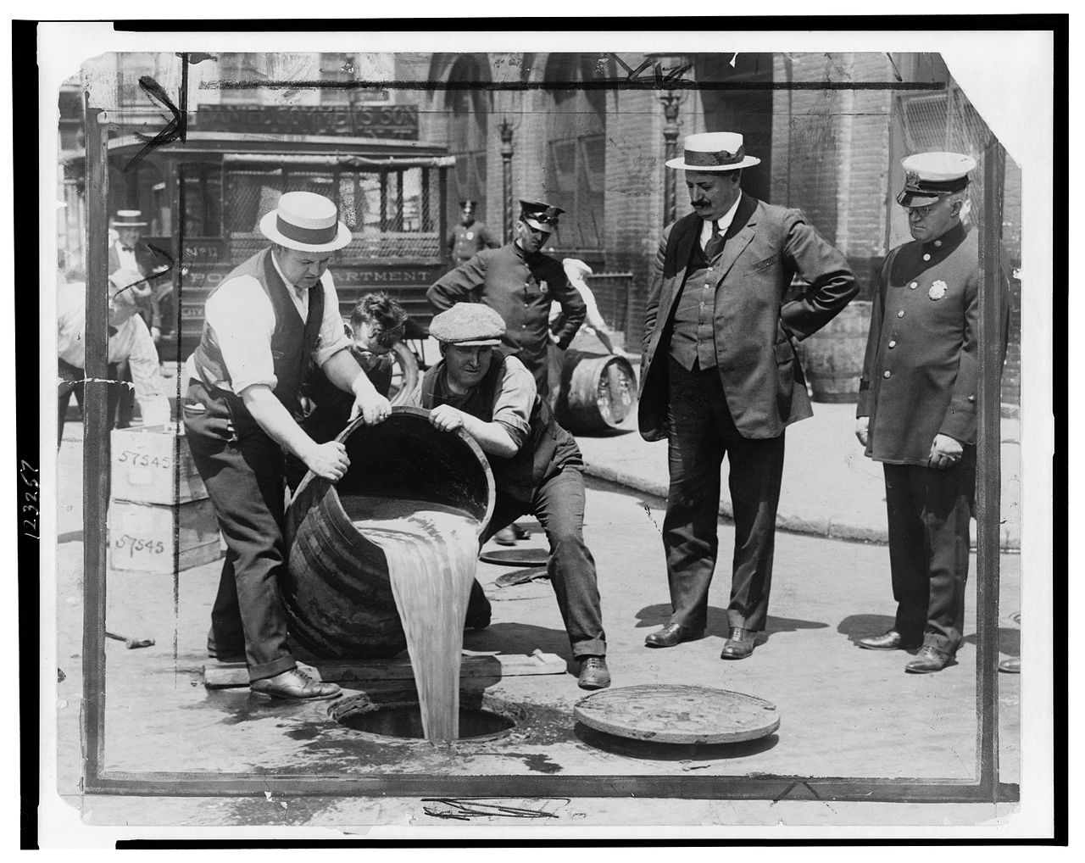

Slide 4
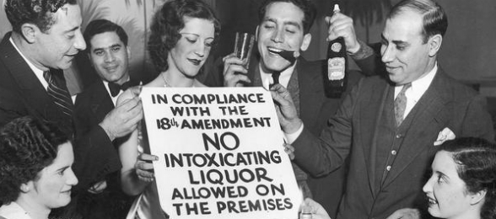
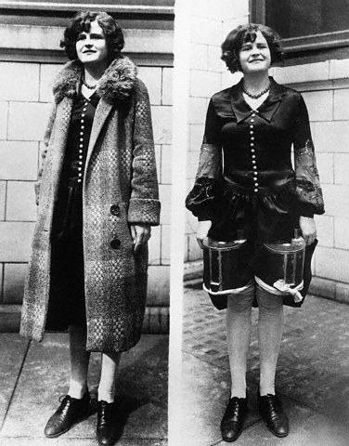
Prohibition Experiment
Speakeasies
  Places where people could illegally buy liquor
Bootleggers
  Individuals who smuggled alcohol into the U.S
Notes:
Cellars, office buildings, tenements, hardware stores, penthouses
Mix of upper-middle to middle class
Built own stills
Medicinal and religious alcohol sales increased

Slide 5
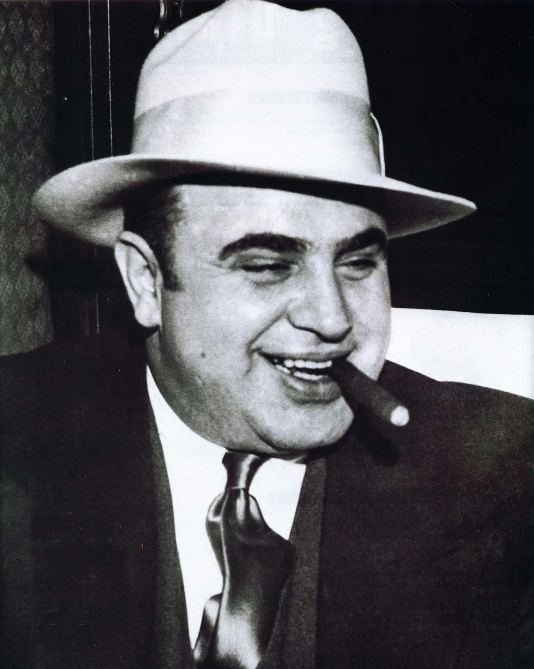
Prohibition Experiment
Organized Crime
  Criminals began making profit selling illegal alcohol
Al Capone
  The most famous organized crime boss in Chicago
  Killed off most of his competition
By Mid 20s only 19% support Prohibition
1933: 21st Amendment repealed Prohibition
Notes:
Prohibition led to a rise in every major city
Reportedly linked to 522 murders
Convicted of tax evasion

Slide 6
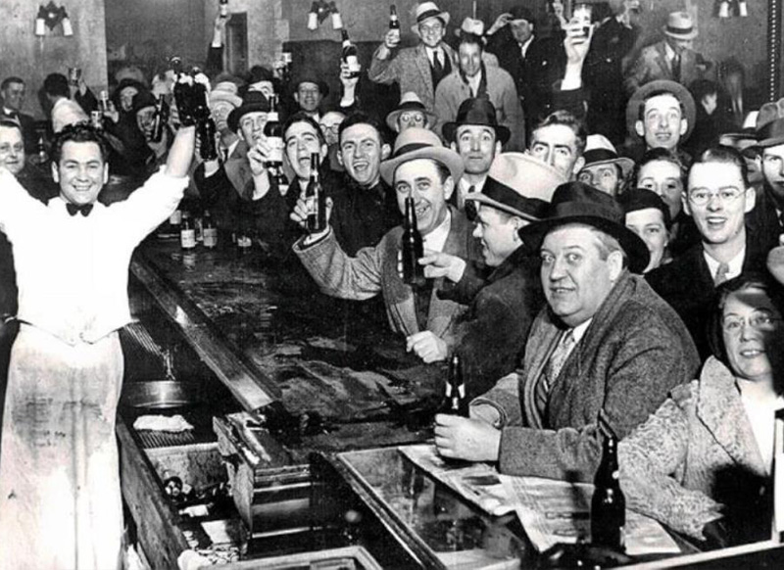
The Night Prohibition Ended
1933

Slide 7
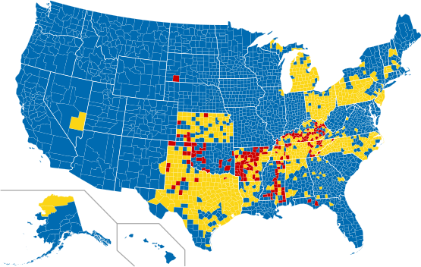
“Prohibition” Today (2012)

Slide 8
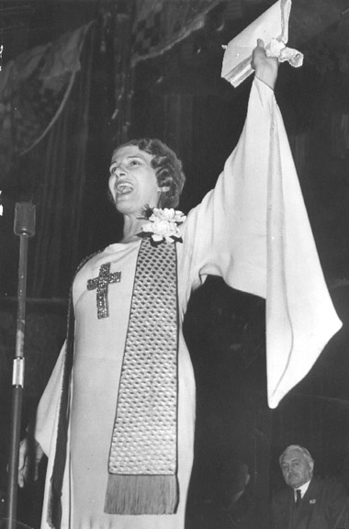
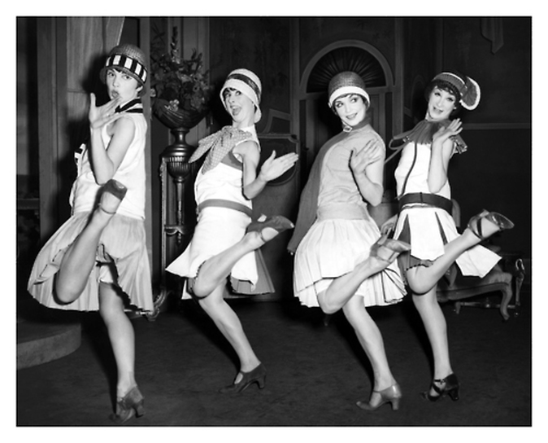
Religion during 1920’s
Modernism vs Fundamentalism

Slide 9
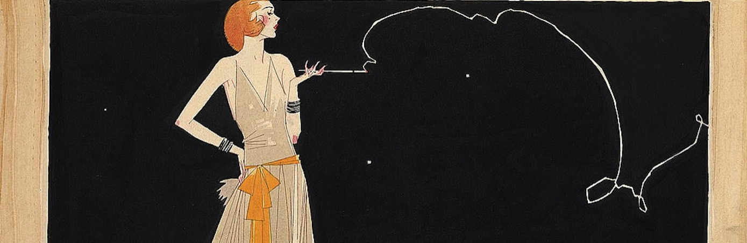
American Modernism
Modernism
  Growing philosophical movement during the 1920s
  Seen in art, gender roles, religions, music, entertainment
  Critical view of many aspects of traditional religion.
  Believed science (Darwinism) and religion could coexist.
Notes:
All important knowledge found in the Bible
Could not believe that evolved from Apes

Slide 10
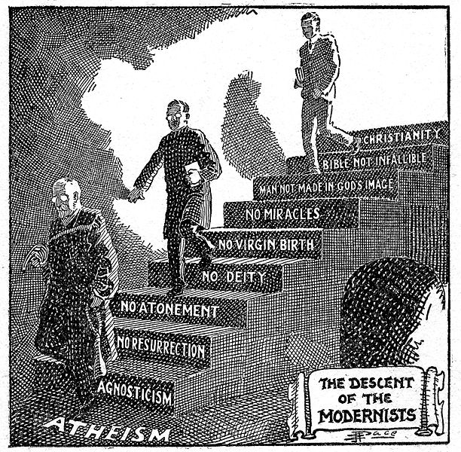

Slide 11
American Fundamentalism
Fundamentalism
  Literal interpretation of the bible.
  Skeptical of science
  Rejected theory of evolution
  Use religious revivals or radio to spread beliefs
Notes:
All important knowledge found in the Bible
Could not believe that evolved from Apes

Slide 12
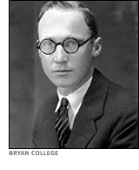
The Scopes “Monkey” Trial
Issue
  TN made it a crime to teach evolution
  John Scopes defied the law
Trial
  ACLU hired Clarence Darrow to defend him
  Prosecutor: William Jennings Bryan
Notes:
ACLU promised to defend teacher who defied it
Darrow was the most famous trial lawyer at the time

Slide 13
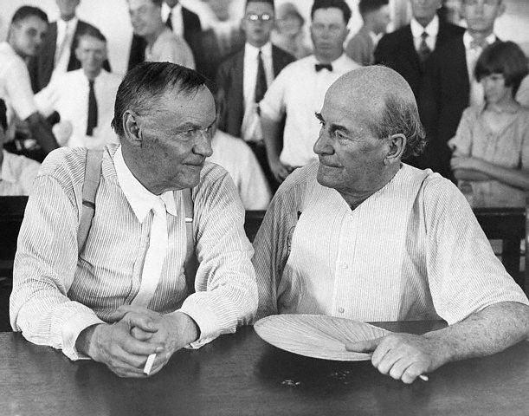
The Scopes Trial (July 10, 1925)
Trial
  Becomes a publicity stunt
  Spent days debating whether or not the Bible should be taken literally
Ruling
  Darrow found guilt
  TN Supreme Court overturned ruling
  W.J. Bryan died 5 days later
Darrow and Bryan
Notes:
Judge moved the trial outside to accommodate all the people
Darrow asked: Do you think Earth made in 6 days? PEOPLE WERE SHOCKED
Bible left to interpretation
Overturned on a technicality: Law remained in place

Slide 14
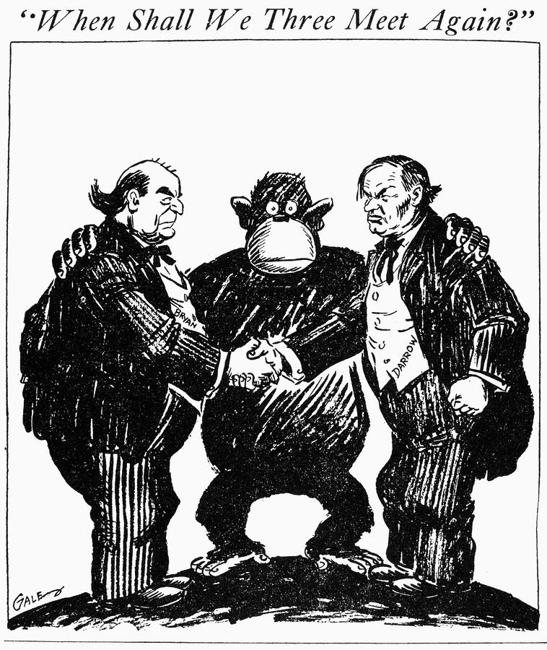

Slide 15
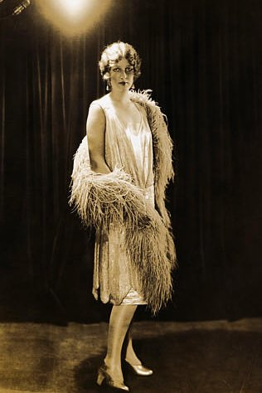
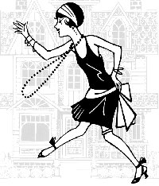
Women
Flappers
  Emancipated women who embraced new fashions and attitudes
  Not all subscribed to Flapper

Slide 16
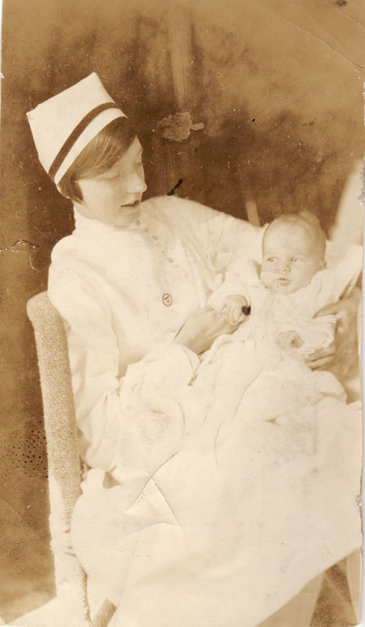
New Work Opportunities
Teaching, nursing, libraries, clerks, secretaries
1930: 10 million employed

Slide 17
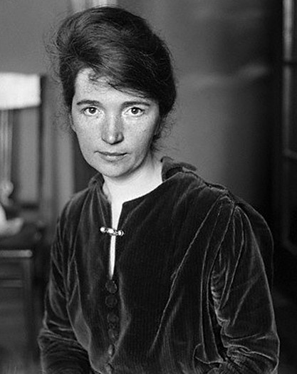
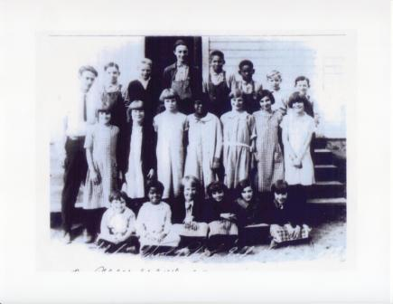
Changing Family
Births decreased
  Margaret Sanger
    Advocated use of Contraceptives
More free time for women
More children in schools

Slide 18
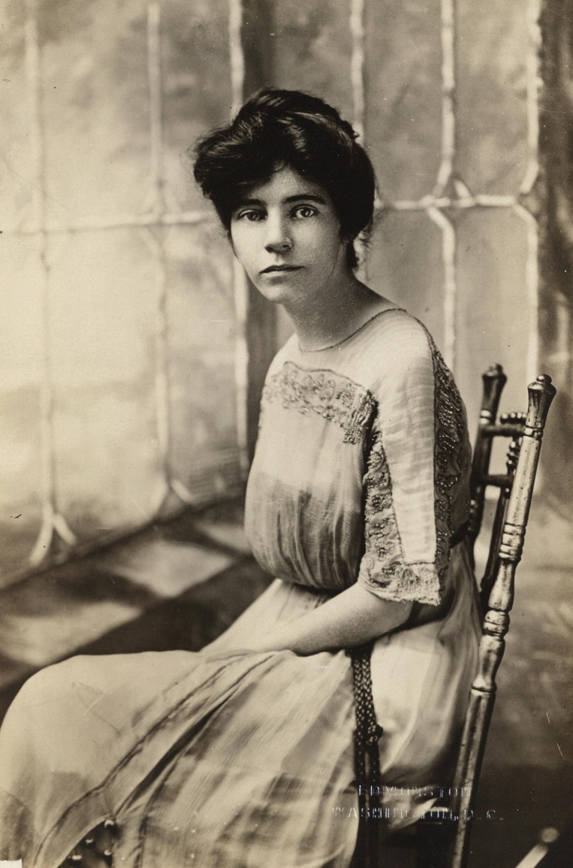
Women
Equal Rights Amendment
  1923 -Originally proposed by Alice Paul
  Fails to pass either house
Future of ERA
  Passes through Congress 1972
    Ratification deadline set for 1982
      Only 35 States ratified (needed 38)

Slide 19
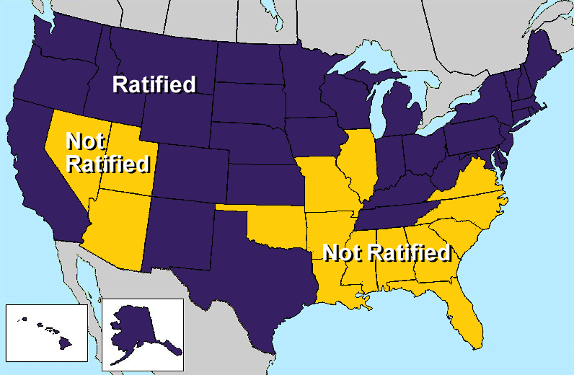

Slide 20
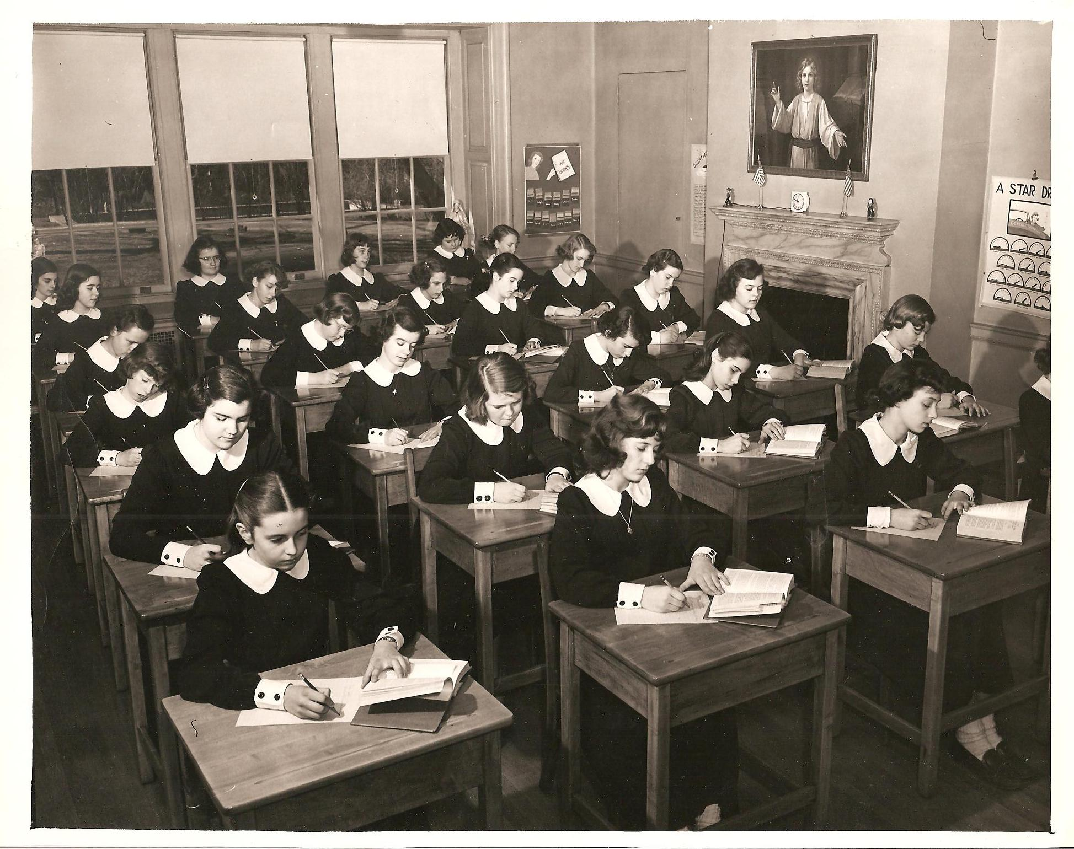
Education
School enrollment continued to rise
Offered a broader range of vocational courses.
Notes:
1914: only 1million 1926: 4million enrolled
Determined teachers met challenge of teaching illiterate immigrants
School costs double through the 20s to 2.7billion

Slide 21
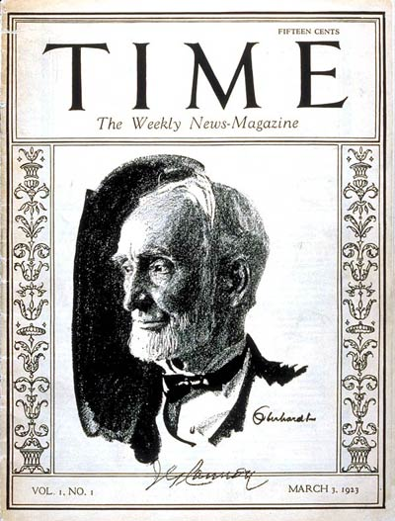
Mass Media
Newspaper circulation continued to rise
Mass circulation magazines summarized the weeks news
Americans tuned into radio which became the most powerful means of mass communication
Joseph Cannon
  Speaker of the House
Notes:
Mastered sensationalized journalism to hook readers
600 local papers shut down and 230 taken over by national chains
Time, Reader’s Digest
Heard News as it happened; could hear President and World Series
29: Spent 4.5billion on entertainment
Had money and time to enjoy leisure activities

Slide 22
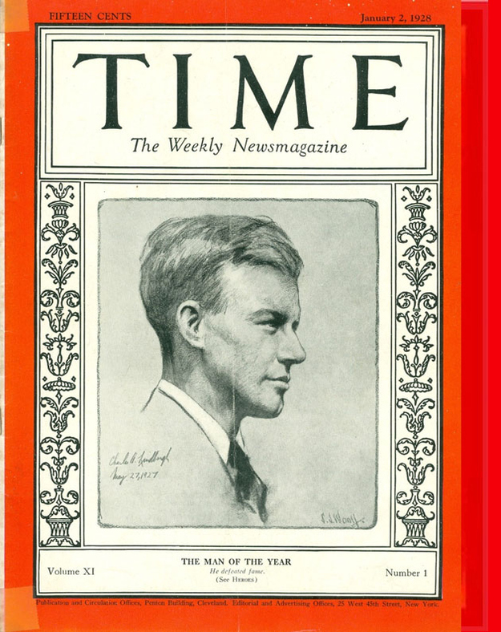
First “Man of the year”

Slide 23
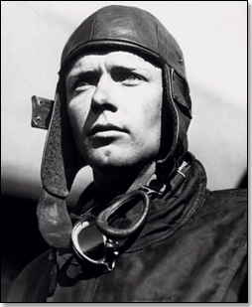
American Heroes in the 1920s
Charles Lindberg made the first non stop solo flight across the Atlantic
Flew in his plane the Spirit of St. Louis.
Became a national hero
Notes:
Prize of $25,000 offered
Left near NYC on May 20, 1927
Took 33hrs and 29 minutes
Stood for bravery and honor in a time that lost it

Slide 24
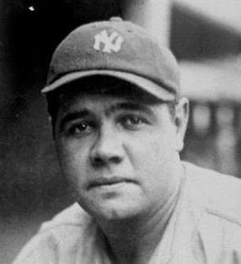
Babe Ruth: Hit 60 Home Runs

Slide 25
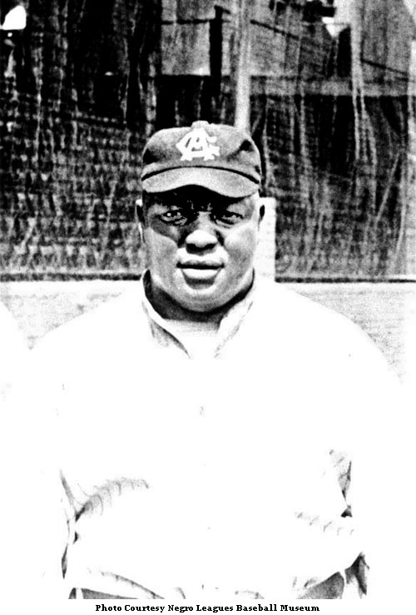
Andrew “Rube” Foster: Founded Negro National Baseball League

Slide 26
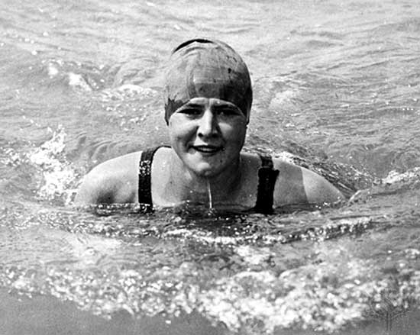
Gertrude Ederle: First Woman to Swim the English Channel

Slide 27
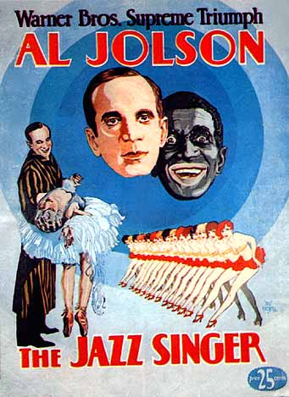
Movies, Writers, and Artists
In 1927 The Jazz Singer was the first “Talkie”
Steamboat Willie was the first talking animated movie
Talkies doubled attendance
Notes:
Steamboat Willie (’28): First animated movie with Sound

Slide 28
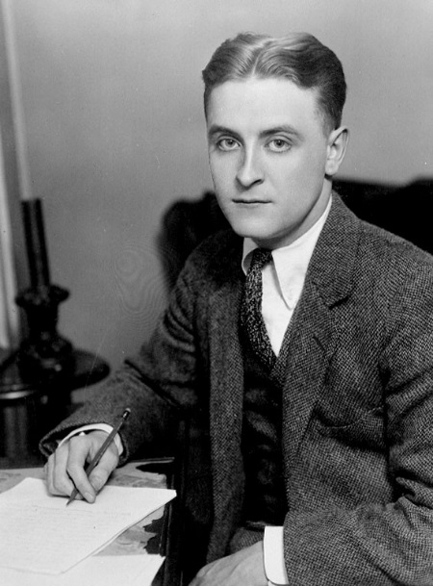
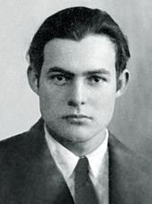
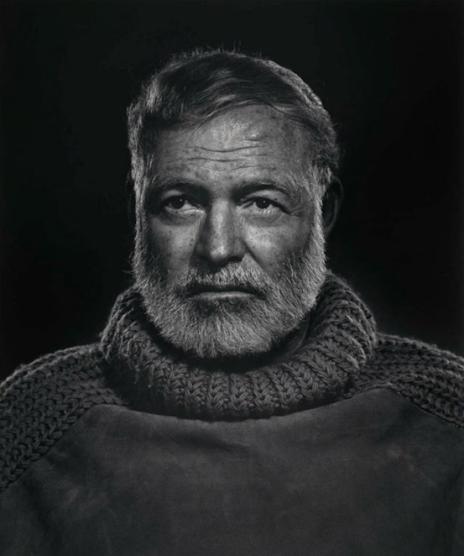
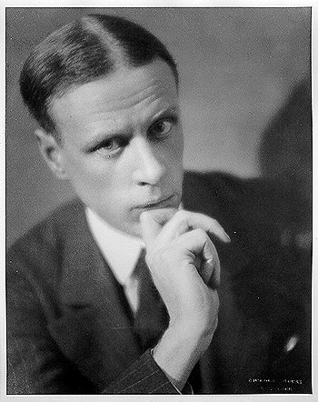
American Authors
F Scott Fitzgerald
  The Great Gatsby
  Coined the term “Jazz Age”
Ernest Hemmingway
  The Sun also Rises (1926)
  The Old Man and the Sea (1951)
  Fought in WWI
  Wrote about love, loss, and war
Sinclair Lewis
  Criticized Materialism
  First American to win the Nobel Prize in Literature
Notes:
Writers of the 1920s:
Sinclair Lewis- first American to win Noble prize in literature
Criticized Americans for conforming and materialism
This Side of Paradise and Gatsby
Age of Innocence (Edith Wharton): tackled clash of moral and traditional value

Slide 29
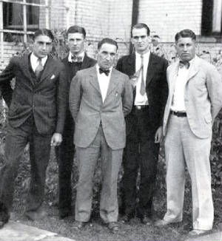
The Lost Generation
The “Lost Generation” was a term used to describe people in post WWI America
This term also characterizes a specific group of writers during this era.
Fitzgerald, Gertrude Stein and Ernest Hemingway were some of this “club’s” members
Most of these authors focused on the negative aspects of the era
Notes:
Mainly in Paris
Joined by Gertrude Stein, T.S. Eliot, and Ezra Pound
Socialized in Paris Cafés
Hemingway introduced tough, simplified style of writing; A Farewell to Arms and The Sun Also Rises

Slide 30
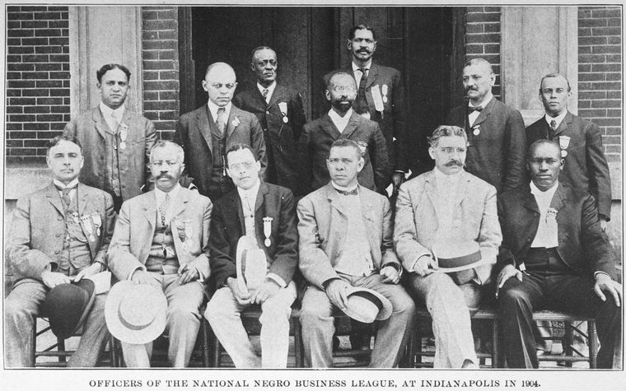
Civil Rights in the 1920’s
African Americans
  Harding
    Supported Anti Lynching Laws
    First President to openly do so
  Coolidge
    Spoke in favor of African American Rights
    Applauded role in WWI
  Southern Democrats filibustered most proposed laws

Slide 31
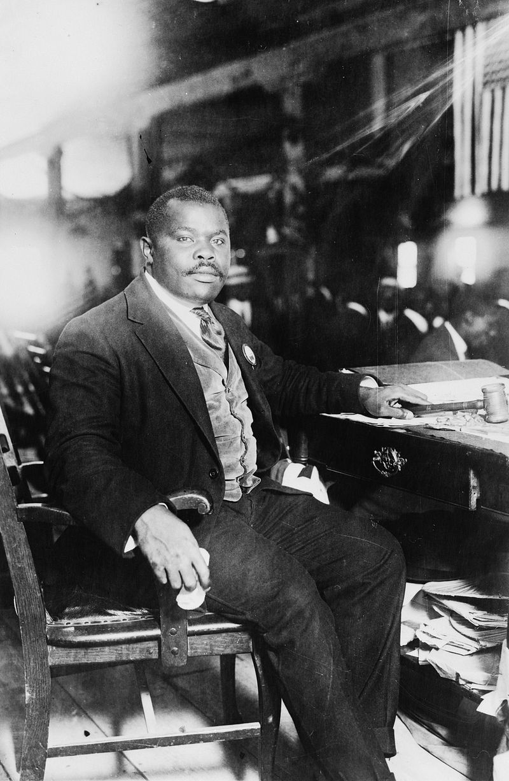
Civil Rights in the 1920’s
Marcus Garvey
Founded the UNIA
  Universal Negro Improvement Association
Advocated for blacks to start a colony in Africa

Slide 32
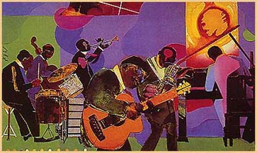
The Harlem Renaissance
An artistic “rebirth” of African American Culture and entertainment
Seen primarily in NE United States (Gr. Migration)
Seen primary in music, literature, art, and poetry
Often focused on struggles faced by African Americans (Slavery, discrimination)

Slide 33
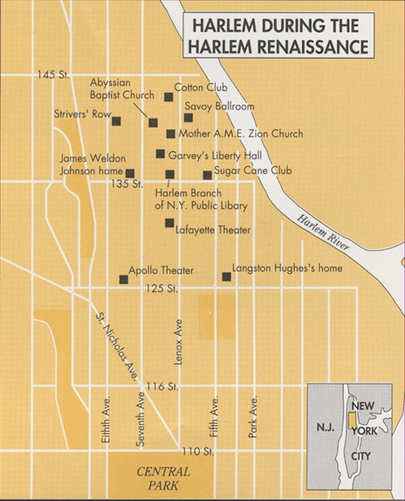

Slide 34
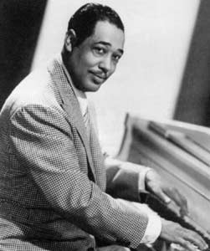
Duke Ellington
Jazz pianist
Self-taught musician
“Soda Fountain Rag” at the age of 15

Slide 35
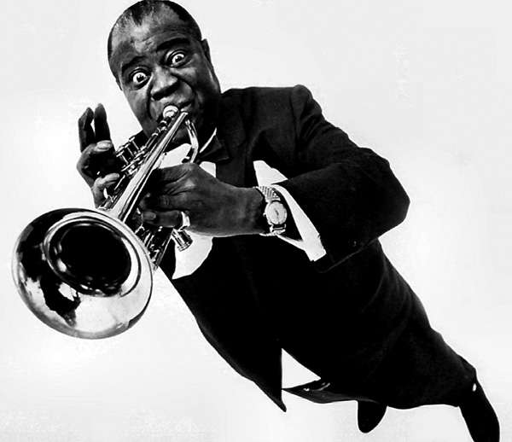
Louis Armstrong
One of the most influential musicians in the history of Jazz

Slide 36
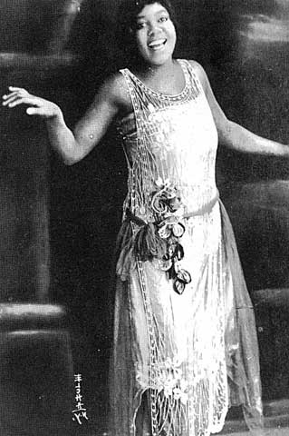
Bessie Smith
Female blues singer
1927, highest paid black artist in the world.

Slide 37
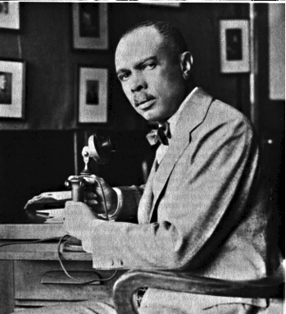
James Weldon Johnson
Poet
Lawyer
Executive Secretary of the NAACP

Slide 38
Lift Every Voice and Sing ---James Weldon Johnson
Lift every voice and sing, till earth and Heaven ring,
Ring with the harmonies of liberty;
Let our rejoicing rise, high as the listening skies,
Let it resound loud as the rolling sea.
Sing a song full of the faith that the dark past has taught us,
Sing a song full of the hope that the present has brought us;
Facing the rising sun of our new day begun,
Let us march on till victory is won.

Slide 39
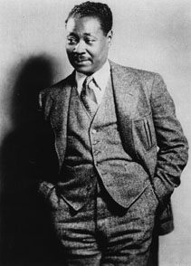
Claude McKay
Jamaican immigrant
Poems – militant versus encouraged blacks to resist prejudice

Slide 40
If We Must Die --Claude McKay
If we must die—let it not be like hogs
Hunted and penned in an inglorious spot,
While round us bark the mad and hungry dogs,
Making their mock at our accursed lot.
If we must die—oh, let us nobly die,
So that our precious blood may not be shed
In vain; then even the monsters we defy
Shall be constrained to honor us though dead!
Oh, Kinsmen! We must meet the common foe;
Though far outnumbered, let us show us brave,
And for their thousand blows deal one death blow!
What though before us lies the open grave?
Like men we’ll face the murderous, cowardly pack,
Pressed to the wall, dying, but fighting back.

Slide 41
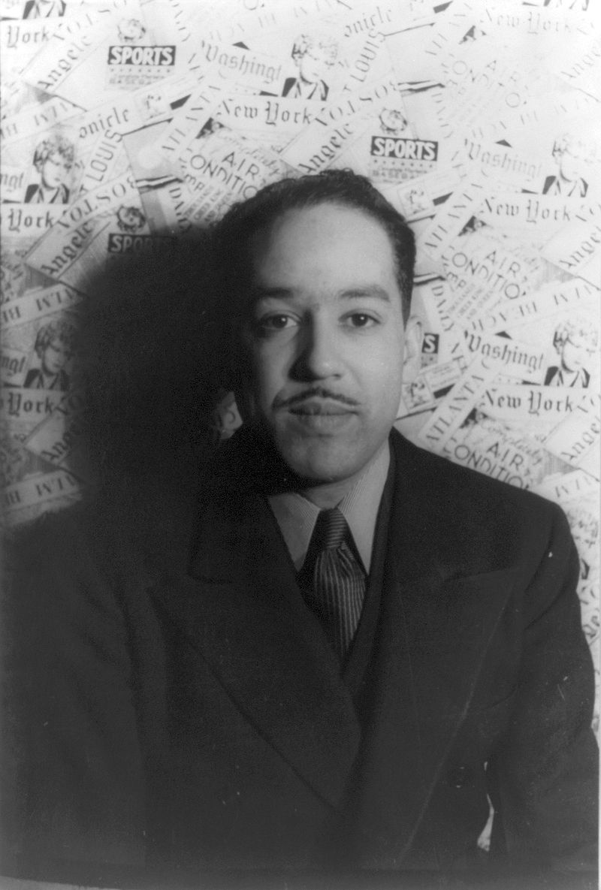
Langston Hughes
Poet
Describes the difficult lives of working-class African Americans

Slide 42
I, too, sing America ---Langston Hughes
I am the darker brother.
They send me to eat in the kitchen
When company comes,
But I laugh,
And eat well,
And grow strong.
Tomorrow,
I'll be at the table
When company comes.
Nobody'll dare
Say to me,
"Eat in the kitchen,"
Then.
Besides,
They'll see how beautiful I am
And be ashamed -
I, too, am America.

Slide 43
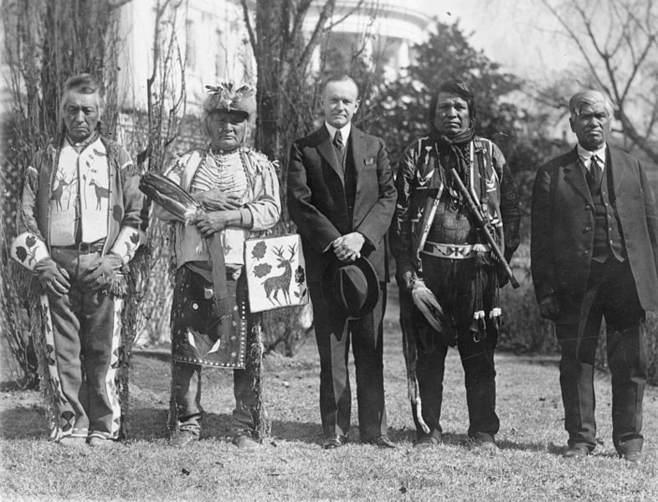
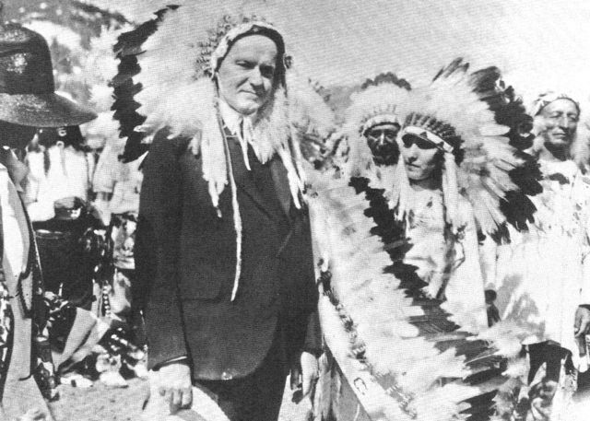
Civil Rights in the 1920’s
Native Americans
  Indian Citizenship Act 1924
    Signed by Coolidge
    Granted citizenship to all Native Americans

