Slide 1
The Revolutionary War

Slide 2
Themes of today
America gets beaten (badly) at first.
Significant battles
The Northern War and The Southern War
Colonial Military Strategy
Foreign assistance
A long, expensive, drawn out war = Victory

Slide 3
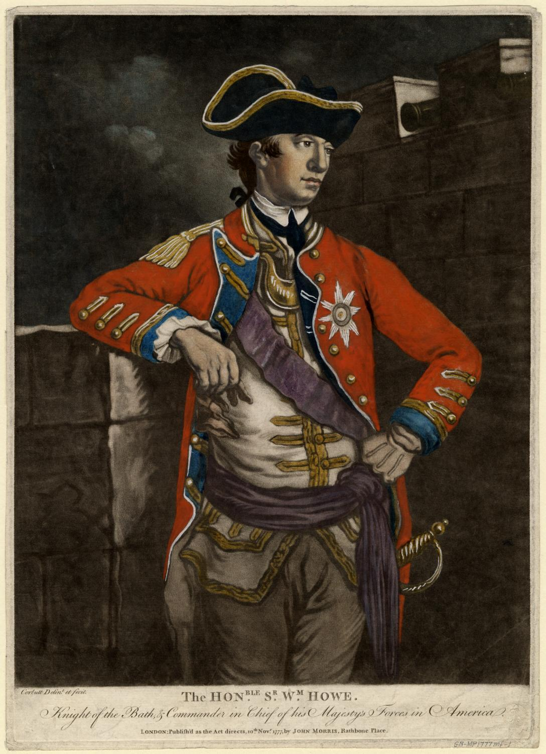
British Move Against New York
British Gen. Howe took one last shot at resolving the Revolution diplomatically, but found no success
Summer 1776, Howe moved to capture New York City, first routing the Continental Army on Long Island

Slide 4
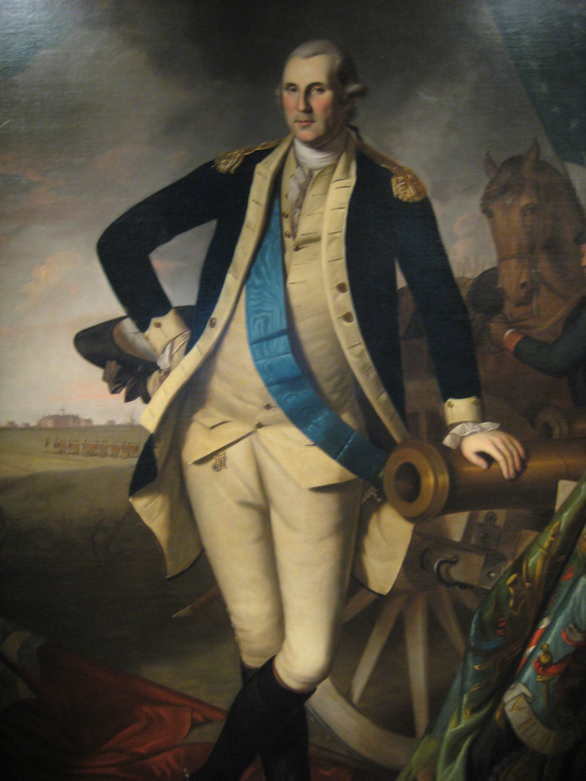
New York Falls
Howe failed to capitalize on this early victory, moving slowly and cautiously towards Manhattan
Washington elected to abandon New York rather than risk becoming surrounded by the British
NYC would remain in British hands for the rest of the war

Slide 5
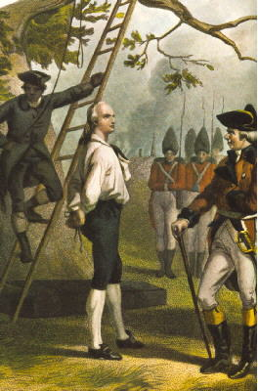
Nathan Hale
Washington left behind an officer named Nathan Hale to spy on the British in the city, but Hale was captured
Hale was sentenced to be hung, but he inspired many with his last words: “I only regret that I have but one life to lose for my country.”

Slide 6
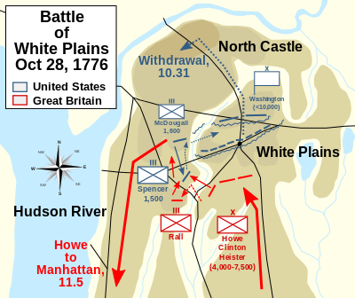
Battle of White Plains
Washington withdrew his forces to White Plains, NY, where he lost once again to the British in October, 1776
After defeating Washington, the British turned towards Philadelphia, but with winter setting in, they decided to encamp until spring in New Jersey

Slide 7
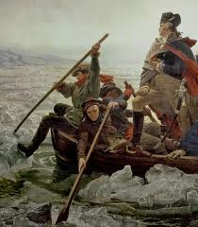
Washington Crosses the Delaware
Washington decided to surprise the British and launched an attack
On December 25, 1776, Washington led 2400 men across the Delaware River and defeated Hessian troops at Trenton, NJ and then went on to defeat a British force in Princeton before encamping himself in the New Jersey hills

Slide 8
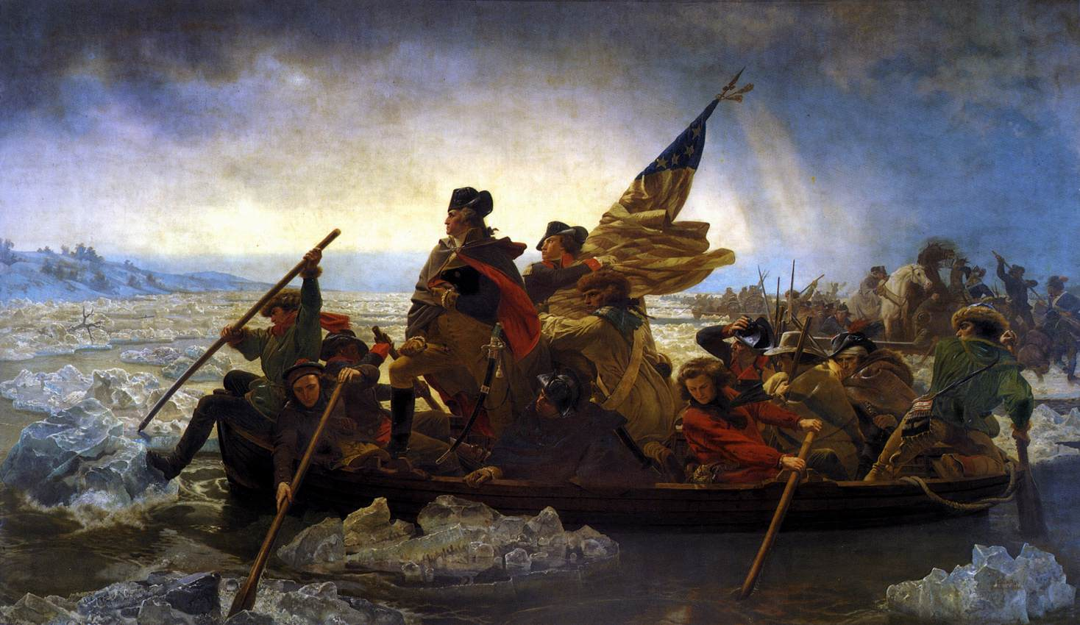
Washington Crossing the Delaware
(by Emanuel Leutze, 1851)

Slide 9
More bad news…

Slide 10
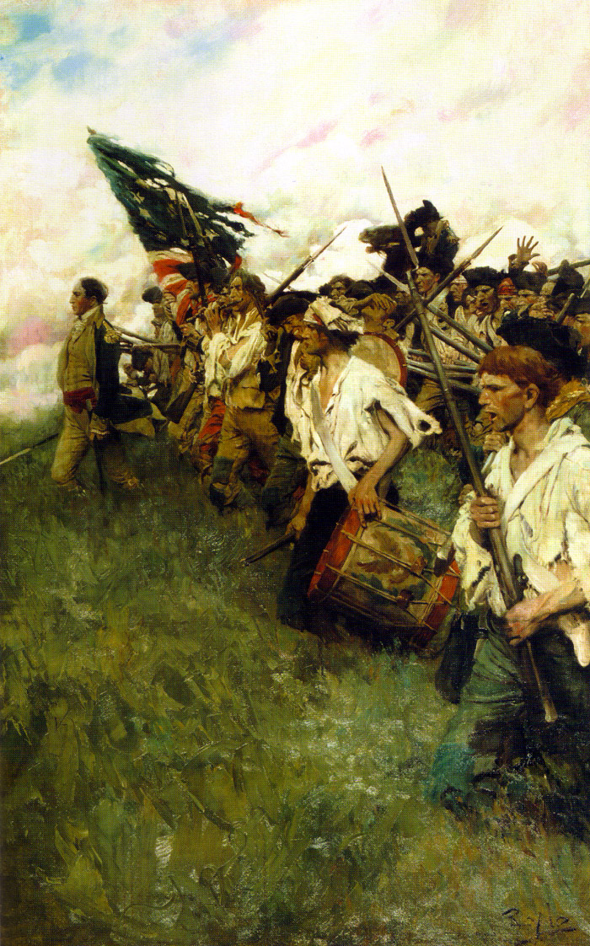
Philadelphia Falls
From spring to fall 1777, Howe moved against Philadelphia, finally defeating Washington at Brandywine Creek in September, giving him control of the city
By this time, however, the Continental Congress had left the city, making Howe’s victory a hollow one

Slide 11
The Continental Army gets its first major victory….

Slide 12
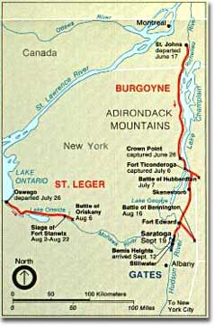
Attack From Canada
In June 1777, British Gen. John Burgoyne, under orders from King George, led his army of about 9000 British out of Quebec and into New York
Burgoyne believed that Howe was moving north to assist him, and did not know that Howe had instead moved against Philadelphia

Slide 13
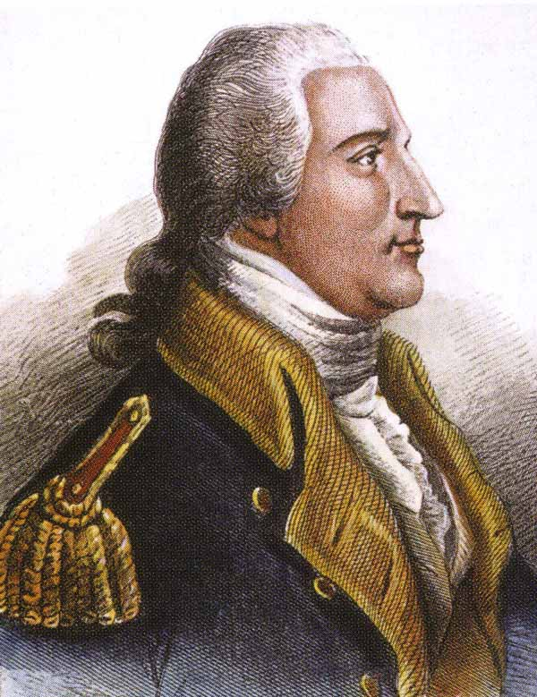
Battle of Saratoga
Burgoyne found himself hounded by American militia and Continental troops under the command of Gen. Benedict Arnold
Without Howe’s help and supplies, Burgoyne was defeated and forced to surrender at Saratoga in October, 1777
Turning Point in the North!

Slide 14
In what season does war come to a halt?

Slide 15
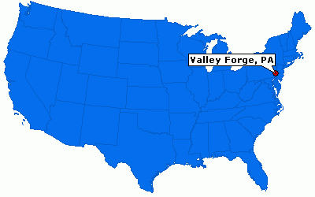
Washington adds to his legacy here…..

Slide 16
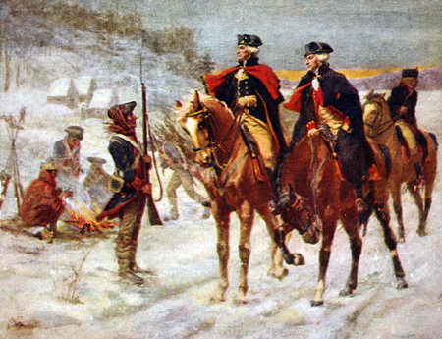
Valley Forge
The Continental Army spent the winter of 1777 encamped at Valley Forge, PA
That winter was an especially brutal one, and Washington lost over 2500 men to the cold and starvation
Washington used the winter to train his soldiers, however, instilling better discipline, skills.

Slide 17
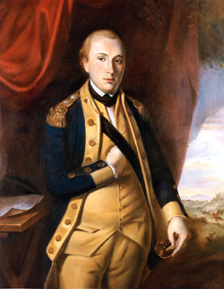
Foreign Aid
Washington enlisted the help of a young French officer, the Marquis de Lafayette, and of a Prussian officer, Baron Friedrich von Steuben, to train his men in European military tactics and strategies

Slide 18
France will only enter the war if the colonies have a chance to win!

Slide 19
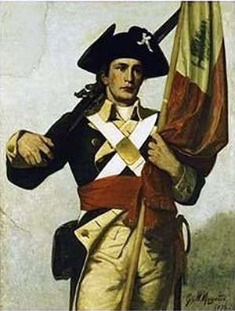
France Enters the War
The American victory at Saratoga, coupled with positive reports from Lafayette, led France to enter the war on the side of the Americans in February, 1778
France became the first country to diplomatically recognize American independence and signed a military alliance against Britain with the US

Slide 20
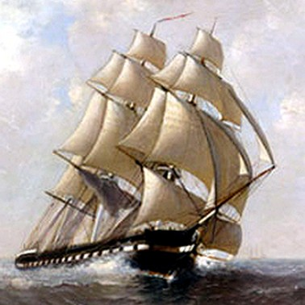
The War at Sea
At sea, American warships concentrated on attacking British merchant ships with the intent of inflicting damage on the British economy
The Continental Navy generally avoided head-to-head battles with the much more powerful British Navy

Slide 21
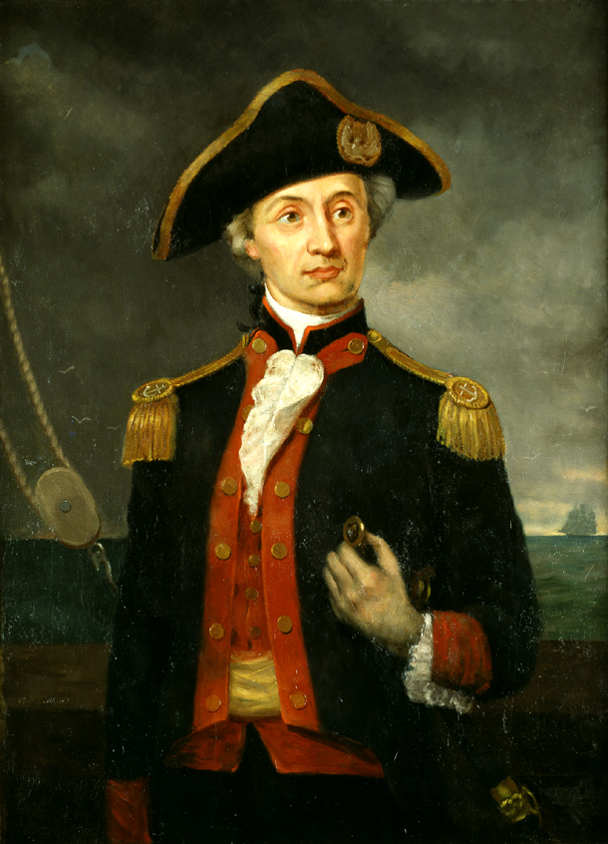
John Paul Jones
The most notable American naval victory of the war came in Sept. 1779 when the Bonhomme Richard, commanded by John Paul Jones, captured the British warship Serapis
When challenged to surrender early in the battle, Jones famously responded: “I have not yet begun to fight!”

Slide 22
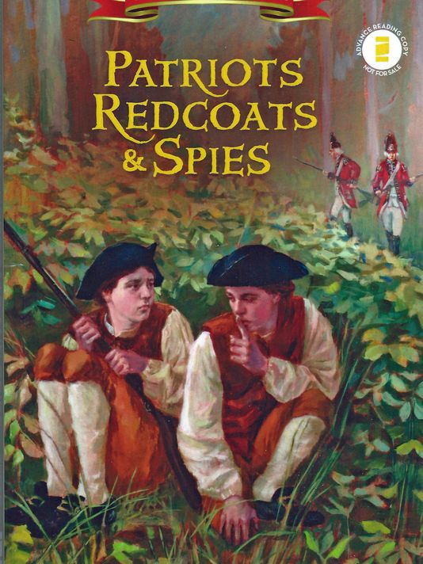
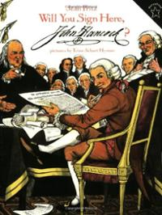
Revolution Children’s Book
Create a Children’s Book outlining the 5 MOST IMPORTANT EVENTS of the American Revolutionary War.
Front page must be your cover which must have a title. Inside cover must have a table of contents.
For each event, provide and image, and explanation of the event, and an explanation of why you consider this event to be in the top 5.
Must use color

Slide 23
End Pt.1

Slide 24
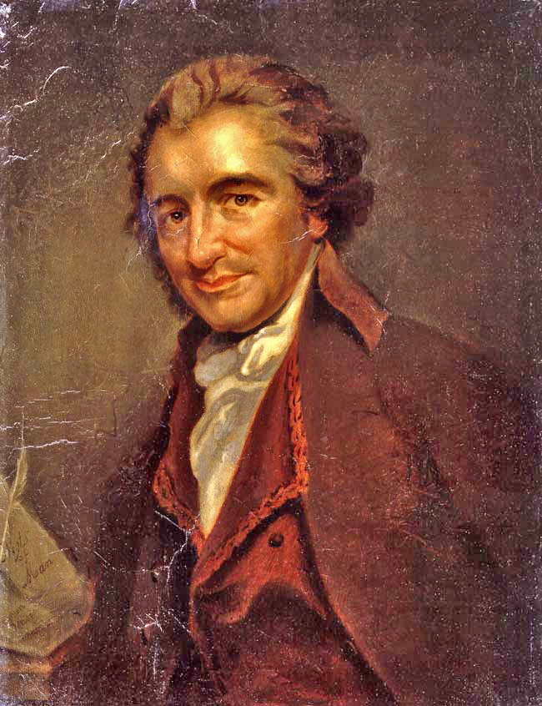

Slide 25
Excerpt From Common Sense
O! ye that love mankind! Ye that dare oppose not only the tyranny but the tyrant, stand forth! Every spot of the old world is overrun with oppression. Freedom hath been hunted round the Globe. Asia and Africa have long expelled her. Europe regards her like a stranger, and England hath given her warning to depart. O! receive the fugitive, and prepare in time an asylum for mankind!

Slide 26
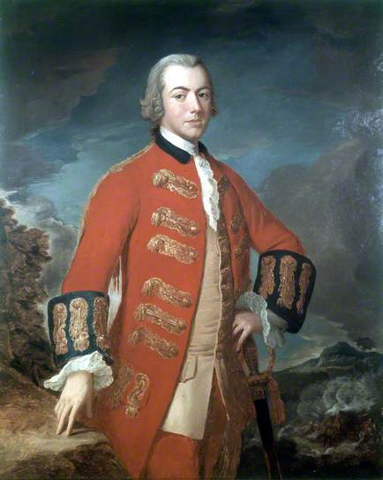
British Turn South
After the defeat at Saratoga, Howe resigned and was replaced with Gen. Henry Clinton
Clinton decided to focus on gaining control of the Southern colonies and their valuable cash crops, believing that he would be assisted by the large numbers of Loyalists in Georgia & the Carolinas

Slide 27
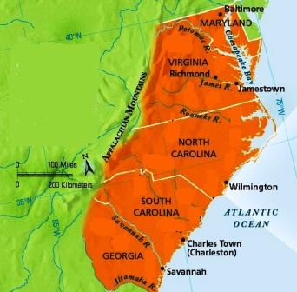
Georgia Falls
December 1778: Clinton’s forces captured Savannah, Georgia and rapidly followed up by subduing the entire colony and putting a royal governor back in power
Clinton then sent Gen. Charles Cornwallis north with 14,000 men to attack Charles Town, SC

Slide 28
Charles Town Falls
May 1780: 5500 American soldiers in Charles Town were forced to surrender, marking the Americans’ largest defeat of the entire war
Washington dispatched Gen. Horatio Gates to defend the South Carolina backcountry

Slide 29
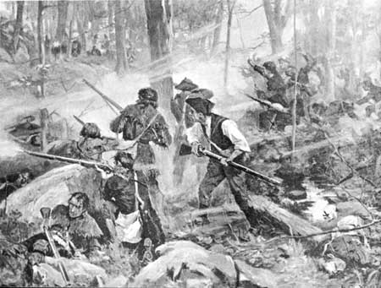
Battle of Kings Mountain
Gates found himself fighting both the British and a strong contingent of Loyalists
Gates, however, won the support of many of the settlers in the Appalachians and defeated the British-Loyalist force in the Battle of Kings Mountain in October 1780

Slide 30
American Military Strategy Changes For The Better…

Slide 31
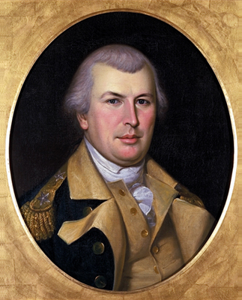
Hit-and-Run Raids
American Gen. Nathaniel Greene decided that, rather than face the British head-on in major battles across the South, that he would instead keep his men in small units designed to carry out hit-and-run raids against British supply lines
In this way, Greene took back the interior South, leaving the British holding just Savannah, Charles Town, and Wilmington, NC by late 1781

Slide 32
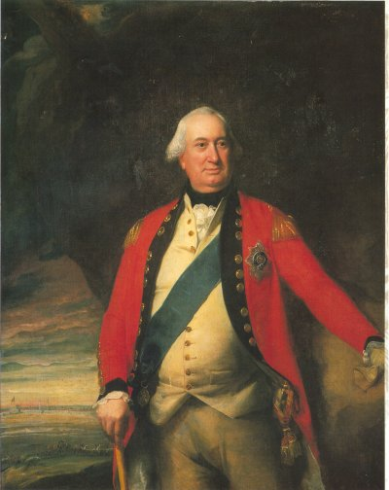
British Attack Virginia
In Spring 1781, Gen. Cornwallis decided to leave the Carolinas and attack Virginia
Cornwallis joined his forces with those of Benedict Arnold (who had switched sides during the war) and began terrorizing the Virginia countryside

Slide 33
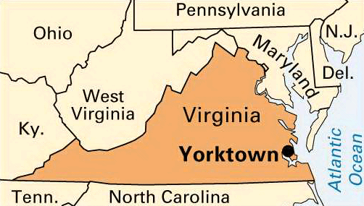

Slide 34
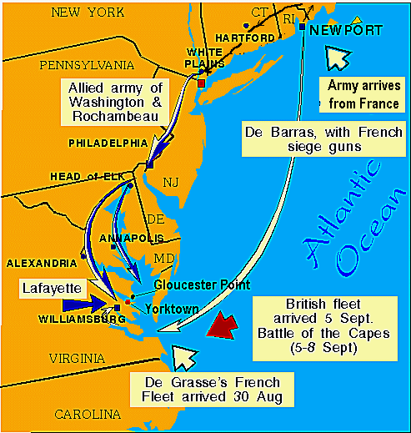
Cornwallis Moves to Yorktown
When a large American force moved into Virginia to counter Cornwallis, he moved his forces to the river-town of Yorktown, where he could be more easily resupplied by British ships
Cornwallis did not know, however, that a French fleet had blockaded the Chesapeake Bay and that no British supply ships could reach him at Yorktown

Slide 35
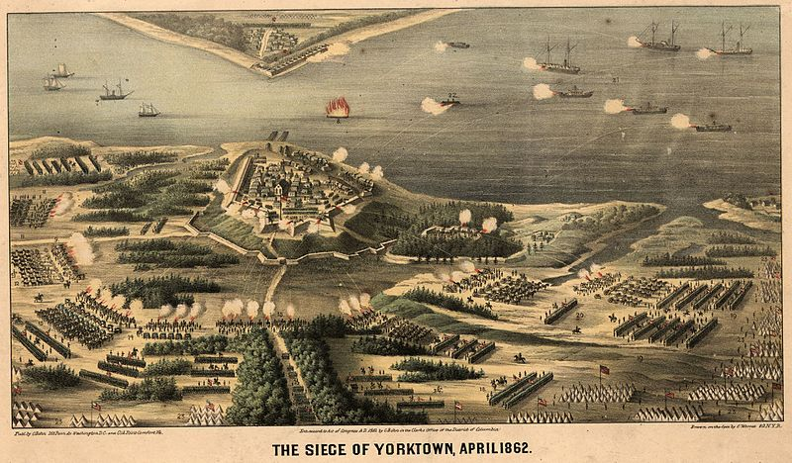

Slide 36
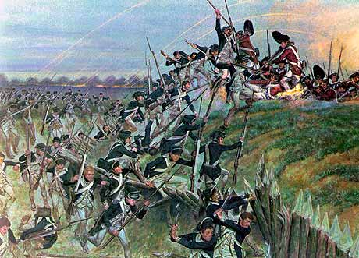
Battle of Yorktown
Meanwhile, Washington’s Continental Army, reinforced by 6000 French soldiers, had moved down from New York and surrounded Yorktown, trapping Cornwallis
After 3 weeks of fighting, Cornwallis surrendered his 8000 men, effectively ending the war

Slide 37
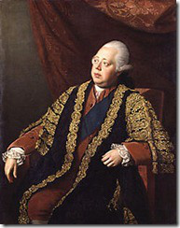
The War Ends
The surrender at Yorktown was the breaking point for public support for the war back in Britain and in Parliament – the war had lasted for 6 years and had become too expensive and embarrassing
In March 1782, Parliament voted to begin peace negotiations

Slide 38
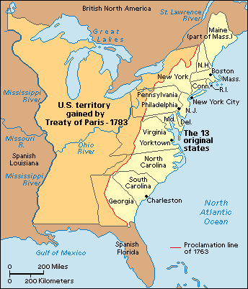
Treaty of Paris (1783)
September 3, 1783
Britain agreed to recognize the United States of America as an independent nation
Ceded all territory east of the Mississippi River, North of Florida (which Britain returned to Spain) and south of Canada
On November 24th, the last British soldiers left the United States

Slide 39
How have revolutions been different throughout world history?
Lets think of the revolutions we know…..

Slide 40
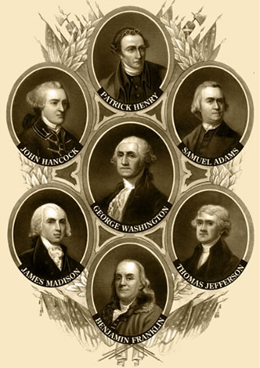
A Conservative Revolution
Not fought to create new liberties but rather to preserve established ones.
Not fought to resolve class conflicts or inequalities in wealth.
The leaders were uniquely rational men, not revolutionaries in the radical sense. They were immune to the utopian visions of later revolutionaries
Did not lead to a period of chaos, a “reign of terror,” or the imposition of a dictator.
The American Revolutionaries did not redistribute property and, arguably, never abandoned the rule of law

Slide 41
Now comes the hard part……..

Slide 42
Revolution Children’s Book
Create a Children’s Book outlining the 5 MOST IMPORTANT EVENTS to understanding the American Revolutionary War.
Front page must be your cover which must have a title. Inside cover must have a table of contents.
For each event, provide and image, and explanation of the event, and an explanation of why you consider this event to be in the top 5.
Must use color, 7 total pages

