Slide 1
The Renaissance
1350-1550

Slide 2
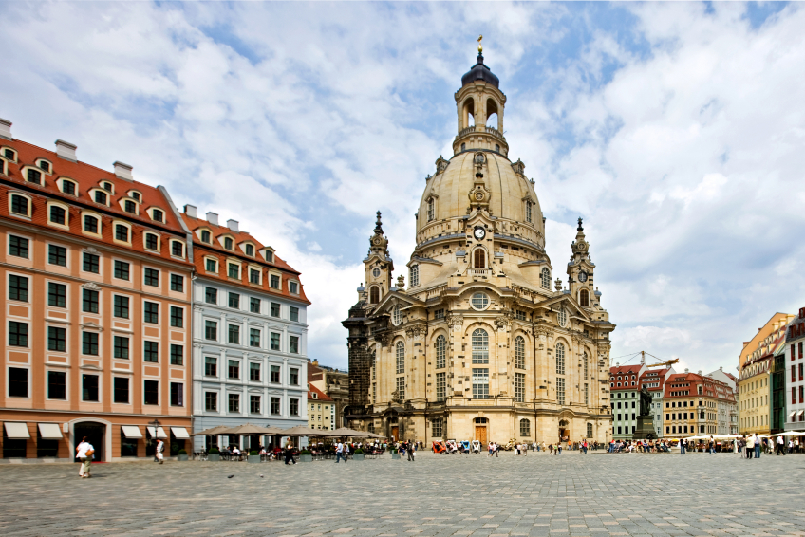
The Italian Renaissance
Renaissance means “REBIRTH”
The Italian Renaissance is a period of European History that began in Italy and spread to the rest of Europe.

Slide 3
Important Characteristics of the Italian Renaissance
An URBAN, SECULAR society – powerful city-states – increasing wealth creating new possibilities for enjoyment
Age of Recovery from disasters such as plague, political instability, & decline of Church power – interest in culture revival affected both POLITICS and ART
A new view of HUMAN BEINGS emerged as they emphasized INDIVIDUAL ability – Focus on the well-rounded people - Virtu

Slide 4
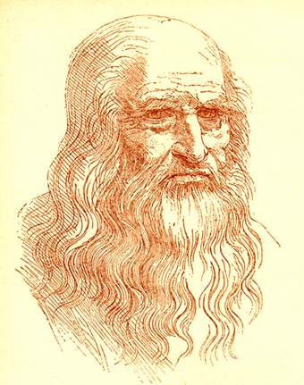
“Renaissance Man”
Leonardo da Vinci
  Painter
  Sculptor
  Architect
  Inventor
  mathematician

Slide 5
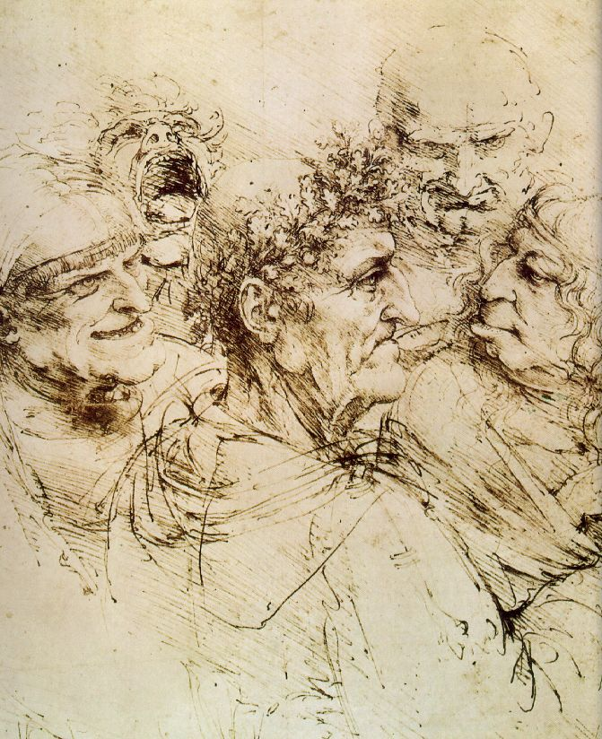
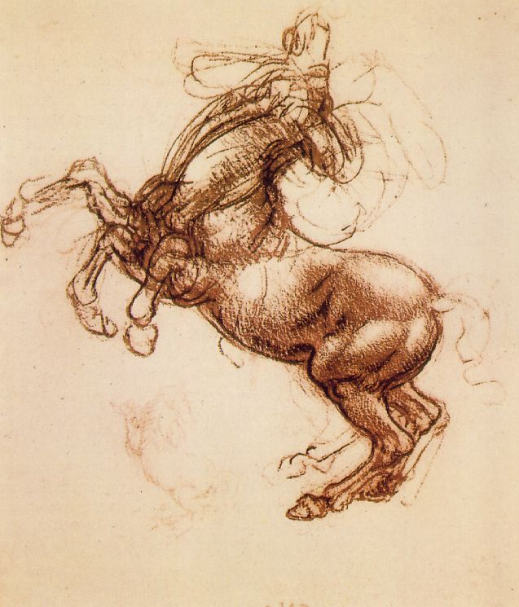
Leonardo, the Artist:
From hisNotebooks of over 5000 pages (1508-1519)

Slide 6
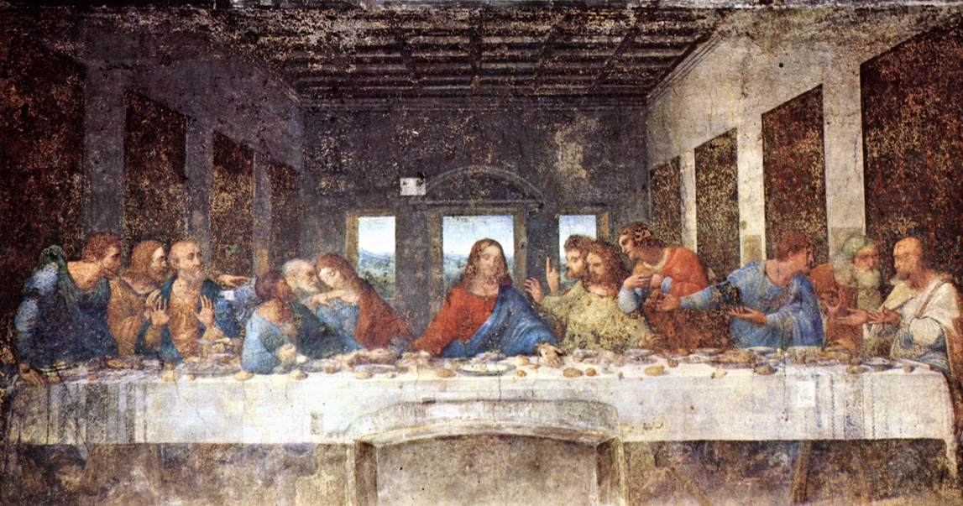
The Last Supper - da Vinci, 1498
& Geometry

Slide 7
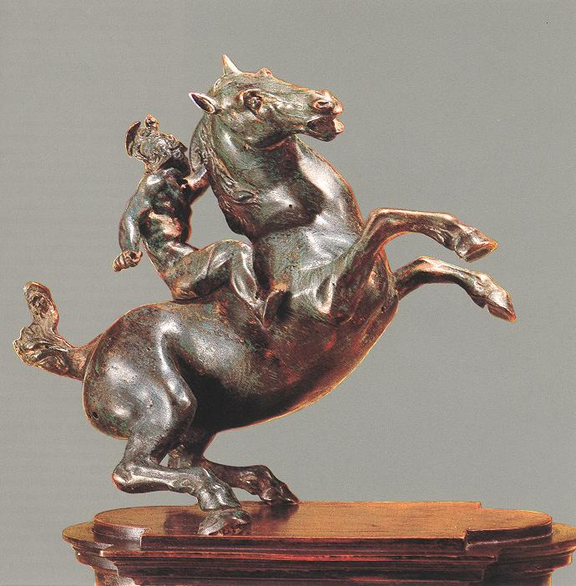
Leonardo, the Sculptor
An Equestrian Statue
1516-1518

Slide 8
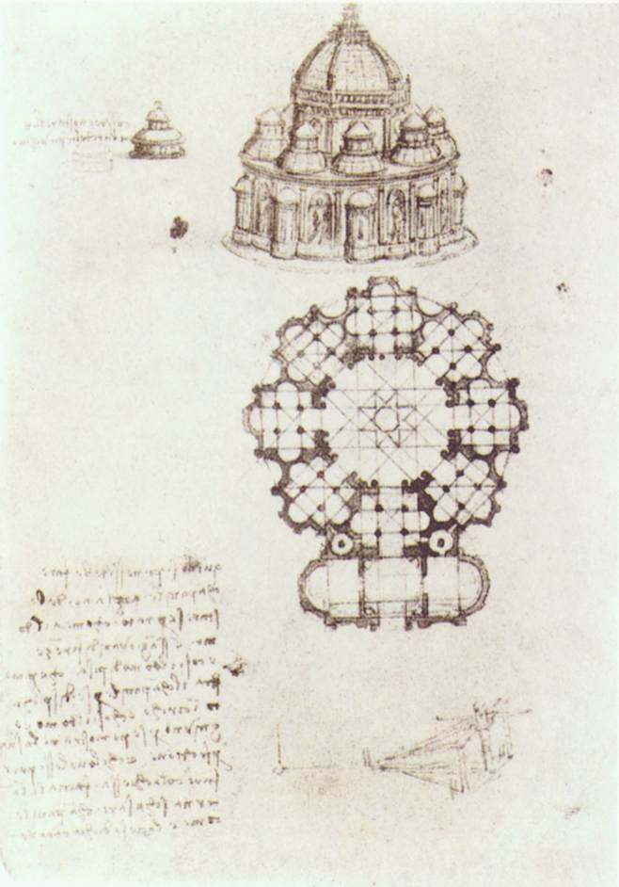
Leonardo, the Architect:
Pages from his Notebook
Study of a central church.
1488

Slide 9
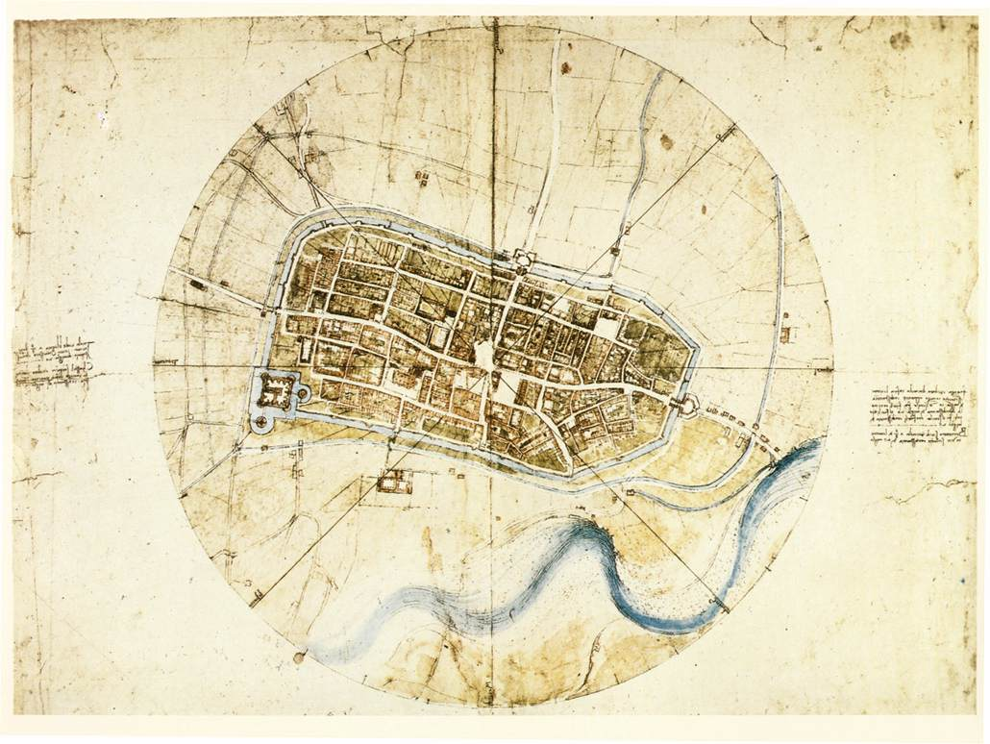
Leonardo, the Architect:
Pages from his Notebook
Plan of the city of Imola, 1502.

Slide 10
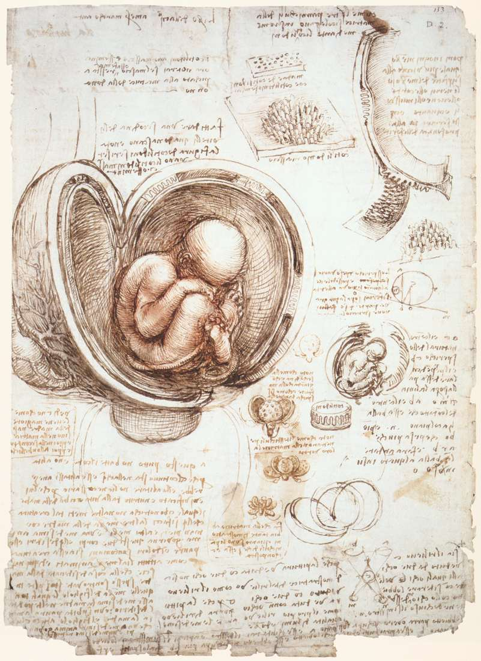
Leonardo, the Scientist (Biology):
Pages from his Notebook
An example of the humanist desire to unlock the secrets of nature.

Slide 11
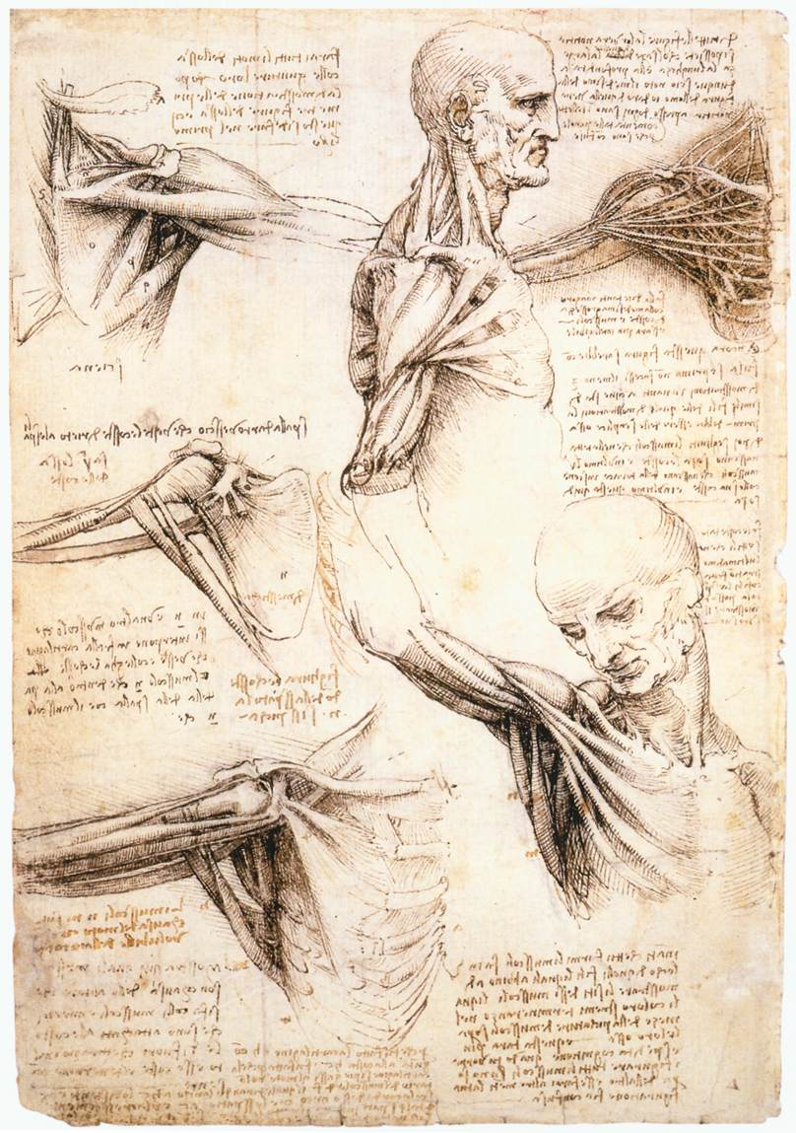
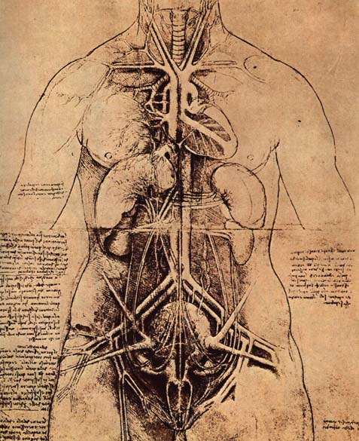
Leonardo, the Scientist (Anatomy): Pages from his Notebook

Slide 12
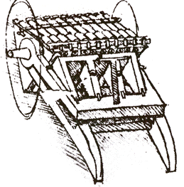
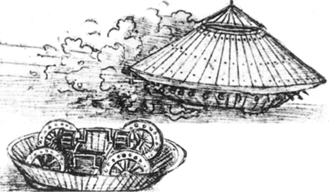
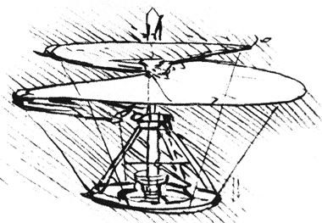
Leonardo, the Inventor: Pages from his Notebook

Slide 13
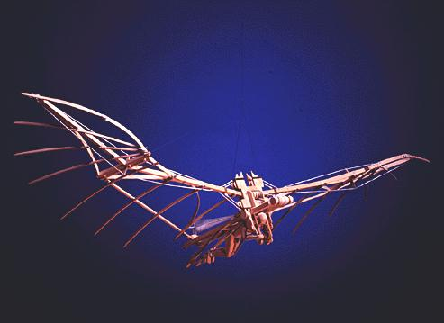
Man Can Fly?

Slide 14
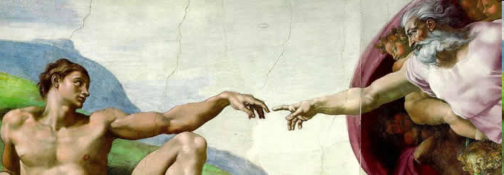
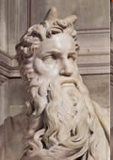
The Renaissance mostly affected the Upper class people of Europe.
Churches, homes, and public buildings were decorated with Renaissance art.

Slide 15
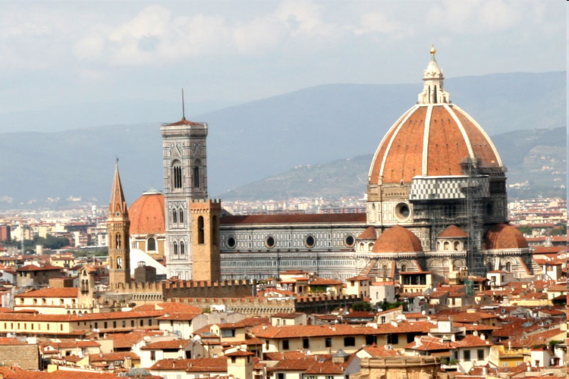
The Italian States
In Italy there wasn’t a single, strong ruler, so they formed a number of CITY-STATES – they traded all around the world!

Slide 16
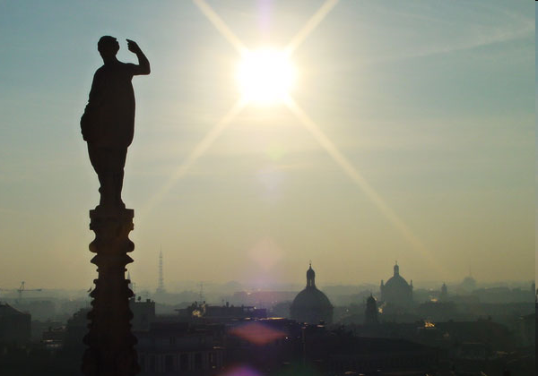
Milan
One of the RICHEST city-states and the crossroads of the main trade routes from the coast to the mountains
Ruling Family- Visconti
MERCENARIES – soldiers that sold their services to the highest bidder – under Francesco Sforza (1447) conquered the city
Created an efficient TAX system that generated revenues

Slide 17
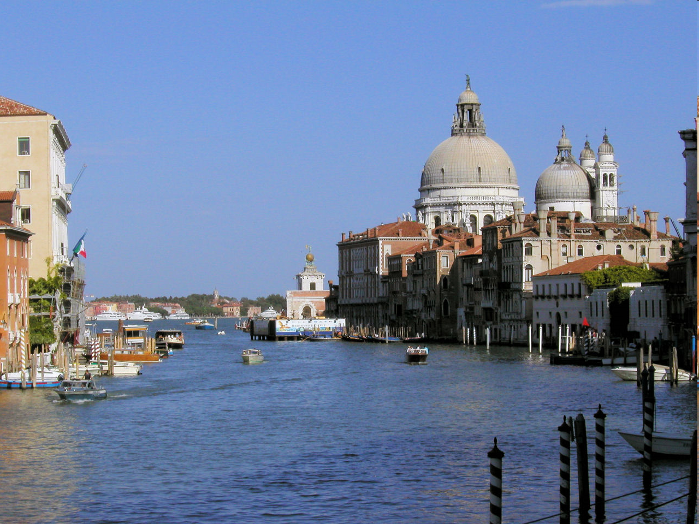
Venice
Drew TRADERS from all over the world!
A small group of merchant-aristocrats ran the government even though it was a republic with an elected Doge
Venice became an INTERNATIONAL power

Slide 18
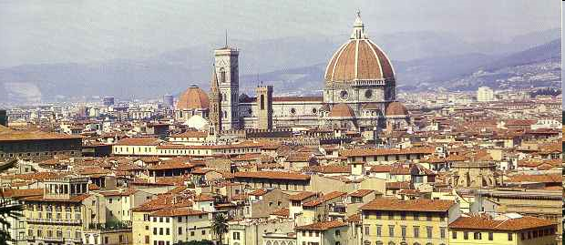
Florence
The MEDICI family took control of the government in 1434.
Because of a decline in the economy and a Dominican preacher Girolamo Savonarola, townspeople condemned the Medici family, citizens turned to Savonarola.
But people got tired of Savonarola’s strict regulations on gambling, horseracing, swearing, painting, music, and books
  Savonarola even attacked the corruption of the Church, so he was accused of HERESY and condemned to DEATH
  The Medici family returned to power.

Slide 19
Hapsburg-Valois Wars
The Italian Wars
France and Spain made Italy their battlefield as they fought to take over the country. (1494)
1527 – King Charles I from Spain brought mercenaries.
  Mercenaries were angry because they hadn’t been paid for months – so they tore down the gates of ROME, pillaged and looted.
They sold church officials into slavery.
The Sack of Rome ended the Spanish – French War – Spain Won!

Slide 20
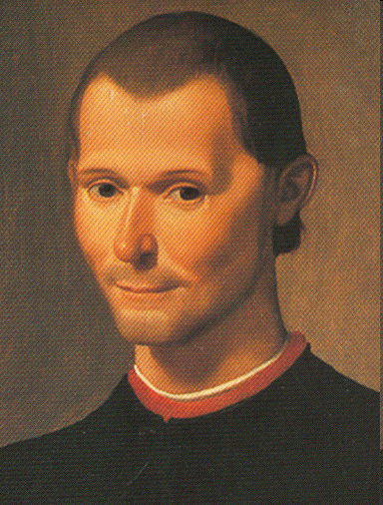
Machiavelli and the New Statecraft
Niccolo Machiavelli gave expression to the Italians’ love affair with political power.
He wrote and influential book called The Prince.
The book is about how to acquire and keep POLITICAL POWER.
He said a prince’s attitude toward power must be based on understanding that human nature is SELF-CENTERED
  He should not be restricted by moral principles.

Slide 21
Think Pair Share
What was Machiavelli’s view of human nature?
How did Machiavelli’s ideas and actions reflect his respect for ancient Rome?
What in Machiavelli’s background influence the ideas he shares in his work, The Prince?
Based on the document, how would Machiavelli feel about Modern American politics?
Is there anywhere today where we still see Machiavelli’s influence? If so, where? Explain.

Slide 22
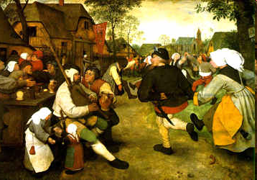
Renaissance Society

Slide 23
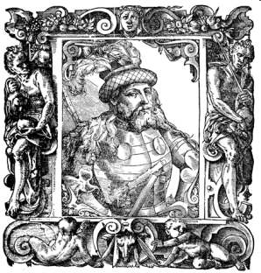
The Nobility
Nobles dominated society – they made up 2-3 percent of the population.
Rules of a noble according to Castiglione, The Book of the Courtier:
  A noble was born, not made – had to have character, grace, and talent.
  A perfect noble had to have two skills: perform military and physical exercises and have a classical education and enrich his life with the arts.
  Needed to follow a certain standard of conduct – not supposed to hide achievements, but show them with grace.

Slide 24
The Peasants and Townspeople
The peasants made up 85-90 percent of the total population.
More and more peasants became legally free.
Townspeople were divided:
  Top – PATRICIANS – wealth from trade, industry, and banking
  BURGHERS – shopkeepers, artisans, guild masters
  WORKERS – earned pitiful wages
  UNEMPLOYED – no jobs

Slide 25
Family and Marriage
Marriages were often to strengthen business and family ties – sometimes they were arranged when a kid was 2-3 years old.
DOWRY – sum of money given by the wife’s family to the husband upon marriage – required
FATHER-HUSBAND (Pater Familias) was the center of the family
  The mother supervised the household
Children became adults when fathers went before a judge and formally freed them.

Slide 26
Humanism
Intellectual Movement of the Renaissance
Reaction to Scholasticism
Based on the study of classic literary works of Greece and Rome to learn what they reveal about human nature, leading a moral life, etc.
  They studied grammar, rhetoric, poetry, philosophy, & history. Today these subjects are called the LIBERAL ARTS.
  It was considered one’s duty to use one’s education in service to the state (i.e. civic duties)

Slide 27
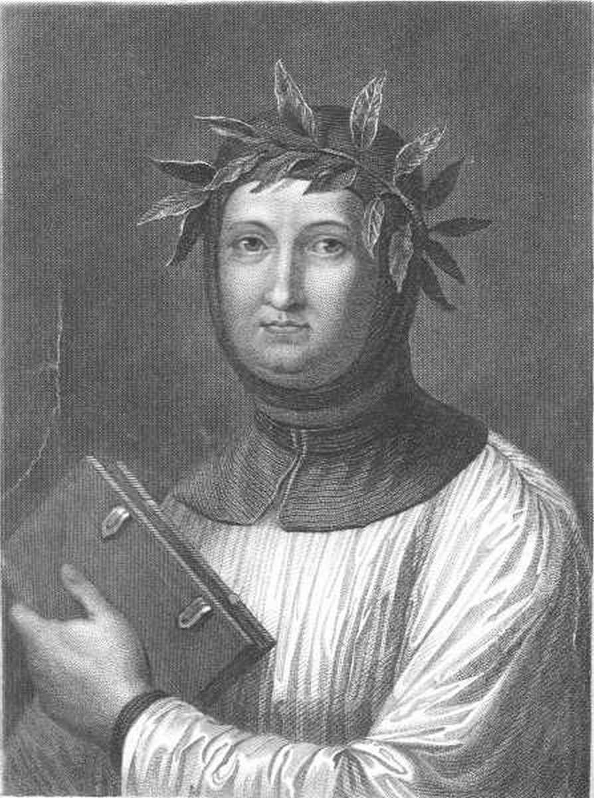
Petrarch
Father of Italian Renaissance Humanism
Poet, historian, & scholar
Introduced the Latin Classics to his contemporaries
Used classical Latin in his own writing

Slide 28
Vernacular Literature
Many scholars, lawyers, and theologians used classical Latin
  Some writers wrote in the VERNACULAR, the language of their own region.

Slide 29
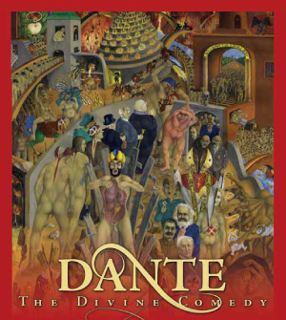
Italian author Dante wrote the DIVINE COMEDY about the soul’s journey
  The poem is divided into 3 sections: HELL, Purgatory, and HEAVEN (or Paradise)
  Dante goes through a journey until he reaches Paradise and meets God.

Slide 30
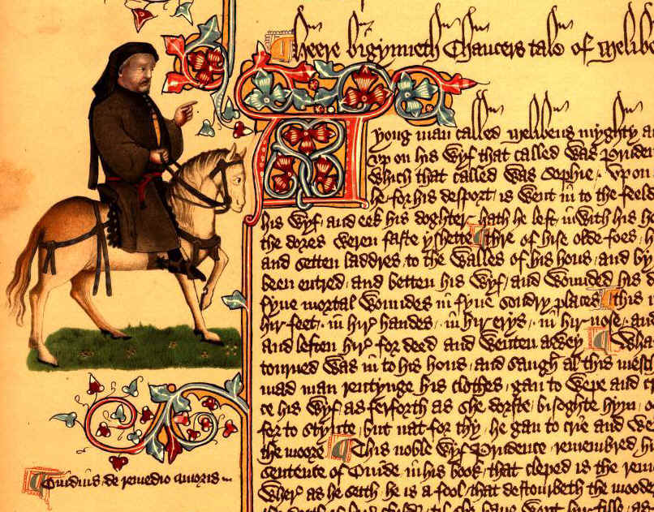
English author Geoffrey Chaucer wrote THE CANTERBURY TALES
  A collection of stories by 29 pilgrims journeying to the tomb of Saint Thomas a Becket at Canterbury, England.

Slide 31
Humanist Education in the Renaissance
Humanists believed at the core of schools should be the Liberal Arts.
  The purpose was to follow a path of VIRTUE and WISDOM.
Humanists also stressed PHYSICAL education – javelin throwing, archery, dancing, running, wrestling, hunting, etc.
Women were told not to learn math or rhetoric.
  They mostly learned religion and morals so they could be good mothers and wives.

Slide 32
THE ARTISTIC RENAISSANCE IN ITALY
  PAINTING
    A FRESCOE is a painting done on fresh, wet plaster with water-based paints – it makes the picture come alive – by using perspective, he developed a new, REALISTIC style of painting
    They focused on understanding the laws of PERSPECTIVE and the organization of outdoor space and light through geometry
    They also investigated movement and the HUMAN BODY

Slide 33
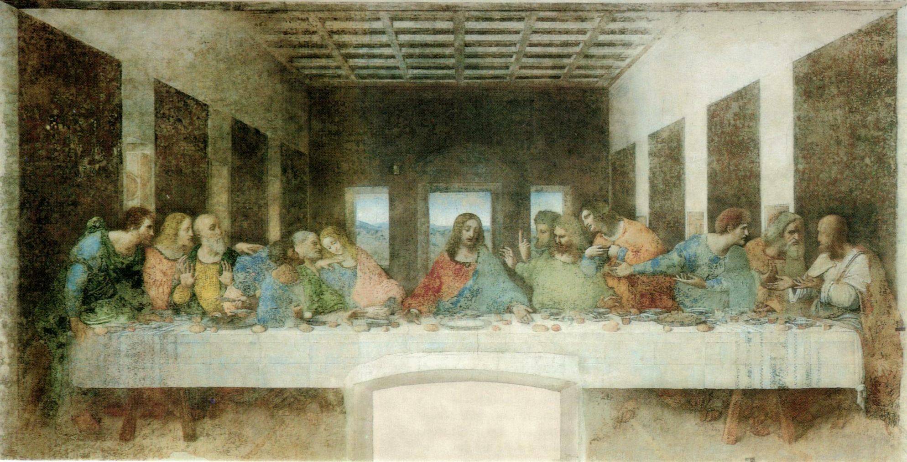

Slide 34
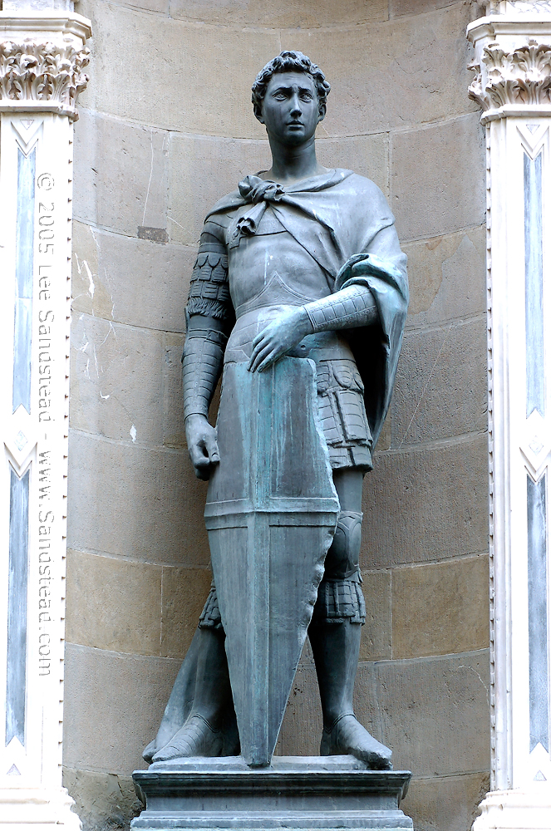
  SCULPTURE AND ARCHITECTURE
    DONATELLO - statue of Saint George
    FILIPPO BRUNELLESCHI - hired by Medici family to design the church of San Lorenzo

Slide 35
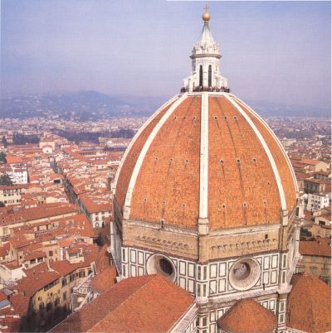
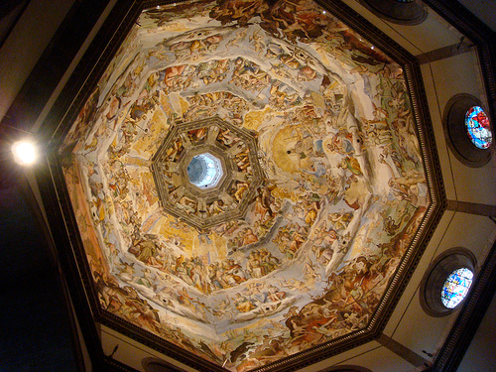

Slide 36
  MASTERS OF THE HIGH RENAISSANCE
LEONARDO DA VINCI had a goal to capture the perfection of nature and the individual
RAPHAEL painted many pictures of the Virgin Mary – he is well known for frescoes in the VATICAN (where the pope lives)
MICHELANGELO - painted the ceiling of the SISTINE CHAPEL in Rome – shows that human is supposed to be the reflection of divine beauty – the more beautiful the body, the more godlike

Slide 37
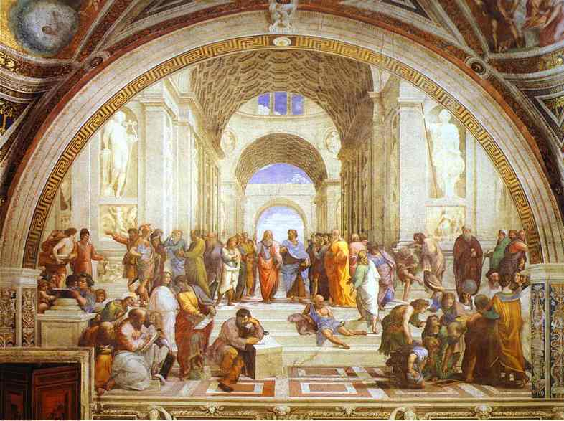

Slide 38
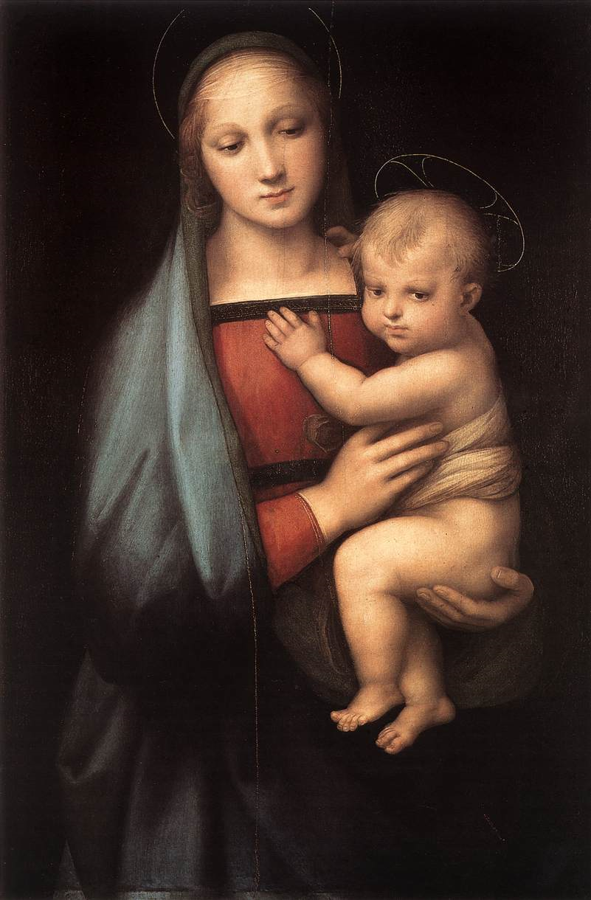
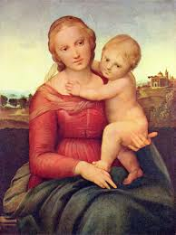

Slide 39
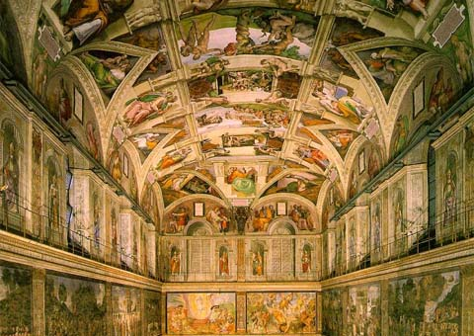
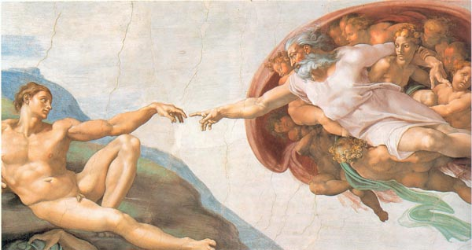

Slide 40
THE NORTHERN ARTISTIC RENAISSANCE

Slide 41
Renaissance Art in Northern Europe
Should not be considered an appendage to Italian art.
But, Italian influence was strong.
  Painting in OIL, developed in Flanders, was widely adopted in Italy.
The differences between the two cultures:
  Italy → change was inspired by humanism with its emphasis on the revival of the values of classical antiquity.
  No. Europe → change was driven by religious reform, the return to Christian values, and the revolt against the authority of the Church.
More princes & kings were patrons of artists.

Slide 42
Characteristics of Northern Renaissance Art
The continuation of late medieval attention to details.
Tendency toward realism & naturalism [less emphasis on the “classical ideal”].
Interest in landscapes.
More emphasis on middle-class and peasant life.
Details of domestic interiors.
Great skill in portraiture.

Slide 43
  Jan van Eyck used OIL PAINT, which allowed him a use of variety of colors and fine details

Slide 44
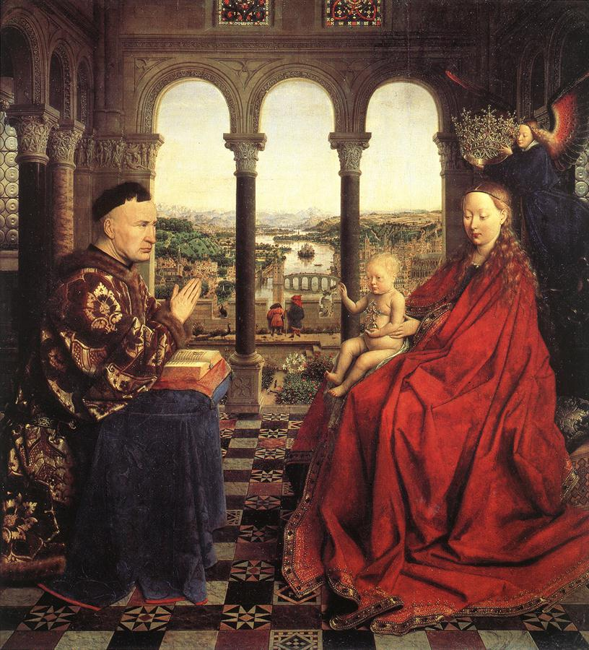
Jan van Eyck (1395 – 1441)
More courtly and aristocratic work.
  Court painter to the Duke of Burgundy, Philip the Good.
←The Virgin and Chancellor Rolin, 1435.

Slide 45
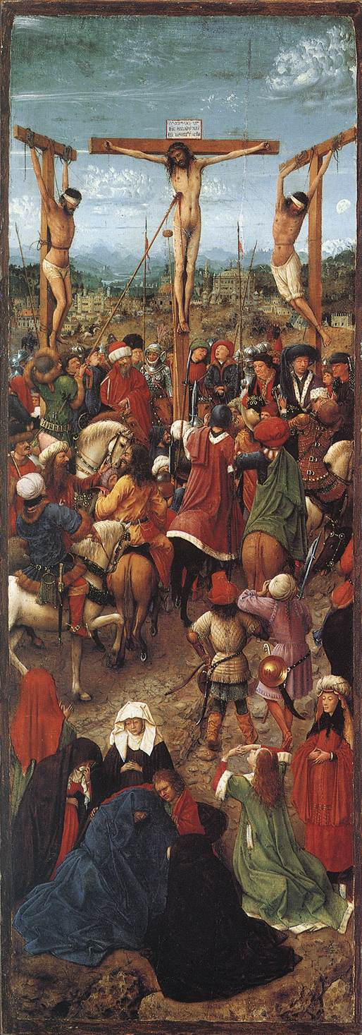
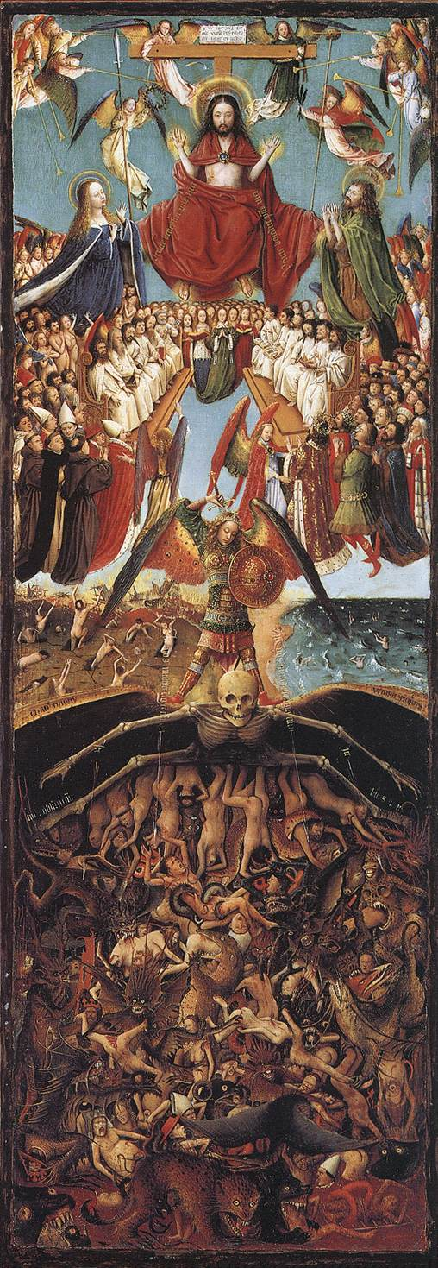
Van Eyck:
← The Crucifixion
&
The Last Judgment →
1420-1425

Slide 46
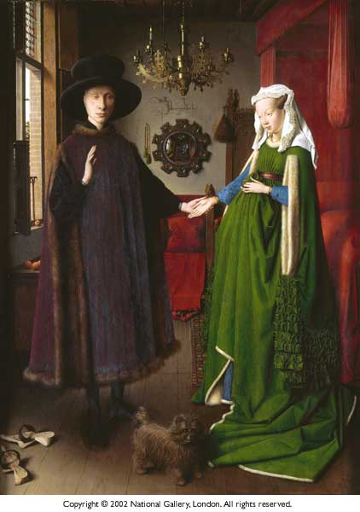
Giovanni Arnolfini and His Wife
(Wedding Portrait)
Jan Van Eyck
1434

Slide 47
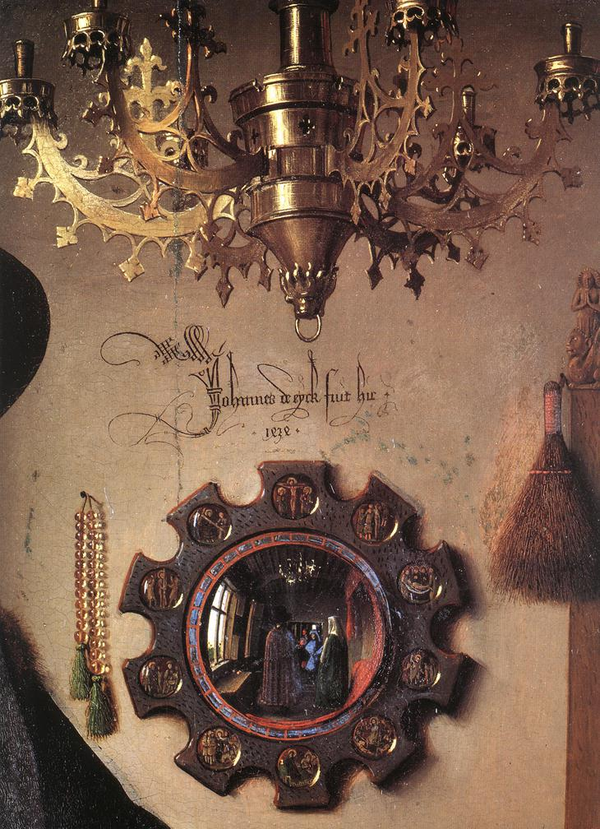
Jan van Eyck - Giovanni Arnolfini & His Wife
(details)

Slide 48
Other Northern Renaissance Artists:

Slide 49
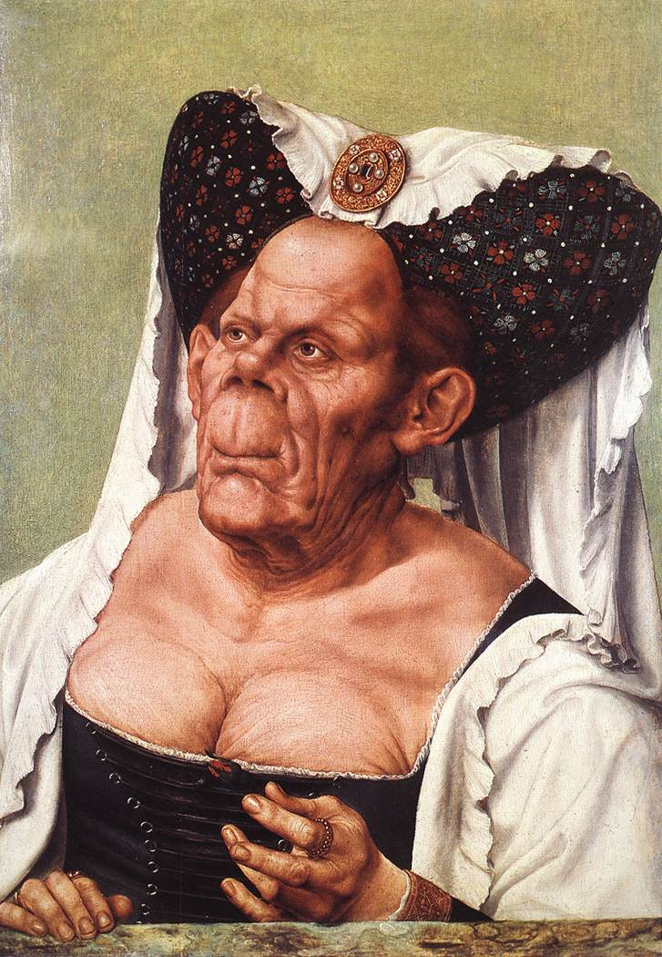
Quentin Massys (1465-1530)
Belonged to the humanist circle in Antwerp that included Erasmus.
Influenced by
da Vinci.
Thomas More called him “the renovator of the old art.”
The Ugly Dutchess, 1525-1530 →

Slide 50
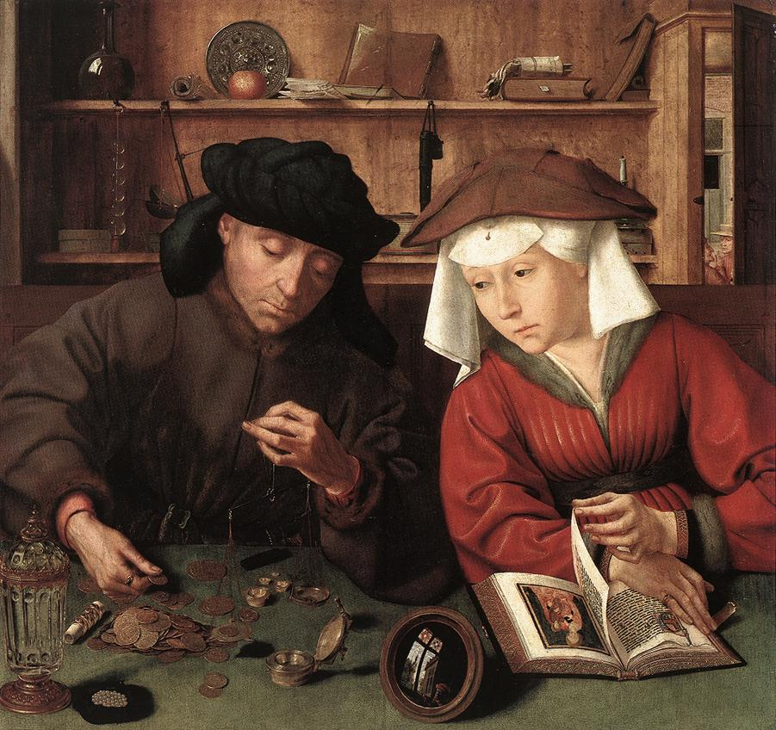
Massys’ The Moneylender & His Wife, 1514

Slide 51
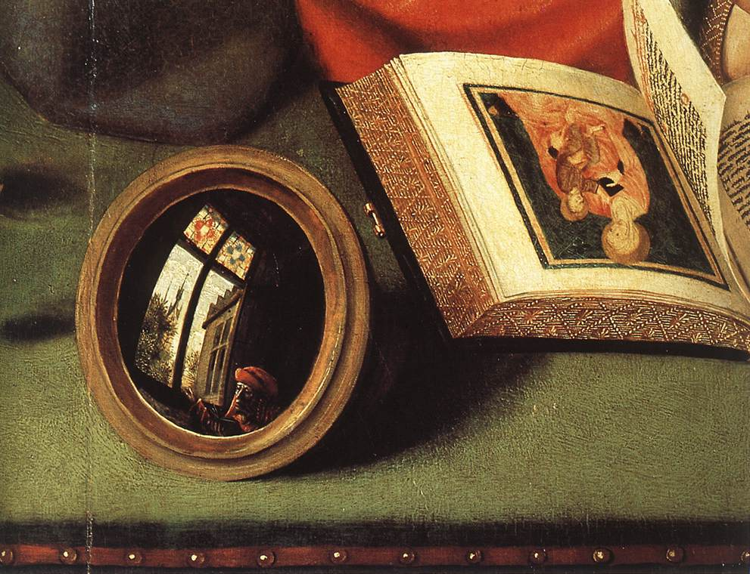

Slide 52
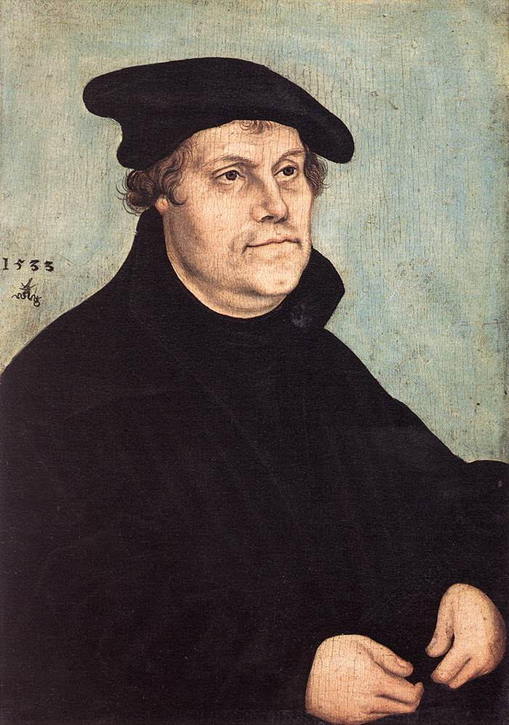
Lucas Cranach the Elder (1472-1553)
Court painter at Wittenberg from 1505-1553.
His best portraits were of Martin Luther (to the left).

Slide 53
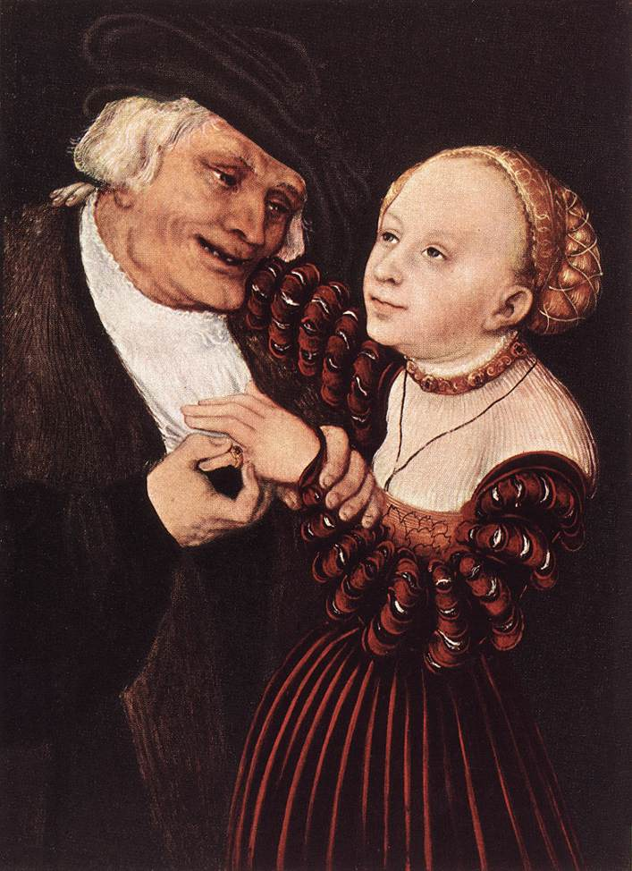
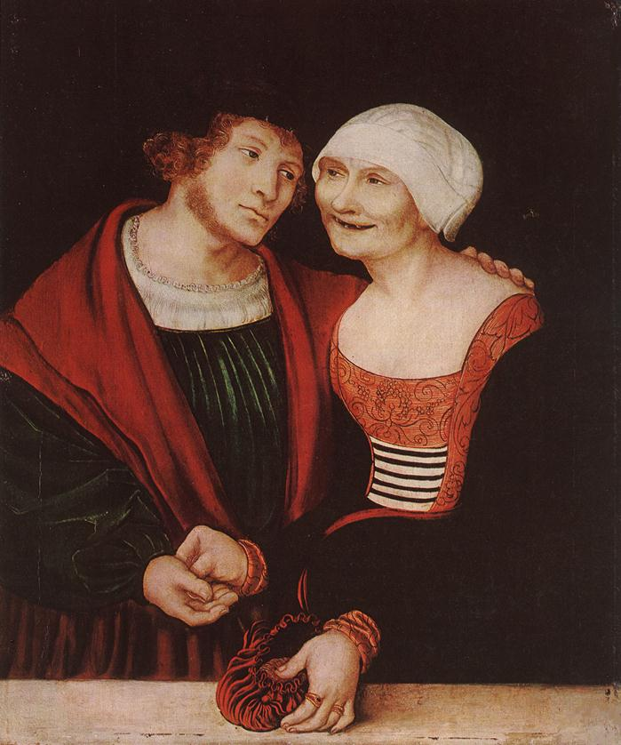
Lucas Cranach the Elder
Old Man with a Young Woman
Amorous Old Woman with a Young Man

Slide 54
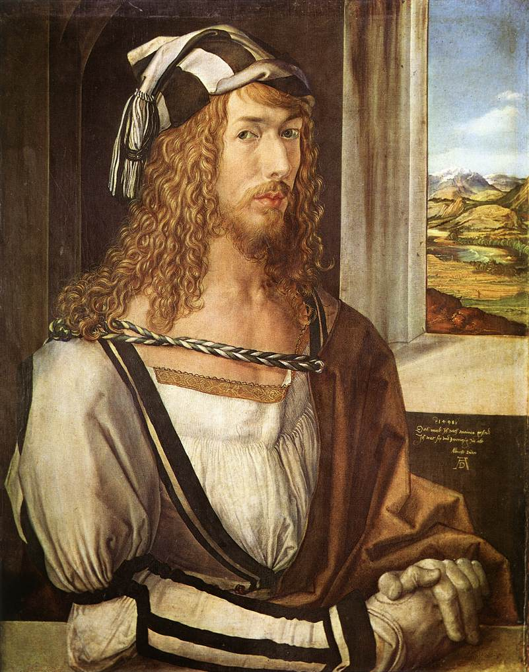
Albrecht Dürer (1471-1528)
The greatest of German artists.
A scholar as well as an artist.
His patron was the Emperor Maximilian I.
Also a scientist
  Wrote books on geometry, fortifications, and human proportions.
Self-conscious individualism of the Renaissance is seen in his portraits.
← Self-Portrait at 26, 1498.

Slide 55
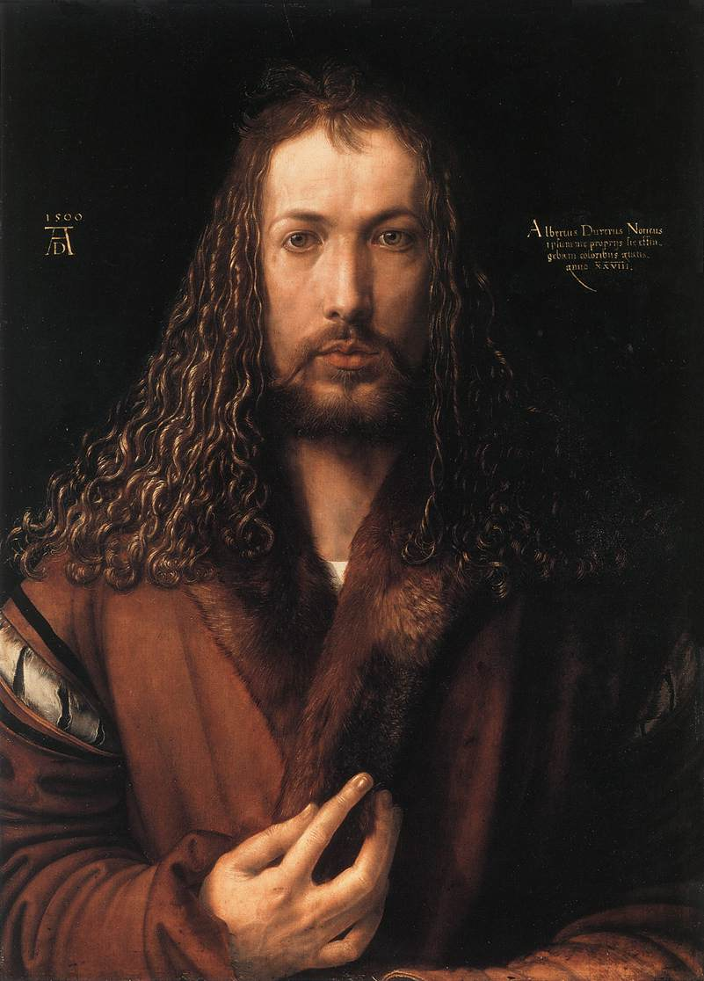
Dürer – Self-Portrait in Fur-Collared Robe, 1500

Slide 56
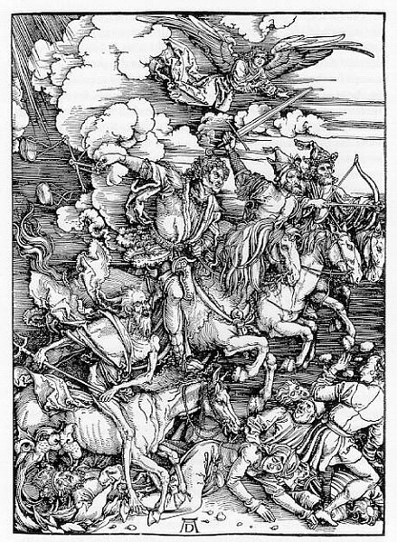
Dürer
Four
Horsemen of the
Apocalypse woodcut, 1498

Slide 57

Hans Holbein, the Younger (1497-1543)
One of the great German artists who did most of his work in England.
While in Basel, he befriended Erasmus.
  Erasmus Writing, 1523 →
Henry VIII was his patron from 1536.
Great portraitist noted for:
  Objectivity & detachment.
  Doesn’t conceal the weaknesses of his subjects.

Slide 58


Artist to the Tudors
Henry VIII (left), 1540 and the future Edward VI (above), 1543.

Slide 59
Pieter Bruegel the Elder (1525-1569)
One of the greatest artistic geniuses of his age.
Worked in Antwerp and then moved to Brussels.
In touch with a circle of Erasmian humanists.
Was deeply concerned with human vice and follies.
A master of landscapes; not a portraitist.
  People in his works often have round, blank, heavy faces.
  They are expressionless, mindless, and sometimes malicious.
  They are types, rather than individuals.
  Their purpose is to convey a message.

Slide 60

Bruegel’s, Parable of the Blind Leading the Blind, 1568

Slide 61

Bruegel’s, Hunters in the Snow, 1565

Slide 62

El Greco
Christ in Agony on the Cross
1600s

Slide 63


El Greco’s, The Burial of Count Orgaz, 1578-1580

Slide 64

El Greco
The View of Toledo
1597-1599

Slide 65
Conclusions
The artistic production of Northern Europe in the 16c was vast, rich, and complex.
The Northern Renaissance ended with a Mannerist phase, which lasted a generation longer in the North than it did in Italy, where it was outmoded by 1600.

Slide 66


What’s the difference?
Italian Renaissance
Northern Renaissance

