Slide 1
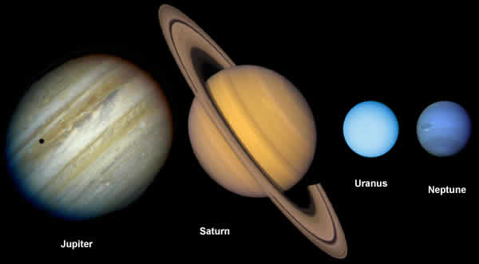
The Outer Planets

Slide 2
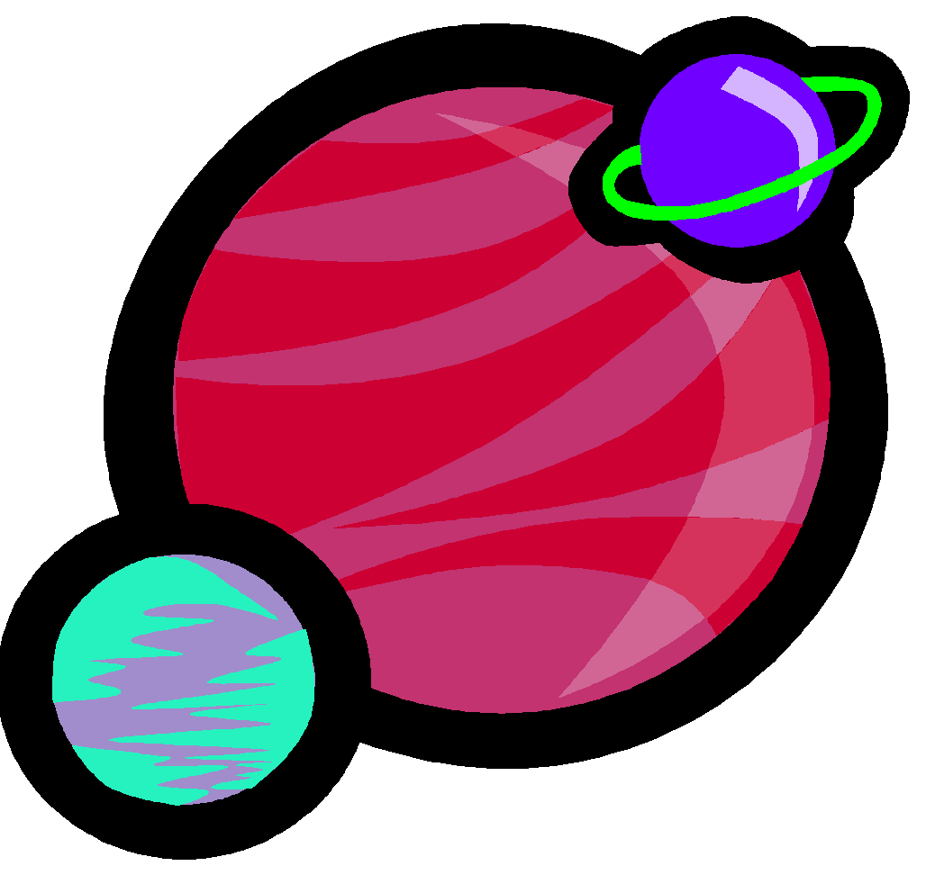
The Outer Planets
Very large planets that are made mostly of gas.
Called Gas giants.
Have deep massive atmosphere.
ALL HAVE RINGS!!

Slide 3
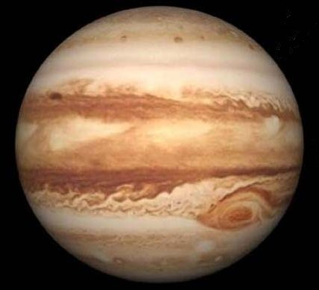

Jupiter
Largest Planet
Gas Giant
Distance From Sun: 778.3 million km
Diameter: 142,984 km
Surface Temperature: -222° F
Length of Day: 9.8 hours
Length of Year: 11.9 years
Number of Moons: 79
Symbol:
Zeus (King of the Gods)
Giant, spinning storm in Jupiter's atmosphere; more than twice the size of Earth; wind speed is about 270 mph.
Great Red Spot

Slide 4
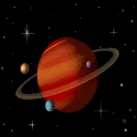
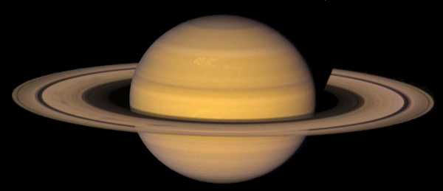

Saturn
Gas Giant
Distance From Sun: 1.4 billion km
Diameter: 120,536 km
Surface Temperature: -360° F
Length of Day: 10 hours and 14 minutes
Length of Year: 29.5 years
Number of Moons: 82
Symbol:
Rings made of crushed planets, asteroids and comets
Saturnus (God of Agriculture)

Slide 5
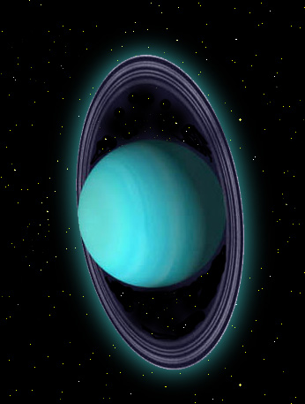

Uranus
Gas Giant
Distance From Sun: 2.9 billion km
Diameter: 51,118 km
Surface Temperature: -370° F
Length of Day: 17.9 hours
Length of Year: 84 years
Number of Moons: 27
Symbol:
Tipped over
Caelus (God of the Sky)

Slide 6
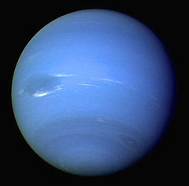

Neptune
Gas Giant
Distance From Sun: 4.5 billion km
Diameter: 49,528 km
Surface Temperature: -382° F
Length of Day: 16 hours
Length of Year: 164 years
Number of Moons: 14
Symbol:
Has 4 rings
God of the Sea

Slide 7
How Much Would I Weigh?
Jupiter
Uranus
Saturn
Neptune

Slide 8
