Slide 1
Themes Activity
Choose one of the following American History themes
Get into groups of two or three
Grab a plank sheet of computer paper (not notebook paper)
Your assignment:
Choose one of themes listed on the board and completed the following:
  Draw a picture that best represents your theme
  Define it with examples using at least a paragraph (include an example if you can think of one)
  Make sure everyone’s name is on the back

Slide 2
Quote of the Day
“The joy of losing consists of this: Where there are no expectations, there is no disappointment”
- Charles Krauthammer

Slide 3
Please get out your binder, day 1 paperwork and homework

Slide 4
The New World

Slide 5
New France, Virginia & Maryland

Slide 6
The French come late to the Colonization party

Slide 7
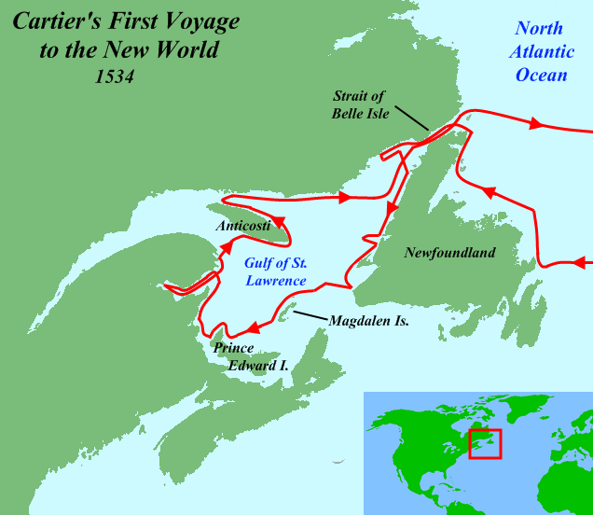
Early French Explorers
In 1524, France sent Giovanni da Verrazano to map the North American coastline and search for the Northwest Passage— a hoped-for northern route around North America to the Pacific Ocean.
In 1534, Jacques Cartier, another French explorer, discovered and mapped the St. Lawrence River.

Slide 8
How did the French make money in New France? (Modern day Canada)

Slide 9

The Fur Trade
Despite having laid claim to Canada for nearly 70 years, no real effort had been made to colonize the region.
By 1600, however, beaver fur had become very fashionable in Europe and French merchants became interested in colonization to expand the Canadian fur trade.
In 1602 the French king authorized a group of merchants to establish colonies in North America.

Slide 10
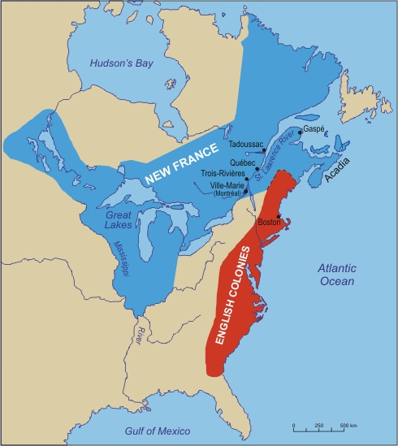
New France
The merchants hired geographer Samuel de Champlain to help them colonize North America.
Champlain established a French colony in what is present-day Nova Scotia, and he founded Quebec, which became the capital of the colony of New France.

Slide 11
Are large numbers of people needed for Fur trapping?
What does this mean for France’s population growth?

Slide 12
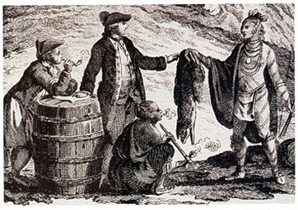
Slow Population Growth
Since New France was founded for the fur trade, large numbers of settlers were not needed to clear land or start farms. Consequently, the population grew slowly.
Most of the fur traders did not even live in the colony, but among the Native Americans with whom they traded.

Slide 13
France decides to step it up!

Slide 14
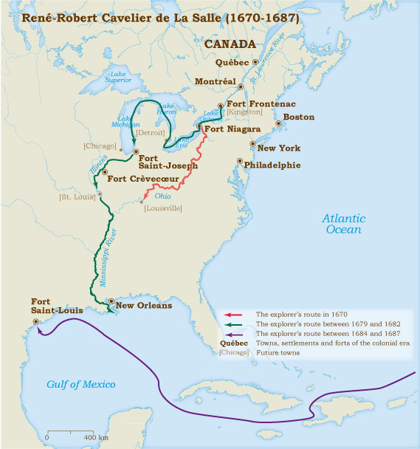
The Mississippi & Louisiana
In 1663, the French government introduced plans designed to increase the colony’s population and strengthen France’s claims to North America.
The French also began exploring North America’s interior; Louis Joliet and Jacques Marquette explored the Mississippi River, and René-Robert Cavelier de La Salle followed the river to the Gulf of Mexico and claimed the region, which he named Louisiana, for France.

Slide 15
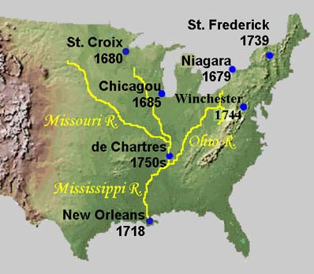
French Settlements
Settlements, including New Orleans and St. Louis, were established in Louisiana over the next few decades.
The French quickly realized, however, that crops suitable for the region required hard manual labor, which few settlers were willing to do.
By 1721 the French in Louisiana had begun importing enslaved Africans and forcing them to work the plantations.

Slide 16
Nations behave much like the NFL, they COMPETE!

Slide 17
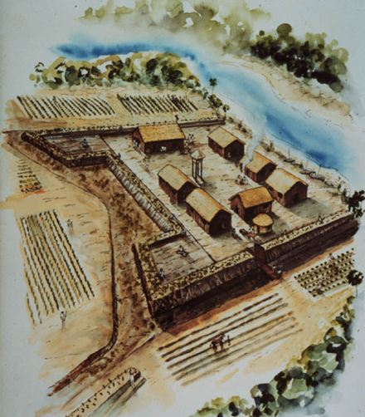
Spain Counters in Florida
The Spanish established the town of St. Augustine, Florida, in 1565 to protect their claim to the region after the French tried to settle the Carolinas. St. Augustine became the first permanent settlement established by Europeans in the present-day United States.
After the French arrived at the mouth of the Mississippi River, the Spanish established a mission in eastern Texas to attempt to block French expansion into that region.

Slide 18
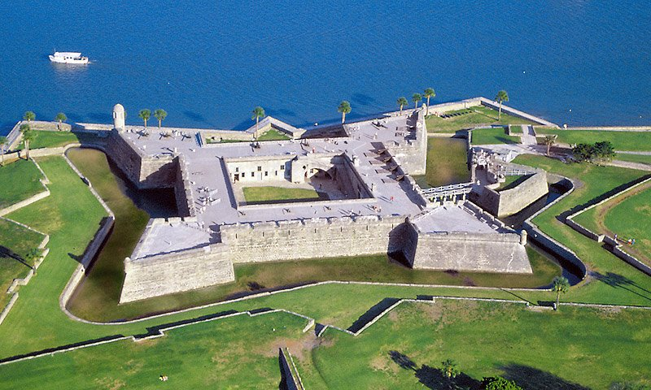

Slide 19
Which important nation has not been mentioned yet?

Slide 20
England finally joins in…But why?

Slide 21
What about the English?
What motivations would their government have for colonization? Individuals?
Think, Pair and Share

Slide 22
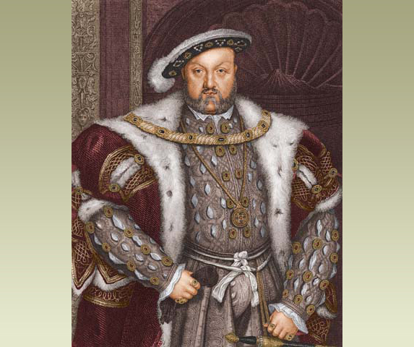

Slide 23
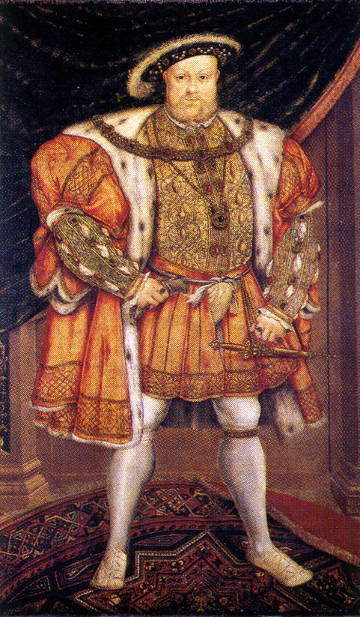
The English Reformation
In the early 1530s, King Henry VIII of England abandoned the Catholic Church and joined the Protestant Reformation by creating the Church of England (or Anglican Church), with himself as head of the Church.
Henry outlawed Catholicism and ordered his entire population to practice only Anglicism; this move angered both loyal Catholics and the members of other Protestant branches of Christianity.
Eventually, strict limits on religious freedom would drive many English dissenters, including Puritans, Quakers, and Catholics, to seek to create new colonies in North America

Slide 24
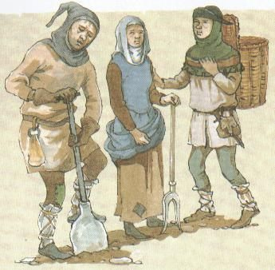
Economic Forces
By the early 1600s, a changeover from grain farming to sheep ranching by wealthy English landowners had left hundreds of thousands of Englishmen impoverished and unemployed. Many of these would seek the opportunity of a new life in America.
English merchants also needed new markets as English industries began overproducing goods. Many organized joint-stock companies, pooling the money of many investors for large projects, such as establishing colonies.

Slide 25
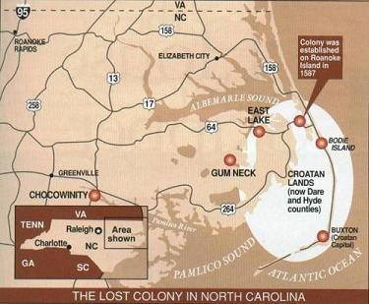
Military Rivalry With Spain
To more easily attack Spanish ships in the Caribbean, England wanted to establish colonies in America.
Sir Walter Raleigh was sent by Queen Elizabeth I to explore the American coastline. In 1585, his ships landed on Roanoke, an island in present-day North Carolina, and he named the surrounding land Virginia, in honor of the “virgin” queen.

Slide 26
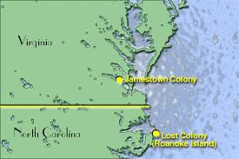

Slide 27
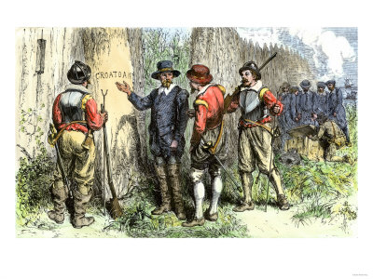
The “Lost Colony”
The colony established at Roanoke in 1587, consisted of 115 men and women.
When a relief ship returned to the island in 1590, no trace of the colonists remained and their fate remains a mystery to this day.
The returning colonists did find the words “CROATOAN” engraved on a nearby tree trunk.

Slide 28
Research Short Essay
What happened to the settlers of the “Lost Colony” in Roanoke?
Historians and others have several different theories? Use chrome books to research these theories.
Research, Identify and Explain AT LEAST THREE different theories argued by historians THEN argue which one you believe is the most accurate. Why is this theory more plausible than the others?
Back up your argument with specific evidence
Reg – 150 words, Honors - 250. CITE your sources!

Slide 29
Quote of the Day
“The joy of losing consists of this: Where there are no expectations, there is no disappointment”
- Charles Krauthammer

Slide 30
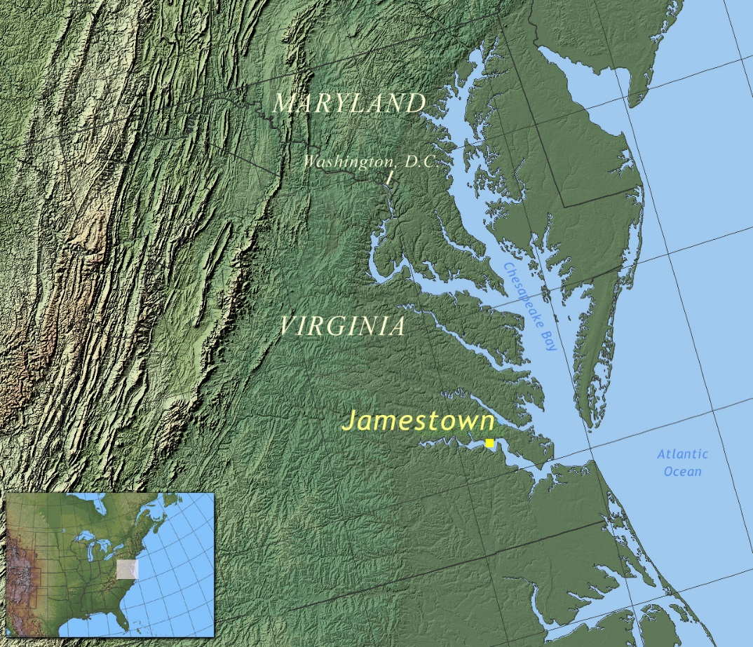
Jamestown
In 1606, King James I of England granted the Virginia Company, a joint-stock company, a charter to establish a colony in Virginia.
In 1607, 104 men established the settlement of Jamestown on an island in the James River in modern-day Virginia.
While Jamestown would become the first permanent English colony in North America, it had to overcome many problems in order to survive.

Slide 31
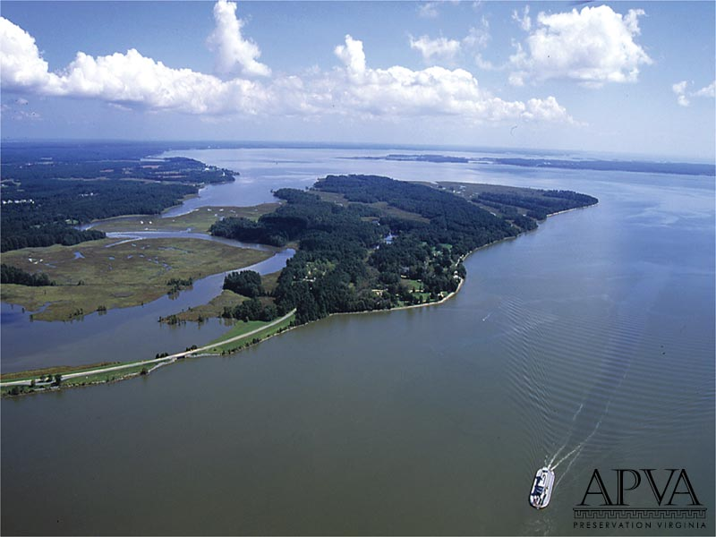

Slide 32
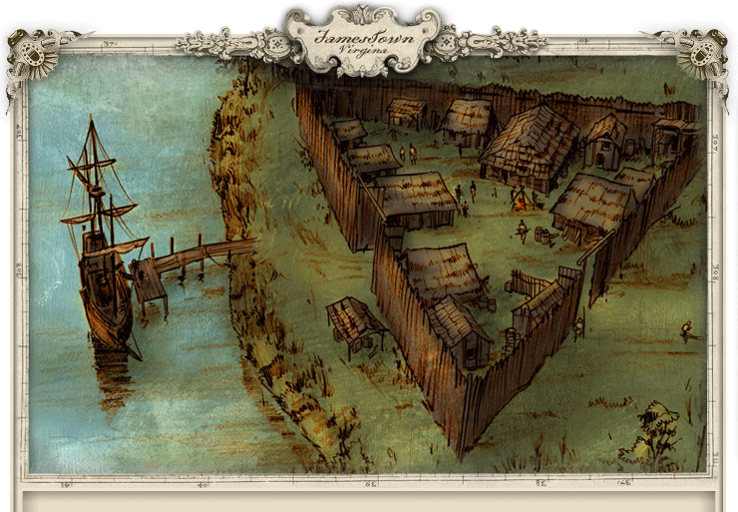
Jamestown’s Struggles
Jamestown, since it was founded by a joint-stock company, was intended to be profitable
As a result, the settlers spent more time looking for gold or other valuables than they did creating a safe, stable, self-sustaining colony

Slide 33
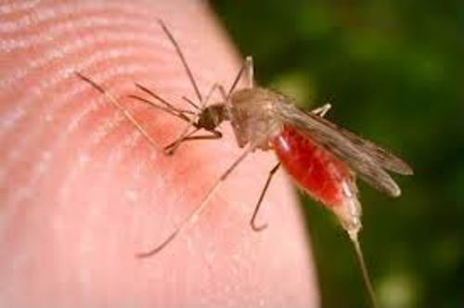
Jamestown’s Struggles
Jamestown had also been poorly sited – the area was swampy and mosquito ridden, so the settlers were forced to battle disease as well as hunger
To make matters even worse, the local Algonquin Indians were often openly hostile, forcing the settlers to spend time building a fort (which they needed in case of Spanish attack, as well)

Slide 34
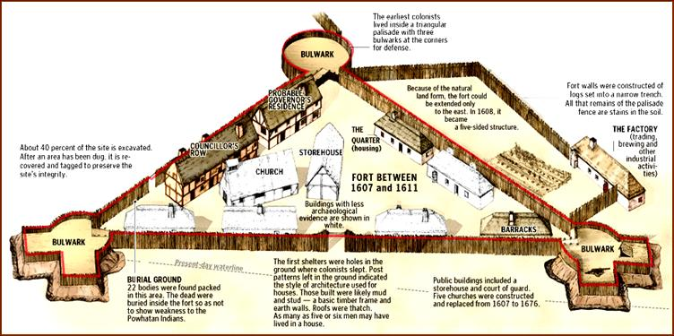
Jamestown Fort

Slide 35
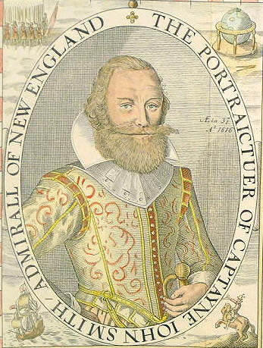
“He who shall not work, shall not eat!”

Slide 36
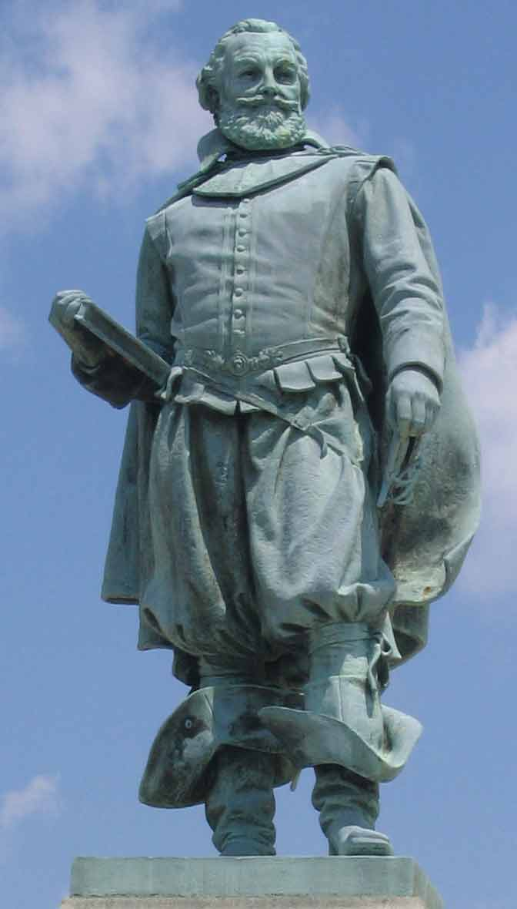
Captain John Smith
The strict discipline of Captain John Smith and the assistance of the friendlier Powhatan Indian Confederacy, helped the colony survive, but neither Smith nor the Indians were very popular with the settlers

Slide 37
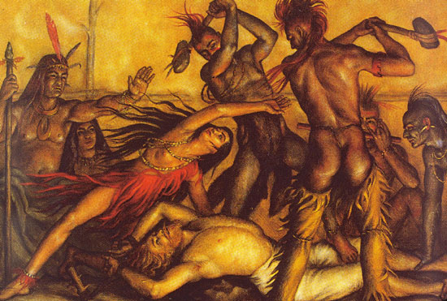
The Pocahontas Legend
According to Smith’s own account, he was able to convince the Powhatan to help the colonists only after being captured by the Indians
The Indian chief, Powhatan, was going to kill Smith, but Powhatan’s daughter Pocahontas begged her father to spare him and help the colonists instead
Modern historians doubt Smith’s account – Smith was a glory-seeking adventurer who stood to profit greatly from being the man who “saved” Jamestown and he recorded the story only after returning to England and writing a book in 1616.

Slide 38

John Smith & Pocahontas?

Slide 39
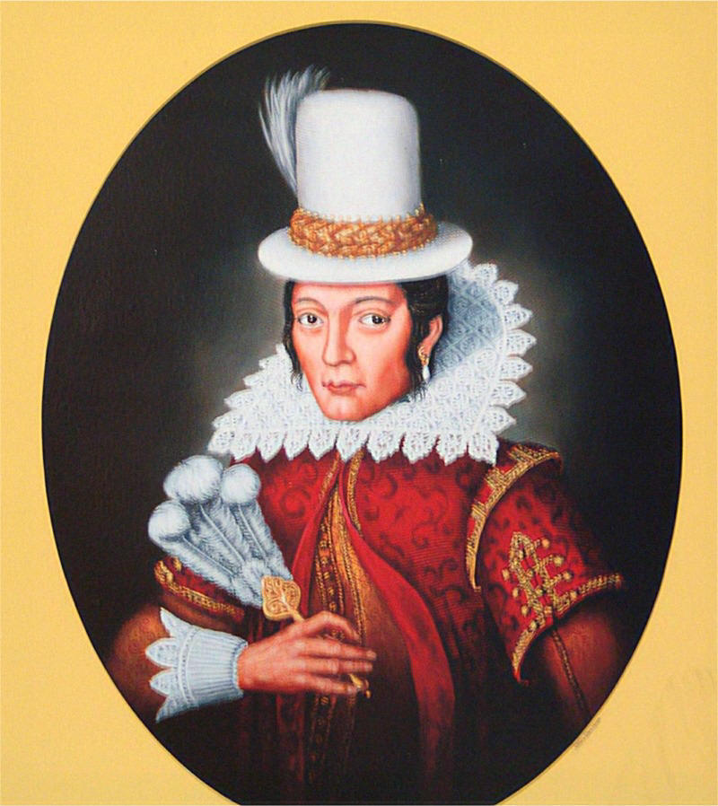
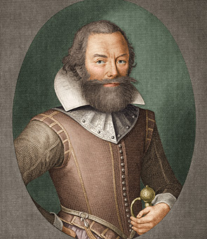
Actual Portraits

Slide 40
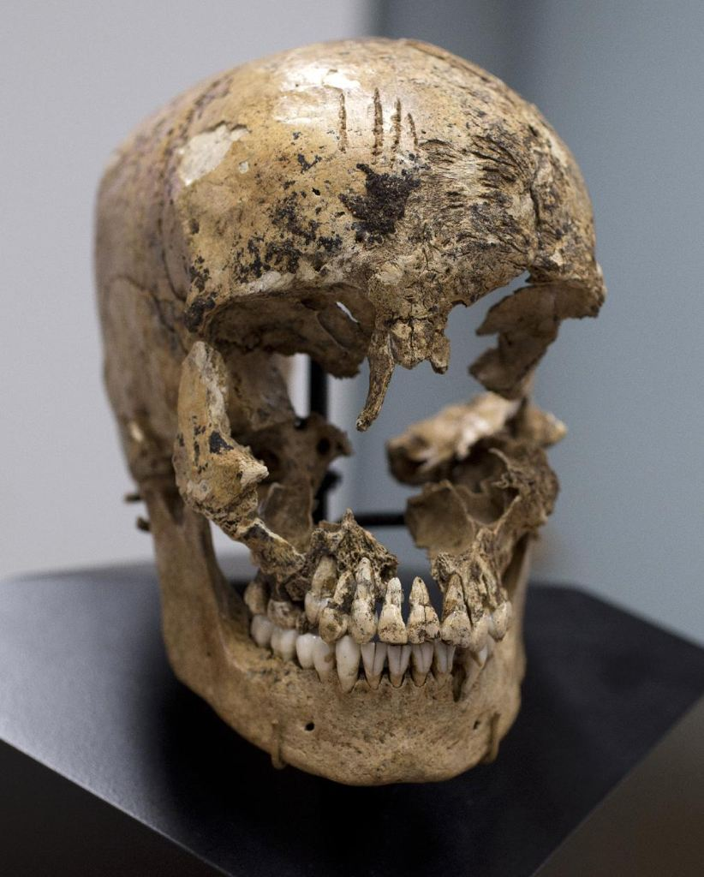
The Starving Time
The Jamestown Company offered free land to people who worked for the colony for seven years. New settlers arrived (and John Smith left) in 1609, but there was not enough food to support them.
The new settlers stole food from the Powhatan, who retaliated by attacking them if they left the safety of the fort.
Recent evidence suggests that the colonists resorted to cannibalism to survive.
By spring of 1610 only 60 out of about 500 settlers survived at Jamestown.

Slide 41
Help is on the way……..

Slide 42
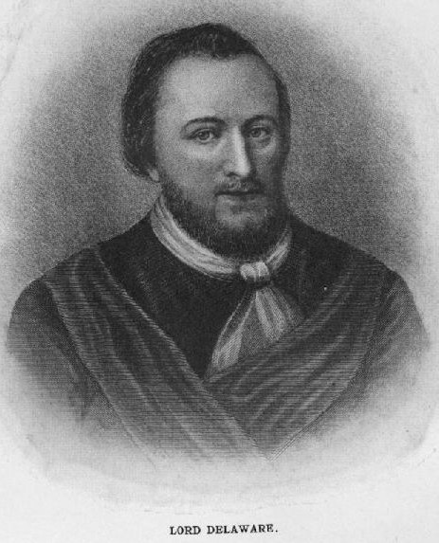
Lord De La Ware
In June 1610, the survivors decided to abandon the town. It was only the arrival of the new governor, Lord De La Ware, and his supply ships that brought the colonists back to the fort and saved the colony.
Although the suffering did not totally end at Jamestown for decades, some years of peace and prosperity followed after the wedding of the Indian princess Pocahontas to colonist John Rolfe (although Pocahontas died in 1617).

Slide 43
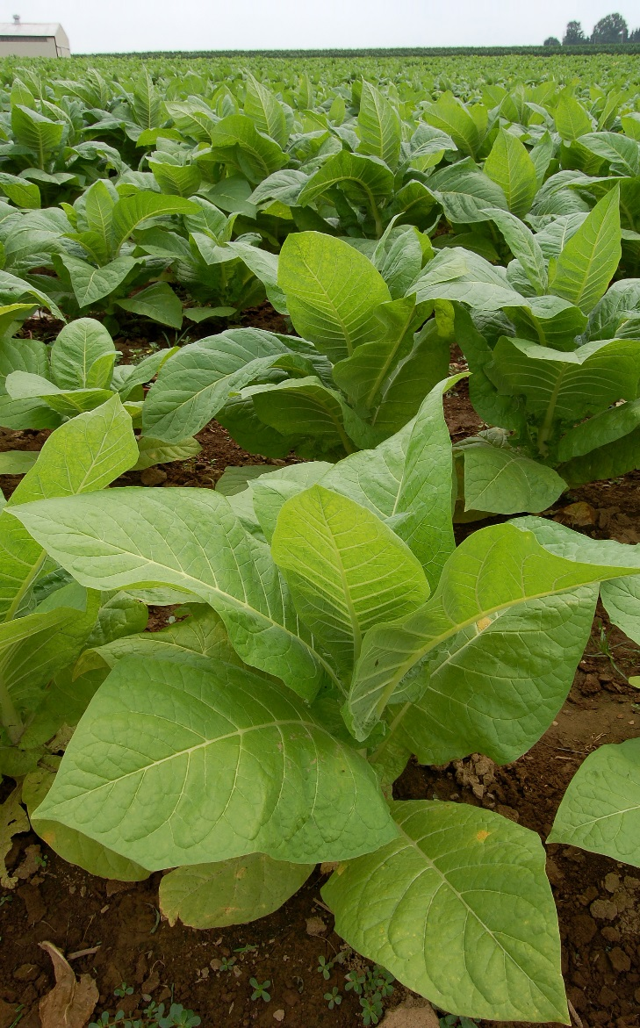
Tobacco Saves the Colony
It was this same John Rolfe who had developed a strain of tobacco that was marketable in England, providing Jamestown with the ability to finally turn a profit for its investors.
The Jamestown settlers soon began growing large quantities of tobacco, but needed to import slave labor to maximize production. The first African slaves arrived in Jamestown in 1619.

Slide 44
AUTONOMY
Concept of the Day

Slide 45
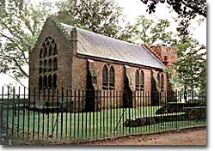
The House of Burgesses
To attract more settlers to Jamestown, the Virginia Company gave the colony the right to elect its own general assembly. The elected representatives were called burgesses, and the legislative body was called the House of Burgesses.
The Virginia House of Burgesses was the first representative law-making assembly in the New World.

Slide 46
Expansion Causes Conflict

Slide 47
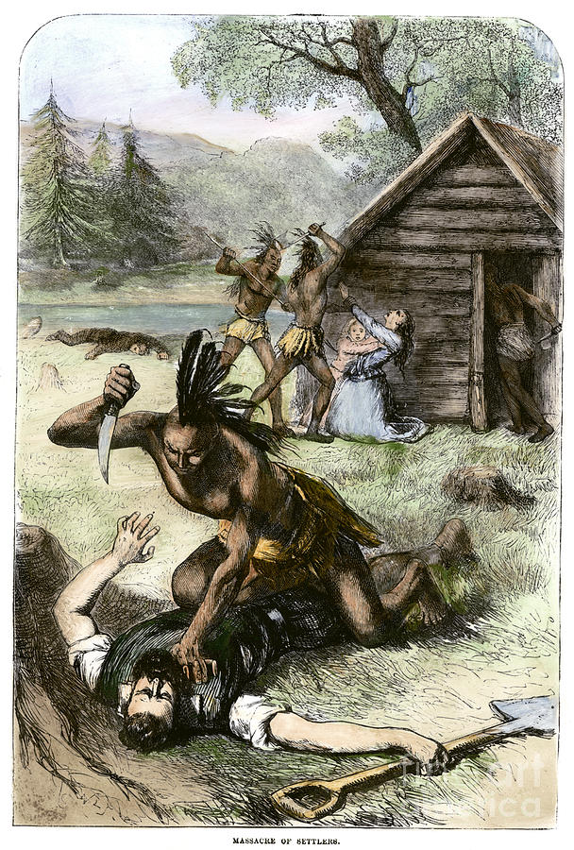
A Growing Population
The Virginia Company also introduced the system of headrights. Under this system, new settlers who bought a share in the company or paid for their passage were granted 50 acres. They received more land for each family member or servant they brought to Virginia.
The Native Americans near Jamestown grew alarmed at the increasing population. In 1622, they attacked the settlements around Jamestown, killing nearly 350 settlers.
The attack, coupled with evidence of mismanagement by the Virginia Company, led King James to revoke the colony’s charter and declare it a royal colony.

Slide 48
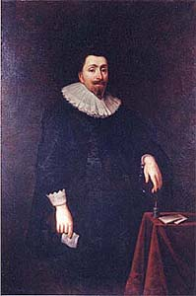
Maryland
Catholics were persecuted in England for their religious beliefs. Lord Baltimore, a Catholic member of British Parliament, decided to found a colony in America where Catholics could practice their religion without persecution.
The king granted Baltimore an area of land northeast of Virginia, which Baltimore named Maryland. Baltimore legally owned Maryland, making it the first proprietary colony.
Although Maryland was founded as a Catholic refuge, most of the colony’s settlers were Protestant.

Slide 49
England is now established in The New World
Before we go further, lets find out what natural advantages and disadvantages the colonies will have
How does geography impact civilizations?

Slide 50
Fact vs Myth
The Pocahontas Legend
Identify at least 5 different examples of how the Disney Pocahontas story differs from the real story. Examples must be factual and historically based, not based on characteristics of cartoons such as personification.
Why do movies often distort the facts of history? Does this trend ultimately have a positive or negative impact? Explain
-Minimum 100 words, Honors -200

