Slide 1
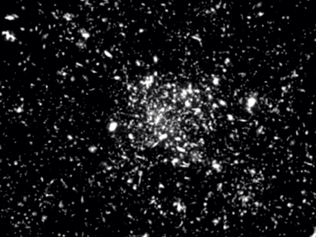
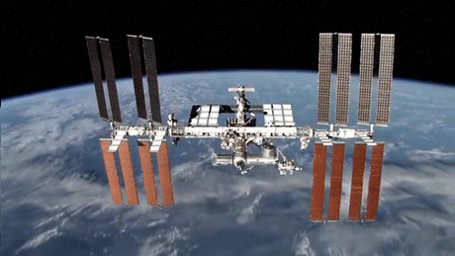
INTERNATIONAL SPACE STATION
(ISS)

Slide 2
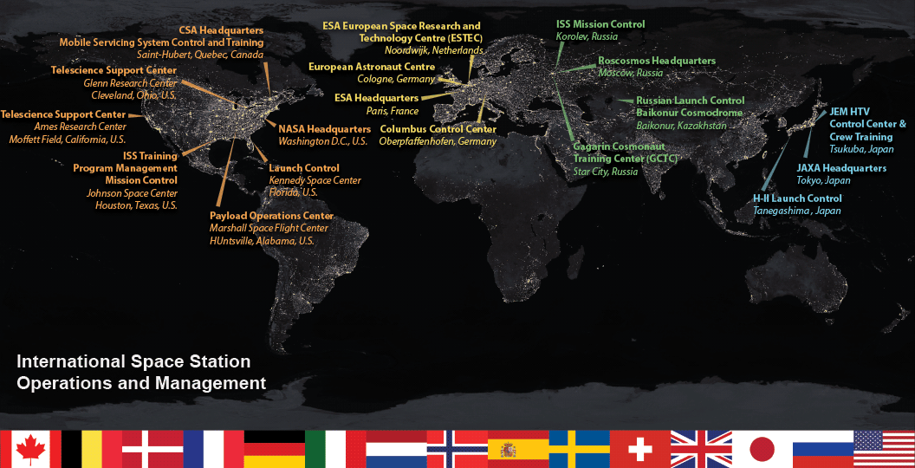
INTERNATIONAL SPACE STATION
(ISS)
Sixteen nations were involved in the construction of the ISS: The United States, Russia, Canada, Japan, Belgium, Brazil, Denmark, France, Germany, Italy, the Netherlands, Norway, Spain, Sweden, Switzerland, and the United Kingdom.
The ISS travels 5 miles-per-second (17,240 mph). That means the station circles the entire planet once every 90 minutes.

Slide 3
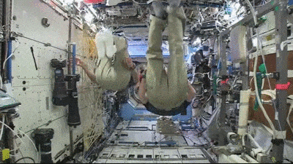
INTERNATIONAL SPACE STATION
(ISS)
The ISS is a platform for long-term research for human health, which NASA bills as a key stepping stone to letting humans explore other solar system destinations.
Its main purpose is to provide an international laboratory for experiments within the space environment.

Slide 4
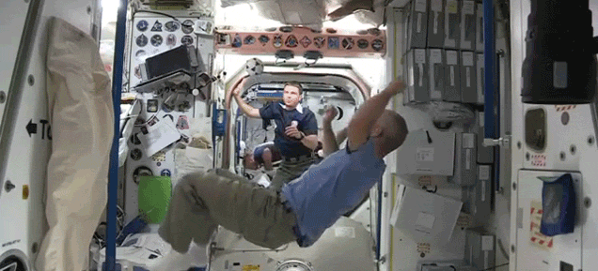
INTERNATIONAL SPACE STATION
(ISS)
The ISS is the single most expensive object ever built. The cost of the ISS has been estimated at over $120 billion dollars!
Because the human body tends to lose muscle and bone mass in zero gravity environments, all astronauts aboard the ISS must work out at least two hours a day to maintain normal Earth-based bodily health.

Slide 5
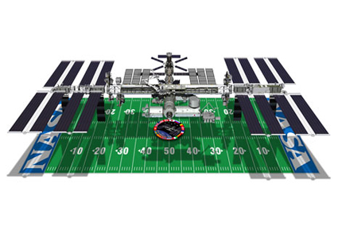
INTERNATIONAL SPACE STATION
(ISS)
How it works
Oxygen in the ISS comes from a process called “electrolysis,” which involves using an electrical current generated from the station’s solar panels to split water molecules into hydrogen and oxygen gas.
It’s bigger than a football field!
Sleeping
Bathroom
Nail Clipping
Smell in space
Brushing teeth
Eating
Spot The Station
Brain

Slide 6
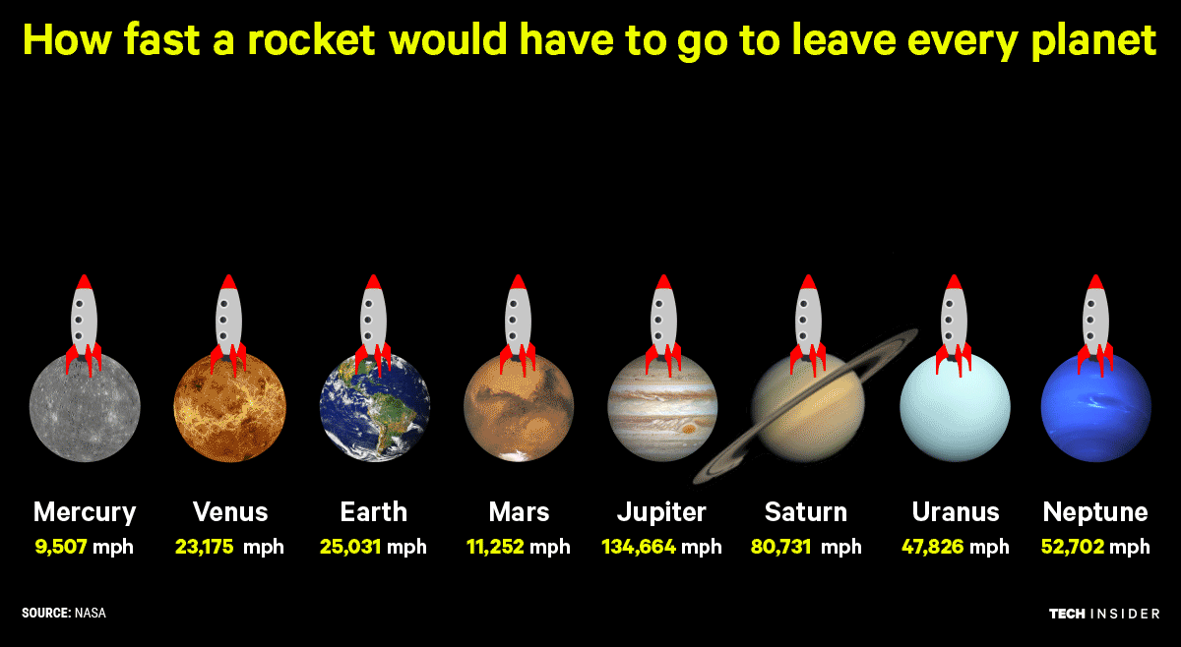
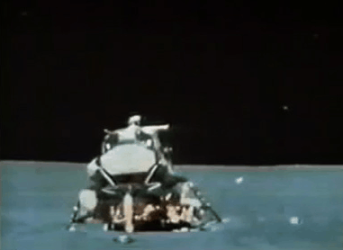
HOW FAST?
The Moon: 5320.73 mph

