Slide 1
The Great Depression Begins
Causes of the Great Depression

Slide 2
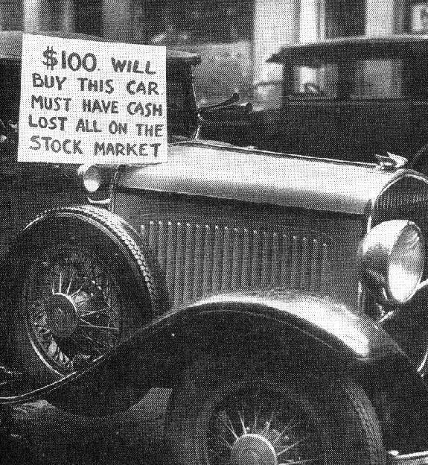
1. Industry
Overproduction of goods
Railroads
  Lose business to new forms of transportation.
Coal mining
  Increased competition with new forms of energy like gasoline.
Housing
  The number of houses being built also dropped dramatically

Slide 3
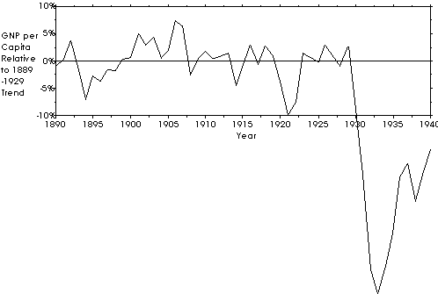
Average
Gross National Product
Amount of “stuff” that we produce per year

Slide 4
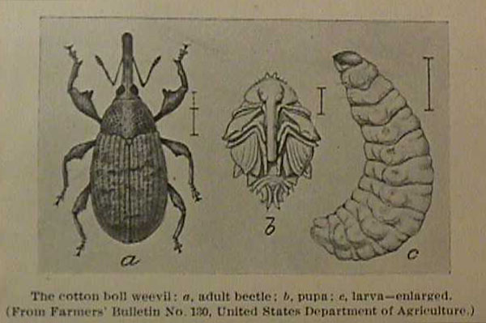
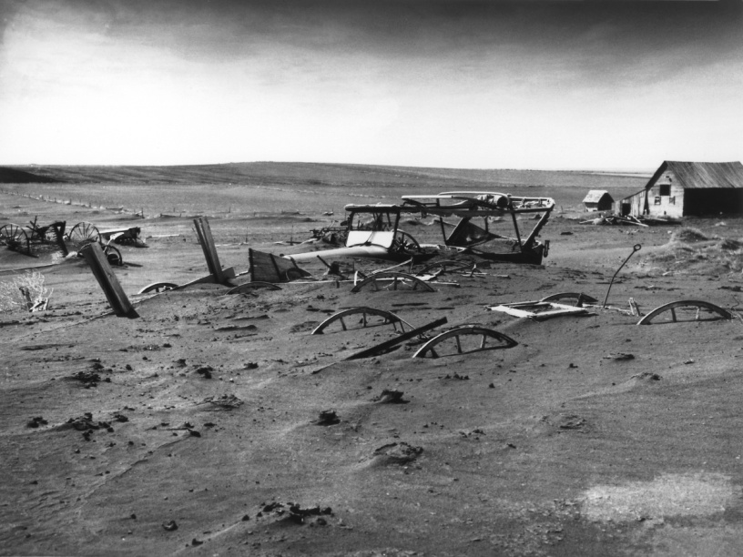
2. Agriculture
Overproduction
  The demand for crops after WWI fell.
Crop Prices
  Supply ↑ = Demand ↓ = Crop prices ↓
McNary-Haugen bill
  Called for govt. price supports.
  Calvin Coolidge vetoed this twice.
“Farmers have never made money. I don’t believe we can do much about it”
Calvin Coolidge

Slide 5
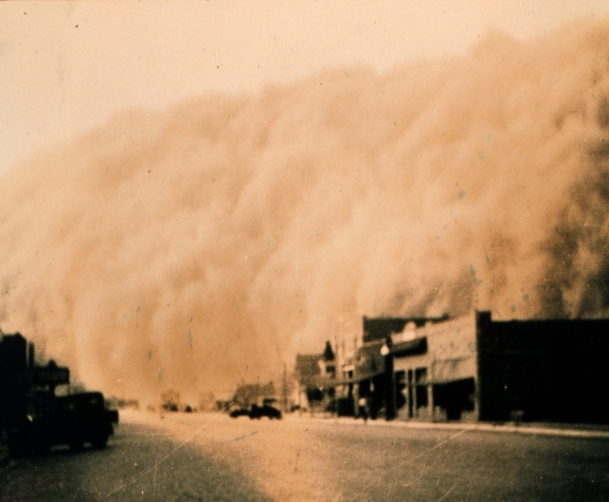
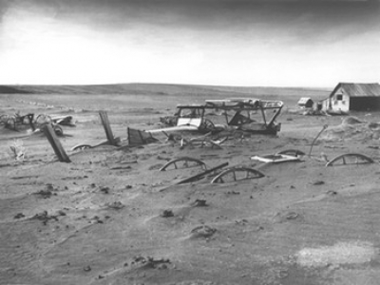
Effects on Farmers
  Dust Bowl
    Farmland was exhausted from overproduction
    Also hit with drought and wind
  Foreclosure
  Banks seize farmers property if bills are not paid
  Migration
  Many farmers packed up and went west or into cities.
  Known as “Okies”

Slide 6
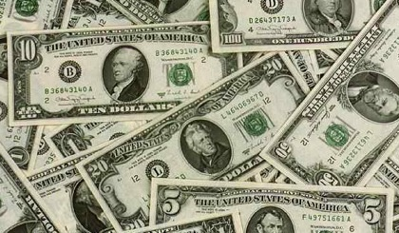
3. Consumer Spending
Americans were buying less by the late 1920s
Why?
  rising prices
  stagnant wages
  overbuying on credit.
Unequal Distribution of Wealth
  Most Americans were not reaping rewards of the “roaring twenties”
  70% of families made under $2,500 a year.
Richest 1%:
Income grew 75 percent
Everyone else:
grew 9 percent

Slide 7
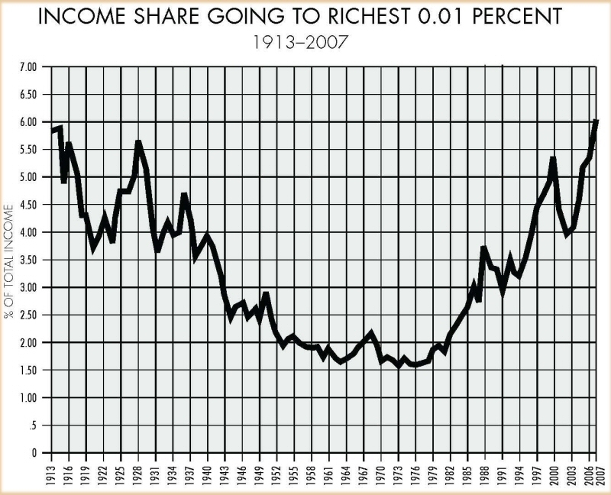

Slide 8
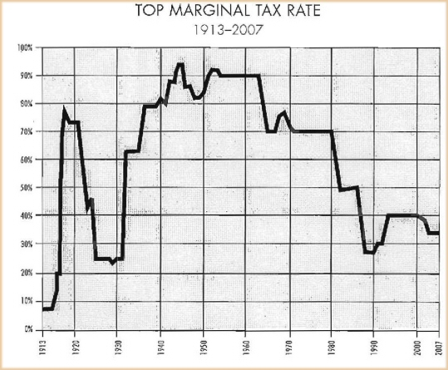

Slide 9
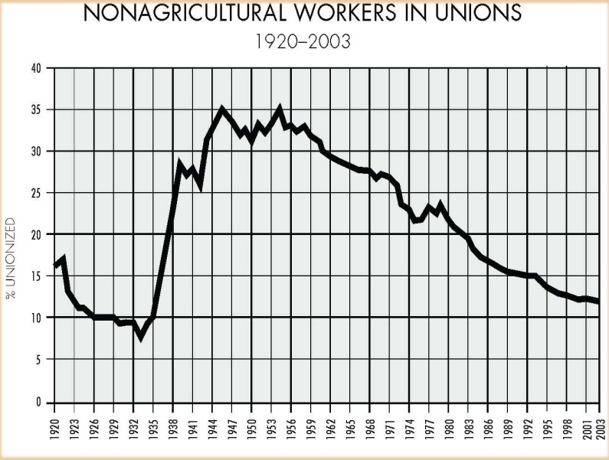

Slide 10
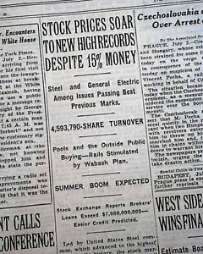
4. The Stock Market
Dow Jones Industrial Average
  30 large firms being traded.
  Reached 381 points at peak
Why?
  Speculation
    Buying stocks on chance of fast profit
    Ignoring risks
  Margin Buying
    Buying stock on credit

Slide 11
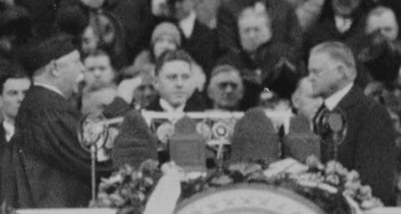
Meanwhile…
Election of Herbert Hoover
Under Harding and Coolidge, Hoover served as secretary of commerce
Hoover pointed to years of prosperity under the Republicans since 1920 and he overwhelmingly won the election.

Slide 12
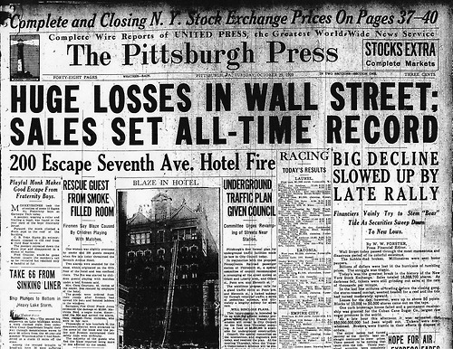
Black Tuesday: Oct. 29, 1929
On October 24,
  Investors began selling off stocks
  Market recovers the next day
Black Tuesday
  October 29
  Investors sell record number of stocks
  Dow drops by 23% over 2 days

Slide 13
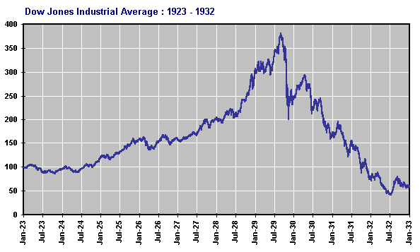
Great Depression
1929-1932
90% Drop
Peak = 381
Low = 41

Slide 14
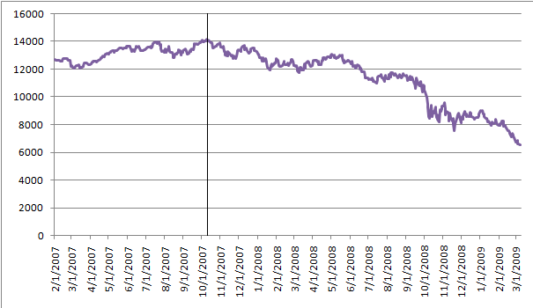
Great Recession
Peak = 14,198
2007-2009
54% Drop
Low = 6,443

Slide 15
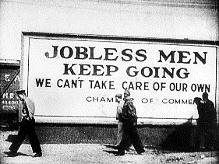
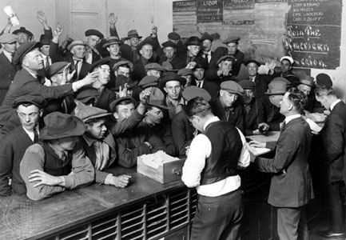
5 . Bank and Business Failures
Run on Banks
  Many Banks had lost millions in the stock market as well.
  Many rushed to the banks to get their money. Banks didn’t have it.
Bankruptcy
  Thousands of industries went bankrupt such as automobile and railroads.
Rising Unemployment
  1933 unemployment = %25

Slide 16
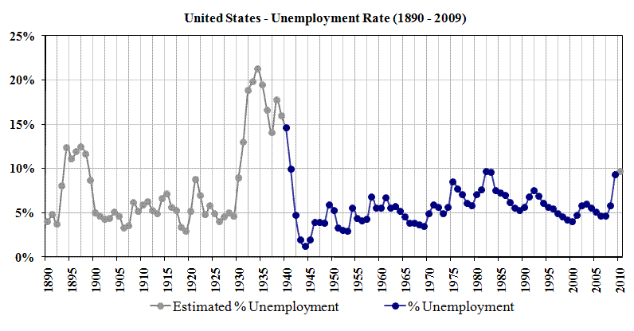

Slide 17
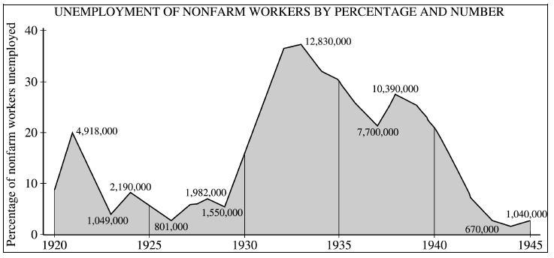
Non Farm Workers

Slide 18
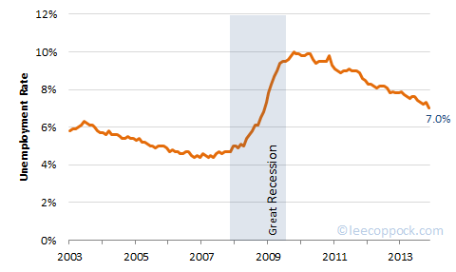
Great Recession

Slide 19
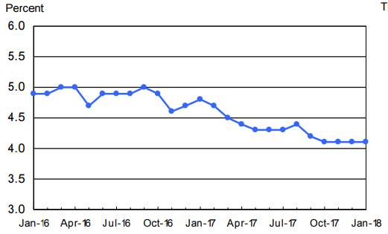
Unemployment today

Slide 20
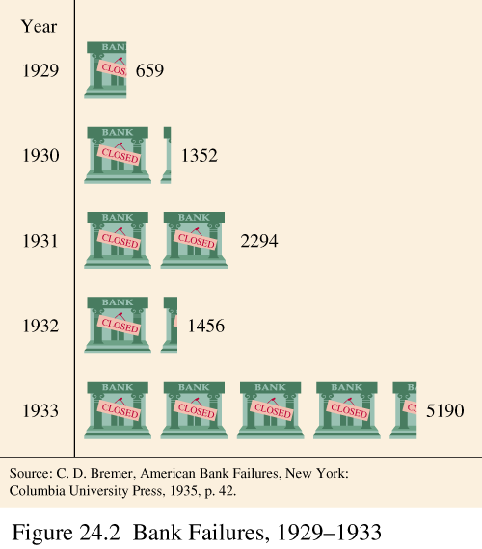

Slide 21
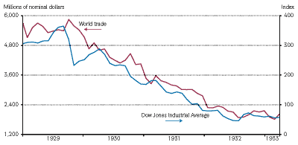
6. Worldwide Depression
European countries still haven’t recovered from WWI
1930: Hawley-Smoot Tariff
  2nd Highest in history (63%)
  Meant to protect against competition.
  Actually has opposite effect
Congress did not understand that we had become a world economy.

Slide 22
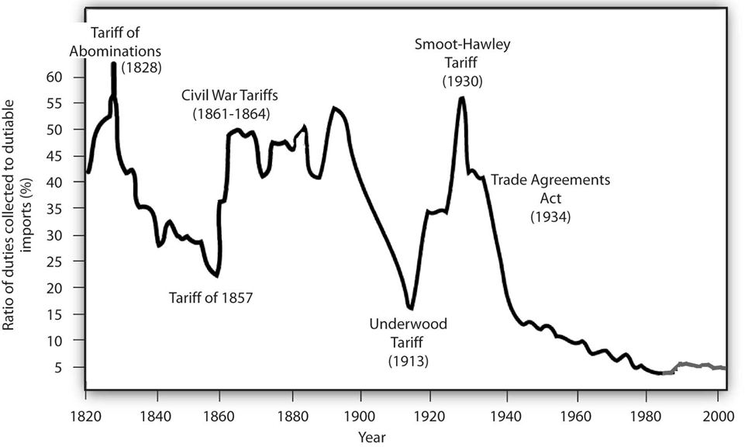
McKinley Tariff
(1890)

Slide 23
Hoover And the Depression
Was it really his fault?

Slide 24
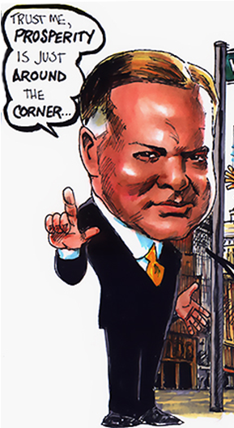
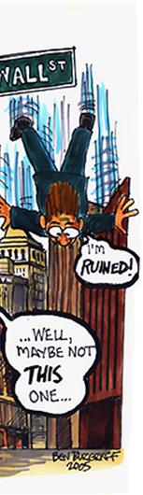
Hoover’s Reassurance
“Any lack of confidence in the economic future… is foolish” -Herbert Hoover 1929’
Believed that Americans should carry on as usual.
Rapid growth and slumps just a part of American economic trend

Slide 25
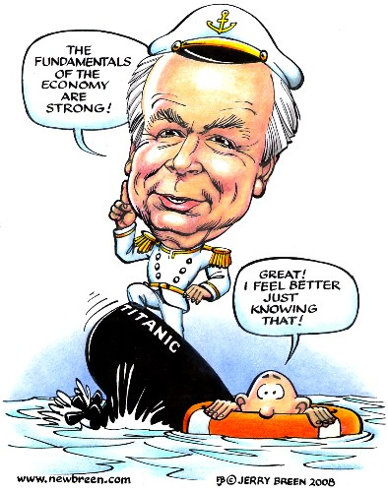

Slide 26
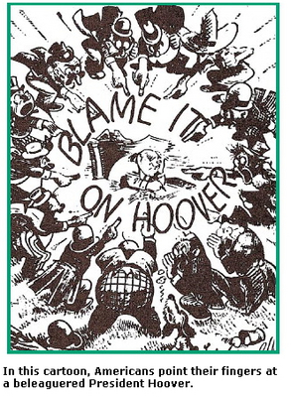
Hoover's Philosophy
Rugged Individualism
  Individuals (not the government) should help themselves.
Hoover believed that Americans should have…
  savings protected
  steady job
  insurance
However, believed this was not governments job.

Slide 27
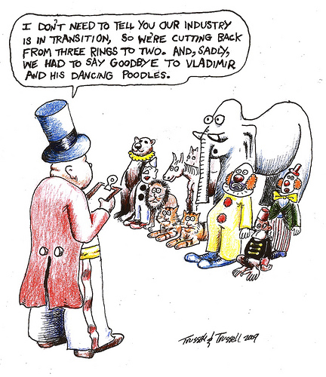
Hoover’s Requests
Asks….
  …employers not to cut wages or lay off workers.
  …labor leaders not to demand higher wages or go on strike.
Provides no incentive

Slide 28
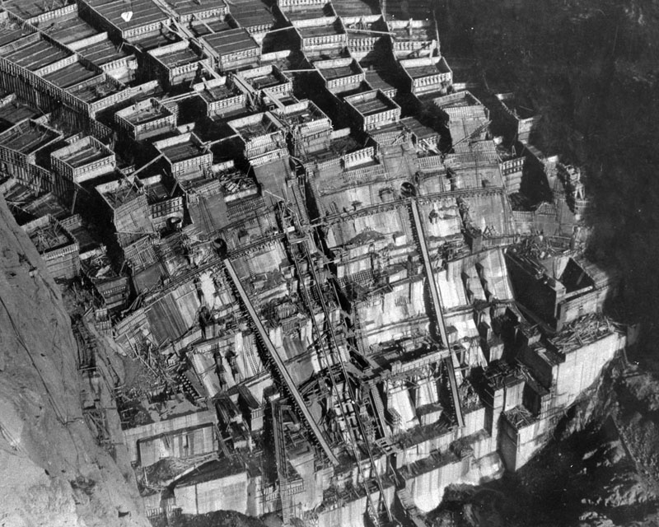
Hoover’s Actions
$423 Million for public works programs
  Boulder Dam Project
  Mount Rushmore
Reconstruction Finance Corporation (RFC)
  $2 billion to finance failing banks and businesses.
Attempts to Aid Farmers
  Agricultural Marketing Act
    Maintain prices
  Farm Board
    Handle surplus goods

Slide 29
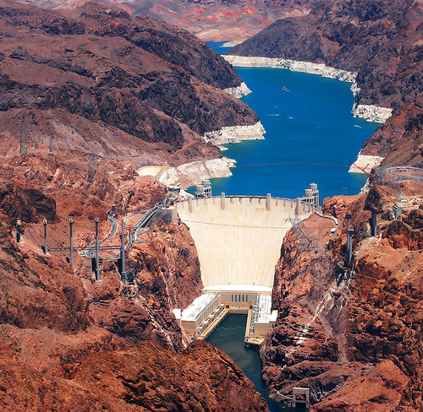
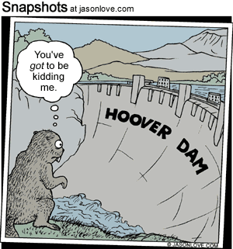
Boulder Dam

Slide 30
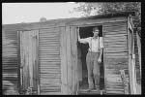
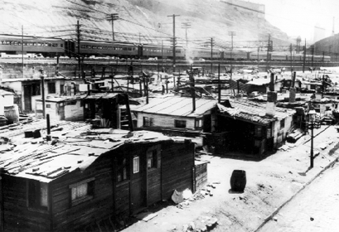
Hoover Gets the Blame
Hoover gets the blame
People living in shantytowns began calling them Hoovervilles
Called newspapers they wrapped themselves in Hoover blankets
In 1930, the Democrats win control of the House of Representatives

Slide 31
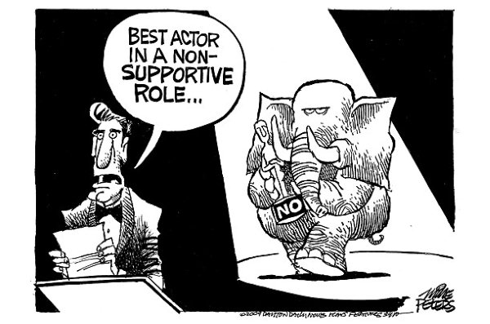
Despite Criticism, Hoover struggles to maintain his principles.
Angry Americans blame him for Depression

Slide 32
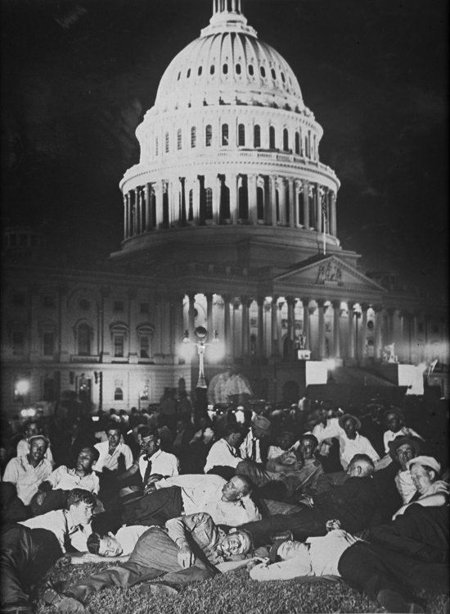
Bonus Army
In 1932 10,000-20,000 WWI veterans march on Washington D.C.
Demanded that a bonus promised for 1945 be paid immediately
Hoover said no

Slide 33
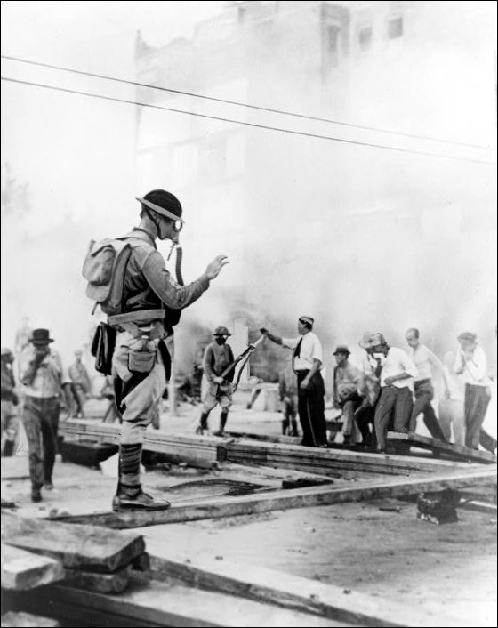
Bonus Army Cont.
The proposal went to the Senate who voted it down.
Hoover asks army to leave
  Most did but 2000 refuse
Hoover calls on a group of 1000 soldiers to remove the veterans
  Led by Douglas Macarthur and Dwight D. Eisenhower
  100 Injured
Seen as a symbol for Hoovers Legacy

