Slide 1
The Gilded Age
Mr. Hulyo
American II
Fall 2017

Slide 2
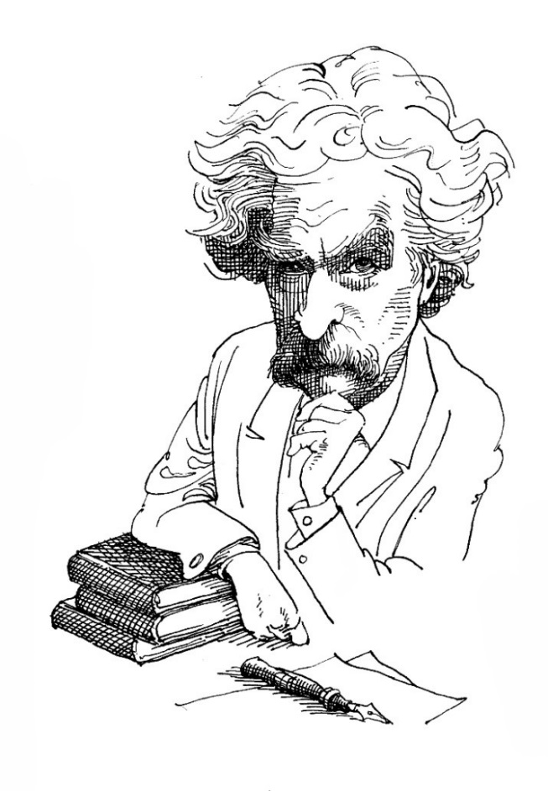
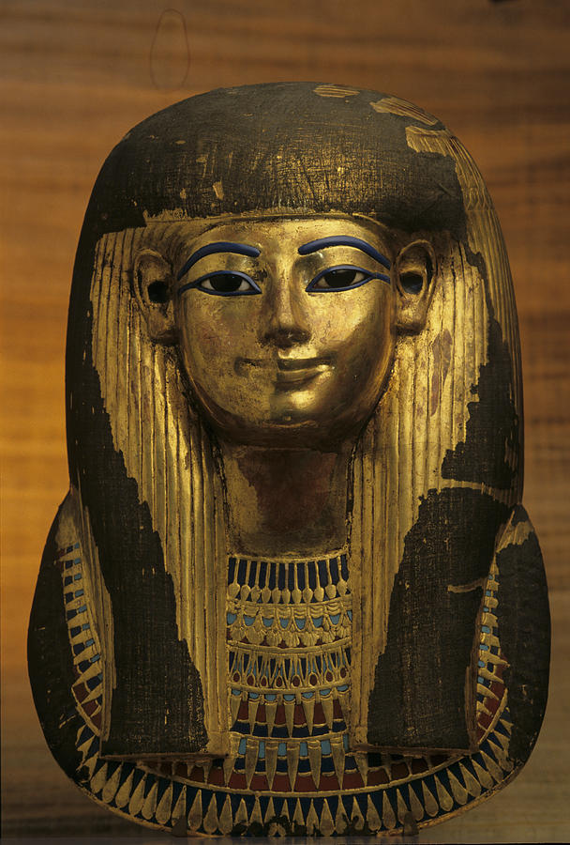
What was the Gilded Age?
“The external glitter of wealth conceals a corrupt political core that reflects the growing gap between the very few rich and the very many poor.”
"Gilded" means to be covered in gold, but the contents inside are not actually gold.

Slide 3
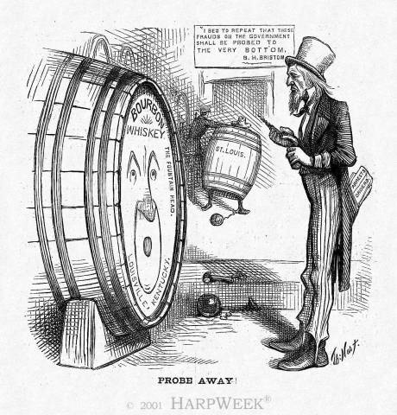
The Whiskey Ring
Scandal involving several members of Grant’s administration, including his personal secretary, where federal employees accepted bribes from whiskey distillers to help them avoid paying federal taxes on alcohol production
110 people were convicted of defrauding the government out of at least $3 million in taxes

Slide 4
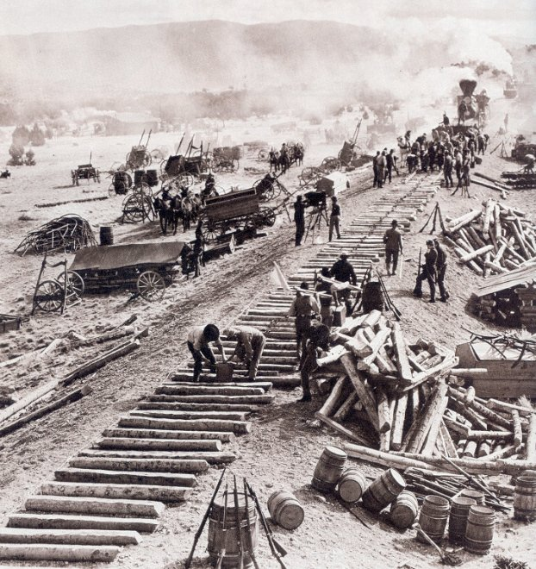
The Credit Mobilier Scandal
Several investors in the Union Pacific Railroad formed a construction company, then used their positions on the railroad’s board to hire their company to do construction work at exaggerated prices
The Union Pacific received their funding from federal grants; when grant money ran out, Ames gave other members of Congress shares in the Union Pacific to bribe them to approve more federal grant money

Slide 5
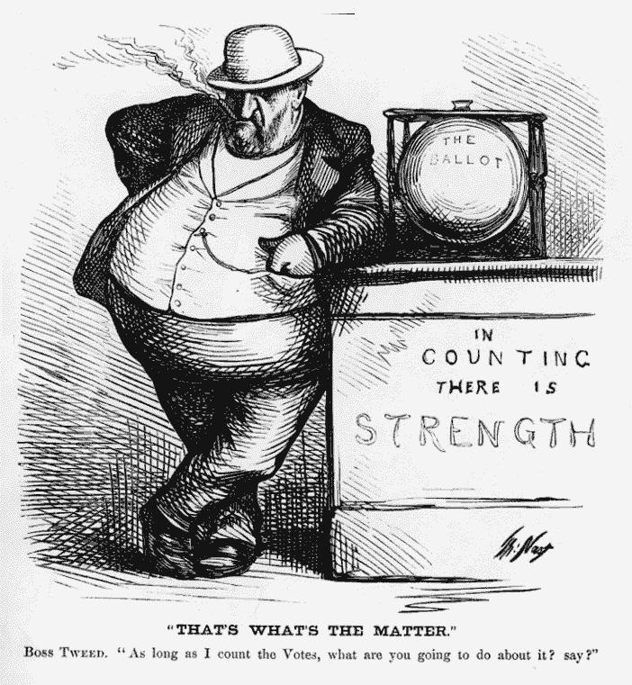
Political Machines
Local-level political group designed to gain and keep power
Growth of cities had outpaced the ability of city governments to meet the needs of citizens
Run by party “bosses”
Party bosses helped immigrants find jobs, housing, food, heat, and protection; in return they told immigrants who to vote for in elections

Slide 6
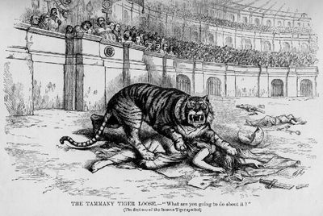
Political Machines
Political machines loved immigrants, WHY?
  Never voted, tried to sway votes by bribery, intimidation, and other means
Political machines used power to:
  Rig elections
  Become wealthy from kickbacks-illegal payments
  Control police force to stay out of trouble

Slide 7

How A Political Machine Works
City Boss: controlled activities of city
Ward Boss: worked to secure all votes in their ward
Precinct Captains: tried to gain voters in city neighborhoods

Slide 8
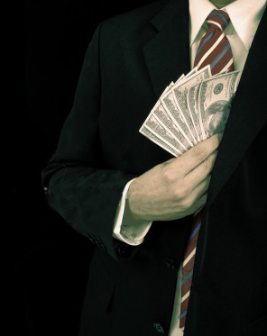
Graft
Graft –money acquired through dishonest or questionable means
Example: party bosses would know when and where the city might want to build a park, so they would buy up the property cheap before it became public knowledge and then sell the land to the city for personal profit

Slide 9
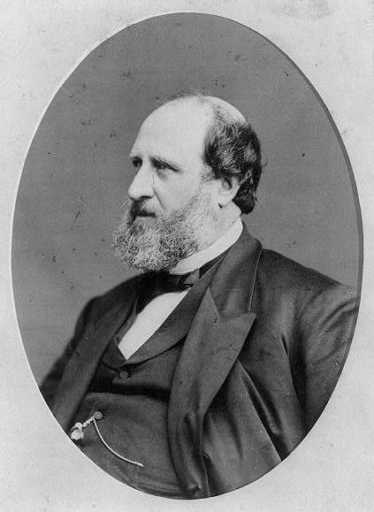
William “Boss” Tweed
1823 – 1878
Ran Tammany Hall (The Democratic Party’s political machine in NYC) from 1858 – 1871
Used his position to make himself wealthy
Arrested in 1871 and convicted of defrauding the city government of about $200 million

Slide 10
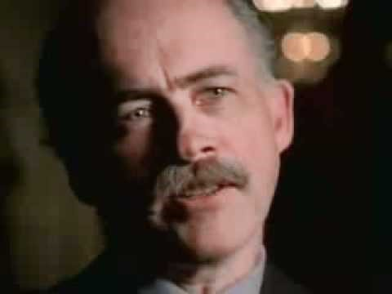
Boss Tweed
Used graft, bribery, and rigged elections to steal over $200 million in NYC
Created jobs that helped support the local economy
Constructed public buildings at hugely inflated prices to create kickbacks
Machine bosses like Tweed became very rich

Slide 11
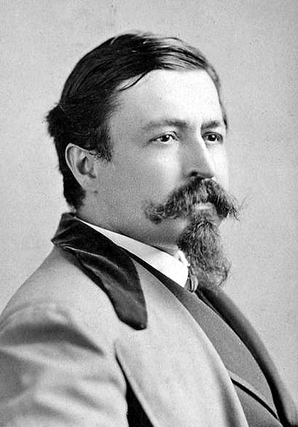
Thomas Nast
1840 – 1902
Worked for Harper’s Weekly as political cartoonist from 1859 to 1886
Targeted Boss Tweed and political machines; was so effective that Tweed offered him a $500,000 bribe to go study art in Europe – Nast turned it down.
Creator of modern image of Uncle Sam, the Donkey and Elephant symbols for Democratic and Republican Parties

Slide 12
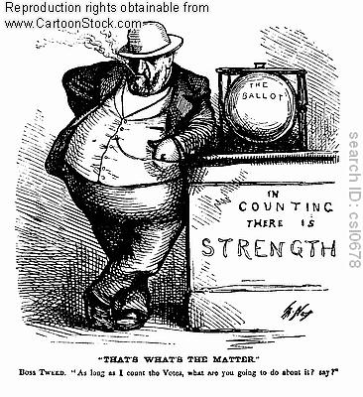
Rise of the Political Cartoon
Late 1800s
Thomas Nast – artist
  Favorite Subject- William Tweed (a.k.a. “Boss” Tweed)
  "Stop them damned pictures. I don't care what the papers write about me.
  My constituents can't read. But, damn it, they can see pictures.”
  –Boss Tweed
Boss Tweed. “As long as I count the Votes, what are you going to do about it?”

Slide 13
That’s What's The Matter

Slide 14
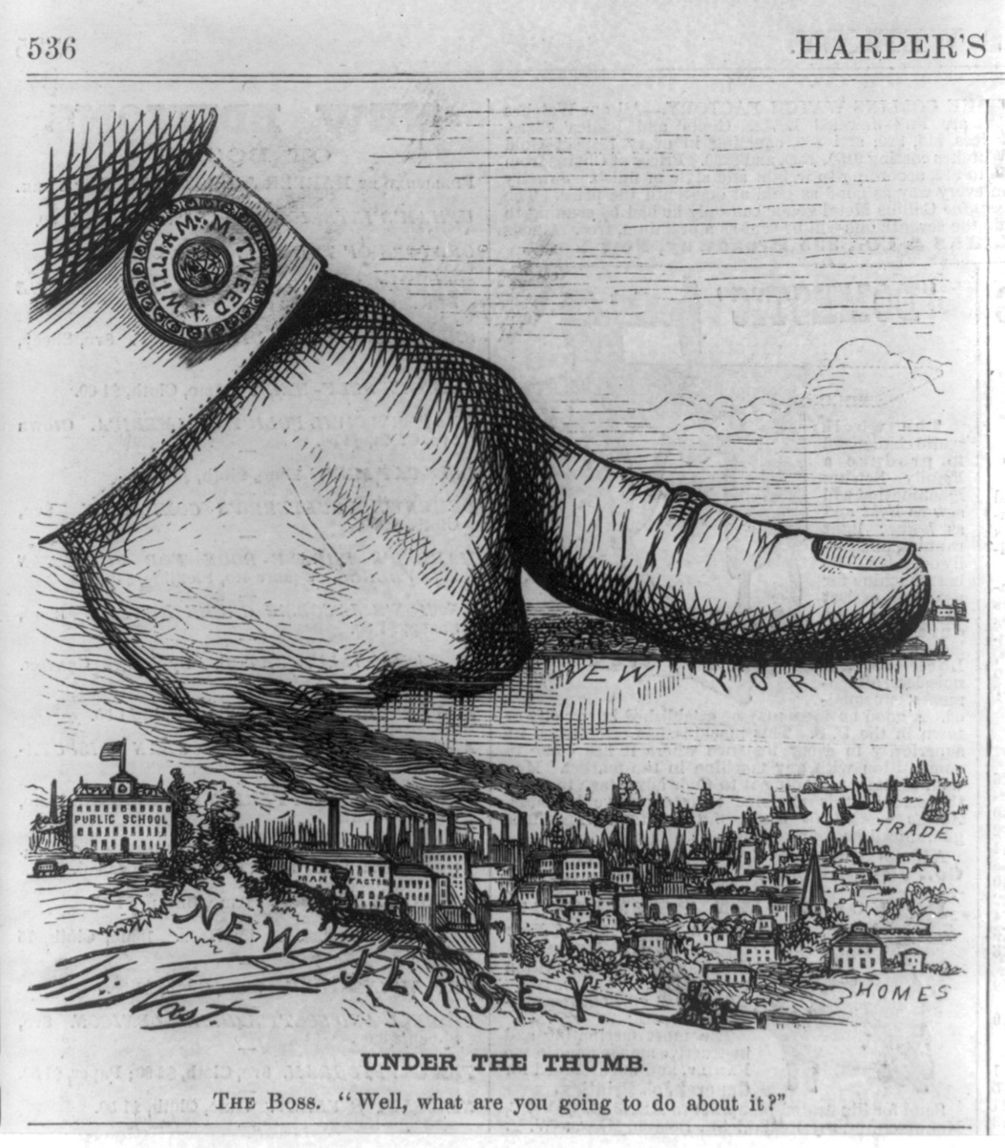
Under the Thumb

Slide 15
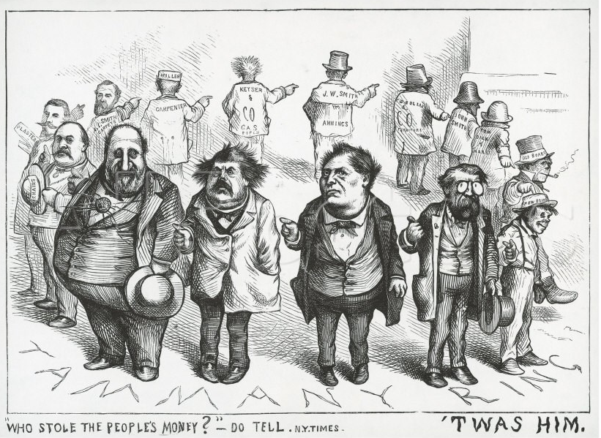
Who Stole the People’s Money?

Slide 16
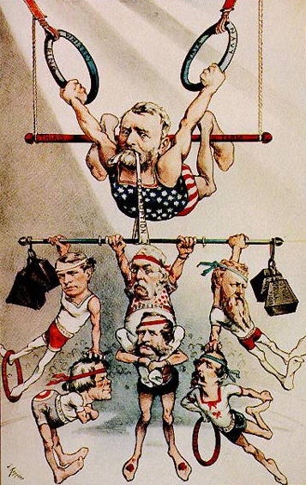
Stalwarts & Halfbreeds
Stalwarts: Republicans who supported the political machines and spoils system (Patronage)
Half-breeds: Republicans who supported civil service reform and an end to the political machines and spoils system

Slide 17
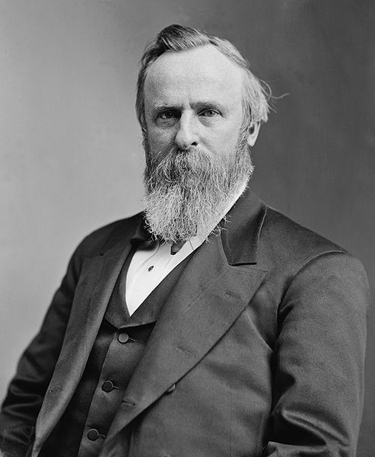
Rutherford B. Hayes
1822 – 1893
Republican
19th President (1877 – 1881)
Reformer
Replaced officials who had been appointed by party bosses
No spoils system in his administration!!!!

Slide 18
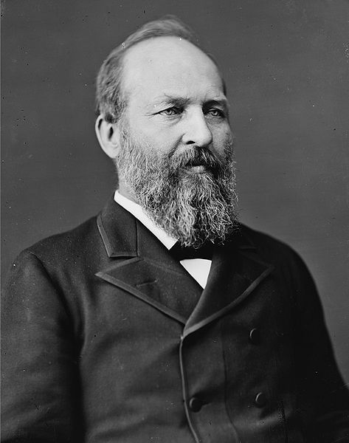
James Garfield
1831 – 1881
Republican
20th President (1881)
Appointed Halfbreeds to important positions
He was assassinated after only 200 days in office by a disgruntled office seeker(Stalwart) who felt he had been cheated out of a good government job

Slide 19
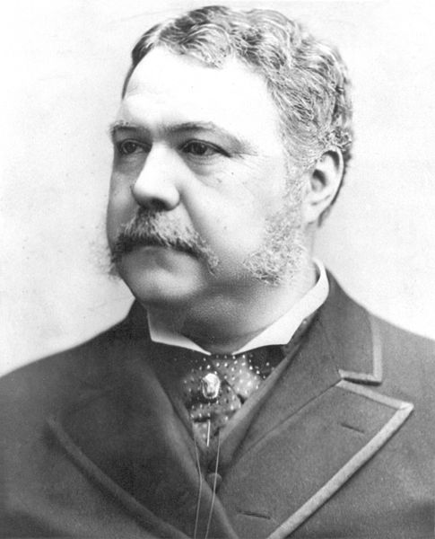
Chester A. Arthur
1829 – 1886
Republican
21st President (1881-1885)
A “Stalwart,” he was so affected by Garfield’s assassination that he switched to being a “Half-breed” and championed civil service reform
Did not receive nomination in election of 1884 due to terminal kidney condition

Slide 20
The Government Reforms!

Slide 21
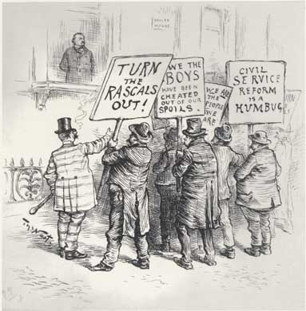
Pendleton Act of 1883
Ended the spoils system by creating the US Civil Service Commission
Federal employees would get jobs based on skills and merit, not political favoritism
Had to pass a civil service exam to enter politics

Slide 22
The Pendleton Act took care of APPOINTED government employees!
But what about the employees who are voted into office?

Slide 23

Political Reforms
Secret ballot: individual’s votes would be kept secret, not published
Referendum: allows citizens to vote directly on important issues rather than leave the issues in the hands of elected officials
Recall: allows voters to remove an elected official from office before their term is up
Initiative: allows voters to force elected officials to vote on a certain issue (petition)

Slide 24
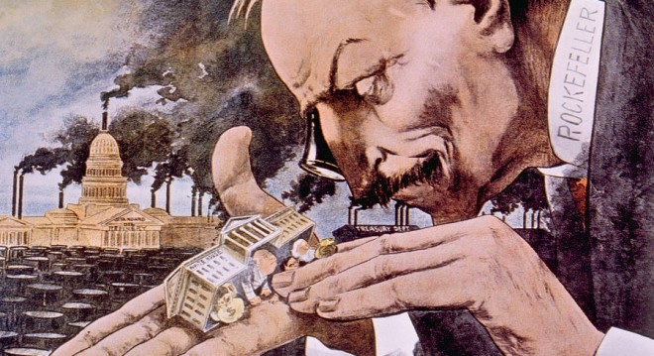
Analyzing Political Cartoons
How did Rockefeller represent the reality of “the Gilded Age?”
What is the political cartoon implying about Rockefeller (and other tycoons’ from the era for that matter)?
Make 3 observations about this political cartoon
What major individual does this cartoon portray?
Does this suggest the person as being a Robber Baron or Captain of Industry?

Slide 25
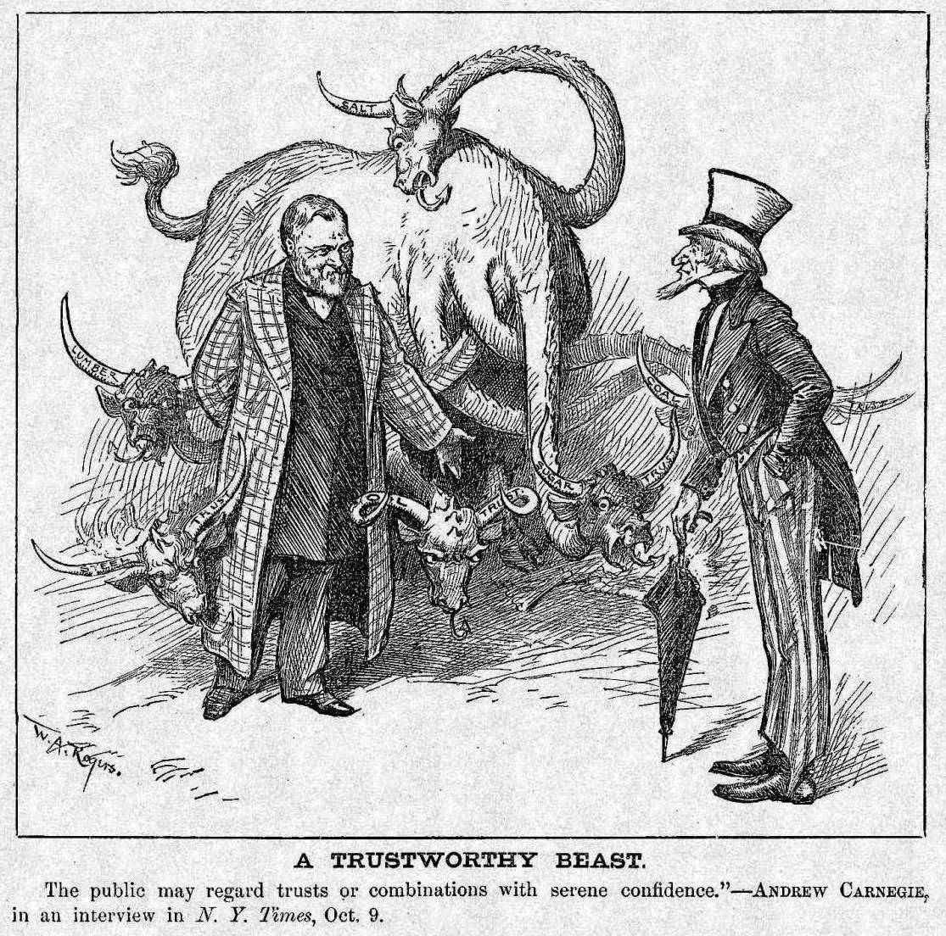
Analyzing Political Cartoons
What are the names of the beasts horns? What were they?
Do you think it is a problem if the government leaders are too close with private companies?

Slide 26
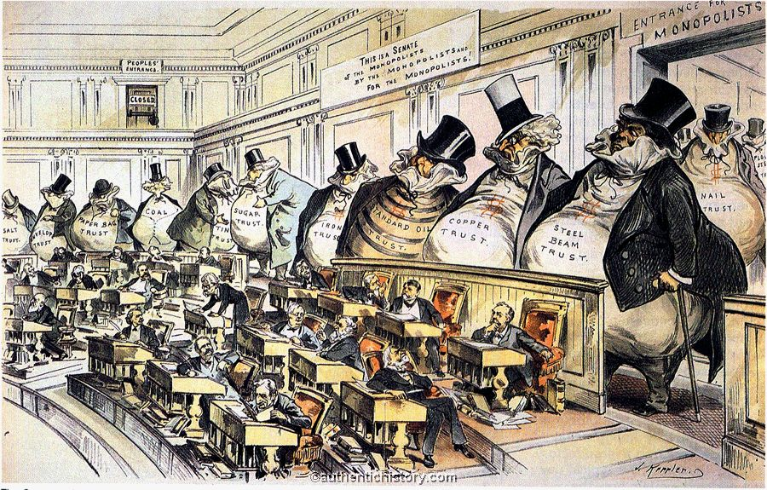
Analyzing Political Cartoons
Make 3 observations about this political cartoon
After analyzing this political cartoon, whom is in charge; Congressmen or the big barons?

Slide 27
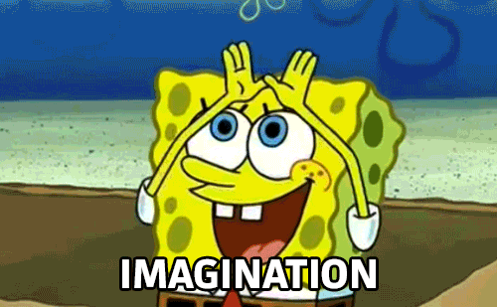
A company wants a road fixed in front of their business because its terrible condition is costing them customers, but getting the repairs approved by the city and finding the money for the project could take years. There are many other roads that need to be fixed in the city. The mayor goes to the business owner and offers to fix the road immediately but only if the owner agrees to vote for him and to donate heavily to his campaign in the next election.
Discuss: Is there anything wrong with this arrangement?

Slide 28
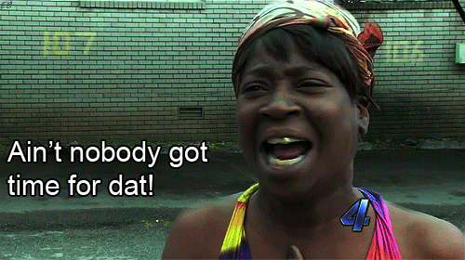
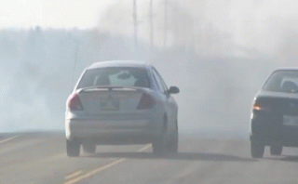
Political Corruption
  In 19th century government, the government was expected to take care of roads and such but not much else. It was responsible to make sure that the law was enforced and that was all.
  People were responsible for everything else.

Slide 29
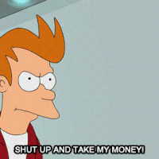
Political Corruption
  Consequently, associations formed that helped people find jobs, help in an emergency, legal assistance, and provided help to small businesses because no one else would. The leaders of these associations were called “bosses”.
  Eventually they ran for office for leadership positions in the cities. But they were more loyal to the people that got them there than the purpose of the office.
  The government was supported and manipulated by a shadow government.
  This was nicknamed “machine politics” because they could “call out the votes, like a machine” to support any political agenda.

Slide 30
Key Terms
  Political bosses political leaders who got people to vote for them by giving favors. They also made deals with contractors.
  Political Machine: The ring of people who made deals and got votes for the political boss.
  Kickback: A percentage of income given to a person in a position of power or influence as payment for having made the income possible
  Graft: To get money or political power through illegal or dishonest methods.

Slide 31

Reflection Questions
  Why did you vote for Dr. Poole?
  What are some positives of the political machine?
  Negatives?

