Slide 1
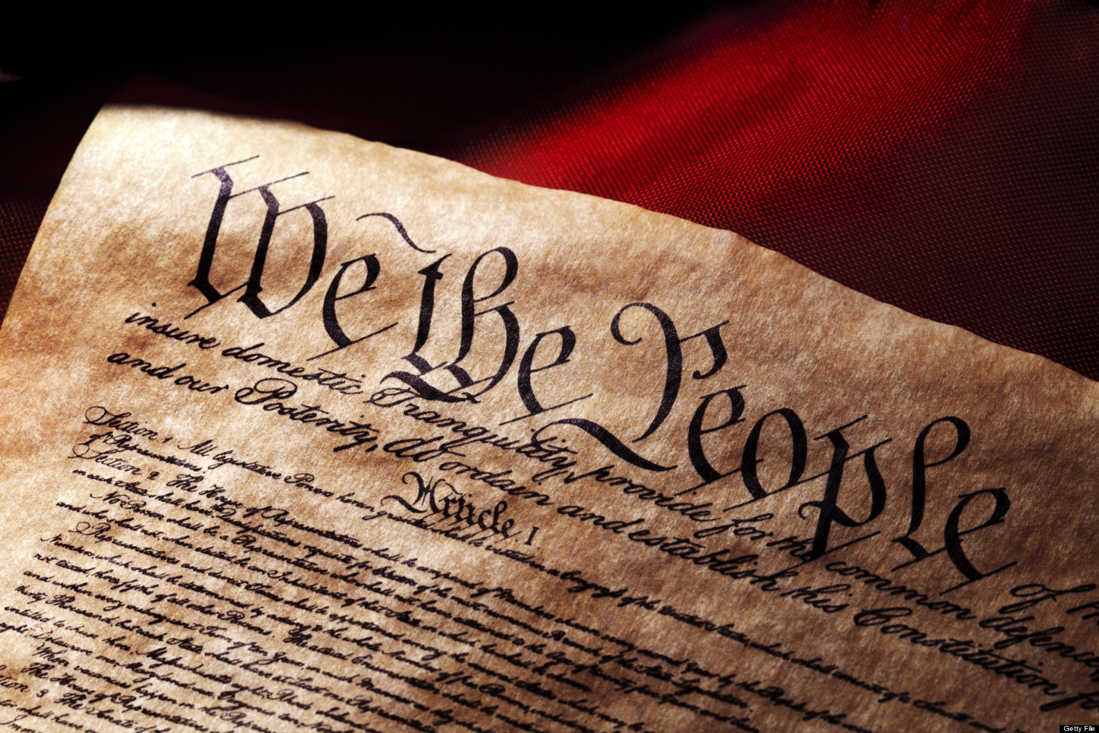

Slide 2
Quote of the Day
“He who knows nothing is closer to the truth than he whose mind is filled with falsehoods and errors.”
-Thomas Jefferson

Slide 3
"I never considered a difference of opinion in politics, in religion, in philosophy, as cause for withdrawing from a friend."
-Thomas Jefferson

Slide 4
Patrick Henry: “Give Me Liberty or Give Me Death”
"The war is inevitable-and let it come! I repeat it, sir let it come! It is in vain, sir, to extenuate the matter. Gentleman may cry, Peace, peace; but there is no peace. The war is actually begun. The next gale that sweeps from the north will bring it our ears the clash of resounding arms. Our brethren are already in the field. Why stand we here idle? What would they have? If life so dear, or peace so sweet, as to be purchased at the price of chains and slavery? Forbid it, Almighty God! I know not what course other may take, but as for me-give me liberty, or give me death!"

Slide 5
The Early Days of the Revolution

Slide 6
Shortly after Lexington and Concord, The British send reinforcements to Boston

Slide 7
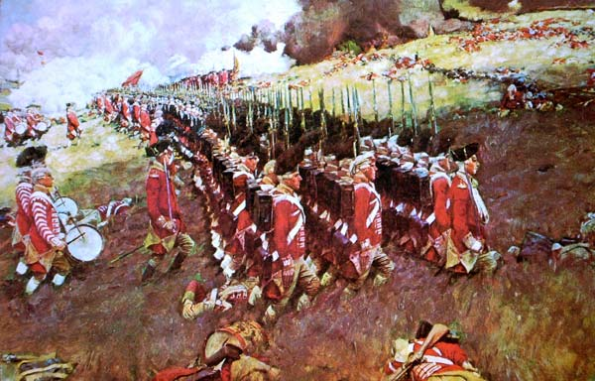

Slide 8
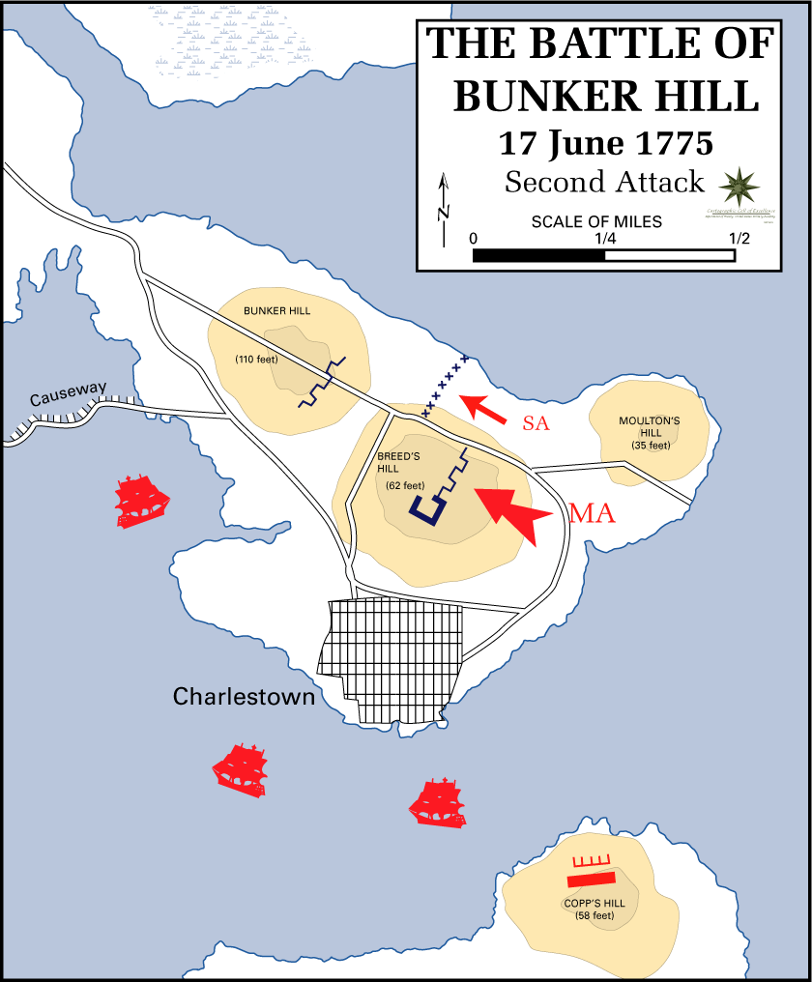
Breed’s Hill or Bunker Hill?
Following the Battles of Lexington & Concord, the British reinforced their position in Boston and brought in additional troops
The Massachusetts militia dug in and began fortifying Breed’s Hill (mistakenly confused by later reporters with nearby Bunker Hill) north of town

Slide 9
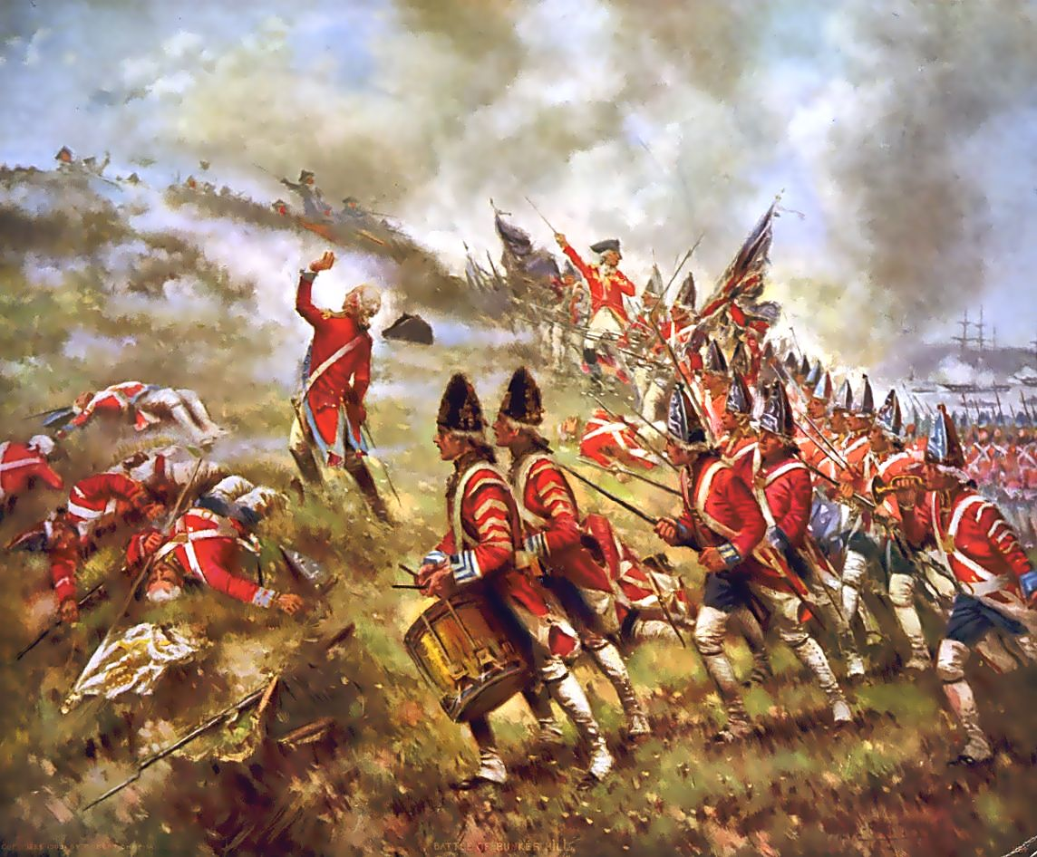
Battle of Bunker Hill
June 17, 1775: Gen. Gage sent 2200 British soldiers up the hill
The British suffered over 1000 casualties, but succeeded in taking the hill (because the American militia ran out of ammunition and retreated)
Despite the victory, Gage would be replaced by Gen. William Howe

Slide 10
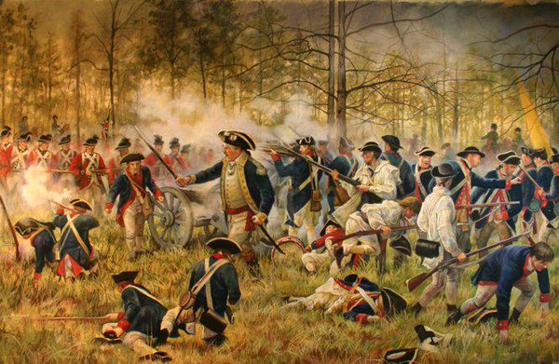

Slide 11
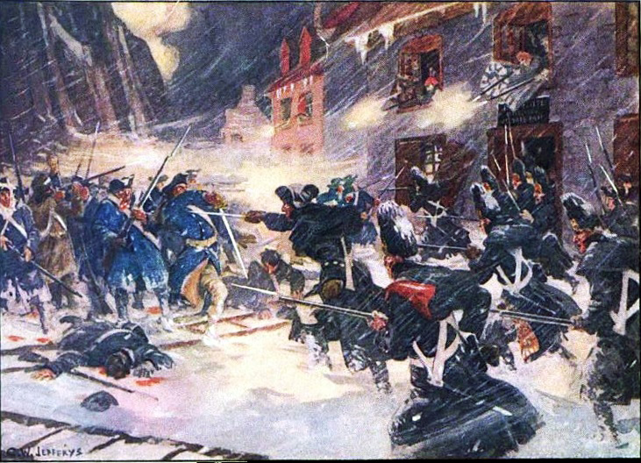
Battle of Quebec
American forces attacked Quebec and captured the Canadian town of Montreal, hoping French-Canadians would join the rebellion
The French did not join the rebellion, and the Americans retreated back inside their own border

Slide 12
Who will govern the colonies during the revolution?

Slide 13
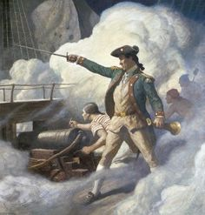
An American Government
The Continental Congress responded by taking on the formal role of government for the Colonies: they opened negotiations with the Native American tribes, created a postal service, and established a Navy and Marine Corps (who began attacking British shipping)

Slide 14
During the War , Colonists had to deal with internal problems such as……..

Slide 15
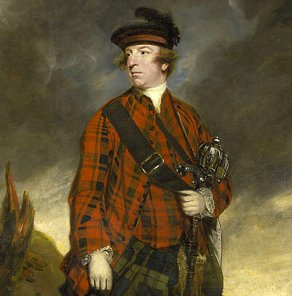
Southern Loyalists
The governor of Virginia, Lord Dunmore, organized Loyalists in creating two armies to support the King – one white and one black
The black army was built through the governor’s promise that any slaves who joined would be freed as a reward for their service
As a result, all of the major Virginia plantation owners joined the Revolution
Huge!!! Because now wealthy planters were no longer loyalists!!

Slide 16
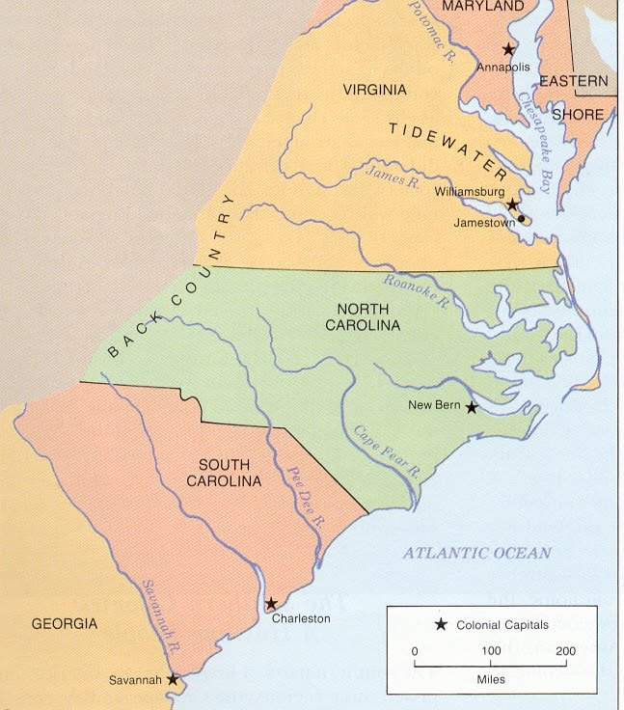
Southern Patriots
Patriot forces defeated the Loyalists near Norfolk, Virginia in late 1775, taking control of the colony
Patriots followed up by defeating the Loyalists in North Carolina and blocked British troops from occupying Charles Town, SC in early 1776

Slide 17
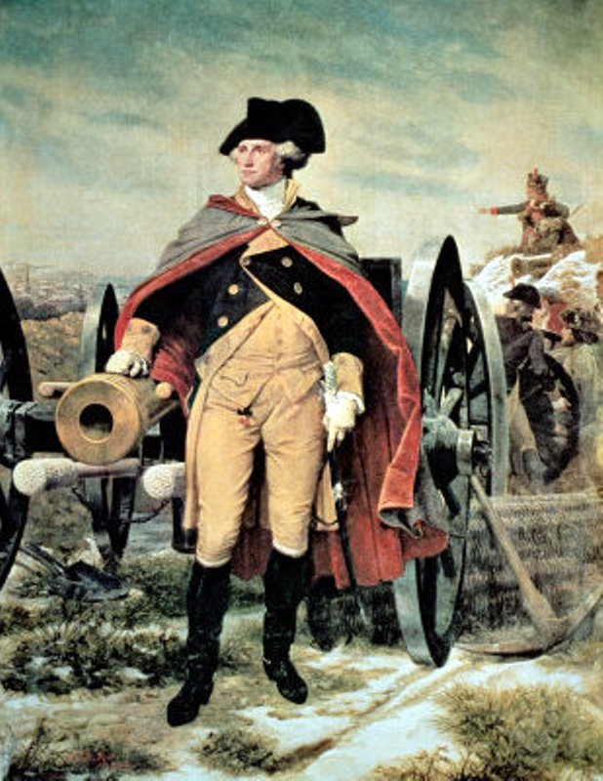
Boston Retaken
George Washington’s first move was to send reinforcements to Boston and secure the hills to the south of the city
American military pressure around Boston prompted the British to evacuate their troops from the city rather than fight to keep the city

Slide 18
What will Britain’s War Plan be?
What advantages do they have?

Slide 19
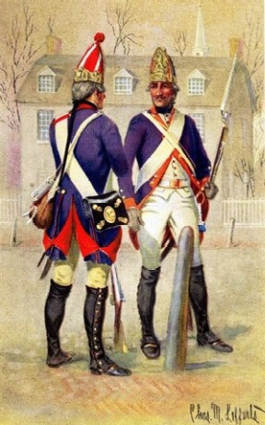


Slide 20
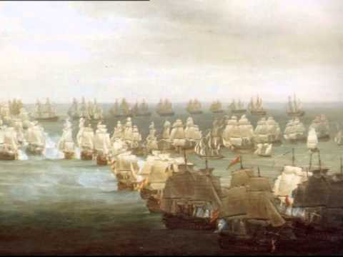
Britain’s War Plan
Britain responded by blocking all trade with the Colonies and establishing a naval blockade of American ports
They also hired 30,000 Hessian (German) mercenaries to beef up the British Army

Slide 21
The colonies need more support…Who will help them?

Slide 22
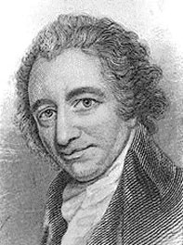

Slide 23
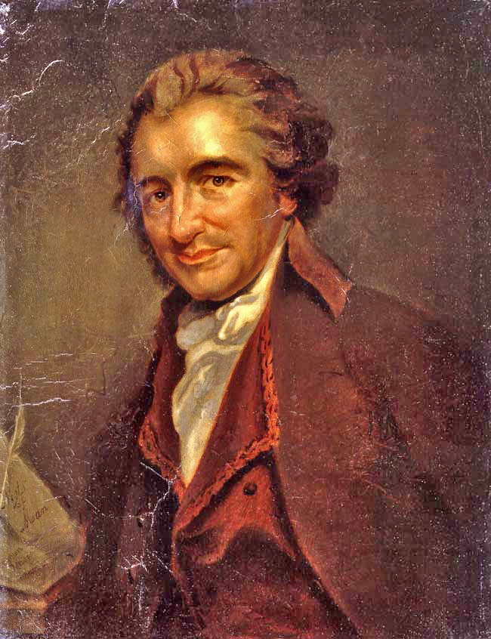
Thomas Paine’s Common Sense
Published in January, 1776; by late spring it had sold over 100,000 copies
Paine attacked the idea of monarchy (and King George in particular) claiming that power should belong to the people
Paine’s arguments convinced many colonists to support the Revolutionary cause

Slide 24
Excerpt From Common Sense
O! ye that love mankind! Ye that dare oppose not only the tyranny but the tyrant, stand forth! Every spot of the old world is overrun with oppression. Freedom hath been hunted round the Globe. Asia and Africa have long expelled her. Europe regards her like a stranger, and England hath given her warning to depart. O! receive the fugitive, and prepare in time an asylum for mankind!

Slide 25
Then comes one of the most important documents ever devised in the history of Human Beings!!!
What could it be?

Slide 26
END PART 1

Slide 27
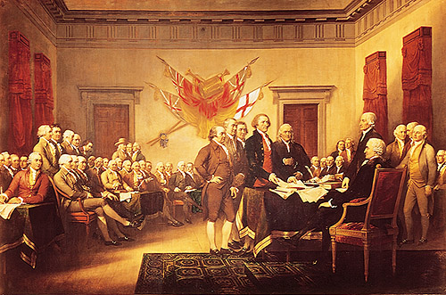

Slide 28
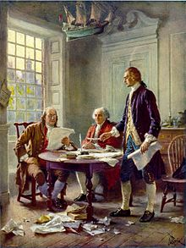
The Declaration of Independence
July 4, 1776: The Continental Congress issued the Declaration of Independence
The document listed the colonists’ complaints against the King and declared themselves to no longer be subjects of the British Empire

Slide 29
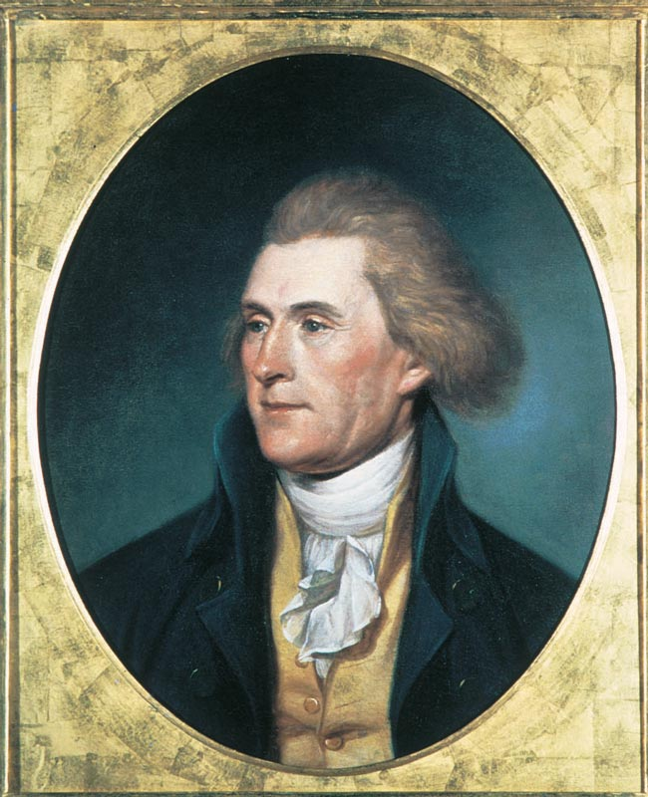
Historical Context
Thomas Jefferson
About The Author
Born on April 13, 1743 in Virginia to a wealthy family.
He was very well educated. Attended The College of William & Mary.
Served in the Virginia House of Burgesses.
Eloquent correspondent, but not good public speaker
Known as the "silent member" of the Congress (Introvert)
Was unanimously chosen by the Committee of Five to prepare a draft of the Declaration alone.

Slide 30

Major Writings of The Time
Common Sense is published
North Carolina produces the Halifax Resolves making it the first British colony to officially authorize its delegates to vote for independence.
Richard Henry Lee of Virginia proposes a resolution calling for a Declaration of Independence.
Virginia Declaration of Rights by George Mason is adopted by the Virginia Convention of Delegates.
The Delaware General Assembly votes to suspend government under the British Crown

Slide 31
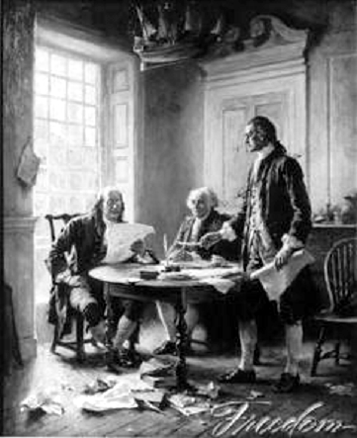
Intended Audience
Colonists wanting independence from England
British members of Parliament and King George III
Also aimed to win support from an international audience

Slide 32
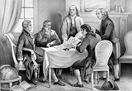
Jefferson’s Viewpoint on the Major Issues of His Time
He believed in the separation of church and state.
He believed that the colonies had the right to overthrow a tyrannical government.

Slide 33
Main Points of the Declaration of Independence
All men are created equal.
“We hold these Truths to be self-evident, that all men are created equal.
Men are given by God certain unalienable rights.
“They are endowed, by their Creator, with certain unalienable rights, that among these are Life, liberty and the Pursuit of Happiness.”
We have the natural right by God to declare our independence from England.
“When in the course of human events it becomes necessary for one people to dissolve the political bands which have connected them with another, and to assume among the Powers of the earth, the separate and equal station to which the Laws of Nature and of Nature’s God entitle them…

Slide 34
Main Points of the Declaration of Independence
Governments derive their authority from the consent of the people.
“Governments are instituted among Men, deriving their just powers from the consent of the governed.”
When a government abuses it’s power, the people have the right to overthrow it.
“That whenever any form of Government becomes destructive to these ends, it is the Right of the People to alter or to abolish it…
The colonies tried repeatedly to compromise with King George, but has been a tyrant.
“Such has been the patient sufferance of these Colonies; and such is now the necessity which constrains them to alter their former Systems of Government.

Slide 35
Historical Significance
The American Colonies finally declared their independence from England
It was the first step in the creation of a new nation.

Slide 36
How will the British respond to the Declaration?

Slide 37
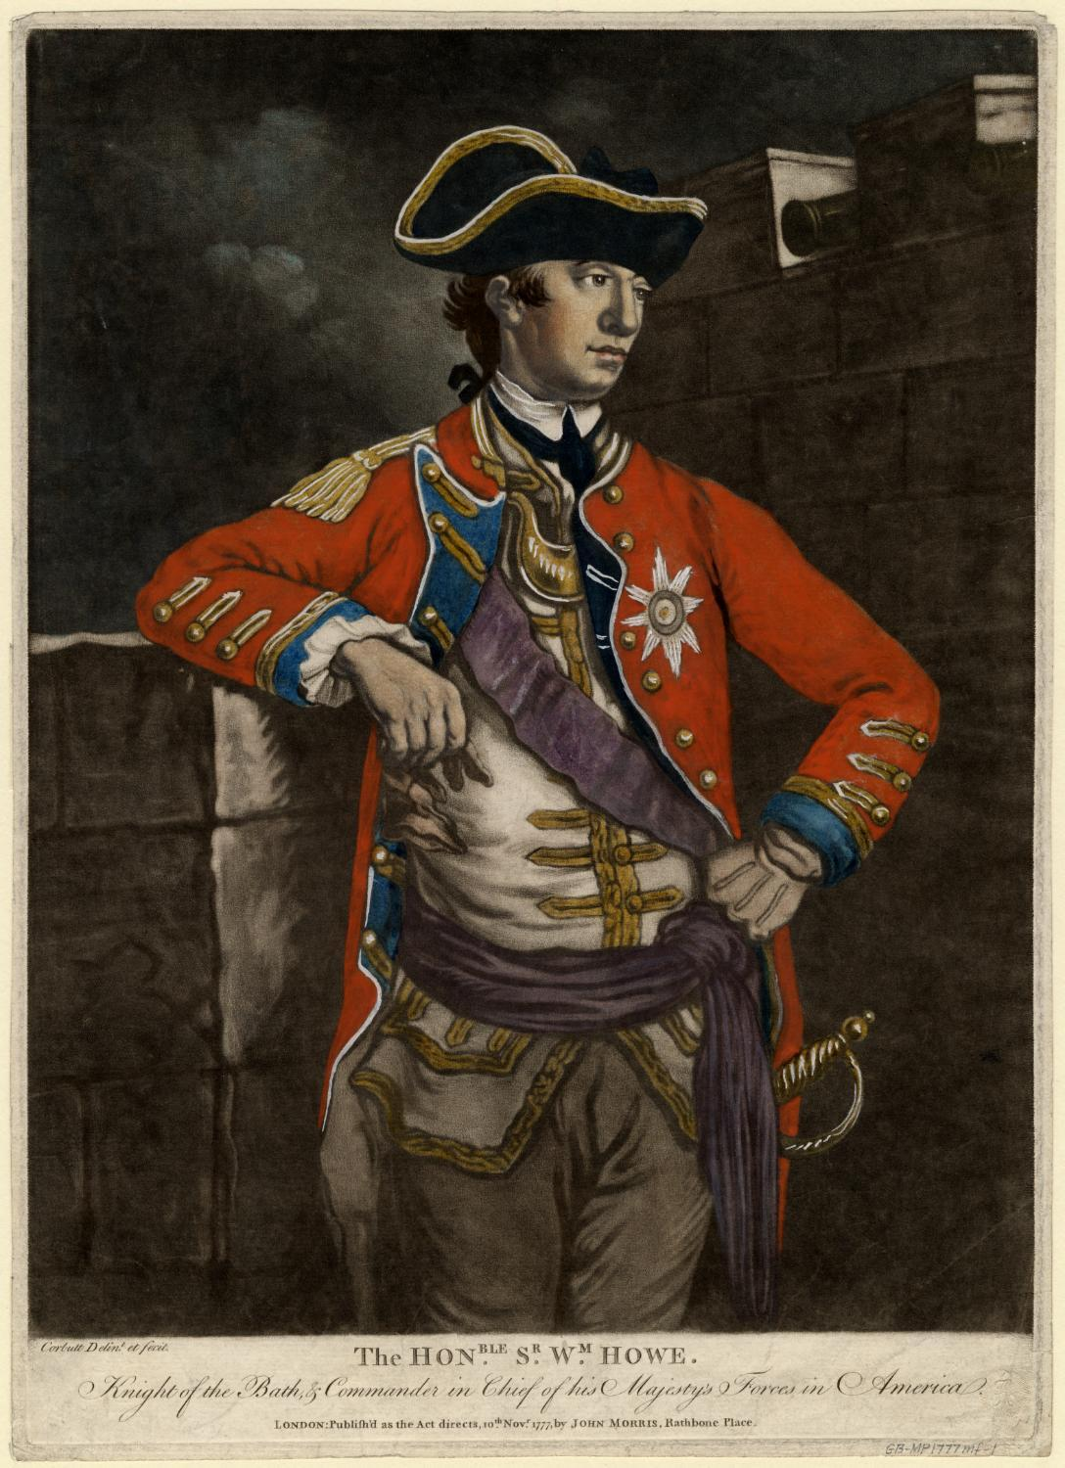
The British in New York
At the same time, the British, under General Howe, landed 32,000 troops in New York with an eye towards capturing New York City, thereby threatening the colonial capital of Philadelphia and hopefully separating New England from Virginia

Slide 38
What major problems face the colonists during the war?

Slide 39
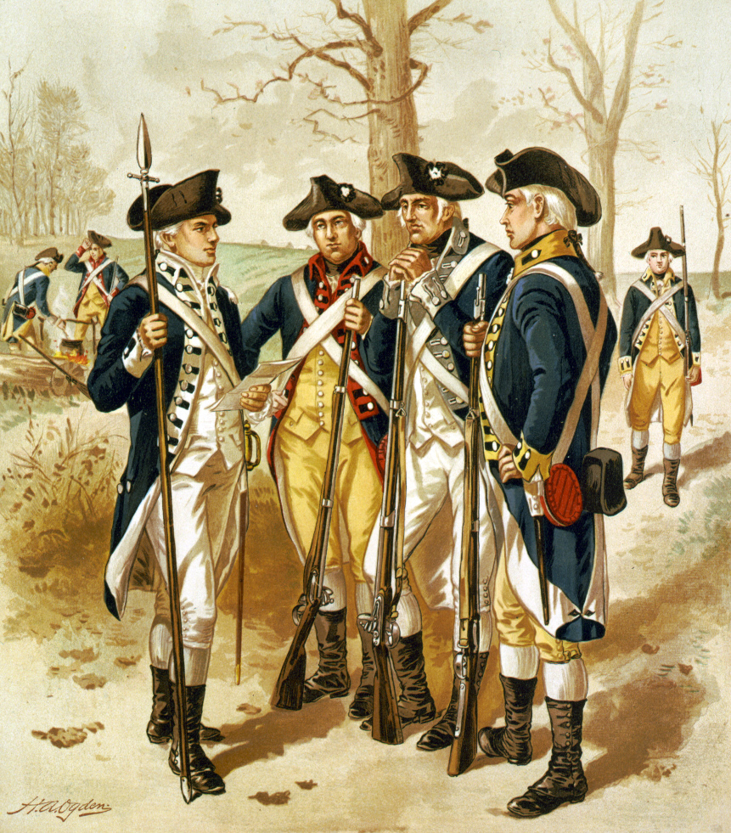
Colonial Problems
The Continental Army struggled to stay in the field
Many soldiers simply went home during planting or harvesting season; others deserted or refused to serve when their wages weren’t paid
Despite over 230,000 men serving at one time or another, the Continental Army rarely had more than 20,000 serving at any one time

Slide 40
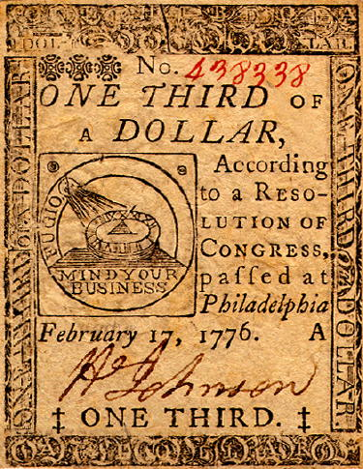
Colonial Problems
Congress lacked the ability to levy taxes, so paying for the war was difficult
Congress tried issuing paper money with no gold or silver backing, but the money quickly became worthless

Slide 41
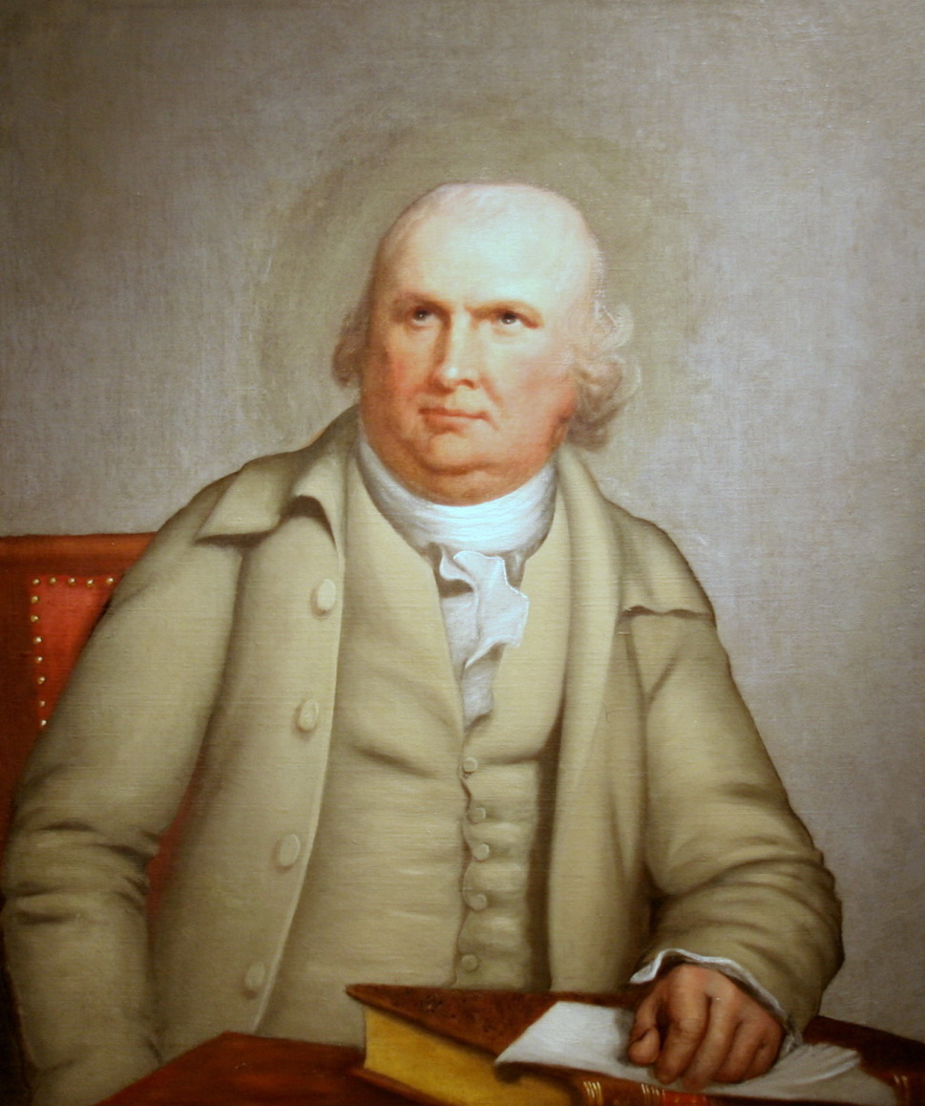
Financial Rescue
Pennsylvania merchant Robert Morris pledged most of his own wealth to help pay for the war and negotiated foreign loans to fund the rest
He also convinced the Continental Congress to create the Bank of North America to help keep the war funded and to build an economy for the new nation
One of the most underrated figures of the revolution

Slide 42
What problems will the British face?

Slide 43
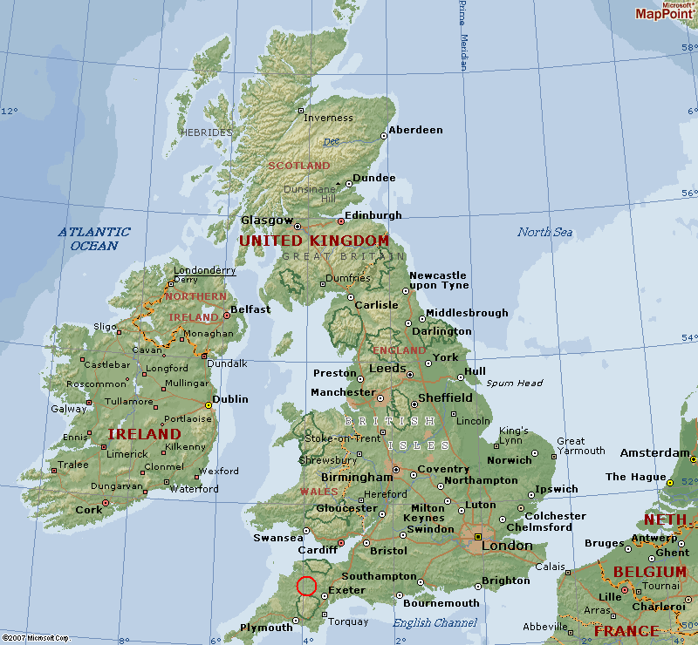
British Problems
Many people in Britain opposed the war – especially merchants, who stood to suffer financially from lost trade, and fiscally conservative members of Parliament who did not want to add to the debt
The British knew they had to win quickly and cheaply, or support for the war would quickly dissolve

Slide 44
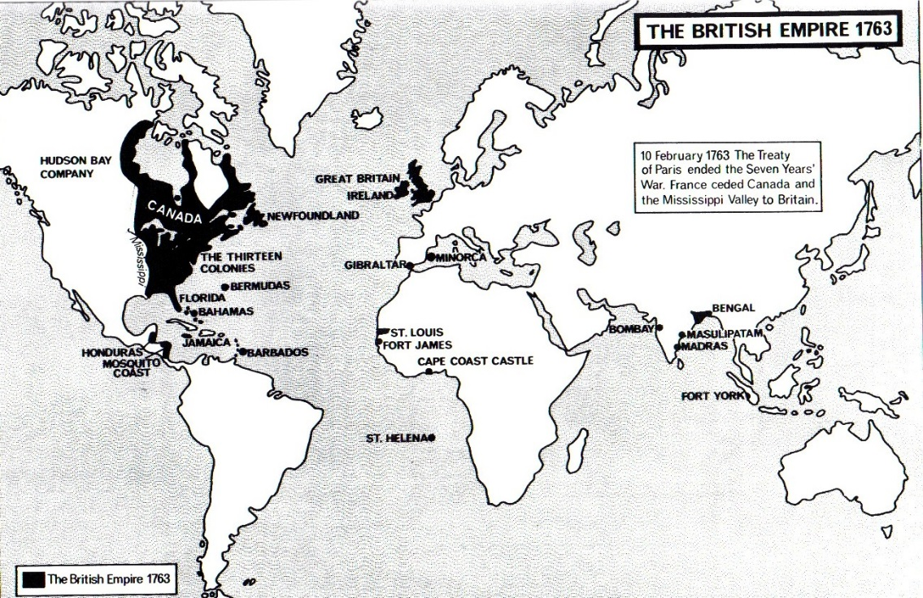
British Problems
The British also had rivals in Europe who were eager to exploit the colonists’ rebellion
Spain, France, and the Netherlands all posed a threat to British interests elsewhere, forcing the British to reserve much of their military strength to act as a deterrent against European aggression

