Slide 1
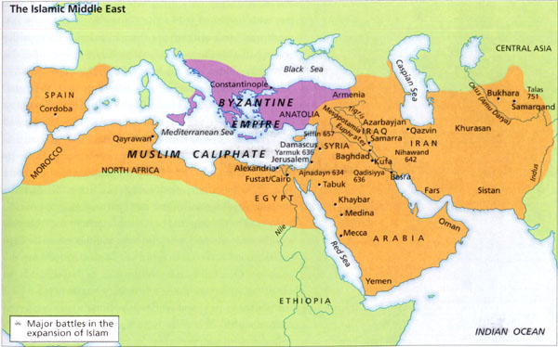
http://www-personal.umich.edu/~vika/TeachPort/islam00/esposito/chapt2.html
What is this map a representation of? How would you think the Byzantine Empire and Europe would react? Why would they react in that way?

Slide 2
The Crusades
1096-1204 AD

Slide 3
A Call from the Pope
In 1093 Byzantine Emperor, Alexius Comnenus, sent an appeal regarding the threat against Constantinople by Turkish armies and Muslim’s control of Jerusalem
Pope Urban II received word of this appeal and issued a call for a Crusade to gain back the Holy Land.
  Holy Land- Palestine and Current day Israel; the area where Jesus lived and preached

Slide 4
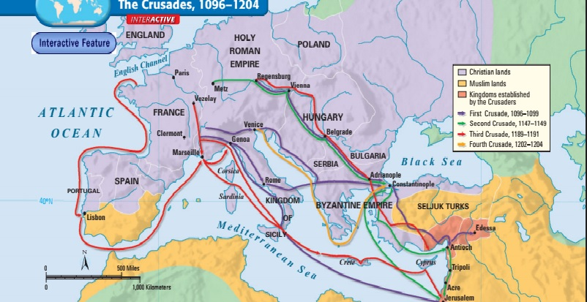
What were the Crusades?
A series of expedition and war brought by Europeans to recover the Holy Land from the Muslims in the 11th, 12th, and 13th centuries.
In total there were nine Crusades

Slide 5
Those who answered the Call
Feudal Lords and Kings
Knights
Peasants
Most of the Crusaders were French, but Bohemians, Germans, Englishmen, Scots, Italians, and Spaniards came as well.
  Deus Vult- “God wills it”

Slide 6
The First Crusade 1096-1099
Primary goal was to retake Jerusalem
1097-1098 Four Crusading armies joined up the Byzantines retaking many cities in modern Syria and Turkey
Jerusalem was besieged by the Crusaders and their Byzantine allies for over a month before finally taking it on July 15, 1099
  Ill-prepared for war with no key strategy on taking Jerusalem
  Most of the knights and peasants knew little about the geography or climate of the region

Slide 7
What Follows After?
Short Term
Long Term
Four feudal Crusader states were carved out of the Holy Land territory
The region remained and prospered under Christian control until around 1130
  Edessa falls in 1144 leading to a call for the Second Crusade
Knights Templar is established
Slowed the spread of Islam
Unity under Monarchs and Religious figures
A period of Renaissance emerges
  Trade of Ideas and commerce
Retaliation and counter-attacks by Muslims creating centuries of conflict
Fall of Byzantine Empire

Slide 8
Group Work Activity
Get into groups of 4 and rotate the sources completing all sections EXCEPT for Corroborate
Summarizing - What does the source tell us? (details)
Contextualizing - When, why, how, where was the source produced?
Inferring - What does the source suggest? (insight)
Monitoring - What else would I like to find out? (questions/ what’s missing for better understanding)
Corroborate - What similarities and differences exist between the sources
Once all sources have been filled out, talk with your group and fill out the Corroborate section together

Slide 9
Primary Source Group Activity
Page 382
Come then, with all your people and give battle with all your strength, so that all this treasure shall not fall into the hands of the Turks. . . . Therefore act while there is still time lest the kingdom of the Christians shall vanish from your sight and, what is more important, the Holy Sepulchre [the tomb where Jesus was buried] shall vanish. And in your coming you will find your reward in heaven, and if you do not come, God will condemn you.
  EMPEROR ALEXIUS COMNENUS, quoted in The Dream and the Tomb by Robert Payne

