Slide 1

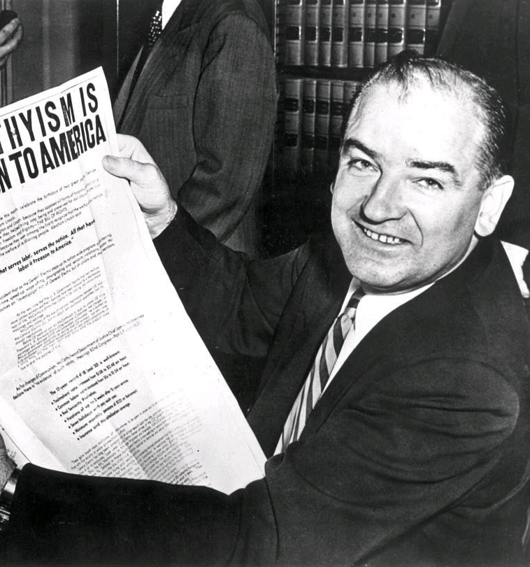
Mr. Hulyo
APUSH
Spring 2019

Slide 2
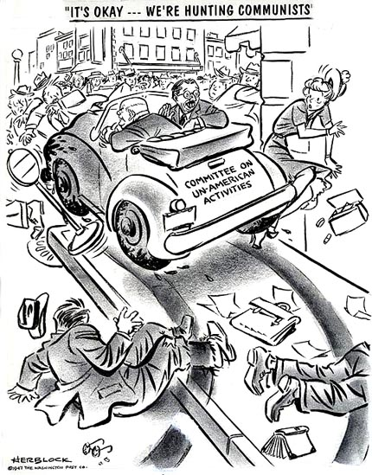
House of Un-American Activities Committee (HUAC)
Find and prosecute those participating activities which attacked “the form of government guaranteed by our constitution”
Areas of Concern
Government
Armed forces
Education
Newspapers
Unions
Science
Film

Slide 3
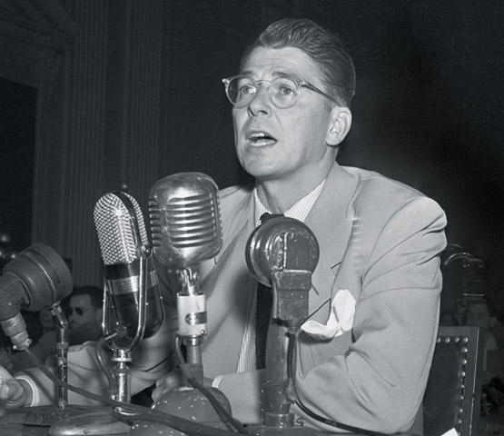
Hollywood Blacklisting - 1947
Many people in the industry had supported the communist party during the years of the Great Depression
HUAC called for the firing of these individuals.
Began forcing testimonies from prominent individuals in the industry
    Walt Disney – Provided a list of suspected commies
    Ronald Reagan – Claimed to not know any names.

Slide 4
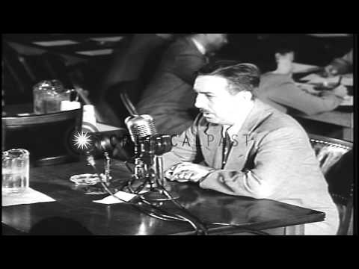

Slide 5
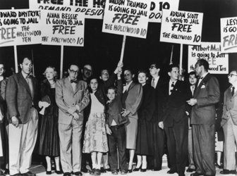
The Hollywood 10 - 1947
Most famous group who refused to testify
Charged with contempt of court
Sentenced 1 year in prison
*Over 300 people were blacklisted between 1947 and 1960

Slide 6
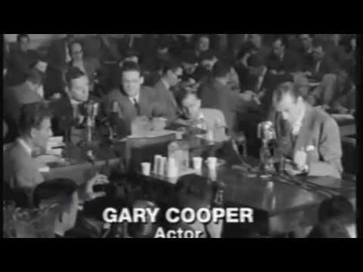

Slide 7
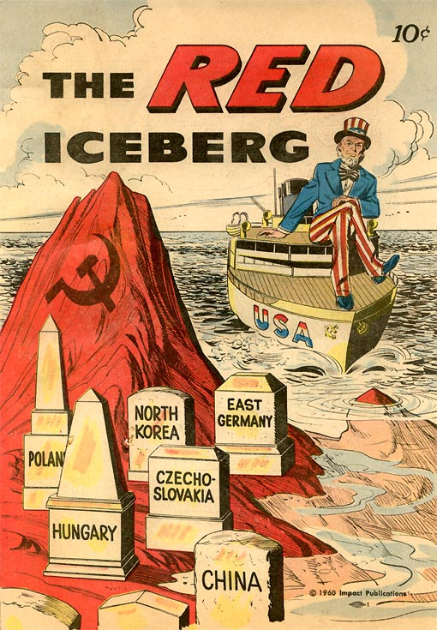
McCarran Internal Security Act 1950
A.k.a. Subversive Activities Control Act
All communist organization must register with the government and release all records of activity
Truman’s veto overruled by congress

Slide 8
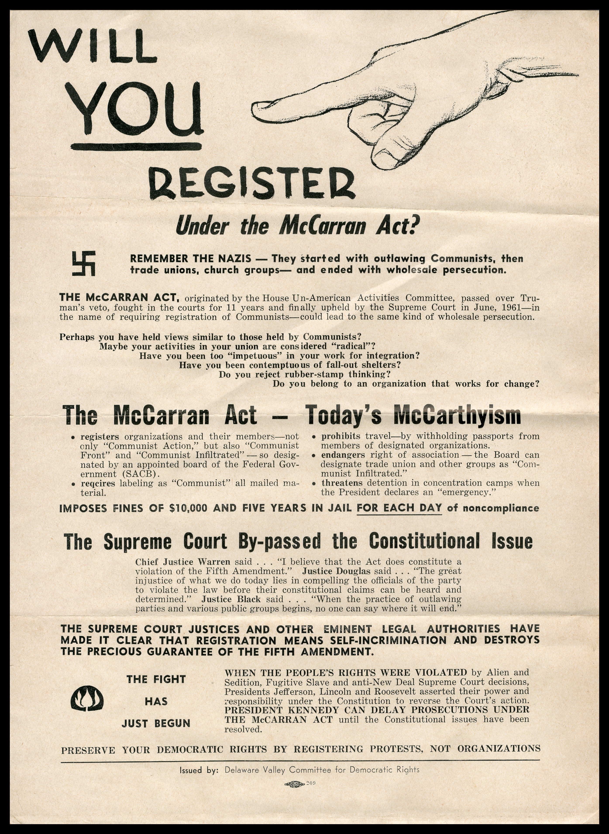

Slide 9
McCarran Internal Security Act
Gave the President the authority to apprehend and detain…
"each person as to whom there is a reasonable ground to believe that such person probably will engage in, or probably will conspire with others to engage in, acts of espionage or sabotage.”

Slide 10
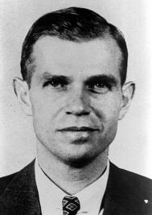
Alger Hiss
Liberal Democrat
Active member of FDR’s administration
Accused of stealing government documents for Soviets
Sentenced to prison for perjury
  Only served 3.5 years
Shows growing distrust of Liberal Democrats

Slide 11
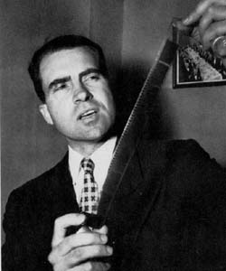
“Pumpkin Papers”
**Puts Richard Nixon on the map – he convinced HUAC to press the case and in 1952 he is Eisenhower’s running mate

Slide 12
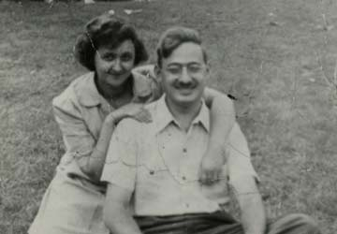
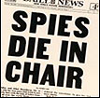
Ethel and Julius Rosenberg
Charged with passing secret information nuclear weapons to the Soviets
Pleading innocent, the Rosenberg’s said they were being targeted because they were Jewish and had unpopular political beliefs
They were executed in 1953.

Slide 13
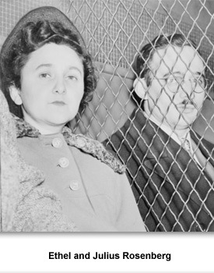
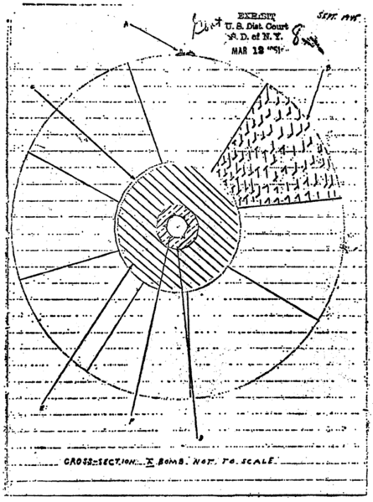
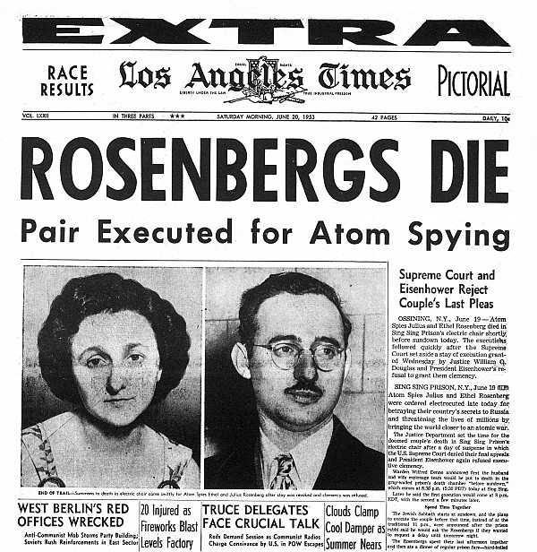

Slide 14
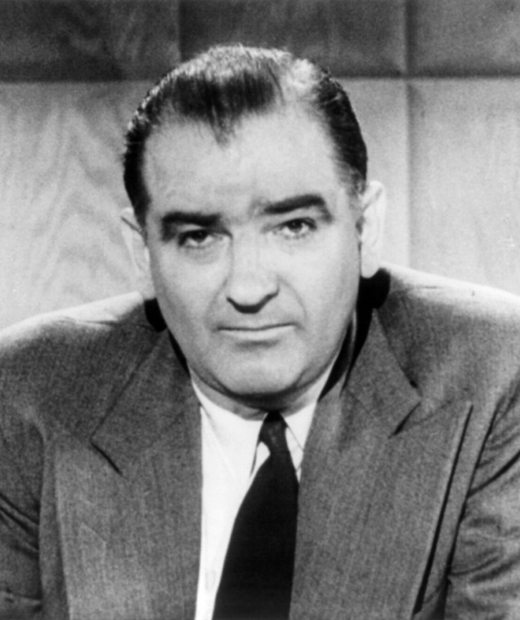
Joseph McCarthy
Known for his Communist “witch-hunts”
Republican senator who faced almost certain defeat in 1950 re-election
Used fear of communism as a way to promote his career
Claimed to have a list of 205 names that were Communist and still working for the government
Lost support during Army-McCarthy Hearings
“There is a conspiracy on a scale so immense as to dwarf any previous such venture in the history of man”

Slide 15

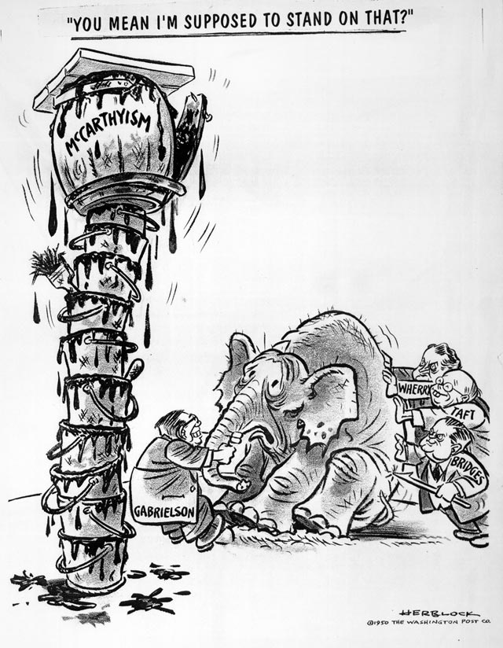

Slide 16
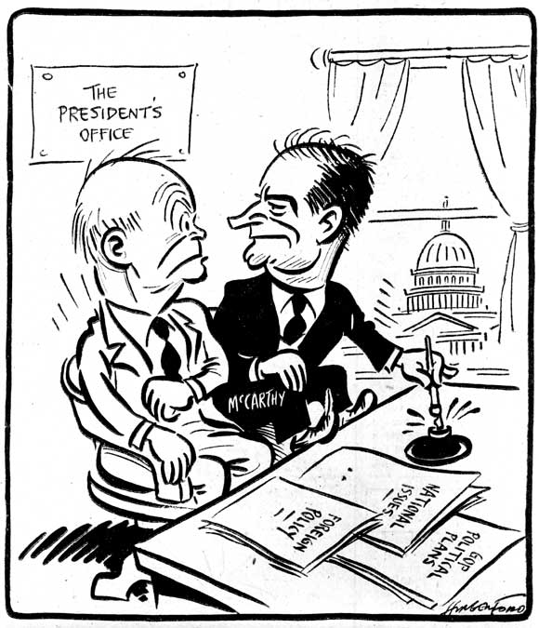

Slide 17
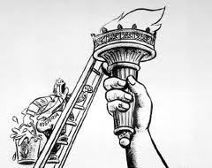

Slide 18
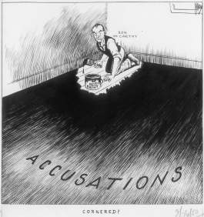

Slide 19
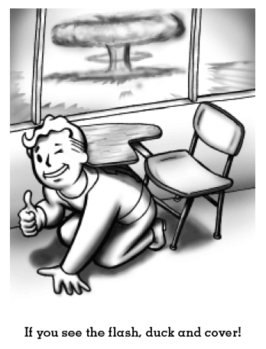
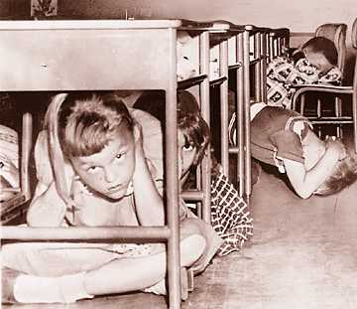
Life for the “Duck and Cover” Generation

Slide 20
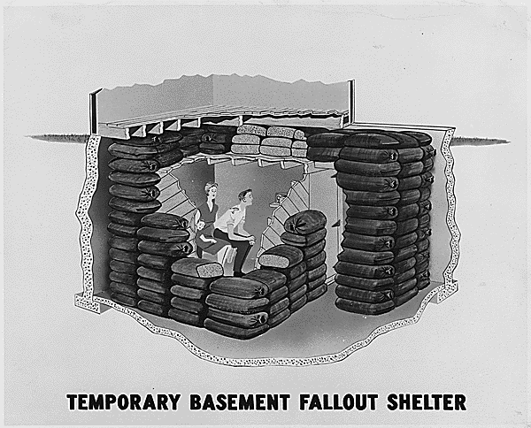

Slide 21
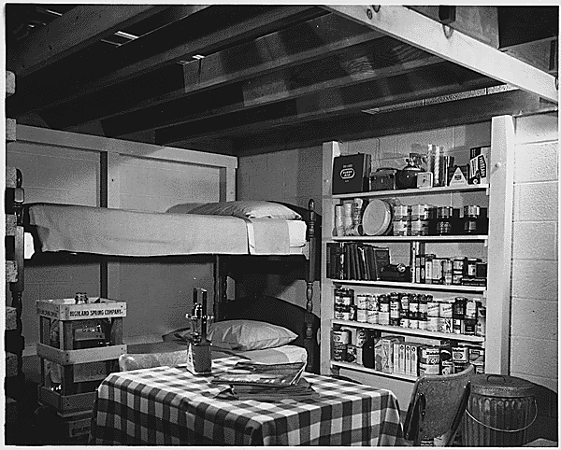

Slide 22
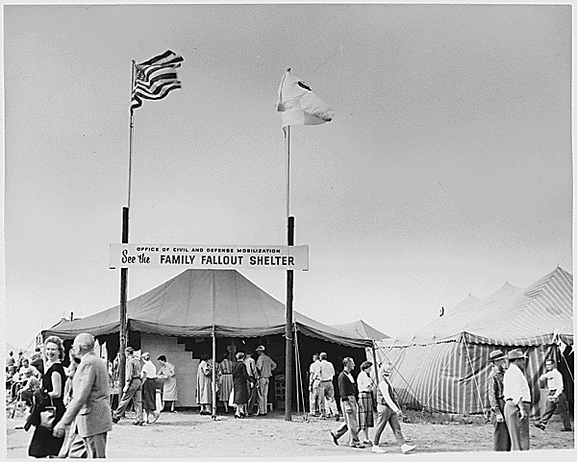

Slide 23
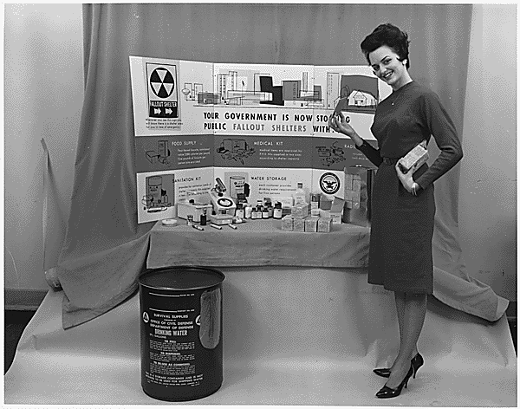

Slide 24
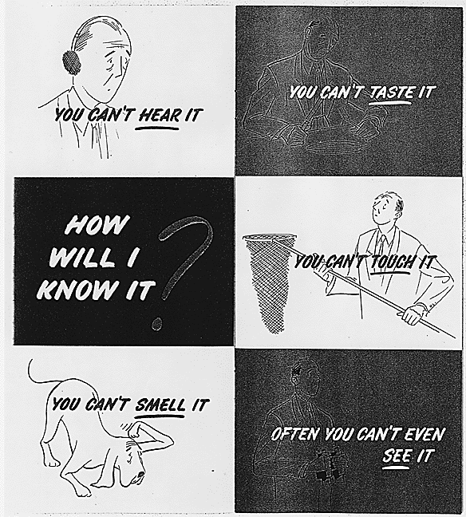

Slide 25
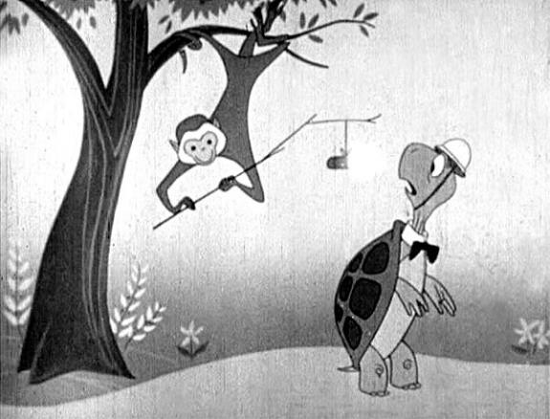
Meet Bert the Turtle

