Slide 1
THE CARDIAC CYCLE

Slide 2
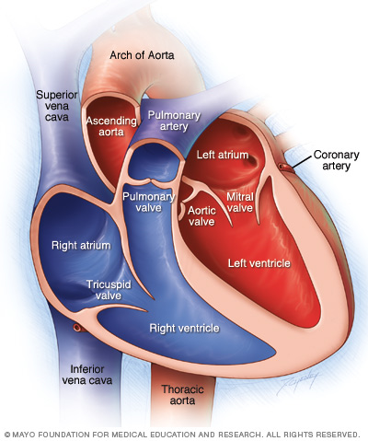
HEART
Can be considered a
4-chamber, double-pump system.
The L & R sides work in parallel simultaneously.
OXYGENATED BLOOD
DE-OXYGENATED BLOOD

Slide 3
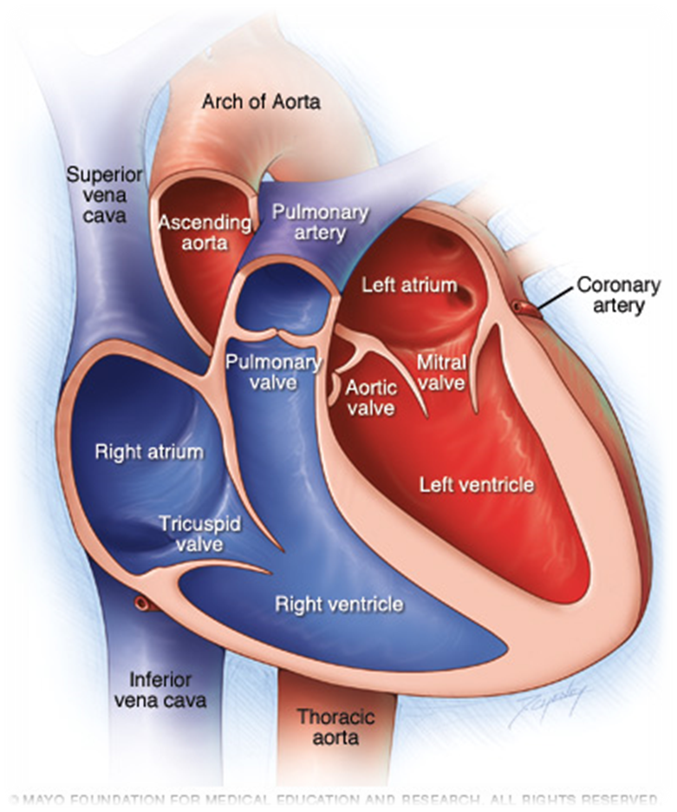
Blood Flow
Atrium receives blood
from a vein.
Pushes it into larger & thicker-walled ventricle.
Pushes blood out of the heart into an artery for transport away from the heart.

Slide 4
VALVES
-Located between chambers.
-Close and open by force in response to a highly coordinated sequence of muscle contractions.
-Ensure that the system operates in 1 direction.
-Enable heart muscle contraction to increase pressure in the chambers for ejection of blood.

Slide 5
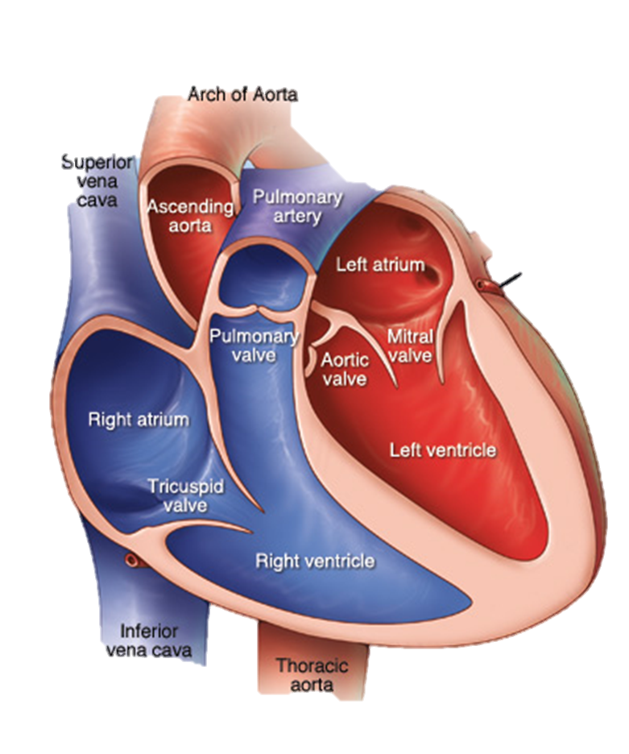
CONTRACTIONS
-Cardiac cycle doesn’t require a nerve stimulation.
-Heart makes itself contract. This is called;
MYOGENIC CONTRACTION
-Initiated from a specialized group of cells called PACEMAKER (sinoatrial node/ SAN) located in the wall of the R atrium.
-Pacemaker firing rate is heavily influenced by many factors.

Slide 6
PACEMAKER
-With direct hormonal (i.e. adrenaline) or manipulation of drugs.
PRIMARY
The INVOLUNTARY nervous system can speed it up or slow it down.
-Does this by adjusting the relative contributions from the sympathetic & parasympathetic branches.
-Trying to maintain homeostasis by or the release of neurotransmitters.

Slide 7
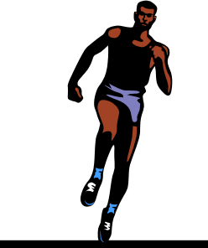
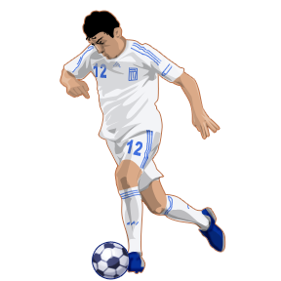
EXAMPLE:
EXERCISE BEGINS
PARASYMPATHETIC STIMULATION
(Keeps the HR low)
SYMPATHETIC STIMULATION
(Increasing the HR)

Slide 8
PACEMAKER
-Primary pacemaker (SAN) sends an impulse through the walls of the atriums to a secondary group of cells.
SECONDARY
Atrioventricular (AV) node
Rapid conduction of the impulse=
Atria muscle contraction=
Increase atria pressure=
Forcing blood from the atria.

Slide 9
PACEMAKER
-Following a brief delay, impulse is rapidly conducted via bundle of specialist cells called;
SECONDARY
BUNDLE OF HIS
These rapidly conduct the impulse along the Purkinje Fibers.
Spread impulse for the ventricles to push blood up and out.

Slide 11
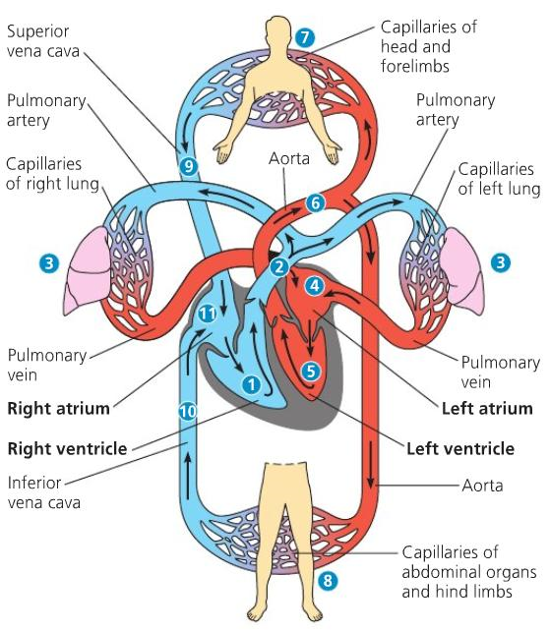

Slide 12
