Slide 1
The American Revolution and Beginning a New Nation
1775 - 1787
Due to continuous conflict over British treatment of the colonies, America entered into a revolution that would ultimately lead to the creation of a new, independent country.

Slide 2
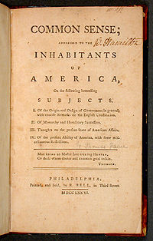
Goals of the War
2nd Cont. Congress meets shortly after war begins
  Disagree on goals
Some desire reunification with Britain
  Vote to send additional petitions to the King
Others desire Independence
  Common Sense
    Thomas Paine
    Argues against Brit system of Govt
  This idea wins out

Slide 3
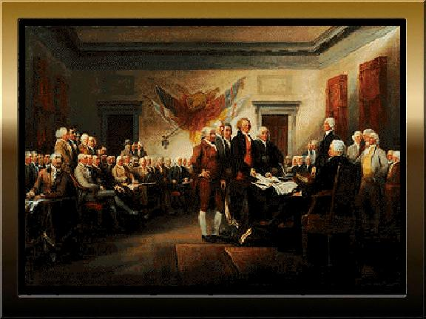
Documents Guide the Colonists
Declaration of Independence
  Drafted by Cont. Congress
  Life, Liberty, Pursuit of Happiness
Articles of Confederation
  Created in 1777 to unite colonies under decentralized Government

Slide 4
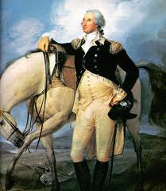
Mobilization
Funding
  No Taxes under A of C
  Print Currency
    Leads to Inflation
  Borrow most from other Countries
Continental Army
  Placed under G Washington
  Underfunded and undersupplied for much of the war

Slide 5
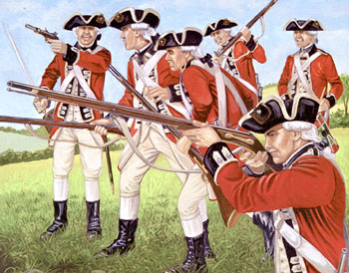
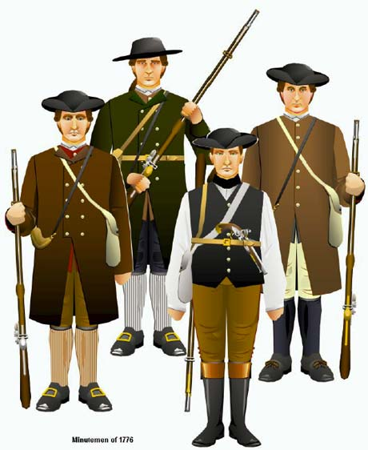
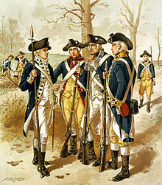
Advantages
British
Superior Navy
Well Structured
More Money
Better Equipment
Colonists
Knowledge of Land
More Committed
French Assistance
  Thanks to B Franklin

Slide 6
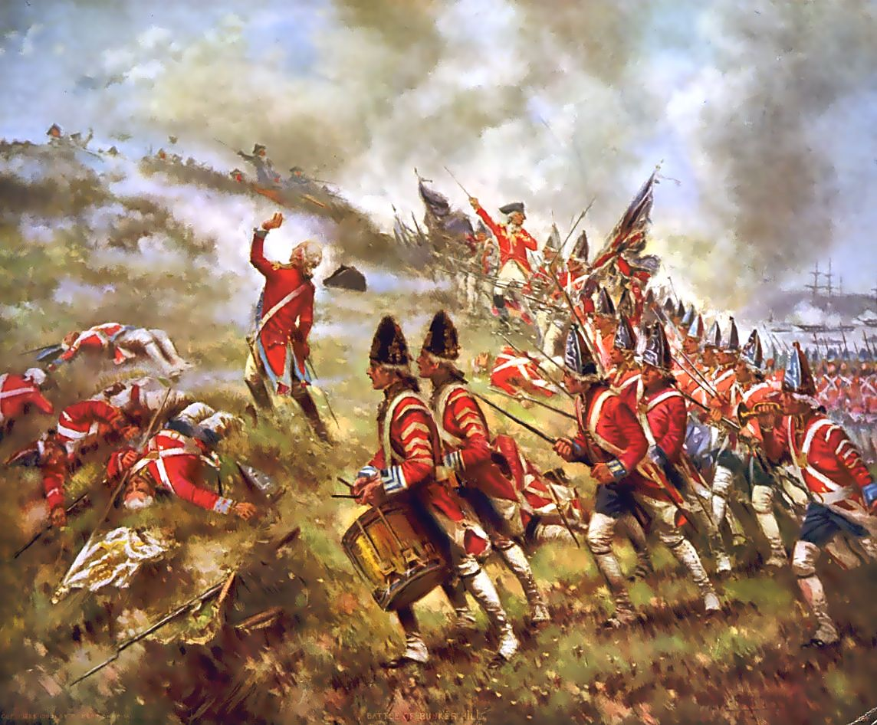
Major Battles – 1st Phase
Bunker Hill
  Brits win but suffer major losses
  Proves colonists can mount a legitimate defense against the Brits
Invasion of Canada

Slide 7
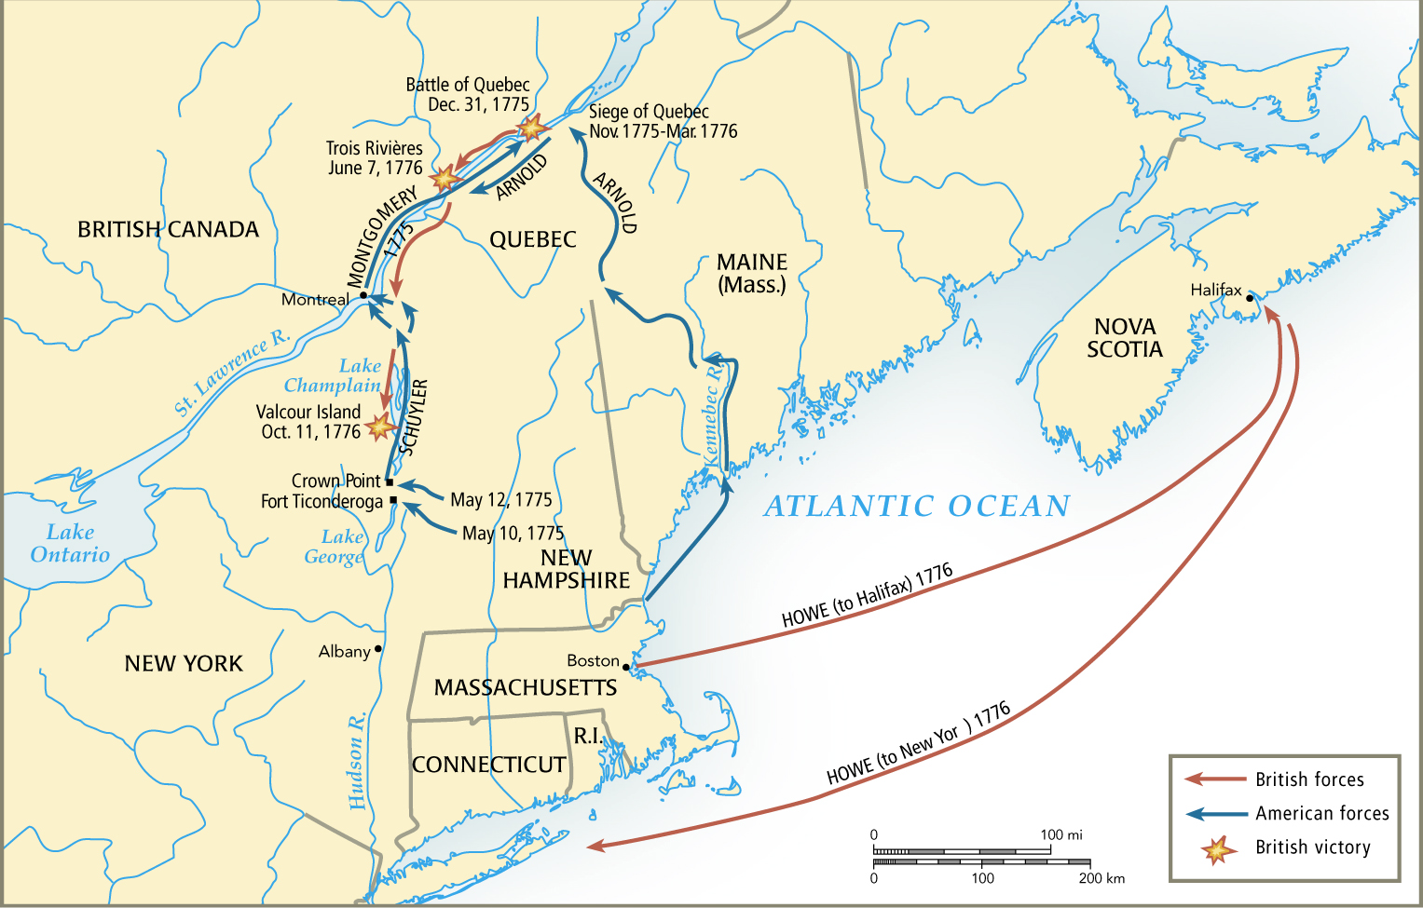
First Phase – New England/Canada

Slide 8
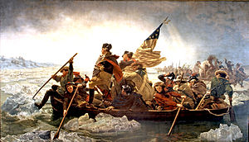
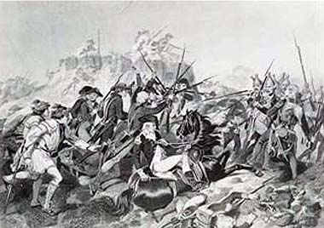
Major Battles – 2nd Phase
Trenton
  Washington surprises Hessian Mercenaries Near NYC after crossing the Delaware River at night
Saratoga - 1777
  Brits lose several small battles around G Lakes
  Convinces French to support/join the colonists

Slide 9
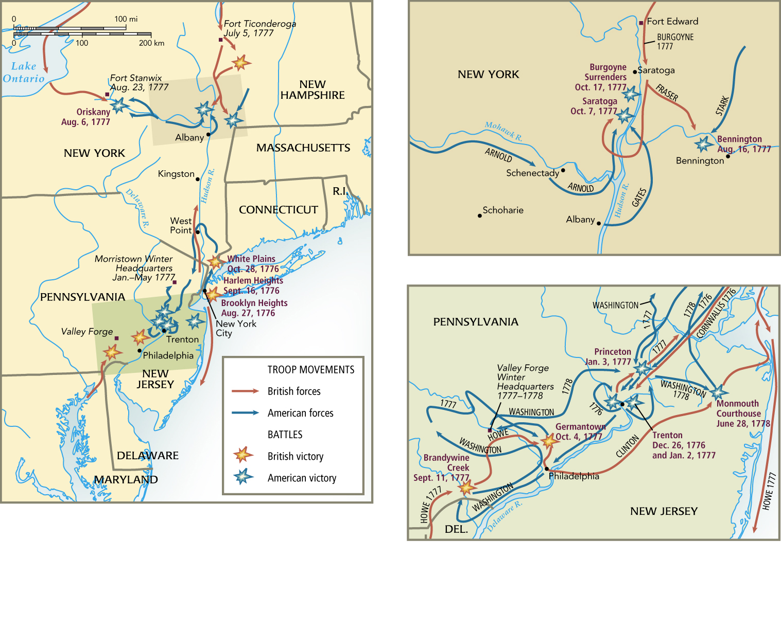
2nd Phase – Mid Atlantic

Slide 10
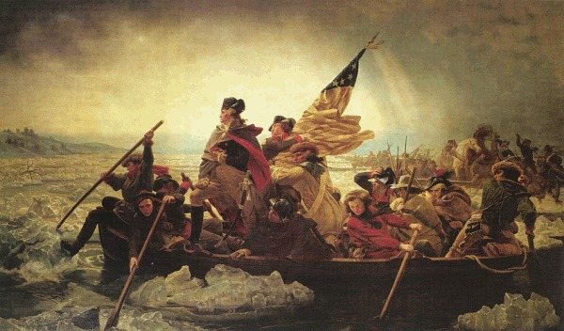

Slide 11
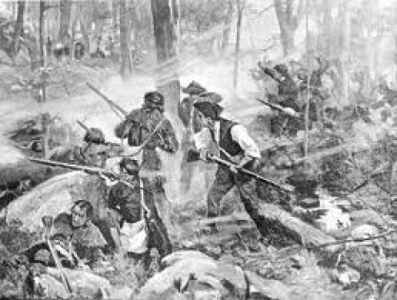
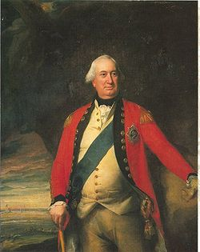
Phase 3 – Southern Colonies
Brits try their luck in the South
  Believe loyalists will be more abundant
Brit Victories
  Capture Savannah and Charleston
  Win Conventional battles
Colonist counter
  Guerilla Warfare
  Angry about loss of slaves
“Hornets Nest”
  Victories in NC force Cornwallis to retreat to VA

Slide 12
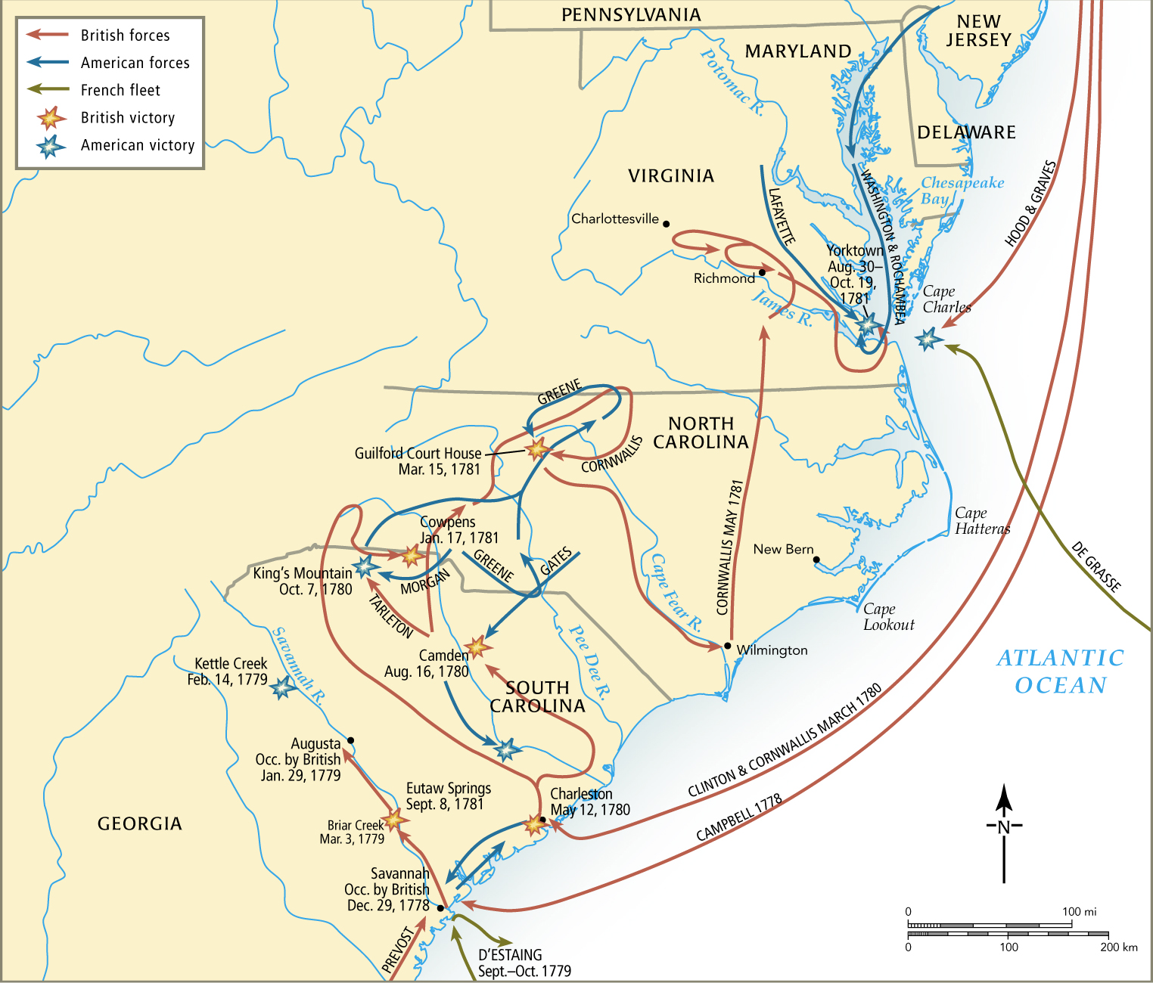
3rd Phase – South

Slide 13
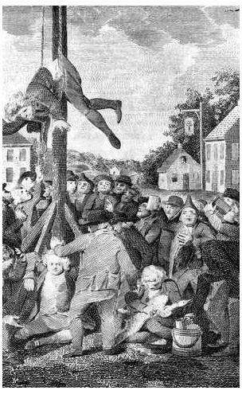

Slide 14
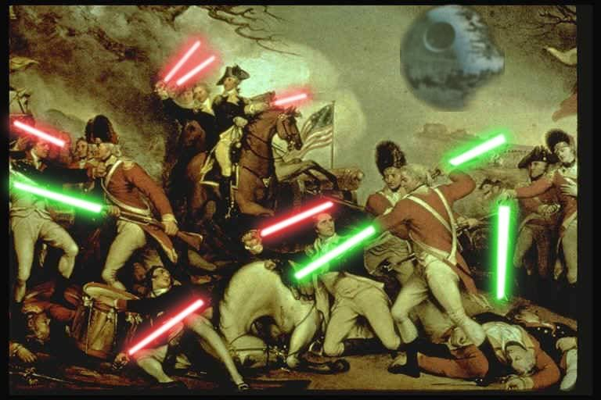

Slide 15
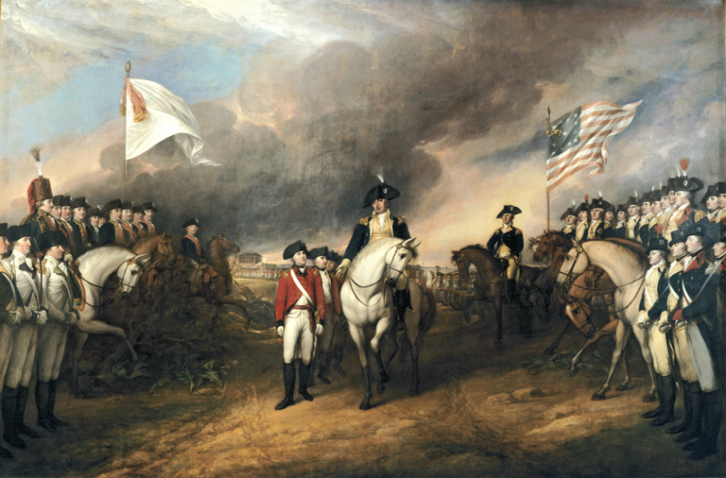
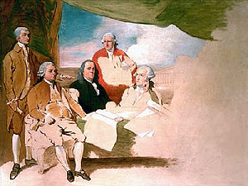
End of the War
Yorktown
  Cornwallis surrenders after surrounded by Colonists on land and French at sea
Treaty of Paris 1783
  Ben Franklin, John Adams, John Jay
  U.S. Gets colonies from Southern Canada to Northern Florida

Slide 17

Henry Laurens
William Temple Franklin

Slide 18
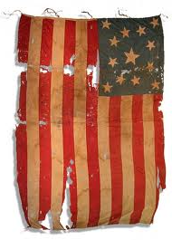
Treaty of Paris - 1783
Acknowledged Independence
1. Acknowledging the United States to be a free, sovereign and independent nation, and that the British Crown and all heirs and successors relinquish claims to the Government, property, and territorial rights of the same, and every part thereof;

Slide 19
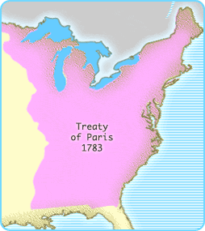
Treaty of Paris - 1783
Setting Boundaries
2. Establishing the boundaries between the United States and British North America;

Slide 20
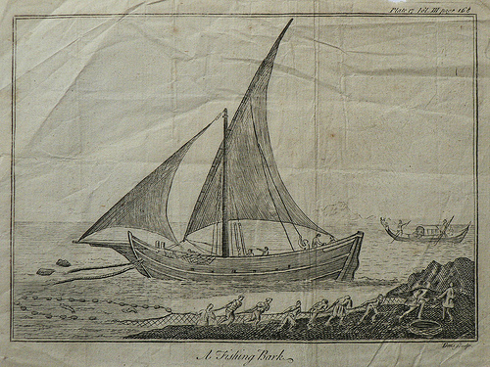
Treaty of Paris - 1783
Guaranteeing Fishing Rights
3. Granting fishing rights to United States fishermen in the Grand Banks, off the coast of Newfoundland and in the Gulf of Saint Lawrence;

Slide 21
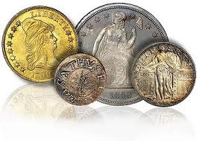
Treaty of Paris - 1783
Repayment of Debts
4. Recognizing the lawful contracted debts to be paid to creditors on either side;

Slide 22
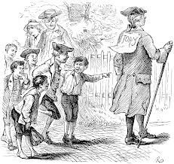
Treaty of Paris - 1783
Confiscated Land
5. The Congress of the Confederation will "earnestly recommend" to state legislatures to "provide for the restitution of all estates, rights, and properties, which have been confiscated belonging to real British subjects [Loyalists]";
6. United States will prevent future confiscations of the property of Loyalists
;

Slide 23
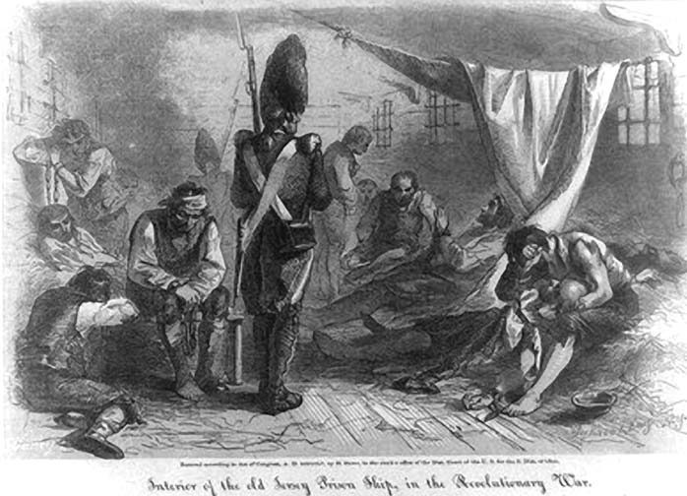
Treaty of Paris - 1783
Prisoners of war
7. Prisoners of war on both sides are to be released and all property left by the British army in the United States unmolested (including slaves);

Slide 24
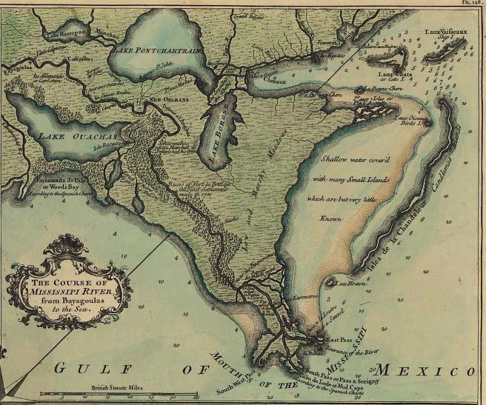
Treaty of Paris - 1783
Trading Rights
8. Great Britain and the United States were each to be given perpetual access to the Mississippi River;

Slide 25
Treaty of Paris - 1783
9. Territories captured by Americans subsequent to treaty will be returned without compensation;
10. Ratification of the treaty was to occur within six months from the signing by the contracting parties

Slide 26
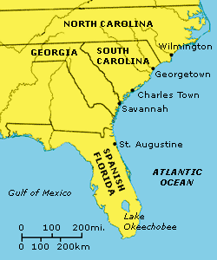
Later…
Spain received East and West Florida under the separate Anglo-Spanish peace agreement

Slide 27
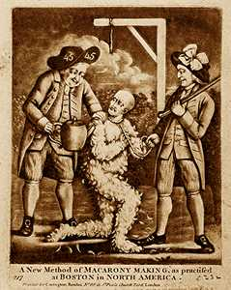
Effects on Society
Loyalists
  Up to 1/3rd of all whites
    Office holders
    Merchants
    Now what?
  Many leave the country
    Up to 100,000
  Those that stayed
    Often had land confiscated despite Treaty of Paris

Slide 28
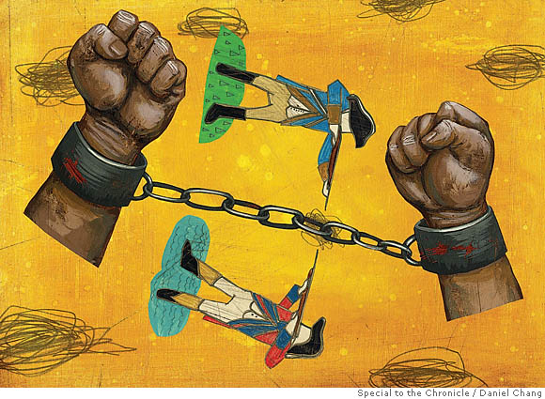
Effects on Society
Slavery
  South
    Many escape during war
    Up to 1/3 in SC
  North
    Many states end trade
    Penn. 1st to free slaves
  Brings about discussion/ argument
    Liberty vs. Slavery
    How can you have both?

Slide 29
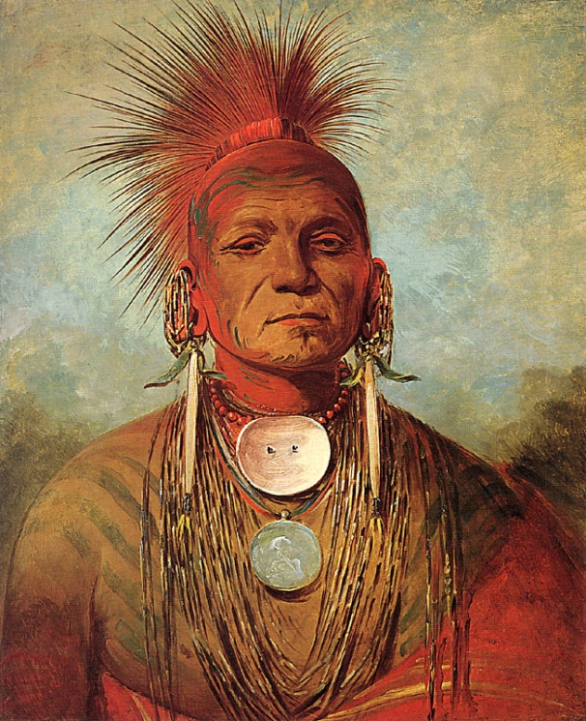
Effects on Society
Natives
  During the War
    Many side w/ Brits
  After war
    Seen as conquered people
    “Noble” Savages – T Jeff.
      Enemies in war, Partners in Peace

Slide 30
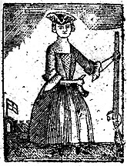
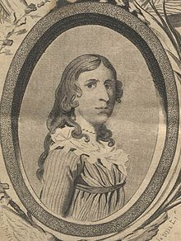
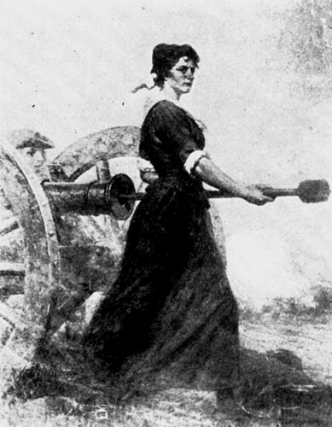
Effects on Society
Women Before War
  Lead protest before war
    Daughters of Liberty
Women During War
  “Camp followers” during war
  Deborah Sampson
    Pretended to be man
  Molly Pitcher
    Fought along side men

Slide 31
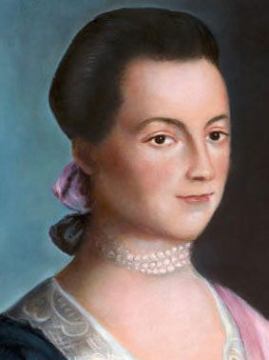

Effects on Society
Women After War
  Many argue for better rights
    Abigail Adams – Abuse
      “Remember the Ladies”
    Judith S. Murray Education
  If married, still could not...
    Own Land, Vote, Legally own Children, Divorce

Slide 32
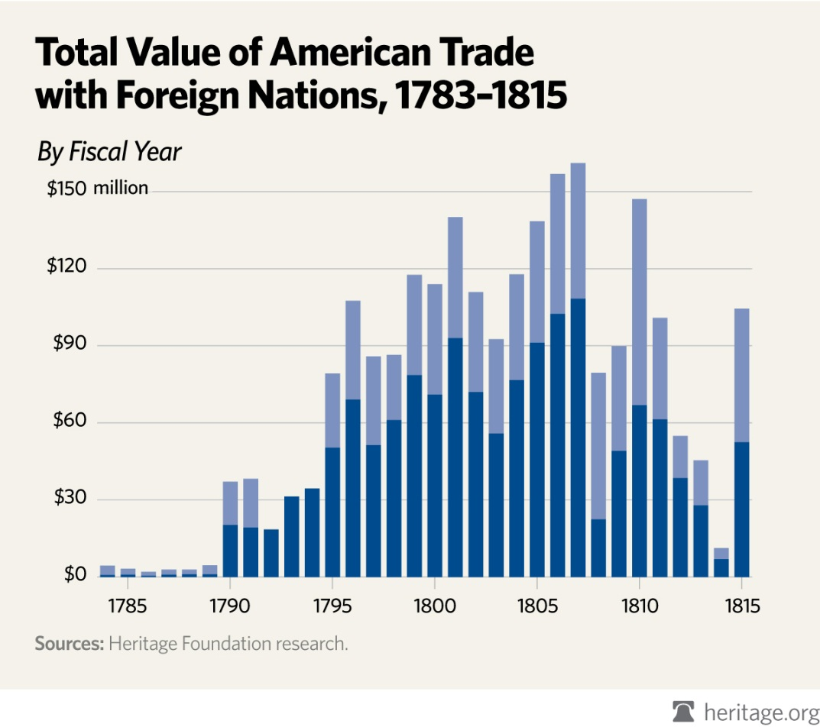
Effects on Society
Economy
  Colonies Forced to find new trade partners
  Asia, S. America, Caribbean, Interstate’

Slide 33
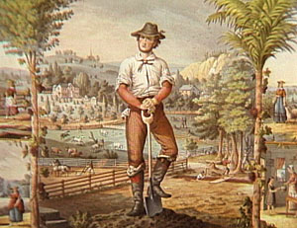
State Governments
Republicanism
  Power from the people
  Yeomen Farmer
    Small Land Owner
    Self Reliant
  NOT….
    Small Upper class with large dependent lower class
All “Created Equal”
  “Rhetoric” vs. “Reality”

Slide 34
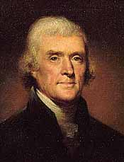
State Governments
Constitutions
  At first…
    Limit Executive power
    Separation of Exec. and Leg.
  Re thinking Republicanism
    Is too much democracy bad?
    Most states resort to Representative Legislation
    Many Renew Executive power
    Does the Government trust us?
Side Note:
Statute of Religious Freedom – Presented by T Jefferson to keep states from establishing “official churches” who would be granted special privileges (like C of Eng.)
“Separation of Church and State”

Slide 35
Slavery in the States
All but GA end foreign slave trade by the end of the war
In 1807
  ALL importation of slaves is banned
  *State to State trade maintained

Slide 36
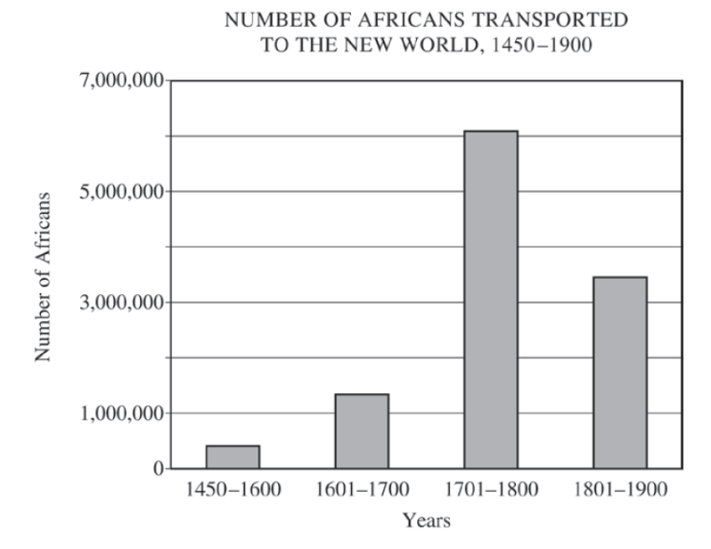

Slide 37
National Government
Articles of Confederation
Could…
  Declare war
  Make treaties
  Print/Borrow $
  Set up new settlements in the “West”
*Each state one vote
  9 vote minimum
  13 for amendments
Could Not…
  Regulate Trade
  Draft Army
  Impose Taxes/Laws

Slide 38
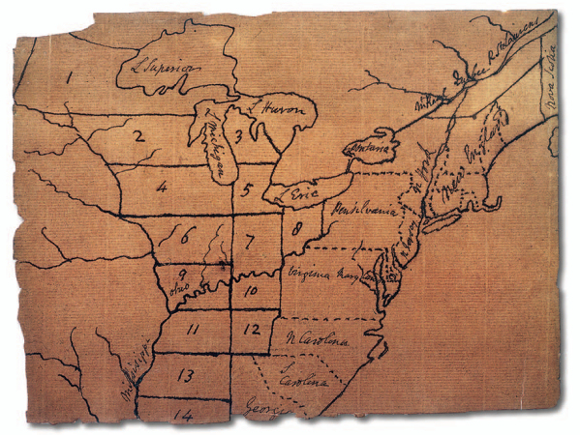
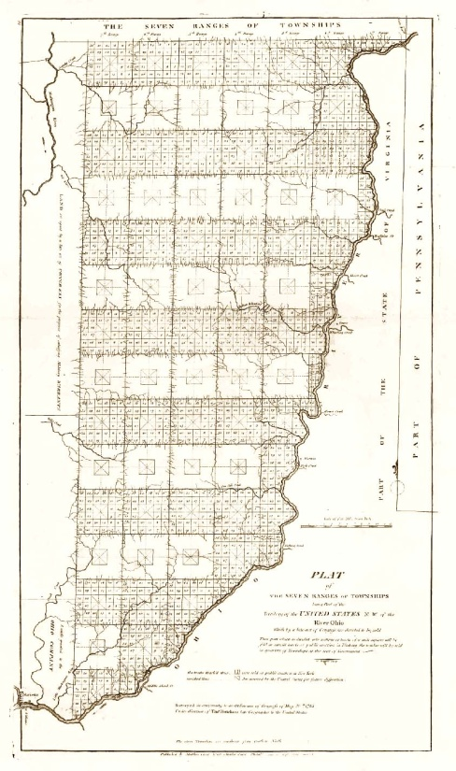
Northwest Territory
America now feels that this is their land to settle
  Ordinance of 1784
    Divided land into 10 sections
    Sets standards for statehoods
  Ordinance of 1785
    Establishes system for surveying/distributing land
    6 mile x 6 mile blocks = 36 total
    4 reserved for government
    Others sold
      Profit used to fund schools

Slide 39
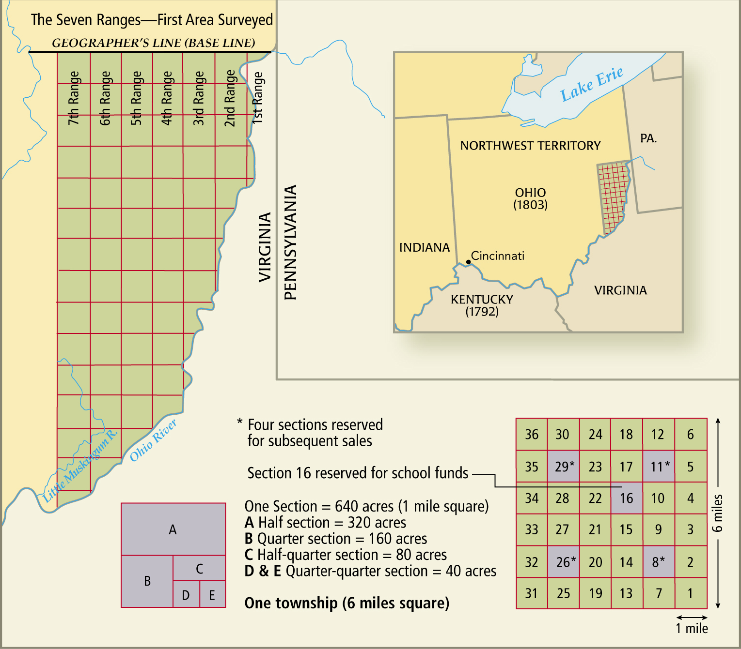

Slide 40
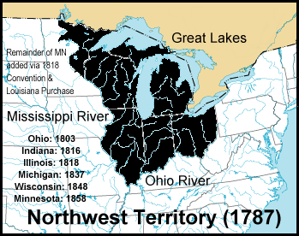
Northwest Territory - 1787
Northwest Ordinance
  Creates one big territory
  Chunks of 60,000 people would be granted statehood
  Guarantees..
    Freedom of speech
    Trial by Jury
    No Slavery
Ordinances Speed up Western Expansion
  What will this lead to?

Slide 41
Native American Resistance
1780’s – Congress “persuades” N.A. to sign away lands
  Many Natives refuse to acknowledge treaties
  Leads to Violence
Miami Confederacy
  Located in Ohio
  Refuse to leave
  Defeat colonists in several confrontations

Slide 42
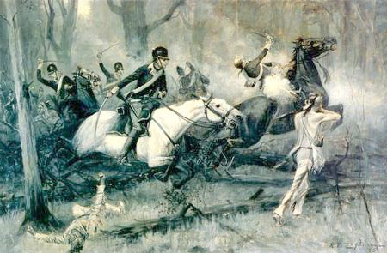
Native American Resistance
Battle of Fallen Timbers - 1794
  Mad Anthony Wayne defeats N.A.
  Final major confrontation in Ohio Valley region
Treaty of Greenville
  Fed govt pays natives for land
  First time Federal govt officially recognizes Natives

Slide 43
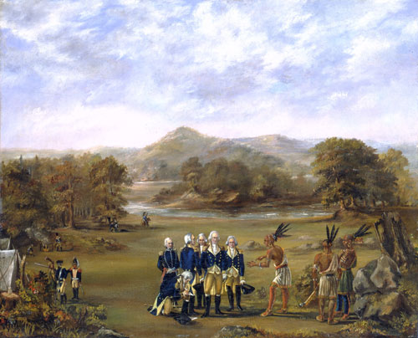

Slide 44
Postwar Depression 1784-1787
Result of Inflation and War Debt
  Govt owes…
    Private Lenders
    Foreign Nations
    Soldiers
  No Power to tax

Slide 45
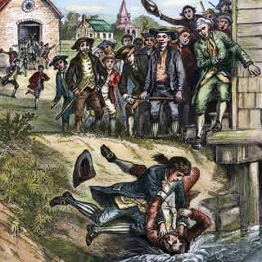
Postwar Depression 1784-1787
State Debts
  Individual States also in debt
  DO have ability to tax
  Taxes hit farmers the hardest
  Shays Rebellion
    Daniel Shay – Former soldier
    4000 people involved
    Demands…
      Paper $
      Lower Taxes
      Moratoriums on Taxes
      Release of imprisoned Debtors
    Failure but some concessions are made
      Shows need for stronger central govt

