Slide 1
“The key to success can be found underneath one’s alarm clock”
-Poor Richards Almanac

Slide 2
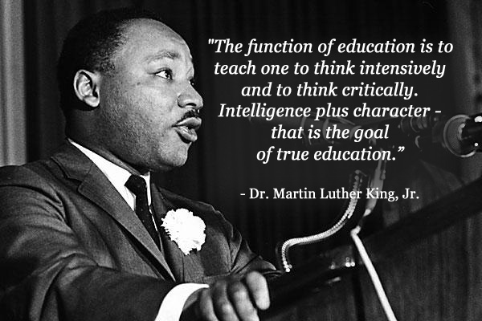

Slide 3
FIRST…..
Take 3 minutes and organize yourselves into groups of 2-3. Use the entire room.
Here comes your first grade of the semester!

Slide 4
PART 1:
WHAT IS HISTORY?
Discuss this question in your groups and be prepared to explain your thoughts. The more specific you can be, the better.
Create a group definition and write it down!

Slide 5
WHAT is History?
History is the interpretation and analysis of the human past
History is an umbrella term that relates to past events as well as the discovery, collection, organization, and presentation of information about these events

Slide 6
PART 2:
WHY IS HISTORY IMPORTANT?
Discuss this question in your groups and be prepared to explain your thoughts. The more specific you can be, the better.
Create a group answer and write it down!

Slide 7
WHY is History Important?
Understanding the past helps us understand the present. Analyzing the past can drastically alter your perception of the world around you. Historical knowledge is a pre-requisite.
Those who don’t know history are doomed to repeat it.
Studying history is the key to developing authentic, educated opinions about society, politics, economics, etc.
Gives us insight into the immense complexity of our world.

Slide 8
WHY is History Important? -Continued
History teaches us lifelong lessons and wisdom
History fulfills our desire to know and understand ourselves and our ancestors. Gives us identity. Gives our country identity
History is fun, fascinating and stimulates the mind. Makes you a better reader, critical thinker and skeptic.
I am not the one with the important lessons. I am simply the middle man between you and the important people and events that have shaped our world

Slide 9
Concept Group Work
Part 3:
Define the "American Dream"?
What is it about America that draws immigrants to our country and keeps those citizens here from wanting to leave?
Provide 1-2 paragraphs

Slide 10
Get Back into yesterday’s groups ASAP!!!

Slide 11
Part 4
In groups of 4-5, come up with a group definition of the following concepts: 1.Equality, 2.Rights, 3.Liberty, 4.Opportunity and 5.Democracy. Groups will discuss findings with class.

Slide 12
Part 5
Next, in groups, determine the concept that is most essential to the American Dream and the least essential. You must explain why!!!!

Slide 13
DEBRIEF

Slide 14
Part 6 - Short Response
In a minimum of ½ page, construct a written response in your own words re-answering the essential question of the day (What is the American Dream?) Use as many of the 5 concepts in your response as possible.
Before you begin, lets discuss what I call “Short Essay Format”
Minimum ½ Page
No Numbering

