Slide 1
Temperature and Stars
6th Grade PBL: Colonizing a Planet

Slide 2
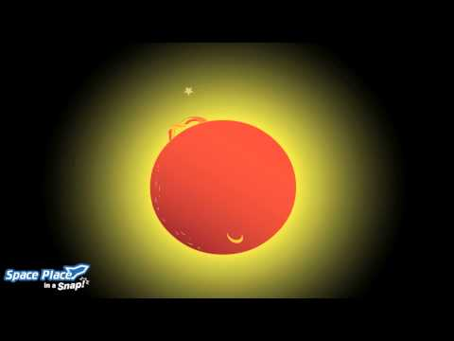
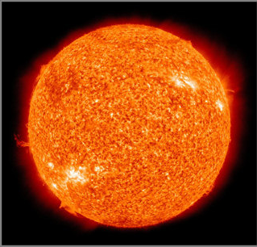
Temperature:
Where does Heat come from?

Slide 3
Different Kinds of Stars
Category | Light Color | Temperature | Mass (The Sun=1) | Luminosity (brightness) (The Sun=1)
O | Blue | Over 25,000 K | 60 | 1,400,000
B | Blue | 11,000-25,000 K | 18 | 20,000
A | Blue | 7,500-11,000 K | 3.2 | 80
F | Blue-White | 6,000-7,500 K | 1.7 | 6
G | White-Yellow | 5,000-6,000 K | 1.1 | 1.2
K | Orange-Red | 3,500-5,00 K | 0.8 | 0.4
M | Red | Under 3,500 K | 0.3 | 0.04 (very faint)

Slide 4
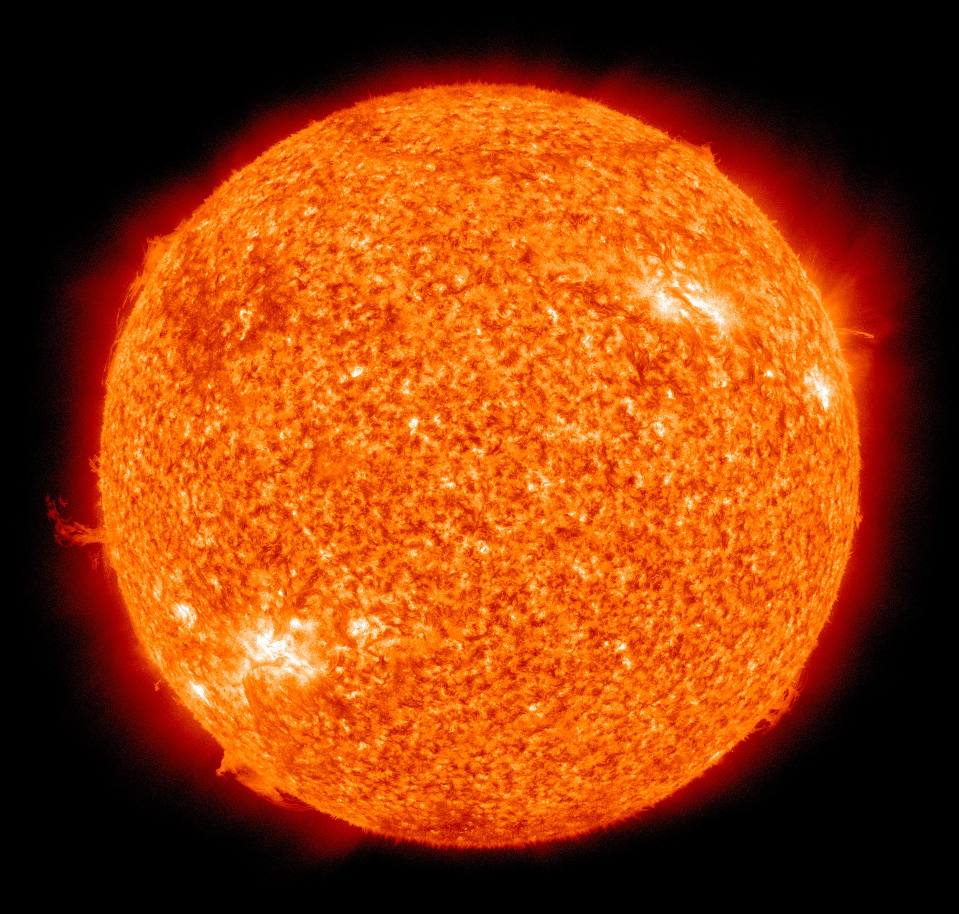
Facts about our sun
Our sun is a G2V star. This means that the light it gives off look yellow or white . It’s average surface temperature is about 5,800 K. The sun is a yellow dwarf star meaning it is in a very stable stage of its life, which lasts about 5 billion years.

Slide 5
What does this mean for your colony?
Use the chart on the next page to figure out what the temperature is for your planet and what your star is like for your planet.
Fill in the information on your Note-taking Sheet.

Slide 6
Planet | Temperature
Mercury | -274° F to +752° F
Venus | 896° F
Mars | -225° F to 62.6° F
Jupiter | -234.4° F
Saturn | -288.4° F
Uranus | -360.4° F
Neptune | -562° F
Titan | -390° F
Europa | -210° F to -370° F
TRAPPIST-1f | -40° F to 100° F
Proxima Cen b | Average 85° F
Kepler-22b | Average 60° F
Remember:
Earth’s Average Temperature:
-126 to 136°F
Boiling Point: 212°F
Freezing Point: 32°F

Slide 7
The Stars of your Colony
Conditions | Our Sun | TRAPPIST | Proxima Cen | Kepler
Type of Star | Yellow Dwarf | M | M | G
Distance from Earth (1 light year = 5,878,499,810,000 miles) | 92.96 million miles | 39 light years | 4 light years | 620 Light years
Magnitude (brightness) Lower the number, the brighter it is | 3.83 | 18.8 | 11.11 | 11.664
Mass | 4.835 x 10³⁰ lbs | 0.08 Suns | 0.12 Suns | 0.97 Suns
Part of Milky Way | Orion’s Spur part of Sagittarius | Aquarius | Centaurus | Cygnus

Slide 8
How would the star and the planet’s temperature affect living there?
How does the temperature compare to Earth’s temperature?
Is your colony’s star similar or different than our sun? How so?
What affect does this have on us if we colonize there?
  Would we have liquid water?
  What affect would the temperature have on people’s bodies? Would you get hypothermia?
  What color would our light be? Would the star be as bright as ours?

Slide 9
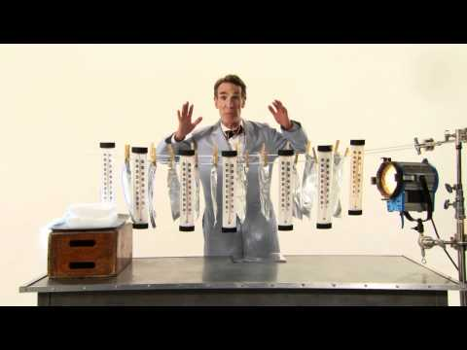
How could we fix this?
As a team, brainstorm ways that you could address the problems that the temperature of your planet creates.
Use the following to help you:
Staying Cool on the International Space Station
NASA’s Icy Concept for Living on the Red Planet

