Slide 1

17-4/17-5
Taft
&
Wilson

Slide 2
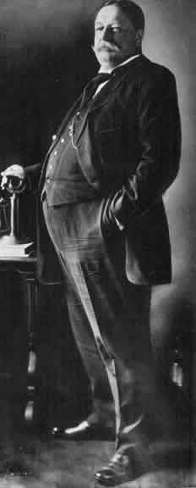
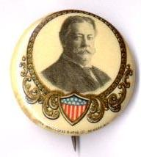
The Republican Party
&
President
William H. Taft

Slide 3
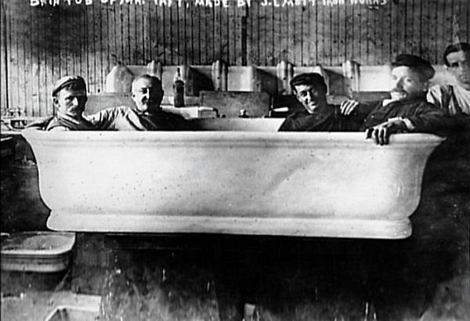
President Taft
Won election against William Jennings Bryan in 1908
  “Vote for Taft this time, You can vote for Bryan any time”
Supported by Theodore Roosevelt
  Taft was TR’s Secretary of State
Taft never really feels like the President.
  Felt that he was always being compared to T.R.
Taft
Notes:
Bryan ran for a 3rd time and Slogan: “Vote for Taft this time, you can vote for Bryan anytime!”
Overshadowed by Roosevelt. When I am addressed as Mr. President I turn to see whether you are not at my elbow!”
Payne Bill in the House wanted to lower rates on imported goods and the Aldrich Bill in the Senate made few cuts and increased rates failed to reduce tariffs significantly
He was a wealthy lawyer from Seattle

Slide 4
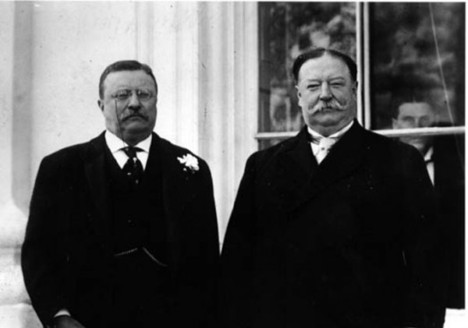

Slide 5
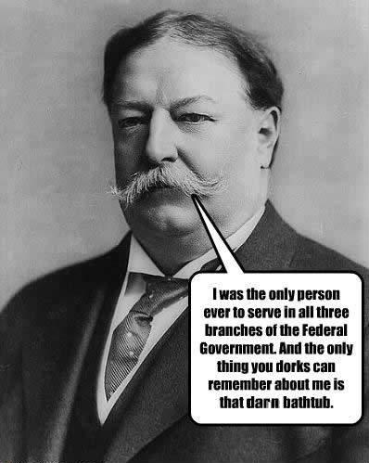
No Respect
Breaks up 90 trusts
  Both “Good” and “Bad”
Payne Aldrich Tariff
  Taft had promised to lower tariffs
  This tariff actually raised tariffs
  Angers “Progressives”
Conservation
  Taft’s Sec. of the Interior disagreed with Teddy’s conservation ideas.
  Fires Gifford Pinchot
    T.R.’s chosen president of U.S. Forest Service

Slide 6
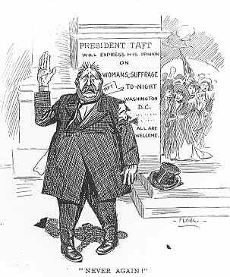
Never Again!
Taft Abandons Support for Women’s Suffrage

Slide 7
1912
Election

Slide 8
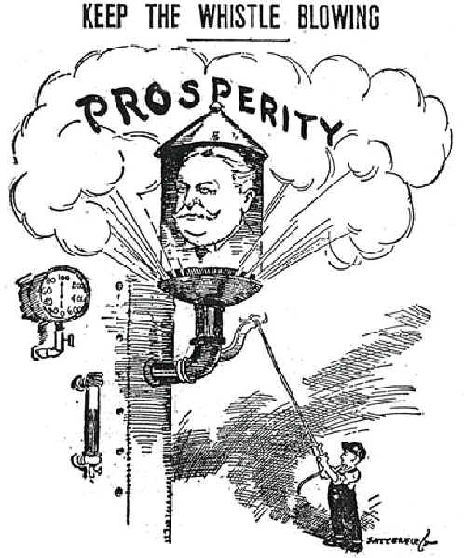
Keep
the
Whistle
Blowing
Taft was determined to prevent TR from winning and preserve the Republican Party.

Slide 9
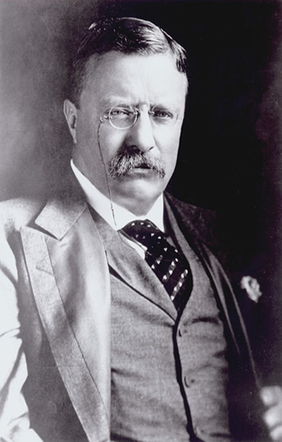

The Progressive Party &
Former President
Theodore
Roosevelt
People should rise
above their sectarian
interests to promote the general good.

Slide 10
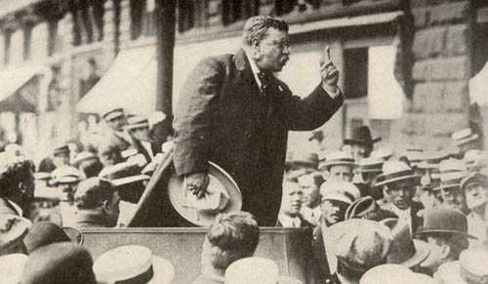
Theodore Roosevelt at
Osawatomie, KS: New Nationalism
Big business requires big government.

Slide 11
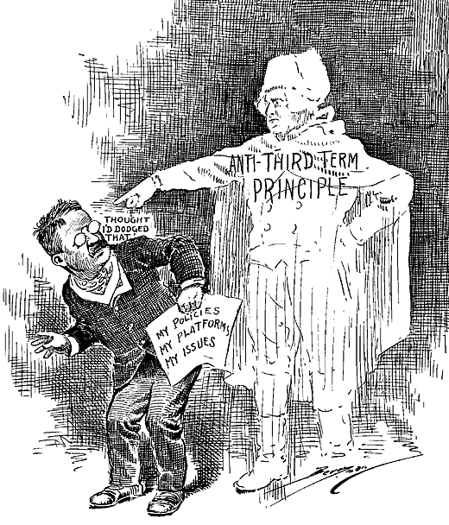
The
Anti-
Third-Term
Principle

Slide 12
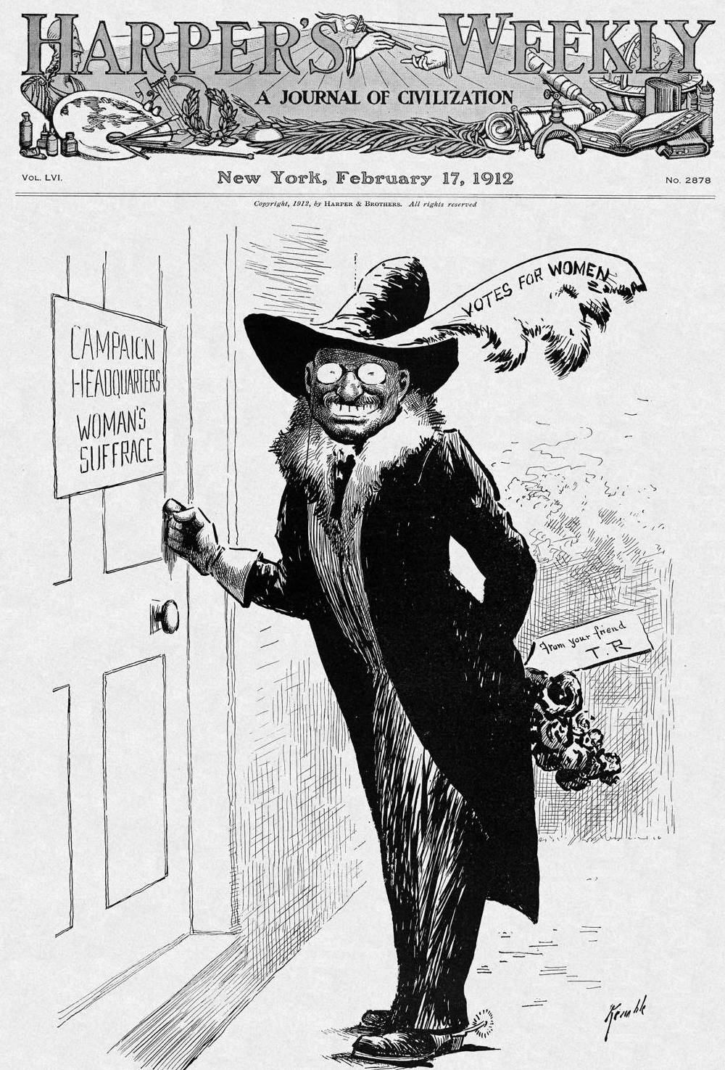
TR
&
Women’s
Suffrage:
The Militant Recruit

Slide 13
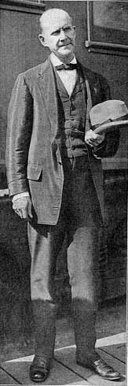
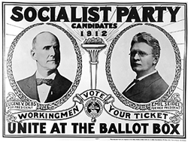
The Socialist Party
& Eugene V. Debs
The issue is Socialism versus Capitalism. I am for Socialism because I am for humanity.

Slide 14
Growth of the Socialist Vote
Year | Socialist Party | Socialist Labor Party | Total
1888 |  | 2,068 | 2,068
1890 |  | 13,704 | 13,704
1892 |  | 21,512 | 21,512
1894 |  | 30,020 | 30,020
1896 |  | 36,275 | 36,274
1898 |  | 82,204 | 82,204
1900 | 96,931 | 33,405 | 130,336
1902 | 223,494 | 53,763 | 277,257
1904 | 408,230 | 33,546 | 441,776
1906 | 331,043 | 20,265 | 351,308
1908 | 424,488 | 14,021 | 438,509
1910 | 607,674 | 34,115 | 641,789
1912 |  |  | 901,873

Slide 15
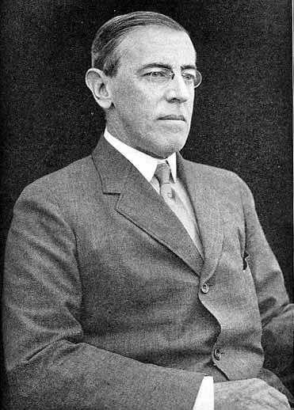
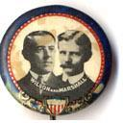

The Democratic Party &
Governor Woodrow Wilson (NJ)
Could he rescue the Democratic Party from “Bryanism”??

Slide 16
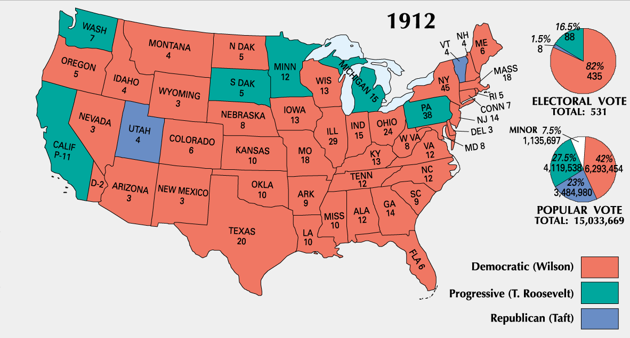
Election Results
By 1912, 100,000 fewer people had voted for Wilson than had voted for Bryan in 1908.
The 1912 election marked the end of the Socialist movement in America.

Slide 17
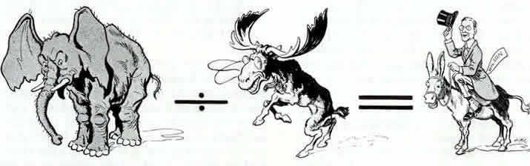
GOP Divided by Bull Moose
Equals Democratic Victory!

Slide 18
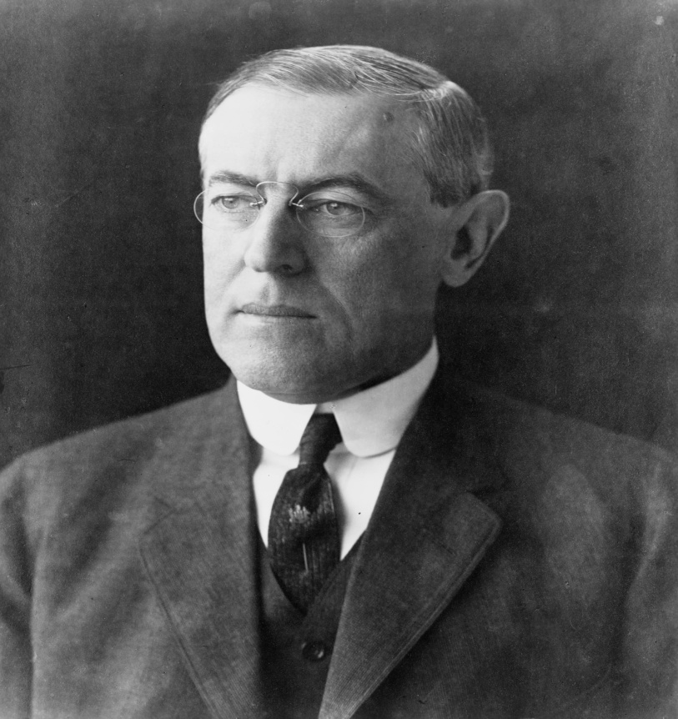
Democrats Take The White House
NJ Gov. Woodrow Wilson elected President
New Freedom Platform

Slide 19
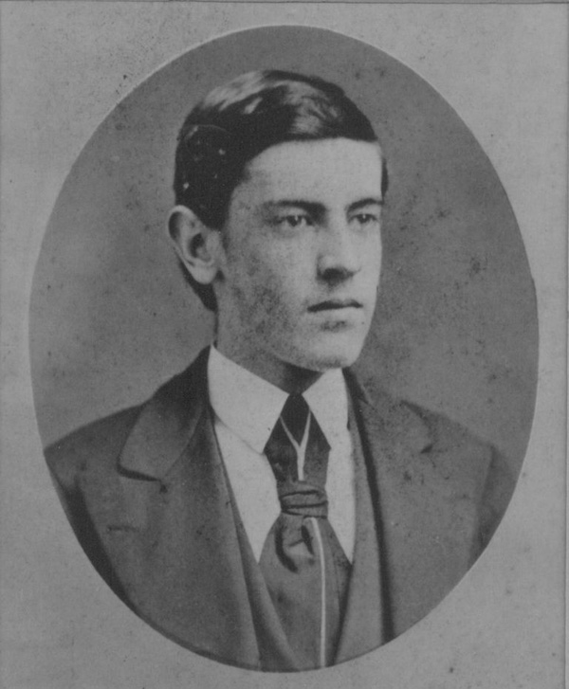
Background
Grew up in the South during Civil War and Reconstruction
Family of Ministers
Lawyer
President of Princeton

Slide 20
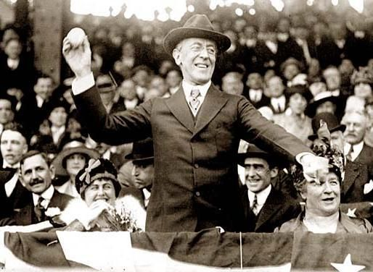
Clayton Anti-Trust Act of 1914
Prevents companies from forming monopolies
Protects Labor Unions
  No longer subject to Anti-Trust laws
  Samuel Gompers (AFL) calls it the Magna Carta for labor

Slide 21
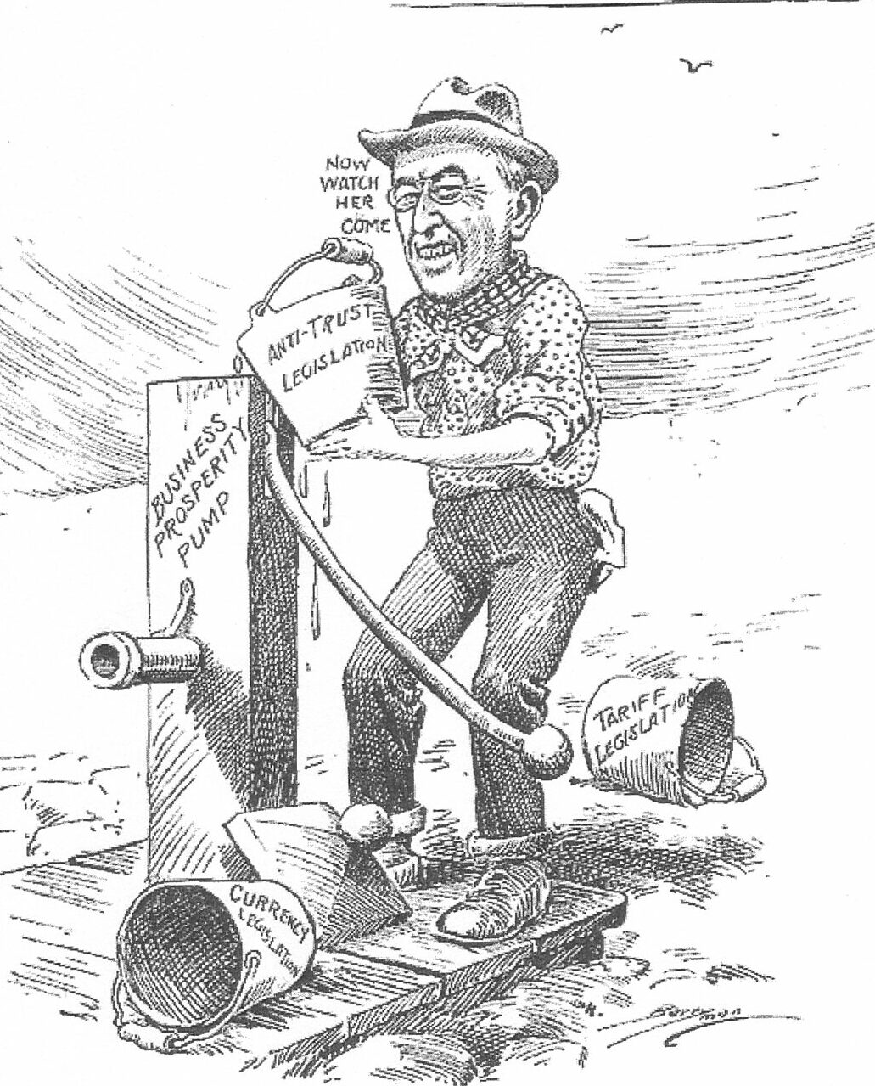
Clayton Anti-Trust Act of 1914

Slide 22
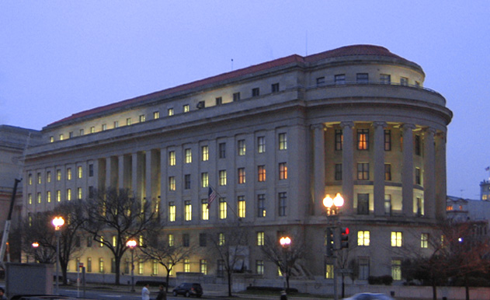
The Federal Trade Commission 1914
Enforce Anti Trust Laws
  Investigate corporations/unfair business practices
  Prevent Monopolies from forming
  Required periodic reports from corporations

Slide 23
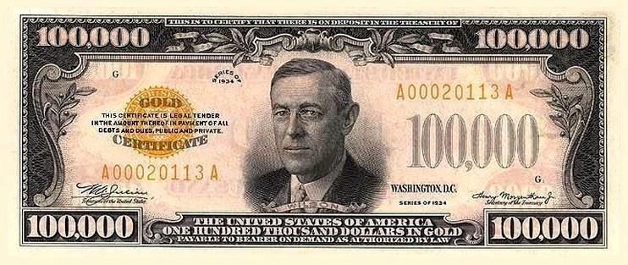
The Underwood Act of 1913
Greatly reduced tariffs
The Sixteenth Amendment
    Creates a Graduated Income Tax
    Replaces money lost from tariffs

Slide 24
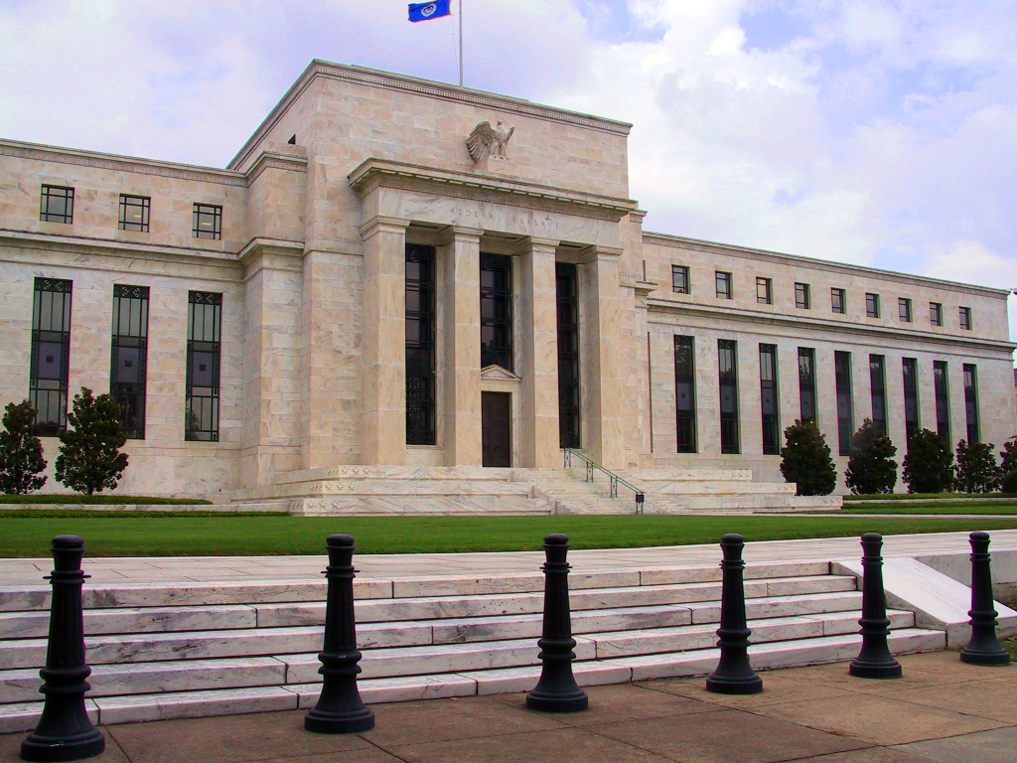
The Federal Reserve System (1913)
Transfers money to banks in trouble
Regulates amount of money in circulation
Hoped to avoid “Panics” which had occurred throughout the 1800’s

Slide 25
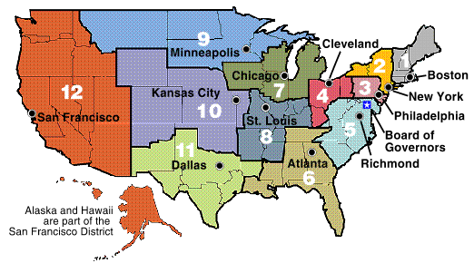
The Federal Reserve System (1913)

Slide 26
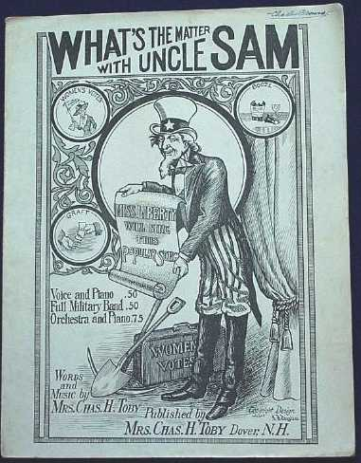
The Women’s Struggle
By 1910, only 5 states allowed women to vote
Boston groups organized door to door campaign
National Women’s Party created (Radical)
→ picketed the White House

Slide 27
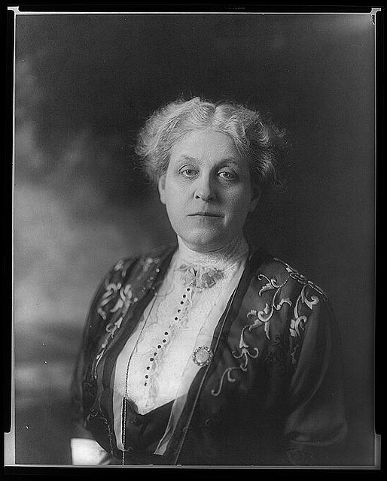
Success to Women’s Suffrage
Active local & grass root groups
New strategies to build enthusiasm
National Movement under Carrie Chapman Catt
19th Amendment finally passed in 1920

Slide 28
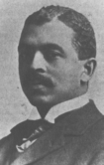
President Wilson’s Broken Promises
Opposed federal anti-lynching legislation
Appointed segregationists to his Cabinet
Failed to oppose resegregation of federal offices
Delegation of African-
Americans told Wilson he
betrayed them (11/12/1914)
→ William M. Trotter

Slide 29
Wilson
Presidents

Slide 30
BIBLIOGRAPHY
“1912—Competing Visions for America.”
Ohio State University.
http://history.osu.edu/projects/1912/
HarpWeek/Elections. “Election of 1912.”
http://www.elections.harpweek.co
Susan M. Pojer – Horace Greely HS, NY
Chris Balga – Hickory Ridge HS, NC

