Slide 1
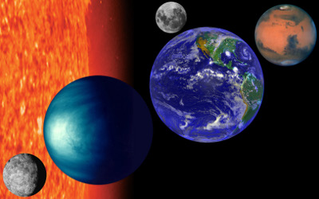
INNER PLANETS
NOTES

Slide 2
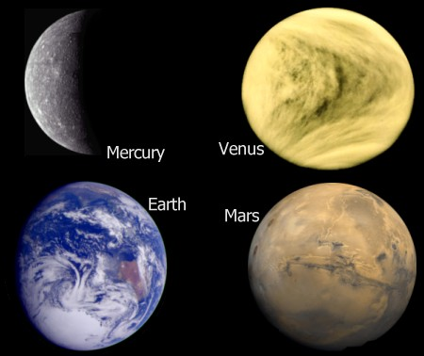
INNER PLANETS:
Also called Terrestrial Planets.
Smaller, denser, and rockier than the Outer Planets.

Slide 3
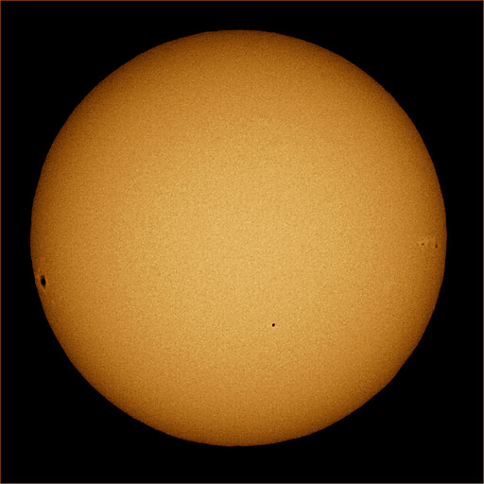

MERCURY:
Terrestrial Planet
Distance From Sun: 57.9 million km
Diameter : 4,878 km
Surface Temperature: 698 ° F
Length of Day: 58.65 Days
Length of Year: 87.97 Days
Number of Moons: 0
Symbol :

Slide 4
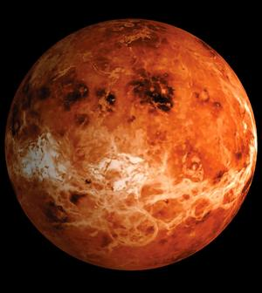

VENUS:
Terrestrial Planet
Distance From Sun: 108.2 million km
Diameter : 12,104 km
Surface Temperature : 900° F
Length of Day : 243 Days
Length of Year : 224.7 Days
Number of Moons : 0
Symbol :
Earth’s Twin
Retrograde Rotation (Clockwise)

Slide 5
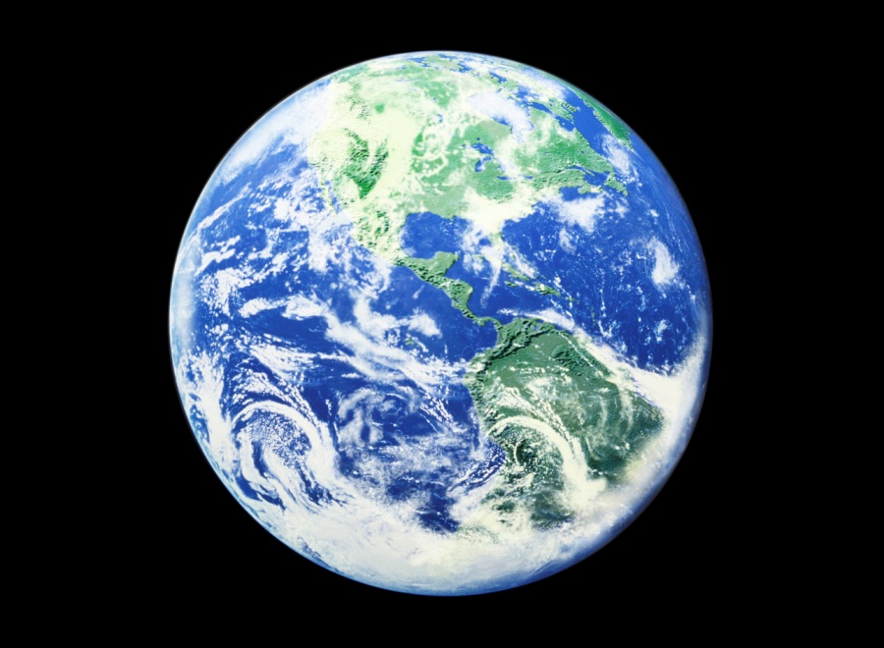

EARTH
Terrestrial Planet
Distance From Sun : 149.6 million km
Diameter : 12,756 km
Surface Temperature : 55.4 ° F
Length of Day : 23 hours and 56 minutes
Length of Year : 365 ¼ days
Number of Moons : 1
Symbol :
Atmosphere

Slide 6
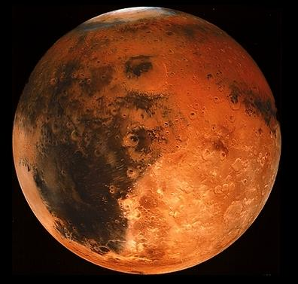

MARS
Spring Time
Terrestrial Planet
Distance From Sun : 227.9 million km
Diameter : 6,794 km
Surface Temperature : -200° F
Length of Day : 24.6 hours
Length of Year: 687 days
Number of Moons: 2
Symbol :
Ice on Pole
The Red Planet
NASA
Ice on Pole
Curiosity

Slide 7
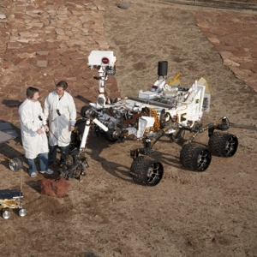
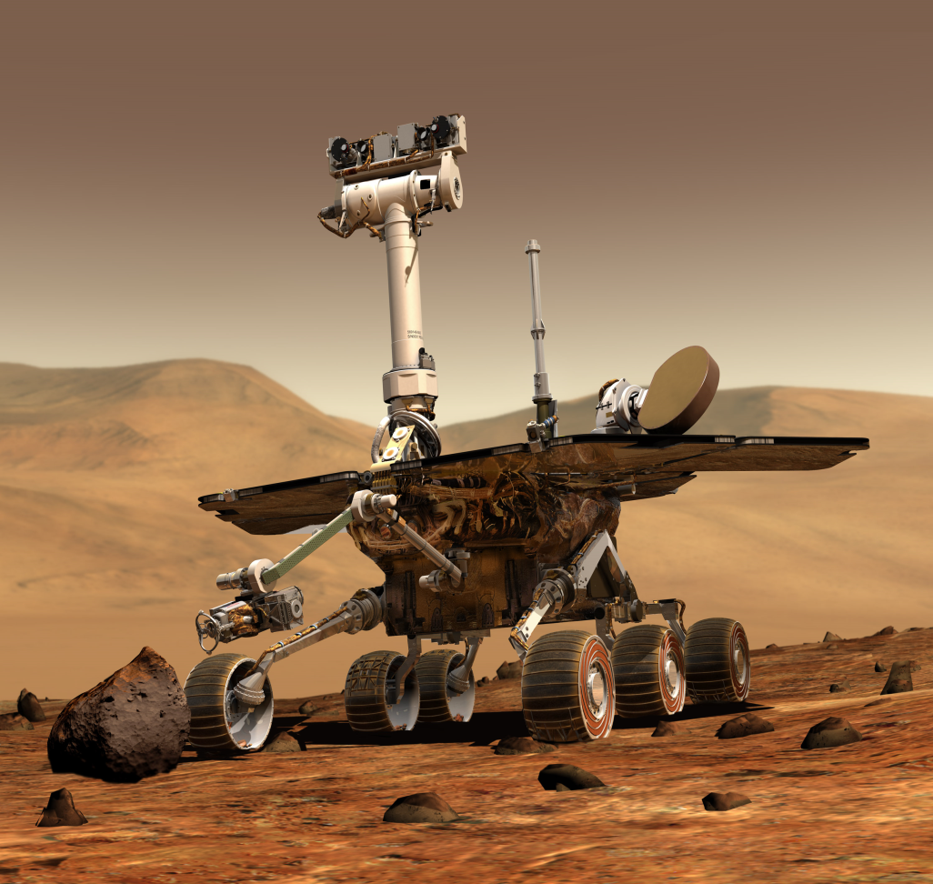
CURIOSITY
Video
Drive

Slide 8
Mercury
Venus
Earth
Mars
Planet’s Revolution Animation

